Slide 1
HISTORY OF ORTHODONTICS
DEPARTMENT OF ORTHODONTICS AND DENTOFACIAL ORTHOPEDICS

Slide 2
Orthodontics (Greek word)-
Orthos - to correct
Odontos – teeth
British Society of Orthodontics (1922) –
“Orthodontics includes the study of growth and development of the jaws and face particularly and the body generally, as influencing the position of the teeth; the study of action and reaction of internal and external influences on the development, and the prevention and correction of arrested and perverted development.”

Slide 3
AIMS OF ORTHODONTIC TREATMENT
JACKSON’S TRIAD
STRUCTURAL BALANCE
ESTHETIC HARMONY
FUNCTIONAL EFFICIENCY

Slide 4
SCOPE OF ORTHODONTIC TREATMENT
Alteration in tooth position
Alteration in skeletal pattern
Alteration in soft tissue pattern

Slide 5
SERVICES OFFERED BY ORTHODONTIST
PREVENTIVE ORTHODONTICS
Procedures undertaken prior to the onset of a malocclusion in anticipation of a developing malocclusion.
INTERCEPTIVE ORTHODONTICS
Procedures that are undertaken at an early stage of a malocclusion to eliminate or reduce the severity of the same.

Slide 6
CORRECTIVE ORTHODONTICS
Procedures undertaken to correct a fully established malocclusion.
SURGICAL ORTHODONTICS
Undertaken in conjunction with orthodontic treatment.

Slide 7
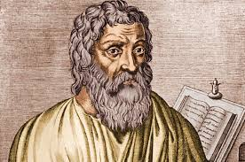
HISTORY OF ORTHODONTICS
Oldest speciality of dentistry .
HIPPOCRATES :
Pioneer in medical science.
Medical tradition based on facts rather than religion or fancy.

Slide 8
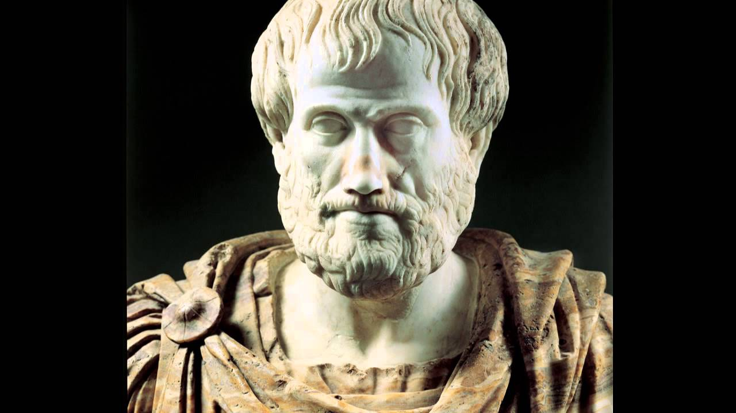
ARISTOTLE :
Medical science the first system of comparative anatomy.
Human teeth and compared them with those of various other species.

Slide 9
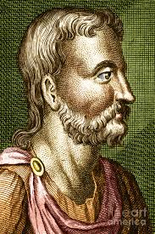
AULIUS CORNELIUS CELSUS
Use of finger pressure to align irregular teeth

Slide 10
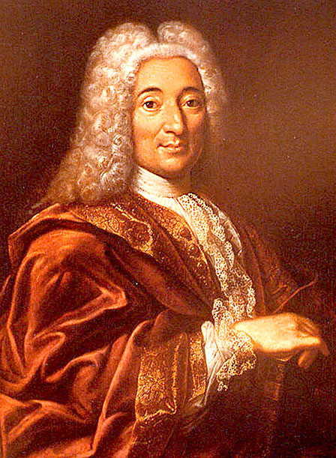
PIERRE FAUCHARD
Founder of modern dentistry
Bandelette – expand dental arch

Slide 11
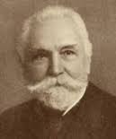
NORMAN KINGSLEY
Pioneer in cleft palate treatment.
Extra oral force to correct protruding teeth.

Slide 12
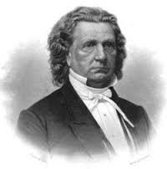
EMERSON C. ANGELL
Opening of mid-palatal suture.

Slide 13
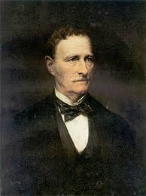
WILLIAM E. MAGILL
Band teeth for active tooth movement.

Slide 14
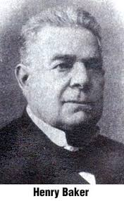
HENRY A. BAKER
Baker’s anchorage
Intermaxillary elastics to treat malocclusion.

Slide 15
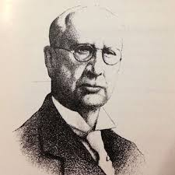
EDWARD H. ANGEL
Father of modern orthodontics.
Classification of malocclusion, pin and tube and edgewise appliance.

Slide 16
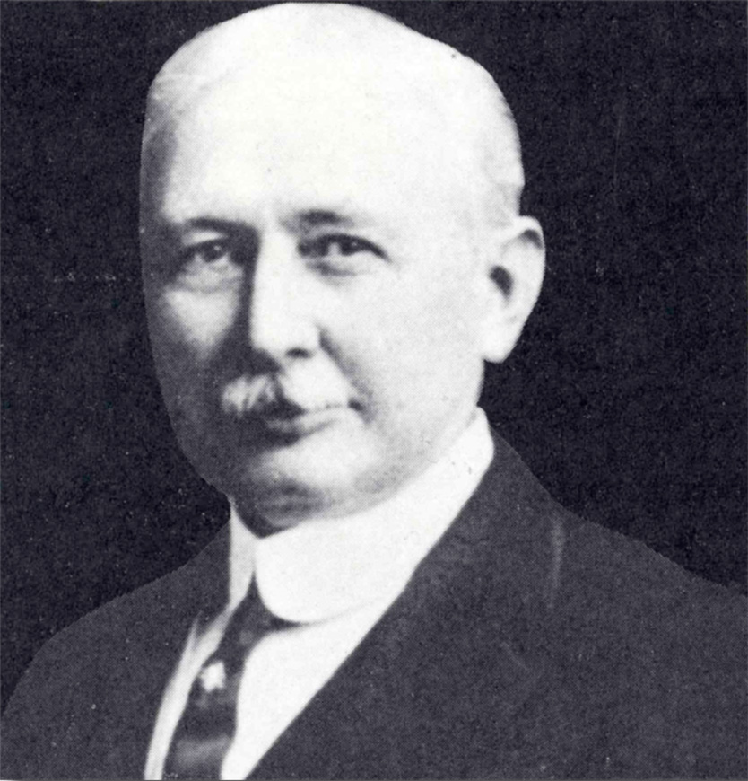
CALVIN CASE
Intermaxillary elastics.
Removal of certain teeth to achieve stable treatment results and to improve facial esthetics.

Slide 17
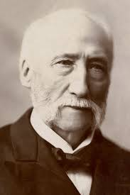
MARTIN DEWEY
Modified Angle’s classification of malocclusion.
Champion of non- extraction.

Slide 18
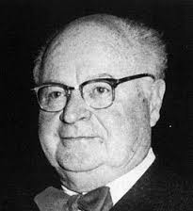
HOLLY BROADBENT
1931- cephalometric radiography.

Slide 19
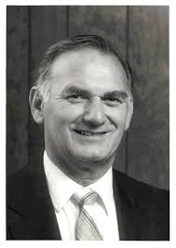
BUONOCARE
1955 – ACID ETCH Technique.

Slide 20
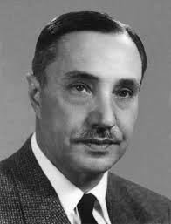
RAYMOND BEGG
Light wire fixed appliance technique

Slide 21

ROLF FRANKEL
Function regulator to treat a variety of malocclusion.

Slide 22
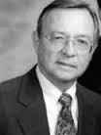
LAWRENCE ANDREWS
Straight wire appliance

Slide 23


