Slide 1
GROWTH AND DEVELOPMENT OF CRNIAL AND FACIAL STRUCTURES
DEPARTMENT OF ORTHODONTICS AND DENTOFACIAL ORTHOPEDICS

Slide 2
CONTENTS
INTRODUCTION
DEVELOPMENT OF PHARYNGEAL ARCHES
PRENATAL DEVELOPMENT OF FACE
PRENATAL DEVELOPMENT OF PALATE
PRENATAL DEVELOPMENT OF MANDIBLE

Slide 3
INTRODUCTION
Growth and development of an individual can be divided into prenatal and the post-natal periods.
The prenatal life can be divided into three periods:
1. Period of the ovum
2. Period of the embryo
3. Period of the fetus

Slide 4
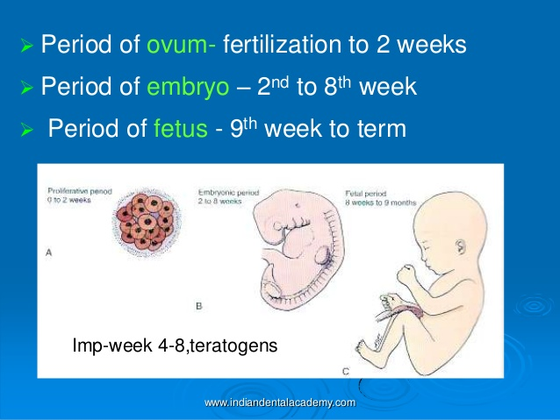
Notes:
ovum period extends for a period of approximately 2 weeks from the time of fertilization. During this period the cleavage of the ovum and the attachment of the ovum to the intra-uterine wall occurs.
Embryonic period extends from the fourteenth day to the fifty sixth day of intra-uterine life. During this period the major part of the development of the facial and the cranial region occurs.
Fetal period extends between the fifty sixth day of intra-uterine life till birth. In this period, accelerated growtb of the cranio-facial structures occurs resulting in an increase in their size

Slide 5
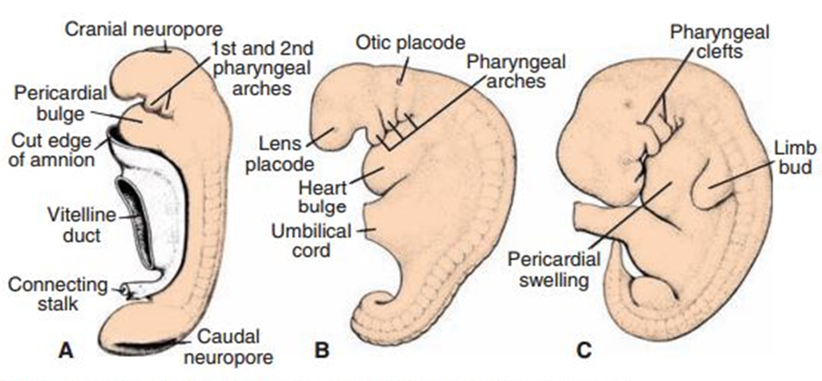
FORMATION OF PHARYNGEAL ARCHES
These arches appear in the fourth and ﬁfth weeks of development and contribute to the characteristic external appearance of the embryo.
Notes:
The most distinctive feature in development of the head and neck is the presence of pharyngeal arches (the old term for these structures is branchial arches because they somewhat resemble the gills [branchia] of a ﬁsh).
In figure : a: 25 days b: 28 days c: 5 weeks

Slide 6
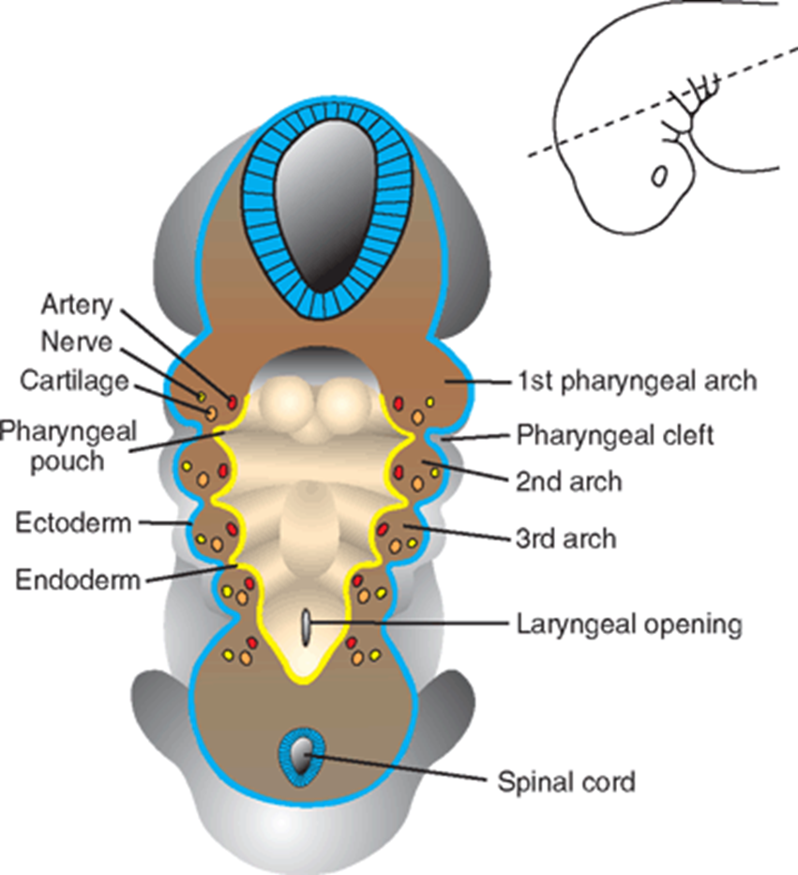
Mesenchymal tissue separated by deep clefts known as pharyngeal clefts.
A number of out pocketings, the pharyngeal pouches, appear along the lateral walls of the pharynx, the most cranial part of the foregut.
Notes:
Initially, they consist of bars of
Simultaneously, with development of the arches and clefts
The pouches penetrate the surrounding mesenchyme, but do not establish an open communication with the external clefts.
Pharyngeal arches play an important role in formation of the face.

Slide 7
FORMATION OF FACE
During the 4th week of embryonic development.
By the 6th week the external face is completed.
Between the 6th and 8th weeks the development of the palate subdivides into nasal and oral cavities.
This development continues into the 12th week with completion of the soft palate
Larsen 3rd edition
Notes:
1. The human face begins to form

Slide 8
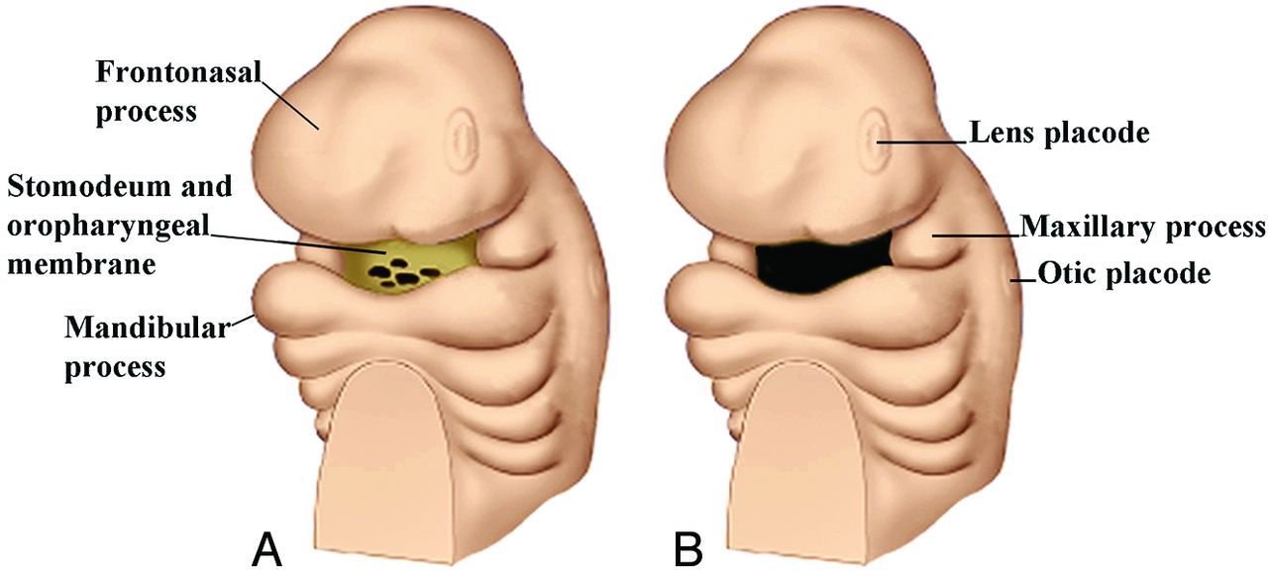
An oropharyngeal membrane (oral membrane)
Notes:
During the third week of development
is first seen at the site of the future face, between the primordium of the heart and the rapidly enlarging primordium of the brain.
Primordium means an organ or part in the early stage of development

Slide 9
The external face forms from two sources that surround the oropharyngeal membrane.
The tissues of the frontonasal process that cover the forebrain, predominantly of neural crest origin.
The tissues of the first pharyngeal arch, of mixed mesoderm and neural crest origin.

Slide 10
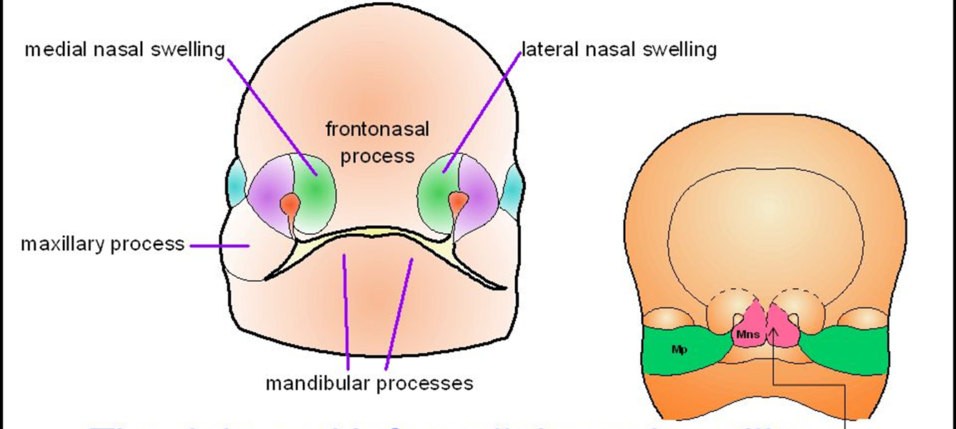
A series of individualized tissue swellings gives rise to the different parts of the face. These are known as facial processes (prominences). The following facial processes may be recognized:
A) The frontonasal process gives rise to:
Notes:
• a pair of medial nasal processes (that later contribute to a single globular [intermaxillary] process), and
• a pair of lateral nasal processes.

Slide 11
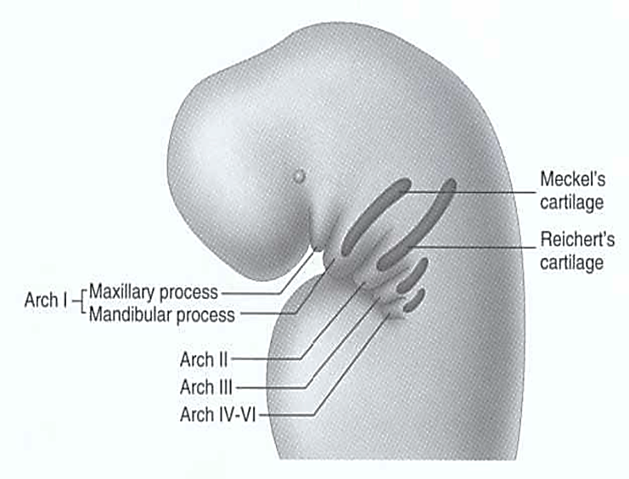
the first pharyngeal arch gives rise to:
Notes:
Cranial part is maxilla and caudal part is mandible.
a pair of mandibular processes (actually the pharyngeal arch itself), and
• a pair of outgrowths of the arch: the maxillary processes (that later give rise to a pair of palatal processes

Slide 12
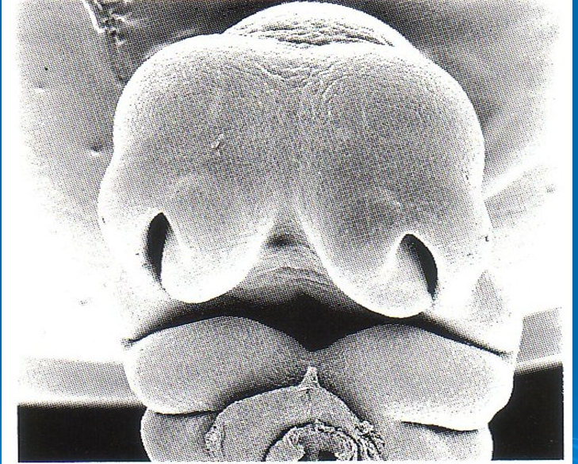
At the end of the fourth week, two ectodermal thickenings: nasal placodes, appear on the frontonasal process.
Notes:
They are the precursors of the olfactory epithelium, responsible for the sense of smell.

Slide 13
During the fifth week, lateral nasal and medial nasal swellings that surround the nasal placodes appear on the frontonasal process.
These four nasal processes grow forward, while the nasal placodes remain relatively stationary. This gives the impression that the nasal placodes “invaginate”.
They actually stay behind and come to lie in blind nasal pits, surrounded by the nasal processes.
This is the first step in the development of the nasal cavities.

Slide 14
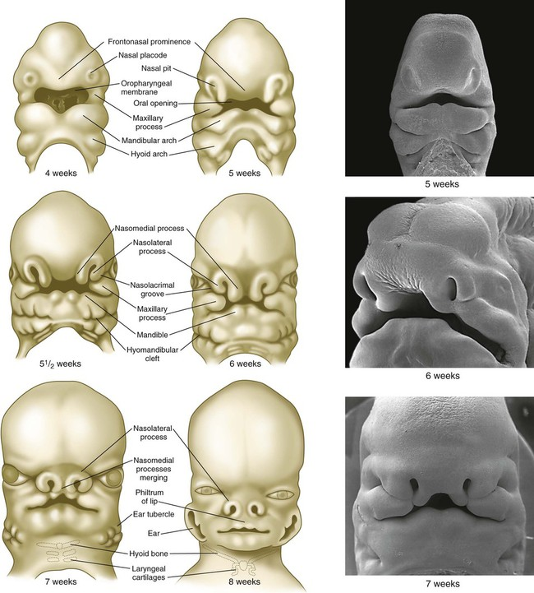
Notes:
lateral nasal and medial nasal swellings that surround the nasal placodes appear on the frontonasal process.
These four nasal processes grow forward, while the nasal placodes remain relatively stationary. This gives the impression that the nasal placodes “invaginate”.
They actually stay behind and come to lie in blind nasal pits, surrounded by the nasal processes.
This is the first step in the development of the nasal cavities.

Slide 15
Simultaneously, paired maxillary processes develop near the base of the first pharyngeal arch.
They enlarge and grow ventrally and medially, surrounding the future oral cavity.
The maxillary processes grow rapidly, first meeting the lateral nasal processes, and then the lower extension of the medial nasal processes.
This lower extension is known as the globular or intermaxillary process and will give rise to the mid structure (philtrum) of the upper lip.

Slide 16
Notes:
The maxillary process enlarge and grow ventrally and medially, surrounding the future oral cavity.
The maxillary processes grow rapidly, first meeting the lateral nasal processes, and then the lower extension of the medial nasal processes.
This lower extension is known as the globular or intermaxillary process and will give rise to the mid structure (philtrum) of the upper lip.

Slide 17
MERGING VS. FUSION OF FACIAL PROCESSES
Merging is the process by which the groove between two facial processes is eliminated.
The tissues in the groove “catch up” by proliferating more rapidly than the surrounding tissues, causing the groove to become progressively shallower until it smoothes out.
Notes:
Most facial processes begin as two separate swellings separated by a groove
Examples of merging are: merging of the 2 mandibular processes in the midline, merging of the 2 medial nasal processes in the midline, merging of lateral nasal and maxillary processes, and the merging of mandibular and maxillary processes

Slide 18
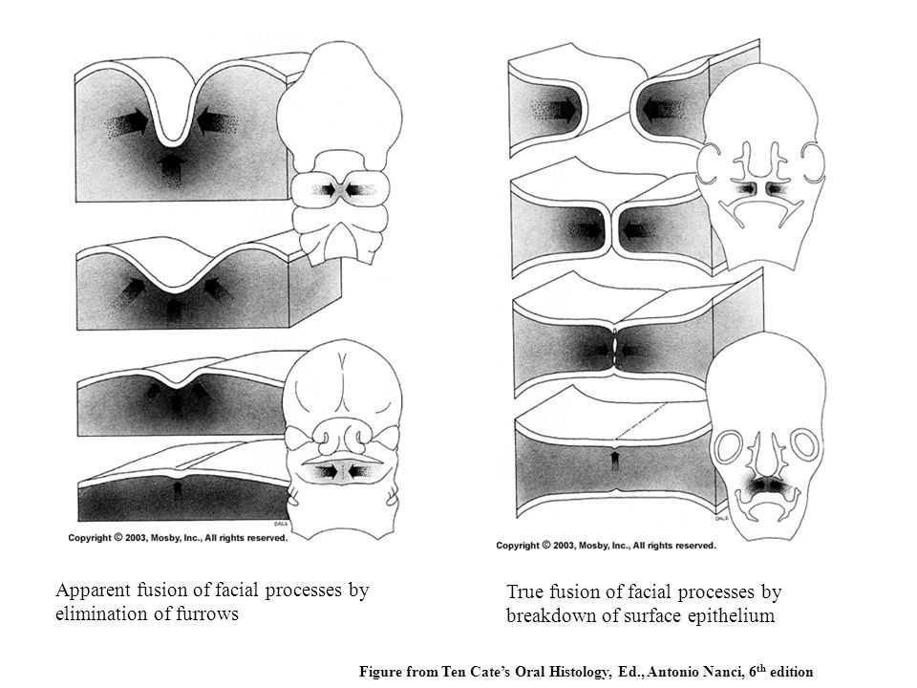
Notes:
Apparent fusion of facial processes by elimination of groove.

Slide 19
FUSION
Fusion is the process by which two facial processes, that were initially separated by a space, grow together.
An example of fusion is the formation of the secondary palate where two facial processes grow toward each other, touch each other and then fuse in the midline.
In fusion, unlike merging, the epithelium is broken down where the two processes meet

Slide 20
Notes:
True fusion of facial processes by breakdiown of surface epithelium.
An example of fusion is the formation of the secondary palate where two facial processes grow toward each other, touch each other and then fuse in the midline.

Slide 21
PALATE FORMATION
Tissue intervening between nasal and oral cavities is known as the palate.
By the 6th week the primary palate, formed by the two maxillary and two medial nasal processes, separates the developing oral and nasal cavities.
Subsequently, between 6th and 8th weeks, the secondary palate is formed from two palatal processes (outgrowths of the maxillary processes).
Notes:
Primary and secondary palates together form the definitive palate.

Slide 22
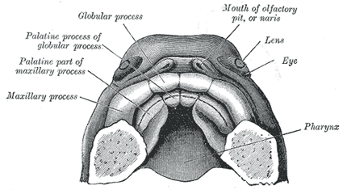
DEVELOPMENT OF THE PRIMARY (PRIMITIVE) PALATE
The primary palate develops at the same time as the external face (fifth and sixth weeks). The maxillary processes undergo extensive growth, first coming into contact with the lateral nasal processes and secondly with the globular process of the merged medial nasal processes (philtrum).

Slide 23
Initially the medial nasal and lateral nasal processes come into contact.
Secondarily, the medial nasal and maxillary processes come together (just below and in front of the contact site between the medial and lateral nasal processes) and pinch some epithelium between them.
This sheet of epithelium is composed of future nasal epithelium superiorly, and future oral epithelium inferiorly

Slide 24
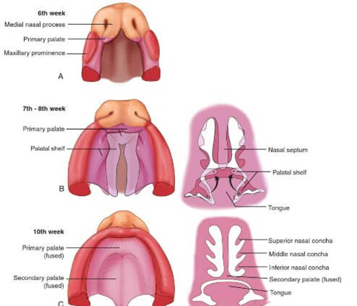
Notes:
The two layers of epithelium are then pulled apart, making the mesenchyme between medial nasal and maxillary processes continuous : the core of the primary palate.
Posteriorly, behind the primary palate, the nasal epithelium continues to touch the oral epithelium. This patch of epithelium is called the oronasal membrane

Slide 25
Around the 6th week of development this membrane is ripped open in the same manner as the oropharyngeal membrane (cells stop undergoing mitosis).
The resulting opening is called the primitive choana, and it connects the nasal cavity to the oral cavity.
A choana must then be surgically established at birth.
Notes:
Remember that there are two primitive choanae, one for each nasal cavity. Occasionally the oronasal membrane does not break apart.

Slide 26
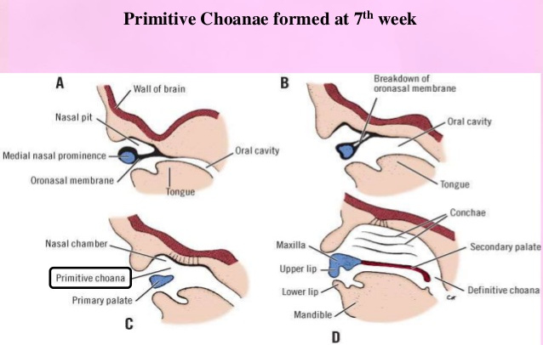
Notes:
. Formation of the nasal cavity and primitive choana. A, B, The nasal pits invaginate to form a single nasal cavity separated from the oral cavity by a thick partition called the nasal fin. C-E, The nasal fin thins to form the oronasal membrane, which breaks down completely to form the primitive choana. The posterior extension of the intermaxillary process forms the primary palate.

Slide 27
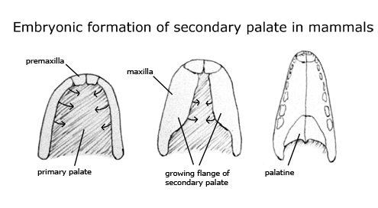
DEVELOPMENT OF THE SECONDARY PALATE
During the seventh and eighth weeks, the medial walls (the oral surfaces) of the maxillary processes produce a pair of thin medial extensions, called the palatal processes (shelves).
Initially these grow predominantly vertically: downward and parallel to the lateral surfaces of the tongue.
Notes:
The posterior border of the primary palate is located just posterior (caudal) to the site of the future incisive foramen of the skull. As the face grows in an antero-posterior (rostro-caudal) dimension, the primary palate soon is too short to provide adequate separation between the nasal cavities (respiratory function) and the oral cavity (digestive function). A new structure: the secondary palate develops to further separate these cavities.

Slide 28
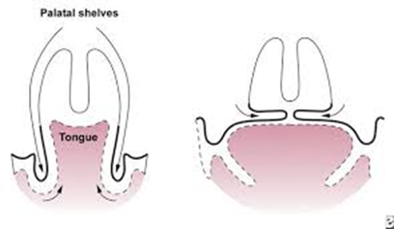
By the beginning of the eighth week, however, the tongue begins to contract and move out of the way. In addition, the lower jaw drops as it grows downward and forward.
Notes:
Initially these grow predominantly vertically: downward and parallel to the lateral surfaces of the tongue.

Slide 29
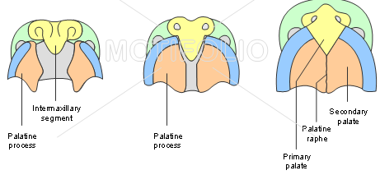
By the end of the eighth week, the palatal processes rotate rapidly upward to a horizontal position and fuse with each other and with the primary palate.
Notes:
7,8 and 10 week
The fused palatal processes form the secondary palate - together with the primary palate they form the definitive palate.

Slide 30
PRENATAL GROWTH OF MANDIBLE
The cartilages and bones of the mandibular skeleton form from embryonic neural crest cells that originated in the mid and hind brain regions of the neural folds.
These cells migrate ventrally to form the mandibular facial prominences, where they differentiate into bones and connective tissues.
Notes:
Sperber

Slide 31
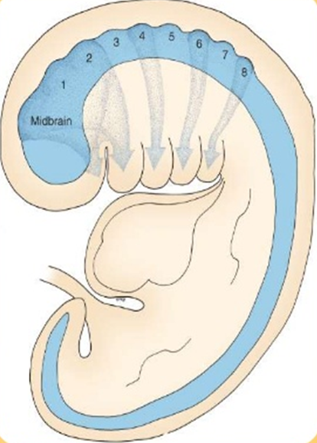
Notes:
the source and pattern of neural crest migration to the developing face and branchial arch system.
The midbrain and rhombomeres 1 and 2 contribute to the face and first branchial arch.

Slide 32
The cartilage of the first pharyngeal arch is Meckel's cartilage, right and left
In the middle of week 5 of fertilization ,a pair of Meckel cartilage appeared in the centre of mandibular arch along with the growth of mandibular nerves and vessels to form the hyaline cartilaginous tissue and thick perichondral fibrous mesenchyme.
It occupies a location that becomes the core of the mandibular corpus, which forms around it. The bony mandible itself develops, independently, directly from the embryonic connective tissue that surrounds Meckel's cartilage.
Notes:
Enlow, Donald H. Essentials of facial growth I Donald H. Enlow, Mark G. Hans
Prenatal Development of the Human Mandible : lee sk et al. Anat Rec263:314–325,2001

Slide 33
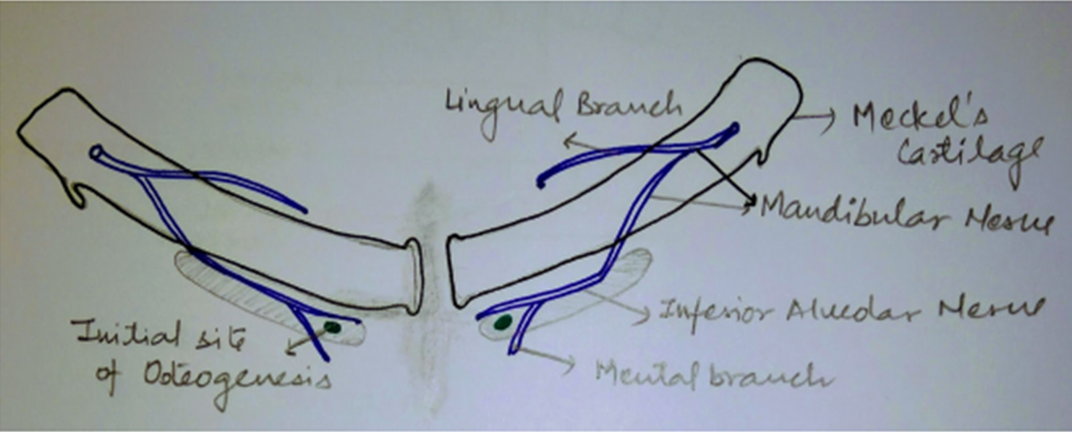
From the middle of week 6 of fertilization, the mandibular ossification appeared as intramembranous bony apposition in close approximation to the Meckel cartilage.
Notes:
The first structure to develop in the region of the lower jaw is the mandibular division of the trigeminal nerve that precedes the ectomesenchymal condensation forming the first (mandibular) pharyngeal arch.

Slide 34
Spread of the intramembranous ossification dorsally and ventrally forms the body and ramus of the mandible.
Meckels cartilage becomes surrounded and invaded by bone.
Ossification stops dorsally at the site that will become the mandibular lingual, from where meckels cartilage continue into middle ear.

Slide 35
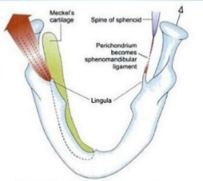
Notes:
Ossification of mandible spreads away from meckels cartilage at the lingula.

Slide 36
The 1st pharyngeal arch core of meckels cartilage almost meets its fellow of the opposite side ventrally.
It diverges dorsally to end in the tympanic cavity of each middle ear, which is derived from the 1st pharyngeal pouch, and is surrounded by the forming petrous portion of temporal bone.
The dorsal end of meckels cartilage ossifies to form the basis of two of the auditory ossicles, namely the malleus and incus.
The 3rd ossicle, the stapes, is derived primarily from the cartilage of the second pharyngeal arch.

Slide 37
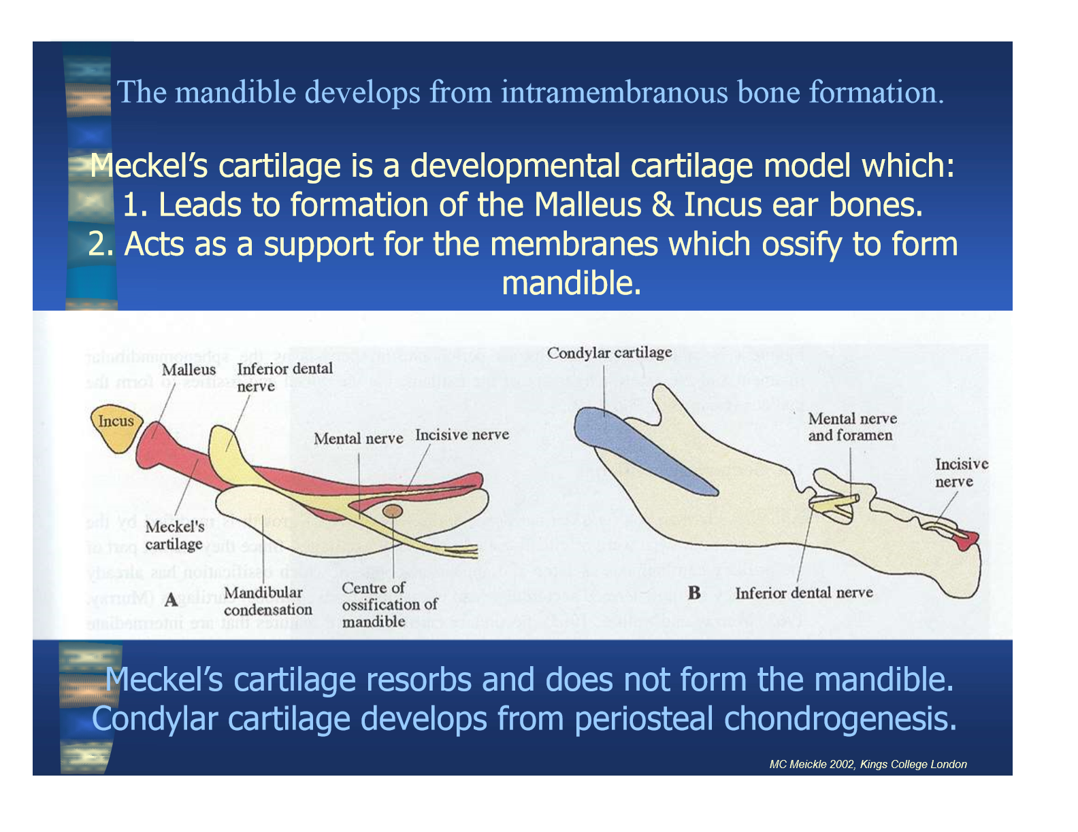
Notes:
The dorsal end of meckels cartilage ossifies to form the basis of two of the auditory ossicles, namely the malleus and incus.

Slide 38
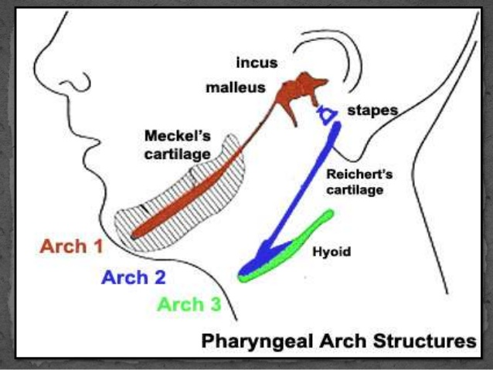
Notes:
The 3rd ossicle, the stapes, is derived primarily from the cartilage of the second pharyngeal arch.

Slide 39
Almost all of the meckels cartilage disappears.
Parts transform into the sphenomandibular and anterior malleolar ligaments.
Meckels cartilage dorsal to the mental foramen undergoes resorption on its lateral surface at the same time as intramembranous bony trabeculae are forming immediately lateral to the resorbing cartilage.
Thus, cartilage from the mental foramen to the lingual is not incorporated into ossification of the mandible.

Slide 40
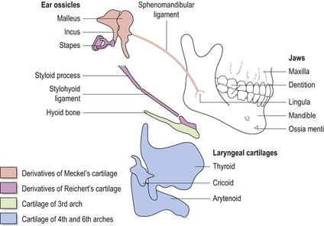
Notes:
Almost all of the meckels cartilage disappears.
Parts transform into the sphenomandibular and anterior malleolar ligaments.

Slide 41
SECONDARY CARTILAGES
Appear between the10th and 14th weeks postconception
Form the head of the condyle, part of the coronoid process and the mental protuberance.
Coronoid cartilage develops within temporalis muscle.
Later, it is incorporated into the expanding intramembranous bone of ramus and disappear before birth.
Notes:
Secondary accessory cartilages
The secondary cartilage of the coronoid process develops within the temporalis muscle as its predecessor.
The coronoid accessory cartilage becomes incorporated into the expanding intramembranous bone of the ramus and disappears before birth.

Slide 42
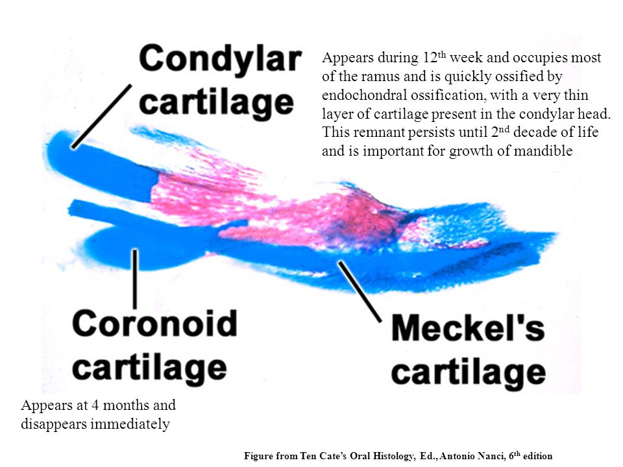
Notes:
Condylar cartilage appears during 12th week and occupies most of the ramus and is quickly ossified by endochondral ossification, with a very thin layer of cartilage present in the condylar head. This remnant persists until 2nd decade of life and is important for growth of m,andible.
Coronoid cartilage appears at 4 months and disappears immediately.

Slide 43
In the mental region, on either side of the symphysis, one or two small cartilages appear and ossify in the 7th month pc to form a variable number of mental ossicles in the fibrous tissue of the symphysis.

Slide 44
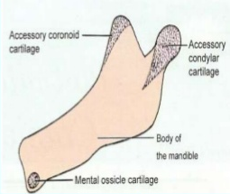
Notes:
The ossicle become incorporated into the intramembranous bone when the symphysis menti is converted from a syndesmosis into a synostosis during the 1st postnatal year.

Slide 45
CONDYLAR CARTILAGE
• Appears at 10th week .
• Seen as a cone shaped structure in ramal region.
• Primordium for future condyle.
• Condylar head increases by interstitial and appositional growth.
• Important centre of growth for ramus and body.
Notes:
The condylar secondary cartilage appears during 10th week pc as a cone shaped structure in the ramal region. this condylar cartilage is the primordium of the future condyle.
Cartilage cells differentiate from its centre, and the cartilage condylar head increases by interstitial and appositional growth.
The condylar cartilage serves as an important centre of growth for the ramus and body of the mandible

Slide 46
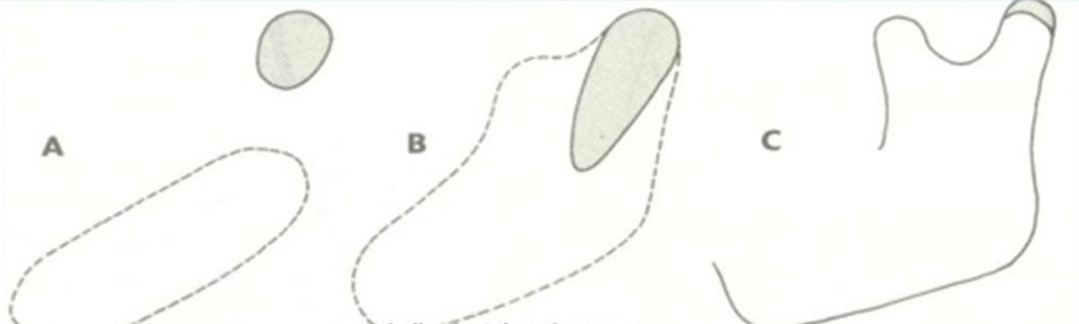
Notes:
The condylar cartilage develops initially as a separate area of condensation from that of the body of the mandible , and only later is incorporated within it. a) separate areas of mesencymal condensation, at 8 weeks. B) fusion of the cartilage with the mandibular body,at 4 months. C) situation at birth.

Slide 47
By the 14th week, the 1st evidence of endochondral bone appears in the condyle region.
Much of the cone shaped cartilage is replaced with bone by the middle of the fetal life.

Slide 48
The shape and size of the diminutive fetal mandible undergo considerable transformation during its growth and development.
The ascending ramus of the neonatal mandible is low and wide.
The coronoid process is relatively large and projects well above the condyle.
The mandibular canal runs low in the body.

Slide 49
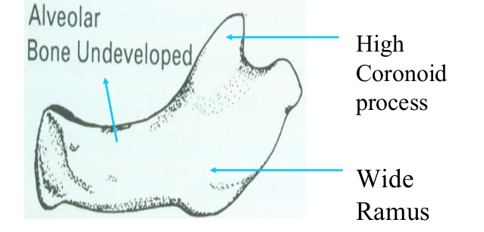
Notes:
The coronoid process is relatively large and projects well above the condyle.

Slide 50
REFERNCES
Langman’s medical embryology. — 12th ed. / T.W. Sadler
Larsen 3rd edition - Facial And Palatal Development
Enlow, Donald H. Essentials of facial growth.
Sperber – Craniofacial Embryogenetics And Development.
Prenatal Development of the Human Mandible : lee sk et al.

Slide 51


