Slide 1

GOOD MORNING

Slide 2
ETIOLOGY OF MALOCCLSION
DEPARTMENT OF
ORTHODONTICS AND DENTOFACIAL ORTHOPEDICS

Slide 3
CONTENT
Introduction
Classification
Graber’s classification
Conclusion

Slide 4
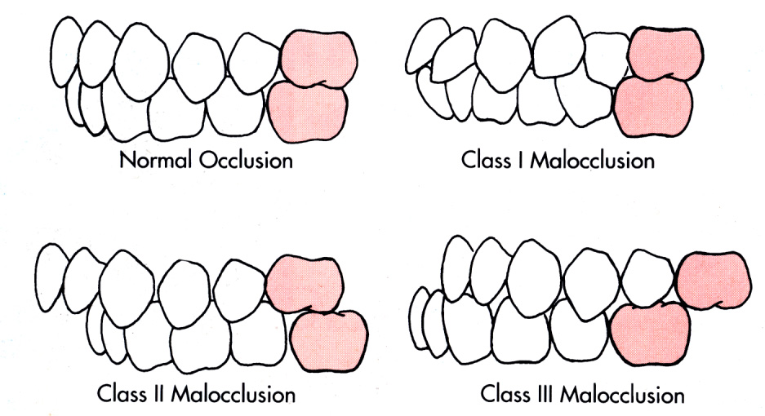
INTRODUCTION
Normal occlusion
Angle’s Definition - The normal relation of the occlusal inclined planes of the teeth when the jaws are closed
Notes:
Normal is always a range and never a fixed value
Normality changes with age
According to Dr. Angle, normal occlusion exists when the mesiobuccal cusp of the upper first molar occludes with the buccal groove of the lower first molar)

Slide 5
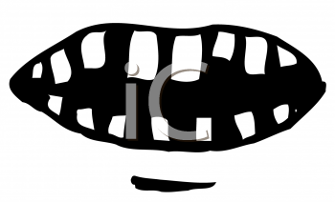
Malocclusion
An occlusion in which there is mal-relationship between the arches in any of the planes of space or in which there are anomalies in tooth position beyond the limits of normal
Notes:
Malrelationship between arches : class I II and III

Slide 6
Development of normal dentition and occlusion depends on a number of factors including dentoalveolar, skeletal and neuromuscular
Etiology of malocclusion - the study of its causes
Notes:
Localisation of etiology may be a very difficult task
It is not always possible to eliminate causes but it is imp to know for preventive and interceptive orthodontic procedures

Slide 7
CLASSIFICATION OF ETIOLOGY OF MALOCCLUSION
Moyer’s Classification
White and Gardiner’s classification
Graber’s classification

Slide 8
1. Moyer’s Classification
Classification of etiology….
HEREDITY
DEVELOPMENTAL DEFECTS OF UNKNOWN ORIGIN
TRAUMA
PHYSICAL AGENTS
MOYER’S
CLASSIFICATION
HABITS
DISEASES
MALNUTRITION
Notes:
Neuromuscular system, bone, teeth, soft parts
Developmental defects
Prenatal and postnatal trauma
Premature extraction of primary teeth, nature of food
Thumb sucking, yongue trusting, lip and nail biting
Systemic endocrine and local diseases- nasopharyngeal disturbances, gingival and periodontal diseases, tumors, caries

Slide 9
Classification of etiology….
A. Heredity -
Neuromuscular,
Bone,
Teeth,
Soft parts
B. Trauma -
Prenatal trauma and birth injuries,
Postnatal trauma
C. Physical agents -
Premature extraction of primary teeth,
Nature of food

Slide 10
Classification of etiology….
D. Habits -
Thumb sucking or finger sucking,
Tongue thrusting,
Lip and nail biting,
Other habits
E. Diseases -
Systemic diseases,
Endocrine diseases,
Local diseases- nasopharyngeal diseases, gingival and periodontal diseases, tumors, caries

Slide 11
2. White and Gardiner’s classification
Classification of etiology….
A. DENTAL BASE ABNORMALITIES
B. PRE-ERUPTION ABNORMALITIES
C. POST ERUPTION ABNORMALITIES

Slide 12
Classification of etiology….
A. Dental base abnormalities
Antero-posterior malrelationship,
Vertical malrelationship,
Lateral malrelationship,
Disproportion between teeth and basal bone size,
Congenital abnormalities

Slide 13
Classification of etiology….
B. Pre-eruption abnormalities
Abnormal position of developing tooth germ,
Missing teeth,
Supernumerary teeth,
Prolonged retention of deciduous teeth
Large labial frenum,
Traumatic injury
C. Post-eruption abnormalities
Muscular,
Premature loss of deciduous teeth,
Extraction of permanent teeth
Notes:
Muscular – active muscle forces, rest position of musculature, sucking habits, abnormalities of path of closure

Slide 14
3. Graber’s Classification
Classification of etiology….
GENERAL
HEREDITY
POSTURE
LOCAL
ANOMALIES OF NUMBER
CONGENITAL
ENVIRONMENT
PRE-DISPOSING METABOLIC CLIMATE AND DISEASE
DIETARY PROBLEMS
ABNORMAL PRESSURE HABITS
TRAUMA AND ACCIDENTS
ANOMALIES OF TOOTH SHAPE
ANOMALIES OF TOOTH SIZE
ABNORMAL LABIAL FRENUM
PREMATURE LOSS OF DECIDUOUS TEETH
PROLONGED RETENTION OF DECIDUOUS
DELAYED ERUPTION OF PERMANENT
ABNORMAL ERUPTIVE PATH
ANKYLOSIS
DENTAL CARIES

Slide 15
A. General factors :
Classification of etiology….
1) Heredity
Number of human traits that are influenced by the genes include (according to Lundstrom):
  Tooth size
  Arch dimension
  crowding/spacing
  Abnormalities of tooth shape
  Abnormalities of tooth number
  Overjet
  Inter-arch variations
  Frenum
Notes:
Heredity has for long been attributed as one of the causes of malocclusion
Another reason attributed for genetically determined malocclusion is the
Racial, ethical & regional inter-mixture

Slide 16
Classification of etiology….
2) Congenital
They are malformations seen at the time of birth
Its causes can be broadly classify as
  - General congenital factors
  - Local congenital factors
Notes:
Due to genetic, radiologic, chemical, endocrine, infections and mechanical factors

Slide 17
Classification of etiology….
General congenital factors
  Abnormal state of mother during pregnancy
  Malnutrition
  Endocrinopathies
  Infectious disease
  Metabolic and nutritional disturbances
  Accidents during pregnancy and child birth
  Intra-uterine pressure
  Accidental traumatization of the fetus by external forces

Slide 18
Classification of etiology….
Local congenital factors
  Abnormalities of jaw development due to intra-uterine position
  Clefts of the face and palate
  Macro and microglossia
  Cleidocranial dysostosis

Slide 19
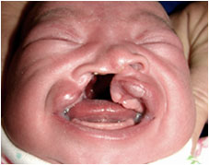
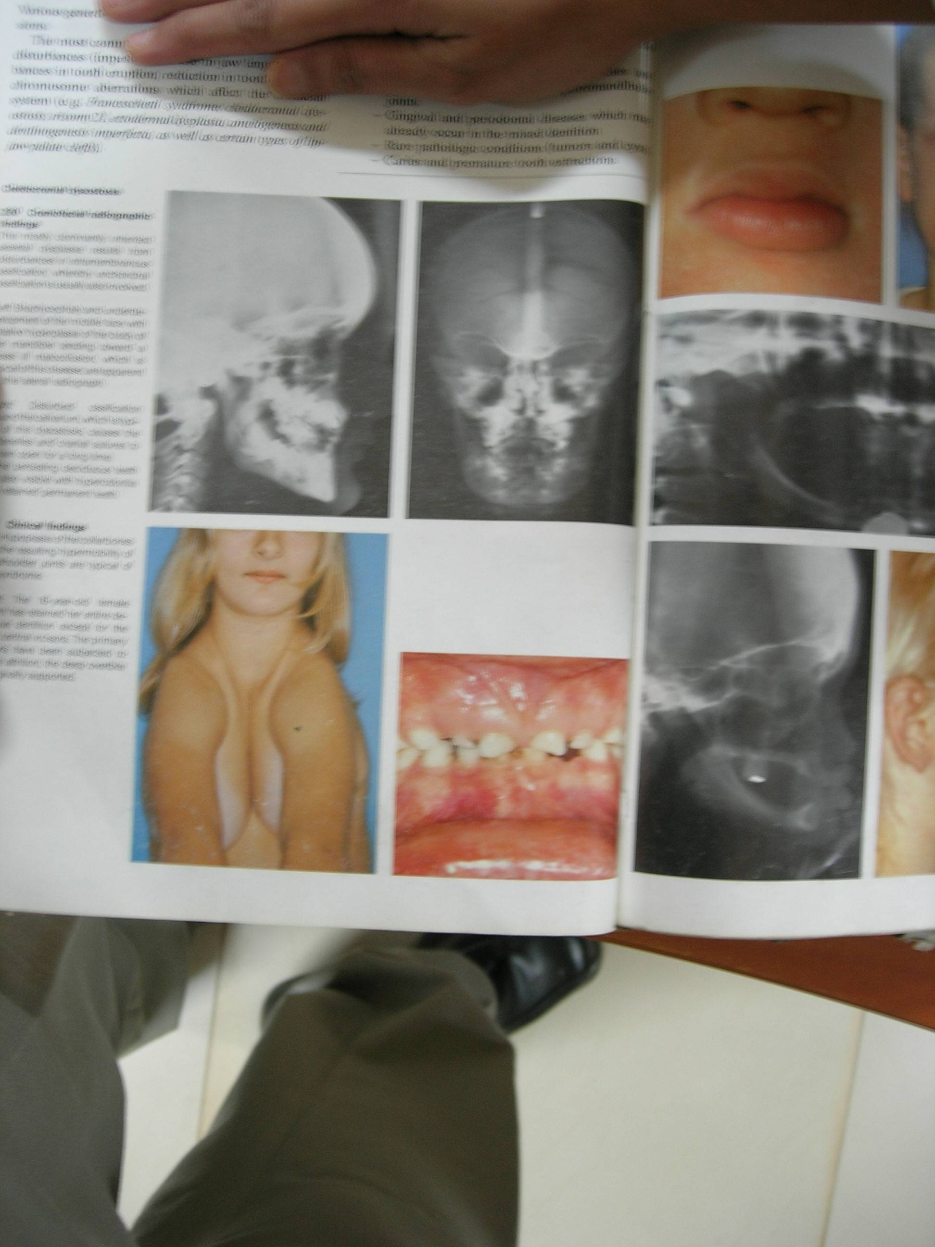
Classification of etiology….
  Some of the congenital conditions frequently encountered by orthodontist are –
  Clefts of the lip and palate
  Congenital syphilis
  Maternal rubella infections
  Cleidocranial dysostosis
  Cerebral palsy
Notes:
Clefts – missing teeth, mobile teeth, rotations, crossbites
Syphilis – smaller maxilla, extensive decay
Rubella – dental hypoplasia, retarded tooth eruption, extensive caries
Dysostosis – small maxilla, protruded mandible,

Slide 20
Classification of etiology….
3) Environment
- Pre-natal factors
Abnormal fetal posture
Amniotic lesions
Maternal diet and metabolism
Maternal infection like German measles
Certain drugs during pregnancy; thalidomide- clefts
Notes:
Fetus is well protected against injuries & nutritional def during pregnancy
But there are certain factors, presence of which can result in abnormal growth of oro-facial region thereby predisposing to malocclusion

Slide 21
Classification of etiology….
- Postnatal factors
Forcep delivery- TMJ damage, retarded mandibular growth and hypoplastic mandible
Cerebral palsy- due to birth injury
Traumatic injury- may cause condylar fracture and marked facial asymmetry
Presence of scar tissue from cleft palate surgery

Slide 22
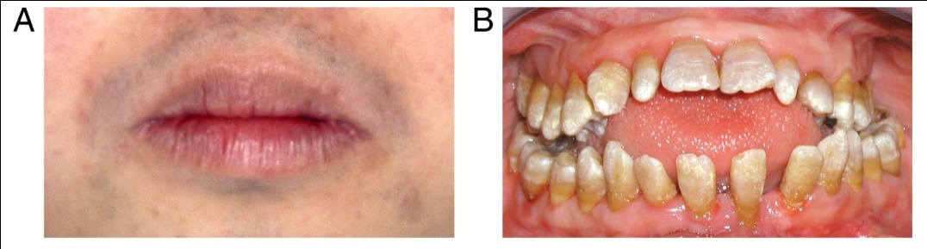
Classification of etiology….
4) Pre-disposing metabolic climate and diseases
a. Endocrine imbalance
Hypothyroidism – delayed eruption, prolonged retention of deciduous, abnormal root resorption, malposed teeth and crowding
Hyperthyroidism – premature eruption, early shedding od deciduous teeth, osteoporosis;which contraindicates orthodontic treatment

Slide 23
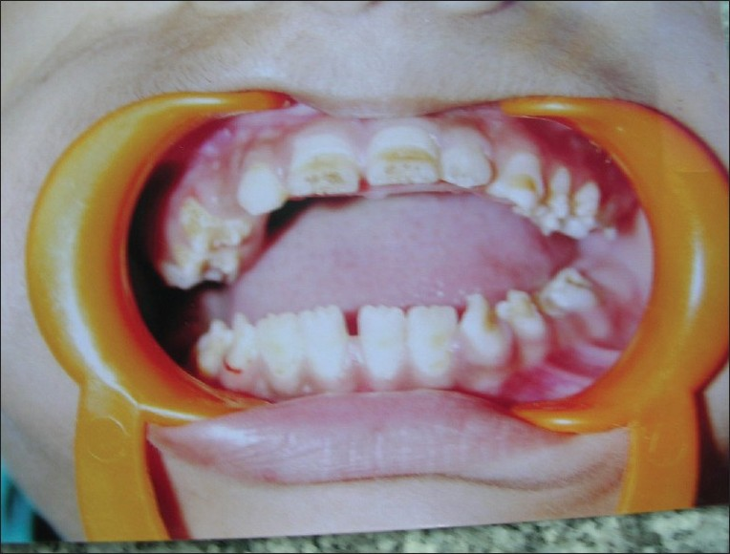
Classification of etiology….
Hypoparathyroidism – delayed tooth eruption, altered tooth morphology, hypoplastic teeth
Hyperparathyroidism – teeth become mobile because of loss of cortical bone and resorption of alveolar bone
b. Metabolic diseases
slows down the pace of growth and development

Slide 24
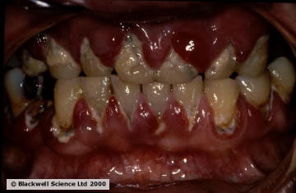
Classification of etiology….
5) Nutritional deficiencies
More common in developing countries
examples: rickets, scurvy, beri beri
6) Posture
Abnormal pressure or muscle imbalance increases the risk of malocclusion
Children supporting their head resting on hand or chin resting on the chest – mandibular deficiency

Slide 25
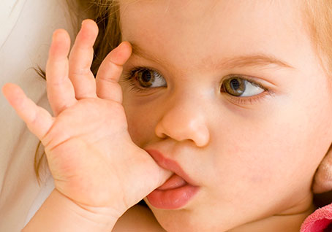
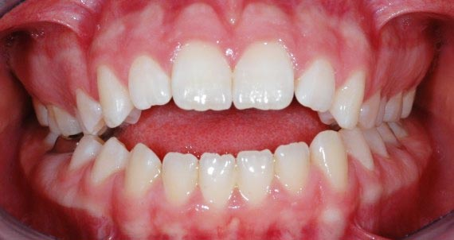
Classification of etiology….
7) Abnormal pressure habits
Thumb and finger sucking
Tongue thrusting
Lip and nail biting
Abnormal swallowing patterns
Speech defects
Respiratory problems
Tonsils and adenoids
Bruxism

Slide 26
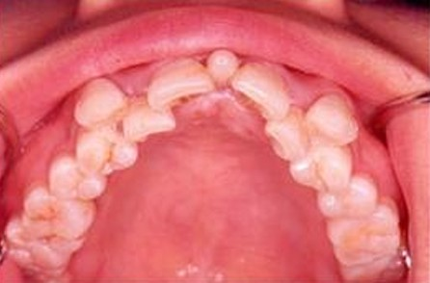
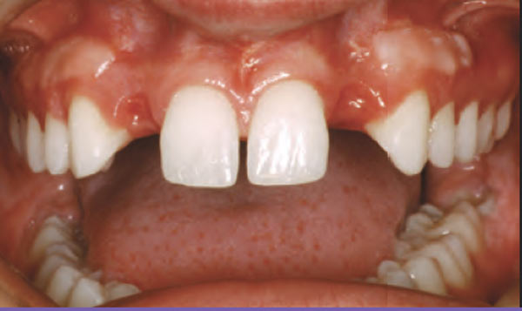
B. Local factors :
Classification of etiology….
1) Anomalies in number of teeth
Supernumery teeth – non-eruption or delay in eruption of adjacent teeth, crowding, deflection of erupting teeth in avnormal locations
Missing teeth
Notes:
Teeth that are extra to the normal
complement are termed supernumerary teeth.
These teeth have abnormal morphology and do not resemble normal teeth.
Extra teeth that resemble normal teeth are called supplemental
They result from disturbances during the initiation and proliferation stages of dental development.
no definitive time when supernumerary teeth may develop.
may form prior to birth or as late as 10- 12 years of age.
usually develop from a 3rd tooth bud arising from the dental lamina near the permanent tooth bud teeth.

Slide 27
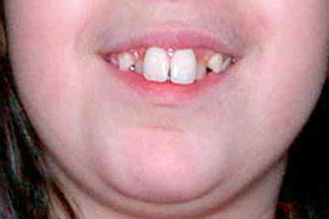
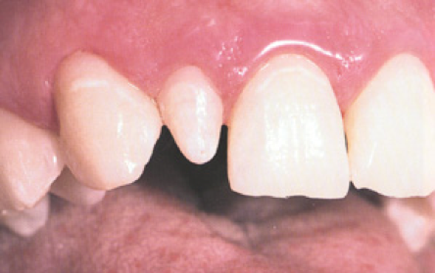
Classification of etiology….
2) Anomalies of tooth size
An increase in size of teeth results in crowding while, smaller sized teeth predispose to spacing.
Anomalies of size of teeth can be of 2 types:
a. Microdontia
b. Macrodontia
Notes:
There should be harmony between the tooth size and the arch length, and also between the maxillary and mandibular tooth size, in order to have normal occlusion.

Slide 28
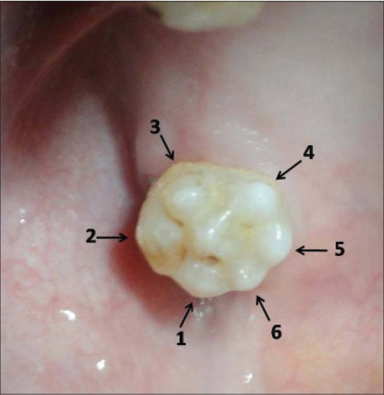
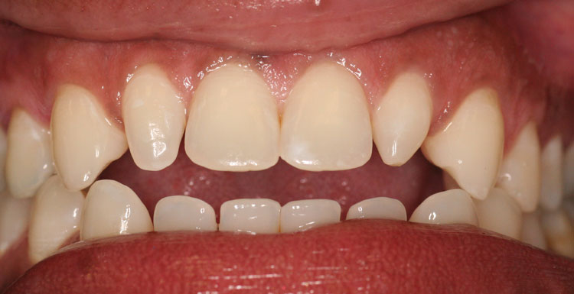
Classification of etiology….
3) Anomalies of tooth shape
Peg shaped maxillary lateral incisors
Abnormally large cingulum on maxillary incisors
Additional lingual cusp on mandibular second premolars
Congenital syphilis

Slide 29
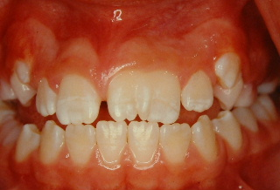
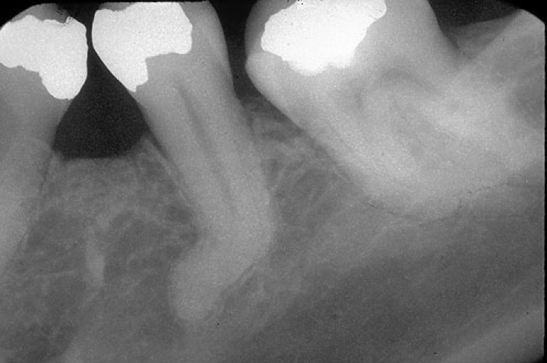
Classification of etiology….
e. Fusion
f. Gemination
g. Dilaceration
h. Hypoplastic teeth

Slide 30
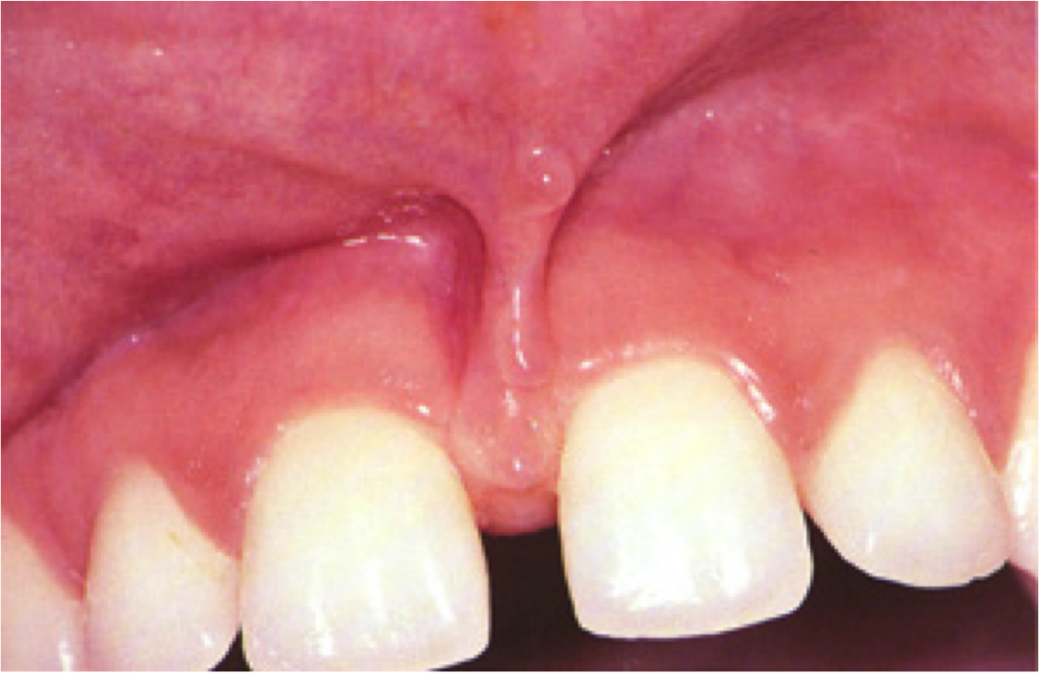
Classification of etiology….
4) Abnormal labial frenum
Midline diastema due to presence of thick fibrous tissue, labial frenum

Slide 31
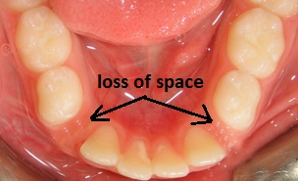
Classification of etiology….
5) Premature loss of deciduous teeth
Loss of teeth before permanent successor is sufficiently advanced in its development
Cause migration of adjacent teeth in the space
Prevent eruption of the permanent successor
Notes:
Premature loss can occur due to:
1. Caries
2. Trauma
3. Endocrinal disturbances like hyperthyroidism
4. Metabolic disturbances like hypophosphotasia

Slide 32
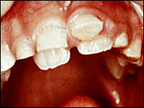
Classification of etiology….
6) Prolonged retention of deciduous teeth
Results in lingual or palatal eruption of permanent successors
Sometimes permanent teeth may remain impacted
Notes:
Premature loss can occur due to:
1. Caries
2. Trauma
3. Endocrinal disturbances like hyperthyroidism
4. Metabolic disturbances like hypophosphotasia

Slide 33
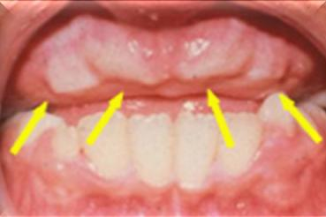
Classification of etiology….
7) Delayed eruption of permanent teeth
Some reasons for delay in eruption are:
Congenital absence of permanent tooth
Supernumery tooth
Heavy mucosal barrier
Premature loss of deciduous teeth
Deciduous root fragments

Slide 34
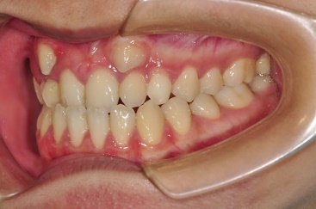
Classification of etiology….
8) Abnormal eruptive path
Can be due to arch length tooth size deficiency
Impacted tooth, retained root fragments, formation of bony barrier
Maxillary canines most commonly show ectopic eruption

Slide 35
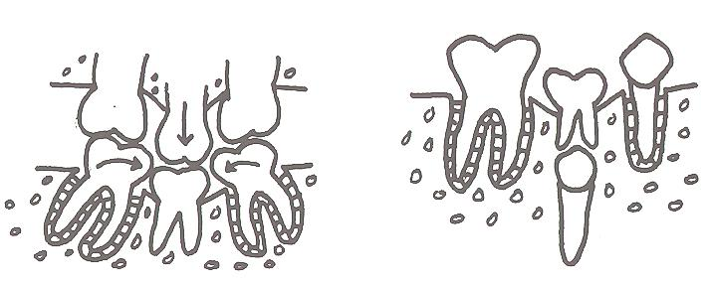
Classification of etiology….
9) Ankylosis
Fusion of part or whole of root surface with absence of intervening periodontal ligament
These teeth fail to erupt at normal level – submerged teeth
Totally submerged teeth cause migration of adjacent teeth into the space

Slide 36
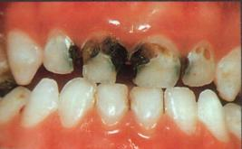
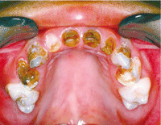
Classification of etiology….
10) Caries
Lead to premature tooth loss – migration of adjacent teeth, abnormal axial inclinations and supra-eruption of adjacent teeth
Proximal caries – decreased arch length

Slide 37
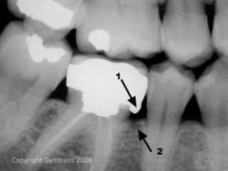
Classification of etiology….
11) Improper dental restorations
Predispose to malocclusion
Over-contoured occlusal restorations – premature contacts
Under-contoured occlusal restorations – supraeruption of opposite tooth
Poor proximal contacts – food lodgement and periodontal weakening of teeth
Notes:
Over-contoured occlusal restorations – premature contacts leading to functional shift of mandible

Slide 38
CONCLUSION
Knowledge of the contribution of genetic and environmental causes of malocclusion obligates clinicians to differentiate between patients whose malocclusions are primarily of genetic origin from those whose are of environmental origin.
For most patients the differentiation between genetic and local environmental factors is of great importance when choosing the appropriate treatment and retention plans.

Slide 39

THANK YOU

