Slide 1


Slide 2
CLASSIFICATION
OF
MALOCCLUSION
DEPARTMENT OF ORTHODONTICS AND DENTOFACIAL ORTHOPEDICS

Slide 3
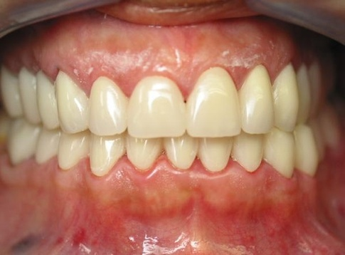
OCCLUSION
Occlusion is defined as the relationship of the maxillary and mandibular teeth when the jaws are closed in centric relation without strain of the musculature or displacement of condyle in their fossae

Slide 4
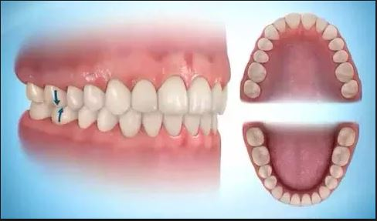
Occlusion…
Ideal occlusion:
An ideal occlusion is a hypothetical or theoretical concept based on the anatomy of the teeth and rarely found in nature

Slide 5
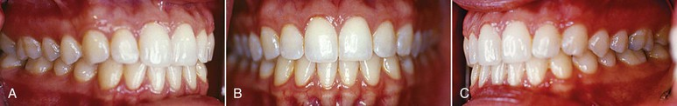
Occlusion…
Normal occlusion:
The normal occlusion was when the upper and lower molars were in a relationship whereby the mesiobuccal cusp of the upper molar occluded in the buccal grove of the lower molar and the teeth were arranged in a smoothly curving line of occlusion
Contemporary orthodontics,by William Proffit, 5th edition
Notes:
This refers to an occlusion that deviates in one or more ways from ideal yet it is well adopted to that particular environment, is esthetic and shows no pathologic manifestations or dysfunction

Slide 6
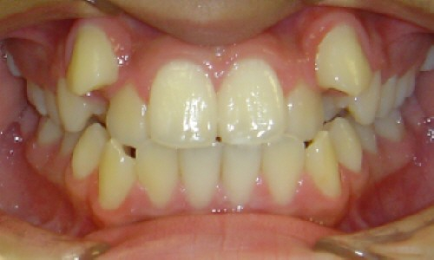
Occlusion…
Malocclusion:
Malocclusion is a condition that reflects an expression of normal biologic variability in the way the maxilla & mandible teeth occlude
Contemporary orthodontics,by William Proffit, 5th edition
Notes:
This refers to an occlusion that deviates in one or more ways from ideal yet it is well adopted to that particular environment, is esthetic and shows no pathologic manifestations or dysfunction

Slide 7
CLASSIFICATION OF MALOCCLUSION

Slide 8
TYPES OF MALOCCLUSION
Intra-arch
Inter-arch
Skeletal

Slide 9
INTRA-ARCH MALOCCLUSIONS
Tipping – mesial, distal, labial, lingual
Displacements - mesial, distal, labial, lingual
Infraversions and supraversions
Rotations
Transposition

Slide 10
INTER-ARCH MALOCCLUSIONS
Sagittal plane
Pre-normal occlusion
Post-normal occlusion
Vertical plane
Deep bite
Open bite
Transverse plane
Crossbites

Slide 11
SKELETAL MALOCCLUSIONS
Sagittal plane
Prognathism
Retrognathism
Vertical plane
Affects Lower facial height
Transverse plane
Crossbites
Narrowing or widening of jaws
Open bite and deep bite
Notes:
Defect in size, position or relationship between the jaws

Slide 12
Methods of recording & measuring malocclusion is broadly divided into two types by Tang & Wei in 1993
Qualitative methods Quantitative methods
Angle’s classification - Little's Irregularity Index
Mod: Dewey’s modification - Treatment Priority Index
Lischer’s modification - IOTN
Simon’s classification
Bennett’s classification
Ackermann- Profit classification
British standard classification
for incisors
GRABER,orthodontics principle and practice

Slide 13
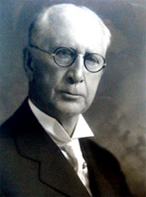
ANGLES CLASSIFICATION
By EDWARD HARTLEY ANGLE
Was considered the ‘father of modern dentistry’
Based on the anterior posterior relationship of the jaws
Maxillary 1st molar was the key to normal occlusion
June 1, 1855 – August 11, 1930
GRABER, orthodontics principle and practice
Notes:
In his 1907 book, Angle emphasized using the maxillary first molars as reference teeth for determining the classification:
1.Are the largest teeth.
2.Are the firmest in their attachment.
3.Have a key location in the arches.
4.Help determine the dental and skeletal vertical proportions due to the lengths of their crowns.
5.Occupy normal position in the arches far more often than any other teeth because they are the first permanent teeth and are less restrained in taking their position.

Slide 14
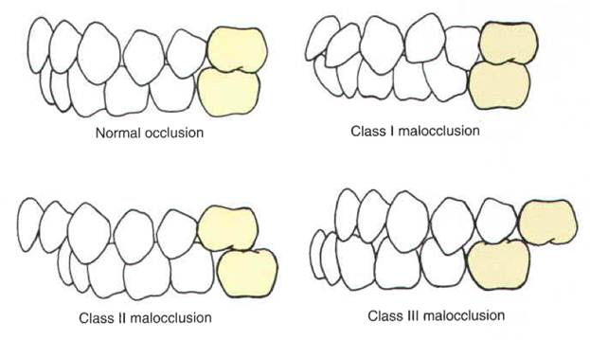
Angle’s classification
GRABER, Orthodontics principle and practice

Slide 15
Angle’s classification
CLASS I
CLASS II
DIVISION I
DIVISION II
TYPE A
TYPE B
TYPE C
CLASS II SUB DIV
CLASS III
TRUE
PSUEDO
CLASS III SUB DIV
GRABER,orthodontics principle and practice

Slide 16
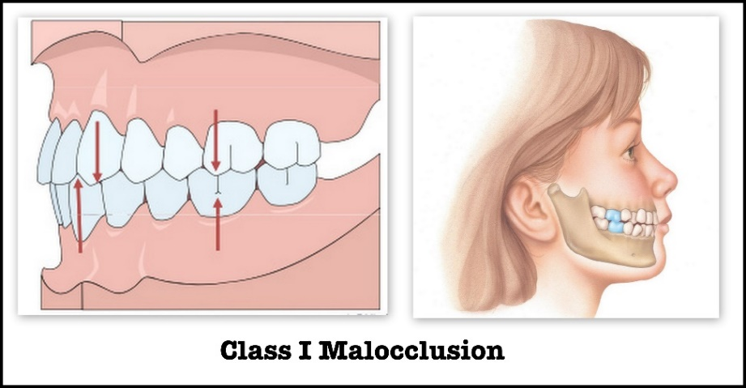
CLASS I MALOCCLUSION
Angle’s classification
The mesiobuccal cusp of maxillary permanent first molar occludes in the buccal groove of the mandibular permanent first molar
Textbook of orthodontics, by Samir Bishara
Notes:
The mesiolingual cusp of maxillary permanent first molar occludes with the occlusal fossa of the mandibular permanent first molar when the jaws are at rest and the teeth are approximated in centric occlusion.

Slide 17
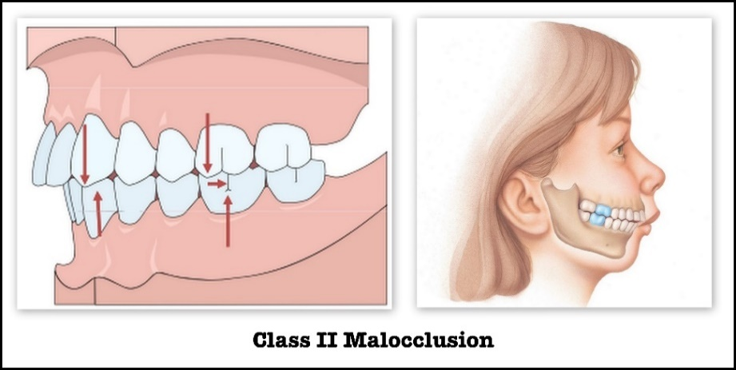
CLASS II MALOCCLUSION
Angle’s classification
The mesiobuccal cusp of maxillary permanent first molar occludes in the space between mesiobuccal cusp of mandibular permanent first molar and distal aspect of buccal cusp of second premolar.
Textbook of orthodontics, by Samir Bishara
Notes:
The mandibular dental arch and the body of the mandible are in distal relation to the maxillary arch.

Slide 18
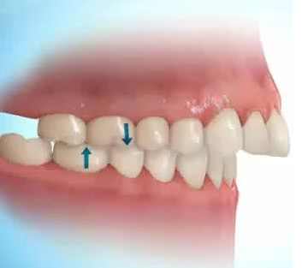
CLASS II DIVISION 1
Angle’s classification
A Class II malocclusion in which the maxillary incisor teeth are in labioversion.
Textbook of orthodontics, by Samir Bishara

Slide 19
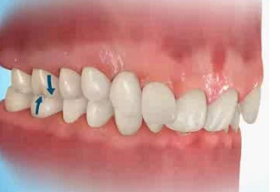
CLASS II DIVISION 2
Angle’s classification
A Class II malocclusion in which the maxillary incisor teeth are not in labioversion.
Textbook of orthodontics, by Samir Bishara

Slide 20
Class II division 2 is classified as :
The maxillary central incisors are tipped palatally and the laterals are in labioversion or normally inclined
The four maxillary permanent incisors are tipped palatally, with the canines are in mesiolabial version
Linguoversion of all six anterior teeth
Mixed type of frontal malposition with lingually inclined incisors on one side

Slide 21
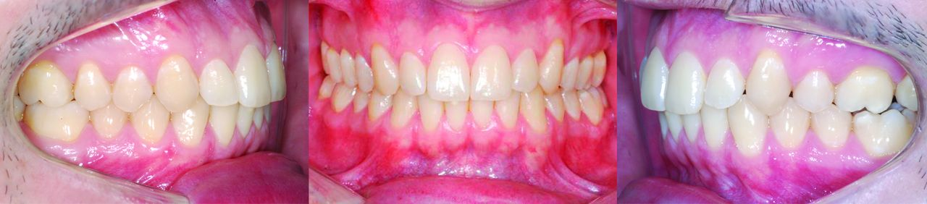
CLASS II SUBDIVISION
Angle’s classification
When there is class II molar relation on one side and class I molar relation on the other side it is known as class II subdivision
Textbook of orthodontics, by Samir Bishara

Slide 22
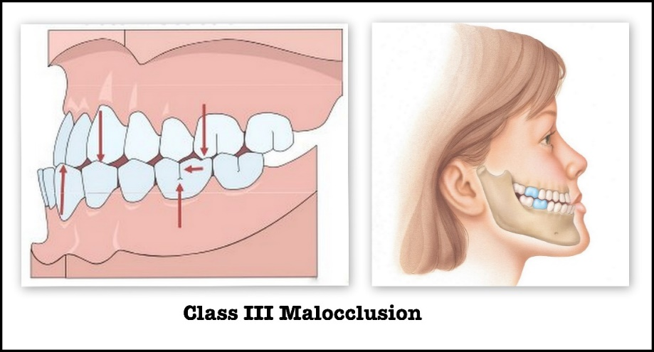
CLASS III MALOCCLUSION
Angle’s classification
The mesiobuccal cusp of the maxillary permanent 1st molar occludes in the interdental space between the mandibular 1st and the 2nd molars.
Textbook of orthodontics, by Samir Bishara
Notes:
The mandibular dental arch and the body of the mandible are in bilateral mesial relationship to the maxillary arch.

Slide 23
DEWEY’S MODIFICATION
(1935)
Given by Martin Dewey, initially Angle’s protégé but later his rival.
He gave modification for Angle’s class I and III classifications

Slide 24
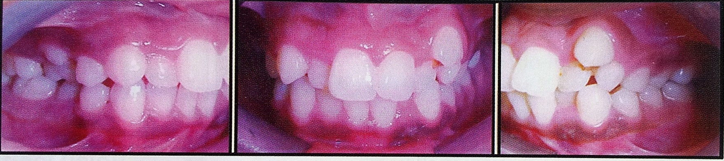
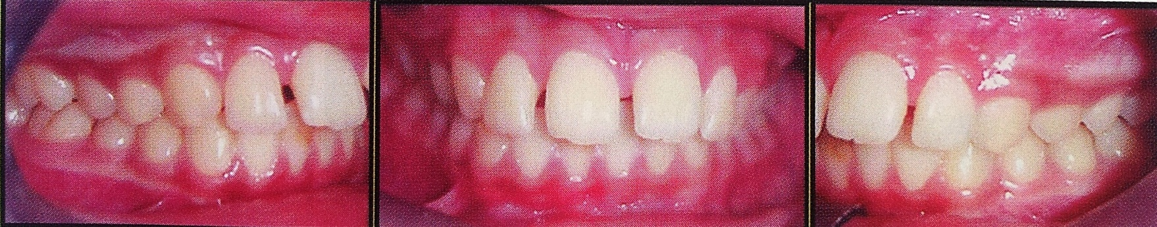
Angles’s classification..
Modification of Class I
Class I molar relation with :
Type 1: crowding of anterior teeth.
Type 2: proclined upper incisors.
Type 2: proclination of anterior teeth.

Slide 25
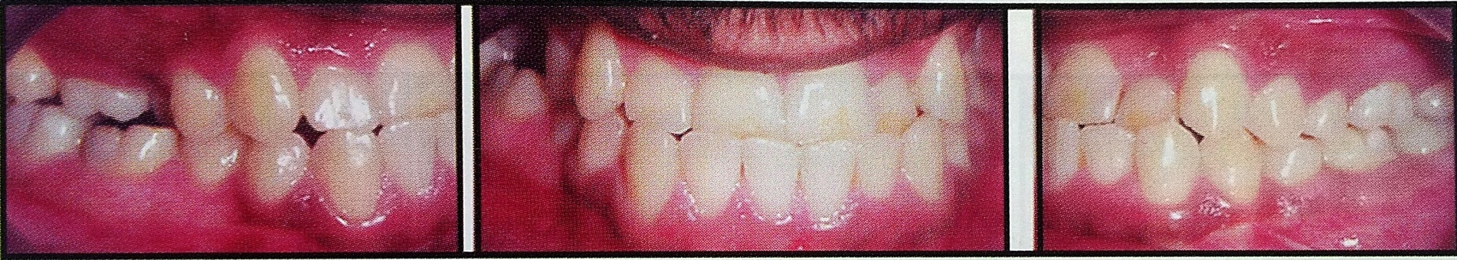
Angles’s classification..
Type 3: anterior cross bite
Type 4: posterior cross bite

Slide 26
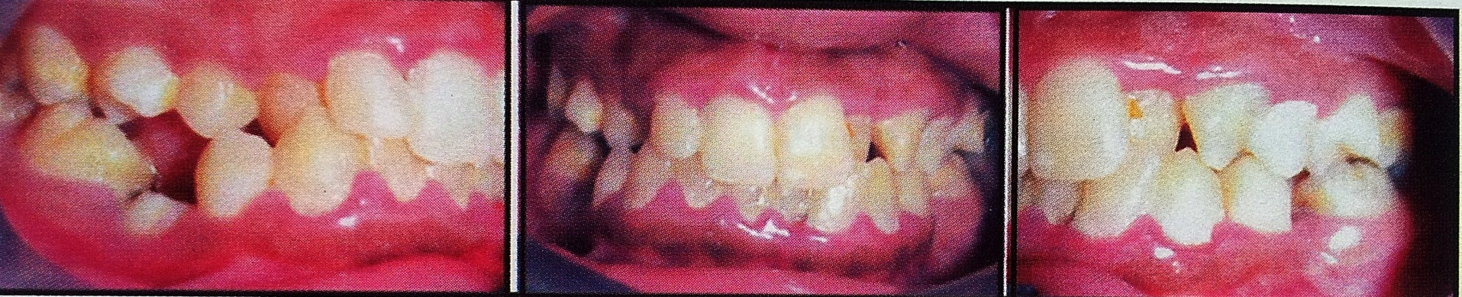
Angle’s classification..
Type 5: mesial migration of molars due to early loss of teeth mesial to them

Slide 27
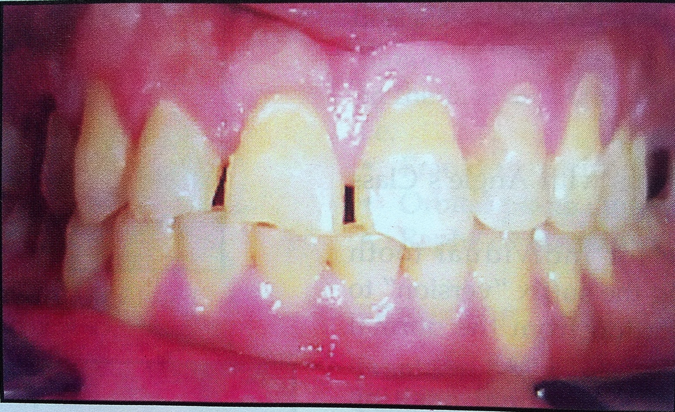
Angles’s classification..
Modification of Class III
Class III molar relation with :
Type 1 :edge to edge incisor relationship.
Notes:
1:The upper and lower dental arches whn viewd separately are in normal alignment.but when the arches are made to occlude the patient shows an edge to edge incisor alignment, suggestive of forwardly moved mandible

Slide 28
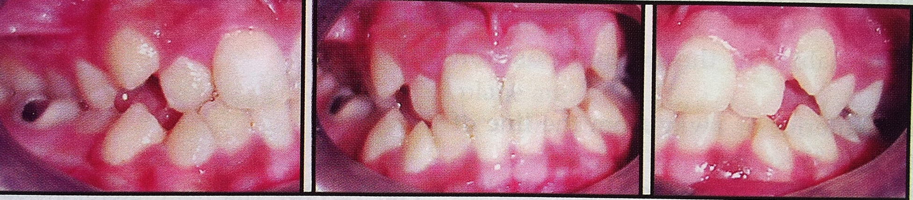
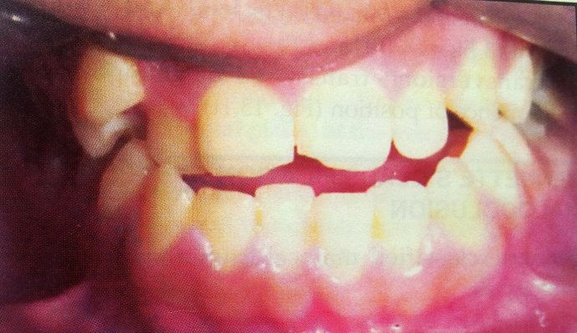
Angles’s classification..
Type 2 :mandibular incisor crowding and lingual relation to maxillary incisors
Type 3 :maxillary incisors are crowded and in cross-bite

Slide 29
LISCHER’S MODIFICATTION
Angle’s classification..
Used different terminologies for the same molar relationships described by Angle.
Nuetro – occlusion: synonymous to Angle’s class I malocclusion.
Disto - occlusion : synonymous to Angle’s class II malocclusion.
Mesio - occlusion : synonymous to Angle’s class III malocclusion.
Handbook of orthodontics, 4th edition, Robert E. Moyers

Slide 30
Angle’s classification..
He described individual tooth malpositions :
position– version.
Lingoversion/ labioversion
Mesioversion/distoversion
Infraversion/supraversion
Torsiversion or rotation
Perversion or impaction
Transversion or transposition
Handbook of orthodontics, 4th edition, Robert E. Moyers

Slide 31
SIMON’S CLASSIFICATION
Simon classified malocclusion in three planes:
1. Frankfort horizontal plane
2. Orbital plane
3. Mid-Sagittal plane
Handbook of orthodontics, 4th edition, Robert E. Moyers

Slide 32
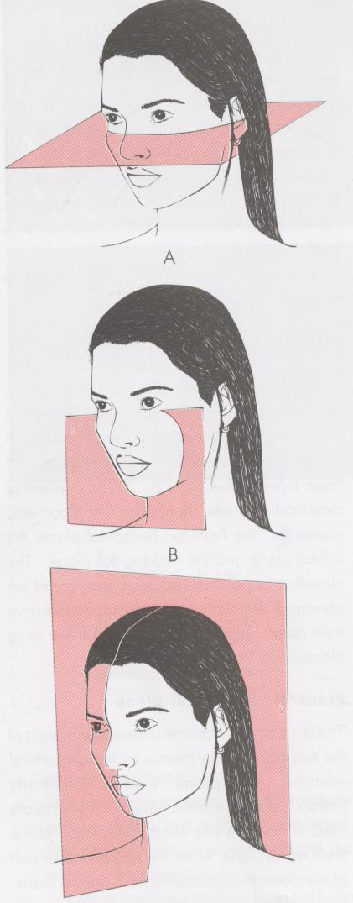
1. Frankfort horizontal plane:
this plane connects the upper margin of external auditory meatus to infra-orbital margins
Used to classify malocclusion in vertical plane
2. Orbital plane :
perpendicular to FHP, this plane should pass through the distal third of the upper canine (Simons law of canine)
Describes malocclusion in sagittal plane
3. Mid-sagittal plane:
used to describe malocclusion n transverse direction
Handbook of orthodontics, 4th edition, Robert E. Moyers

Slide 33
ATTRACTION
FRANKFORT HORIZONTAL PLANE
ABTRACTION
PROTRACTION
ORBITAL PLANE
RETRACTION
MID SAGITAL PLANE
CONTRACTION
DISTRACTION

Slide 34
BENNET’S CASSIFICATION
Norman Bennett classified malocclusion based on its etiology:
Class I - Abnormal position of one or more teeth due to local causes.
Class II - Abnormal formation of a part or whole of either arch due to developmental defects of bone
Class III- Abnormal relationship between upper and lower arches, between either arch & facial contour or correlated abnormal formation of either arch
Handbook of orthodontics, 4th edition, Robert E. Moyers

Slide 35
ACKERMAN-PROFIT CLASSIFICATION
Ackerman and Proffit proposed a diagrammatic classification scheme of malocclusion
It is based on Venn symbolic diagram that identifies five characteristics and their interrelationships
GRABER,orthodontics principle and practice

Slide 36
Ackerman-profit classification
TYPE
CLASS
Sagittal Deviation
(A-P)
Cl I Ant displacement
Cl II div 1
div 2
Cl III -dental
-skeletal
Transverse
Deviation (Lateral)
Buccal
Palatal – Unilateral
- Bilateral
- dental
- skeletal
Trans
Sagittal
Trans-
Sagitto-
Vertical
Vertico-
Transverse
Sagitto-
Vertical
Ant Divergent
Post Divergent
Straight
Concave
Convex
Profile
Vertical Deviation
Open bite-Anterior
-Posterior
Deepbite
Collapsed bite
-dental -skeletal
BITE
DEPTH
Ideal
Crowding
Spacing
Intra-arch
Alignment / symmetry

Slide 37
BRITISH INCISOR CLASSIFICATION
Class I
Class II
Division 1
Division 2
Class III
GRABER,orthodontics principle and practice
Notes:
class1- the lower incisor edgesocclude with or lie immediately below the cingulum prominence of upper incisors
Class 2 – the lower incisor edges lie posterior to the cingulum prominanc e of upper incisors
Div 1-upper central incisors are proclines or of average inclination.increase in overjet
Div 2-the upper central incisor are retroclined, overjet is usuall minimal but many be increased
Class 3-lower incisor edge lie anterior to the cingulum prominence of upper incisor the over jet is reduced or reversed

Slide 38
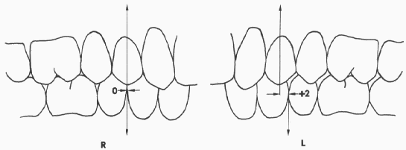
KATZ PREMOLAR CLASSIFICATION(1992)
Class I: The most anterior upper premolar fits exactly into the embrasure created by the distal contact of the most anterior lower premolar.
Orthodontics,diagnosis and management of malocclusion and dentofacial deformities, Kharbanda

Slide 39
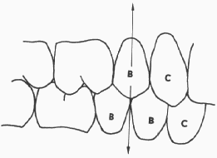
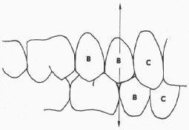
Class II : The most anterior upper premolar is occluding mesial of the embrasure created by distal contact of the most anterior lower premolar
Class III: The most anterior upper premolar is occluding distal of the embrasure created by the distal contact of the most anterior lower premolar
Orthodontics,diagnosis and management of malocclusion and dentofacial deformities, Kharbanda

Slide 40


