Slide 1
Occlusion-
Basic concepts
DEPARTMENT OF ORTHODONTICS AND DENTOFACIAL ORTHOPEDICS

Slide 2
OC= UP, CLUSION= CLOSING
OCCLUSION= CLOSING UP
Defined as Relationship of dental arches when tooth contacts are made
In ideal occlusion teeth alignment is such that the masticatory loads are within physiological range and act through long axis of as many teeth in the arch as possible

Slide 3
Types of occlusion
Static
Functional
Centric
Eccentric

Slide 4
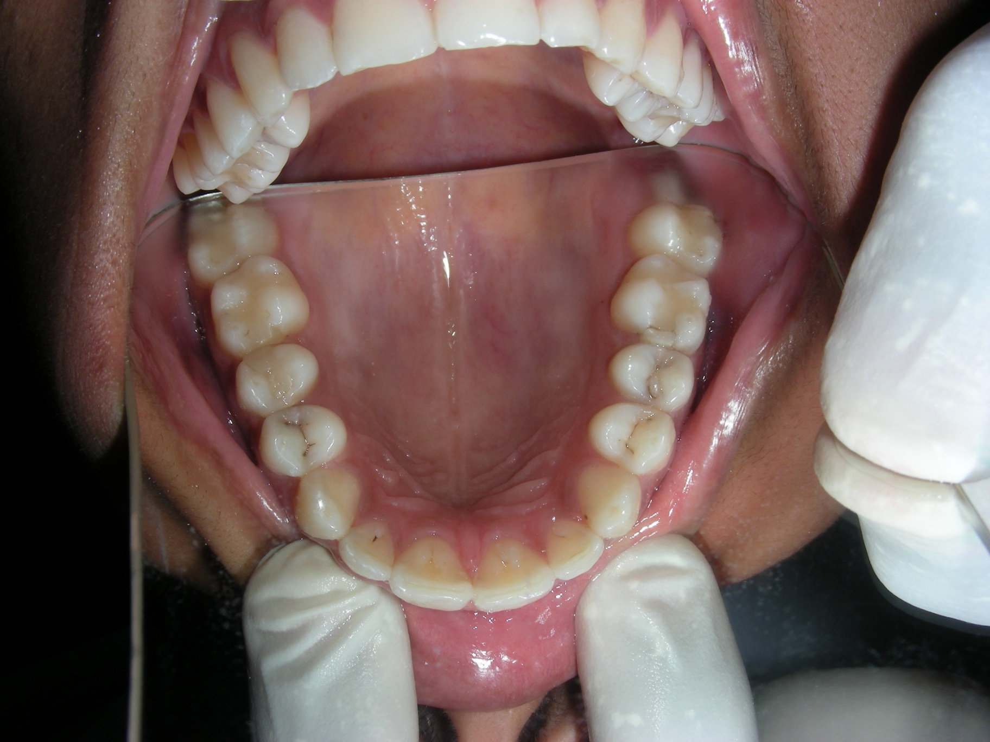
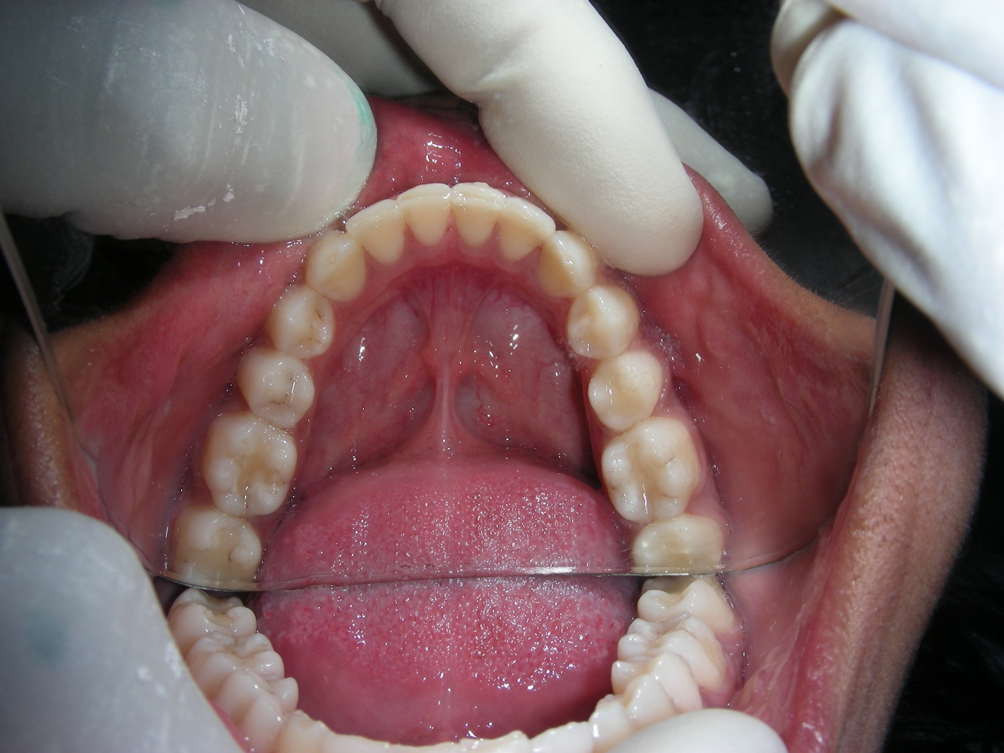
TYPES OF CUSPS
Centric holding cusps- e.g mand facial and max palatal(blue dots)
Non supporting cusps- e.g mand lingual and max buccal(red dots)
.
.
.
.
.
.
.
.
.
.
.
.

Slide 5
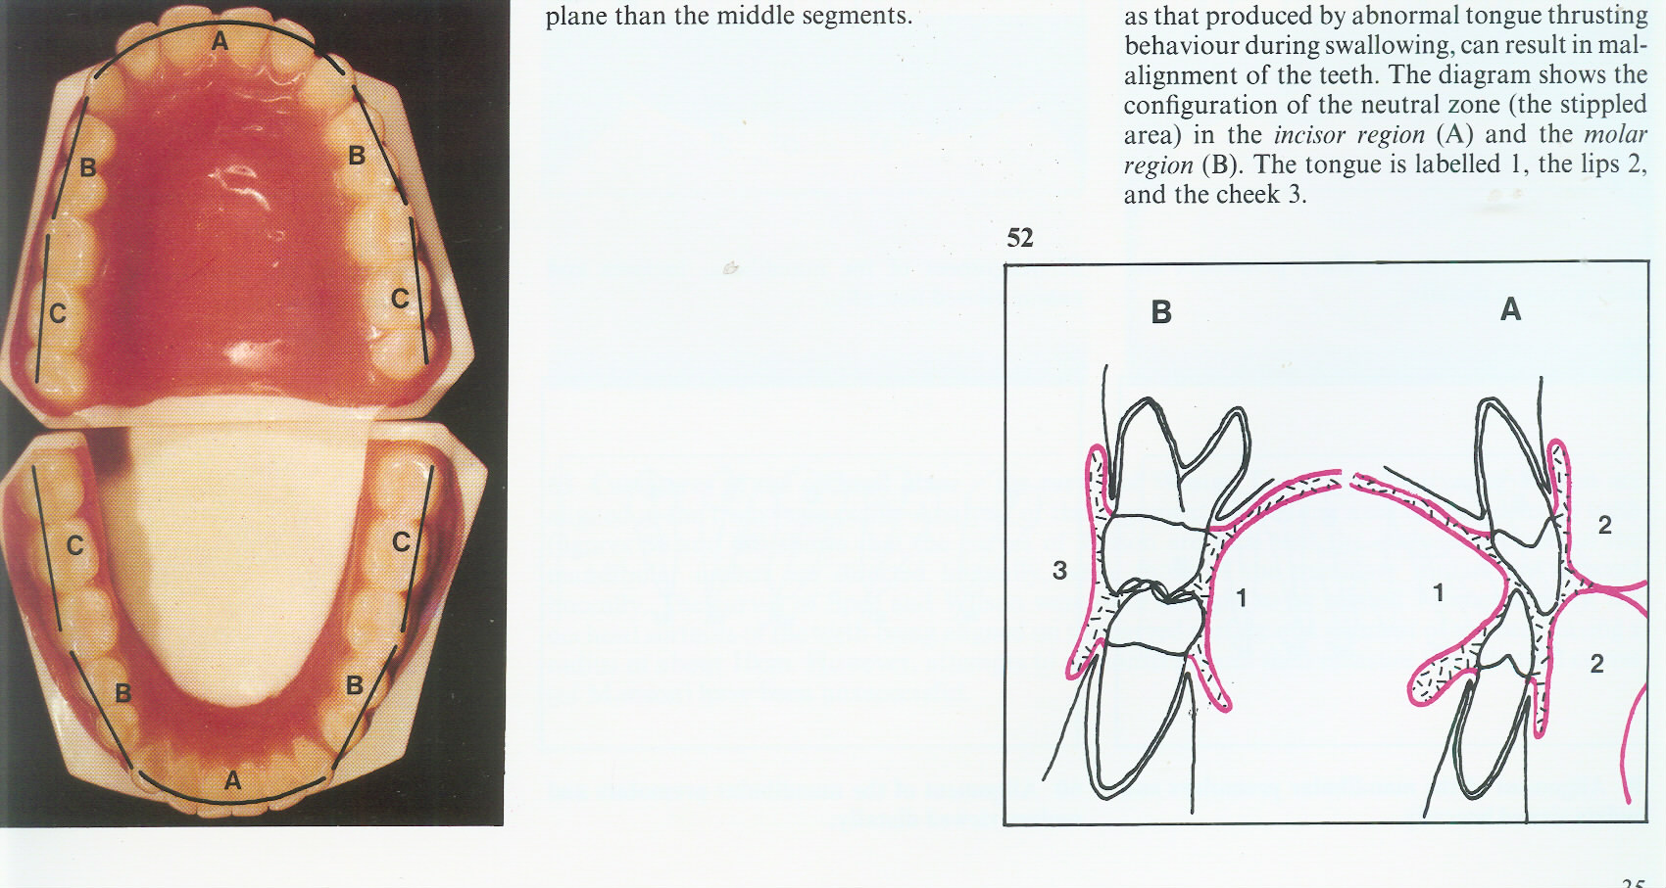
Anatomical alignment of teeth
DENTAL ARCHES
size & shape
caternary curve
NEUTRAL ZONE

Slide 6
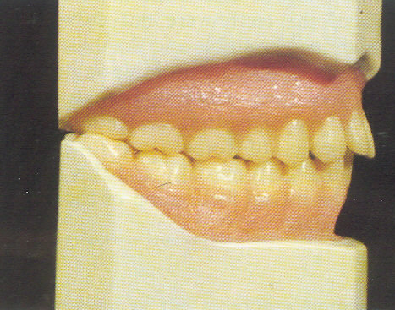
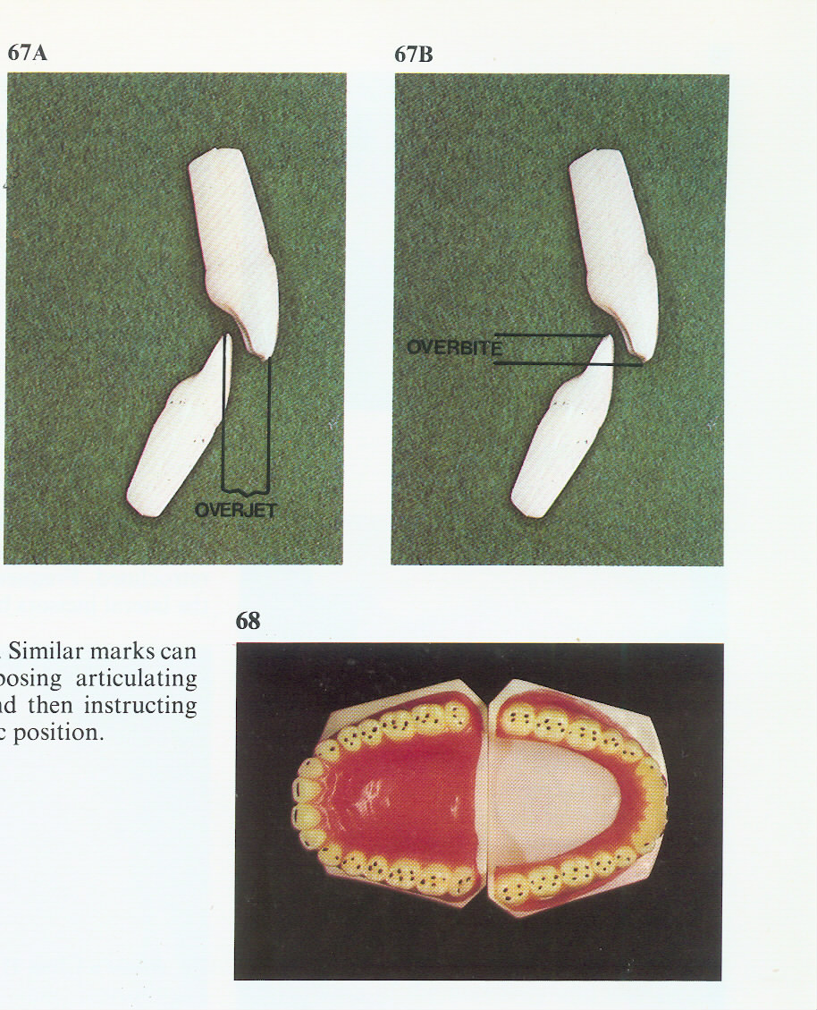
ANATOMIC OCCLUSION OF TEETH
Centric occlusion
Centric relation
LABIOLINGUAL RELATION
i

Slide 7
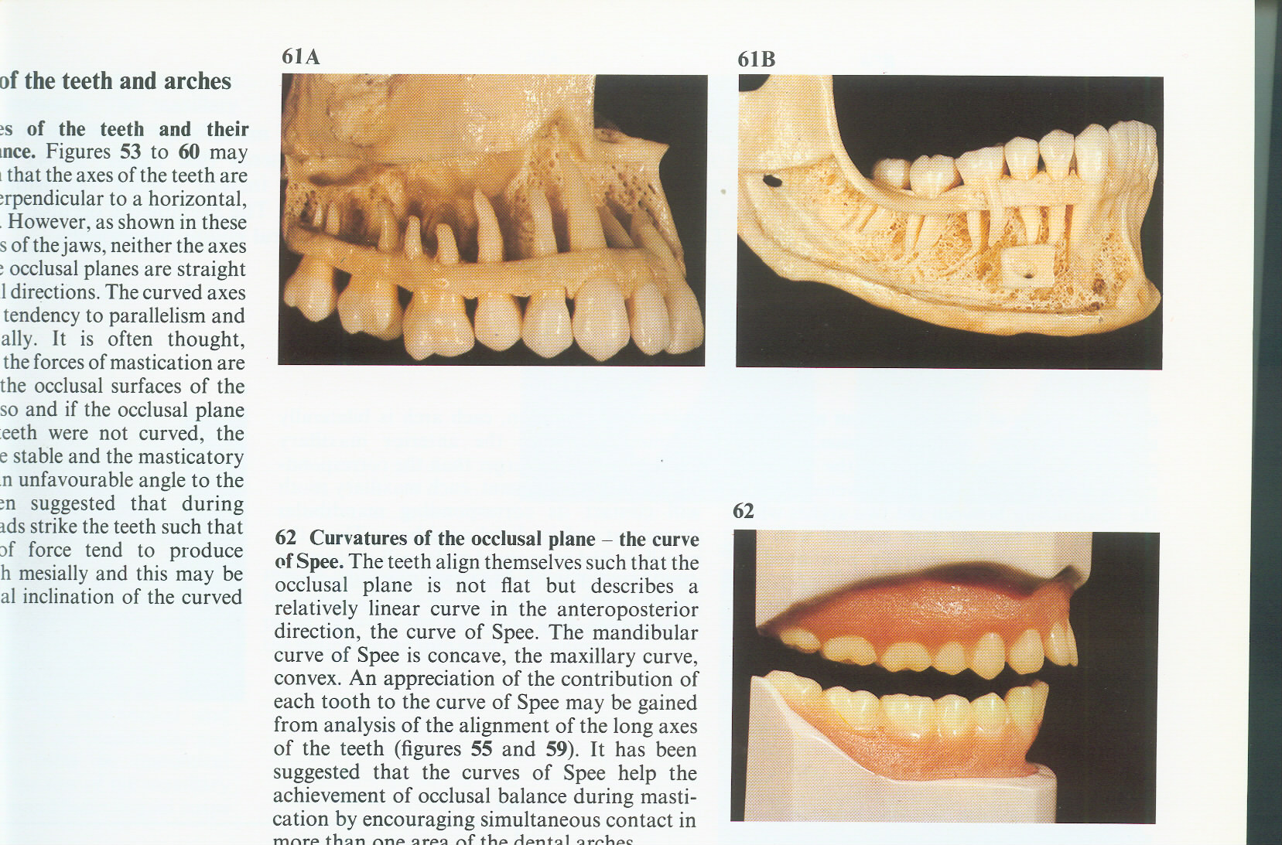
Curve of spee
“The occlusal surface of human dental arch (seen in norma lateralis) is described by the arc of the circle whose center is located on the surface of the middle of the orbits behind cristia lachryma posterior”
GRAF SPEE—1890

Slide 8
Significance of curve of Spee
For determination of space requirement during Rx planning
Tooth guidance e.g, canine, incisal
In orthodontic treatment for finalising occlusion

Slide 9
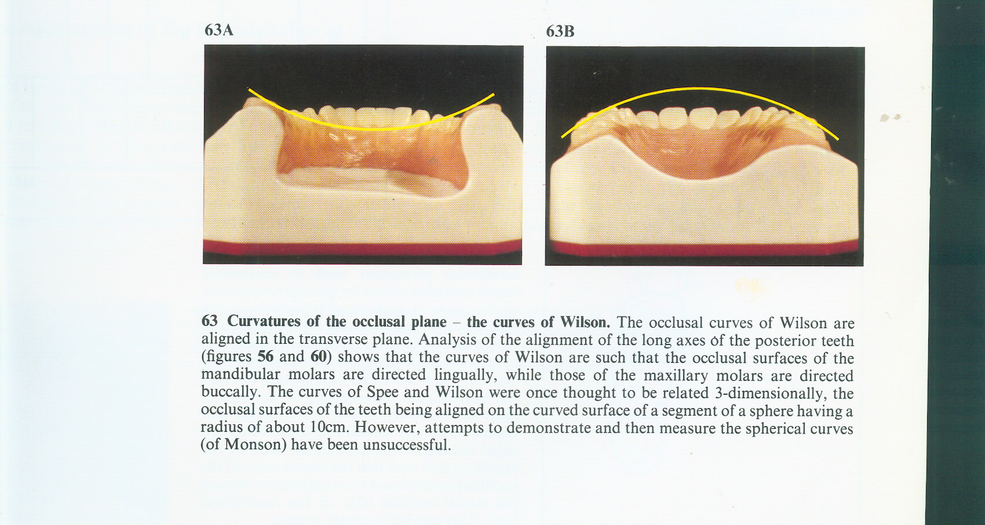
Curvatures of teeth and arches
Curve of wilson

Slide 10
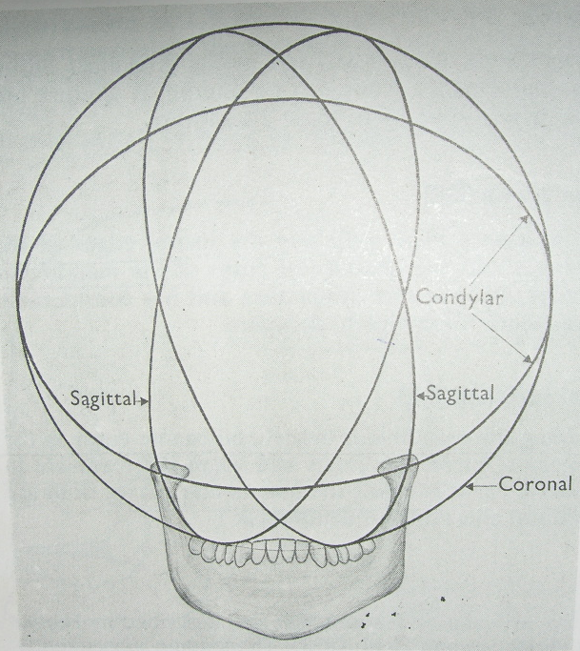
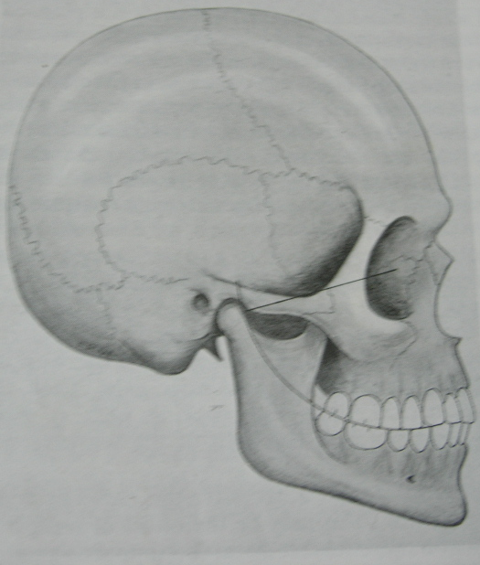
MONSON CURVE

Slide 11
CENTRIC RELATION
“ It is the unstrained, neutral position of the mandible in which the anterosuperior surfaces of the mandibular condyles are in contact with the concavities of the articular disks as they approximate the posterioinferior third of their respective articular eminentia”
CENTRIC OCCLUSION: “ It is the maximum intercuspation of maxillary and mandibular teeth when the mandible is in centric relation”

Slide 12
Eccentric occlusion types
Functional occlusion:-
Lateral :-
Canine guided
Group functional
protrusive

Slide 13
KEYS TO STATIC
AND FUNCTIONAL OCCLUSION

Slide 14
ANDREW’S SIX KEYS TO OCCLUSION(1972)
Molar interarch relationship
Mesio-distal crown angulation
Labio-lingual crown inclination
Absence of rotation
Tight contacts
Curve of spee
Correct tooth size

Slide 15
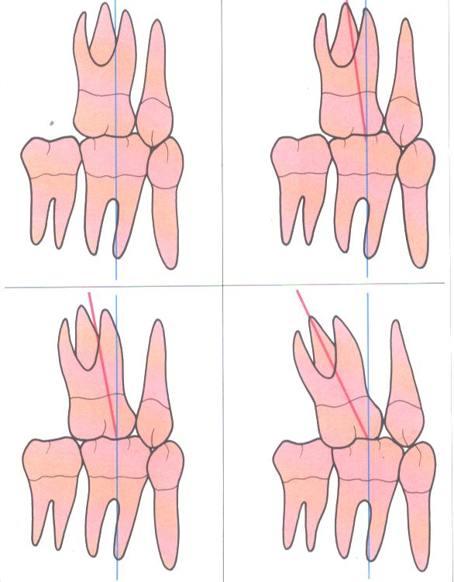
First key of normal
Occlusion: molar interarch
relationship

Slide 16
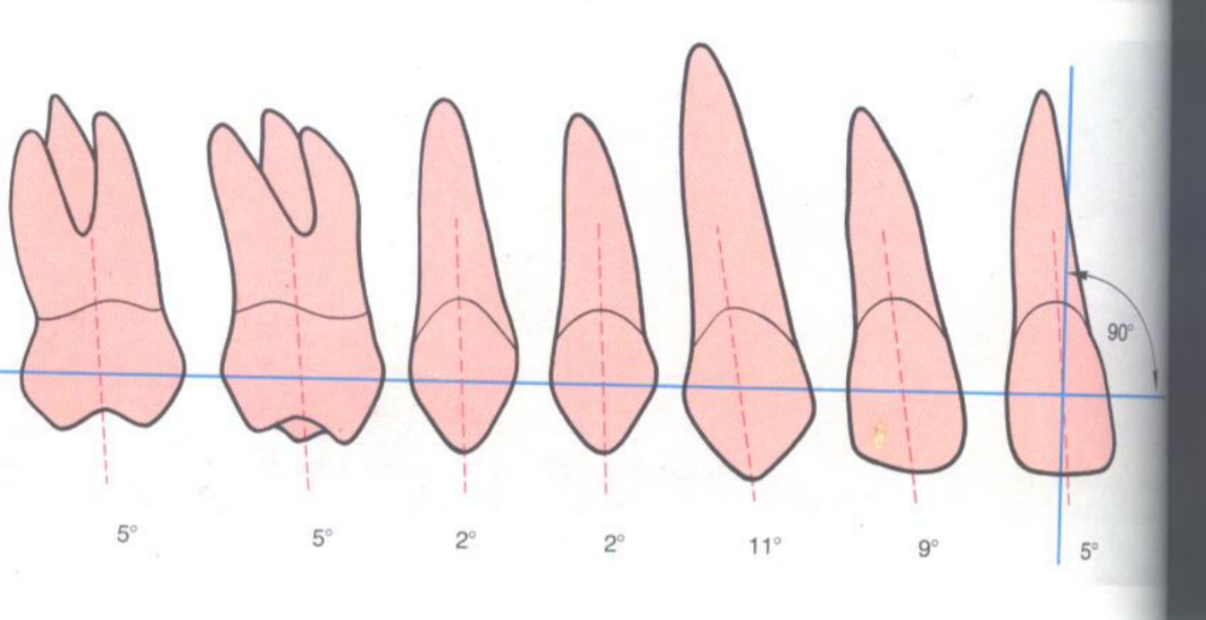
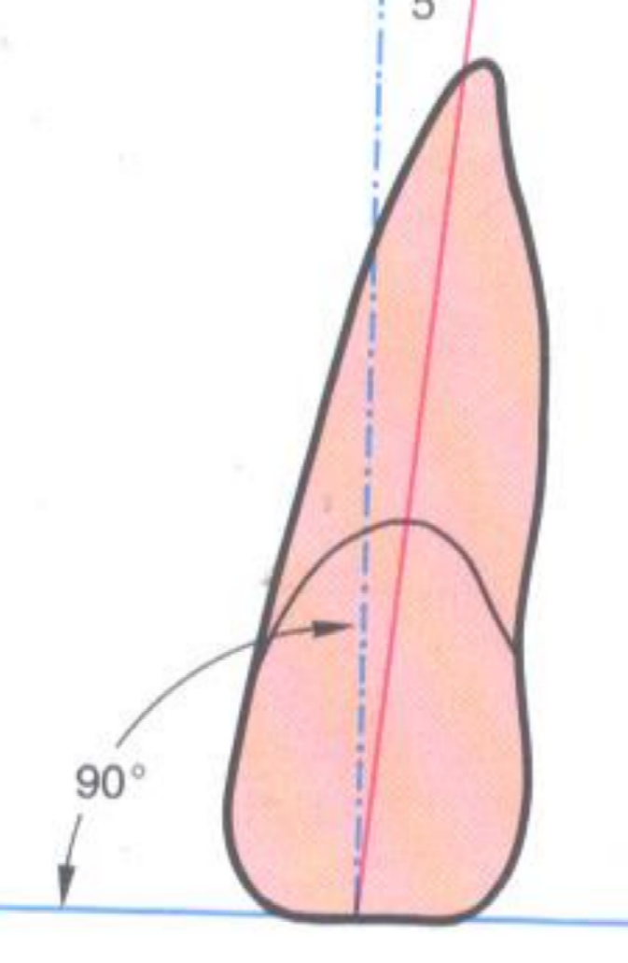
Second key of normal occlusion:
Mesiodistal crown angulation

Slide 17
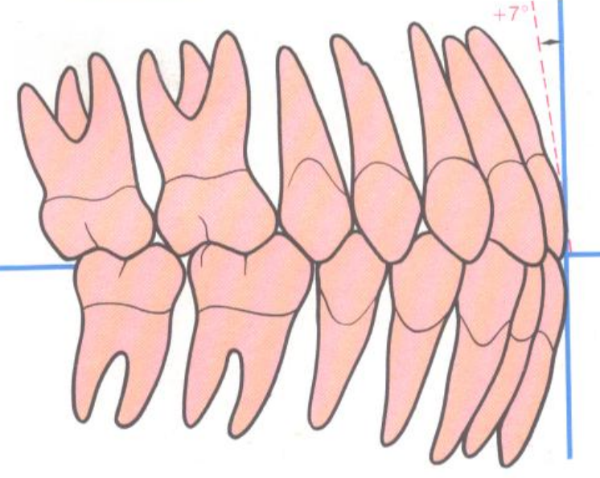
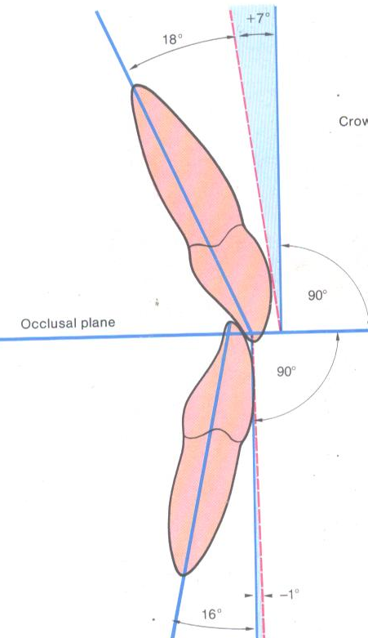
Third key of occlusion: labiolingual inclination

Slide 18
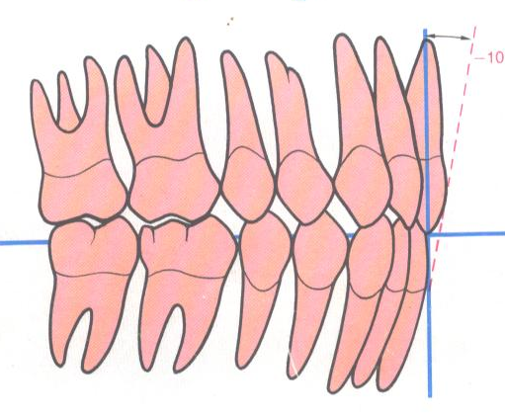
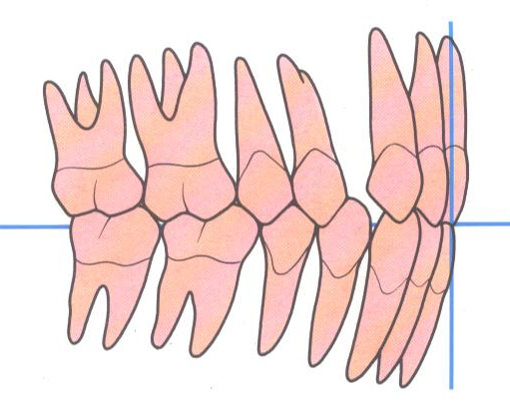
Improper labiolingual relationships

Slide 19
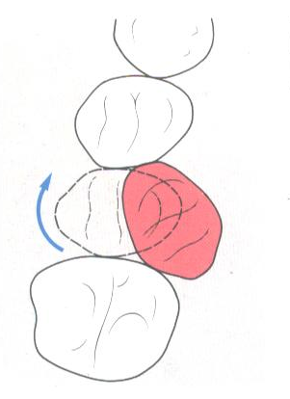
Fourth key of occlusion: rotations

Slide 20
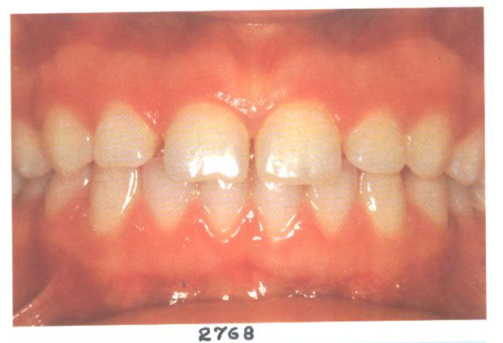
Fifth key to occlusion: tight contacts , no spacing

Slide 21
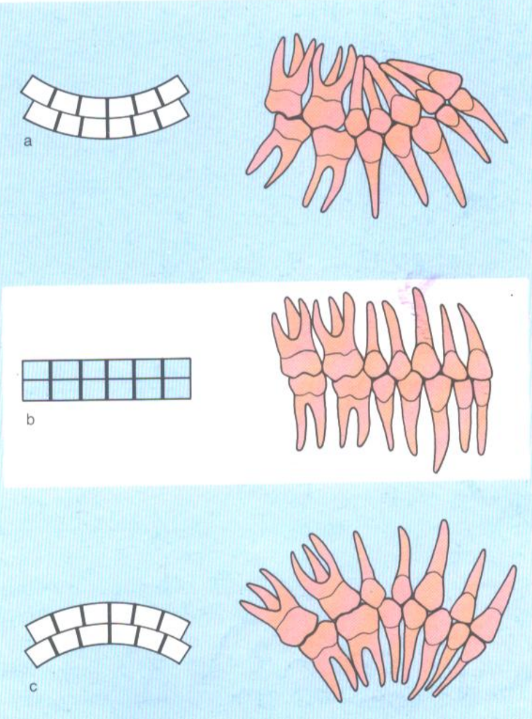
Sixth key of
Occlusion:
CURVE OF SPEE

Slide 22
The harder I work, the luckier I get.
Samuel Goldwyn
THANK YOU

