Slide 1
CYSTS OF ODONTOGENIC ORIGIN-II
Dept. of Oral Pathology& Microbiology

Slide 2
Purpose Statement
At the end of the class the students will be able to,
Describe classification, clinical features, pathogenesis, radiographic features, histologic features, differential diagnosis, treatment & prognosis of the lesion.

Slide 3
Learning Objectives
S.N. | Learning Objectives | Domain | Level | Criteria | Condition
1 | Enumerate clinical features | Cognitive | Must Know | All
2 | Write classification | Cognitive | Must Know | All
3 | Write pathogenesis | Cognitive | Must Know | All
4 | Write radiographic features | Cognitive | Must Know | All
5 | Write histologic features | Cognitive | Must Know | All
6 | Enumerate differential diagnosis | Cognitive | Nice to Know | All
7 | Write treatment & prognosis | Cognitive & Psychomotor | Must Know | All

Slide 4
Contents
Odontogenic keratocyst
Etiology
Clinical features
Radiological features
Histopathological features

Slide 5
Odontogenic Keratocyst/ Keratocystic Odontogenic Tumor
Keratocyst= Cyst epithelium produced keratin fills up the cystic cavity
Introduction
The term odontogenic keratocyst was 1st used by Philipsen in 1965.
The name ‘primordial cyst’ has been used synonymously with OKC for years.
The cyst with following characteristics are called as OKCs.
  Corrugated para/orthokeratinized surface.
  Uniform thickness of epithelium 6-10 layers thick.
  Prominent palisaded, polarized basal layer often described as ‘picket-fence’ or ‘tombstone’ appearance.

Slide 6
Etiopathogenesis
OKC is an abnormality arising from odontogenic epithelium
Two main sources of the epithelium from which the cyst is derived:
  The dental lamina or its remnants
and
  Extensions of basal cells from the overlying oral epithelium
The epithelium of OKC -far more active than other odontogenic cysts

Slide 7
OKCs are sometimes located in the ascending ramus
and have no relationship to a tooth follicle or dental
lamina. Such cysts, may arise from basal cell
offshoots or basal cell hamartias which originate
from the overlying oral mucosa

Slide 8
Clinical features
Age : Wide age range; 1-9thdecade, peak 2nd & 3rd decade
Bimodal: (a) II & III decades (b) V decade
Site :- Mandible > maxilla
Males > Females
Pain, soft tissue swelling, expansion of bone
Neurologic manifestations

Slide 9
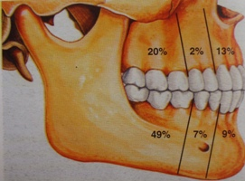
Relative distribution of OKC in Jaws

Slide 10
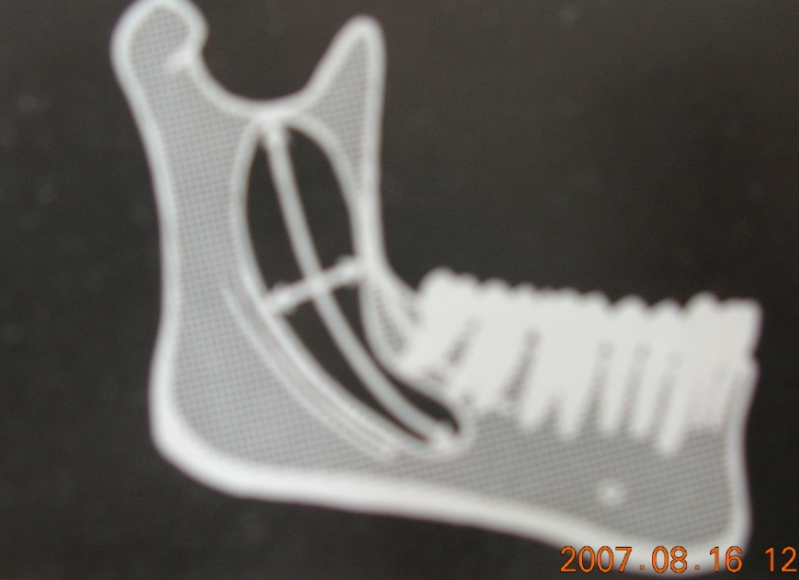
Cyst enlargement
Grows in antero-posterior direction within the medullary cavity of the bone without causing obvious bone expansion

Slide 11
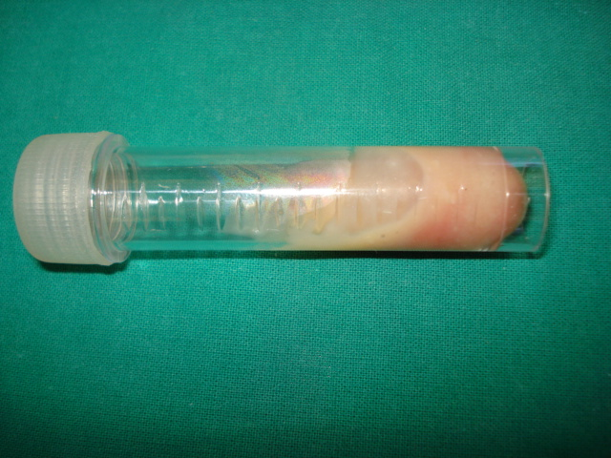
Aspirate analysis
Aspirate- thick yellowish cheesy material

Slide 12
Aspirate analysis
Toller (1970a) considered that estimation of the soluble protein level in aspirated cyst fluid might be a valuable aid in the preoperative diagnosis of OKCs.
Toller postulated that a protein level of less than 4.0g per 100ml indicated a diagnosis of OKC.
A value of over 5.0 g per 100ml however would
suggest a radicular, dentigerous or fissural cyst, or
even an ameloblastoma.

Slide 13
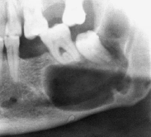
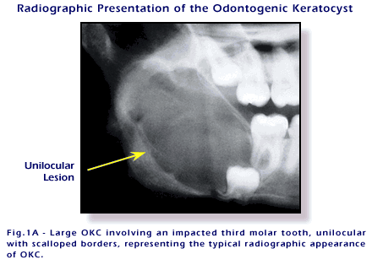
Radiographic features
Well defined radiolucent area with smooth & often corticated margins
Scalloping of border – represents variation in growth pattern
Unilocular with scalloped borders
Unilocular with scalloped margin

Slide 14
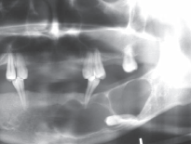
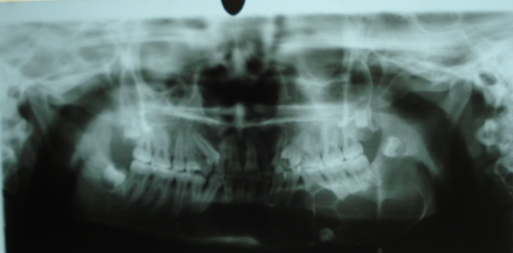
Multilocular in posterior body & ramus of mandible
May confused with Ameloblastoma

Slide 15
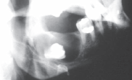
May mimic dentigerous cyst, if crown of retained tooth within its lumen

Slide 16
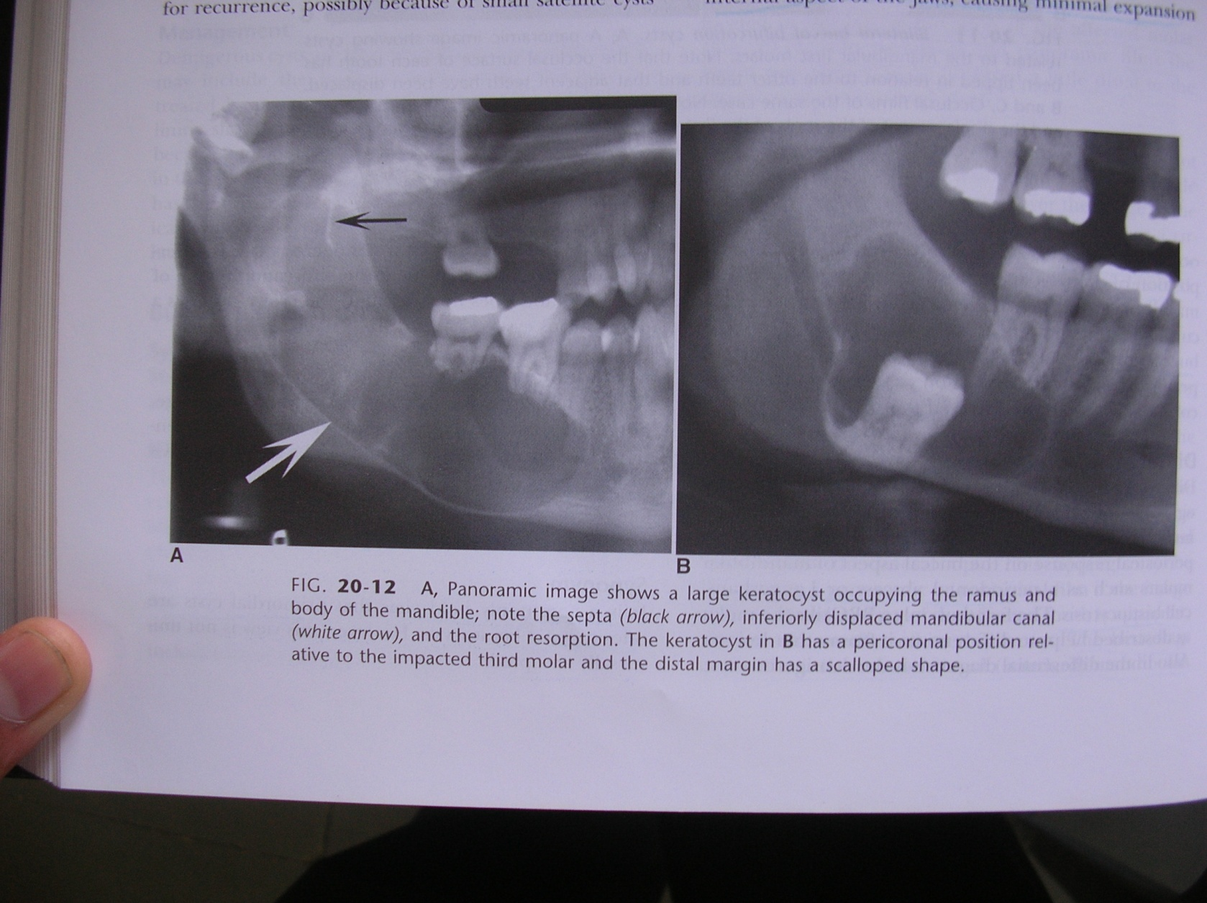

Slide 17
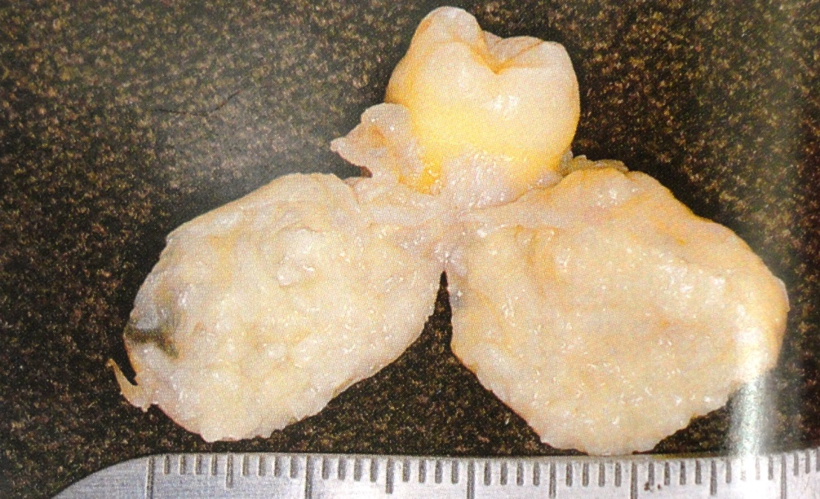
Gross specimen
The linings of OKCs are rarely received intact in the laboratory. They are usually thin walled, collapsed and folded. However, if one is seen intact, the unequal growth that is responsible for the scalloped radiographic margins may be observed

Slide 18
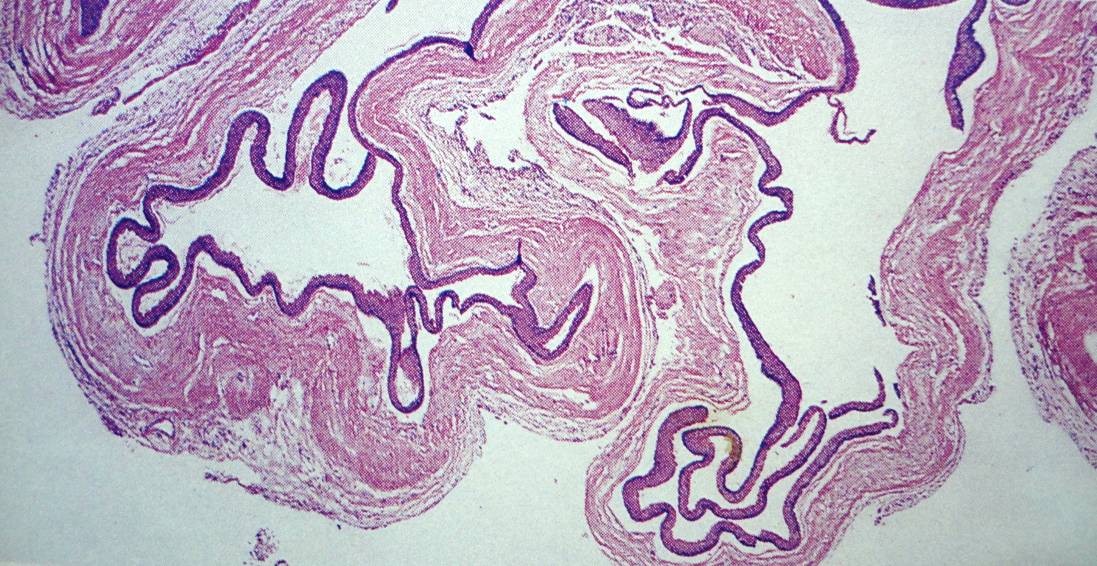
Histopathology

Slide 19
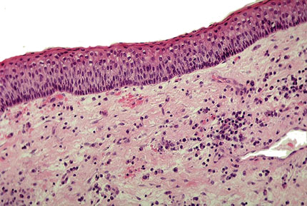
Histopathological features
The cysts are lined by a regular, narrow, keratinized, stratified squamous epithelium which is usually about 5–8 cell layers thick and without rete ridges.
Depending upon the pattern of keratinisation, the OKC’s can be divided into
  Parakeratotic -80–90%
  Orthokeratotic - 10 -20%
  and both forms may be found in different parts of some cysts

Slide 20
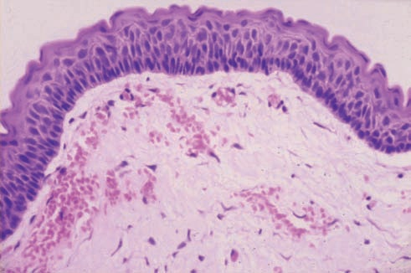
The parakeratotic layers often have a corrugated surface.
Well-defined, often palisaded, basal layer consisting of columnar or cuboidal cells or a mixture of both.
Cuboidal basal cells occur relatively more frequently in relation to the orthokeratinised linings.

Slide 21
Flattened basal cells may also be found in some orthokeratinised linings.

Slide 22
The nuclei of the columnar basal cells in the parakeratotic linings are orientated away from the basement membrane and in the majority of cases are intensely basophilic.

Slide 23
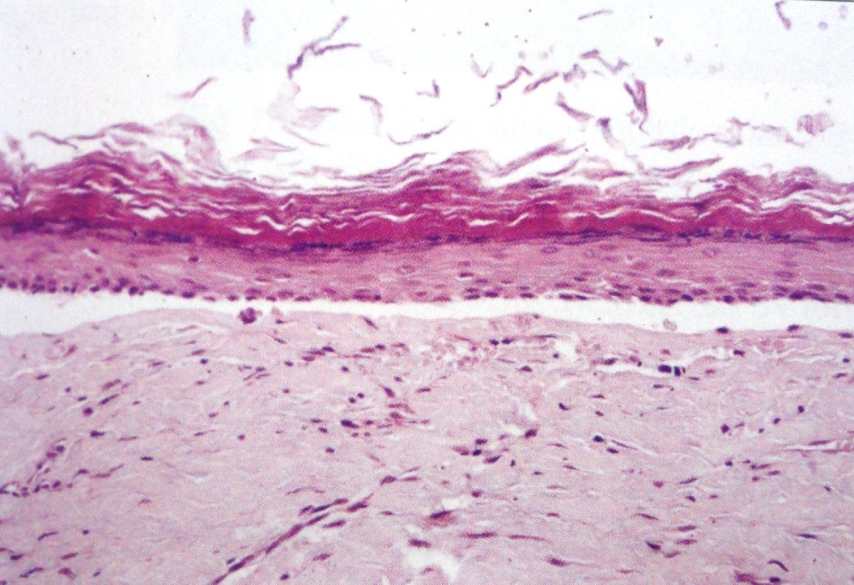
Desquamated keratin is present in many of the cyst cavities.
Mitotic figures are found in the basal layer but more frequently in the suprabasal layers, and mitotic activity is significantly greater in OKCs from patients with the NBCCS than from patients without

Slide 24
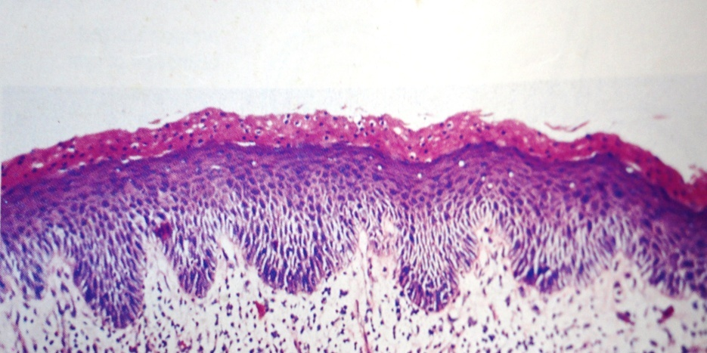
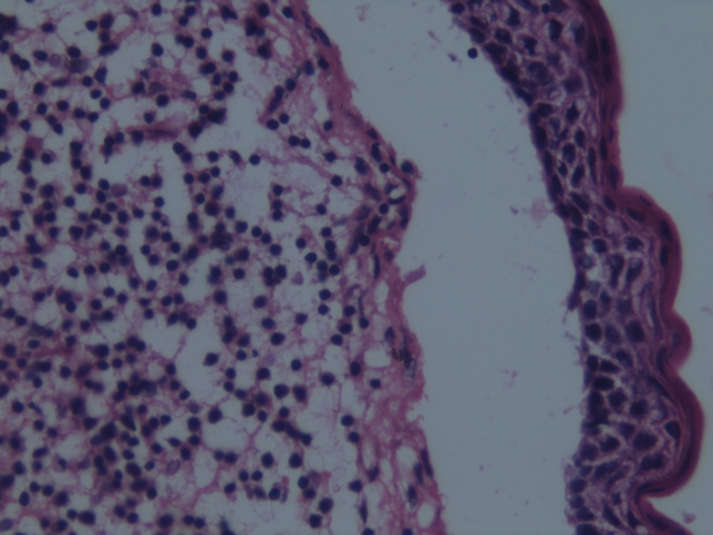
Occasional linings show features of epithelial dysplasia
The fibrous capsule of the OKC is usually thin & loose with relatively few cells widely separated by a stroma.
Unlike other odontogenic cysts the epithelial lining is weakly attached to & readily separates from the underlying connective tissue

Slide 25
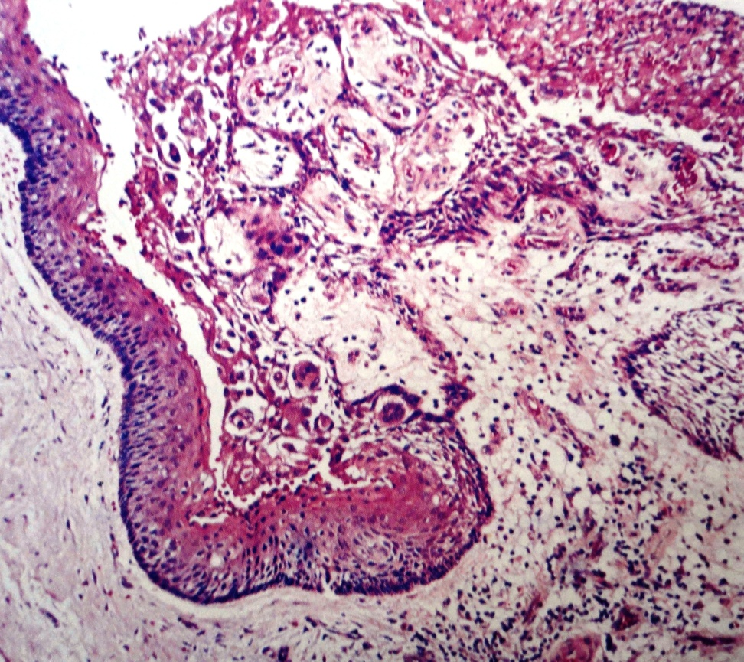
Inflammatory cells are very infrequent but there may be a mild infiltration of lymphocytes and monocytes.
In the presence of an intense inflammatory process, the adjacent epithelium loses its keratinized surface, may thicken and develop rete processes, or may ulcerate.

Slide 26
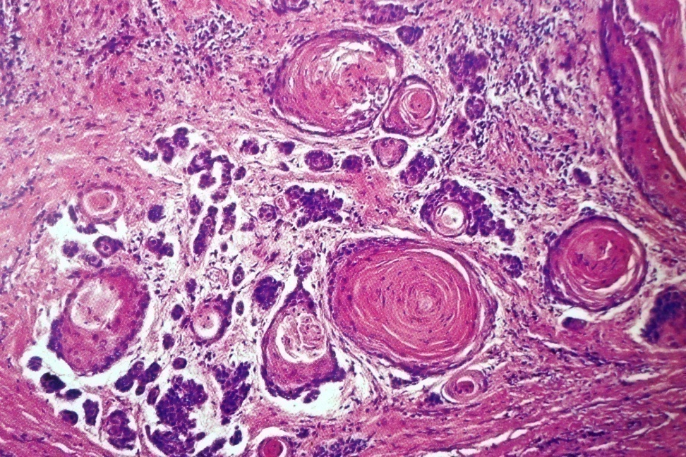
Satellite cysts/daughter cysts , epithelial rests and proliferating dental lamina are sometimes seen in the cyst capsules, particularly in patients with multiple cysts and with the NBCCS
Budding of the basal layer

Slide 27
SUMMARY
Clinical features,Pathogenesis, Radiological
features & Histopathological features of
Odontogenic KERATOcyst

Slide 28
BIBLIOGRAPHY
Text book of oral pathology Shafer's, 5 & 6th edition
Cysts of the Oral Regions Shear M 3rd edition
Color Atlas of Oral Diseases Cawson, R. 2nd edition
Oral and Maxillofacial Pathology Neville, Brad W. 2nd
Lucas’s Pathology Of Tumor’s of the Oral Tissues
Cawson, R. A., Bennie, W. H 5th edition

Slide 29
THANK U

