Slide 1
Postnatal growth and development of Craniofacial complex

Slide 2
Contents
Introduction
Terminologies
Concepts of growth
Osteogenesis
Regional development
  Mandible
  Nasomaxillary complex
  Cranium
  Conclusion
  References

Slide 3
Introduction
‘Growth is an increase in size; development is progress towards maturity’
                - TODD

Slide 4
What is postnatal growth?
Post natal growth is the first 20 years of growth after birth.
How does it differ from prenatal growth??
Prenatal growth is characterised by rapid increase in cell numbers and fast growth rate
Post natal growth is characterised by declining growth rate and increasing
maturation of tissue.

Slide 5
Postnatal growth is defined as the first 20 years of growth after birth.
Infancy
1st postnatal year
Early phase
1-6 yrs
Childhood
Middle phase
6-10 yrs
Late phase
10- 16 yrs
Males
14- 20 yrs
Adolescence
Females
13- 20 yrs
5

Slide 6
TERMINOLOGY
GROWTH FIELDS
The outside and inside surfaces of bone are blanketed by soft tissues, cartilage or osteogenic membranes. Within this, blanket areas known as growth fields, which are spread all along the bone in a mosaic pattern, are responsible for producing an alteration in the growing bone.

Slide 7
GROWTH SITES
Growth sites are growth fields that have a special significance in the growth of a particular bone, e.g. mandibular condyle in the mandible, maxillary tuberosity in the maxilla. The growth sites may possess some intrinsic potential to grow (debatable).

Slide 8
GROWTH CENTERS
Growth centers are special growth sites, which control the overall growth of the bone, e.g. epiphyseal plates of long bones. These are supposed to have an intrinsic growth potential (unlike growth sites).

Slide 9
Growth spurt :-
Period when a sudden acceleration of growth occurs . This sudden increase in growth is called growth spurt.
Timings of growth spurt:-
1. Just before birth
2. One year after birth
3. Mixed dentition growth spurt
Boys- 8-11 yrs
Girl-7-9 yrs
4.Pre pubertal growth spurt
Boys- 14-16 yrs
Girls-11-13 yrs

Slide 10
Growth markers:
1. Biometrics
2. Craniometry
3. Somatometry
4. X-ray cephalometry
5.Mental indicators
6. Superimposition
7. Stereopair images
8. Vital staining
9. Natural markers

Slide 11
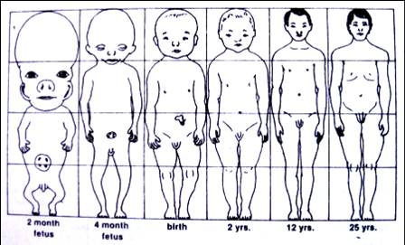
Other concepts
  Cephalocaudal growth
  Scammon’s growth curve
  Enlow’s counterpart principle

Slide 12
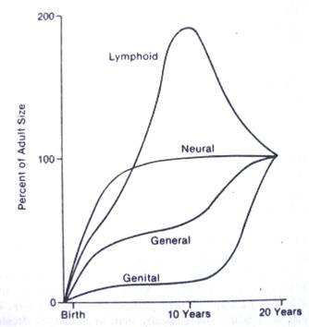
Differential growth scammon’s growth curve

Slide 13
B) Local factors
1. Vascular abnormality
2. Lymphatic disturbance
3. Neurologic disease
4. Local infection
5. Ear infection or mastoiditis
6. Ankylosis
7. Trauma or fracture
8. Birth injury
9. Habits
Factors Affecting Growth
Systemic Factors
Genetic
Hormonal imbalance
Nutrition
Systemic illness or chronic illness
Localized alteration/ diseases of uterus
Systemic illness in mother
Drugs

Slide 14
Characteristics of growth
INTRAMEMBRANOUS OSSIFICATION
ENDOCHONDRAL OSSIFICATION

Slide 15
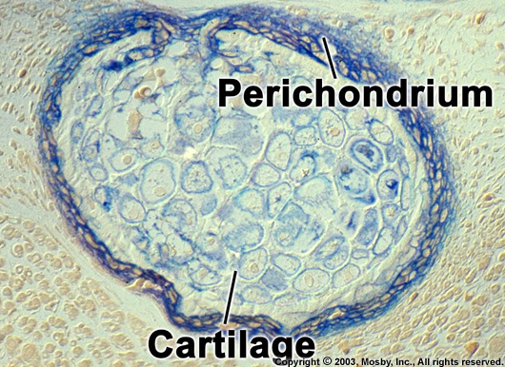
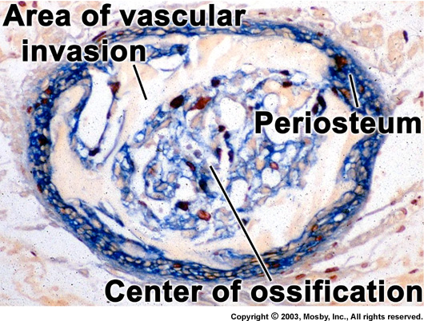
Five steps to Endochondral bone formation
Hypertrophy of chondrocytes and matrix calcifies
Invasion of blood vessels and the connective tissue
Osteoblasts differentiate and produce osteoid tissue
Osteoid tissue calcifies
Membrane covers bone and is essential

Slide 16
Endochondral
Mesenchymal cells
Cart. Matrix of glycoproteins
osteoblast
Cart. template
Blood vessels
Osteoid matrix
mineralized

Slide 17
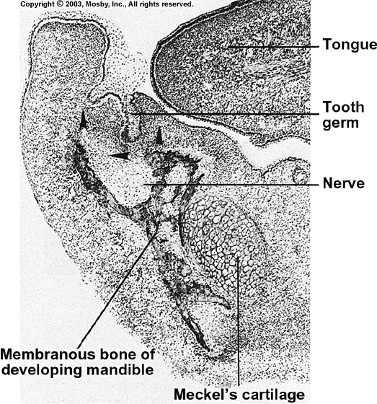
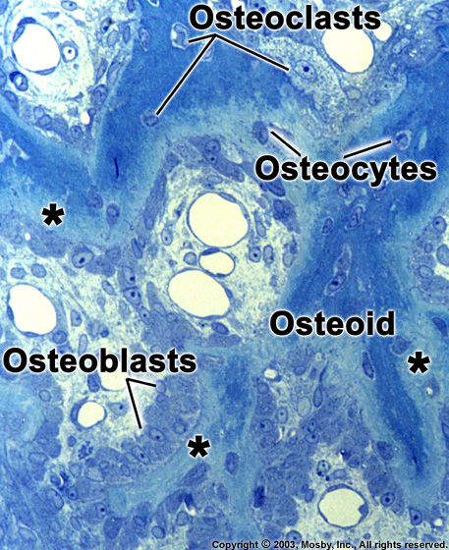
Five steps to Intramembranous bone formation
Osteoblasts produce osteoid tissue
Cells and blood vessles are encased
Osteoid tissue is produced by membrane cells
Osteoid calcifies
Essential membrane covers the bone

Slide 18
Intramembranous
Ectomesenchyme
Epithelium
Osteogenic membrane
Osteoblast
Centre of ossification
Osteoid matrix

Slide 19
Modes of bone growth
Hypertrophy
Hyperplasia
Extracellular material

Slide 20
An in-depth understanding of facial morphogenesis is essential so that the clinician can properly grasp
(1) differences between "normal" and ranges of abnormal;
(2) biologic reasons for these differences and the virtually limitless variations involved;
(3) reasons for rationales utilized in diagnosis, treatment planning, and selection of appropriate clinical procedures; and
(4) the biologic factors underlying the important clinical problems of retention, rebound, and relapse after treatment

Slide 21
The major but mutually interrelated form/function components involved in development are
  the brain with its associated sensory organs and basicranium,
  the facial and pharyngeal airway, and
  the oral complex.

Slide 22
A grasp of how facial growth operates begins with distinction between the two basic kinds of growth movement.
These are
  (1) remodeling
  (2) displacement

Slide 23
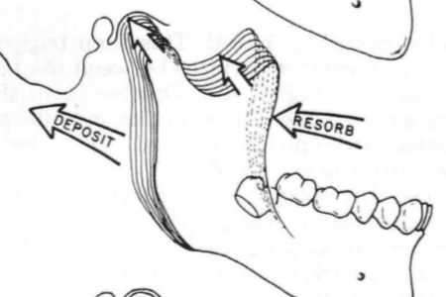
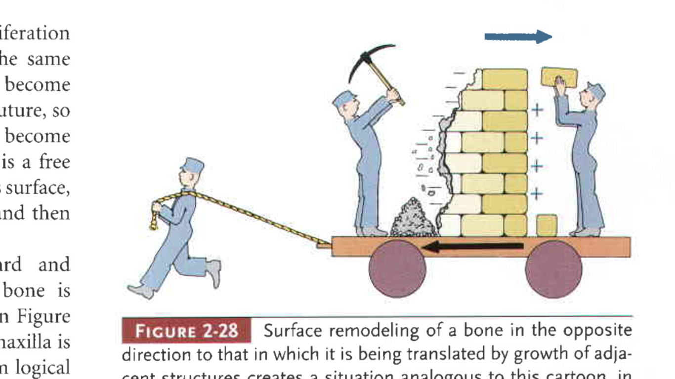
Remodeling
Shape of bone can be changed through removal (resorption) of bone in one area and addition (apposition) of bone in another.
This balance of apposition and resorption, with new bone being formed in some areas while old bone is removed in others, is an essential component of the growth process, known as Remodeling.

Slide 24
The functions of remodeling are to
(1) progressively create the changing size of each whole bone;
(2) sequentially relocate each of the component regions of the whole bone to allow for overall enlargement;
(3) progressively shape the bone to accommodate its various functions;
(4) provide progressive fine-tune fitting of all the separate bones to each other and to their contiguous, growing, functioning soft tissues; and
(5) carry out continuous structural adjustments to adapt to the intrinsic and extrinsic changes in conditions.

Slide 25
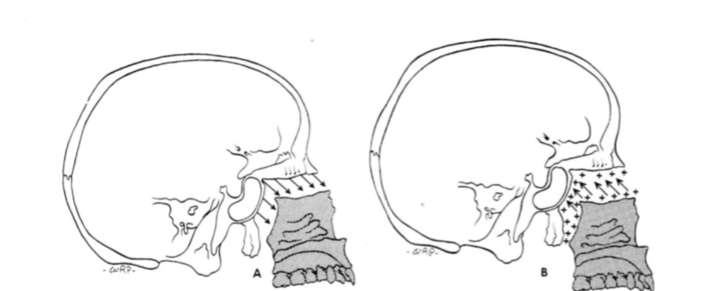
Displacement
As a bone enlarges, it is simultaneously carried away from other bones in direct articulation with it.
This creates the "space" within which bony enlargement takes place at the interface between bone-to-bone joint contacts.
It is a physical movement of a whole bone and occurs while the bone simultaneously remodels by resorption and deposition (to an equivalent extent).

Slide 26
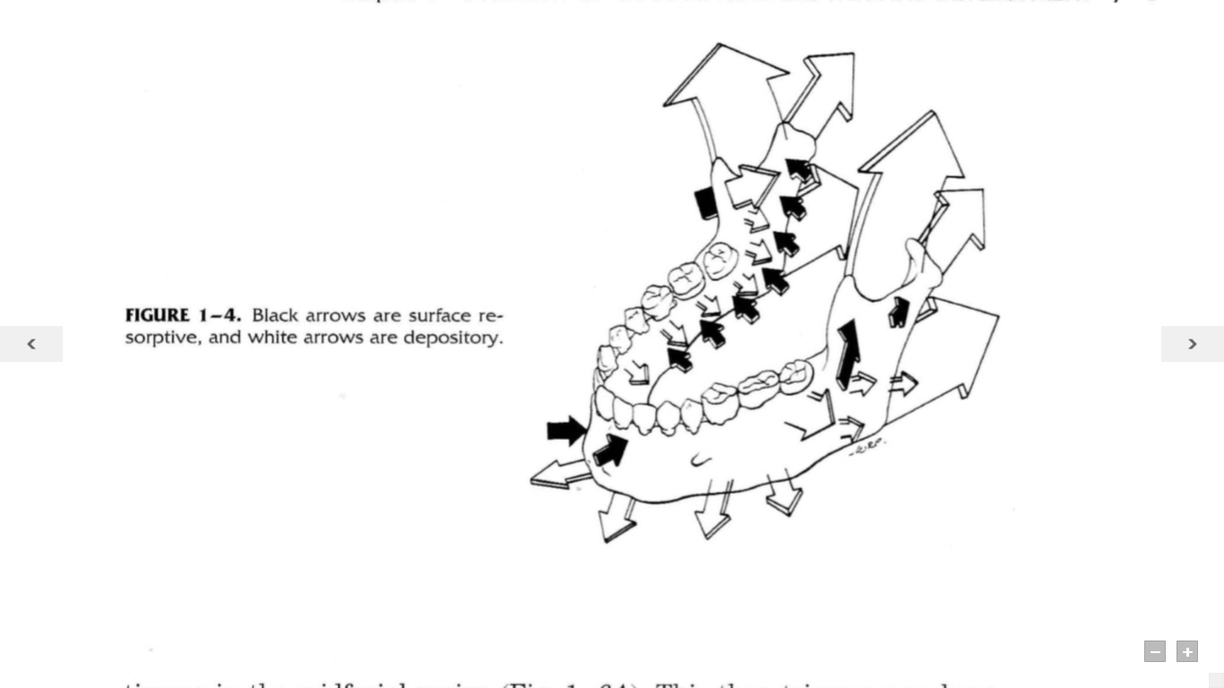
In remodelling, the bone surface moves (relocates) by deposition on the side facing the direction of growth movements
In the process of displacement, however, the whole bone is carried by mechanical force as it simultaneously enlarges.

Slide 27
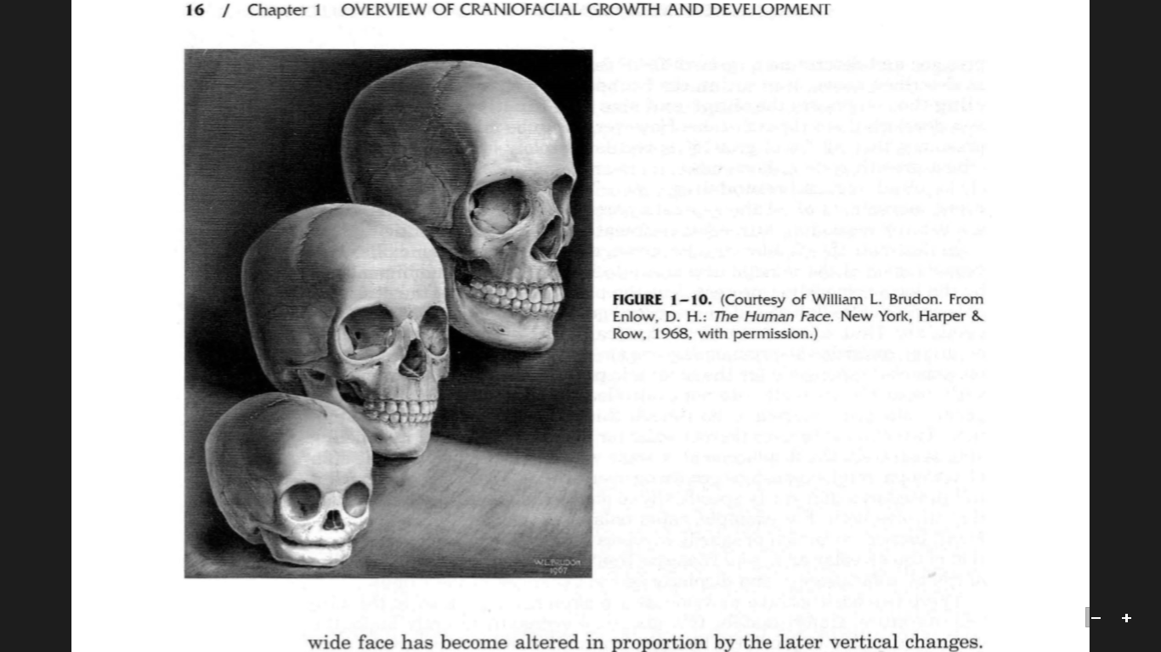
The infant and young child
  A wide-appearing face because of the precociously broad basicranial template,
  The face otherwise is vertically short
  As the nasal and oral regions are yet diminutive
  Mandibular ramus is vertically yet short because it is linked in developmental feedback with the shorter, later-maturing nasal and dental regions

Slide 28
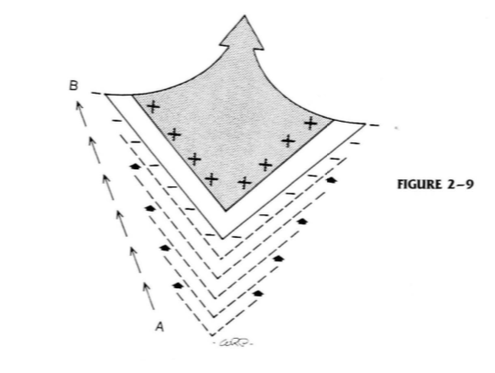
The V principle
Note that bone deposition occurs on the inner side of the V; resorption takes place on the outside surface. The V thereby moves from position A to B and, at the same time, increases in overall dimensions. The direction of movement is toward the wide end of the V.

Slide 29
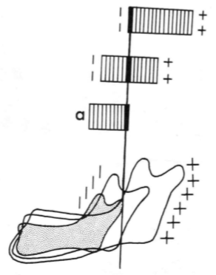
The v principle
the position of the condyle in the smallest mandibular stage becomes relocated into the middle of the ramus and then onto the anterior border of the ramus.
Continuous remodeling is thus involved as this and all other areas change in relative position.

Slide 30
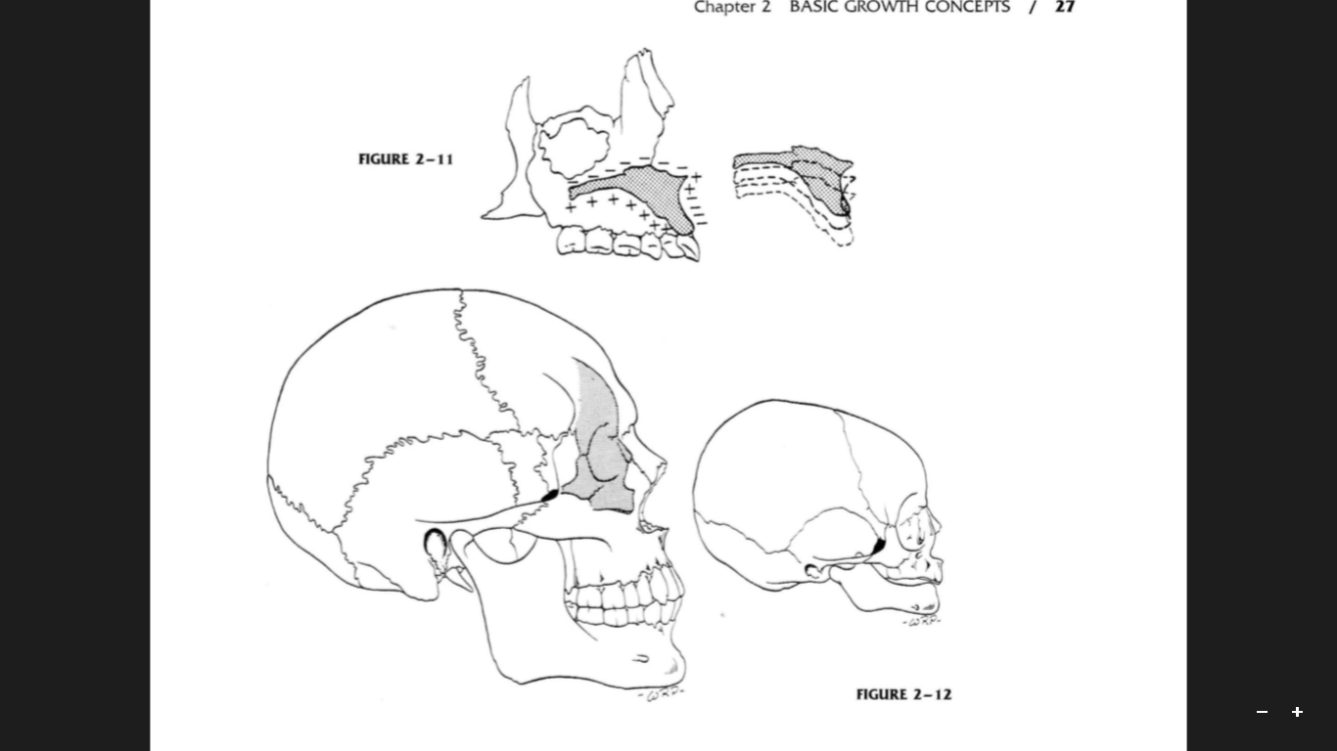
In the face of a young child, the levels of the maxillary arch and nasal floor lie very close to the inferior orbital rim.
The maxillary arch and palate, however, move downward. This process involves (in part) an inferior direction of remodeling by the hard palate and the bony maxillary arch

Slide 31
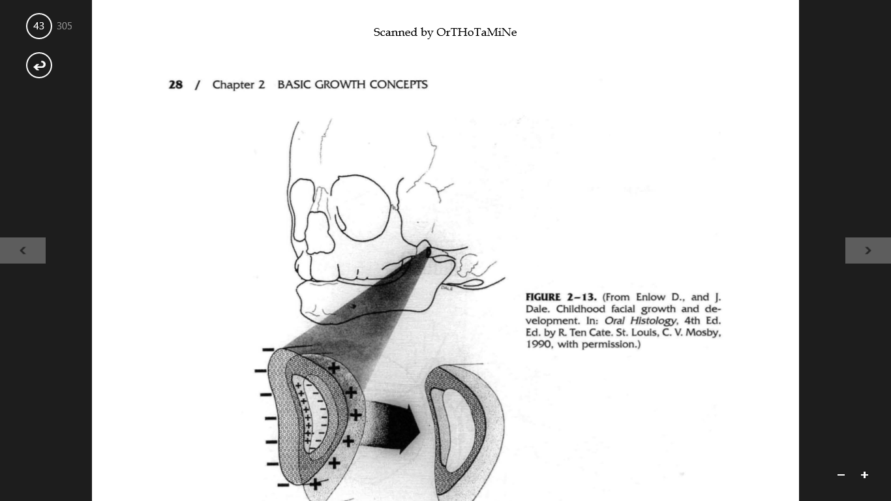
A transverse section through the zygomatic arch demonstrates how a bone relocates laterally as the whole bone simultaneously grows in length.
The zygomatic arch is moving and enlarging laterally and also inferiorly as the entire face, brain, and cranium widen and expand into space formerly occupied by the zygomatic arch.
It does this by progressive deposition on the lateral-facing and downward-facing periosteal and endosteal surfaces, with resorption from the opposite cortical side.

Slide 32
MANDBULAR REMODELING
The Ramus
The Lingual Tuberosity
The Ramus-to-Corpus Remodeling Conversion
The Mandibular Condyle
The Ramus and Middle Cranial Fossa Relationship

Slide 33
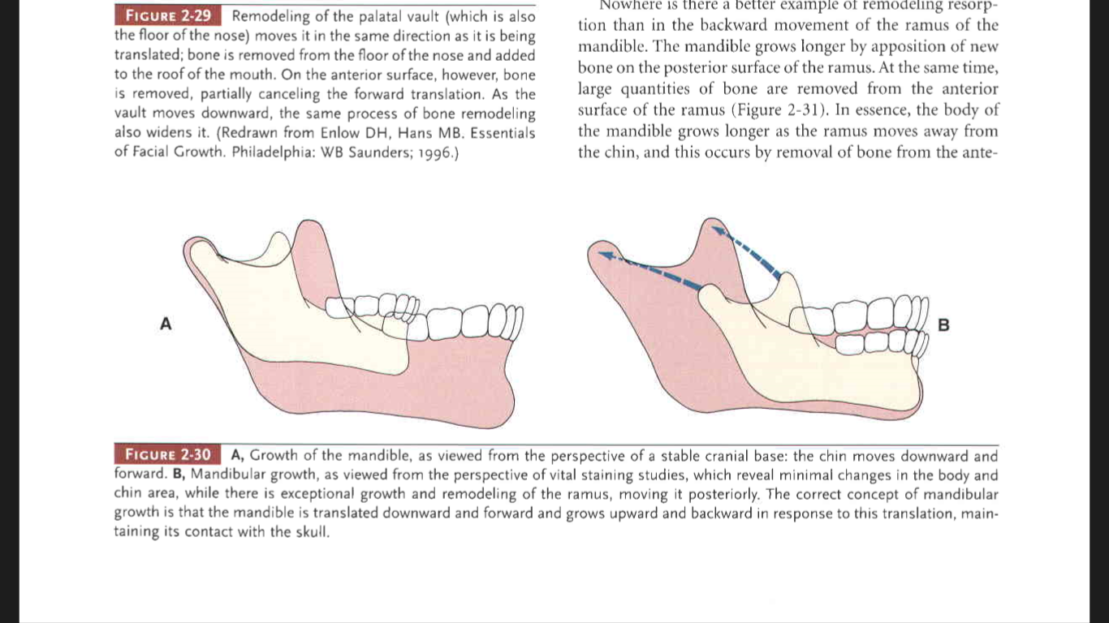
Ramus
the ramus remodels in shape and size as it relocates posterosuperiorly. It becomes longer and wider to accommodate
(1) the increasing mass of masticatory muscles inserted onto it
(2) the enlarged breadth of the pharyngeal space, and
(3) the vertical lengthening of the nasomaxillary part of the growing face

Slide 34
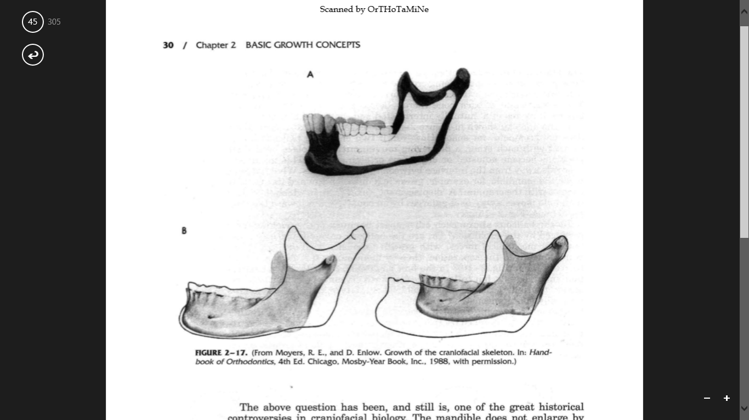
The mandible does not enlarge by simple, symmetrical expansion,
The predominant vectors (direction and magnitude) are posterior and superior
the condyle enlarges directly toward its articular contact in the glenoid fossa of the cranial floor
As this takes place, the whole mandible is moved forward and downward by the same amount that it remodels upward and backward

Slide 35
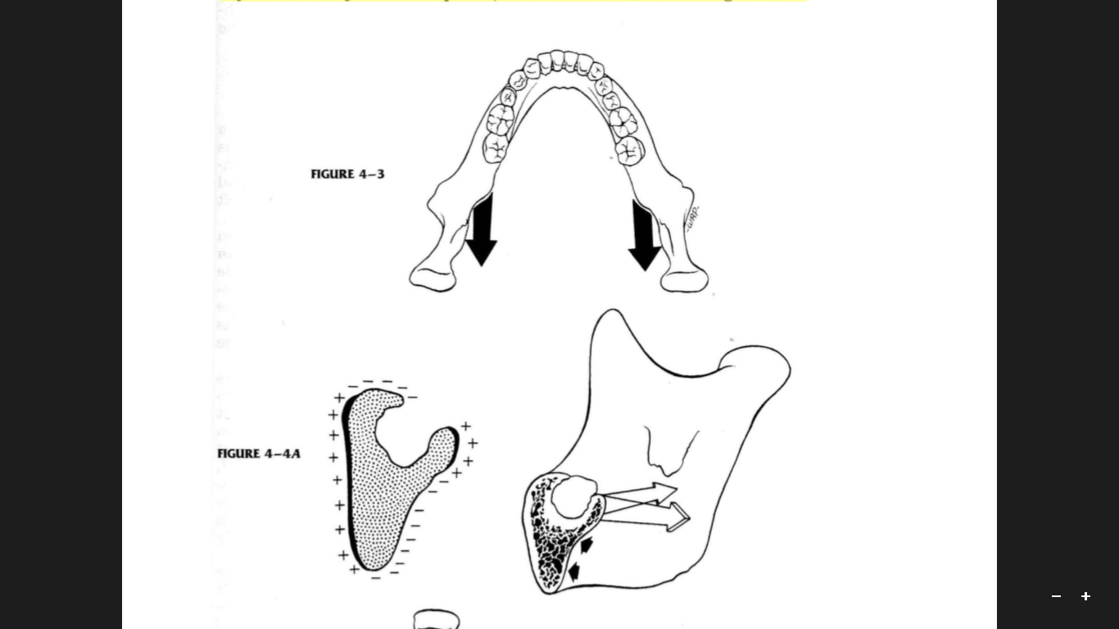
Lingual tuberosity
This is an important structure because it is the direct anatomic equivalent of the maxillary tuberosity
Just as the maxillary tuberosity is a major site of growth for the upper bony arch, so is the lingual tuberosity a major site of growth for the mandible

Slide 36
it also the effective boundary between the two basic parts of the mandible: the ramus and the corpus
The lingual tuberosity grows posteriorly by deposits on its posterior facing surface, just as the maxillary tuberosity undergoes comparable growth additions.

Slide 37
The prominence of the tuberosity is augmented by the presence of a large resorptive field just below it. This resorptive field produces a sizable depression, the lingual fossa.
The combination of periosteal resorption in the fossa and deposition on the medial-facing surface of the tuberosity itself greatly accentuates the contours of both regions

Slide 38
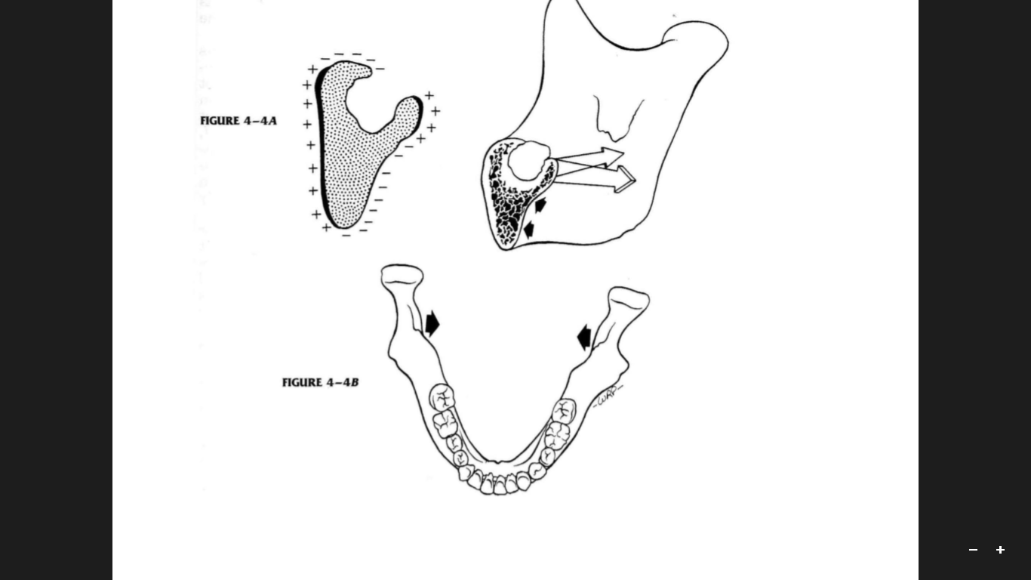
The tuberosity remodels (relocates) in an almost directly posterior direction, with only a relatively slight lateral shift.
As this takes place mandibular ramus just behind tuberosity remodel MEDIALLY
Notes:
bicondylar width does not increase nearly as much as mandibular length beyond the early childhood period, since most of the bilateral growth of

Slide 39
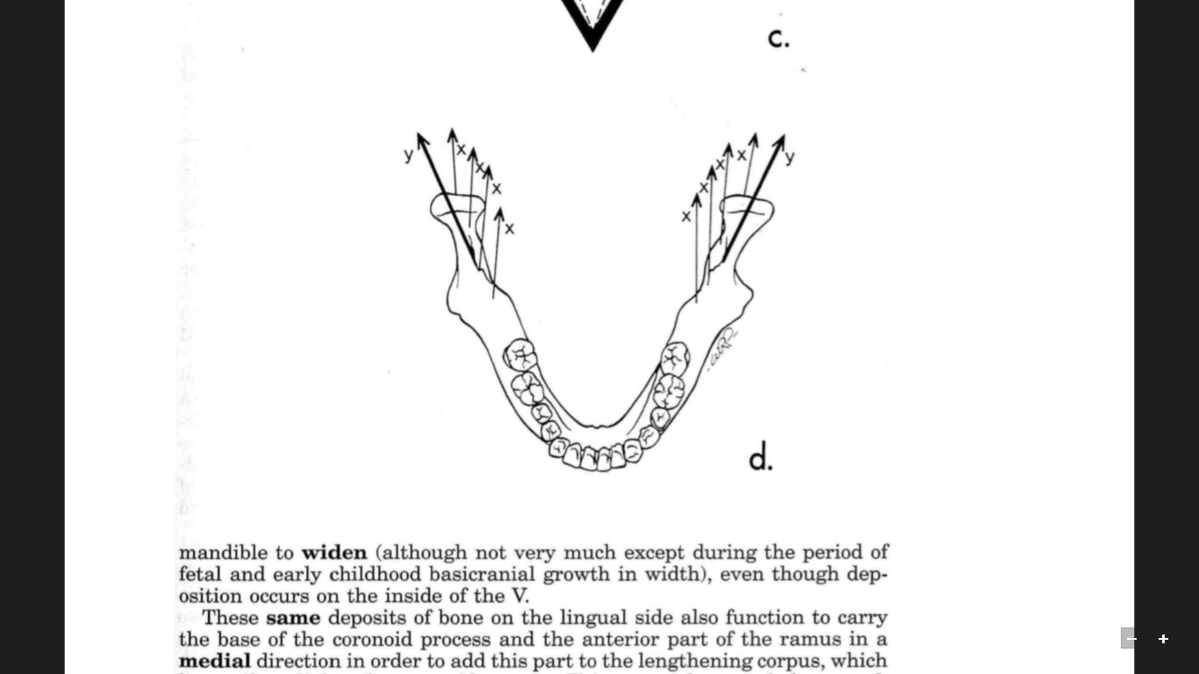
Ramus to corpus remodelling :
Bony arch length has been increased and the corpus has been lengthened by
(1) deposits on the posterior surface of the lingual tuberosity and the contiguous lingual side of the ramus and
(2) a resultant lingual shift of the anterior part of the ramus to become added to the corpus.

Slide 40
Remodeling activity does not occur only on the anterior and posterior margins of the ramus
The coronoid process has a propeller-like twist, so that its lingual side faces three general directions all at once: posteriorly, superiorly, and medially

Slide 41
Comparison of selected physiologic properties of bone and primary cartilage important during growth
Characteristics | Cartilage | Bone
Calcification | Non-calcified | Calcified
Vascularity | Non-vascular | Vascular
Surface membrane | Non-essential | Essential
Rigidity | Flexible | Inflexible
Pressure resistance | Tolerant to pressure | Sensitive to pressure

Slide 42
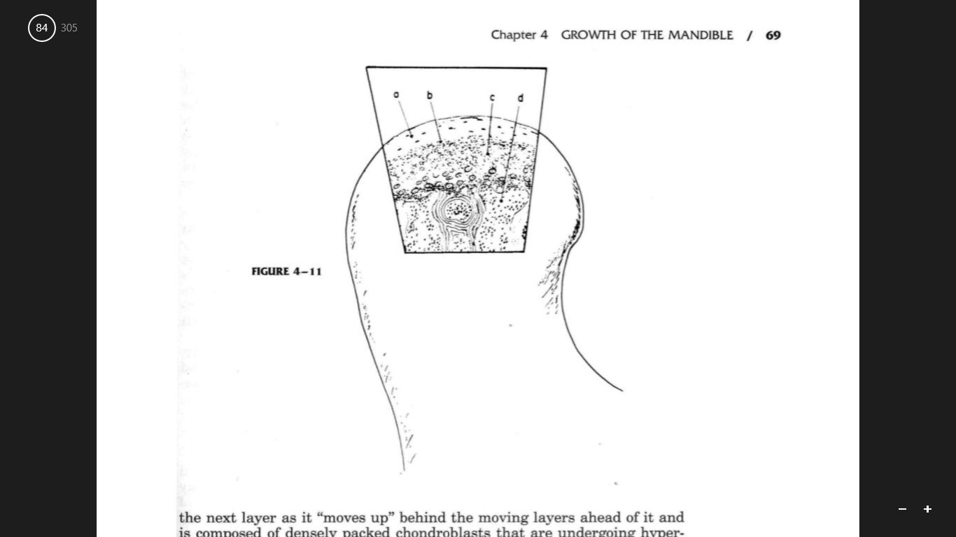
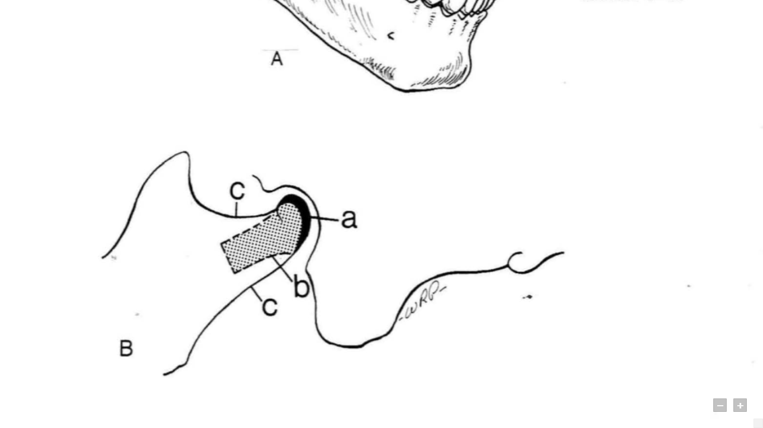
MANDIBULAR CONDYLE :-
The condylar growth mechanism itself is a clear-cut process. Cartilage is a special non-vascular tissue and is involved because variable levels of compression occur at its articular contact with the temporal bone of the basicranium.

Slide 43
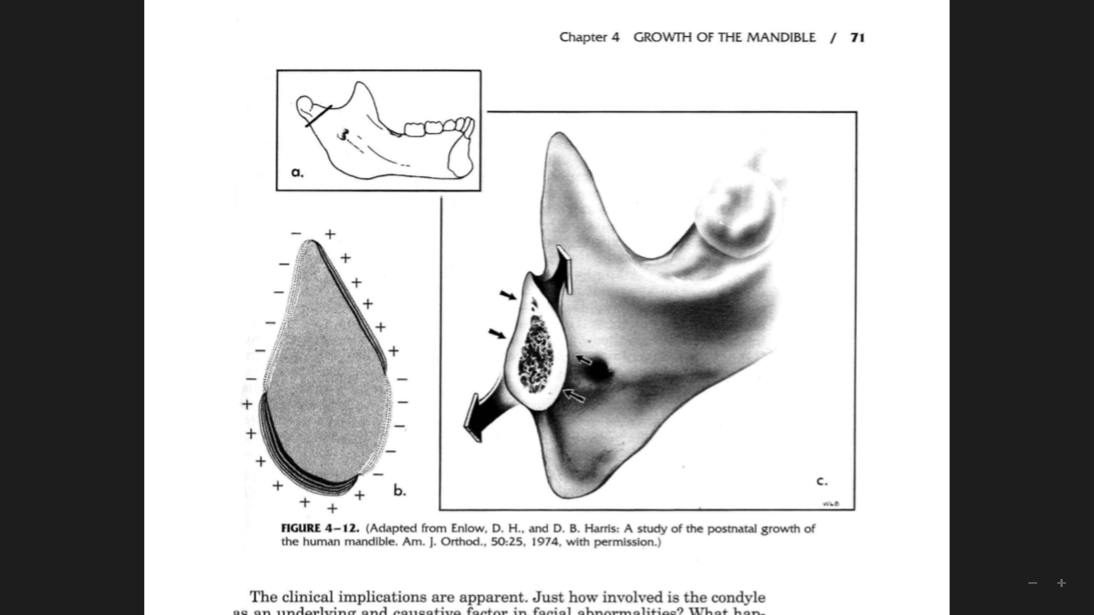
This regional, endochondral bone-forming mechanism develops as a specific response to this particular local circumstance.
The condylar cartilage is a secondary type of cartilage, which means that it does not develop by differentiation from the established primary cartilages of the fetal skull

Slide 44
The Adaptive Role of the Condyle
The histogenetic adaptation of the condylar cartilage provides opportunity for selected, ,multidirectional growth potential.
it is the adaptive responsive nature of the condylar growth process that allows for a latitude of morphologic and morphogenic adjustments and a working (if not perfect) functional relationship among all of them
Notes:
There are dolichocephalic and brachycephalic types of headforms, vertically long and short nasomaxillary regions, wide and narrow palates and upper arches, widely separated versus closely placed glenoid fossae, steep versus shallow cranial floor flexures, broad versus narrow pharyngeal regions, large versus small tooth sizes, male versus female patterns, and so on.
If the growth, shape, and dimensions of the mandible were actually "preprogrammed" within the genes of condylar chondroblasts (according to old theory), and if the condyle were indeed to function as an ultimate "growth control center," without taking into account structural and developmental vagaries in the rest of the craniofacial complex, there is no way that a fitting of the mandible to the basicranium on one end and to the maxilla on the other could be achieved.

Slide 45
The Ramus and Middle Cranial Fossa Relationship
As the horizontal enlargement of the middle cranial fossa and brain growth advance the nasomaxillary complex by forward displacement, the horizontal span of the pharynx correspondingly increases.
The skeletal dimension of the pharynx is established by the size of the middle cranial fossa because the floor of this basicranial fossa is the roof of the pharyngeal compartment.

Slide 46
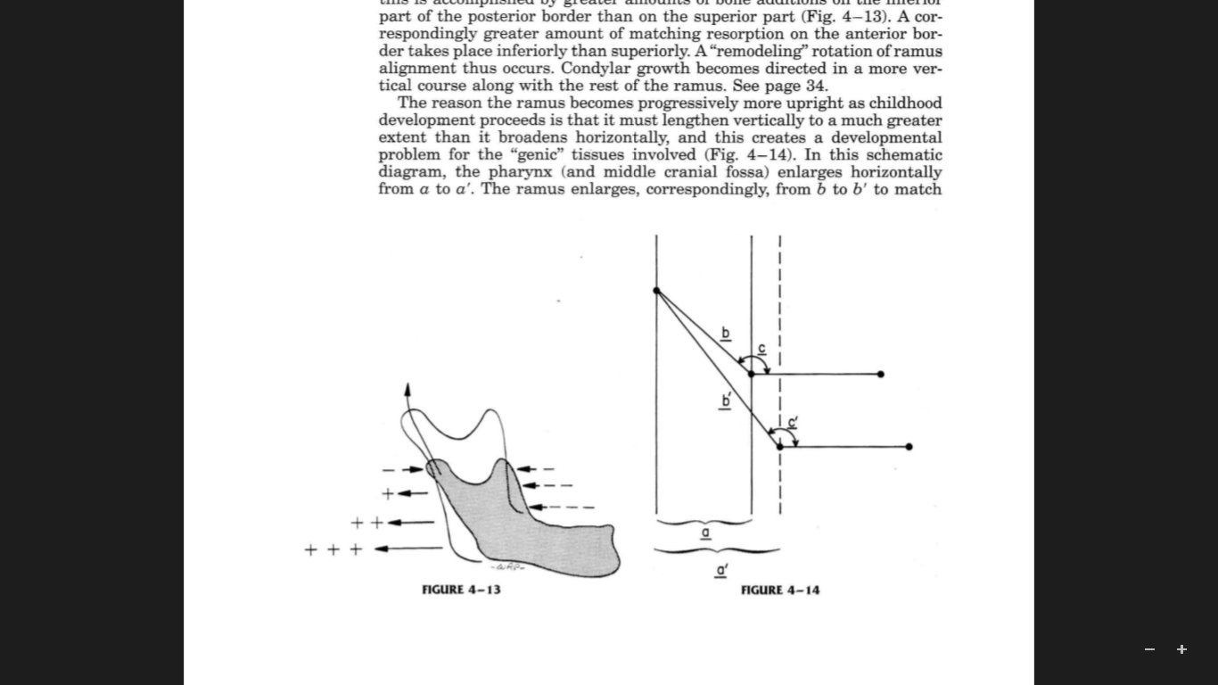
Ramus Uprighting
The reason the ramus becomes progressively more upright as childhood development proceeds is that it must lengthen vertically to a much greater extent than it broadens horizontally
The size of the antigonial notch is determined largely by the nature of the ramus-corpus also by the extent of bone deposition on the underside (inferior margin) just posterior or anterior to the notch.

Slide 47
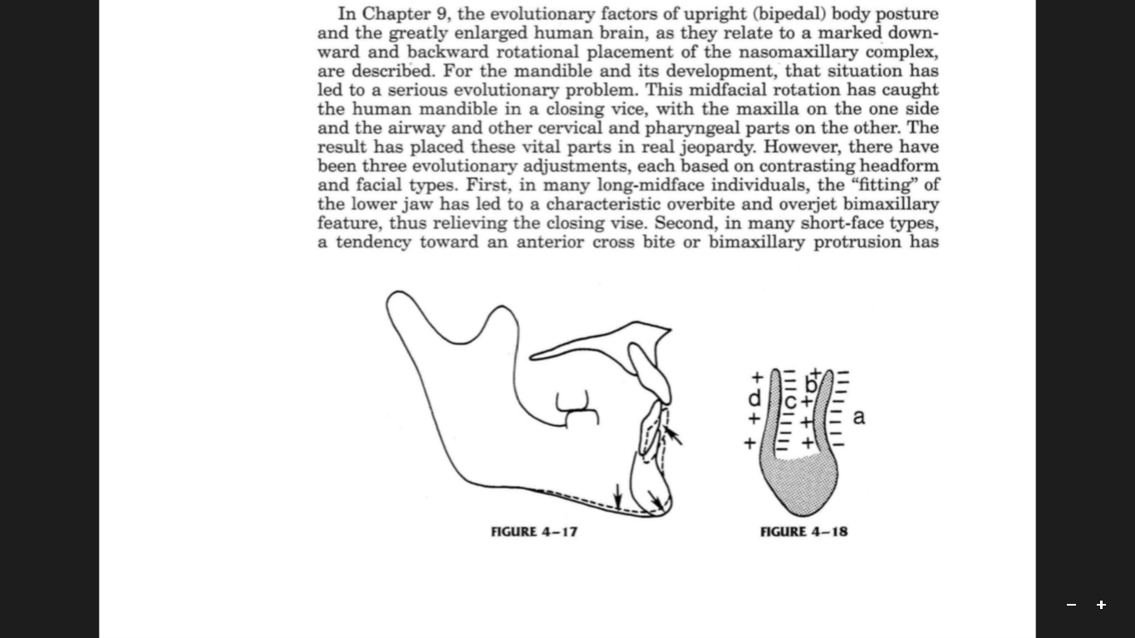
The Human Chin
As a growth site, the chin is almost inactive.
It is translated downward and forward, as the actual growth occurs at the mandibular condyle and along the posterior surface of the ramus.
Notes:
There is considerable variation in the placement of the reversal line between the resorptive alveolar and the depository parts of the chin; it may be fairly high or low

Slide 48
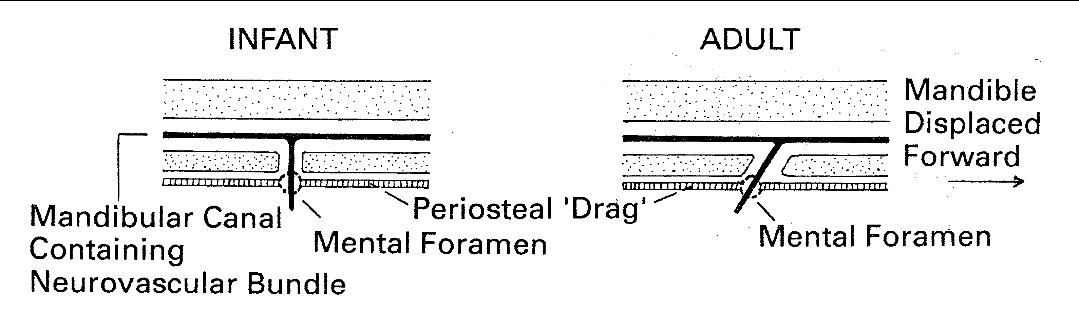
Mental foramen
Measurements between right and left mental foramens show that this dimension is relatively stable after 6th year of life
Both molar and bicondylar widths show small increase until the end of growth in length.
Notes:
Thus ant width dimensions stabilize earlier

Slide 49
AGE CHANGES IN THE MANDIBLE
AT BIRTH the two halves of the mandible are united by fibrous symphysis menti, anterior ends of each rudiments are covered by cartilage.
The mandibular canal is near the lower border, the mental foramen opens below the deciduous molar and is directed forwards, the coronoid process projects above the condyle.

Slide 50
THE BODY elongates, especially behind the mental foramen, providing space for three additional teeth.
During the first and second years as the chin develops, the MENTAL FORAMEN alters direction from anterior to posterosuperior, and then almost horizontally posterior
accommodating a changing direction of emerging mental nerve.

Slide 51
ADULTS
AFTER ERUPTION OF THE PERMANENT TEETH THE MANDIBULAR CANAL IS A LITTLE ABOVE THE MYLOHYOID LINE AND THE MENTAL FORAMEN OCCUPIES ITS ADULT POSITION.
AS THE MANDIBLE INCREASES IN SIZE,
BONE ADDED POSTERIOR BORDER
RAMUS CORONOID PROCESS
RESORPTION ANTERIOR BORDER
FOR ACCOMODATION OF PERMANENT MOLARS

Slide 52
IN OLD AGE
Bone reduced in size LOSS OF TEETH
Mandibular canal &mental foramen
NEAR SUPERIOR BORDER
Ramus OBLIQUE[ ABOUT 140 DEGREES]
Inferior border BONE DEPOSITION
Antegonial notch RESORPTIVE
The anterior side of the condylar neck and the subcondylar region resorptive field bringing about a dished-in appearance.

Slide 53
Anomalies of mandible
The mandible may be grossly deficient or absent
AGNATHIA, which is probably due to a neural crest deficiency in the lower face.
MICROGNATHIC mandible is characteristic of a number of congenital conditions like Pierre Robin Syndrome.

Slide 54
Congenital facial anomalies manifesting a defective mandible are the
--MANDIBULOFACIAL DYSOSTOSIS (TREACHER COLLINS SYNDROME)
--DOWNS SYNDROME (TRISOMY 21)
--TURNERS SYNDROME(XO SEX CHROMOSOME COMPLEMENT).
MACROGNATHIA producing prognathism is generally an inherited condition but abnormal growth phenomena such as hyperpituitarism may also produce mandibular overgrowth of increasing severity with age

Slide 55
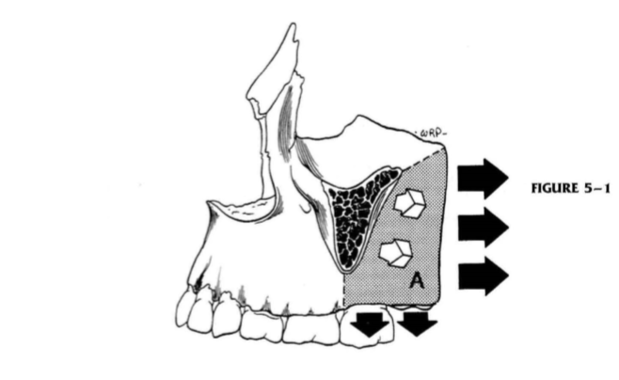
The Nasomaxillary Complex
The Maxillary Tuberosity and Arch Lengthening

Slide 56
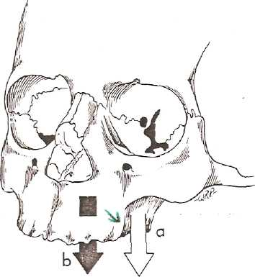
The Maxillary Tuberosity and the Key Ridge
In the growth of the bony maxillary arch, is moving in three directions by bone deposition on the external surface:
It lengthens posteriorly by deposition on the posterior facing maxillary tuberosity;
It grows laterally by deposits on the buccal surface
It grows downward by deposition of bone along' the alveolar ridges and also on the lateral side.
area (a) & (b) is depository .
small arrow - key ridge .

Slide 57
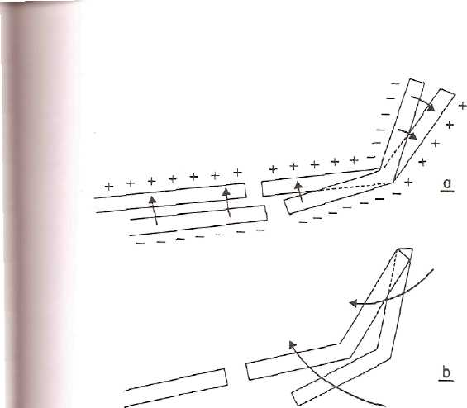
Remodeling change of Lacrimal bone
The lacrimal bone itself undergoes a remodeling rotation, because the more medial superior part remains with the lesser expanding nasal bridge, while the more lateral inferior part "moves markedly outward to keep pace with the great expansion of the ethmoidal sinuses.
(a) remodeling change
(b) primary rotational displacement.

Slide 58
The Vertical Drift of Teeth: An Important Clinical Consideration
Everything "vertical" has been labeled simply "eruption or extrusion/intrusion" when applied clinically.
note that the same process of alveolar remodeling (resorption and deposition) relates to a vertical movement of the tooth as well
As a tooth bud develops and its root elongates, the growing tooth undergoes eruption, bringing its crown into definitive occlusal position above the bone and gingiva

Slide 59
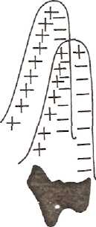
The Vertical Drift of Teeth
Eruption: bringing crown into definitive occlusal position above the bone and gingiva.
Vertical drift : of a tooth is thereafter which is considerable is in addition to eruption

Slide 60
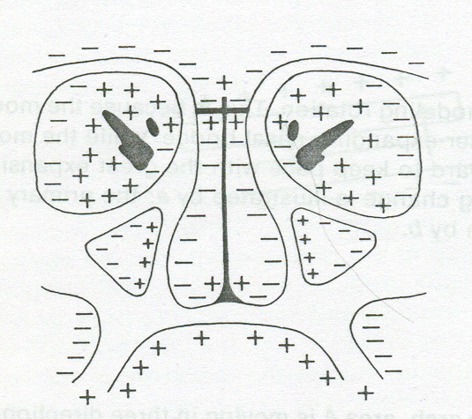
The Nasal Airway
The lining surfaces of the bony walls and floor of the nasal chambers are predominantly resorptive except for the nasal side of the olfactory fossae This produces a lateral and anterior expansion of the nasal chambers and a downward relocation of the palate; the oral sideof the bony palate is depository.

Slide 61
The ethmoidal conchae generally have depository surfaces on their lateral and inferior sides and resorptive surfaces on the superior and medial facing sides of their thin bony plates.
This moves them downward and laterally as the whole nasal region expands in like directions

Slide 62
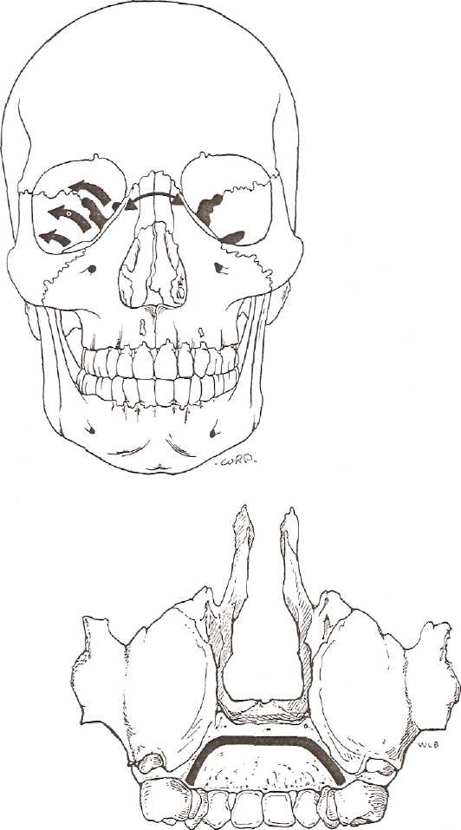
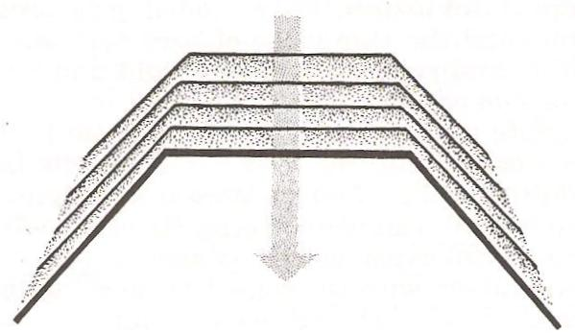
Palatal remodelling
This is another example of the V principle
Growth along the midpalatal suture is known to participate to a greater or lesser extent in the progressive widening of the palate and alveolar arch

Slide 63
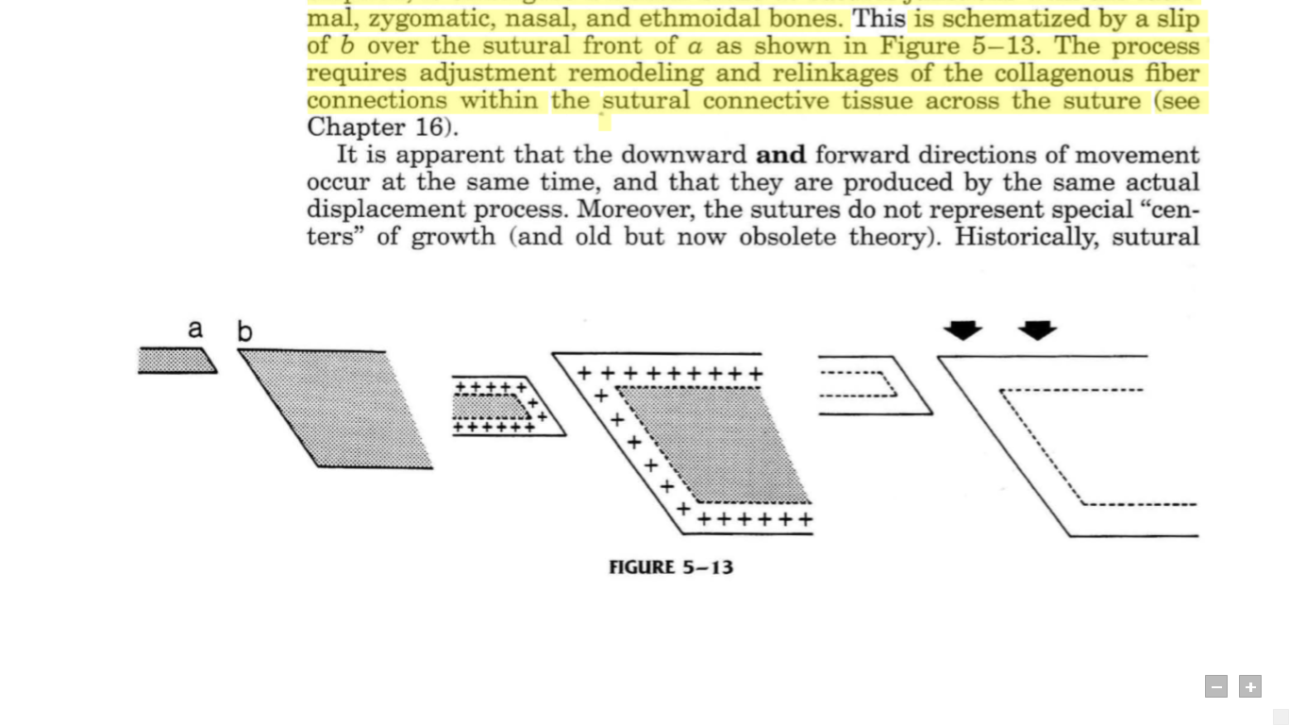
Maxillary Sutures
As the whole maxillary complex is displaced downward and forward, it undergoes a frontal slide at sutural junctions with the lacrimal, zygomatic, nasal, and ethmoidal bone
Notes:
Downward Maxillary Displacement

Slide 64
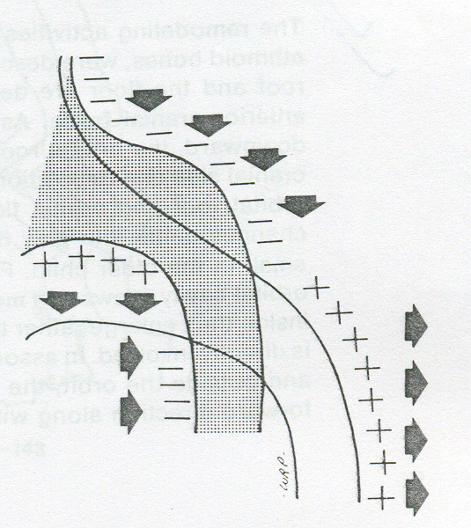
The Cheekbone and Zygomatic Arch
The posterior side of the malar protuberance within the temporal fossa is depository. Together with a resorptive anterior surface, the cheekbone relocates posteriorly as it enlarges.
The zygomatic process of the maxilla thus behaves in a manner similar to that of the coronoid process of the ramus. Both move posteriorly as the maxillary and mandibular arches develop posteriorly to complement each other

Slide 65
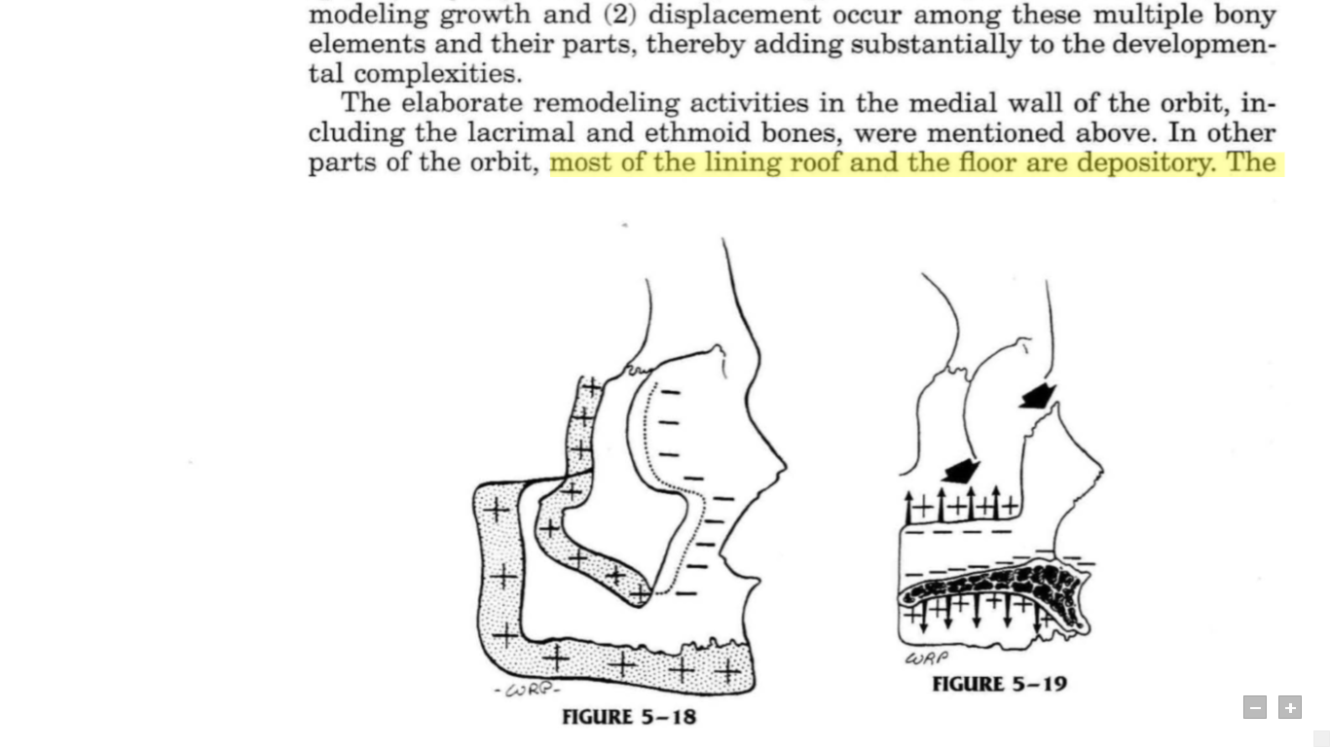
Orbital Growth
The remodeling changes of the orbit are complex.
This is because many separate' bones comprise its enclosing walls, including the maxilla, ethmoid, lacrimal, frontal, zygomatic, and the greater and lesser wings of the sphenoid
Many different rates, timing, directions, and amounts of remodeling growth and displacement occur among these multiple bony elements and their parts, thereby adding substantially to the developmental complexities.

Slide 66
Clinical implications
The articulation of maxilla with mandible gives the classification of occlusion.
Maxillary protrusion can be reduced by maturation and increased tonicity of perioral soft tissue. E.g. functional appliance.
Functional imbalances due to extrinsic factors can be corrected if excess factors are removed. E.g. thumb sucking.
Maxillary arch can be enlarged by the rapid expansion appliances.

Slide 67
The Neurocranium
The Calvaria
The Basicranium

Slide 68
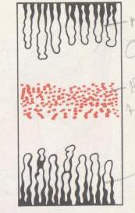
ELONGATION AT SYNCHONDROSES
MOST OF THE BONES OF THE CRANIAL BASE ARE FORMED BY A CARTILAGINOUS PROCESS,THE CARTILAGE IS REPLACED BY BONE.
CERTAIN BANDS OF CARTILAGE REMAIN AT THE JUNCTION OF VARIOUS BONES.THESE AREAS ARE CALLED AS SYNCHONDROSES.

Slide 69
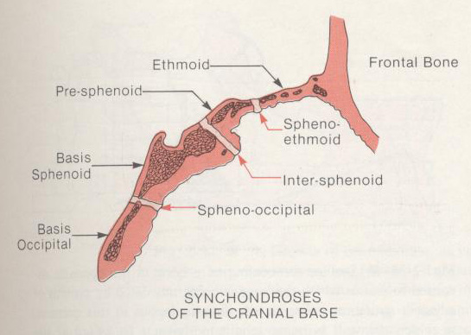
THE IMPORTANT SYNCHONDROSES FOUND IN THE CRANIAL BASE ARE:
SPHENO-OCCIPITAL SYNCHONDROSIS
SPHENO-ETHMOID SYNCHONDROSIS
INTER- SPHENOID SYNCHONDROSIS
INTRA-OCCIPITAL SYNCHONDROSIS

Slide 70
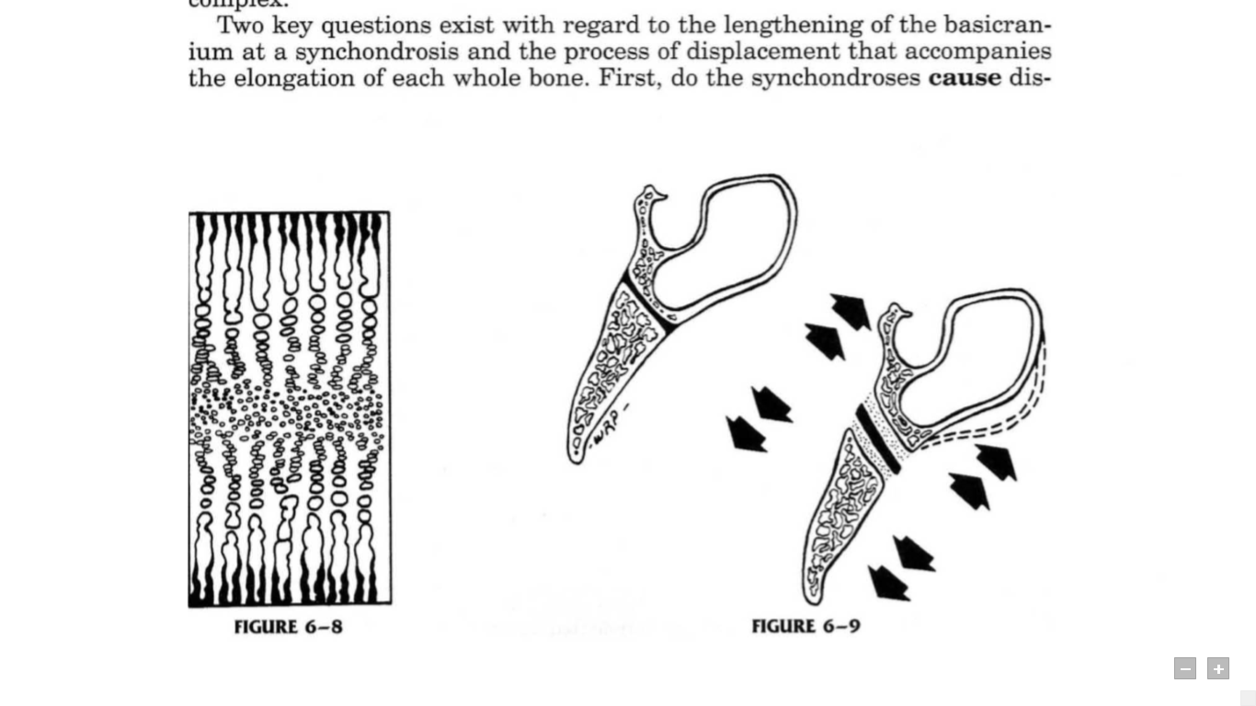
INTER SPHENOIDAL SYNCHONDROSIS – It ossifies at birth
INTRA OCCIPITAL SYNCHONDROSIS – it ossifies at 3-5 yrs of age
SPENO EITHMOID SYNCHONDROSIS – it begins at 5-25 yrs of age
SHENO OCCIPITAL SYNCHONDROSIS – it begins at 12-15 yrs of age

Slide 71
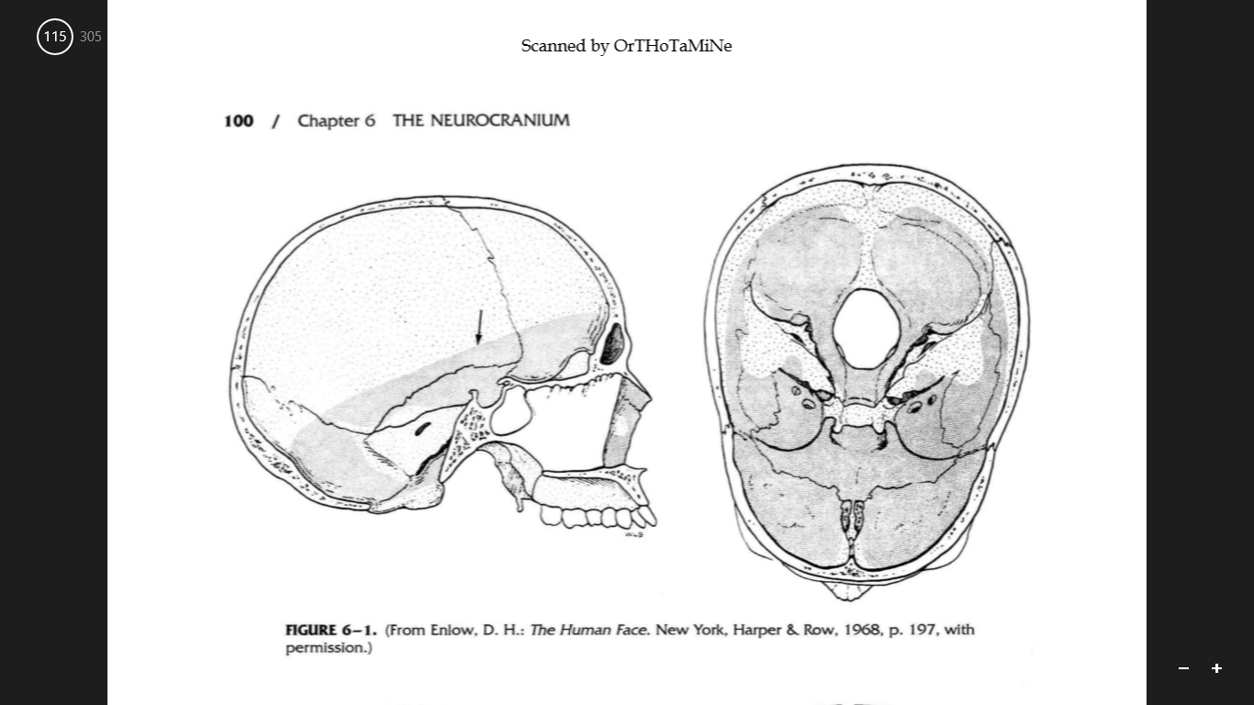
The lining bony surface of the whole cranial floor is predominantly resorptive
This is in contrast to the endocranial surface of the calvaria, which is predominantly depository
The reason for this major difference is that the inside (meningeal surface) of the skull roof is not compartmentalized into a series of confined pockets

Slide 72
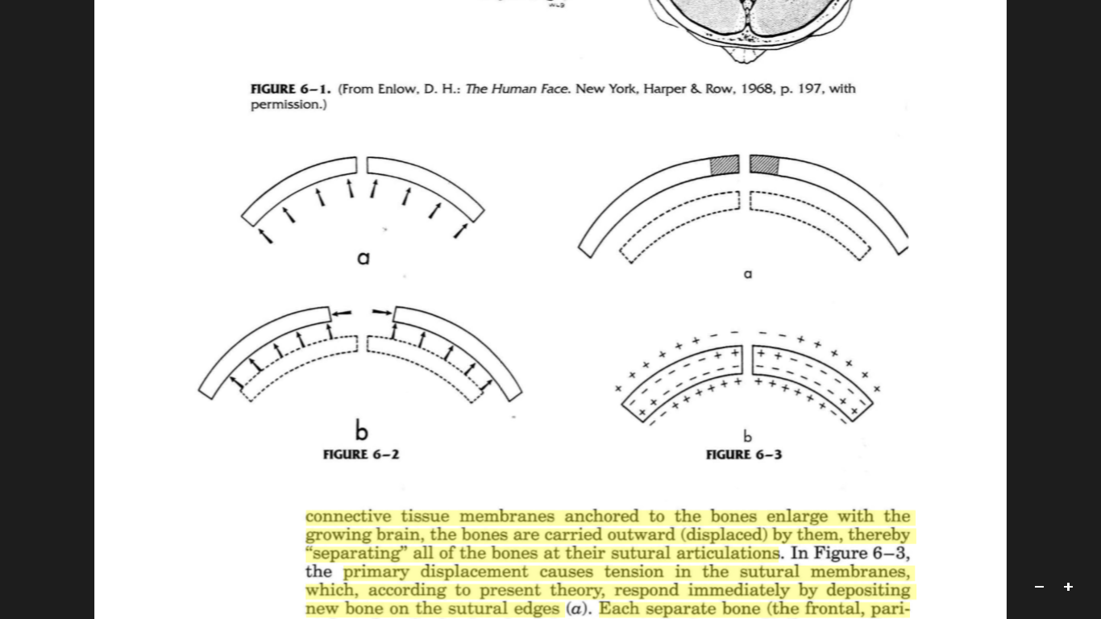
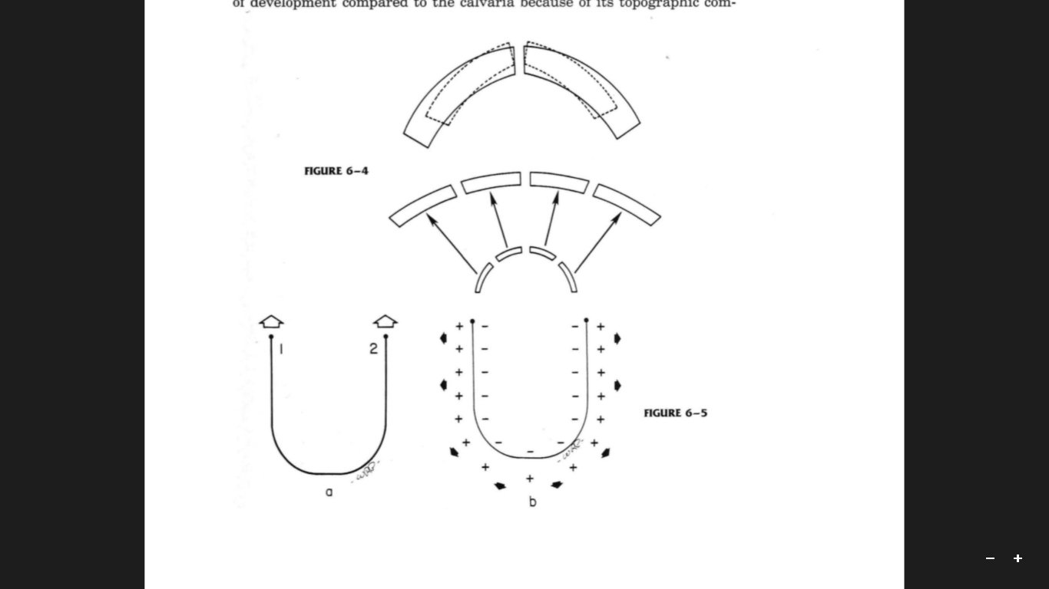

Slide 73
Anomalies of development
AGNATHIA – deficiency of neural crest cells in lower part of the face
MICROGNATHIA -
DOWNS
TREACHER COLLINS
PIERRE ROBIN

Slide 74
Anomalies of development
BIFID /DOUBLE CONDYLE
MACROGNATHIA
MICROGENIA
TORUS MANDIBULARIS

Slide 75
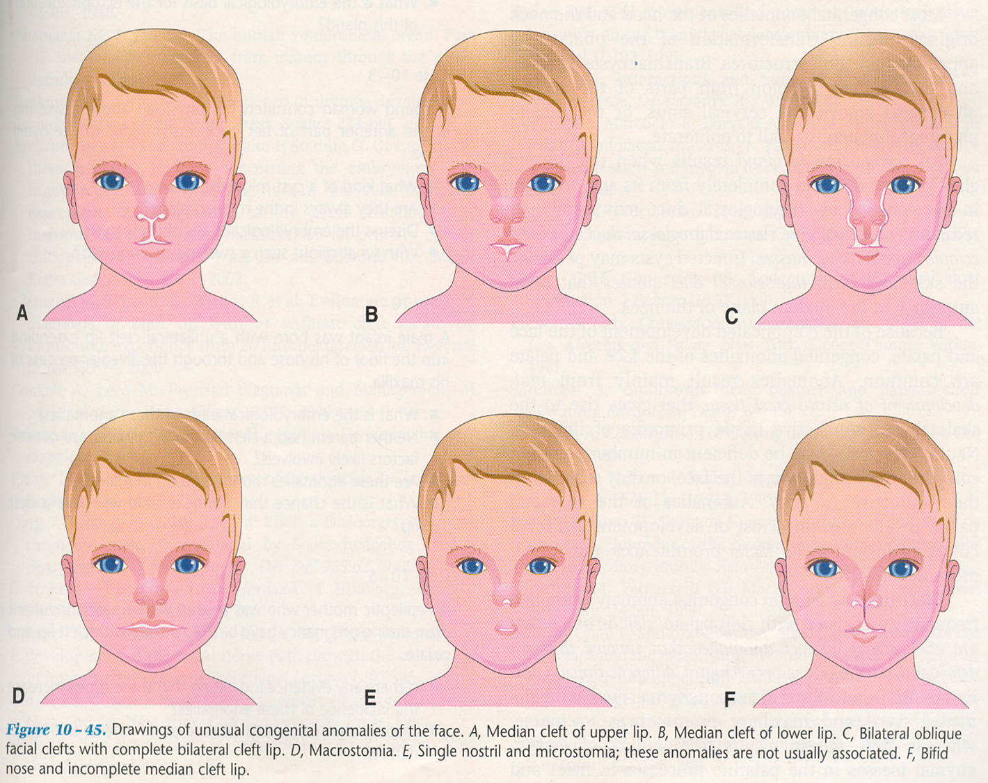
UNUSUAL FACIAL ANOMALIES

Slide 76
Conclusion:-
The study of post natal growth and development imparts us the knowledge of normal process of growth. It is with this knowledge that we can get a better understanding of the deviations from the normal that occurs during growth. “It has been said that if you want to treat the abnormality you have to know what is normal”. Hence the knowledge of embryology essential for Dentist.

Slide 77
Refrences:
1.Essentials of facial growth- Enlow and Hans pg 57
2.Craniofacial development-Sperber pg127
3. Human Embryology-Inderbir singh 9th edition pg91
4.Orthodontics –The art & science S. I. Bhalajhi 5th edition pg 10
5.contemporary orthodontics-Willium R. Proffit

Slide 78

THANK YOU

