Slide 1
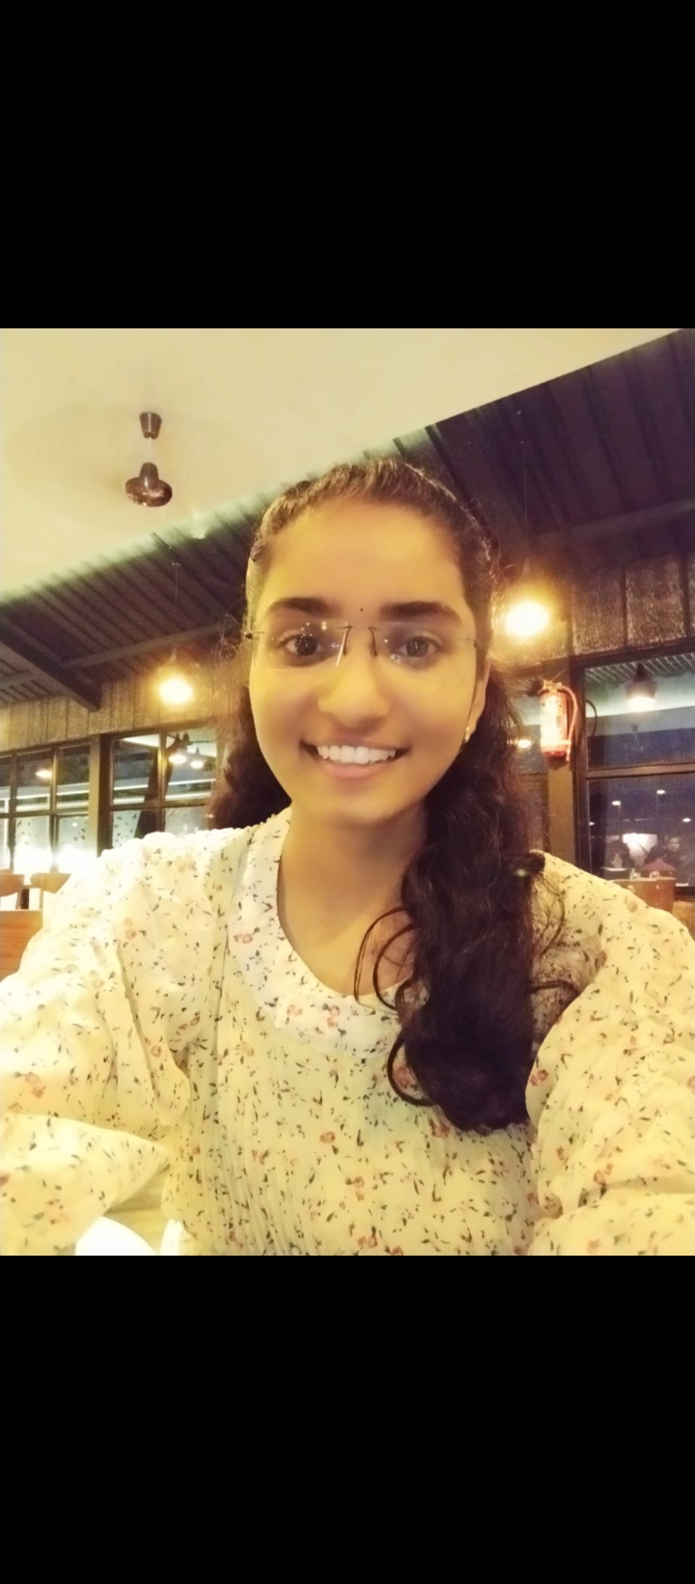
Prosthodontics dept. is very nice and staff is very helpful and supportive.
Whenever we want help , each and everyone help us.
Comfortable chairs are there so it is convenient to do clinical work.
-Amita Dhondge 3rd yr.

Slide 2
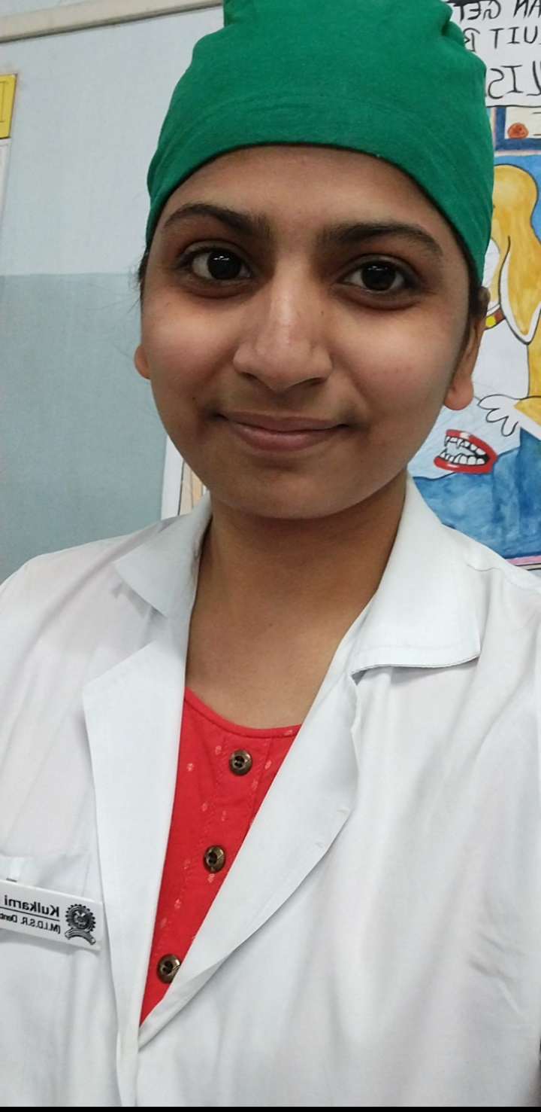
Prosthodontics dept. is always supportive .
Staff members are very helpful and kind.
All the material and instruments are always available in the dept.
- Mrinal Kulkarni.3rd yr

Slide 3
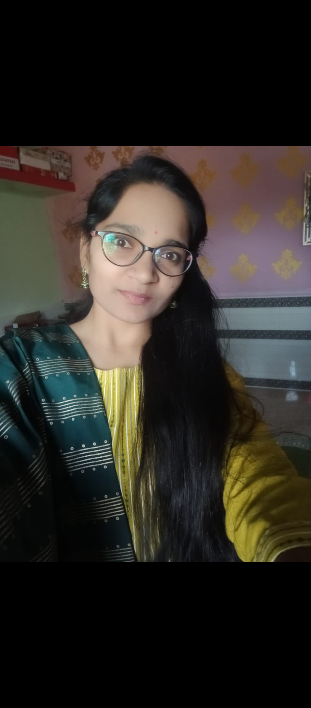
The department is always well clean .
All the staff members are very co-oprative.
Material we required is always available in prosthodontic department.
- Priyanka Ghodke.3rd yr

Slide 4
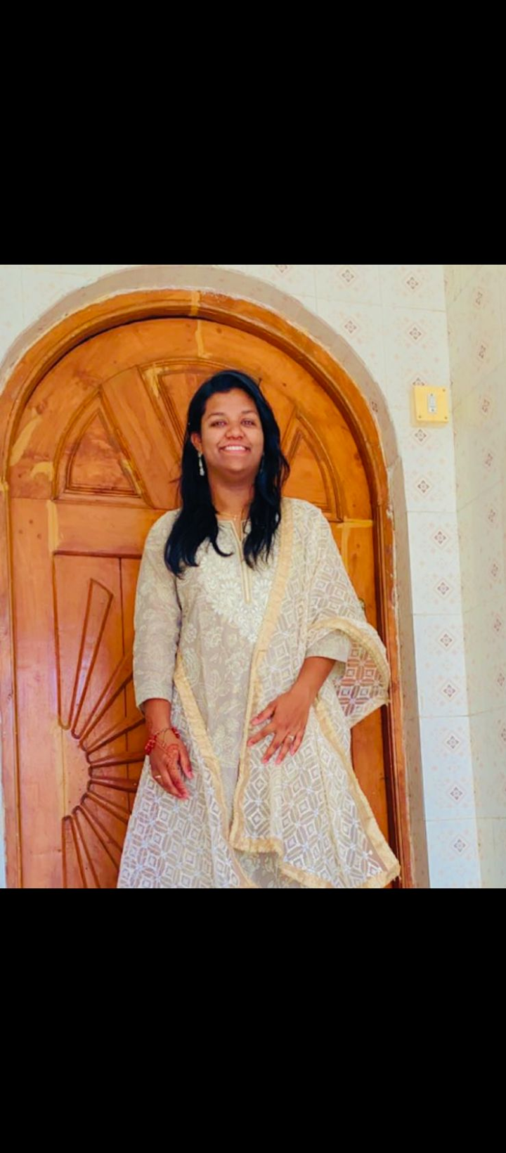
Prosthodontic department is always helpful to all students.
Whenever we feel difficulty in practical work they clearify our problem.
Staff is very supportive.
-Muskan Tamboli.3rd yr

Slide 5
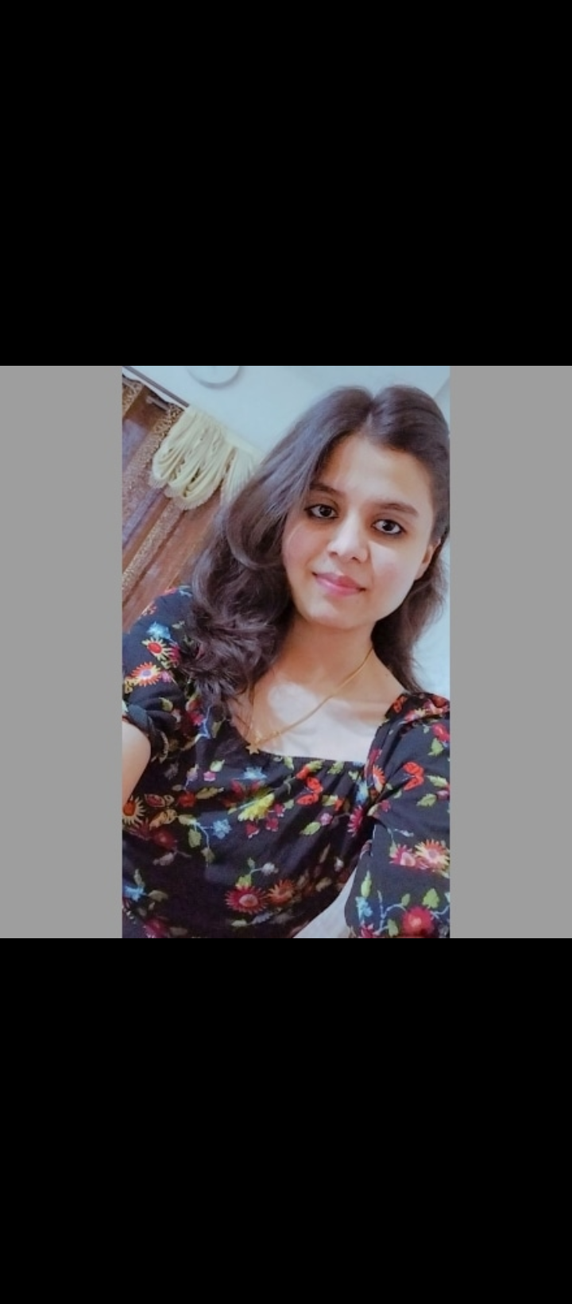
Prosthodontic department is always helpful and co-operative.
Staff is very nice.
Department is always well and clean.
-Mohini Chate.3rd yr

Slide 6
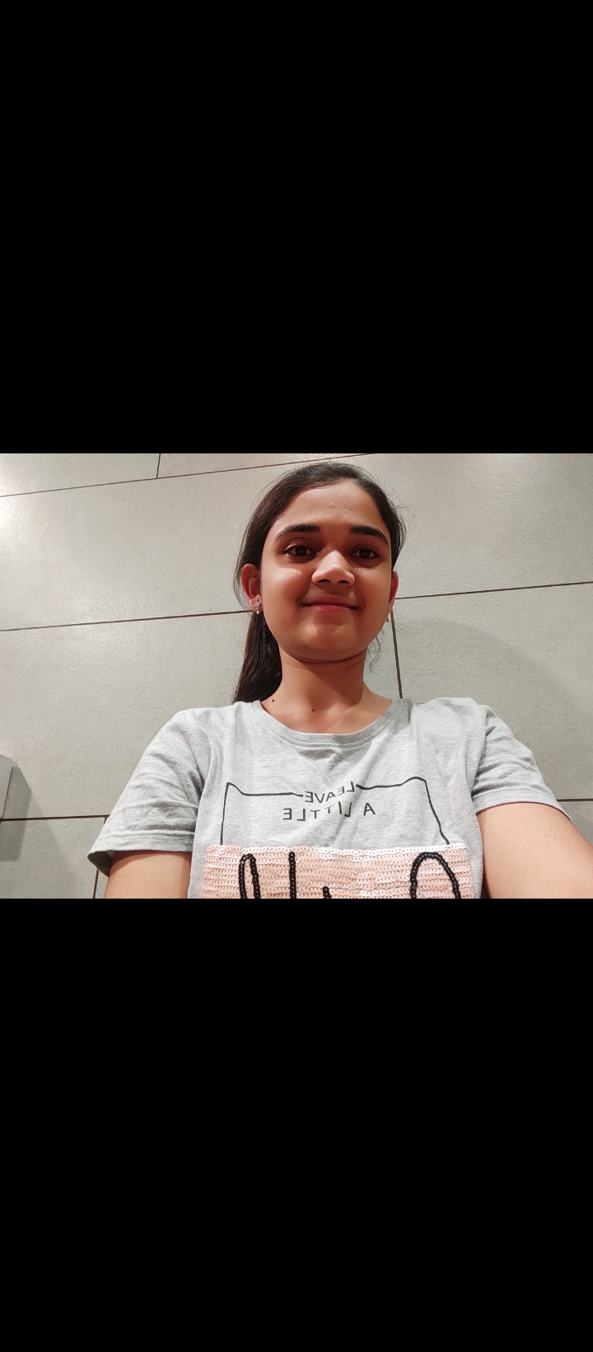
All the staff is very co-operative.
Prosthodontics department is always supportive and helpful.
Material we need is always available in department.
-Mrudulla Bikkad .3rd yr.

Slide 7
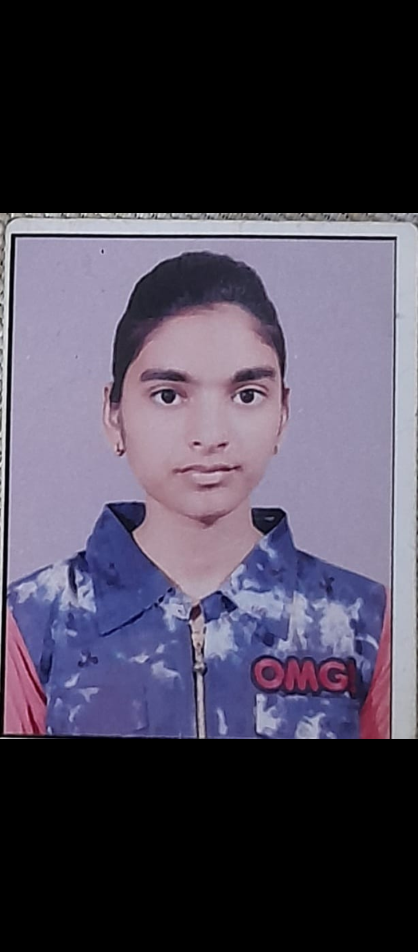
All the staff members are very co-operative.
Good quality material is provided.
Chairs are comfortable for working.
Pranjali kokate 3rd yr.

Slide 8
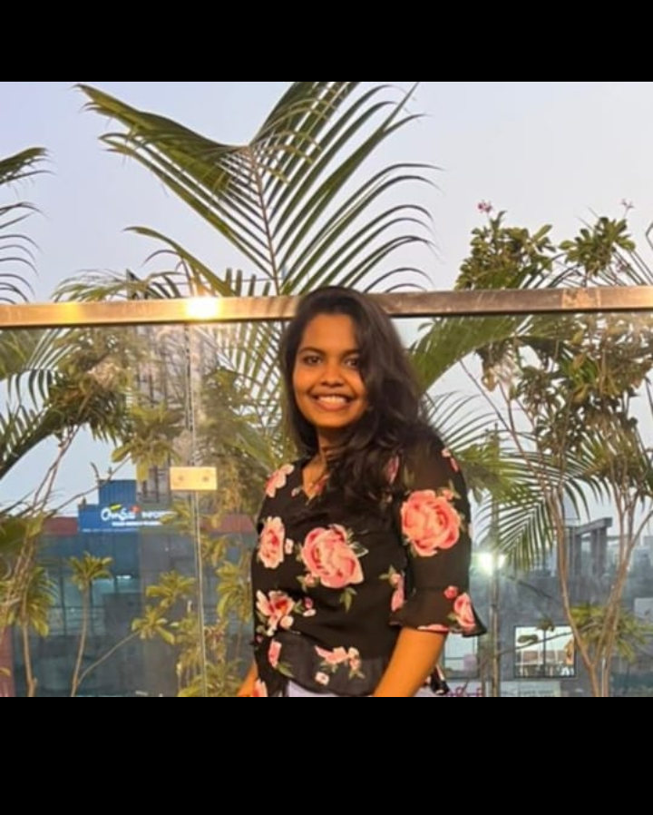
All the dept. is very clean.
Staff members are very nice.
Whenever material is required the Material is provided .
Siddhi shete 3rd yr

Slide 9
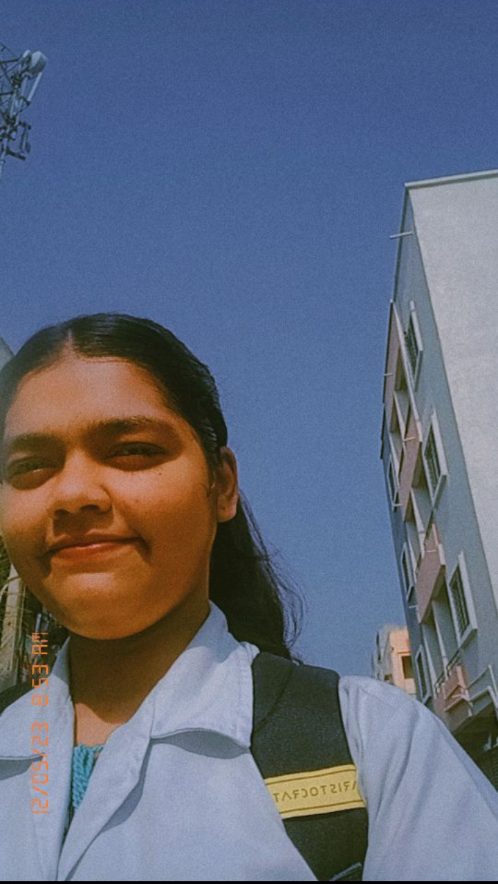
Prosthodontic dept. is well and clean .
Always supportive.
All material is always available in dept.
Eshita parab 3rd yr.

Slide 10
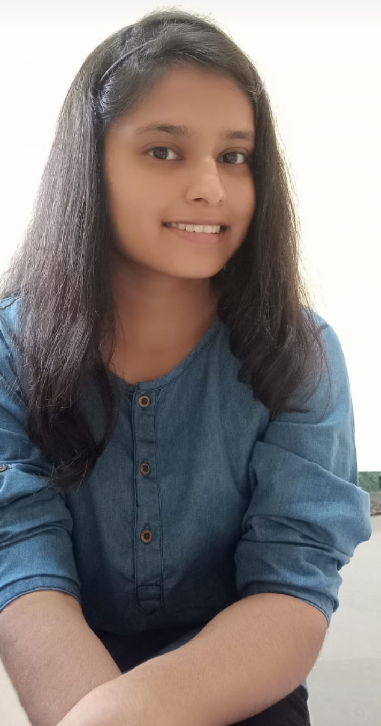
Prosthodontic dept. is very supportive.
I learnt new things and go exposure to practical knowledge.
Also dept is very clean.
Shreya ganage 3rd yr.

Slide 11
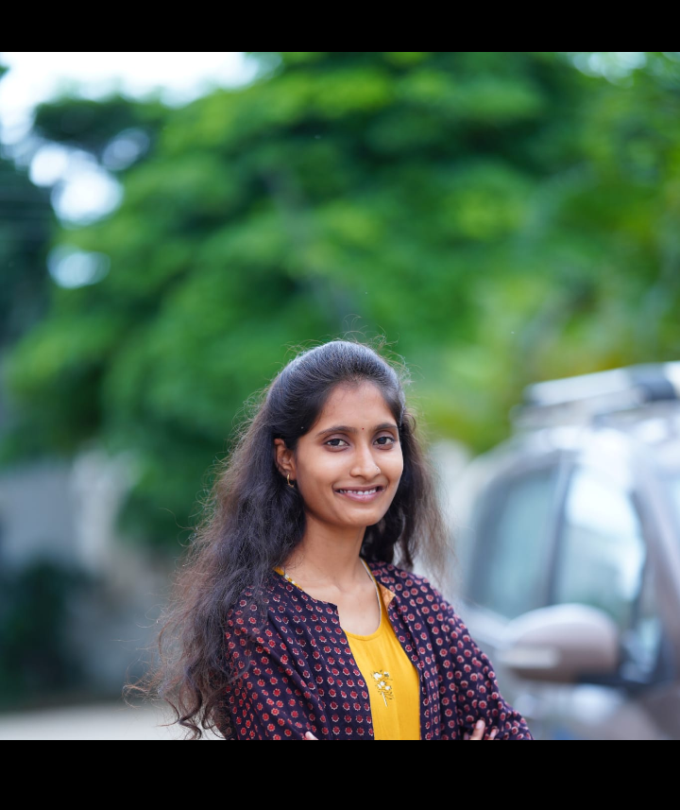
Prosthodontics dept. is always clean and well.
Staff members are always helpful.
Chairs are comfortable for work.
Bhagyashree gadade.3rd yr

Slide 12
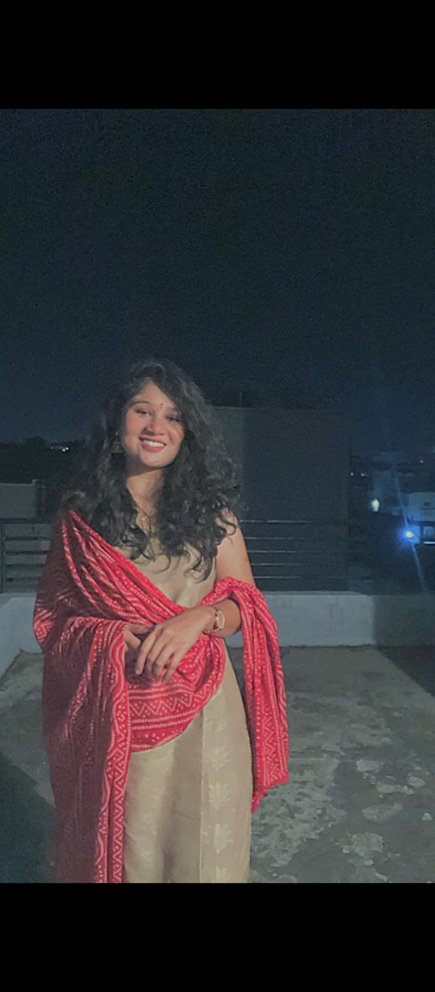
Prosthodontics dept. is one of the most co-opearative dept.
Not only they pay attention while attending patients but also increases our confidence.
Priyanka bavane 3rd yr.

Slide 13
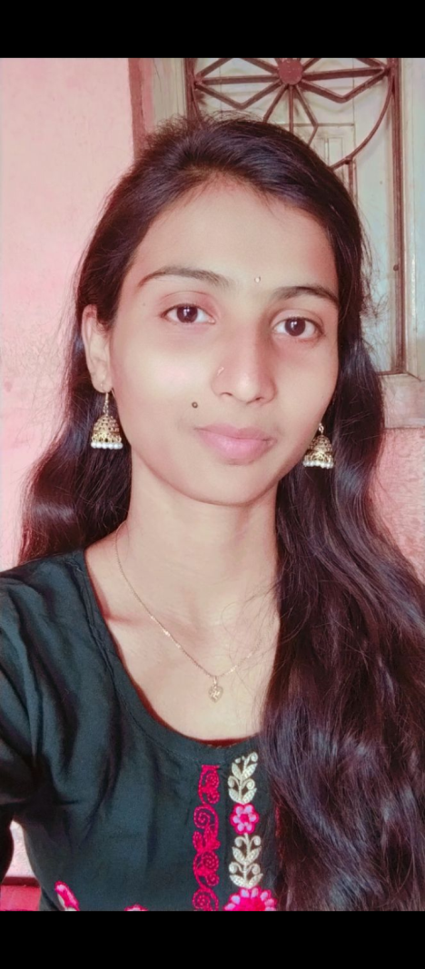
All the staff members are very supportive.
Dept. is Clean.
Material is provided is of good quality.
Rutuja bhusari 3rd yr.

Slide 14
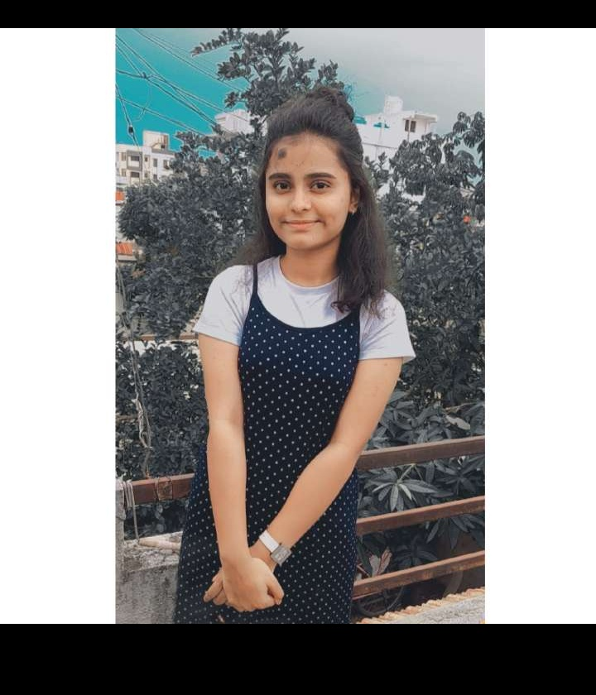
It was best experience in dentistry of doing complete denture.
Dept. is very clean and supportive.
Staff is co-operative.
Sayali helaskar 3 rd yr

Slide 15
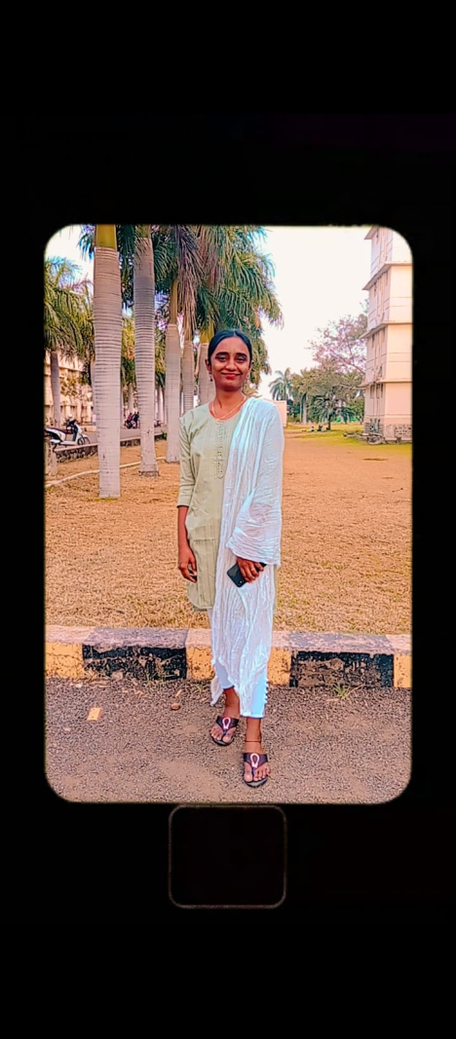
Dept. is always supportive.
Staff members are very helpful.
Chairs are comfortable for work .
Bhagyashree kote 3rd yr

Slide 16
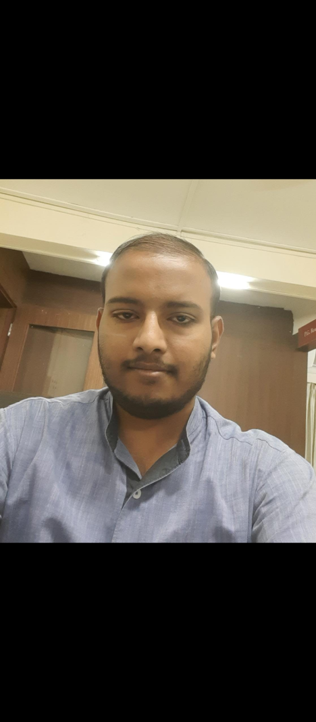
All the staff is very nice.
Dept. is very clean .
Whenever we have some problem related with work it is get solved.
Siddharth harlayya 3rd yr.

Slide 17
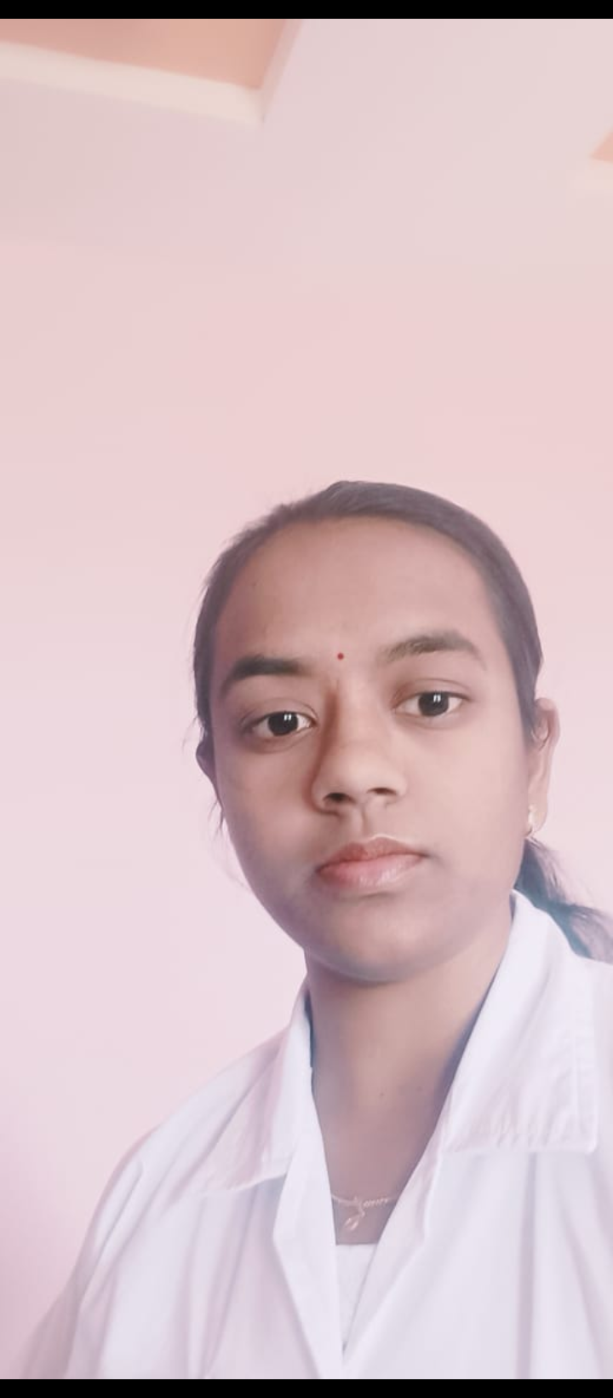
The dept. is very nice and supportive.
Always helpful and teaching is very nice.
All the staff members are very kind and co-operative.
Neha yanpallewar 3rd yr.

Slide 18
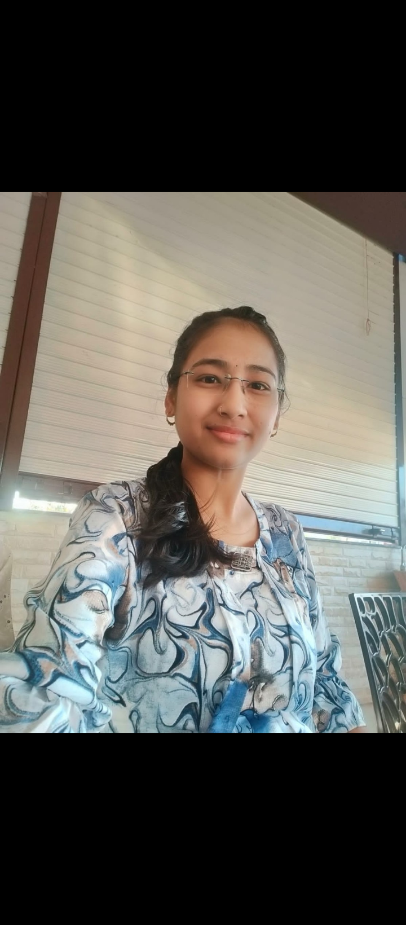
All the material is of good quality .
Teaching is very nice .
All the staff members are very supportive.
Sneha chandrasen 3rd yr.

Slide 19
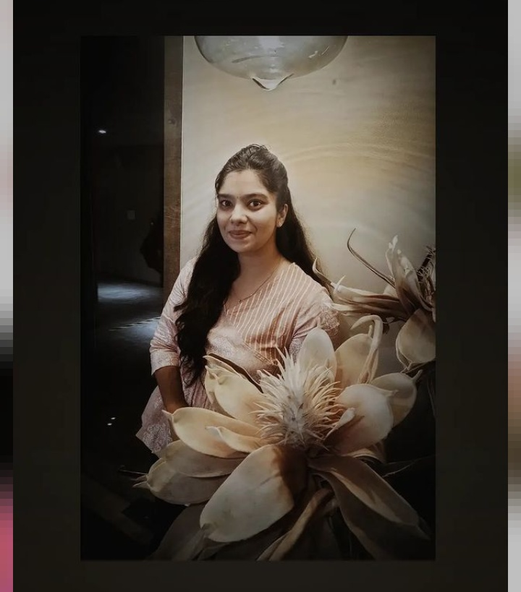
Prosthodontics dept. is very clean and supportive.
Chairs are comfortable .
All the material is provided for work.
Akanksha gosavi 3rd yr.

Slide 20
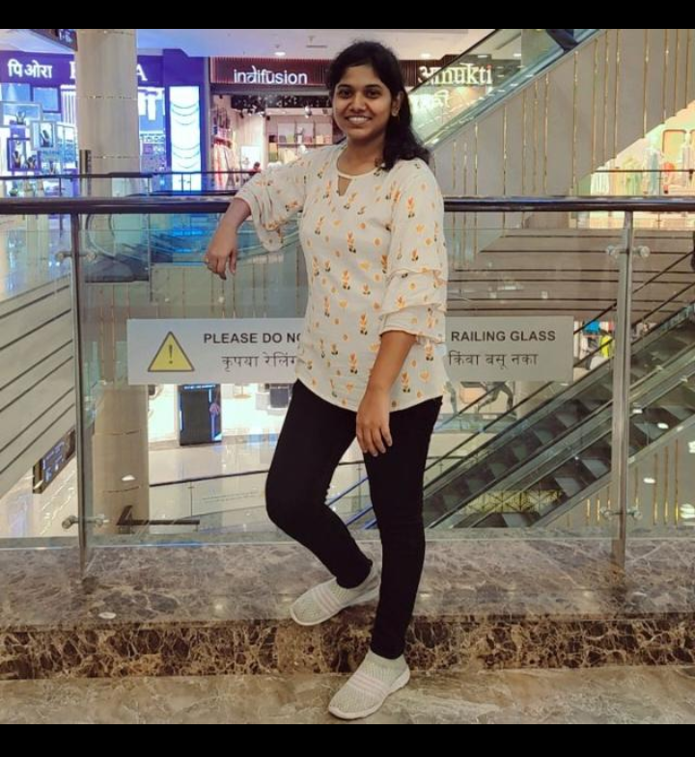
All the staff is very supportive.
Dept is always clean .
Chairs are comfortable for work.
Pooja kalshetti 3rd yr.

