Slide 1
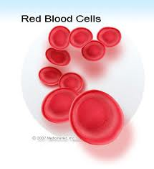
Diseases Involving The Red Blood Cells
DEPT OF ORAL PATHOLOGY AND MICROBIOLOGY,

Slide 2
LEARNING OBJECTIVES:
At the end of lecture student should be able to
Define anaemia
Describe clinical features of thalassemia and sickle cell anaemia
Lab investigations of thalassemia and sickle cell anaemia.

Slide 3
Thalassemia
Genetically determined disorder of Hb synthesis with decreased production of either alpha or beta polypeptide chains of Hb molecules, which results from markedly decreases amounts of globin messenger RNA.

Slide 4
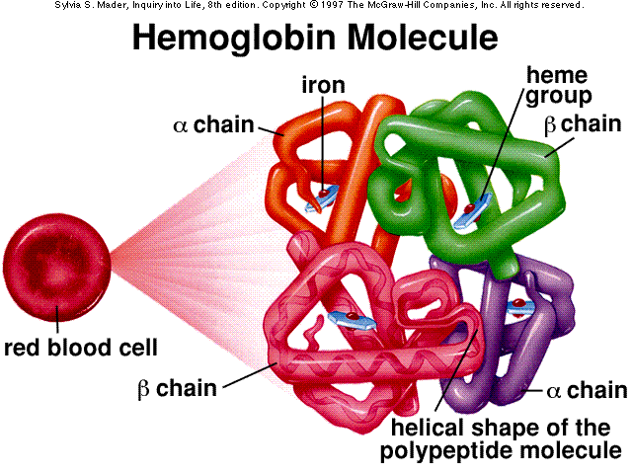
Types
Presence and absence of globin chain
Alpha thalassemia
Beta thalassemia
In heterozygous
Thalassemia minor
Thalassemia trait
In homozygous
Thalassemia major
Homozygous β thalassemia

Slide 5
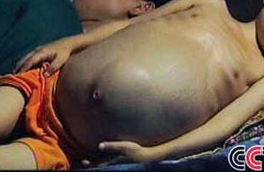
Clinical Features
Siblings are commonly affected
Occurs within the first two years of life.
Yellowish pallor of the skin
Exhibits fever, malaise and generalized weakness.
Splenomegaly and hepatomegaly

Slide 6
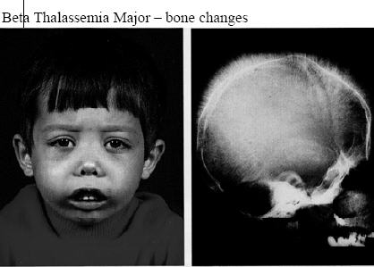
Thalassemia – X-ray features
Rib within a rib appearance
Skull- Extreme thickening of medulla and inner and outer cortex become poorly defined.
Hair on end or crew cut appearance in parietal bones
Intraoral- peculiar trabecular pattern of maxilla and mandible
Coarsening of trabeculae and blurring and disappearance of some- salt and pepper effect

Slide 7
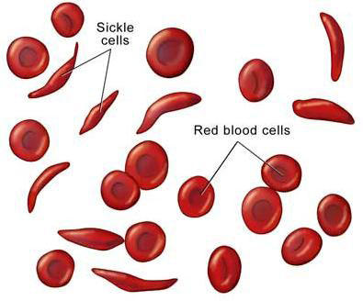
Sickle syndrome
Hereditary type
Characterized by production of structurally abnormal HB
HbA is genetically altered to produce substitution of valine for glutamine at 6th position.

Slide 8
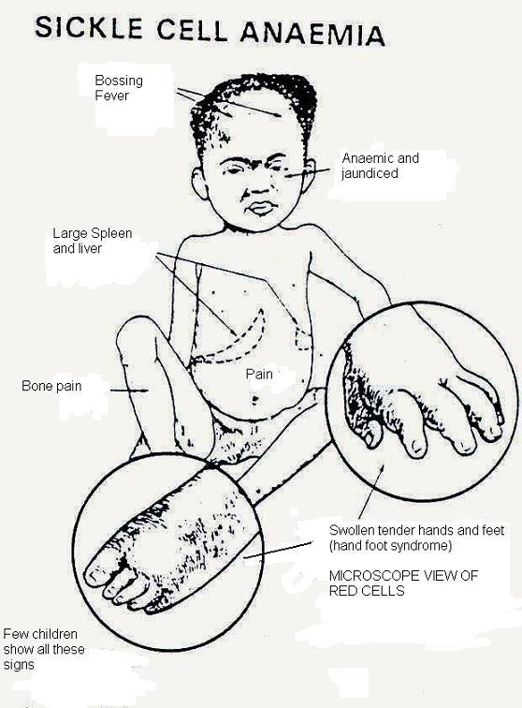
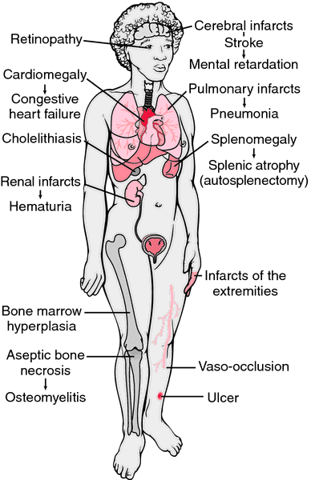
Clinical features

Slide 9
Sickle syndrome - oral manifestations
Significant bone changes in the dental radiograph.
Mild to severe generalized osteoporosis
Loss of trabeculation of jaw bones with the appearance of large, irregular marrow spaces.
Prominent in alveolar bone.

Slide 10
Erythroblastosis Fetalis
Congenital hemolytic anemia due to Rh incompatibility results from the destruction of fetal blood brought about by reaction between maternal and fetal blood factors.
It is due to the inheritance by the fetus of a blood factor from the father that acts as a foreign antigen to the mother.

Slide 11
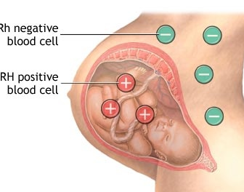
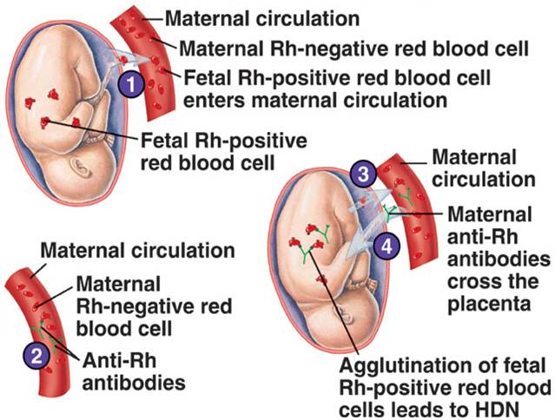
PATHOGENESIS OF ERYTHROBLASTOSIS FETALIS

Slide 12
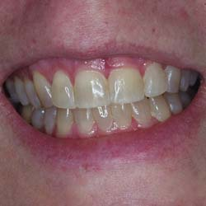
Oral Manifestation
Deposition of blood pigment in enamel and dentin in developing teeth, giving them green, brown or blue hue.
Enamel hypoplasia-usually involves incisal edges of ant. Teeth and middle portion of deciduous cuspid and 1st molar crown.
Characteristic ring like defect occurs –
Rh Hump

Slide 13
SUMMARY:
Types of Anemia -Thalassemia, Sickle cell
Clinical features
Lab investigations

Slide 14
References
Basic Pathology. Kumar, Cortan, Robbin. sixth edition.
Shafers Oral Pathology.
Basics of hematology. Kwathilkar.3rd edition.
Neville Oral Pathology

Slide 15


