Slide 1
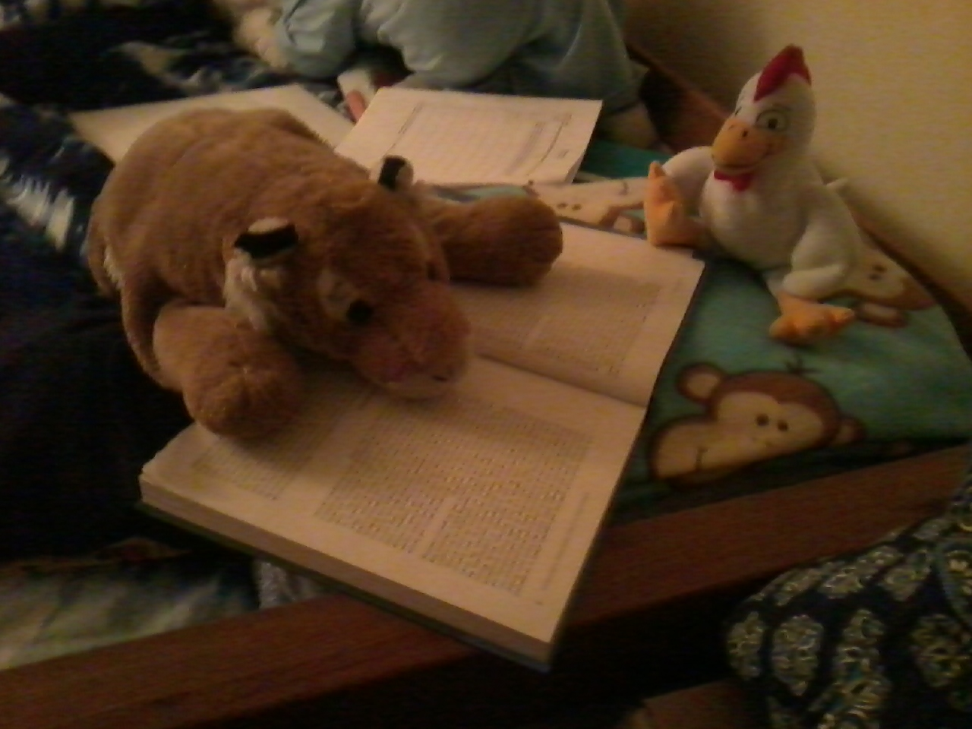
Sampling

Slide 2
Contents
Introduction.
Need for sampling.
Characteristics of a good sample.
Steps in sampling.
Different types of sampling design.
Probability sampling.
Non- probability sampling.
Conclusion.
References.

Slide 3
INTRODUCTION
Population
Sample

Slide 4
Sample design: a sample design is a definite plan for obtaining a sample from the given population.
Sampling frame: A list of all sampling units is called as sampling frame.

Slide 5
Need for sampling.........

Slide 6
Saves a lot of time and money.
Enable more accurate measurements for a sample study- trained and experienced investigators.
The only way when the population contains many members.

Slide 7
4. Sampling is the only choice when a test involves the destruction of the item under study.
5. Sampling helps to measure the sampling errors.

Slide 8
Characteristics of a good sample design

Slide 9
Truly representative sample.
Small sampling error.
Must be viable in terms of the funds available.

Slide 10
Systematic bias can be controlled.
The results obtained should be applicable to the entire population within a given confidence interval.

Slide 11
Considerations for deciding the sampling design

Slide 12
Type of the universe:
either finite or infinite.
Eg.- number of school children in a particular school.
Eg.- number of stars in the sky and throwing of a dice.

Slide 13
Sampling unit.
Source list: it is also known as the sampling frame.
It should be representative of the sample as close as possible.

Slide 14
Size of the sample.
Parameters of interest.

Slide 15
Budgetary constrains.
Sampling procedure:
For a given sample size and cost, select the one with the least possible errors.

Slide 16
Different types of sampling designs:
Probability sampling Non- Probability sampling
    Simple random sampling i . Convenience sampling
    Cluster sampling ii. Quota sampling
    Systematic sampling iii. Judgemental Sampling
    Stratified sampling iv. Snow-ball Sampling
    Area sampling
    Multi- stage sampling
    Sequential sampling

Slide 17
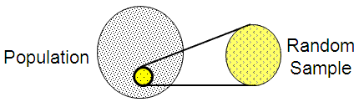


Slide 18
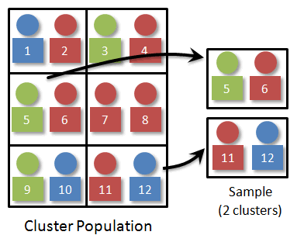
Cluster Sampling-
Reduces the cost involved.
It is less precise than random sampling.

Slide 19
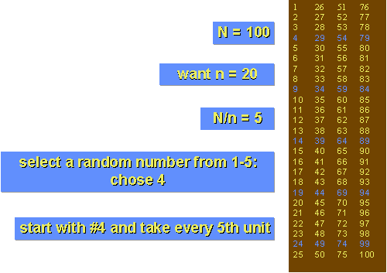
Systematic Sampling-

Slide 20
Stratified Sampling-
The population is divided into a number of homogenous sub- groups
and then items from each of the sub-groups or stratas are selected to constitute a sample.

Slide 21
In case of stratified sampling, 3 major questions arise-
a) How to form strata?
b) How should the items selected?
c) How many items should be selected from each of the strata?

Slide 22
Basis of the common characteristics.
Purposively formed based upon the experience.
Personal judgement of the researchers.

Slide 23
A pilot study.
The elements are most homogenous within each stratum.
Most heterogeneous between the different strata.

Slide 24
Number of items-
Simple random sampling can be used.

Slide 25
Proportional allocation is usually followed.
A population of 8000 is divided into 3 stratas of 4000, 2400 and 1600 and 30 samples have to be drawn,
then form the first strata of 4000, n1= 30(4000/8000) = 15 will be selected. From the second strata of 2400, n2= 30(2400/8000) = 9 will be selected.
From the third sample of 1600, n3= 30(1600/8000) = 6 will be selected.

Slide 26
Area Sampling-
If the cluster, happens to be some geographic subdivisions, in that case cluster sampling is better known as area sampling.

Slide 27
Multi- stage Sampling-
Select large primary sampling unit such as states in a country.
Then certain districts .
Certain villages are selected.
Ordinarily, multi-stage sampling is applied in big enquires.

Slide 28
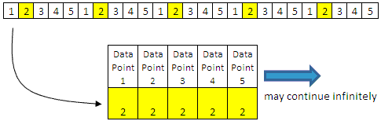
Sequential sampling

Slide 29
Convenience Sampling-
Based on the ease of access, it can be called convenience sampling.
Quota Sampling-
In other words, the actual sample selection procedure is left to the discretion of the interviewer.

Slide 30
Judgement sampling-
It is used quite often in qualitative research where the desire happens to be to develop hypotheses rather than to generalise it to the entire population.

Slide 31

Snow ball sampling

Slide 32
Power of the study
The ability of the study to detect the difference if exists any.
Power of the study = 1- Beta.

Slide 33
When calculating a sample size, if the investigators accept a 20% possibility of missing a true finding (beta error =0.2).
So the study should have a statistical power of 0.8, or 80% that means…
The best way to incorporate beta error into a study..
Incorporation of beta error in the sample size calculation is easy, but it is likely to increase the sample size considerably.

Slide 34
Sample size determination for a descriptive study
n= z ²p*(1-p)/ d ²

Slide 35
n= z². N σ ² / (N-1) e ² + z ² σ² -
Finite population.
Where
σ= standard deviation( estimated from past experience or on basis of a trail sample)
N= sample size known to us.
e= minimum acceptable error.
z= constant for a given confidence interval.

Slide 36
In a RCT-
Go for precise measurements.
Use paired measurements.

Slide 37
Consequences of incorrect sampling
Poor quality of the research.
Unreliable conclusion.
Ethically inappropriate.
Under powered study or over powered study.

Slide 38
Conclusion-
Normally one needs to resort to simple random sampling technique because under it bias is eliminated and sampling error can be estimated.
But purposive sampling is considered more appropriate when the universe happens to be small and a known characteristic of it is studied intensively.

Slide 39
References-
Kothari CR. Research Methodology, Methods and Techniques. 2nd edition. New Age International Publishers, Mumbai, India. 14-6, 55-67.
Park K. Textbook of Preventive and Social Medicine. 22nd edition. Bhanot Publication, New Delhi, India.
Mason J. Concepts in Dental Public Health. 2nd edition. Lippincott Williams and Wilkins. 215-8.

Slide 40
Grimes DA, Schulz KF. Bias and casual associations in observational Studies. The Lancet, 2002 (359); 248-52.
Schulz KF, Grimes DA. Sample size calculations in randomised trials: mandatory and mystical. Lancet 2005; 365: 1348-53.

Slide 41

Thank you.......

