Slide 1
Monomorphic Adenoma
Benign salivary gland tumor showing a more uniform histopathologic pattern
Basal cell Adenoma
Basal cell Adenoma is a benign salivary tumor that is composed of basaloid appearance of the tumor cells.
Uncommon neoplasm 1-2% of all salivary tumors
First reported by Kleinasser and Klein in 1967
Batsakis reported intercalated duct/ reserve cell is the histogenetic source.

Slide 2
Clinical Features
Primarily in major salivary gland particularly the parotid gland.
Painless, slow growth, freely movable
5:1 male predilection
<3cm in diameter
Usually located within the superficial lobe of parotid gland.

Slide 3
Histopathology
Well defined C.T. capsule
Multiple island and cords of epithelial cells
Cells are isomorphic and basaloid in appearance
Nuclei are basophilic round to oval
Cytoplasm is scanty and ill-defined

Slide 4
Histopathology
Benign Salivary Gland Tumors
Well defined C.T. capsule
Multiple island and cords of epithelial cells
Cells are isomorphic and basaloid in appearance
Nuclei are basophilic round to oval
Cytoplasm is scanty and ill-defined

Slide 5
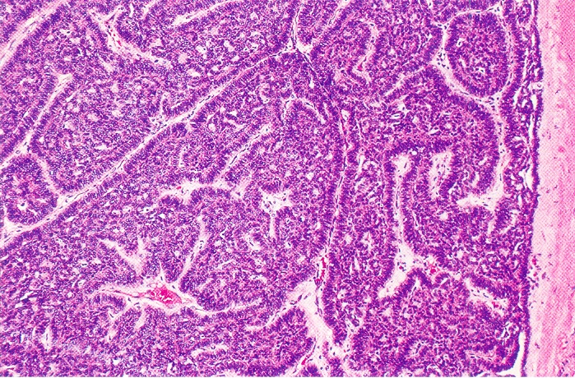
Benign Salivary Gland Tumors
Peripheral cells are hyperchromatic and palisaded
Scanty stroma present between the nests of tumor cells.
Electron microscopy show that the cells bear similarity with secretory cells of the intercalated duct.

Slide 6
Benign Salivary Gland Tumors
According to morphologic appearances four subtypes
Solid
Tubular
Trabecular
Membranous

Slide 7
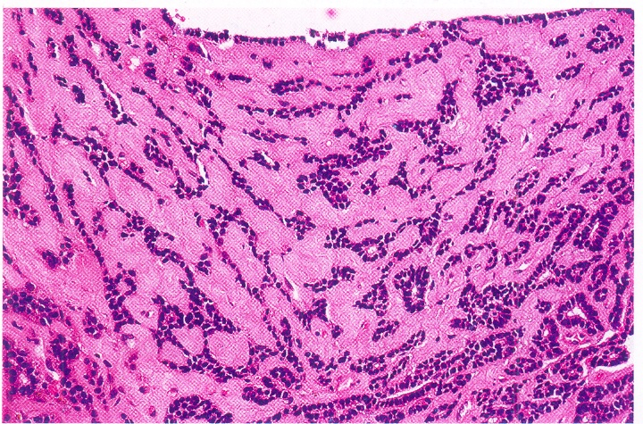
Benign Salivary Gland Tumors
Trabecular
Membranous

Slide 8
Peripheral cells are hyperchromatic and palisaded
Scanty stroma present between the nests of tumor cells.
Electron microscopy show that the cells bear similarity with secretory cells of the intercalated duct.
Treatment and Prognosis
Excision
Recurrence is rare

Slide 9
SUMMARY
Etiology, clinical features, histopathological features of:
Basal cell adenoma

Slide 10
BIBLIOGRAPHY
Text book of oral pathology Shafer's, 5 & 6th edition
Surgical Pathology of Salivary Glands Ellis 1st Edition
Color Atlas of Oral Diseases Cawson, R. 2nd edition
Oral and Maxillofacial Pathology Neville, Brad W. 2nd
Lucas’s Pathology Of Tumor’s of the Oral Tissues
Cawson, R. A., Bennie, W. H 5th edition

Slide 11
THANK YOU!

