Slide 1


Slide 2


Dental Manpower
Seminar 11
Dr. Sneha c. k.
Notes:
Global Scenario of

Slide 3
Contents
Introduction
History
Definition
Classification of Dental Auxiliaries
1. Non operating Auxiliaries
 Dental Surgery Assistant
 Dental Secretary / Receptionist
 Dental Laboratory Technician
 The Dental Health Educator
Notes:
Description of each type of dental auxiliary

Slide 4
Contents
2. Operating Auxiliaries
 School Dental Nurse
 The Dental Therapist
 The Dental Hygienist
 EFDA
 Frontier Auxiliaries
New auxiliary type:
 Dental Licentiate
 Dental Aide
 Community Dental Health Coordinator (CDHC)

Slide 5
Contents
Dental Manpower Planning
  Analysis of existing situation
  Policy formulation
Governing Bodies of dental Manpower
Dental Manpower in India
Conclusion
References
Questions from previous year

Slide 6

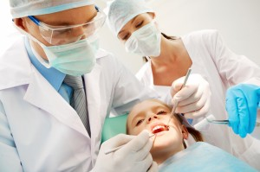
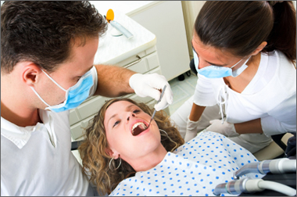
Introduction

Slide 7
Dental Manpower
Dental Auxiliaries
Dentist

Slide 8
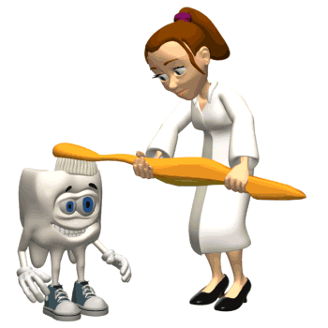
Dentist
A dentist is a person licensed to practice dentistry under the law of the appropriate state or nation.
Dentists must be both licensed and registered.

Slide 9
To become licensed, a prospective dentist must satisfy certain qualifications such as,
1. Completion of an approved period of professional education in an approved institution.
2. Demonstration of competence.

Slide 10

Oral health Care Team
The dentist along with his auxiliaries comprise the oral health care team.
Notes:
It was Dr. Fones in the year 1900 who coined the term dental auxiliaries.

Slide 11
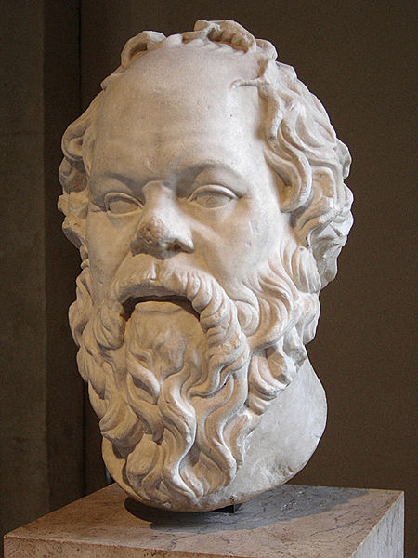
History
SOCRATES
(469 BC - 399 BC)
Socrates, in defining the ideal state, gives as a prerequisite that men should divide labor, certain men becoming expert in certain fields, others in other fields, and all working as a team for the common good.

Slide 12
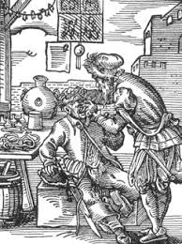
History
1723 Pierre Fauchard, a French surgeon is known as Father of modern dentistry
In 1924 – The 1st dental college of India was established in Calcutta by Dr. R. Ahmed.
In 1933 - The Nair dental college & Hospital, Bombay
In 1938 – The Govt. Dental college; Bombay.
Notes:
2600 BC Hesy-Re, an Egyptian scribe, often called the first “dentist.”

Slide 13
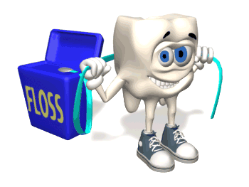
History
Prior to 20th century, dentists employed men and boys to help them in their dental practice.
In 1885, Dr. C. Edmund Kells of New Orleans, Louisiana hired a female to replace a male assistant.
In 1887, Kells mentioned “the lady in attendance” in a paper published in the Ohio Journal of Dental Science.
Dr. Fones coined the term dental auxiliaries in the year 1900 .

Slide 14
History
By the early 1900’s, signs denoting “lady in attendance” were common in dental office windows.
In 1911, Dr. Henry Fowler, of New York City, hired Juliette Southard as his permanent assistant.

Slide 15


Dental assistant societies were organizing throughout the country, the first in Nebraska in 1917.
The A.D.A.A. was incorporated on March 17, 1925, in Illinois. Within the membership, no distinction is made with respect to chairside assistant, receptionist, or general assistant.
Notes:
American dental assistants association

Slide 16
History
Due to a shortage of labor to meet the demand of the military service during World War II (1939-1945), 'helpers' were trained to work at the chair side.
These dentists retained the concept of auxiliary utilization after the war.

Slide 17
History
In 1947, a certifying board was established as a separate and autonomous agency responsible for testing and qualifying dental assistants for certification and the right to use C.D.A. (Certified Dental Assistant) after their names.
It was a 104 hour course.

Slide 18
History
Dental Assisting National Board can also qualify for Certified Dental Practice Management Assistant (CDPMA), Certified Orthodontic Assistant (COA), Certified Oral and Maxillofacial Surgery Assistant (COMSA)

Slide 19
History
There was a marked change during the 60's with the advent of fourhanded sit - down dentistry.
The term four-handed dentistry is given to the art of seating both the dentist and the dental assistant in such a way that both are within easy reach of the patient's mouth.

Slide 20

Definition

Slide 21
Manpower: The term is restricted to persons who have received or are receiving education and training for specific occupation.
“Dental auxiliary personnel are defined as persons involved to a greater or lesser extent in the practice of dentistry in its widest forms but are not qualified with a degree in dentistry”.
-- WHO 1977

Slide 22
“A dental ancillary is a person who is given responsibility by a dentist so that he or she can help the dentist render dental care, but who is not himself or herself qualified with a dental degree. The duties undertaken by dental ancillaries range from simple tasks, such as sorting instruments, to relatively complex procedures which form part of the treatment of patients”.
- Slack

Slide 23
In Britain, Dental auxiliaries have been known as "dental ancillaries". Since 2002 , General Dental Council has adopted the term Professionals Complementary to Dentistry (PCDs)
The word auxiliary means, being helpful, subsidiary; whereas ancillary means subservient, subordinate.
Notes:
Dental auxiliary is a generic term for all persons who assist the dentist in treating patients.
The words dental auxiliary has found common usage.

Slide 24
Classification

Slide 25
DENTAL AUXILIARIES
Non-operating auxiliaries
Operating auxiliaries
CLINICAL
LABORATORY
------ WHO ,New Delhi 1967
Notes:
This was suggested at a conference conducted by the WHO in New Delhi in 1967.

Slide 26
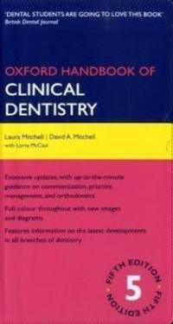
WHO classification (Oxford Handbook of Clinical Dentistry)
Non-operating auxiliaries:
    Type I- dental technician
    Type II- dental nurse
    Type III- dental preventive worker
Operating auxiliaries:
    Type IV- hygienist
    Type V- dental therapist

Slide 27
Revised Classification
Non-Operating
Dental Surgery Assistant
Operating
School Dental Nurse
Dental Secretary/Receptionist
Dental Laboratory Technician
Dental Health Educator
Dental Therapist
Dental Hygienist
Expanded Function Dental Ancillaries

Slide 28
New Auxiliary Types:
The expert committee on auxiliary dental personnel of the WHO has suggested two new types of dental auxiliaries:
The dental licentiate
The dental aide
Further more ADA has recommended another type of auxiliary: Community Dental Health Coordinator (CDHC)

Slide 29
WHO (1965) classification of dental health services
Group I – dental services provided by dentist and dental auxiliaries and financed directly by the consumer or through a non government organization.
Group II- services provided by dentists and dental auxiliaries who are partly or entirely financed by Government but who are not considered to be Government employees.
Group III- services provided by dentists and auxiliaries who are employed by the government.

Slide 30
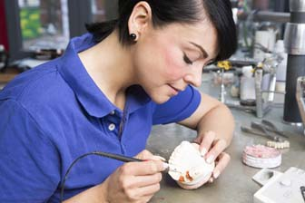
Non- Operating Auxiliary

Slide 31
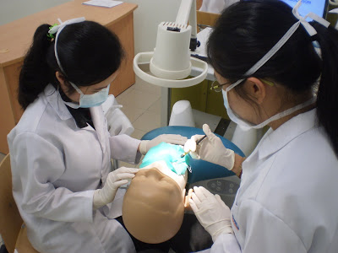
Dental Surgery Assistant
A dental assistant is a non-operating auxiliary who assists the dentist or dental hygienist in treating patients, but who is not legally permitted to treat patient independently.
Work under the supervision of a licensed dentist
The common ones include dental assistant, chair side dental assistant and dental nurse.
Notes:
A dental assistant may only work under the supervision of a licensed dentist, carrying out duties prescribed by the dentist or by a dental hygienist employed by the dentist.

Slide 32
The Duties of Dental assistants :
1. Reception of the patient.
2. Preparation of the patient for any treatment he or she may need.
3. Preparation and provision of all necessary facilities such as mouthwashes and napkins.
4. Sterilization, care and preparation of instruments
Notes:
Dentists who do not expect too much from their assistants prefer to train them on the job.
Training courses do exist, extending over a period of one year to two years.

Slide 33
5. Preparation and mixing of restorative materials including both filling and impression materials.
6. Care of the patient after treatment until he or she leaves, including clearing away of instruments and preparation of instruments for reuse.
7. Preparation of the surgery for the next patient.
8. Presentation of documents to the dental surgeon for his completion and filing of these.

Slide 34
9. Assistance with x-ray work and the processing and mounting of x-rays.
10. Instruction of the patient, where necessary, in the correct use of the toothbrush.
11 .Aftercare of persons who have had general anesthetics.

Slide 35
Four-handed dentistry
Working With an Assistant
Assistant seated 4-6 inches above operator
Facing toward head of dental chair
Oral cavity accessible to operator and assistant
Instruments within arm’s reach of assistant

Slide 36
Advantages
Reduces physical and mental strain of operator.
Improved quality of service.
Appointment periods also may be shorter

Slide 37
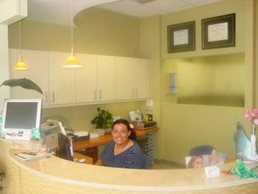
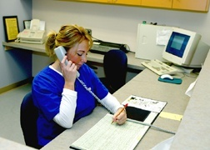
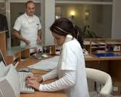
Dental Secretary /Receptionist
This is a person who assists the dentist with his secretarial work and patient reception duties.

Slide 38
Dental Laboratory Technician
Non-operating auxiliary who fulfills the prescriptions provided by dentists regarding the extra oral construction and repair of oral appliances and bridge-work.
This category of personnel have also been known as dental mechanics.
As per the Indian Dentist Act of 1948, dental mechanic is a person who makes or repairs dentures and dental appliances.

Slide 39
Dental laboratory technicians receive formal training at a dental school or technical college.
The formal training period covers two years.
Duties:
Casting of models from impressions made by the dentist
Fabrication of dentures, splints, orthodontic appliances, inlays, crowns and special tray
Notes:
their training through apprenticeship which is associated with

Slide 40
Dental mechanic is a person, who makes or repairs dental appliances and dentures including inlay, crown and bridge work. He shall , restrict his activities to purely mechanical laboratory work at the instance of the registered dental surgeon. He shall riot do any chair side work.
- The Dental Council of India

Slide 41
The Dental Council of India has prescribed that,
The course of studies should extend over a period of two academic years and lead to the qualification of dental mechanic certificate.
The candidate should be at least 15 years of age at the time of admission or within 3 months of it and should be medically fit.
The candidate must have passed at least matriculation examination of a recognized university taking science subject or an equivalent recognized qualification.

Slide 42

Denturist
Is a term applied to those dental laboratory technicians who are permitted to fabricate dentures directly for patients without a dentist's prescription.
They may be licensed or registered.
The desire for autonomy among dental laboratory technicians led to the formation of ‘denturists’.

Slide 43
Their craft is called 'denturism'.
According to that, if the patient is in need of a denture, the process of fabricating a denture, from the impression onwards, is done by the technician in direct relationship with the patient.
The ADA defines 'denturism' as the fitting and dispensing of dentures illegally to the public.

Slide 44
The ADA has vigorously opposed the denturist movement at the political level.
The Association's principal argument is that denturists are unqualified to treat patients and that poor-quality care and even actual harm could result to patients.
The WHO Expert Committee on Auxiliary Dental Personnel (1959) has recommended that only qualified dentists may work directly on patients.

Slide 45

Dental Health Educator
This is a person who instructs in the prevention of dental disease and who may also be permitted to apply preventive agents intra orally.
In a few countries - the duties of some dental surgery assistants have been extended
Notes:
In a few countries, the duties of some dental surgery assistants have been extended to allow them to carry out certain preventive procedures.

Slide 46
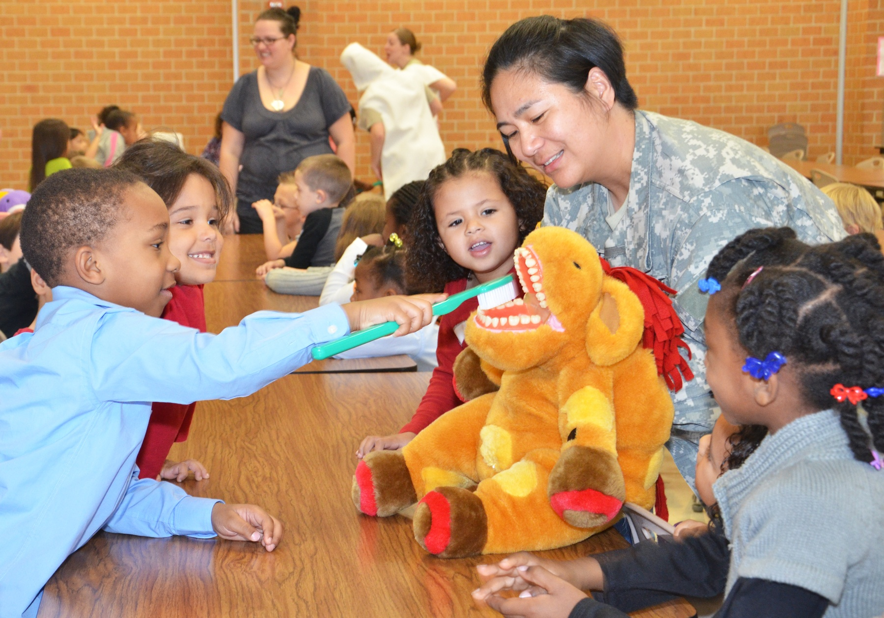
Operating Dental Auxiliaries

Slide 47
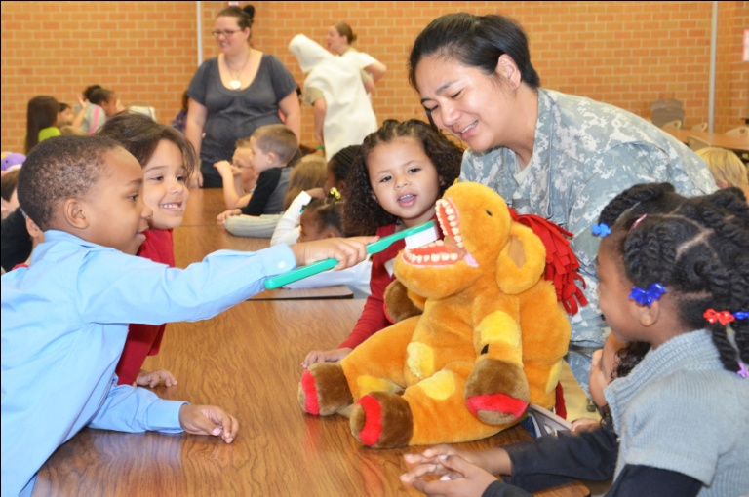
School Dental Nurse
This is an operating auxiliary, who is permitted to diagnose dental disease and to plan and carry out certain specified preventive and treatment measure, including some operative procedures in the treatment of dental caries and periodontal disease in defined groups of people, usually school children.

Slide 48

History
It has become evident first in New Zealand in1905.
T.A. Hunter, founder of the New Zealand Dental Association and a pioneer in the establishment of a dental school in New Zealand.
The Dental Nurse Scheme was established in New Zealand in 1921 due to the extensive dental disease found in army recruits during World War I.

Slide 49
Training
The training extends to over a period of two years to cover both the reversible and irreversible procedures.
Upon completion of training, each school dental nurse is assigned to a school where she is employed by the government to provide regular dental care for between 450 and 700 children.
Notes:
Curriculum

Slide 50
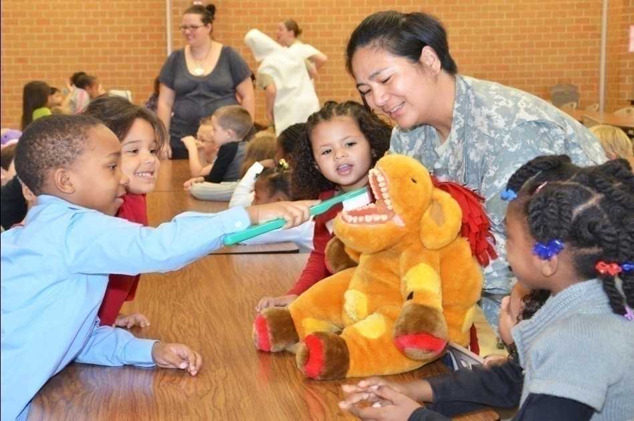
Duties:
1. Oral examination.
2. Prophylaxis.
3. Topical fluoride application.
4. Advice on dietary fluoride supplements.
5. Administration of local anesthetic.
6. Cavity preparation and placement of amalgam filling in primary and permanent teeth.
7. Pulp capping.

Slide 51

8. Extraction of primary teeth.
9. Individual patient instruction in tooth brushing and oral hygiene.
10. Classroom and parent-teacher dental health education.
11. Referral of patient to private practitioners for more complex services, such as extraction of permanent teeth, restoration of fractured permanent incisors and orthodontic treatment

Slide 52
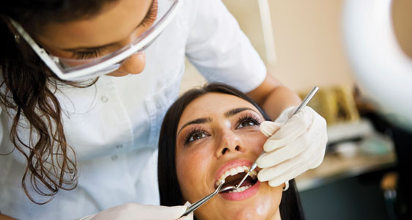
Dental Therapist
This is an operating auxiliary, who is permitted to carry out to the prescription of a supervising dentist, certain specified preventive and treatment measures including the preparation of cavities and restoration of teeth.

Slide 53
History
In 1979, in the U.K., the name auxiliary was changed to therapist.
In Australia, therapists-the personnel categories who are derivatives of the New Zealand Dental Nurse model - have been in service since 1966.
They are like New Zealand type school dental nurses but their role is quite different, as they are not permitted to diagnose and plan dental care

Slide 54
They are permitted to work based on the written treatment plans devised by the supervising dentists
The operative procedures they are entitled to carry out are similar to those of the New Zealand School Dental Nurses, including the administration of local infiltration analgesia.

Slide 55
The training of dental therapists is for about a period of two years involving both the reversible and irreversible procedures.
Their duties include,
Clinical caries diagnosis,
Cavity preparation in deciduous and permanent teeth,
Vital pulpotomies under rubber dam in deciduous teeth
Extraction of deciduous teeth under local anaesthesia.

Slide 56
They have little training in interpretation of X-rays.
They often take radiographs at the request of the supervising dentist.
They are not trained to provide endodontic care.
Apart from Australia and United Kingdom, other countries using the services of therapists include Hongkong, Singapore, Vietnam and Tanzania.

Slide 57
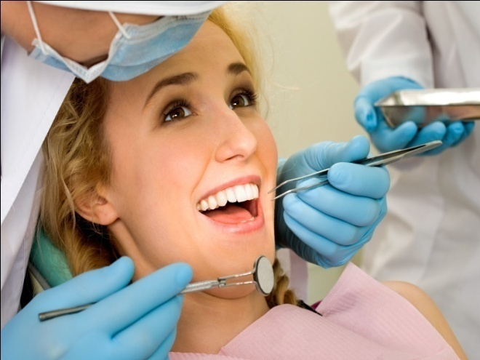
Dental Hygienist
A dental hygienist is an operating auxiliary licensed and registered to practice dental hygiene under the laws of the appropriate state, province or nation.
The dental hygienist works under the supervision of dentists.

Slide 58

Dental hygienist is a person, not being a dentist or a medical practitioner; who does oral prophylaxis, gives instructions in oral hygiene & preventive dentistry, assists the dental surgeon in chair side work and manages the office, He/She shall work under the supervision of the dental surgeon. -The Dental Council of India

Slide 59
Dr. Fones is considered as the 'father of dental hygiene'. He is often credited with the first training school for dental hygienists, in November 1913.
The duration of the course was for a period of about seven months.

Slide 60
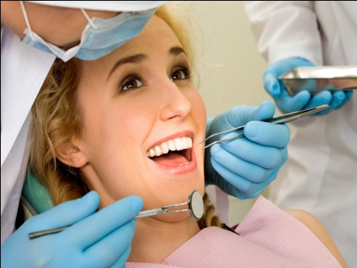
Training
The Dental Council of India has prescribed that,
The course of studies should extend over period of two academic years and lead to the qualification of Dental Hygienist Certificate.
The candidate should be at least 15 years of age at the time of admission or within 3 months of it and should be medically fit.
The candidate must have passed at least matriculation examination of a recognized university taking science subject or an equivalent recognized qualification.

Slide 61
Duties:
1. Cleaning of mouths and teeth with particular attention to calculus and stains.
2. Topical application of fluorides, sealants and other prophylactic solutions.
3. Screening or preliminary examination of patients as individuals or in groups, such as school children or industrial employees, so that they may be referred to a dentist for treatment

Slide 62

4. Instruction in oral hygiene.
5. Resource work in the field of dental health.

Slide 63
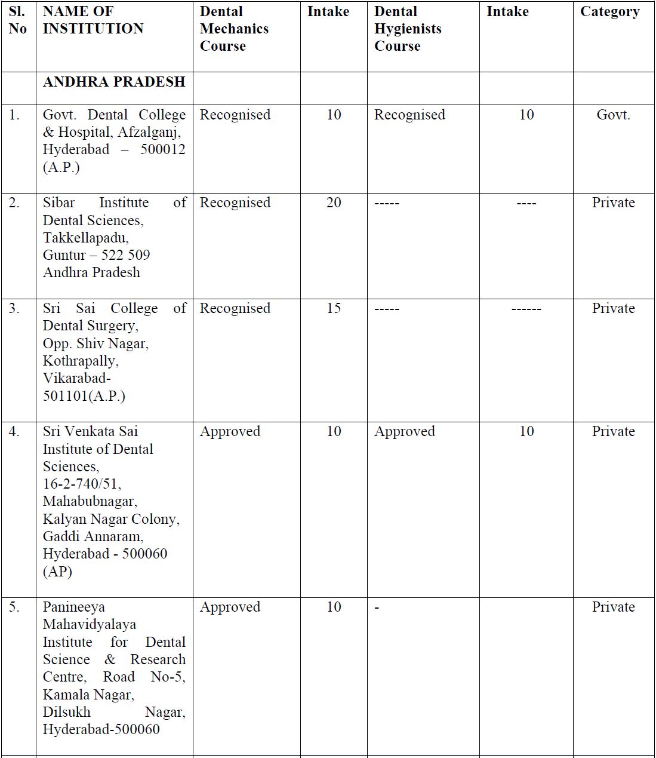
DENTAL COUNCIL OF INDIA
List of Recognised / Approved dental institutions conducting
DENTAL MECHANIC And DENTAL HYGIENIST Courses In India

Slide 64
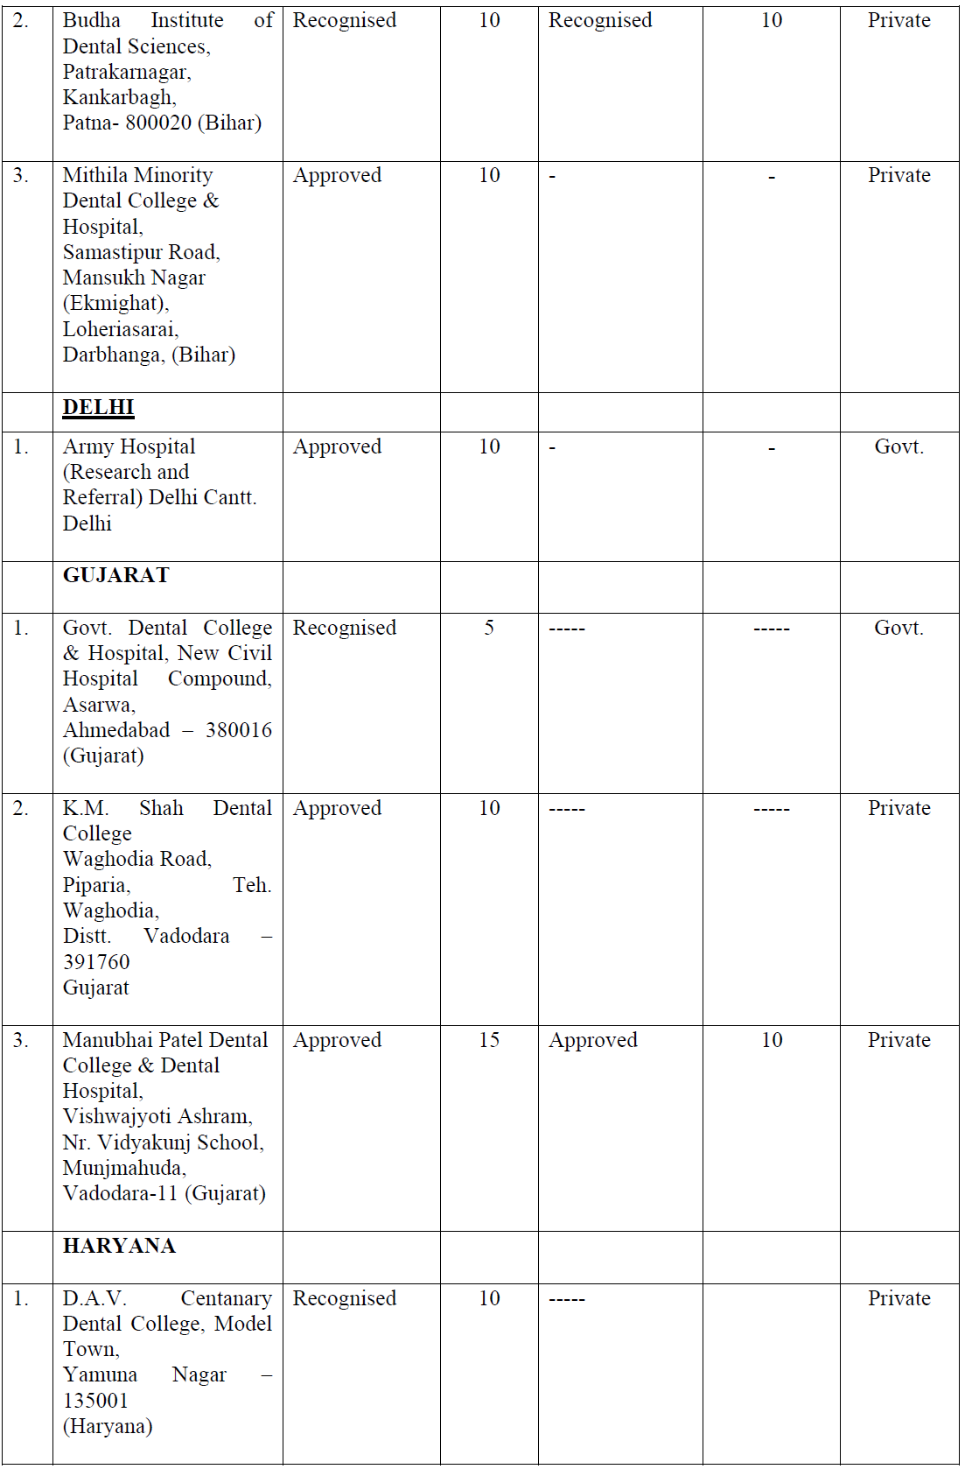

Slide 65
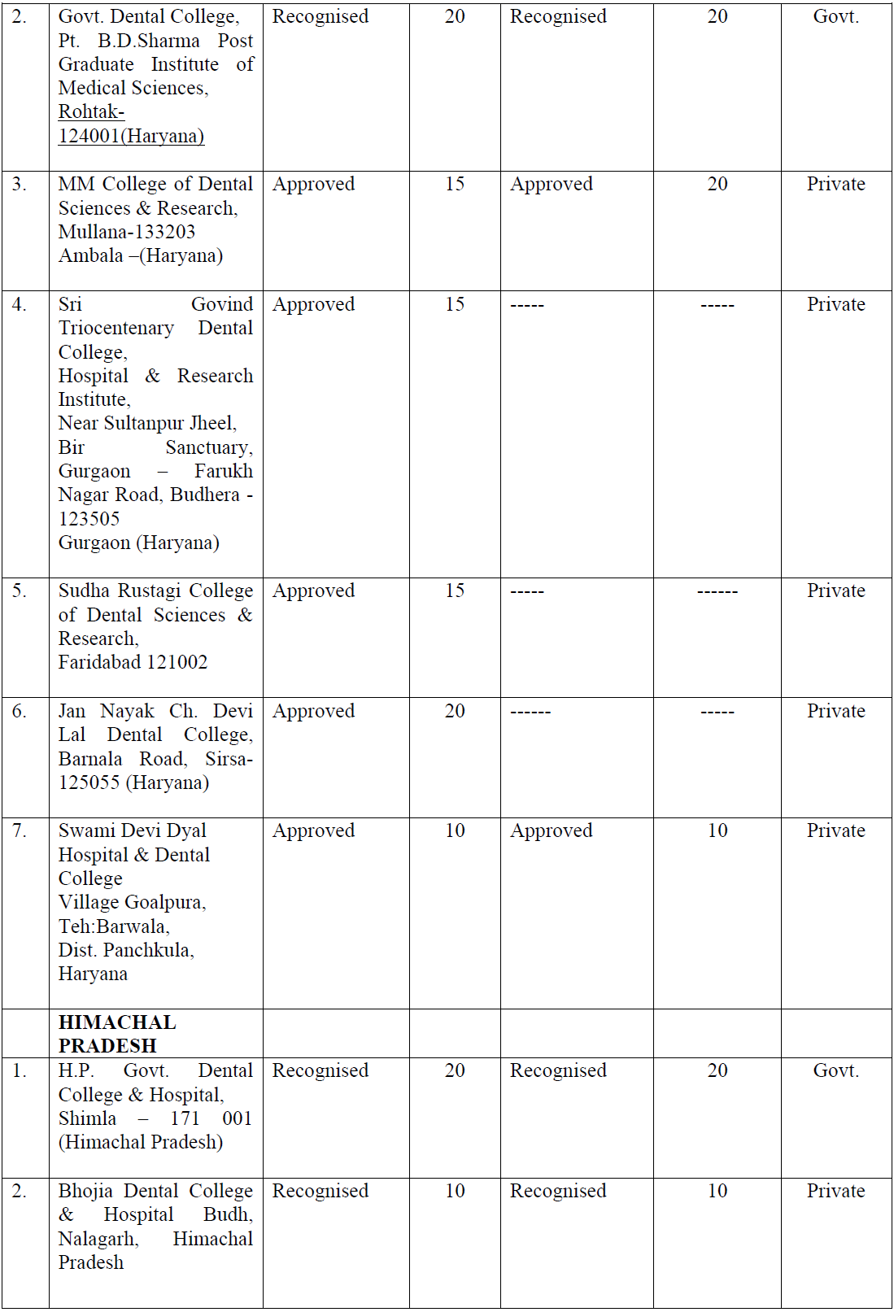

Slide 66
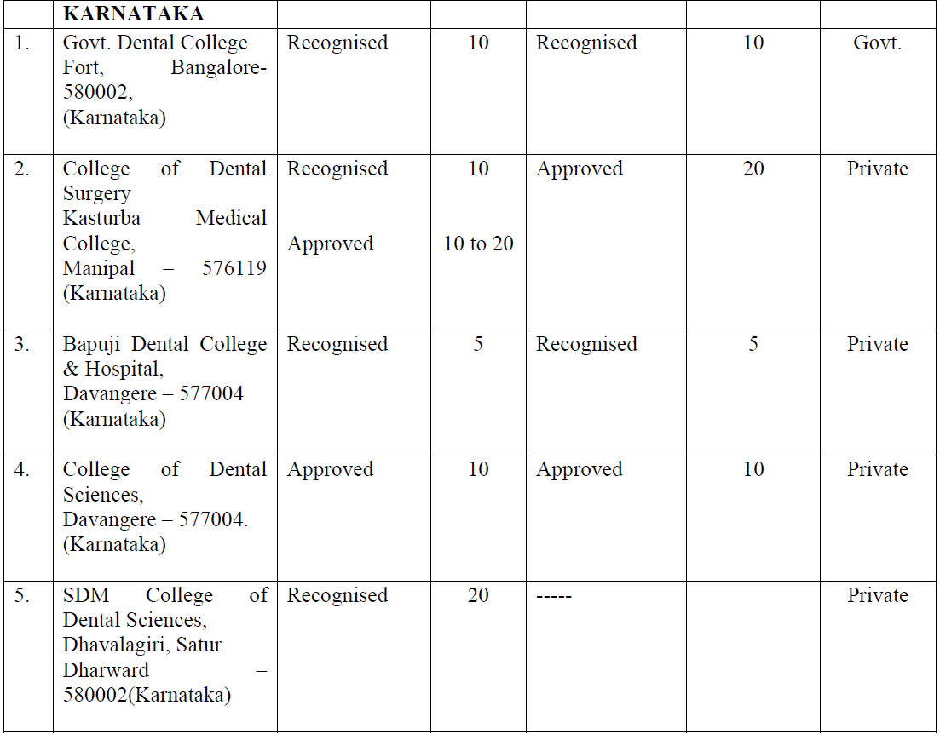

Slide 67
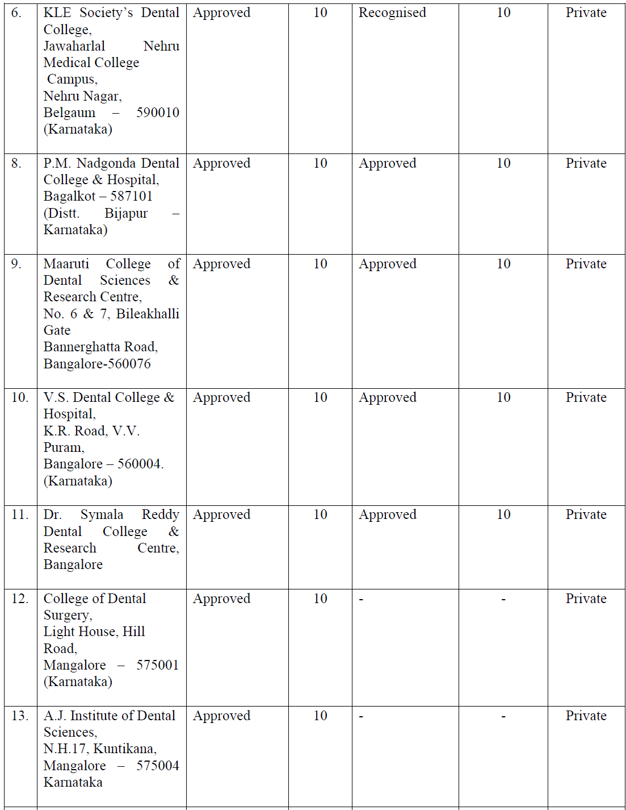

Slide 68

EXPANDED FUNCTION DENTAL
AUXILIARY (EFDA)
An EFDA is a dental assistant or a dental hygienist in some cases, who has received further training in duties related to the direct treatment of patients, though still working under the direct supervision of a dentist.
They undertake reversible procedures - that is which could be either corrected or redone without undue harm to the patient's health.

Slide 69
The first large scale service applications of the expanded duty principle were made in Philadelphia. They were called "Technotherapists".

Slide 70
Duties :
Placing and removing rubber dams.
Placing and removing temporary restorations.
Placing and removing matrix bands.
Condensing and carving amalgam restoration in previously prepared teeth.
Placing of acrylic restorations in previously prepared teeth.
Applying the final finish and polish to the previously listed restorations.

Slide 71
Training
Four levels of training and qualification were recognized,
1. Certified dental assistant
2. Preventive dental assistant
3. Dental hygienist
4. Dental hygienist with expanded duties.

Slide 72
Training
1. Certified dental assistant:
The training course is of 8 months duration.
The assistant was taught traditional chairside duties.
The only intraoral duty was exposing radiographs.

Slide 73
Training
2. Preventive dental assistant:
The trainee had to be a certified dental assistant.
Full time courses were of three to six weeks lengths.
They were permitted to:
Polish the coronal portions of teeth without instrumentation.
Make impressions for study models.
Topically apply caries preventive agents.
Place and remove rubber dams
Maintain a patients oral hygiene.

Slide 74
Training
3. Dental hygienist:
The eight month training program allowed them to,
Carry out scaling
Conduct a preliminary examination of the oral cavity including taking a case history, a periodontal examination and recording clinical findings.
Provide a complete prophylaxis including scaling, root planning and polishing of fillings.
Apply and remove a periodontal pack.
Apply fissure sealants.

Slide 75
4. Dental hygienist with expanded duties:
Training of 4 months duration was given to dental hygienists who had atleast one year's practical experience. They were allowed to carry out,
Removing sutures
Placing, finishing and polishing restorations of amalgam and resin.
Placing and removing matrix bands.
Placing cavity liners

Slide 76
Retracting gingiva for impression making.
Fitting and removing orthodontic bands.
Separating of teeth prior to banding by a dentist.
Cementing temporary crowns previously fitted by a dentist.
Placing temporary fillings

Slide 77

FRONTIER AUXILIARIES
Nurses and former dental assistants in such areas can provide valuable service with the minimum of training.
Simple dental prophylaxis can be performed,
Basic dental health education can be provided,
Dental first-aid can be rendered in cases with pain and patients can be referred to the nearest dentist more intelligently than would be possible by untrained people.

Slide 78
In 1981, one week training programs for such “frontier auxiliaries” in Alaskan communities for 40 or more miles from the nearest dentist was reported.
Two years later, case reports from the two communities showed that a large variety of simple dental problems had been solved and intelligent references had been made to urban dentists for elective work.
    The practical duties of frontier dental auxiliaries in Alaskan communities: a progress report.
    Dunning JM. J Public Health Dent. 1984 Fall;44(4):138-40.

Slide 79
NEW AUXILIARY TYPES
The expert committee on auxiliary dental personnel of the
WHO (1959) has suggested two new types of dental auxiliaries:
The dental licentiate
The dental aide.

Slide 80

The Dental Licentiate
He is a semi-independent operator, trained for 2 years to perform.
Dental prophylaxis.
Cavity preparations and fillings of primary and permanent teeth.
Extractions under local anesthesia

Slide 81
Drainage of dental abscesses.
Treatment of the most prevalent diseases of supporting tissues of the teeth.
Early recognition of more serious dental conditions.

Slide 82

Dental aide
This type of auxiliary personnel performs duties which include, elementary first – aid procedures for the relief of pain, including :
Extraction of teeth under local anesthesia
Control of hemorrhage
Recognition of dental disease which is important enough to justify transportation of the patient to a center where proper dental care is available.

Slide 83
Training
The formal training extends from 4 to 6 months, followed by a period of field training under direct and constant supervision

Slide 84
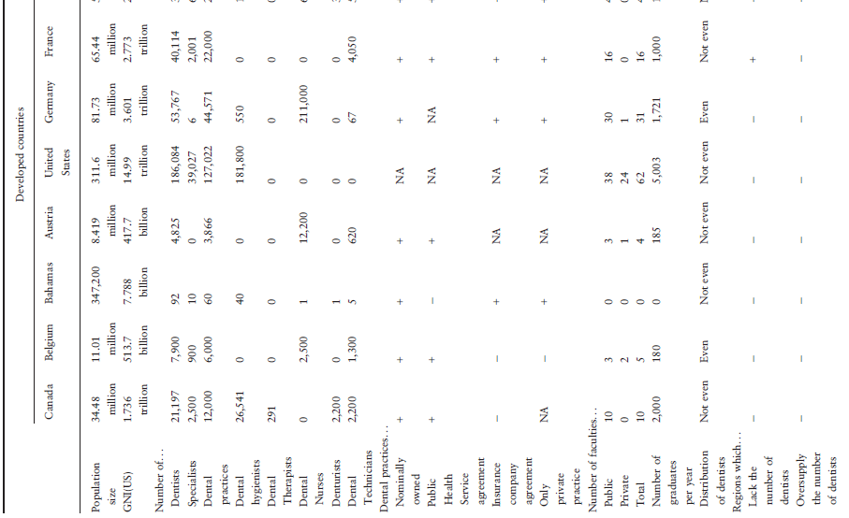

Slide 85
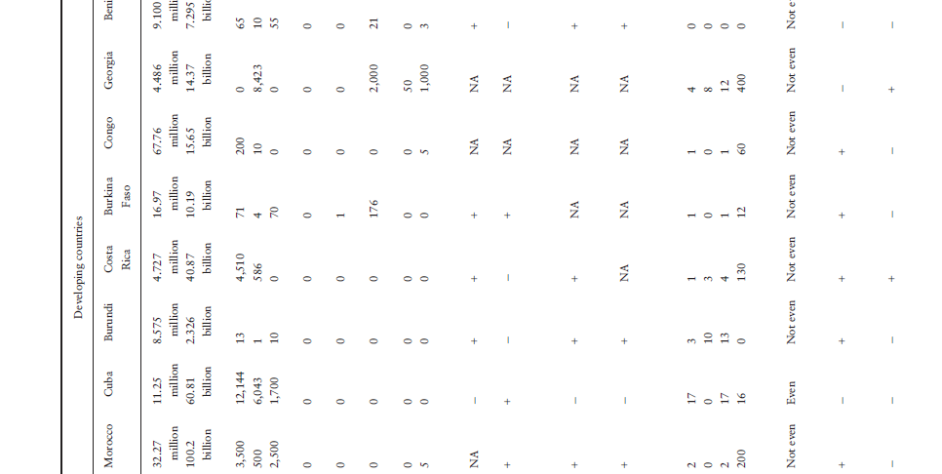

Slide 86
Degrees of Supervision of Auxiliaries
ADA (1975) defined four degrees of supervision of auxiliaries, with the assumption that ultimate responsibility was assumed by the licensed dentist.
General supervision
Indirect supervision
Direct supervision
Personal supervision

Slide 87
1. General supervision :
The dentist has authorized the procedures and they are being carried out in accordance with the diagnosis and treatment plan completed by the dentist.
2. Indirect supervision :
The dentist is in the dental office, authorizes the procedure and remains in the dental office while the procedures are being performed by the auxiliary.

Slide 88
3. Direct supervision :
The dentist is in the dental office, personally diagnoses the condition to be treated, personally authorizes the procedure and before dismissal of the patient, evaluates the performance of the dental auxiliary.
4. Personal supervision :
The dentist is personally operating on a patient and authorizes the auxiliary to aid treatment by concurrently performing supportive procedures

Slide 89

Dental Manpower Planning
Notes:
Manpower planning is integral part of a general plan for providing health services.

Slide 90
Health manpower planning has been defined as “ the process of estimating the number of persons and the kind of knowledge, skills and attitudes they need to achieve predetermined health targets and ultimately health status objectives. Such planning also involves specifying who is going to do what, when, where, how, and with what resources for what population groups or individuals so that the knowledge and skills necessary or adequate performance can be made available according to predetermined policies and time schedules.”
Notes:
Definition This planning must be a continuing and not sporadic process, and it requires continuous monitoring and evaluation'
Which Mainly consist of 6 steps

Slide 91
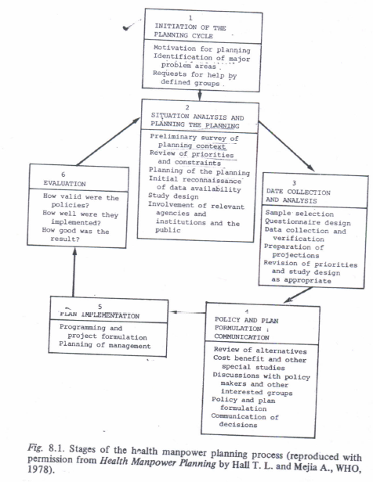

Slide 92
WHO framework for formulation of plan (1969)
1. Analysis of the existing situation
Dental health needs and demands for services
Dental health manpower supply
Utilization of dental health manpower
2. Policy formulation
Dental health manpower planning
Notes:
Based on this background WHO suggested framework for formulation of plan (1969) for development of manpower

Slide 93
Dental health needs and demands for services
Met demand – Utilization data
Identified but unmet need – needs identified by the profession which are not met or met after harmful delay
Unidentified need – Undiscovered morbidity in the community which is capable of being alliveated.
(submerged portion of the iceberg)
Usually measured in terms of prevalence and severity of dental disease
Indices not adequate to assess needs
Wide variation in methods and types of treatment for a given dental condition - Difficulty in diagnosing true dental needs
Surveying- target population-standardized way.
Hence
Notes:
Utilization of dental health services by the public will vary according to the availability, acceptability and accessibility.
Physical and mental conditions of the population and the capabilities of the prevailing medical and dental methods to deal with them.

Slide 94
Dental health needs and demands for services
A survey system used for planning the dental resources should have the following properties British Association for the Study of Community Dentistry,1997
The survey should be comprehensive and include data collection, processing, analysis and presentation
The methods should be based on established criteria of need which are known to be valid and reliable.
Notes:
Properties of the dental survey

Slide 95
British Association for the Study of Community Dentistry,1997
3. An assessment of the status of the teeth and their supporting structure, the oral cleanliness status, the occlusion, the oral tissues and the subjects previous use of dental services and the propensity for good dental health behaviour, should be made.
4. The findings should be expressed in terms of resources required as well as disease prevalence and severity.
5. The systems should be easily used and capable of application at local, regional and national levels.

Slide 96
Dental Services Index (Beck, 1968)
Dental health needs and demands for services
  This was an attempt to overcome the shortcomings of the dental surveys which only record dental disease findings.
  Provides indication of the amount of dental treatment required in a given individual / population
  On individual basis
      Related to cost of dental services
      Assumes a standardized scale of fees
  On population basis : Related to dental manpower & facilities necessary to make population ‘dentally fit’
Notes:
.

Slide 97
Hobdell et al (1974) - expanded Beck's concept
Dental health needs and demands for services
Enumerated nine sequential stages in planning a dental program to satisfy the needs of a population
  Recognition of the need for dental treatment in the population group
  Estimation of the size of the problem
  Definition of feasible treatment aims for the service
  Formulation of treatment strategies designed to achieve those aims

Slide 98
Dental health needs and demands for services
Effects of these treatment strategies on the amount of the individual items of treatment to be carried out
Conversion of the individual items of treatment to Relative Value Units of dental treatment required i.e. satistical expression of the time, cost and the responsibility factors involved with any given dental procedure, relative to other dental procedures.

Slide 99
Dental health needs and demands for services
Calculation of the time required to provide the necessary treatment
Calculation of the relative costs of using dental teams of different composition to provide the treatment
Finally, deciding which dental team will provide the required service most effectively within the constraints prevailing

Slide 100
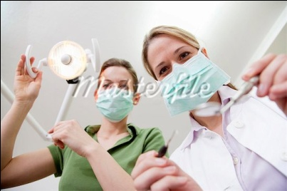
Manpower Requirement
Depends upon
  Whether dentist works with or without auxiliary?
  Experimental dental care project (Allred, 1977) showed that :
    A team of dentist & dental therapist were quickest to carry out dental care
    Dentist & EFDA took 25% more time
    Dentist without auxiliary took 50% more time

Slide 101
Annual working time of dentists
Data derived from the cross-sectional study revealed that the average dentist in India works 7 hours a day, 290 days a year (2030 hours/year).
Except for a very few dental hygienists, no other operative dental auxiliaries are currently working in India and an assumption applied for this study is that all dental treatments are provided only by qualified dentists.

Slide 102

Dental health needs and demands for services
  How dentists are paid ?
Hobdell and Elderton reported that the method of paying the dentist affected the speed of providing care. When the fees was fixed by the dentist, dental care was provided at a slower pace than where the dentists were salaried or when dentists were remunerated by item of service at a fixed rate.

Slide 103
Dental health needs and demands for services
Interval between recall of patients for maintenance care
  Increasing recall interval reduces manpower
  Changing the interval between recall visits from the conventional interval of 6 months to 12-24 months will make a significant difference in the number of dental personnel required.
Notes:
This change is justified because there is no scientific basis for interval of 6 months.

Slide 104
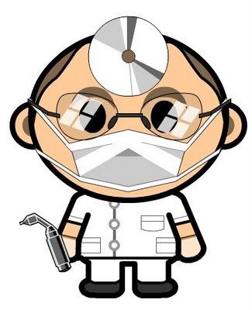
Methods for estimating dental manpower required
Dentist- population ratio
WHO recommends, dentist to population ratio of 1:7500.
Simple, easy to compute with fair degree of accuracy & useful for comparative studies
Notes:
Better the ratio - more likely the demands are met.
Comparison of the ratios btw countries with similar social structure – indication of relative position with respect to adequacy of supply.

Slide 105
Methods for estimating dental manpower required
      Disadvantages:
      Dental needs are not evenly distributed in a population
      Demand for care is affected by education, income, dental status, geographical location
      Assumes constant productivity of dentists and quality of care

Slide 106
Methods for estimating dental manpower required
  2. Need based approach
    Measurements of oral needs in a population
    Estimate how much treatment and time required to meet these
    needs
  Disadvantages:
    Dentists can treat same condition in different ways
    Demand for some types of care is difficult to predict
    e.g. esthetic restorations
Notes:
Both the accumulated and estimates of future needs must be
included

Slide 107
Components of health manpower supply
LOSSES
INCREMENTS
SUPPLY
Retirement
New graduates
Active manpower supply
Deaths
Transfer from
other occupation
Emigration
Inactive manpower supply
Transfer to other
occupation
Immigration of health
Personnel from abroad
Health manpower planning by Hall T.L and Meija A, WHO, 1978

Slide 108
Utilization of Dental Manpower
Utilization
Supply
Socio-demographic factors
Age
Gender
Education
Socio-economic status
Income
Occupation
Residence
Socio-cultural factors
Socio-psychological factors
Notes:
Areas with the greatest shortage of the manpower has got the poorest utilization.
Dental produvtivity : Quantity of work carried out by dental team.

Slide 109
Essential profiles for estimation of Manpower
Population
Total
Rate of growth
Distribution- urban, rural, density
School age population
Economics
Socio-economic status
Source of funds for health

Slide 110
Political factors
Government attitude towards and responsibility for health services
Level of authority of dental administrator
Prevalent status of dentistry, self or government employed
Communications
Transport
Distances between centers

Slide 111
Demographic data
Educational levels
Cultural aspects
Religions
Present manpower
Availability
Distribution
General education

Slide 112
Desirable profiles
Dental disease pattern
Levels of oral hygiene
Variable profiles
General – geography, climate, economic factors
Dietary pattern – custom, habits, staple foods, water supply
Disease pattern – oral cancer, orofacial defects
Attitudes of dental personnel towards practice

Slide 113
Dental Health Manpower Planning
Analysis and projection of dental health needs and demand for service by the population.
The assessment of present dental health manpower availability and the analysis of its pattern of utilization.
The formulation of policy
The estimation of manpower requirement.

Slide 114
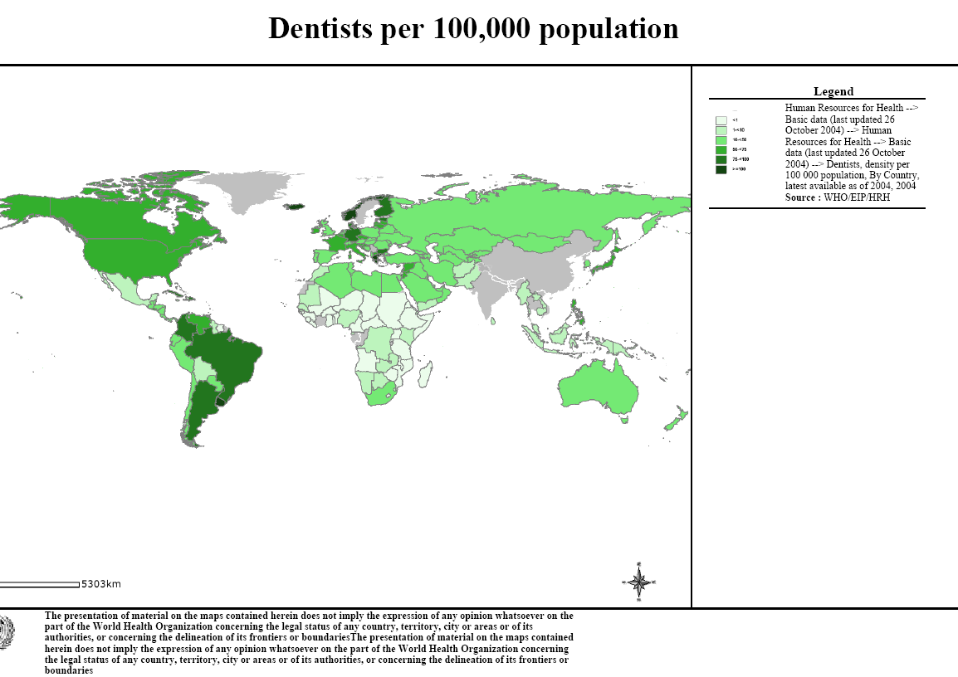

Human Resources for Health - Basic data

Slide 115
Country | Dentist per 1 lakhs population | Population per dentist
Sweden | 143 | 700
Finland | 98 | 1024
Denmark | 92 | 1090
Norway | 91 | 1100
Argentina | 83 | 1200
France | 72 | 1390
Switzerland | 62 | 1613
USA | 55 | 1810
Canada | 54 | 1834
Spain | 40 | 2525
Singapore | 29 | 3500
Turkey | 21 | 4668
Thailand | 10 | 9800
India | 3 | 36,538
Cameroon | 1 | 119,200
Ethiopia | <1 | 1,200,000

Slide 116
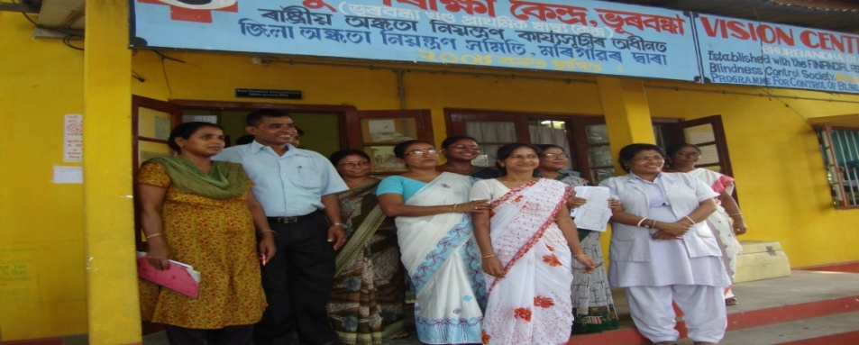
Existing Health Infrastructure
Health services in rural areas are administered through the primary health centers (PHC), one in each block.
The PHC occupies a key position in the nation’s health care system; it aims to provide comprehensive (Preventive, Promotive, Curative) health care services to the people living in a defined geographical area of 100-200 square miles.

Slide 117
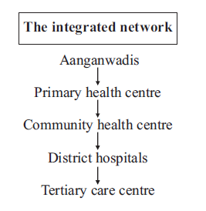
Existing Health Infrastructure
COMMUNITY HEALTH
CENTRE – 4,400
80,000-1,20,000
Each PHC further has eight to ten subcenters, each responsible for providing health services to 3,000-5,000 people; there are 1, 46,026 such subcenters.
PRIMARY HEALTH
CENTRE – 23,730
30,000
SUB CENTRE- 1, 46,026
5000
VILLAGE
LEVEL
LOCAL
DAIS
VILLAGE
HEALTH
GUIDES
ANGANWADI
WORKERS
WORKER

Slide 118
Existing Health Infrastructure
In 1996, there were a total of 1,043 dentists posted at the PHC level in different rural areas.
Thus, not even 20 percent of the existing primary health centers in India have the services of a dentist available for the population.
Also, there are no set criteria for posting a dentist at the PHC level in rural areas around the country.

Slide 119


National Health Expenditure
India’s overall health spending as a percentage of GDP 4.9%
As 80% of this is on salaries, there is little for other medical conditions.
Notes:
is substantially high when compared to other developing nations.
As a percentage of GDP, India’s public
expenditure (Central Budgetary Allocation)
on health is about 1.0% of GDP as
compared to an average of 2.2% of GDP
in other developing nations.

Slide 120

National Health Expenditure
The irony of the budget allocation in India is that, out of the total budget, the amount that is dedicated to health expenditure is very less, and out of this amount only a minute percentage is allocated for oral health-related activities.
In fact, there is no specific separate allocation for oral health in the Indian budget.

Slide 121
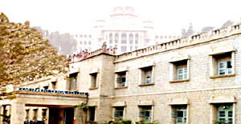
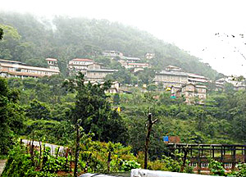
ORAL HEALTH CARE SYSTEM IN INDIA
Government organizations
  a. Government Dental Colleges
  b. Government Medical colleges with dental wing
  c. District Hospitals with Dental Unit
  d. Community Health Centers
  e. Primary Health Centers - Dental units
2. Non-governmental
  a. Private Dental Colleges
  b. Private Medical Colleges with Dental Wing
  c. Corporate Hospitals with Dental Units

Slide 122
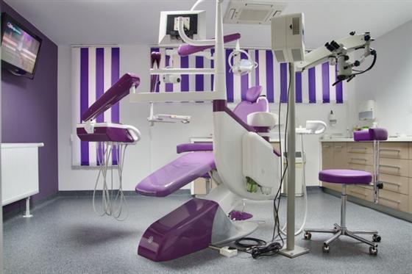

ORAL HEALTH CARE SYSTEM IN INDIA
3. Private practitioners
a. Private dental practitioners
b. Private dental hospitals
c. Private medical hospitals with dental units
4. Indigenous systems organizations
a. Ayurveda
b. Sidda
c. Unani
d. Homeopathy

Slide 123




ORAL HEALTH CARE SYSTEM IN INDIA
5. Voluntary organizations
  NGOs
  State IDAs
  Colgate palmolive
  Rotary clubs
  Local authorities, etc.
Notes:
National oral health programme: The proposed Oral Health Care Programme envisages three pronged implementation strategies of; Oral Health Education, Preventive Programme and Curative Service Programme at various levels of primary, secondary and tertiary health care delivery services.

Slide 124
UTILIZATION OF MANPOWER IN DENTAL INSTITUTIONS
The manpower mainly identified as main resource for Dental Public health Measures in Dental Institutions
  1. Dental Teaching Faculty
  2. Dental Interns
  3. Dental Students during III and Final Year BDS
  4. Dental Auxiliaries (Hygienists, Health Workers etc.)

Slide 125
Dental Teaching Faculty
The faculty from Dental Institutions can perform in 3 different ways.
A. Administrative, planning and supervisory
B. Role playing
C. Monitoring and evaluation
Notes:
to develop strategies for the oral health primary prevention activities to be conducted in the adopted areas training health workers

Slide 126
Dental Interns
Internship period may be used as true field training
Conducting an awareness campaign for smaller population
Topical fluoride and pit and fissure sealants, Atraumatic restorative technique (ART)
Safe drinking water program in a fluoride endemic area

Slide 127
Dental Students
Oral health talks
Diet counseling
Helping the interns and faculty in various tasks
Exposure to community activities like vaccination, health talks, ante-natal clinics and dental health care facilities in the rural areas.

Slide 128
Dental Auxiliaries
Regular component of the teams
Oral prophylaxis, topical fluoride application and pit and fissure sealant application
Role of Dental Council of India /Govt of India
Frame policies and strategies for oral health promotion.

Slide 129
RECOMMENDATIONS
Adoption of an area is the best option for providing oral health services
Adopting PHCs in the rural areas as well as schools, old age homes, schools for children with special needs, orphanages and homes for women in distress etc in the district and providing services at least once a week
Expose the students to primary health care and rural situation

Slide 130
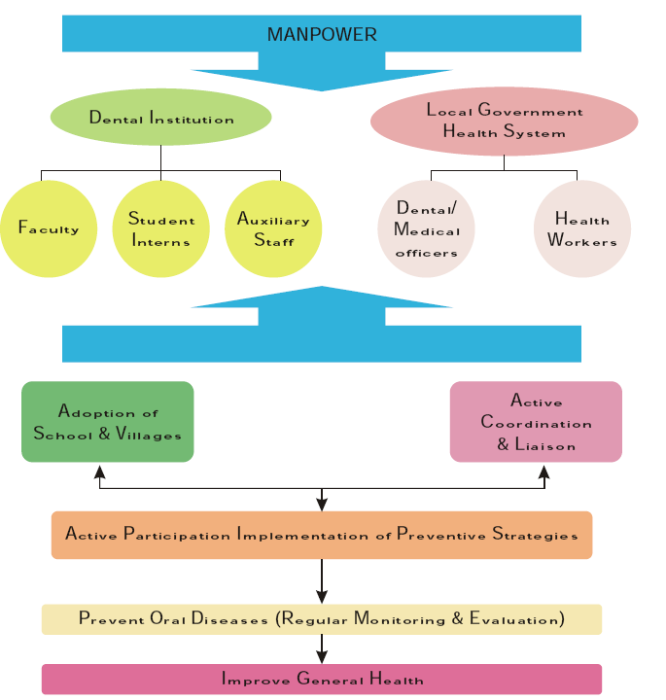
Notes:
Utilization of manpower

Slide 131

National oral health care program implementation strategies
MAN POWER REQUIREMENT
District Dental Clinic (With Dental X-Ray and Laboratory
  Chief Medical Officer (Dental) 1
  Medical Officer (Dental) 5
  (Preferably all 6 above should have MDS qualification in different specialties)
  Dental Technician 2
  Dental Hygienists 2
  Chair-side Assistants 6
  Staff Nurse 2
  Dental instrument Mechanic 1

Slide 132
National oral health care program implementation strategies
MAN POWER REQUIREMENT
Dental clinic in 100 & above bedded hospital other than district hospital (with dental x-ray and laboratory)
  Chief Medical Officer (Dental) (With MDS qualification) 1
  Sr. Medical Officer (Dental) 3
  Dental Technician 1
  Dental Hygienist 1
  Chair-side Assistant 4

Slide 133
National oral health care program implementation strategies
MAN POWER REQUIREMENT
Sub-Divisional Dental Clinic
  Medical Officer (Dental) 2
  Dental Hygienist 1
  Chair-side Assistant 2
District School Health Clinic
  Senior Medical Officer (Dental) 1
  Chair-side Assistant 1
Mobile Dental Clinic
  (One for each district along with garage)

Slide 134
National oral health care program implementation strategies
MAN POWER REQUIREMENT
Community Health Centre Dental Clinic
(With X-Ray and Dental Laboratory)
  Senior Medical Officer (Dental) 1
  (Preferably With MDS qualification)
  Medical Officer (Dental) 1
  Dental Hygienist 1
  Dental Technician 1
  Chair Side Assistant 1

Slide 135
National oral health care program implementation strategies
MAN POWER REQUIREMENT
Primary Health Centre Dental Clinic
  Sr. Medical Officer (Dental ) 1
  Chair-side Assistant 1
Sub-Centers
  Multipurpose Health Worker (MHWs) after suitable training, should function for
      1. Prevention of Oral Diseases
      2. Oral Health Education
      3. Relief from Pain
      4. Referral to a dentist

Slide 136
National oral health care program implementation strategies
MAN POWER REQUIREMENT
Village Level Centre
Anganwadi workers be trained for
    Educating for Prevention of oral health diseases.
    Promotion of oral health care in mother and child.
Special primary school check up
Model dental clinics

Slide 137
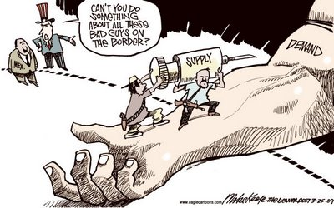
Models for Assessing Dental Manpower
Supply and Demand Model
  Most commonly used method
  Often implemented for political reasons
  STEPS:
    Indices of demand are constructed based upon the utilization rates by age, sex, occupation
    The dentist: population ratio is projected at a given date
    Then assumptions are made on the increase in numbers of dental visits to be made per year
Notes:
Depending upon the social philosophy towards dental health care :
Based upon reduction in the financial barriers and increase in percapita income and education.

Slide 138

2. Function Analysis Model:
Based on the assumptions of supply demand and on cost benefit methods
Involves matching qualifications of dental health personnel to the requirements of 'job performance‘
E.g. training and use of school dental nurses in New Zealand

Slide 139
3. Target Setting Approach Model
  Concentrates on identifying deficiencies in health service system
  Fluoridation of water and reduction in refined sucrose consumption
  Reduction in manpower required to treat dental caries
  Reduction in cost of dental services

Slide 140

Findall Three- phased Model 1968
Findall (1968) has suggested a three-phased program to estimate manpower requirements:
First phase
  Training a minimal corps of dedicated dentists
  Main task must be to act as a teacher, organizer and supervisor to a team of auxiliaries
  Strengthening of departments of Community Dentistry in dental colleges

Slide 141
Findall (1968) - three-phased program to estimate manpower requirements:
Second phase
  Increase number of dentists, but start training existing paramedical and auxiliary health personnel
Third phase
  Improve quality of service and train specific group of dental auxiliaries

Slide 142



Governing Bodies for Dental Manpower
IDA is promoting oral health in India through education, patient awareness and advocacy work across the country.
The Dental Council of India lays down Regulations and Curriculum for the various Courses in Dentistry such as M.D.S, B.D.S, Dental Hygienists, and Dental Mechanics; and to ensure uniformity and maintain standard of dental education in the country
Dental Council of India (March,1949)
Indian Dental Association (1946)
Ministry of Health and Family Welfare
Its key role is the formulation of the policies and programmes for healthcare.
WWW. childhealthfoundation.net
Notes:
DCI constituted by act The Dentist’s Act 1948, came into existence in March, 1949.
IDA The All India Dental Association became IDA in 1946. State branches - 29 and Local branches – 250

Slide 143
Dental Manpower In India
Notes:
Impact of auxiliaries in Indian scenario

Slide 144
India is the second most populated country in the world.
However, more than 70% of the people of India are residing in the villages.
As, far as dentists and their availability is concerned to this huge population, the demand and supply ratio is far inadequate and insufficient.
The dentists: population ratio of India, on date is 1: 10,000. However, the reality is that; in rural India 1 dentist is serving over a population of 2,50,000.
Ahuja NK, Parmar R. Demographics & Current Scenario with Respect to Dentists, Dental Institutions & Dental Practices in India. Indian Journal of Dental Sciences. June 2011 ; 3 (2) : 8-11.

Slide 145
Dental Auxiliaries:
In 1990 there were 3,000 registered hygienists and 5,000 lab technicians. i.e. 1 hygienist for 7 dentists where as the ratio should be 1:1. There were no registered dental nurses or chair side assistants and denturists.

Slide 146
Dental Colleges / Institutions In India
The numbers of Dental Colleges in the country have increased from three at the time of independence (1947) to 39 in 1980 to 301 in year 2014.
Correspondingly, the number of Dental Surgeons in the country has also increased from hundreds to now nearing 80,000.
There is about 3.5 times increase in the population since then and number of dentists has increased to more than 3000 times.

Slide 147
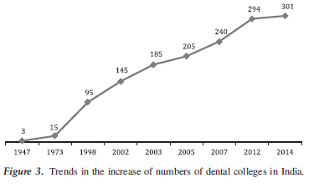

Slide 148
Dental Manpower in India
Trends in Dental Education in India
There has been sudden increase in number of dental institutions in the country, however the growth is not uniform in Government and Private Sectors.
Presently only 13% of the dental institutions are owned by the Govt. as compared to 77% in 1980's.
This change in proportion has also decreased the participation of dental institutions in the national health system.

Slide 149
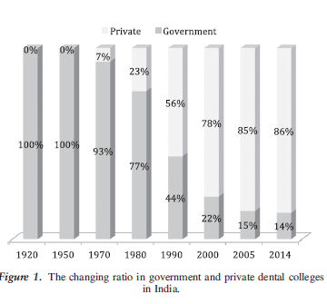

Slide 150
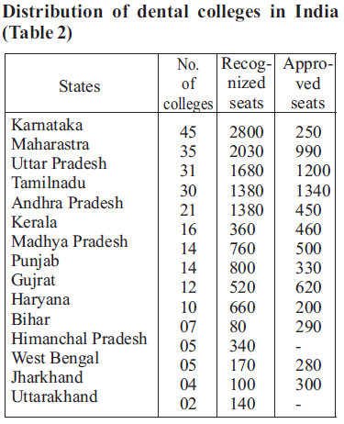

Slide 152
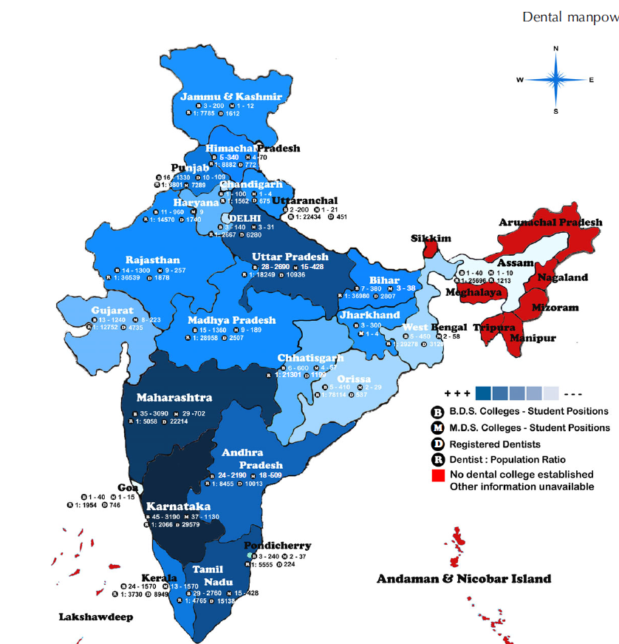
Map showing details of dental manpower of India

Slide 153
Dental Manpower in India
Number of Dental Professionals
The number of Dental Surgeons registered with Dental Council have also increased multi fold over past 3 decades
In addition, there are about 3,856 paradental professionals (Dental Hygienists and Technicians) in the country.

Slide 154
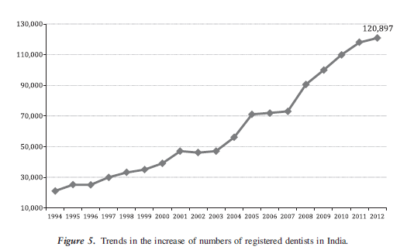
Dental Manpower in India

Slide 155
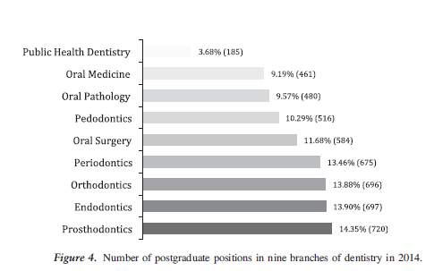

Slide 156
Challenges in Indian scenario
Numerous challenges exist for expanding oral health care in India.
The biggest challenge is the need for dental health planners with relevant qualifications and training in public health dentistry.

Slide 157
There is a serious lack of authentic and valid data for assessment of community demands, as well as the lack of an organized system for monitoring oral health care services need to guide planners.
Another important challenge is to produce a high-quality workforce for future generations

Slide 158
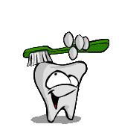
Conclusion
Health manpower is an important aspect of community health planning
Includes both professional and auxiliary health personnel
Requirements are based on health needs and demands of the population
Desired outputs

Slide 159
Previous Year Asked Questions
Dental Manpower - Sumandeep University (April 2012, 10 M)
Describe in detail about dental manpower in India – RGUHS –
( Nov 2011 ,20 M)
Dental Manpower utilization strategies - Manipal University
( April 2010, 7 M)
Notes:
Effective utilization of manpower in primary prevention of oral diseases – Sumandeep University ( December 2009, 20M)

Slide 160
Write in detail about dental manpower – NTR University
( April 2010, 25 M)
Dental Manpower planning in India ( May 2011,75 M)
Dental Manpower in India – RGUHS ( Sep 2007, 10 M)

Slide 161
References
Dunning JM. Principles of dental public health. Harvard University Press. 1986; 4th edition.
Slack GL. Dental public health – An intoduction to community dentistry. 1981: John Wright & Sons Ltd: Briston.
Peter S. Essentials of preventive community dentistry. Arya Publishing House. 2009. 4th edition.
Vundavalli S. Dental manpower planning in India: current scenario and future projections for the year 2020. International Dental Journal 2013. © 2013 FDI World Dental Federation.
Notes:
Health manpower planning by Hall T.L and Meija A, WHO, 1978

Slide 162
References
Sumit et al. Oral Health Care Delivery Systems In India: An Overview . International Journal of Basic and Applied Medical Sciences . 2013 ; 3 (2):171-178.
Jaiswal AK, Srinivas P, Suresh S. Dental manpower in India: changing trends since 1920. International Dental Journal. © 2014 FDI World Dental Federation.
Ahuja NK, Parmar R. Demographics & Current Scenario with Respect to Dentists, Dental Institutions & Dental Practices in India. Indian Journal of Dental Sciences. June 2011 ; 3 (2) : 8-11.
National Health Profile 2013

Slide 163

Thank You

