Slide 1
DEVELOPMENT OF OCCLUSION

Slide 2
Contents:
Introduction
Stages of Tooth Development
Eruption of Tooth
Theories of Eruption of Tooth
Development of Dentition
Stages of Development of Dentition
The Six Keys To Normal Occlusion
Conclusion
References

Slide 3
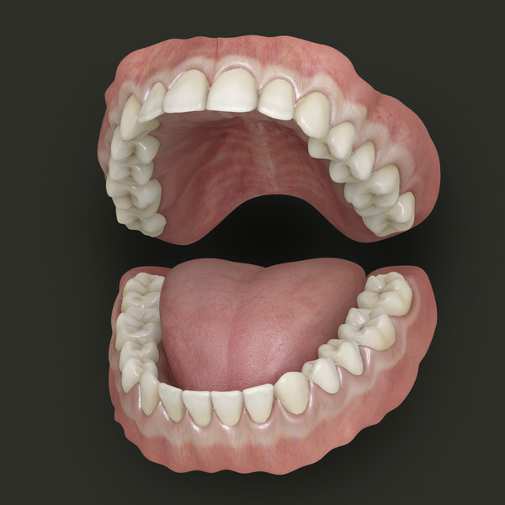
Introduction:
The oral cavity contains a variety of soft and hard tissues.
The soft tissues include the lining mucosa of the mouth and salivary gland.
The hard tissues are the bones of the jaws and the tooth.
The term dentition is used to describe the natural teeth in the jaw bones.

Slide 4
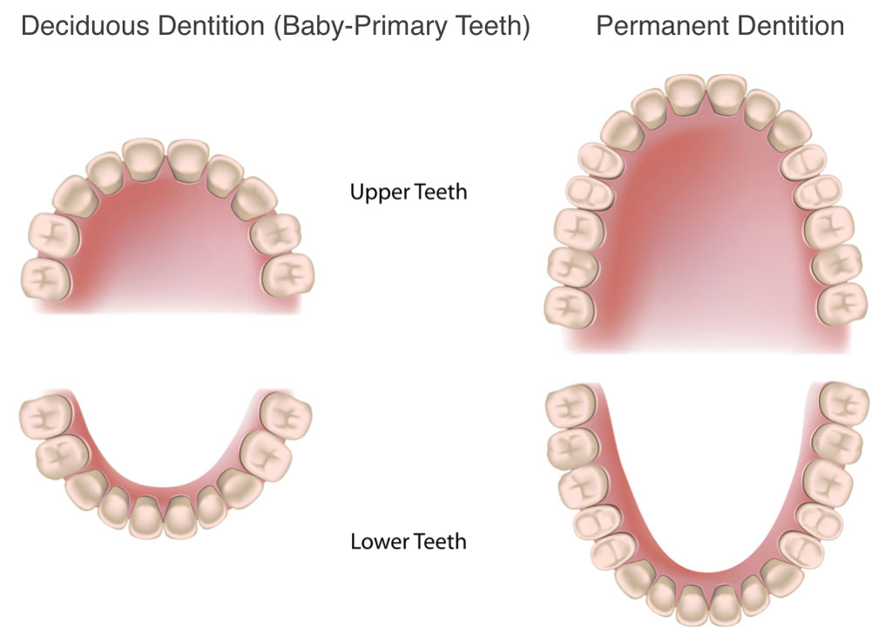
Humans have two sets of teeth in their lifetime.
The first set of teeth to be seen in the mouth is the Primary or Deciduous dentition, which begins to form prenatally at about 14 weeks in utero and is completed postnatally at about 3 years of age and second set of teeth is Permanent or succedaneous dentition.

Slide 5
Formulae for Mammaliam Teeth:
The dental formula for Primary/ deciduous dentition:
I 2/2 C 1/1 M 2/2 =10
The dental formula for Permanent dentition:
I 2/2 C1/1 P 2/2 M3/3 =16

Slide 6
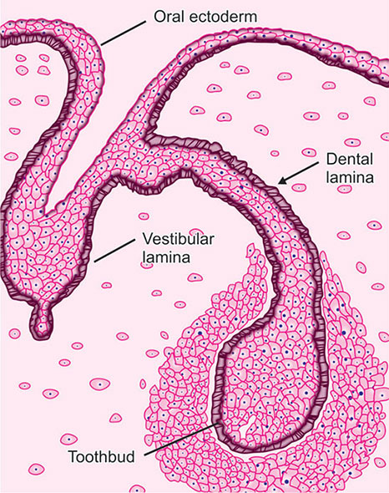
Dental Lamina:
Odontogenesis occurs in the 6th week of intrauterine life with the formation of primary epithelial band.
At about 7th week primary epithelial band divides into lingual process called dental lamina and buccal process called vestibular lamina.

Slide 7
Odontogenic cells continue to proliferate forming ovoid swellings called enamel organs in the areas where teeth are going to form.
All the deciduous teeth arise from this dental lamina, permanent successors arise from its lingual extension while permanent molars from its distal extension.

Slide 8
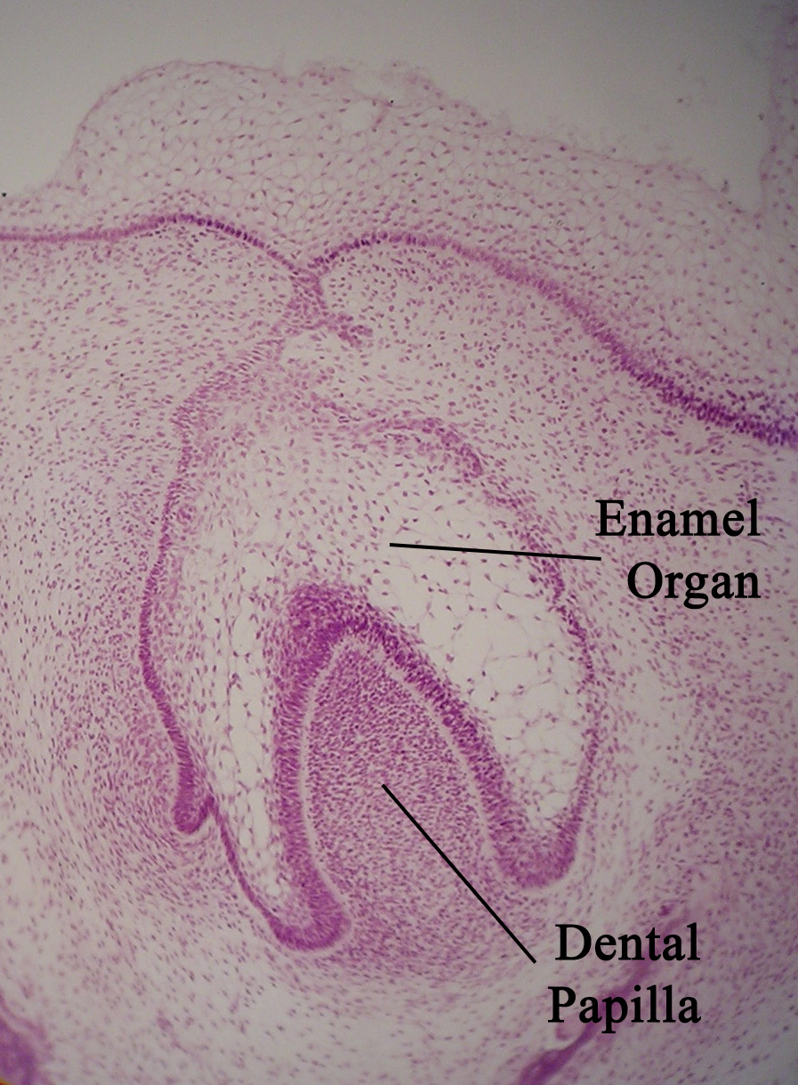
Enamel organ:
The ectoderm in certain areas of dental lamina proliferates and forms knob like structures that grow into underlying mesenchyme.
Each of these knobs represent a deciduous tooth and is called the enamel organ.

Slide 9
Stages Of Tooth Development:
Tooth development is continuous process, the developmental history of tooth is divided into several morphologic stages.
Stages are named after the shape of enamel organ ;
1. Bud stage
2. Cap stage
3. Bell stage
4. Advanced Bell stage

Slide 10
1. Bud Stage:
In this stage there is formation of dental papilla and dental sac.
Peripheral cells: Low columnar cells
Central cells: Polygonal cells

Slide 11
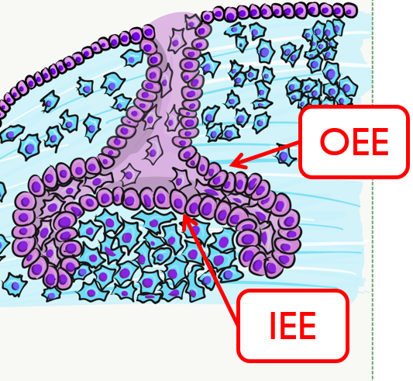
2. Cap Stage:
Stage is characterized by formation of enamel knot, enamel cord and enamel septa.
Three layers are formed Outer enamel epithelium, Stellate reticulum, Inner enamel epithelium.
Stellate reticulum acts as a shock absorber that protect the delicate enamel forming cells.

Slide 12
3. Bell Stage:
In this stage, the crown shape is determined.
Four layers are seen in this stage; Outer enamel epithelium, stellate reticulum, stratum intermedium, inner enamel epithelium.
Stratum intermedium is rich in glycogen so helps in enamel formation.
The junction of inner enamel epithelium and outer enamel epithelium is called cervical loop which marks the future CEJ.

Slide 13
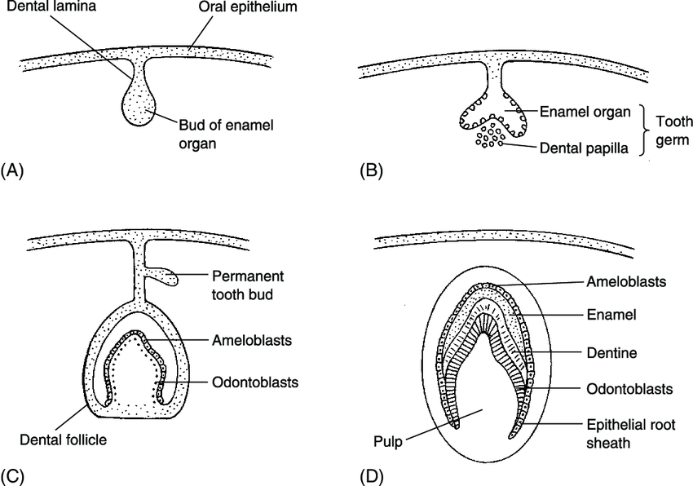

Slide 14
4. Advanced Bell Stage:
There is Commencement of mineralization and root formation.
There is formation of future DEJ.
Cervical portion of enamel organ gives rise to HERS, which molds the shape of roots and initiates radicular dentin formation.
The differentiation of odontoblasts and the formation of dentin follow the lengthening of root sheath.

Slide 15
Inner enamel epithelium → ameloblasts → enamel
Dental Papilla →odontoblast →dentin
Outer enamel epithelium → capillary network
Dental sac → periodontal ligament
The junction between inner and outer enamel epithelium and odontoblast → dentinoenamel junction.

Slide 16
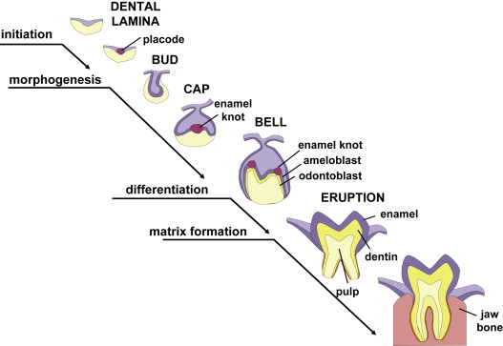
An analysis of successive stages of growth of the tooth germ can also be organized and studied under the following headings:
1. Initiation
2. Proliferation
3. histodifferentiation
4. Morphodifferentiation
5. Apposition

Slide 17
1. Initiation:
The initiation stage is first observed in six weeks old fetus.
Recognized by the initial expansion of basal layer of oral cavity immediately above the basement membrane.
Initiation of the entire deciduous dentition occurs during 2nd month in utero.
Initiation of the entire permanent dentition starts from 5th month in utero.
Initiation of the 1st permanent molar occurs at 4 months in utero.
Initiation of the 2nd permanent molar at 1 year.
Initiation of the 3rd permanent molar occurs at 4 to 5 year.

Slide 18
2. Proliferation:
Further multiplication of the cells of the initiation stage and an expansion of the tooth bud which results in the formation of the tooth germ in the form of a cap.
Any problem in the first two stages leads to Anodontia.

Slide 19
3. Histodifferentiation:
This stage is marked by the histological difference in the appearance of the cells of the tooth germ as they begin to specialize.
The tooth germ assumes the shape of bell in this stage.
With the formation of dentin, the cells of the inner enamel epithelium differentiate into ameloblasts and enamel matrix is formed opposite the dentin.

Slide 20
4. Morphodifferentiation:
It is the stage at which the cells find an arrangement that ultimately dictates the final size and shape of tooth.
It coordinates with advanced bell stage.
Problem in this stage leads to abnormalities in size and shape of teeth.

Slide 21
5. Apposition:
It is the deposition of the matrix of the hard dental structure.
It is the fulfillment of the plans outlined at the stages of histodifferentiation and morphodifferentiation.
Characterized by the regular and rhythmic deposition of extracellular matrix, which is of itself incapable of further growth.
This accounts for the layered appearance of enamel and dentin.

Slide 22
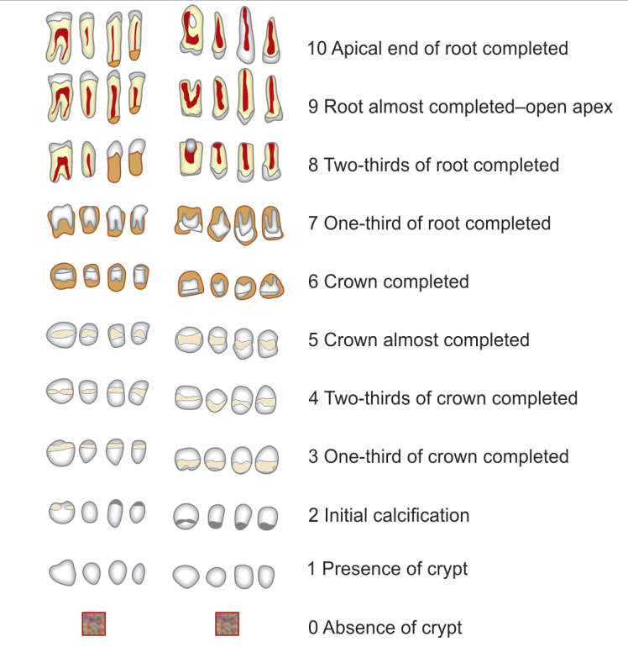
Nolla’s Stages of Tooth Development

Slide 23
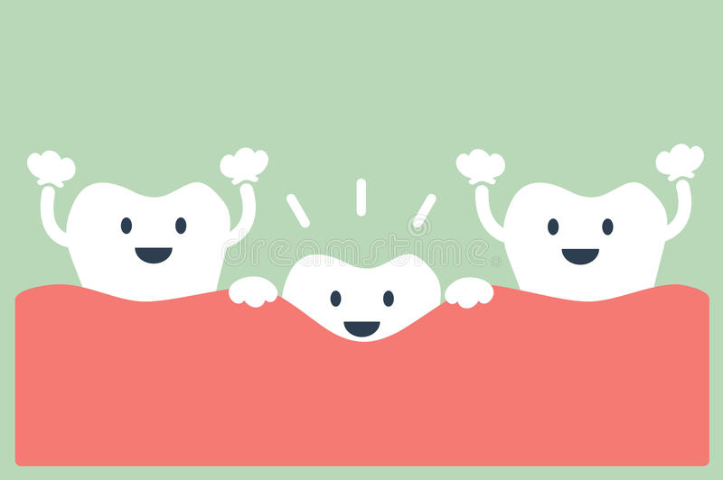
Eruption of Tooth:
Eruption ( Latin word erumpere = to break out)
Tooth eruption is complex series of events occurring in a continuous process to move the teeth in a three dimensional space.
It is a developmental process and can be defined as, “axial or occlusal movement of the tooth from its developmental position within the alveolar crypt in the jaw to its functional position in the occlusal plane within the oral cavity.”

Slide 24
The entire process of tooth eruption may generally be described as follows:
Pre- eruptive tooth movement
Eruptive tooth movement
Post-eruptive tooth movement

Slide 25
1. Pre-eruptive tooth movement:
Movements made by deciduous and permanent tooth germs within the tissues of the jaw before they begin to erupt.
Tooth root begins its formation and begins to move toward the surface of the oral cavity from its bony vault.
Two processes are necessary :
1)There must be resorption of bone and primary tooth roots overlying the crown of the erupting tooth.
2)The eruption mechanism itself then must move the tooth in the direction where the path has been cleared.

Slide 26
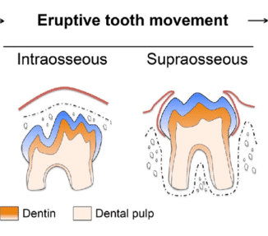
2. Eruptive Tooth Movement:
Made by the tooth to move from its position within the bone of the jaw to its functional position in occlusion.
This phase is divided into Intraosseous and Extraosseous components.

Slide 27
The term Prefunctional eruptive tooth movement is used to describe the movement of the tooth after its appearance in the oral cavity till it attains the functional position.
It includes, the formation of the roots, the periodontal ligament, and dentogingival junction.

Slide 28
3. Post-Eruptive Tooth Movement:
This occurs after the tooth has reached its functional position in occlusion.
Post-eruptive tooth movements are:
Movements made to compensate for the continuous occlusal wear.
Movements made to compensate interproximal wear.
Movements to accommodate growing jaws.
The movements compensating for occlusal and proximal wear continue throughout life and consist of axial and mesial migration, respectively.

Slide 29
When the tooth is in bony crypt, rate of eruption is about 1µ per day.
When the tooth comes out of the socket, eruption increases to 7.5µ and after appearance in oral cavity, the eruption rate accelerates to 1mm per day.
The final position of teeth in the oral cavity is determined by the pressure exerted by tongue, cheeks, lips and teeth which have come in contact.

Slide 30
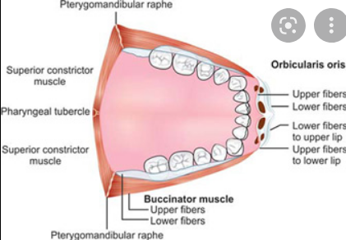
Buccinator Mechanism:
Starting with the decussating fibers of the orbicularis oris the buccinator runs laterally and posteriorly around the corner of mouth it inserts into the pterygomandibular raphe just behind the dentition.
Here it mingles with fibers of superior constrictor which attaches to the pharyngeal tubercle of occipital bone.

Slide 31
Thus completely encircling the face.
The teeth and the supporting structures are continuously under influence of contagious musculature buccinator and lips on other side.

Slide 32
Role of buccinator mechanism:
The integrity of the dental arches and the relationship of the teeth to each other within each arch and with opposing members are result of morphogenetic factors as modified by stabilizing and active function forces of muscle on the tongue on one side and lips and cheek on other side.
If cheek is destroyed the teeth begin to move outwards under the unopposed pressure from the tongue.

Slide 33
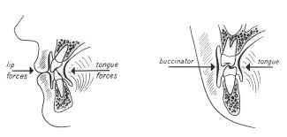

Slide 34
Post-emergent eruption consists of three stages:
Post-emergent spurt: This is the phase where there is rapid tooth movement after the tooth penetrates the gingiva till it reaches the occlusal level
Juvenile Occlusal Equilibrium: This is slow process, during which teeth erupt to compensate for the vertical growth of the mandibular ramus.
Adult Occlusal Equilibrium: Final phase of tooth eruption. Occurs after the pubertal growth spurt ends.
-Tooth continuous to erupt when its antagonist is lost and also because of wear of the tooth structure.

Slide 35
Theories of Tooth Eruption:
The mechanism that brings about tooth movement is still debatable and is likely to be a combination of number of factors.
Four theories merit serious consideration:
Bone remodeling theory
Root formation theory
Vascular pressure theory
Periodontal ligament traction theory

Slide 36
1. Bone Remodeling Theory:
This theory states selective bone formation and resorption which occurs, is the cause for tooth eruption.
If the tooth germ is removed experimentally and dental follicle is left intact, an eruptive pathway forms in the overlying bone.
If silicone replica is substituted for the tooth germ, it also erupts.
If dental follicle is removed, no eruptive pathway forms.
It is the follicle that provides the source for new bone-forming cells and for osteoclasts.

Slide 37
2. Root Formation Theory:
Root formation would appear to be the most obvious cause of tooth eruption since it undoubtedly causes an overall increase in length of tooth along with the crown moving occlusally.
Some experimental studies are strongly against such conclusion as rootless teeth have been found to erupt.
This is most obvious in Dentin dysplasia type 1 and following irradiation.

Slide 38
The advocates of this theory postulated the existence of Cushion- hammock ligament, straddling the base of the socket from one bony wall to other like a sling.
Its function was to provide fixed base to growing root.
But this structure is actually a pulp-delineating membrane that runs across the apex of the tooth and has no bony insertion, so it can not act as a fixed base.
For instance, some teeth move distance greater than the length of their roots, and eruptive tooth movement can occur even after completion of root formation.

Slide 39
3. Vascular Pressure Theory:
It is known that the teeth move in their sockets in synchrony with the arterial pulse, so local volume changes can produce limited tooth movement.
Spontaneous changes in blood pressure have been shown to influence eruptive behavior.
Ground substance can swell from 30% to 50% by retaining additional water, so this also could create pressure.

Slide 40
But experimental surgical excision of the growing root and associated tissues which eliminates the periapical vasculature did not prevent or stop the eruption.
This means that vascular pressure can play an important role by generating eruptive force but they are not absolutely necessary for tooth eruption.

Slide 41
4. Periodontal Ligament Traction Theory And The Role Of Dental Follicle :
It states that the fibroblasts of the dental follicle by their contraction can generate a force, which can pull the teeth in occlusion.
Fibroblasts have their processes attached to collagen fibers by a sticky protein called Fibronectin as the processes are in contact with each other it produces a summative force for eruption.
Experiments in which roots have transected and metallic barrier was placed showed distal fragment of tooth erupted, this is because the attachment of dental follicle to the fragment.

Slide 42
The dental follicle plays important role in eruption.
It produces factor for promoting osteoclastic bone resorption in the coronal part and by promoting bone formation in the apical part.
Dental follicle cells secrete MCP-1 (monocyte chemotactic proteins-1), CSF-1 (colony stimulating factor-1), which promotes osteoclast formation.
According this theory, eruption could be brought about by combination of events involving a force initiated by the fibroblast.

Slide 43
Factors Affecting Eruption Of Teeth:
The factors which affect tooth eruption can be grossly divided into two major categories:
1. Local factors
2. Systemic factors
Local Factors:
Physical obstruction-
Supernumerary teeth
Odontogenic and non-odontogenic tumours
Mucosal barrier

Slide 44
Injuries to deciduous teeth:
Premature loss of primary teeth
Dilacerations
Ankylosis
Delayed root resorption
Carious primary teeth
Impacted Primary teeth
Arch length deficiency
Oral clefts

Slide 45
2. Systemic Factors:
Nutrition
Hormonal influences
Cerebral Palsy
HIV infection
Anemia
Low birth weight
Long term chemotherapy
Tobacco, smoking
Genetic influence

Slide 46
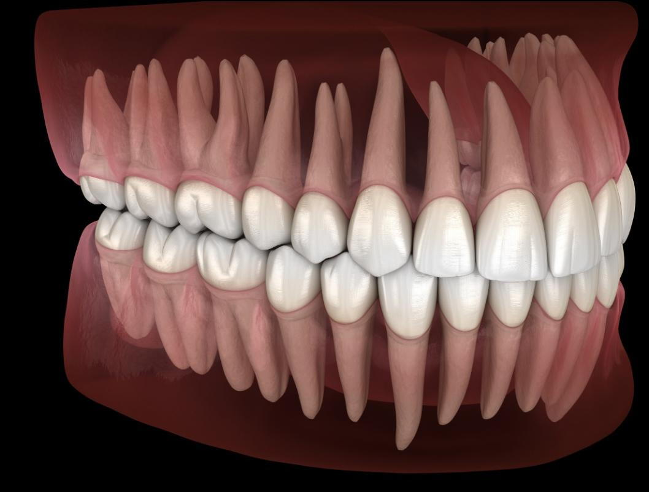
Development of Occlusion:
Occlusion usually means the contact relationship in function.
Salzmann has defined occlusion as “the changing inter-relationship of the opposing surfaces of the maxillary and mandibular teeth which occurs during movements of mandible and terminal full contact of maxillary and mandibular arches.”
It is sum total of many factors like genetic and environmental factors, muscular pressure, changes with development, maturity, ageing.

Slide 47
Periods of Dental Development:
Stages of occlusion development are:
1. Predental stage or mouth of neonate (0-6 months)
2. Deciduous dentition (6months-6years)
3. Mixed dentition stage (6-12 years)
-First transitional stage
-Intertransitional stage
-Second transitional stage
4. Permanent dentition

Slide 48
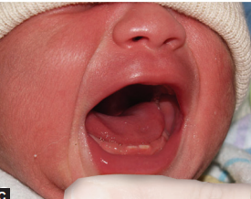
1. Mouth of Neonate/ Gum pads/ Pre-dentition stage(0-6 months)
The alveolar arches at the time of birth are called Gum Pads.
Basic form of arch is determined in the intrauterine life.
Leighton has outlined various factors that determine size of gum pads as follows:
The state of maturity of infant at birth
The size at birth as expressed by birth weight
Size of developing primary teeth
Genetic factors

Slide 49
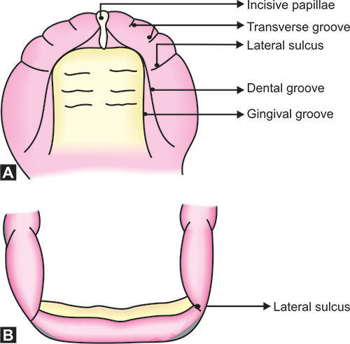
Maxillary arch is horse-shoe shaped, develop in two parts, labiobuccal and lingual.
Labiobuccal portion divided into 10 segments by transverse groove corresponding to deciduous tooth sac.

Slide 50
Groove between canine and deciduous first molar is called Lateral sulcus.
Labiobuccal and lingual portion is demarcated by Dental groove.
Gingival groove demarcates the palate from gum pads.

Slide 51
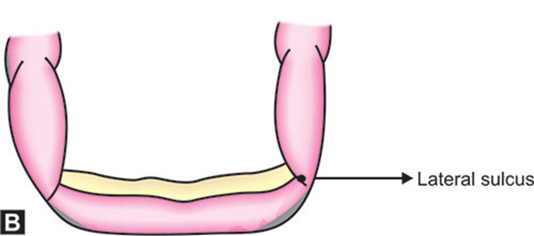
Mandibular gum pads are U shaped.
Anteriorly the lower gum pad is everted.
Gum pad is divided into 10 segments by transverse groove.
But these segments are less defined when compared to maxillary gum pads.

Slide 52
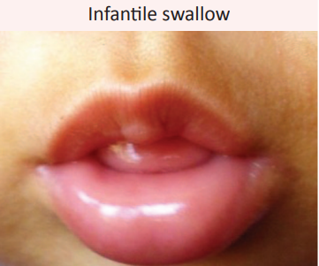
Relationship of the arches:
Gum pad relationship is arbitrary.
Upper lip appears short.
Tongue is interposed between lips.
Maxillary gum pad is wider and there is total overlapping transversally and Antero posteriorly.

Slide 53
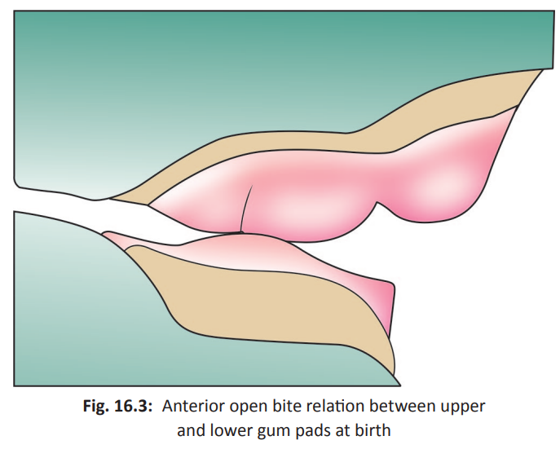
Retrognathic mandible seen
Anterior openbite is seen.
Contact mainly occur at molar region.
Infantile open bite is normal as it helps in suckling.

Slide 54
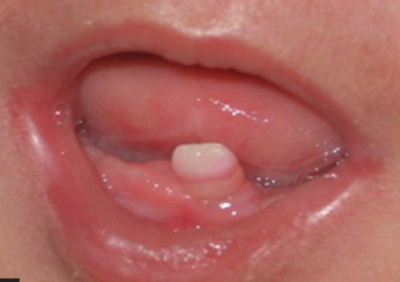
Clinical Considerations:
1. Natal Tooth:
Occasionally child will born with tooth present in mouth, this is called as ‘Natal Tooth’.
If teeth erupts during first month it is called ‘Neo-natal teeth’.
If teeth erupts during second or third month it is called as ‘Pre-erupted teeth’.
Notes:
Riga fede disease- characterized by ulceration on ventral surface of tongue or in the inner surface of lower lip due to trauma from erupted baby teeth.

Slide 55
CLINICAL FEATURES:
Normal or shell like structure.
Enamel hypoplasia
Occurs in pairs
No root growth
As root grows it becomes firmer
Ulceration of tongue-
RIGA-FEDE DISEASE

Slide 56
ETIOLOGY:
Superficial position of tooth germ
Infection or malnutrition
Febrile illness
Heredity
Hyper activity of dental lamina
Hypovitaminosis
Environmental factors
Common teeth (90-99% primary)
Mand. incisors > maxillary incisors > mand cuspid > molars

Slide 57
2.Delayed or Retarded Eruption:
It may be due to local or systemic factors.
Systemic factors includes nutritional deficiency, genetic and endocrinal deficiencies.
Local factors include early loss of deciduous teeth with drifting of adjacent teeth to block the eruptive pathway.
Some syndromic conditions in which delayed eruption of teeth seen are:
1. Cleidocranial dysplasia
2. Apert syndrome
3. Goltz syndrome
4. Hunter’s syndrome
5. Osteogenesis Imperfecta

Slide 58
3. Impaction of Teeth:
The white populations have shown evolutionary trend towards decreased jaw sizes with concomitant increase in incidence of dental crowding in jaws.
The third molars and to certain extent canines often impacted as they erupt later than the rest of the dentition.
As most of the space would already been occupied by teeth that erupted before them.

Slide 59
4. Primary Failure Of Eruption:
Condition wherein permanent teeth, especially molars will fail to erupt.
Familial history of eruption problems and hypodontia were identified in many cases.
Defects in genes like CSF-1, NFB, c-fos may be responsible for this condition.
Orthodontic treatment to force the eruption is generally unsuccessful.

Slide 60
5. Hyper eruption:
Term used to describe a condition wherein the loss of an opposing tooth has caused the tooth/ teeth to erupt to a greater than normal distance into space provided.

Slide 61
6. Teething:
The ‘breaking out’ of the tooth through the oral epithelium is often associated with an acute inflammatory response in the connective tissue adjacent to the erupting tooth.
The child will manifest symptoms of inflammation such as pain, mild fever, general malaise that are popularly called Teething.

Slide 62
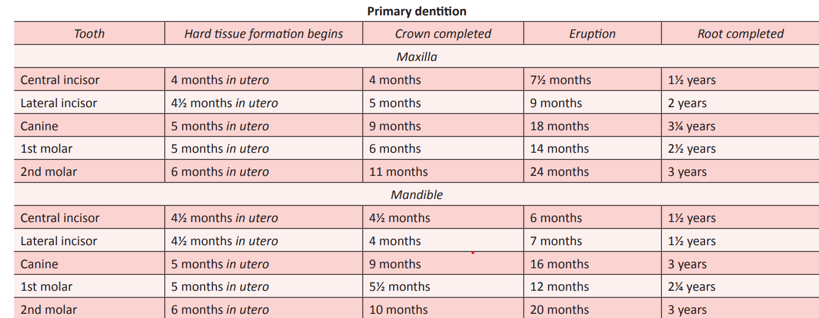
2. Primary Dentition Stage (6months- 6 years):

Slide 63
Features of deciduous dentition:
Ovoid dental arches.
Deep bite initially which changes to edge to edge relationship.
Developmental spaces present.
Flat curve of spee.
Shallow intercuspal contact.
Minimal overjet.
Absence of crowding

Slide 64
Features of deciduous occlusion:
Primary dentition in which spaces are present is called Spaced dentition or open dentition.
There are two types of spacing:
1. Physiologic/ developmental spacing and
2. Primate spaces.

Slide 65
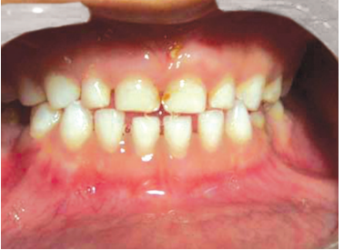
1. Developmental spaces :
Present throughout primary dentition
Reason for this space is the anteroposterior growth of jaws.
Developmental space is on an average 4mm in maxillary arch and 3 mm in mandibular arch.

Slide 66
2. Primate spaces:
Also called as Simian / Anthropoid spaces as it is seen in monkeys.
Present between deciduous lateral incisor and canine in the maxillary arch.
In the mandibular arch, it is present between primary canine and primary first molar.
These spaces are used in early mesial shift in mandibular arch.

Slide 67
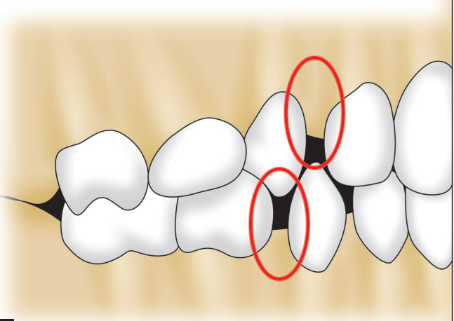
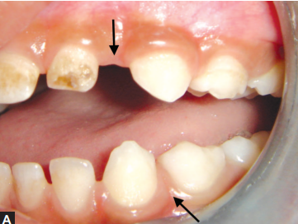

Slide 68
Deep bite:
When the primary incisors erupt, the overbite is deep.
This is due to vertical inclination of the primary incisors.
This deep bite reduces over the period of time because of two reasons:
Eruption of primary molars
Rapid attrition of incisors
Overjet:
Initially it is more.
Then it decreases with the movement of whole dental arch anteriorly.
Average overjet is 1-2 mm.

Slide 69
Terminal plane Relationship:
Baume’s classified primary teeth in occlusion based on the relationship of upper and lower primary second molar.
A line is drawn along the distal surface of maxillary and mandibular second primary molar.
It is classified into 3 categories:
Flush terminal plane – 76%
Mesial step -14%
Distal step -10%

Slide 70
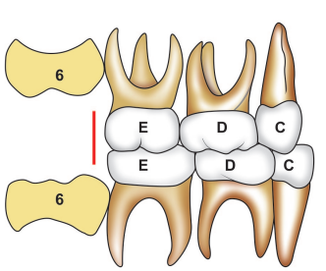
1. Flush Terminal Plane:
The distal surface of upper and lower second deciduous molars are in one vertical plane.
The permanent molars will erupt in flush or end on relationship.

Slide 71
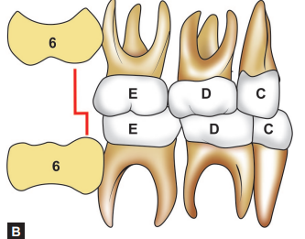
2. Mesial Step:
The distal surface of lower second deciduous molar is more mesial to that of upper second deciduous molar .
The permanent molars will erupt in Angle’s class-I occlusion.
Exaggerated mesial step of 2mm – the permanent molars will erupt in Angle’s class- III occlusion.

Slide 72
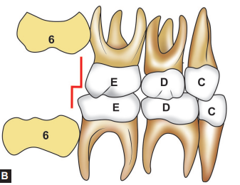
3. Distal Step:
The distal surface of lower second deciduous molar is distal to that of upper second deciduous molar.
The permanent molars will erupt in Angle’s class-II occlusion.

Slide 73
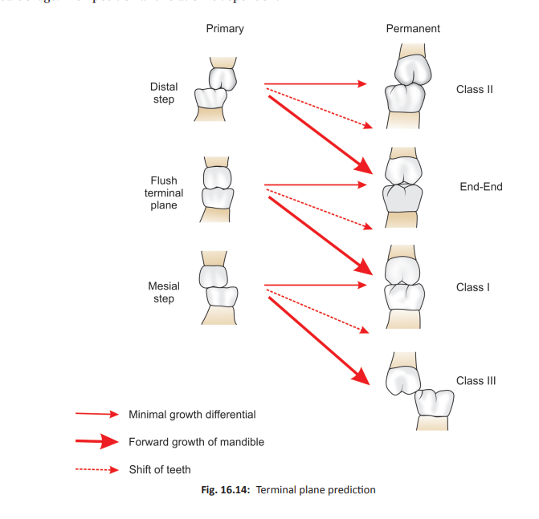

Slide 74
DEVELOPMENT OF OCCLUSION
PART 2
Presented by:
Pooja gopalghare

Slide 75
Contents:
Introduction
Stages of Tooth Development
Eruption of Tooth
Theories of Eruption of Tooth
Development of Dentition
Stages of Development of Dentition
The Six Keys To Normal Occlusion
Conclusion
References

Slide 76
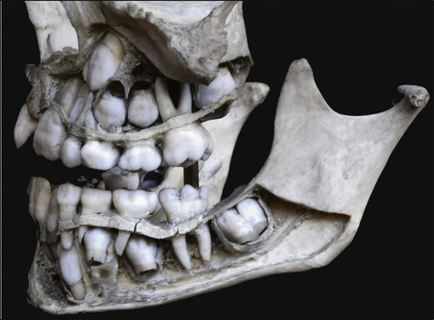
3. Mixed Dentition Stage:
Transition from primary dentition to permanent dentition begins at 6 years of age with eruption of permanent first molars and permanent incisors.
It is the period during which both primary and permanent dentition is present.
It is divided into three stages:
First Transitional
Intertransitional
Second Transitional
Notes:
Succesional and accessional teeth

Slide 77
A. First Transitional Stage:
It marks the first exchange of teeth which begins by 6 years of age and usually completes within 2 years.
Two important events takes place:
Eruption of first Permanent molars
Replacement of incisors

Slide 78
Eruption Of First Permanent Molars:
In patients with spaced dentition and flush terminal plane, when the permanent mandibular first molar erupts at about age of 6 years, they close the primate space distal to canine.
Thereby, flush terminal plane gets converted into Mesial step.
This leads to permanent maxillary first molar to erupt in Class – I Molar relationship.
This process is called Early Mesial Shift.

Slide 79
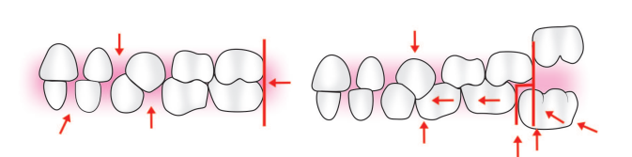

Slide 80
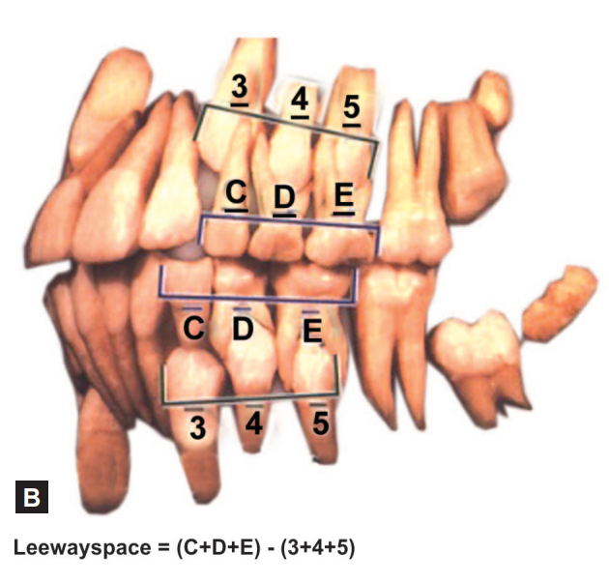
Late mesial shift:
Many children lack primate spaces and have a nonspaced dentition and thus erupting permanent molars are not able to establish Class I relation even as they erupt.
In these cases, the molars establish Class I relation by drifting mesially and utilizing the Leeway space after exfoliation of deciduous molars and this is called late mesial shift.
Notes:
2 deciduous molar mesial step- permanent molars class 1 relation
2 deciduous molar distal step – class 2 relation

Slide 81
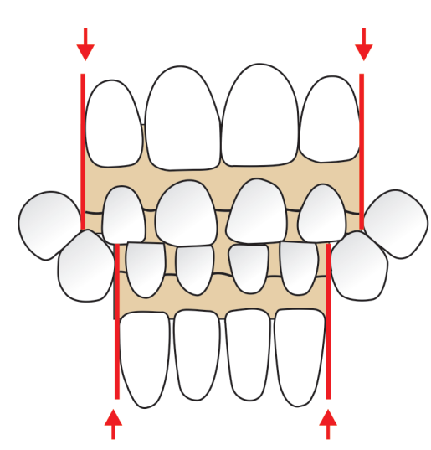
Exchange of incisors:
The deciduous incisors are replaced by permanent incisors during this phase.
This period of transition is from 6½ to 8½ years.
The permanent incisors are larger as compared to their primary counterparts and thus require more space for their alignment.
This difference between space available and space required is called the incisor liability.
This is 7 mm for maxillary arch and 5 mm for mandibular arch.

Slide 82
Some of the factors that help in alignment of incisors by gaining space are:
■ Utilization of interdental spacing of primary incisors:
-Averages 4 mm in the maxillary arch and 3 mm in the mandibular arch.
■ Increase in intercanine arch width:
-This occurs as the child grows. In males, it is 6 mm for maxilla and 4 mm for mandible whereas in females, it is 4.5 mm in maxilla and 4 mm in mandible.

Slide 83
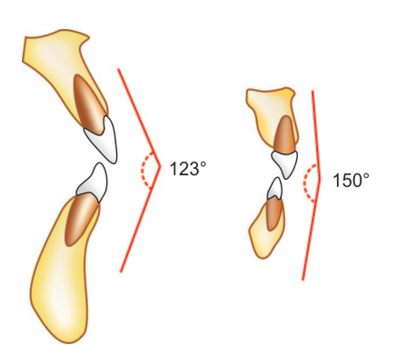
■ Increase in intercanine arch length:
-This is due to growth of jaws.
■ Change in interincisal angulations:
-The angle between the maxillary and mandibular incisors is about 150° in primary dentition, whereas it is about 123° in permanent dentition thus allowing more proclination and gaining space for incisor alignment.

Slide 84
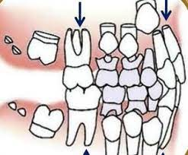
B. Intertransitional Period :
In this period, the maxillary and mandibular arches consist of permanent incisors and permanent molars that sandwich the deciduous canines and molars.
This phase lasts for 1½ years and is relatively stable.
Only a few changes in the morphology of deciduous teeth are seen because they undergo attrition.

Slide 85
C. Second Transitional Period:
This phase is characterized by replacement of deciduous molars and canines by premolars and permanent cuspids and the eruption of maxillary lateral incisors and canines.
This takes place around 9 to 11 years of age and is very critical for the alignment of the erupting permanent teeth.

Slide 86
Replacement of Deciduous Molars and Canine
The combined mesiodistal width of permanent canine and premolars is less than that of deciduous canine and molars. This extra space is called Leeway space of Nance and is utilized by mandibular molars to establish Class I relationship through late mesial shift.
It is 1.8 mm (0.9 mm on each side) in maxillary arch and 3.4 mm (1.7 mm on each side) in mandibular arch.

Slide 87
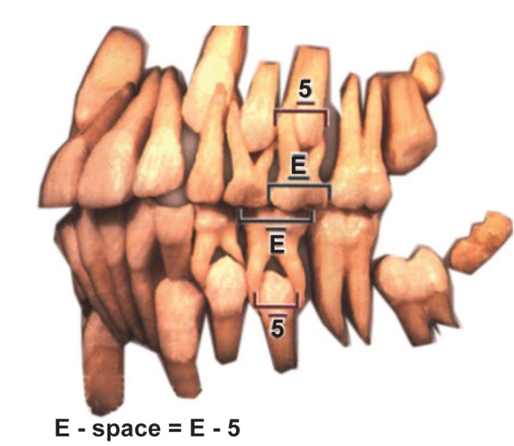
The dimensions of deciduous 2nd molars is more than that of 2nd premolars, this excess space is called as E-space.

Slide 88
Eruption of Maxillary Canine:
The other event of significance in second transition period is eruption of maxillary lateral incisors and canines.
This self-correcting malocclusion is seen around 8 to 11 years of age or during eruption of canines and was first described by H Broadbent in 1937.
As the permanent maxillary canines erupt they displace the roots of maxillary lateral incisors mesially.
This force is transmitted to the central incisors and their roots are also displaced mesially.

Slide 89
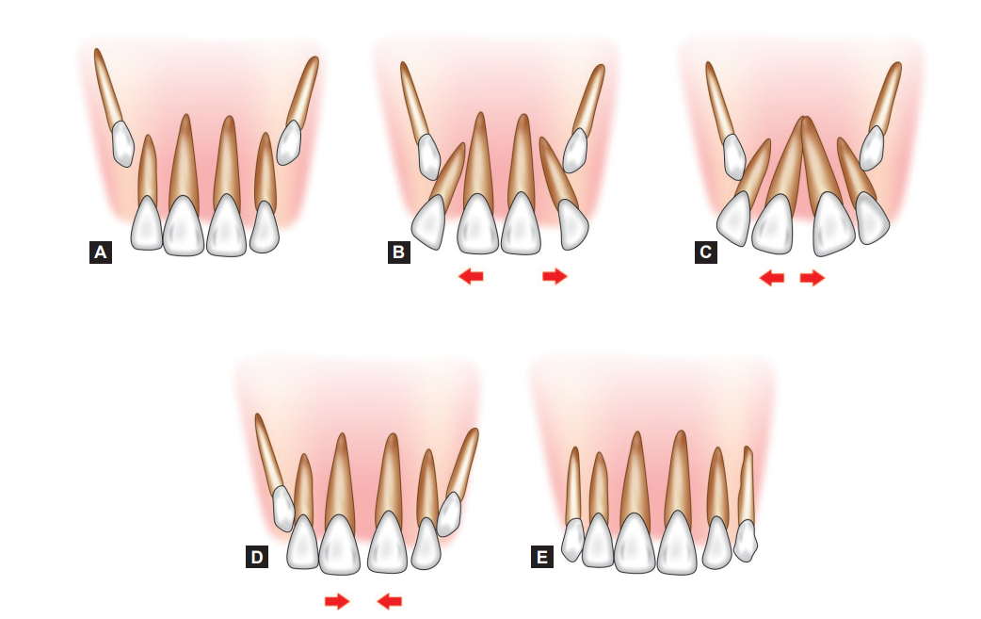
Thus, the resultant force causes the distal divergence of the crown in an opposite direction, leading to midline spacing.
This is called Ugly Duckling Stage or Broadbent phenomenon.

Slide 90

This condition corrects itself after the canines have erupted.
The canines after eruption apply pressure on the crowns of incisors thereby causing them to shift back to original positions.
No orthodontic treatment should be attempted at this stage as there is a danger of deflecting the canine from its normal path of eruption.

Slide 91
4. Permanent Dentition Stage:
The entire permanent dentition is formed within the jaws after birth except for the cusps of 1st molar, which are formed before birth.
Some changes that can be seen in permanent dentition are:
Overbite decreases
Dental arches become shorter
Vertical overbite decreases up to the age of 18 years by 0.5 mm
Overjet decreases by 0.7 mm between 12 and 20 years of age.

Slide 92
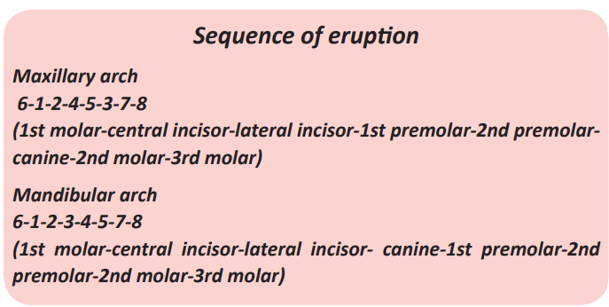

Slide 93
The Six Keys To Normal Occlusion:
The permanent dentition after establishing itself is governed by various factors.
These were underlined as Andrew’s six keys of occlusion.
Andrew in 1970 put forward these keys to occlusion after studying 120 patients with ideal occlusion.

Slide 94
He hypothesized that the presence of the following features is necessary for an ideal occlusion:
1. Molar inter-arch relationship
2. Mesiodistal crown angulation
3. Labiolingual crown inclination
4. Absence of rotation
5. Tights contacts
6. Curve of spee
7. Bolton’s discrepancy.

Slide 95
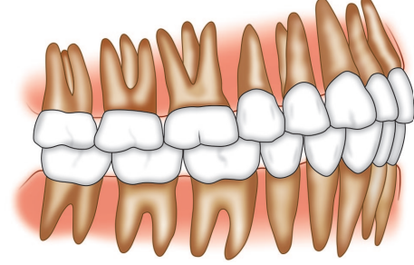
1. Molar Interarch Relationship:
The distal surface of the distobuccal cusp of the upper first permanent molar made contact and occluded with the mesial surface of the mesiobuccal cusp of the lower second molar.

Slide 96
2. Mesiodistal Crown Angulation:
Crown angulation refers to angulation (or tip) of the long axis of the crown, not to angulation of the long axis of the entire tooth.
The gingival part of the long axis of the crown must be distal to the occlusal part of the axis.
The long axis of the crown for all teeth, except molars, is judged to be the middevelopmental ridge, which is the most prominent and centermost vertical portion of the labial or buccal surface of the crown.
The long axis of the molar crown is identified by the dominant vertical groove on the buccal surface of the crown.

Slide 97
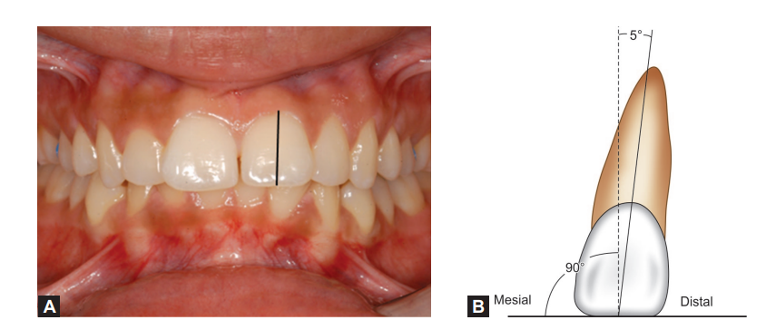
Notes:
Middevelopmental ridhe centermost vertical portion of the labial or buccal surface

Slide 98
3. Crown Inclination :
Crown inclination refers to the labiolingual or buccolingual inclination of the long axis of the crown, not to the inclination of the long axis of the entire tooth.
Crown inclination is determined by the resulting angle between a line 90 degrees to the occlusal plane and a line tangent to the middle of the labial or buccal clinical crown.

Slide 99
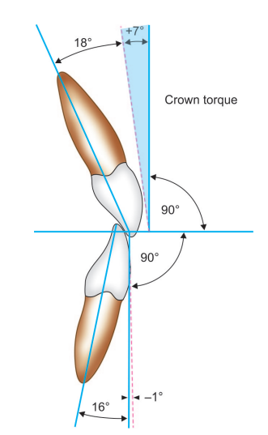
-Cervical area of crown is lingually placed then it is called as positive crown inclination and if it is more buccally then it is called as negative crown inclination.
-Maxillary incisors-positive, mandibular incisors-negative, posteriors-negative crown inclination.

Slide 100
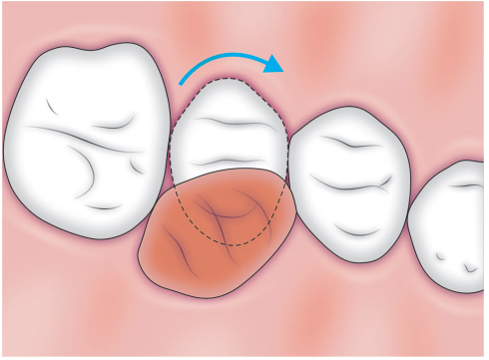
4. Absence of Rotation:
Rotated teeth will occupy more space hence normal occlusion should be free from rotation.
Rotated molars and premolars occupy more space in the dental arch than normal, rotated incisors may occupy less space than those correctly aligned and rotated canines adversely affect esthetics and may lead to occlusal interferences.

Slide 101
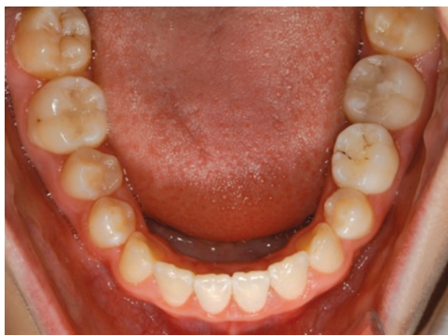
5. Tights Contacts :
Permanent dentition should have close contact to optimize space.
Persons, who have genuine tooth-size discrepancies pose special problems but in the absence of such abnormalities tight contact should exist.

Slide 102
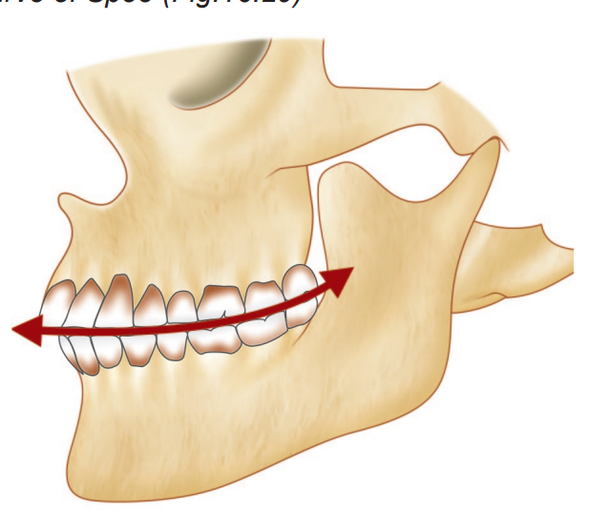
6. Curve of Spee:
Occlusal plane should be flat with curve of Spee not exceeding 1.5 mm.
There is a natural tendency for the curve of Spee to deepen with time, for the lower jaw’s growth downward and forward sometimes is faster and continues longer than that of the upper jaw, and this causes the lower anterior teeth, which are confined by the upper anterior teeth and lips, to be forced back and up, resulting in crowded lower anterior teeth and/or a deeper overbite and deeper curve of Spee.

Slide 103
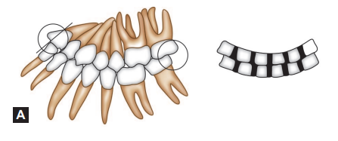
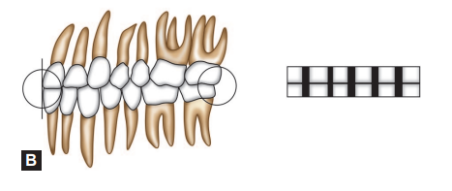
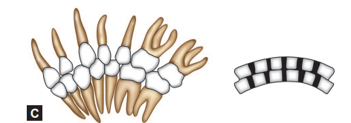
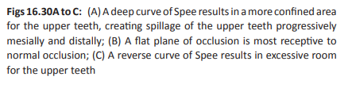

Slide 104
7. Bolton’s Discrepancy:
Boltons ratio, is a mathematical formula that gives the Interarch discrepancy which lies only in presence of occlusal disharmony, i.e. variation in proportionality of tooth size of the upper and lower teeth.
In order for maxillary teeth to fit well with the mandibular teeth, for esthetics, occlusal stability and functional harmony there must be a definite proportionality of tooth size.

Slide 105
Anterior ratio is the percentage relationship of mandibular anterior teeth to maxillary anterior teeth (canine to canine) with a mean of 77.2 %.
Overall ratio is the percentage relationship of mandibular teeth to maxillary teeth (first molar to first molar) with a mean of 91.3 %.

Slide 106
Conclusion:
Occlusion, good or bad is the result of an intricate and complicated synthesis of genetic and environmental relationship at work through out the early developmental stages of childhood and young adulthood.
Understanding the concept can have a far reaching implications in diagnosis, treatment planning and prognosis of malocclusion.

Slide 107
References:
A.R TENCATE: Oral histology.
S.N BHASKAR: Orban’s dental histology and embryology.
Stanley J. Nelson: Wheelers Dental Anatomy Physiology And Occlusion
W.R PROFITT: Contemporary orthodontics
AJO-DO 1972 Sep (296-309): The six keys to normal occlusion – Andrew
Nikhil Marwah: Textbook of Paediatric Dentistry

Slide 108


