Slide 1

PRESENTED BY:

Slide 2
Content :
Introduction
Objectives of non vital pulp therapy
Pulpectomy
Definition
Objectives
Indications
Contraindications
Procedure
Primary tooth root canal anatomy
Apexification
Root canal treatment

Slide 3
Depending on the depth of caries (which may have pulp involvement), two approaches may be considered in the primary dentition: vital pulp therapy (VPT) or non-vital therapy (NPT) .
When the pulp is still recurable, VPT may be an option which includes: indirect pulp treatment (IPT), direct pulp cap (DPC), and pulpotomy .

Slide 4
When the caries lesion progresses to the point where pulp necrotizes, then NPT is performed.
Carious or traumatized primary teeth diagnosed with irreversible pulpitis or necrotic pulp can be treated with:
- non-vital pulp therapies (pulpectomy for primary teeth, root canal
treatment and apexification for permanent teeth)
or extraction.

Slide 5
Objectives of Non-Vital Pulp Treatment (Primary Teeth)
  Maintain tooth free of infection
  Achieve biomechanical cleansing and canal obturation
  Promote physiologic resorption
  Maintain space and function

Slide 6





Slide 7

PULPECTOMY
Pulpectomy -general
Complete removal of necrotic pulp tissue from the root canals and coronal portion of devital primary teeth to maintain the tooth in the dental arch
Justification
Removal of diseased tissue
Space management

Slide 8
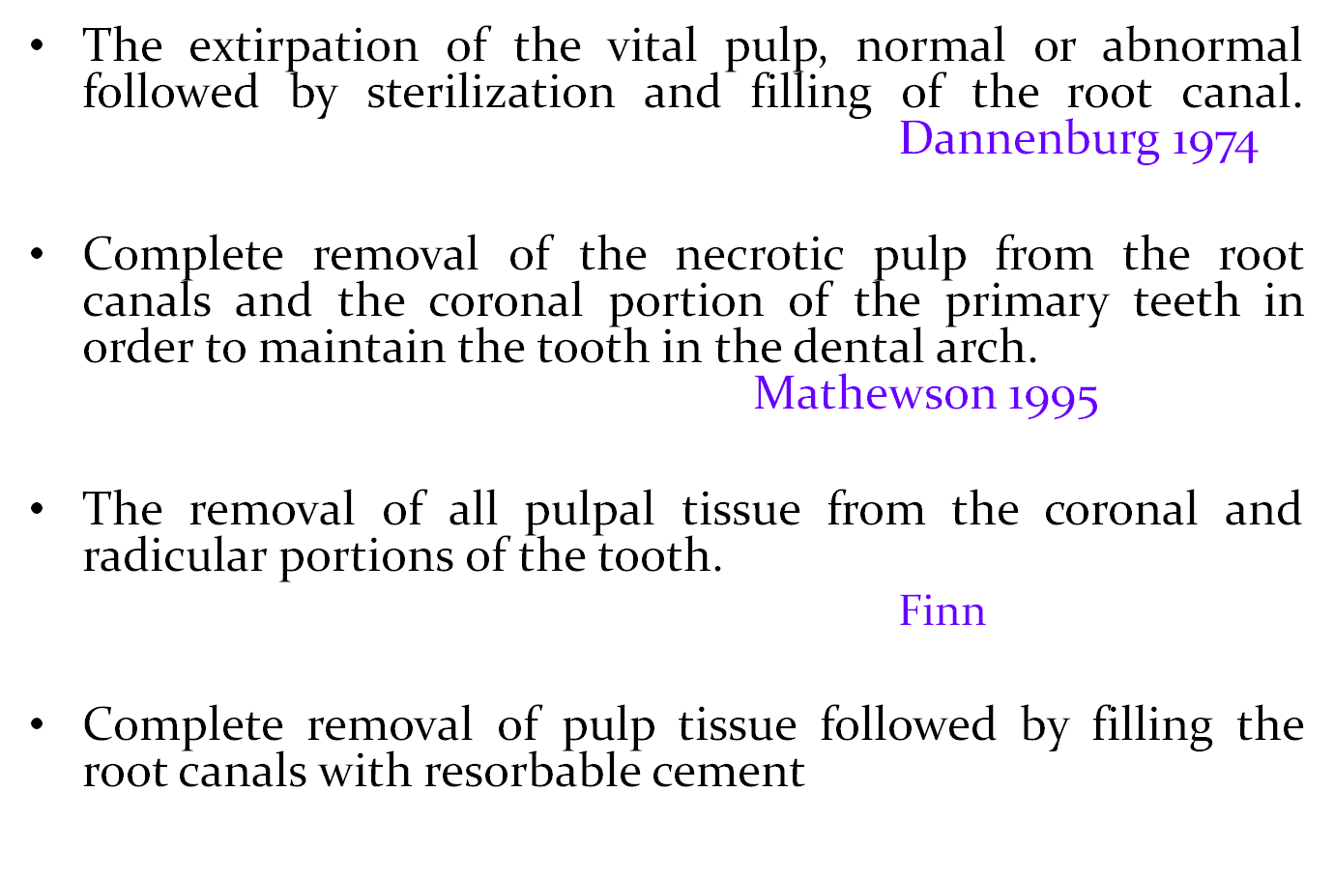
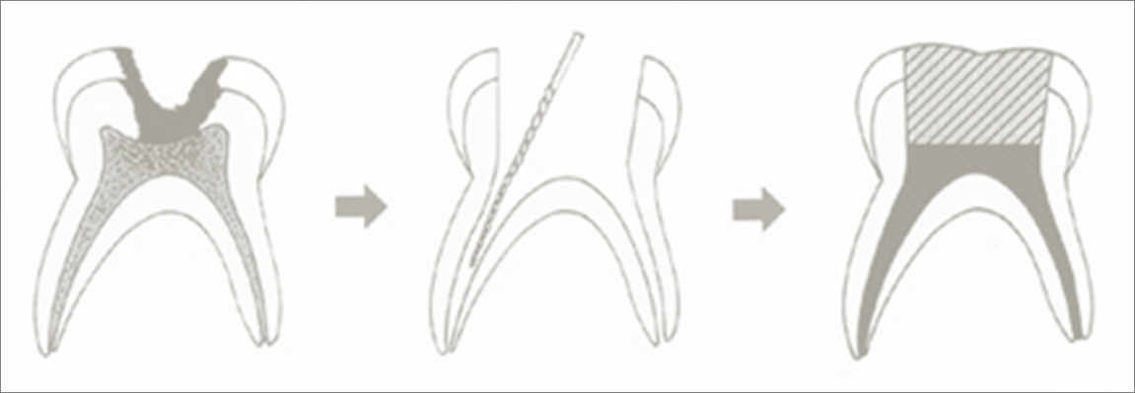
What is pulpectomy?

Slide 9

OBJECTIVES OF PULPECTOMY
Pulpectomy -general
Following the treatment , the infectious process should resolve
There should be radiographic evidence of successful filling without gross overextension or underfilling
The treatment should permit resorption of the primary root structures at the appropriate time to permit normal eruption of succedaneous tooth
No radiographic evidence of further breakdown of supporting tissues
Should prevent further pain and swelling
No internal or external resorption or other pathology

Slide 10

INDICATIONS
Pulpectomy -general
Strategically important tooth
(in case of the deciduous second molar where the permanent first molar has not erupted)
Irreversible pulpits
Minimal periapical changes with sufficient bone support
At least 2/3rd of the root length available
Internal resorption without any obvious perforation

Slide 11

CONTRAINDICATIONS
Pulpectomy -general
Excessively mobile and/or reduced bone support
Non restorable tooth
Internal resorption of the pulp chamber and root canal
Underlying dentigerous or follicular cyst
Pathology extending to the developing permanent tooth bud
Less than2/3rd of root length remaining
Perforation of pulpal floor
Medically compromised children

Slide 12


Pulpectomy -general
The procedure of pulpectomy can be performed in :--
Single-visit
Multi-visit
Single-visit
Partially vital pulp
Multi-visit
Non-vital pulp

Slide 13
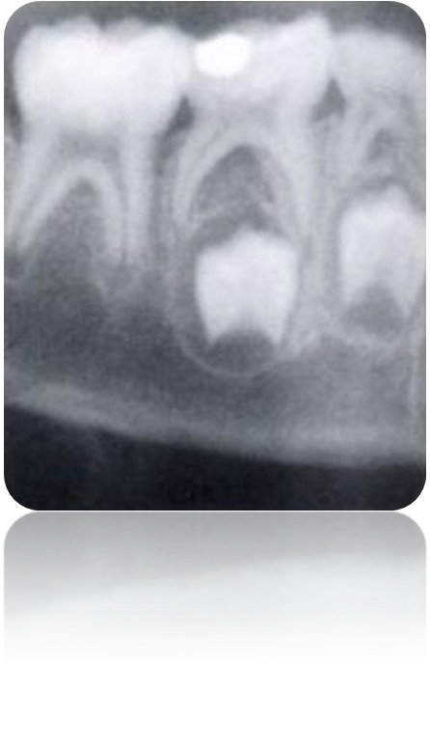
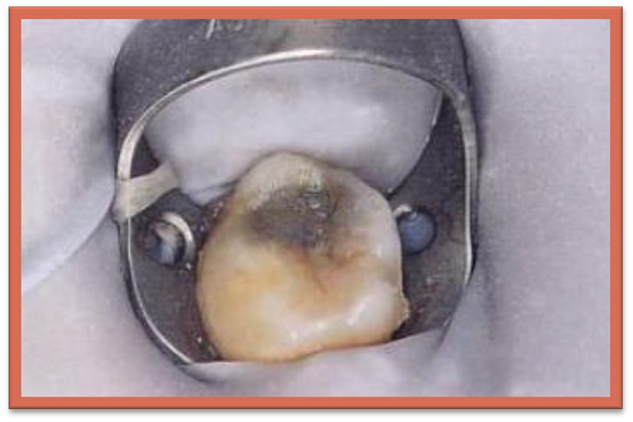
STEP 1 . Give local anaesthesia and isolate the tooth with rubber dam
Basic steps in pulpectomy

Slide 14
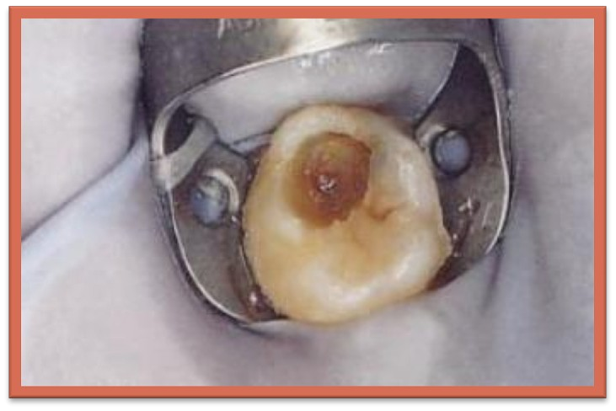
STEP 2 : Remove caries and identify the exposure site
Basic steps in pulpectomy

Slide 15
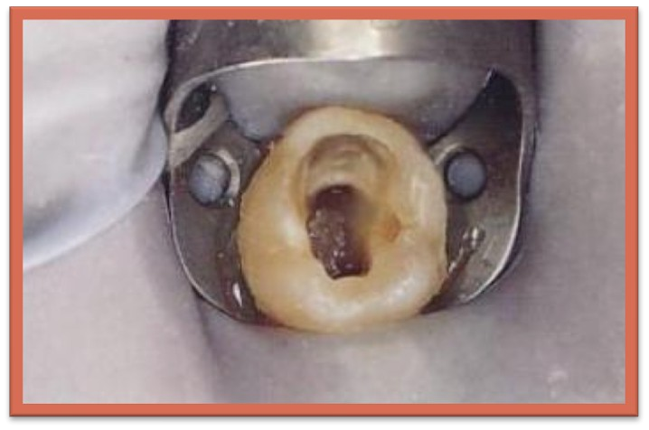
STEP 3 : Remove roof of pulp chamber and identify opening of root canals
Basic steps in pulpectomy

Slide 16
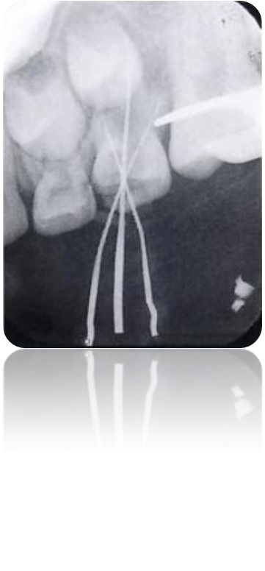
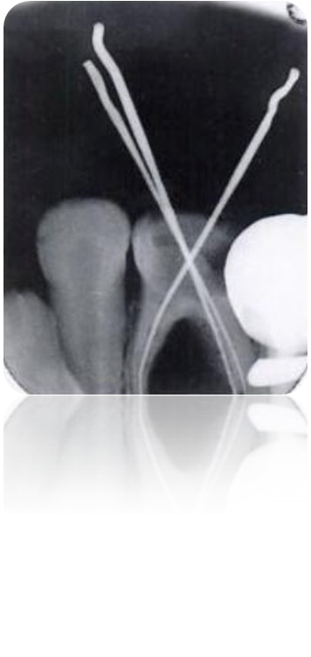
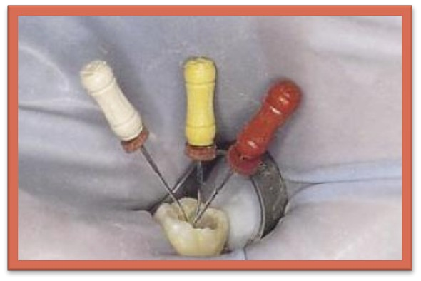
STEP 4 : Take diagnostic radiograph
Basic steps in pulpectomy

Slide 17
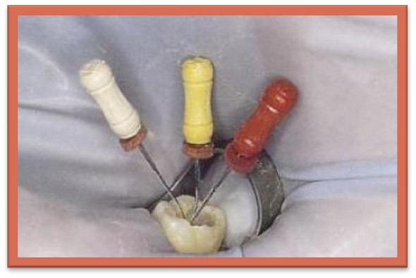
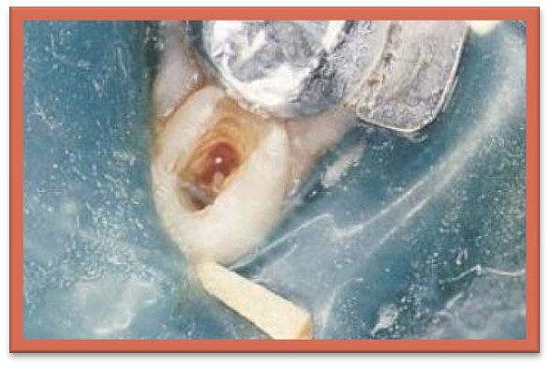
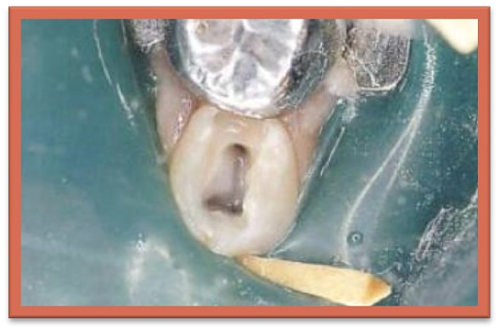
STEP 5 : Clean out root canals with hedstroem files and remove remnants of pulp tissue and irrigate the canal
Basic steps in pulpectomy

Slide 18
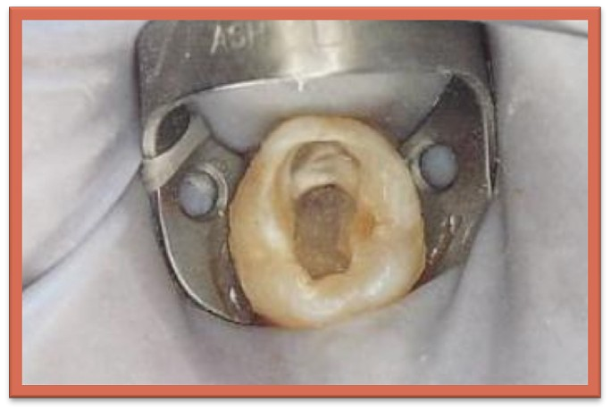
STEP 6 : Dry root canal with paper points and place
a pledget of formocresol in the pulp chamber for 4 minutes
Basic steps in pulpectomy

Slide 19
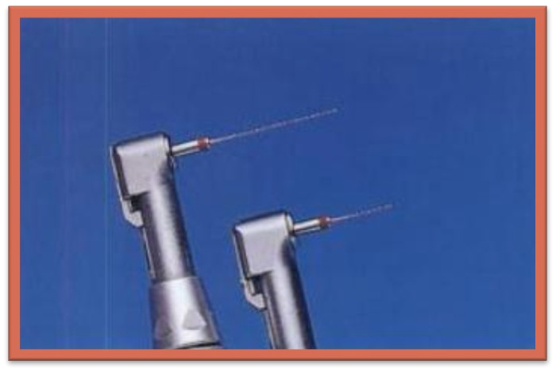
STEP 7 :Select a spiral root canal filler of appropriate size
Basic steps in pulpectomy

Slide 20
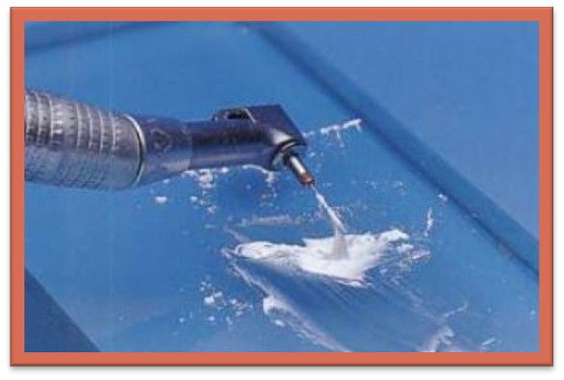
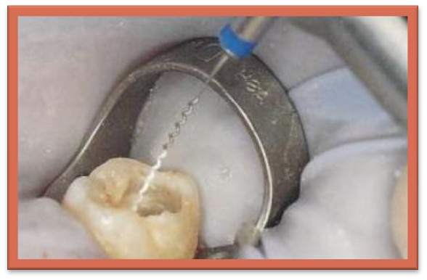
STEP 8 : mix zinc oxide eugenol as a slurry and spin it into the root canals Using the spiral root canal filler
Basic steps in pulpectomy

Slide 21
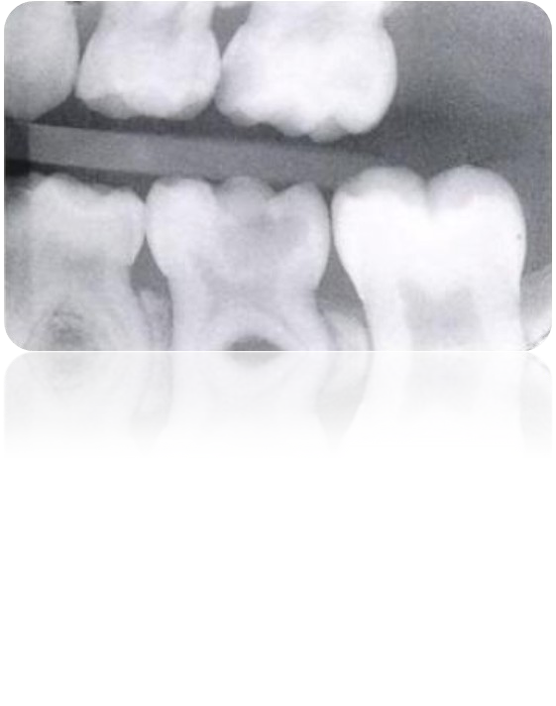

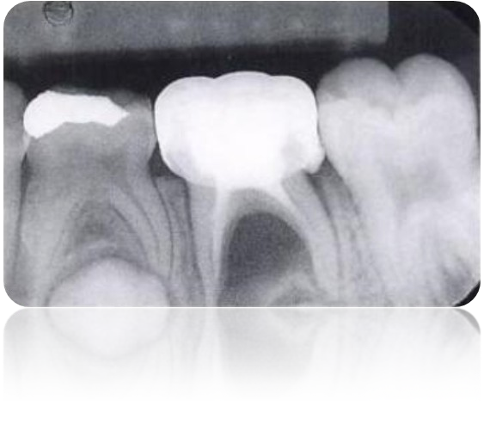
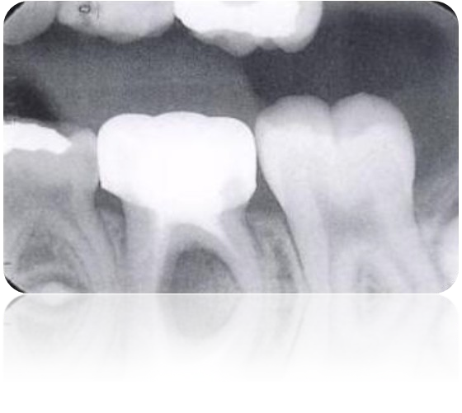
Preoperative
Immediately post operative
3 Months later

Slide 22
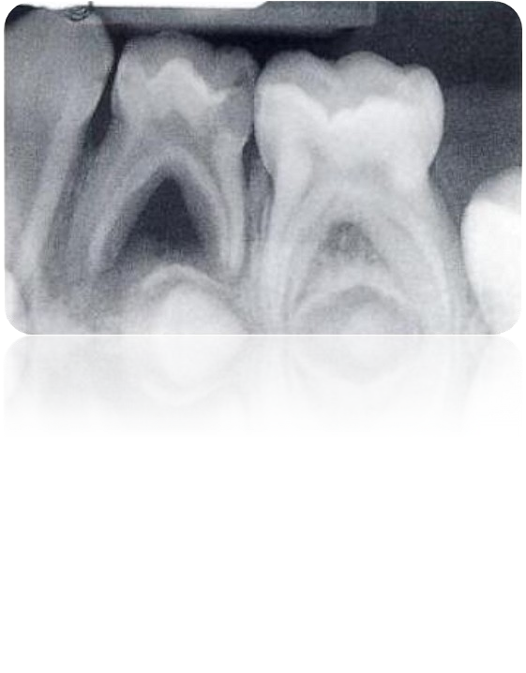
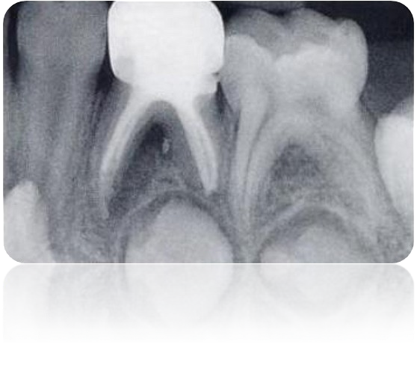
Preoperative
After 6 months

Slide 23
SINGLE VISIT PULPECTOMY TECHNIQUE
1. Acces opening for pulpectomy in primary teeth
It is defined as
That endodontic coronal preparation which enables unobstructed access to the canal orifice , a straight line access to the apical foramen, complete authority over the enlarging instrument and to accommodate the filling technique

Slide 24

IDEALS FOR ENDODONTIC ACCESS
SINGLE VISIT PULPECTOMY TECHNIQUE
Complete removal of pulp chamber roof
Removal of coronal pulp
Straight line access to facilitate placement of endodontic instruments and obturation material
These ideals are balanced with following constraints
Conservation of tooth structure Retention and esthetics
Final restoration

Slide 25

OBJECTIVES
Access openning
3 main objectives
obtaining a straight line access to the apical foramen or to the Initial curvature of the canal to aid in
-improved instrumentation control
-improved obturation
-decreases the incidence of procedural error
Conservation of tooth structure
-to minimize weakening of remaining tooth structure
Unroofing the pulp chamber and removal of the pulp horns to aid in
-locating the root canal orifice
-maximum visibility
-locate canals
-permit straight line preparation
-prevents discoloration of teeth due to pulpal remnants

Slide 26
To achieve optimal preparation 3 factors of internal anatomy must be considered
Access openning
Size of the pulp chamber
-more extensive preparations due to large pulp chambers
Shape of the pulp chamber
-the finished outline form should accurately reflect the shape of the pulp chamber
Example : the floor of the pulp chamber in molar is usually triangular --- triangular position of canal orifice this shape is so extended to the walls of the cavity onto the occlusal surface---- final outline form is usually triangular
Number position and curvature of root canals

Slide 27
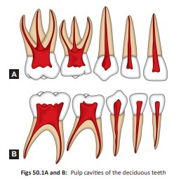
Access openning
Primary tooth root canal anatomy
The clinician must have a thorough knowledge of the anatomy of the Primary root canal and the variations that normally exist

Slide 28
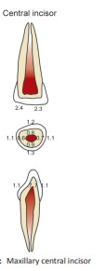
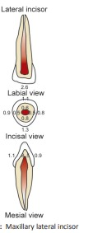
PRIMARY ANTERIORS
Access openning
Maxillary Incisors
The root canals are almost round but somewhat compressed Normally 1 canal without a bifurcation
Accessory canals are rare , but do occur

Slide 29
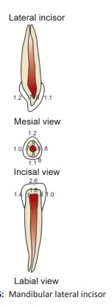
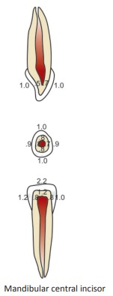
Mandibular Incisors
Root canals are flattened on mesial and distal surfaces and sometimes grooved
2 canals are seen in less than 10% of cases Lateral or accessory canals are rare

Slide 30
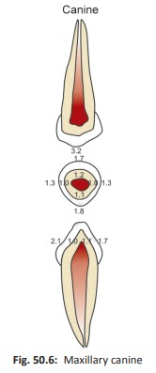
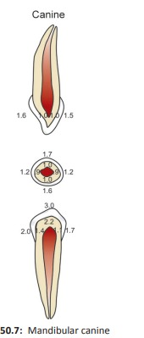
Maxillary and mandibular canine
Root canals correspond to the exterior root shape
A rounded triangular with the base towards the facial surface
Lumen of the canal is sometimes compressed in mesial-distal direction Lateral and accessory canals are rare

Slide 31
PRIMARY MOLARS
Access openning
Normally have same number of roots and positions of the roots as the corresponding permanent molars
The roots of the primary molars are long , slender compared with the crown length and width
They diverge to allow for a permanent tooth bud formation

Slide 32
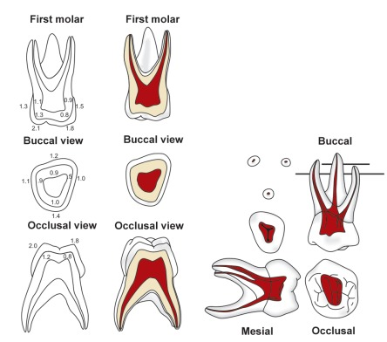
Maxillary 1st primary molar:
3 roots. 2 facial,1 palatal
Palatal root is often round and longer than 2 facial root canals
2-4 canals
Bifurcation of mesiao facial root into 2 canals - 75%

Slide 33
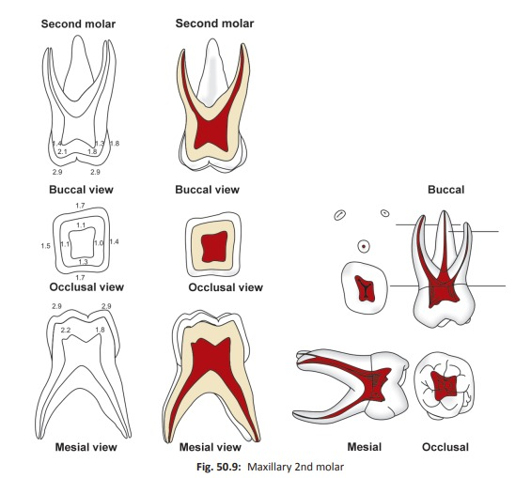
Maxillary 2nd primary molar
3 roots. 2 facial,1 palatal
2 – 5 canals
Mesiofacial root usually bifurcates or contains 2 canals – 85%-95%

Slide 34
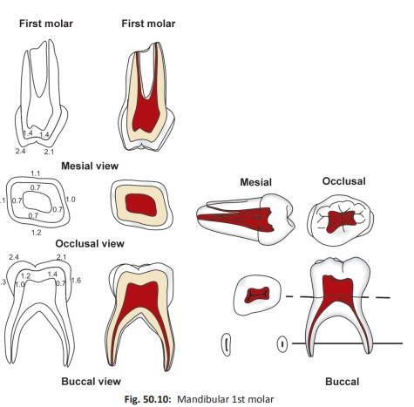
Mandibular 1st primary molar
Access openning
2 roots . 1 Mesial, 1 distal
Usually have 3 canals but may have 2-4 canals Mesial root contains 2 canals- 75%
Distal root contain more than 1 canal- 25%

Slide 35
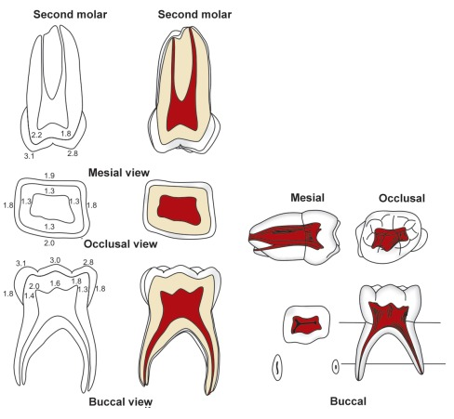
Mandibular 2nd primary molar
2 roots .1 mesial and 1 dis tal
Usually have 3 canals . but may have 2-5 canals Mesial root has 2 canals – 85%
Distal root contains more than 1 canals – 25%

Slide 36
2. canal cleaning and shaping
Using local anaesthesia and rubber dam placement, all accessible radicular pulp is removed
Relative pulpectomy
due to tortuous course of root canal coupled with numerous accessory canals, complete removal of pulp in the primary teeth may often be difficult , if not impossible. Thus all such procedures are regarded as partial pulpectomy procedures
Selective filing
resorption in primary teeth may have started at the time of Treatment. Also the slender roots , with thin apical ends may predispose the tooth to a root fracture in cases of excessive preparation .Thus procedure of selective filing should be used

Slide 37
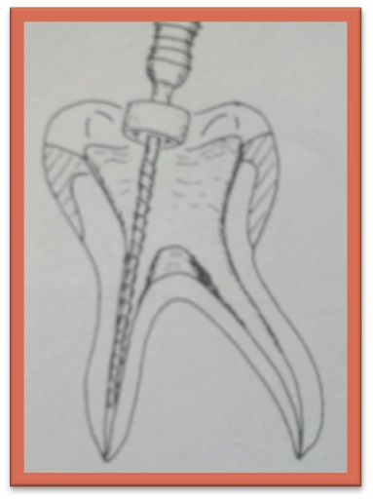
With an endodontic file , remove the diseased pulp tissue from all The canal.
Cleaning and shaping
The canals should be instrumented to the resistance point
Each canal should be enlarged 3 – 4 instrument sizes greater than the First file capable of working the apex

Slide 38
It is not necessary to take an X-ray to determine file length as is done in Permanent teeth endodontic procedure
Cleaning and shaping
Visual comparision of file and root canal length on the pre operative Periapical radiograph will result in sufficient clinical acccuracy
In the primary tooth attempts to mechanically prepare a circular apical 1/3rd may result in lateral perforation of the canal because of its Hour glass shape

Slide 39
Because of the bizzare anatomy of primary molar root canals the use of barbed broaches as in conventional endodontics may be unsuccessful
Also the ribbon shape of the root canals, with a narrow mesiodistal width Compared to their buccolingual dimension, discourages gross enlargement Of the canals
Hedstrom files are recommended since they remove hard tissue only on withdrawal , which prevents pushing infected through the apices. For this Reason reamers are not recommended

Slide 40
Instruments used in conjunction with irrigating solution reduce the possibility of fracture because of the lubricant action of the solution
Cleaning and shaping
5% solution of sodium hypochlorite has an excellent solvent action and is dilute enough to cause only mild irritation when contacting periapical Tissue
-Schilder & Amsterdam,1970
After filing ,the canal should be irrigated and then dried with cotton pellet Or paper points

Slide 41
3. F i l l ing of the primary root canals
Ideal requirements are as follows
. Should resorb at the similar rate as the primary root
Should be harmless to the periapical tissues and to the permanent tooth germ ; if pressed beyond the apex it should resorb readily
Should have a stable disinfecting power
Should be inserted into the root canal and be removed easily if necessary
Should adhere to the walls of the canals and should not shrink
Should not be soluble in water
Should be radiopaque and not discolor the tooth

Slide 42
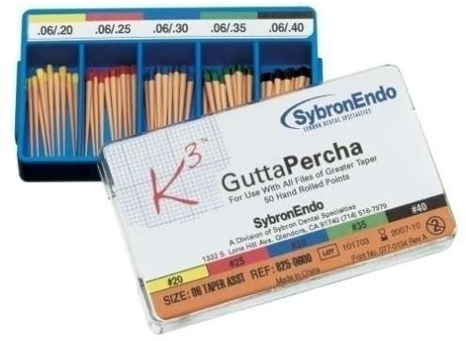
Gutta Percha
Filling of the primary root canals
Not indicated for primary teeth
Since it is not a resorbable material, its use is contraindicated in primary teeth
No material currently available meets al the criteria
The filling material most commonly used for primary pulp canals are :
Zinc oxide - Eugenol paste
Iodoform paste
Calcium hydroxide

Slide 43
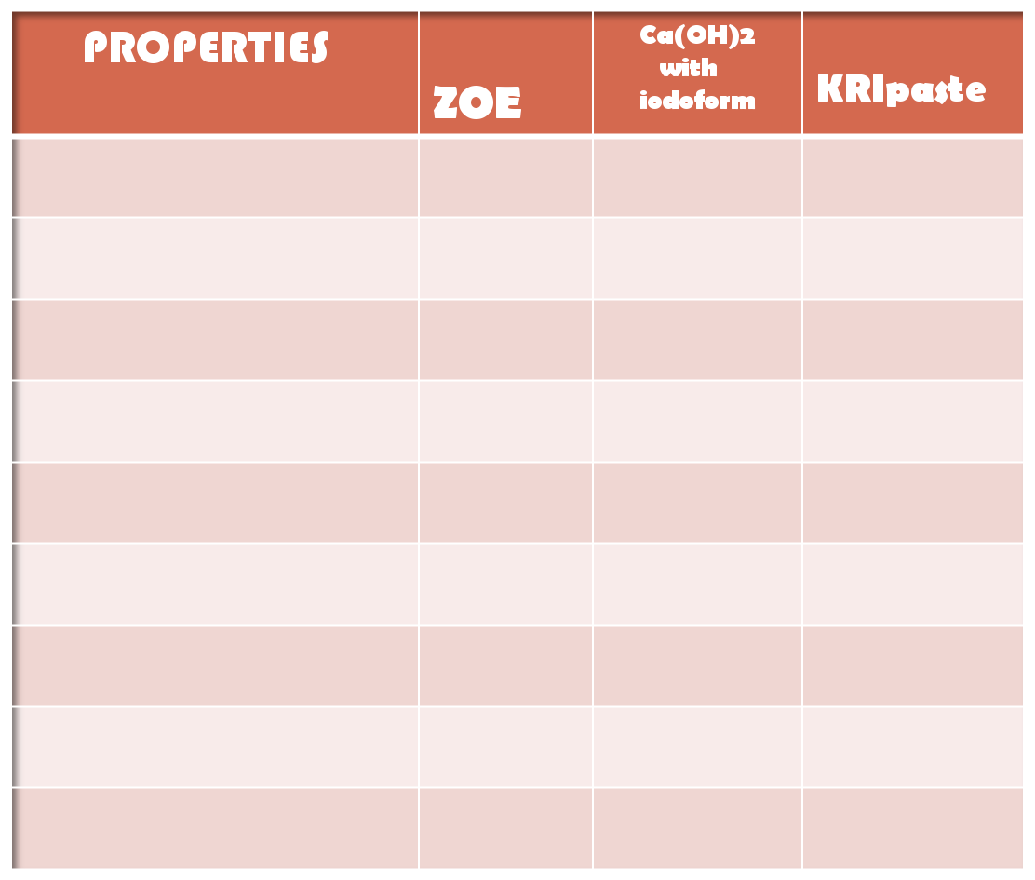
Filling of the primary root canals
Resorbs at the same rate as the tooth
Harmless
🗴
🗴
🗴
🗸
🗸
Overfill resorbs
🗴
🗸
🗸
Antiseptic
🗸
🗸
🗸
Easily applied
🗴
🗸
🗴
Adheres to the wall
Easily removed
Radiopaque No discoloration
 | 🗸 | 🗸
🗴 | 🗸 | 🗸
🗸 | 🗸 | 🗸
🗸 | 🗸 | 🗸

Slide 44
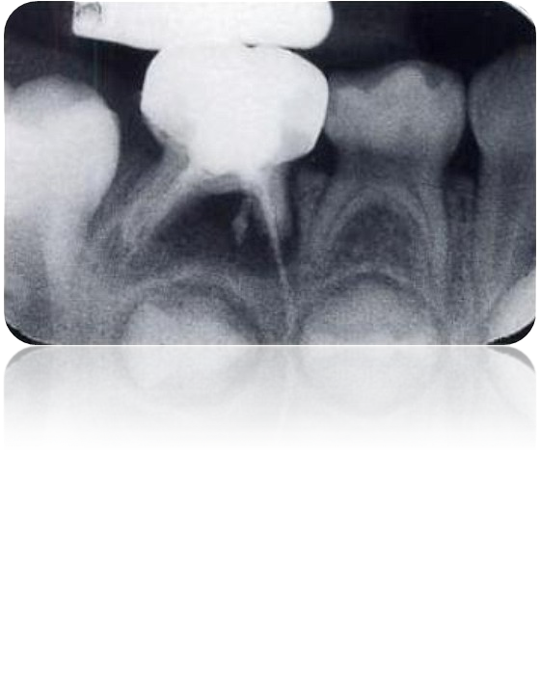
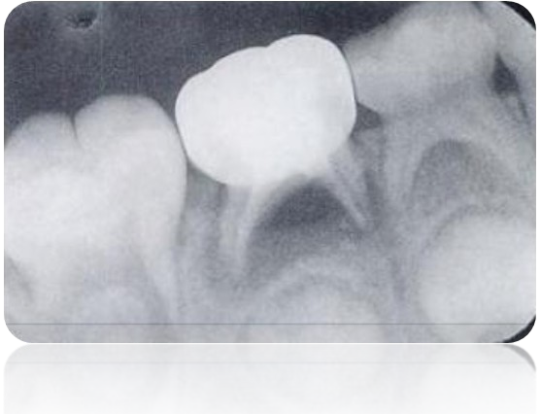
Filling of the primary root canals
Zinc oxide eugenol has extruded through the apex of 85
3 months there is complete disappearance of the material periapically

Slide 45

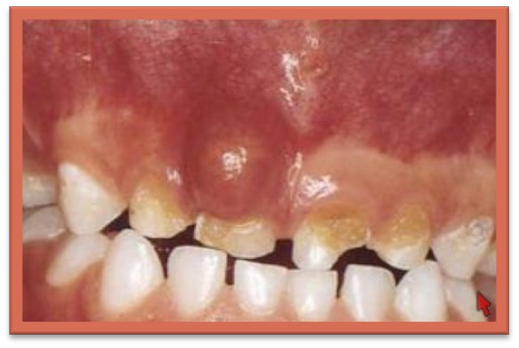

MULTI-VISIT PULPECTOMY
This procedure is used for non vital primary teeth
Studied by (Wittch,1956 ; Lawrence,1966 ; Gould,1972) over short term And by ( starky,1973) over long term
The clinical technique is similar to the single visit pulpectomy

Slide 46
Local anaesthesia and rubber dam placement are recommended
Multi – visit pulpectomy
In cases of swelling and cellulites this can be omitted
Instrumentation of the canal is not recommended at the first visit in in
Mobile tooth
If swelling or a fistula is present
If pus is present in the canals
In absence of signs and symptoms instrumentation can proceed Between and after instrumentation canals are irrigated
Between appointment antibacterial drug is sealed in the pulp chamber, maintained with a temporary cement
In some cases the degree of pre operative cellulites will dictate that drainage will have to be established
A smooth broach is used to perforate the apices and the tooth left open to drain for no more than 1 day
If kept open for more than 24 hrs usually results in food packing into the canal

Slide 47
Systemic antibiotic therapy is also indicated
Multi – visit pulpectomy
External heat should not be applied as this may result in extra-oral Drainage of the infection
In these cases the coronal pulp chamber can be filled with beechwood Cresol soaked cotton pellet after 24 hrs drainage
Appointments are 7 – 10 days apart . The number of appointments and Timing and extent of instrumentation will be determined by signs and symptoms at each visit
The canals should not be filled until they are dry and all other signs and symptoms have been eliminated
-(lawrence,1966)

Slide 48
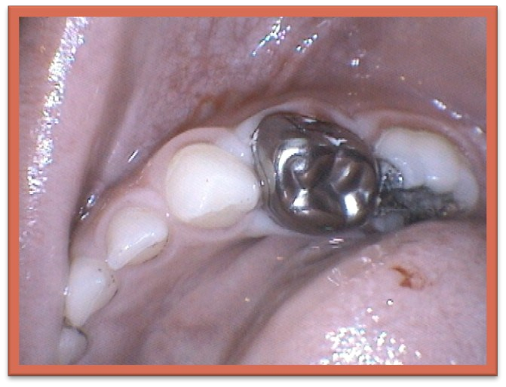
Follow up – primary teeth with pulpectomy
Final restoration
The ideal restoration for an endodontically treated primary tooth is a stainless steel crown.
But in some cases it may be acceptable to delay the crown or leave the tooth with an amalgam restoration

Slide 49

Assessment of success
Post operative follow up at 6 month interval should include an evaluation Of signs and symptoms
evidence of failure
Clinical
Pathological mobility
Presence of fistula
Pain on percussion
Radiographic 11.Increased size of radiolucency
12. external or internal root resorption

Slide 50

Eruption of permanent successor
Non vital teeth treated with pulpectomy , premature root resorption is more marked
The filling material is not the same texture or hardness as normal tooth Or vital pulp
When the erupting permanent successor meets root canal filling material there is increased possibility of deflection
Most problems associated with resorption arise when the erupting tooth Has resorbed the pulpal floor of the primary molar and is contacting the material in the coronal pulp chamber

Slide 51

Part II
PRESENTED BY:
POOJA GOPALGHARE
II MDS

Slide 52
Content :
Introduction
Objectives of non vital pulp therapy
Pulpectomy
Definition
Objectives
Indications
Contraindications
Procedure
Primary tooth root canal anatomy
Apexification
Root canal treatment

Slide 53
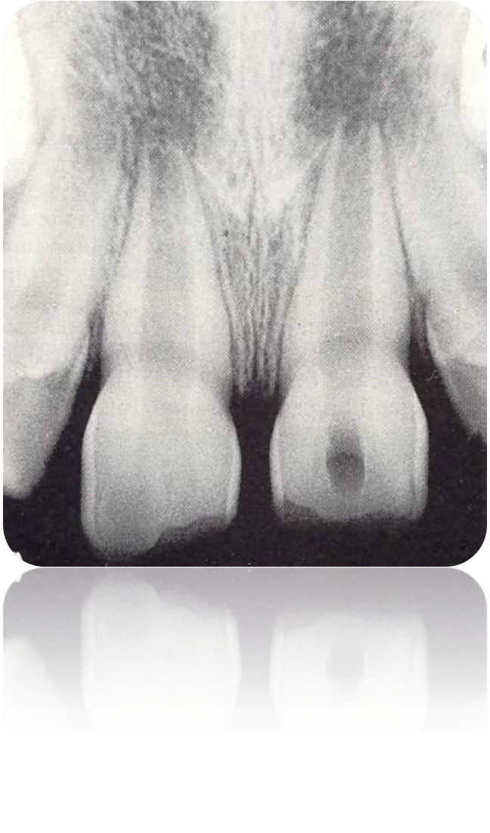
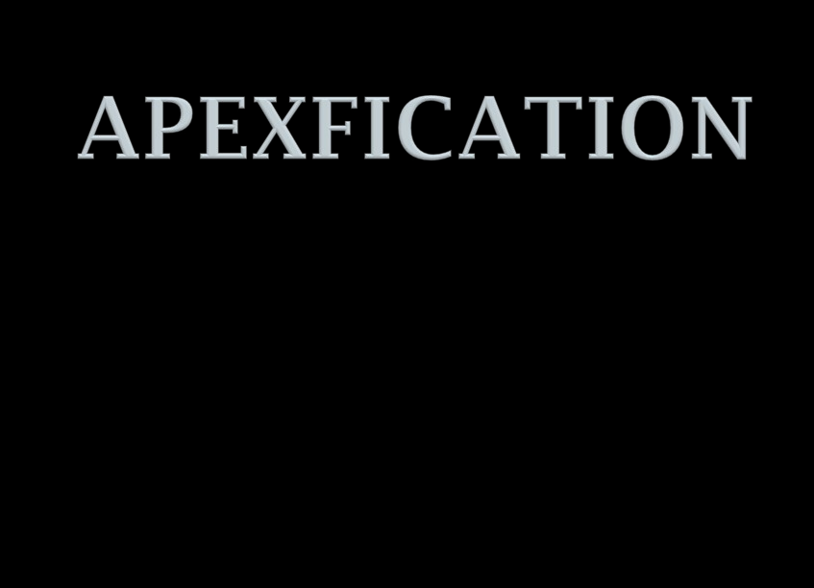

Slide 54

APEXIFICATION
It is a method to induce a calcified barrier in a root with an open apex or the continued apical development of an incomplete root in teeth with necrotic pulp.
(A.A.E.,2003)

Slide 55
Causes of open apex:-
1. Incomplete development-
Pulpal necrosis before root growth and development are complete
2. Extens ive apical root resorption due to trauma , periapical pathosis , orthodontic treatment

Slide 56
Types of open apices
They can be of two types:-
1. Blunderbuss
Flaring root canal walls in which apex is funnel shaped And wider than the coronal aspect of canal
3. Non blunderbuss
root canal walls are parallel or sligh

Slide 57
PROBLEMS OF TREATING IMMATURE TEETH WITH A NECROTIC PULP
There is an open apex , hence no hard tissue stop against which gutta percha can be packed
The open apex of root canal tends to be shaped like blunderbuss making it difficult to obturate with root filling material
Apicoectomy is not advis able because the walls of the immature roots are likely to fracture when sealing the apex

Slide 58

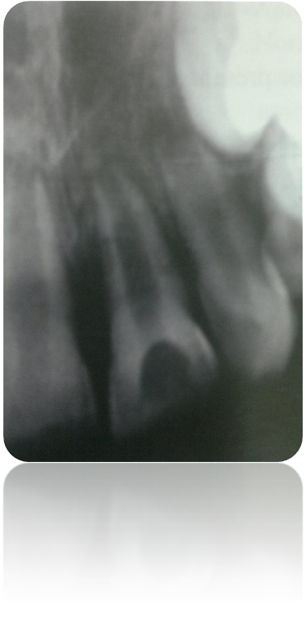
INDICATIONS
This procedure is indicated for non vital permanent teeth
with incompletely formed roots

Slide 59

OBJECTIVES
Procedure should induce root end closure at the apices of immature roots
Adverse clinical signs and symptoms such as prolonged sensitivity,pain or swelling should not be evident
No evidence of abnormal canal calcification or internal or external root resorption

Slide 60
MATERIALS USED
•
Antiseptic and antibiotic paste
•
ZnO and metacresylacetate-camphorated parachlorophenol
•
tricalcium phosphate
•
collagen Ca phos phate gel
•
resorbable tri calcium phosphate
Calcium hydroxide

Slide 61
PROCEDURE
Access is gained into the pulp chamber
removal of coronal pulp and es tablis h file length
clean the canal , irrigate & dry it with paper point
seal the chamber with CMCP in the pulp chamber with a provisional restorative material
Recall in 1 – 3 weeks

Slide 62
In first recall , remove the restoration and clean the canal
Take care to void any instrumentation of the walls of the dentin near the apex
paste of CaOH and CMCP is filled in the canal
The objective is to fill the canal completely
Obtain a radiograph to check for the accuracy

Slide 63
6 month recall
Radiographic evidence of apical clos ure is s een
It is necessary to test the quality of the apical barrier with a size 35 file.
If file easily penetrate continue apexification
Reschedule the patient for another 3 months recall
The follow up evaluation is repeated every 3 months until successful apical bridging has occurred

Slide 64
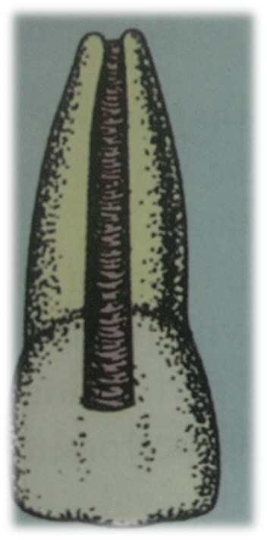
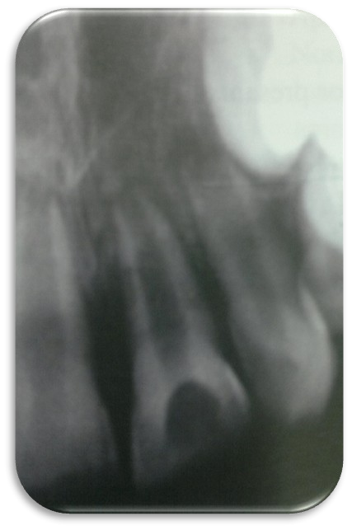

VARIOUS TYPES OF ROOT CLOSURE IN APEXIFICATION
Weine ( 1976 )
1. Continued closure of canal and apex to a normal configuration

Slide 65
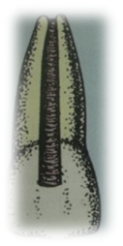
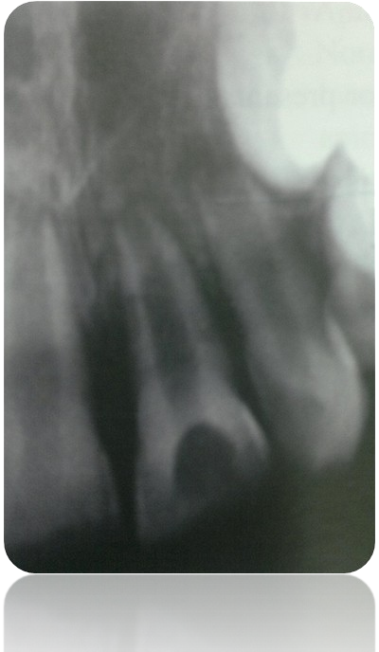
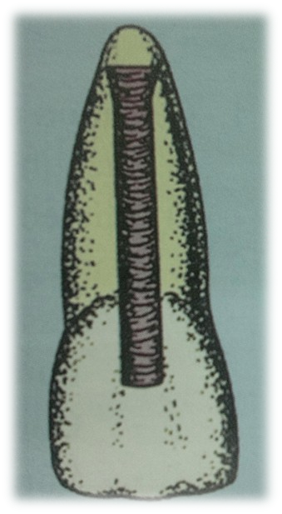

2. Apex closes but canal remains with blunderbuss configuration
VARIOUS TYPES OF ROOT CLOSURE IN APEXIFICATION
1.

Slide 66
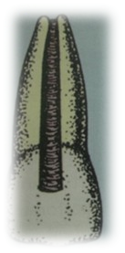
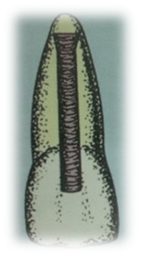
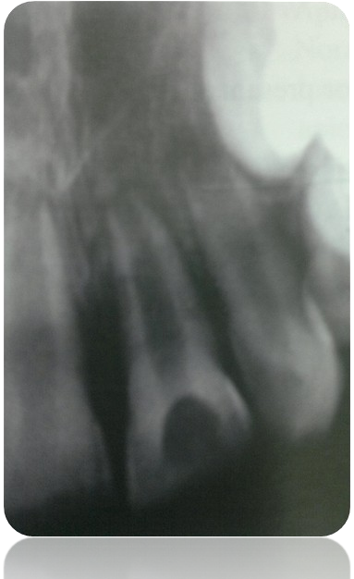


VARIOUS TYPES OF ROOT CLOSURE IN APEXIFICATION
1.
2.
3. No radiographic change, but a thin osteoid like barrier provides a definite stop at or near apex

Slide 67





VARIOUS TYPES OF ROOT CLOSURE IN APEXIFICATION
1.
2.
3.
4. Radiographic evidence of a barrier short of apex

Slide 68


Obturation of the root canal
Thes e canals are probably bes t s uited for obturation by thermoplas ticized tec hnique
Obtura

Slide 69
Alternatives of conventional apexification
Mineral trioxide aggregate ( M.T.A. )
  Allows for the overgrowth of cementum
  May facilitate the regeneration of PDL
MTA was first described in dental literature in 1993 by torabinejad
Mec hanis m of action
S timulated cytokine release from bone cells

Slide 70
Composition
Tricalcium silicate Dicalcium silicate Tricalcium aluminate
Calcium sulphate dehydrate Bismuth oxide
Limitations
cost
S torage problems . sets in presence of moisture ( 4 hrs )

Slide 71

DISADVANTAGES
1. Patient compliance (for attending the recalls)
4. Increased risk of tooth fracture after dressing with the material for extended periods.
3. Although the open apex might be closed by a calcific barrier, apexification does not promote the continued development of the root

Slide 72


Slide 73


Slide 74


Slide 75
WORKING LENGTH DETERMINATION
The distance from a coronal reference point to the point at which canal preparation and obturation should terminate
Anatomical considerations
Root apex
Anatomic apex
: tip or end of the root determined morphologically
Radiographic apex : tip or end of the root determined
radiographically
His tological apex
: it is represented by cementodentinal junction

Slide 76
Apical foramen :-
histologically it is the area where blood vessels and nerve plexus enter the tooth , but is not seen radiographically
major diameter :
it is the main apical opening of the root canal. It is frequently eccentrically located away from the anatomic or radiographic apex
minor diameter :
apical portion of the root canal havig the narrowest diameter

Slide 77
Cementodentinal junction :
region where dentin and cementum are united it is a his tologic landmark
does not always coincide with the apical construction is located 0 .5 – 3 mm s hort of anatomic apex

Slide 78

Pre operative considerations'
curve the instrument by grasping the blade with gauze sponge and bending the instrument in a gentle slope
instrument used – endobender
reference points
anteriors – incisal edges posteriors – cusp tips
use of instrument stop – tear drop shaped
silicon rubber stops

Slide 79
NEED FOR DETERMINING WORKING LENGTH
Cleaning , shaping and obturation of the root canal systems cannot be accomplished accurately unless the working length is determined correctly.
Failure leads to :
Working long :
may lead to overfilling or overextension
Working s hort :
results in incomplete cleaning
Pers is tent dis comfort as the pulpal remnants are left

Slide 80
Loss of working length occurs due to :
•
Straightening of curved canals
•
Accumulation of dentinal and pulpal debris in apical 2-3 mm of canal
•
Failing to maintain foramen patency
•
Failing to irrigate the apical 1/3rd

Slide 81

CONVENTIONAL METHODS
1. GROSSMAN’S METHOD
First method described for determining the working length Grossman’s formula
Actual length of tooth ( AL_{T} )
=
Radiographic length of tooth ( RL_{T} ) × Actual length of instrument (AL_{T} ) Radiographic length of the instrument ( RL_{I} )
OR
( AL_{T} )
( RL_{T} )
=
( AL_{I} )
( RL_{I} )

Slide 82
Working kength determination in multirooted tooth
Working length determination is done for each root canal
example:
in mandibular molar , the mesial root has 2 canals . if both the mesial canals are overlapping , then K-file is inserted in one canal and H-file is inserted in the other canal and radiographs
at 20 degree to 40 degree mesial or distal angulations are taken to view all the canals

Slide 83
2. RADIOGRAPHIC OR INGLE METHOD
1. Measure the tooth on a pre operative radiograph
3. subtract at least 1 mm safety allowance for possible image distortion or magnification
6. Adjust the stop
8. place the instrument in the canal and take another radiograph
10. measure the difference between the end of instrument and end of root
12. And add this amount to the tentative working length. If instrument has gone beyond the apex then subtract this difference
15. From the adjusted length subtract 1mm for safety to confirm to the apical termination of root canal at apical constriction
A conformatory radiograph is desirable
Record the final working length

Slide 84
1. WEINE’S recommendation for determining working length
Method similar to radiographic method
He recommended the following termination points
when no bone or root resorption has occurred
– 1 mm from apex
when only bone resorption has occurred – 1..5 mm from apex
when both bone and root resorption has occurred – 2 mm from apex

Slide 85
4. KUTTLER’S METHOD
According to Kuttler
Narrowest diameter is referred to as apical constriction , site at which he preferred to terminate canal preparation
ADVANTAGES | DISADVANTAGES
1. Errors are minimum | 1. Complicated
2. Accurate in use | 2. Requires excellent quality radiographs
3. Pain free treatment
4. Rapid development of solid apical dentin matrix , will enhance to retain filling within canal

Slide 86
TECHNIQUE
Locate major and minor diameter on pre operative radiographs
estimate length of root
estimate width of the canal on radiograph
S elect the file as per the width of the canal if narrow– size 1 0/1 5
average – size 20/25
wide_ size30/35
As per the length adjust the stopper

Slide 87
5. BY PERIODONTAL SENSITIVITY
Based on patient’s response to pain
Therefore not recommended
6. PAPER POINT METHOD
most reliable method in open apex cases gently pass the blunt end of the paper point
Moisture or blood on the portion of the paper point that passes beyond the apex may be an estimation of working length

Slide 88

7. RADIOGRAPHIC GRID
Superimpose a millimeter grid on the radiograph which overcomes the need for calculation
disadvantages :-
It is inaccurate if radiograph is bent during exposure
Grid may not be correctly oriented to the file for easy
Measurement and may obscure the tip
8. ELECTROMETRIC PROBE
Use of graduations on diagnostic file that are visible on radiograph
disadvantages :-
smallest file size as 21
electrometric probes are etched at millimeter increments

Slide 89


Slide 90
CLEANING AND SHAPING OF PULP SPACE
the current concept of root canal preparation is not cleaning and shaping but is SHAPING AND CLEANING

Slide 91

OBJECTIVES OF CLEANING AND SHAPING
Clinical objectives
•
•
Shaping facilitates cleaning by removing restrictive dentin
Allows an effective volume of irrigant to work deeper into all aspects of root canal
Elimination of pulp , bacteria ,and their endotoxins facilitates obturation
•
•
Biological objectives
to completely remove the pulp space of
Pulp tissue
Bacteria, microorganisms and their endotoxins

Slide 92
Mechanical objectives
Continuously tapering preparation
Maintain original anatomy
Maintaining the position of apical foramen
Foramen as small as practically possible

Slide 93









ANATOMICAL CONCIDERATIONS
IN SHAPING THE ROOT CANAL PREPARATION
Vertucci’s classification of root canal system(1984)

Slide 94

WEINE’S CLASSIFICATION
TYPE I
single canal from pulp chamber to apex
TYPE II
2 canals leaving from the chamber and merging to form a single canal short of apex
TYPE III
2 separate and distinct canals from chamber to apex
TYPE IV
1 canal leaving the chamber and deviding into 2 separate and distinct canals
I
II
III
IV

Slide 95


Variation in canal morphology
1. Curved canal
2. S – shaped canal
3. Ribbon / C- shaped canal

Slide 96


Principles of cleaning and shaping
Outline form
convenience form
sanitaton of the cavity
retention form
resistance form
extention for prevention

Slide 97
1. Outline form
is the basic preparation throughout its length , dictated by canal anatomy
Ideally the initial cavity of the canal should be maintained throughout the procedure
2. convenience form
-the access may have to be expanded if instruments start to bind
Sanitation of the cavity
  meticulous cleaning of the wall of the cavity until they feel glassy smooth , accompanied by continuous irrigation
Retention form
  nearly parallel walls in the apical 2 – 3 mm of the canal , to ensure firm seating of the primary gutta percha point

Slide 98
5. Resistance form
- development of on APICAL STOP at the Cementodentinal junction against which filling has to be compacted
6. Extention for prevention
- the extension of the cavity preparation throughout its entire length and breadth (PEREPHERAL ENLARGEMENT) to ensure prevention of future problems

Slide 99
Establishing apical patency
The canal preparation should terminate at cementodentinal junction slightly short of the anatomic / radiographic apex
canal beyond that has not been properly cleaned
Which is finally cleaned , not shaped with fine instrument No. 10 or 15 file

Slide 100

Techniques of cleaning and shaping

Slide 101
STANDARDISED TECHNIQUE (INGLE)
One of the first technique to be used
Each and every instrument to be placed to full working length
canal enlarged until clean , white dentin shavings are seen
filing continued to further 2 – 3 size
disadvantages
In curved canal it may lead to
ledging , zipping , elbow formation , perforation loss of working length

Slide 102

Step - Back (telescopic) Technique (MULLANEY)
Gross debridement is completed and working length is determined
In apical third
size 10 file size 15 file size 25 file
Circumferential filing
the file is engaged against the dentinal walls with lateral pressure and is withdrawn
which is repeated around the entire perimeter
Apical third is serially enlarged to develop an apical stop of size 25 file

Slide 103

Next stage is step back preparation
increasing the size of the files and decreasing the length
working length 21 mm apical third enlarged to size 25 file
size 30 file
size 35 file
size 40 file
size 45 file
(21-1) = 20 mm
(20-1) = 19 mm
(19-1) = 18 mm
(18-1) = 17 mm
Recapitulation
return to the last file used in the apical preparation to maintain the patency of the apical segment while one cleans and shapes the body of the canal

Slide 104
Once body of canal preparation is complete number 2 and 3 gates glidden Are used to further funnel the preparation coronally
Circumferential filing with the master apical file to smooth out the steps Created by the step-back

Slide 105

CROWN DOWN ( step down ) TECHNIQUE

Slide 106
Recapitulation with a size 10 or 15 file in between each change of instrument
Canal should be irrigated appropriately with irrigants
The final canal taper is accomplished by the master apical file Used in circumferential filing motion
advantages
Shaping of canal is easier
removal of coronal obstruction removes bulk tissue before apical shaping Extrusion of debris is minimized
Better access
Better penetration of irrigants
Working length is likely to change
•
•
•
•
•
•

Slide 107
CROWN DOWN PRESSURE LESS TECHNIQUE
Crown down : early coronal flaring
incremental removal of dentin from coronal to apical
Pressureless
: K – files ; large to small sequences ;reaming motion no apical pressure

Slide 108


Slide 109

DOUBLE FLARE / HYBRID TECHNIQUE
Technique proposed by Fava

Slide 110

BALANCED FORCE TECHNIQUE

Slide 111
advantages
Reduced canal transportation and ledging

Slide 112


Slide 113
Ideal requirements
1. Antimicrobial activity
3. Mechanically flushes out the debris from the root canal
Non toxic and biocompatible in nature
Dissolves and necrotic pulp tissue
Serves as a lubricant
Removes the smear layer
Low surface tension

Slide 114

SODIUM HYPOCHLORITE
Most widely used Reducing agent
5 % of available chlorine
Mechanism of action
NaOCl
hypochlorous acid + hypochlorite ion
antimicrobial activity
penetration into bacterial cell wall
chemical combination with the protoplasm of the bacterial cell wall and disruption of DNA synthesis

Slide 115
Concentration
.5% - 5.2%
Concentration
Effectiveness
Effectiveness
safety
2.5 % is commonly employed
Effectiveness of a low concentrated solution can be increased by :- increasing volume
increasing duration warming
NaOCl pulp solvent + antimicrobial properties

Slide 116
Drawbacks :-
3.Cytotoxicity and caustic effects
5.Inorganic component of smear layer is not removed 7.Unpleasant taste
9.Must be kept in cool dry place , away from sunlight

Slide 117
E.D.T.A.
ethylene diamine tetra acetic acid
calcium chelate dentin becomes more friable
E.D.T.A. + Ca²⁺
COMPOSITION
E.D.T.A(disodium salt) distilled water | = = | 17.0 gm 100 cc
5/N NaOH P.H. = 8.3 | = | 9.25 cc
functions :-
Lubrication
Emulsification
Smear layer removal
viscous form
aqueous form
The recommended regime for irrigation is to employ 17% E.D.T.A. For 1 min followed by final rinse with NaOCl

Slide 118

CHLORHEXIDINE DIGLUCONATE
2 % solution is used
Broad spectrum antimicrobial activity against the most common Endodontic pathogens
Effective against Ent. Fecalis Property of substantivity
Does not remove smear layer hence hence should always be employed in conjunction with other irrigants

Slide 119

M.T.A.D
Mixture of tetra cyclic isomer , citric acid and detergent (Tween 80)
Used after initial irrigation with 1.3% NaOCl antibacterial effect is due to tetracycline

Slide 120
Factors affecting the efficacy of an irrigant
1. Volume of the irrigant used
3. concentration
5. Frequency
7. Temperature
9. Length and time of intra canal contact
11. Gauge of irrigating needle
13. Depth of penetration
15. Diameter of prepared canal
17. Age of the irrigating solution

Slide 121
Irrigation guidelines
The only instrument required is disposable luer lock syringe With an endodontic blunt ended side vented needle
Sufficient room between needle and canal wall allows for the return Flow of the solution
The objective is to wash the canaland not to force the solution under pressure into peri radicular tissue
The return flow of solution is caught on a gauze sponge or is aspirated

Slide 122

INTRACANAL MEDICAMENT
They are used for root canal disinfection as part of control asepsis in an infected root canal

Slide 123
Ideal requirement of root canal medicament ( Grossman )
Effective antimicrobial agent
Non irritating to the peri radicular tissues
Stable in solution
Prolonged anti microbial effect
Should be active in presence of blood , serum , and protein derivatives of tissue
Low surface tension
Should not interfere with the repair of peri radicular tissues
Not stain tooth structure
Should not induce cell mediated immune response

Slide 124






CALCIUM HYDROXIDE
Highly alkine substance
P.H. approximately 12.5
Ca(OH)₂
Anti bacterial properties
Ability to induce repair and Hard tissue formation
In aqueous environment
Ca(OH)₂
_{Ca}2+
+ 2 (OH)⁻
Highly oxidizing free radicals That destroy bacteria

Slide 125
Vehicle used to mix Ca(OH)₂
1. aqueous vehicle(water soluble)
2. Oily vehicle
high degree of solubility
Like
glycerine polyethylene glycol propylene glycol
Slow solubility
Commercially Ca(OH)₂ for intra canal medication is available as a
non settable form which can be sealed inside with a pre sterile paper point and washed off with minimum instrumentation

Slide 126

CHLORHEXIDINE DIGLUCONATE
Recommended bots as root canal irrigant and intra canal medicament
As a medicament is used as
2% CHX gel
mixture of CHX and Ca(OH)
It has been shown to be effective against both Ent. Fecalis and
Candida albicans

Slide 127

TEMPORARY FILLING MATERIAL
Intracanal medicament dressing should be renewed in a week and not longer than 2 weeks because dressings become diluted by periradicular Exudate and are decomposed by interaction with microorganisms
Requirements
Impervious to fluids of the mouth and bacteria
hermetically seal the access cavity peripherally
not cause pressure on the dressing while insertion
hardens within a few minutes of insertion
withstand the forces of mastication
be easy to manipulate and remove
harmonize with the color of tooth structure
cavit and IRM are satisfactory temporary filling
material

Slide 128



Slide 129

OBTURATION OF THE RADICULAR SPACE
Defined as
three dimensional filling of the entire root canal as close to the cementodentional junction possible to obtain a fluid pervious seal which will hinder the invasion of microorganisms and potential nutrients that would support biological growth
Hermetic seal
Grossman
( 1960 )

Slide 130

OBJECTIVES OF OBTURATION
Biologic objectives
3.To establish a barrier to the passage of microorganisms from the oral cavity to the peri radicular tissues by a perfect access cavity restoration
Isolate any microorganisms that may survive the cleaning and shaping procedures by use of an anti bacterial sealer
Prevent leakage ,into the canal system ,of potential nutrients that would support biologic growth
To reduce the risk of bacterial movement and fluid percolation into the canal system from gingival sulcus or a periodontal pocket

Slide 131

Radiographic objectives
11.To attain a radiographic appearance of a dense three dimentional void free filling which extends as close as to the radiographic apex
14.Obturated root canal should reflect a shape that is approximately the same shape as the root morphology
17.Shape of a obturated canal should reflect continuously tapering funnel preparation without excess removal of tooth structure at any level of root canal

Slide 132
When should the root canal system be obturated ???
The root canal system should be obturated
after thorough debridement absence of persistent exudates
without any symptoms of pain and swelling

Slide 133

CLASSIFICATION OF ROOT CANAL FILLING MATERIAL
(BY GROSSMAN)
SOLID – CORE MATERIAL
metals plastics
cements/pastes
SEALERS
plastics cements pastes

Slide 134
REQUIREMENTS FOR AN IDEAL ROOT CANAL FILLING MATERIAL
(Suggested by Grossman)
1. Material should be easily introduced into the root canal
3. It should seal the cavity laterally as well as apically
5. It should not shrink after inserted
7. It should be impervious to moisture
9. It should be bacericidal , or atleast should discourage the growth
11. It should be radio opaque
It should not stain tooth structure
It should not irritate periradicular tissue or affect tooth structure
It should be sterile , or should be easily or quickly sterilized immediately before insertion
10. It should be easily removed from the root canal if necessary

Slide 135
GUTTA – PERCHA OBTURATION TECHNIQUE
Cold lateral condensation
Warm vertical condensation (warm gutta percha)
Continuous wave compaction technique
McSpadden thermochemical compaction
Thermo plasticized gutta percha injection
6. Carrier based gutta percha
thermafil thermo plasticized simplifil sectional obturation
Chemically plasticized gutta percha
Custom cone

Slide 136


COLD LATERAL CONDENSATION TECHNIQUE
1. Apply rubber dam and dry the canal

Slide 137


2. Primary or master cone is fitted to the instrumented main canal
Inserted into the root canal to the established working length
It should fit snugly and should resist removal : TUG – BACK
A radiograph is taken to determine the apical and lateral fit Of primary cone

Slide 138



3. Coat the surface of the root canal with a sealer
Apical half of primary cone is coated with a sealer and is replaced in the canal
Spreader is inserted alongside primary cone to a level 1 mm short of working length lateral compaction of apical 1/3rd

Slide 139

4. An accessory cone is inserted in the space previously occupied by spreader
Limitations :-
Pressence of voids in between the filling
sealer:gutta percha ratio is high as compared to thermo plasticized technique

Slide 140
WARM VERTICAL CONDENSATION METHOD
Primary Gutta percha cone is seated up to the working length
Heat carrier is used to soften the Gutta Percha touch n heat
system B
Vertical condensation is done with a plugger
requirements
Apical foramen should be as small as practically possible
Root canal should be prepared so that it flows with the shape Of the original canal

Slide 141
Advantages
3.Excellent seal apically and laterally 4.Obturation of larger lateral and accessory canal
Disadvantages
10.Amount of time it takes 11.Risk of vertical root fracture
12. Overfilling

Slide 142
CONTINUOUS WAVE COMPACTION TECHNIQUE
Variation of warm vertical condensation
Gutta Percha cones and pluggers mimic the tapered preperation Tapered Ni Ti systems are used to prepare the canal
Pluggers are selected in consistence with the size of the shaping instrument used

Slide 143
Mc Spadden thermochemical compaction method
Heat is used to decrease gutta percha viscosity
Rotating a compacting instrument in a slow speed contra angle hand piece
Flutes are similar to that of H- File, but in reverse , forces the softened Gutta percha apically and laterally

Slide 144
Advantages
3.Ease of selection and insertion of gutta percha cones 5.Economy of time
7.Rapid filling of canal apically and laterally
Disadvantages
1. Inability to use the technique in narrow canal 14.Frequent breakage of compactor blade
16. frequent overfilling
18.Shrinkage of the cooled , set filling

Slide 145

THERMOPLASTICIZED GUTTA PERCHA INJECTION TECHNIQUE
OBTURA III
heats gutta percha at 200 degrees
Hand held gun that contains a chamber surrounded by a heating element where gutta percha pellets are loaded
needle kept 3-5 mm short of working length
gutta percha is then compacted using pluggers
Disadvantages :
lack of precision in delivering the gutta percha near the apical foramen

Slide 146

CARRIER BASED GUTTA PERCHA TECHNIQUE
Thermafil thermoplasticized obturation technique
Simplifil sectional obturation technique
Thermafil thermoplasticized obturation technique
core carrier coated with alpha phase gutta percha thermafil plus system:-
obturator
verifier
heating oven
sealer

Slide 147

Simplifil sectional obturation technique
Used in conjunction with light speed rotary instruments
Apical 5mm plug of gutta percha which performs cold sectional obturation of the root canal
Carrier file is chosen according to the diameter of the master apical file Remaining space can be filled with other techniques

Slide 148
CHEMICALLY PLASTICIZED GUTTA PERCHA TECHNIQUE
Plasticized by chemical solvents
chloroform eucalyptol xylol
Disadvantages
inability to control overfilling , with resultant periapical tissue reaction and shrinkage of the filling after setting

Slide 149

CUSTOM CONE
Chair side procedure
Customizing the gutta percha in wide canals where traditional master cone cannot be adapted
The cones are rolled and fused together between two glass slabs to the desired shape

Slide 150


Slide 151
According to Grossman , an ideal root canal sealer should
provide adequate adhesion among it, the canal walls, and the filling material
Be radiopaque
Provide an excellent seal when set
Be non staining
Be dimensionally stable
Be easily mixed and introduced into the canal
Be easily removed if necessary
Be insoluble in tissue fluids
Be bactericidal or discourage bacterial growth
Be non irritating to peri radicular tissues
Be slow setting to ensure sufficient working

Slide 152


Slide 153


Radiograph showing tracing of the lingual sinus tract with a gutta-percha point.

Slide 154

Radiograph 26 days after the permanent triantibiotic paste was placed. Radiographic signs of healing are already evident.

Slide 155

Radiograph confirming the placement of MTA approximately
3 mm below the CEJ. The MTA was carefully placed over the blood clot, followed by a wet cotton pellet and Cavit.

Slide 156

Six-month recall radiograph. The radiolucency has completely disappeared, and the first signs of apical closure and continued root development can be seen.

Slide 157


pretreatment
Post treatment

Slide 158





REVASCULARISATION

Slide 159

REFERENCES
Pathways of pulp – Cohen & Burn
Endodontics – Ingle
Kennedy’s pediatric operative dentistry
Endodontic practice – L I. Grossman
Stewart scientific foundation
Fundamentals of pediatric dentistry – RJ.mathewson
International endodontic journal 1990, 99, 2004
Pediat dent 2000 & 2002
DCNA 2000
Dent Traumatol 2005
JADA 2006
Net search

Slide 160


