Slide 1
ORAL PREMALIGNANT LESIONS

Slide 2
Oral premalignant lesions are defined as ‘‘a morphologically altered tissue in which cancer is more likely to occur than in its apparently normal counterpart.
Actinic chelitis
Leukoplakia
Erythroplakia
Nicotine stomatitis
Tobacco pouch keratosis

Slide 3
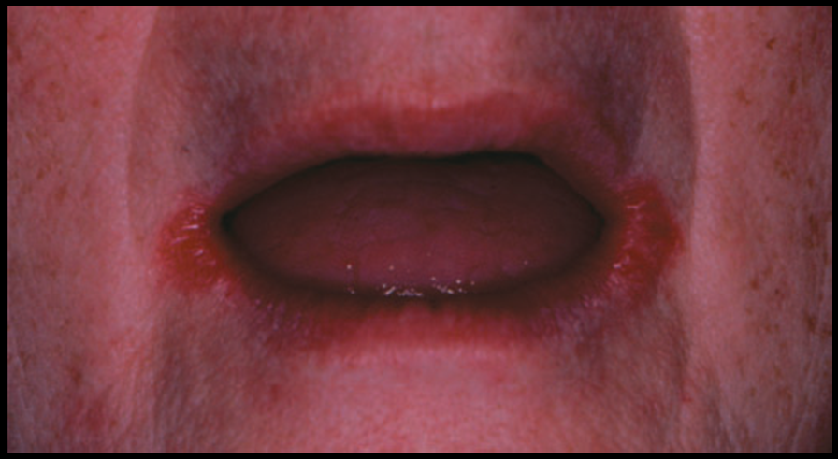
Actinic chelitis
Clinical features | Lower lip- atrophic epithelium, poor definition of vermilion skin margin, focal zones of keratosis;
Cause | UV light
significance | May result in squamous cell carcinoma
H/P | Overlying epithelium is atrophic and hyperkeratotic, basophillic change of sub mucosa, telangiectasia.
Considered to be invasive squamous cell carcinomas
Malignant transformation – 10%

Slide 4
Leukoplakia
A white oral precancerous lesion with a recognizable risk for malignant transformation.
A predominantly white lesion of the oral mucosa that cannot be characterized as any other definable lesion.
Commonly encountered precancerous lesions- leukoplakia and erythroplakia

Slide 5
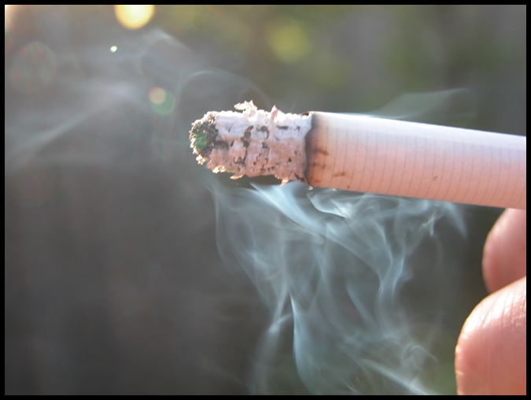
The risk of malignant transformation varies according to the histologic and clinical presentation, but the total lifetime risk of malignant transformation is estimated to be 4 to 6%.
Etiology- Occurs more frequently in smokers of tobacco compared to non-smokers of tobacco
Dose response relationship
Smokeless tobacco is also a well-established etiologic factor for the development of leukoplakia.

Slide 6
Hyperkeratosis
verrucous ca SCC
or SCC
Verrucous hyperplasia
dysplasia
In situ CA

Slide 7
Predisposing Factors
Local
  Poor oral hygiene
  Chronic trauma
  Alcohol
  Candidiasis, syphilis
  HPV infection
  UV radiation
  Electro-galvanism
Systemic
Genetic
  Nutritional Deficiency

Slide 8
The malignant transformation potential of smokeless tobacco–induced lesions is much lower than that of smoking-induced lesions.
There is some evidence that oral leukoplakia in nonsmokers has a greater risk for malignant transformation than oral leukoplakia in smokers.

Slide 9
70% of oral leukoplakia lesions - buccal mucosa, vermilion border of the lower lip, and gingiva.
Less common on the palate, maxillary mucosa, retromolar area, floor of the mouth, and tongue.
Lesions of the tongue and the floor of the mouth account for more than 90% of cases that show dysplasia or carcinoma.

Slide 10
CLINICAL SUBTYPES
Homogenous Leukoplakia
smooth/ furrowed/ ulcerated
Non- Homogenous Leukoplakia
Nodular / Speckled Leukoplakia
Verrucous Leukoplakia

Slide 11
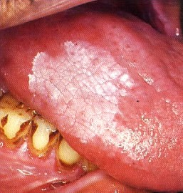
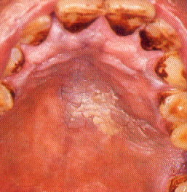
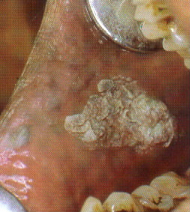
HOMOGENOUS LEUKOPLAKIA
well-defined white patch, localized or extensive, that is slightly elevated and that has a fissured, wrinkled, or corrugated surface
On palpation:- feel leathery to “dry, or cracked mud-like.”

Slide 12
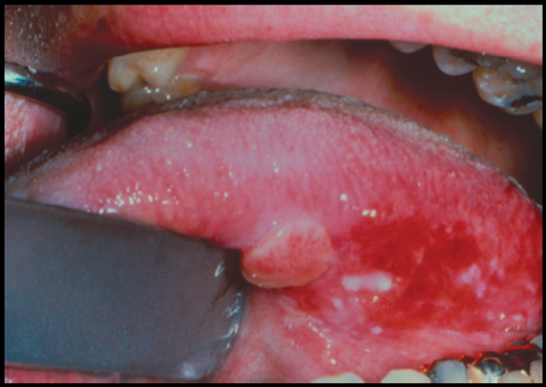
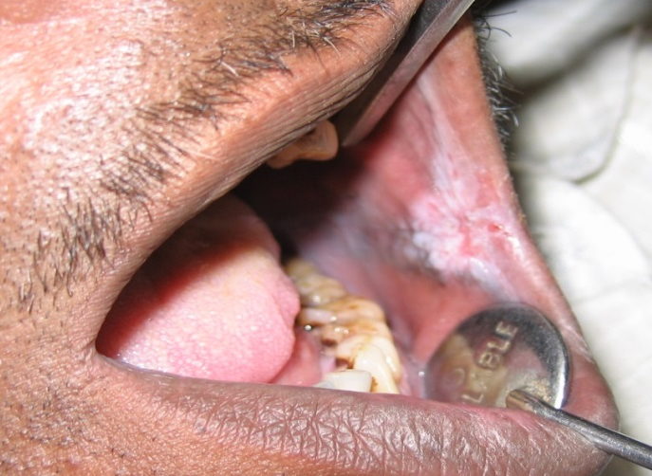
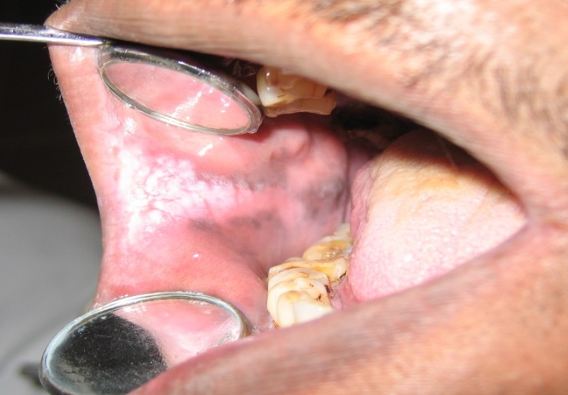
Nodular (speckled) leukoplakia is granular or nonhomogeneous.
A mixed red-and-white lesion in which keratotic white nodules or patches are distributed over an atrophic erythematous background
Associated with a higher malignant transformation rate, 2/3rd - epithelial dysplasia or carcinoma.

Slide 13
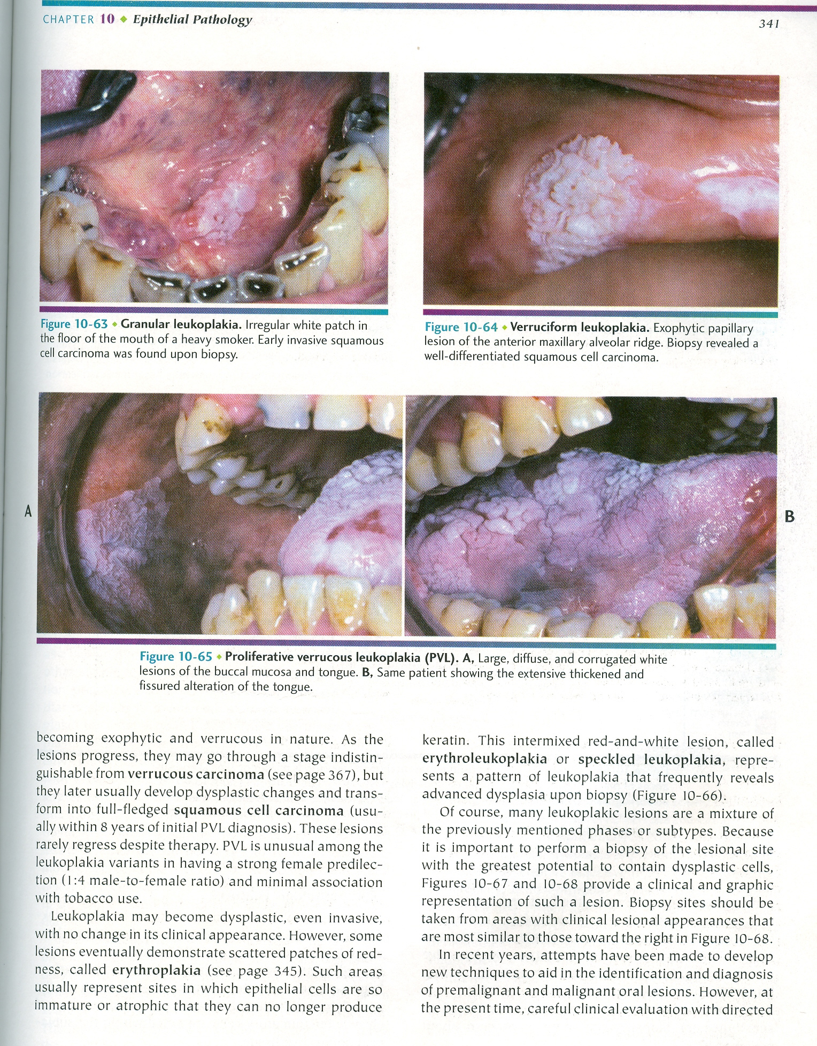
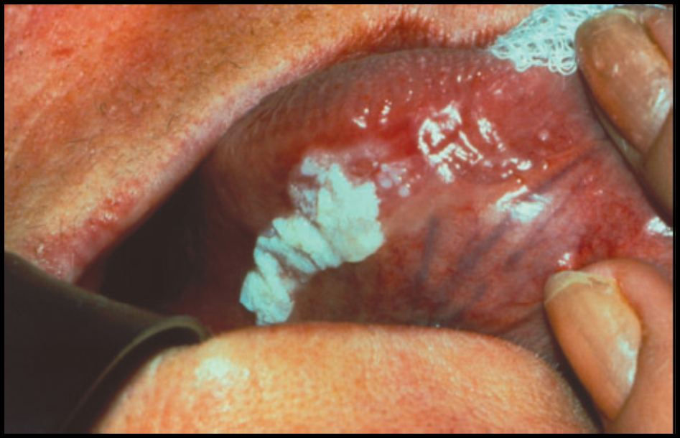
VERRUCOUS LEUKOPLAKIA

Slide 14
Verrucous leukoplakia or “verruciform leukoplakia” is a term used to describe the presence of thick white lesions with papillary surfaces in the oral cavity.
Heavily keratinized, exophytic growth pattern, seen in older adults in the 6th- 8th decade of life.
Proliferative verrucous leukoplakia (PVL) was first described in 1985 by Hansen et al .
Extensive papillary or verrucoid white plaques
Tend to slowly involve multiple mucosal sites
Transform into squamous cell carcinomas over a period of many years.

Slide 16
PVL has a very high risk for transformation to dysplasia, squamous cell carcinoma or verrucous carcinoma 40 -100%
Verrucous carcinoma is almost always a slow growing and well-differentiated lesion that seldom metastasizes.

Slide 17
Waldron and Shafer, in a landmark study of over 3,000 cases of leukoplakia, found that 80% of the lesions represented benign hyperkeratosis (ortho- or parakeratin) with or without acanthosis.
About 17% of the cases were epithelial dysplasias or carcinomas in situ.
The dysplastic changes typically begin in the basal and parabasal zones of the epithelium.
Only 3% of the leukoplakic lesions examined had evolved into invasive SCC.

Slide 18
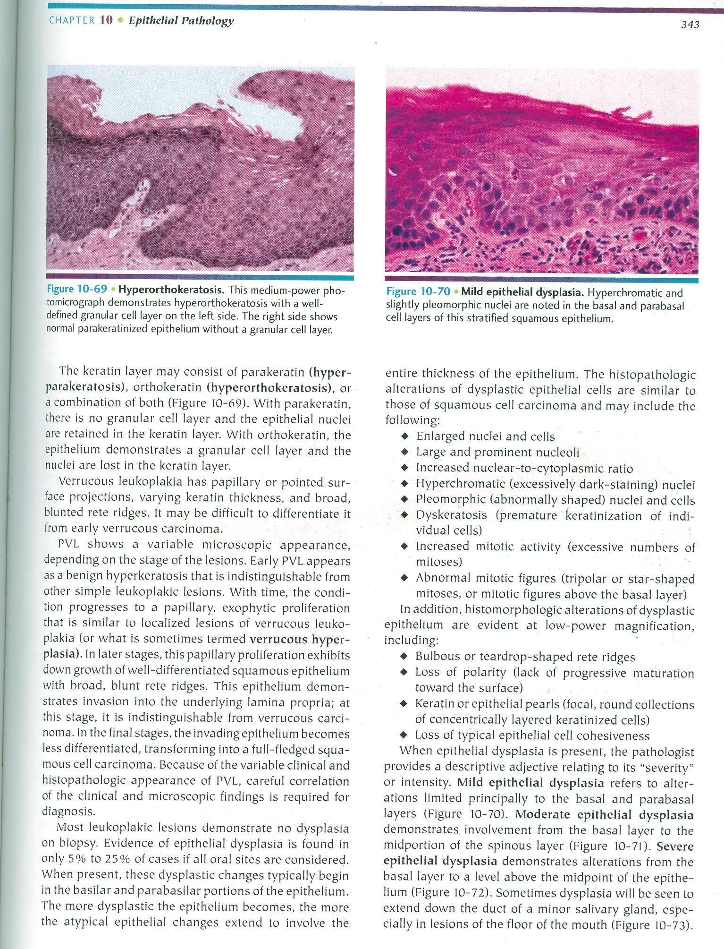
HISTOPATHOLOGIC FEATURES
Hyperkeratosis
Mild Epithelial
Dysplasia

Slide 19
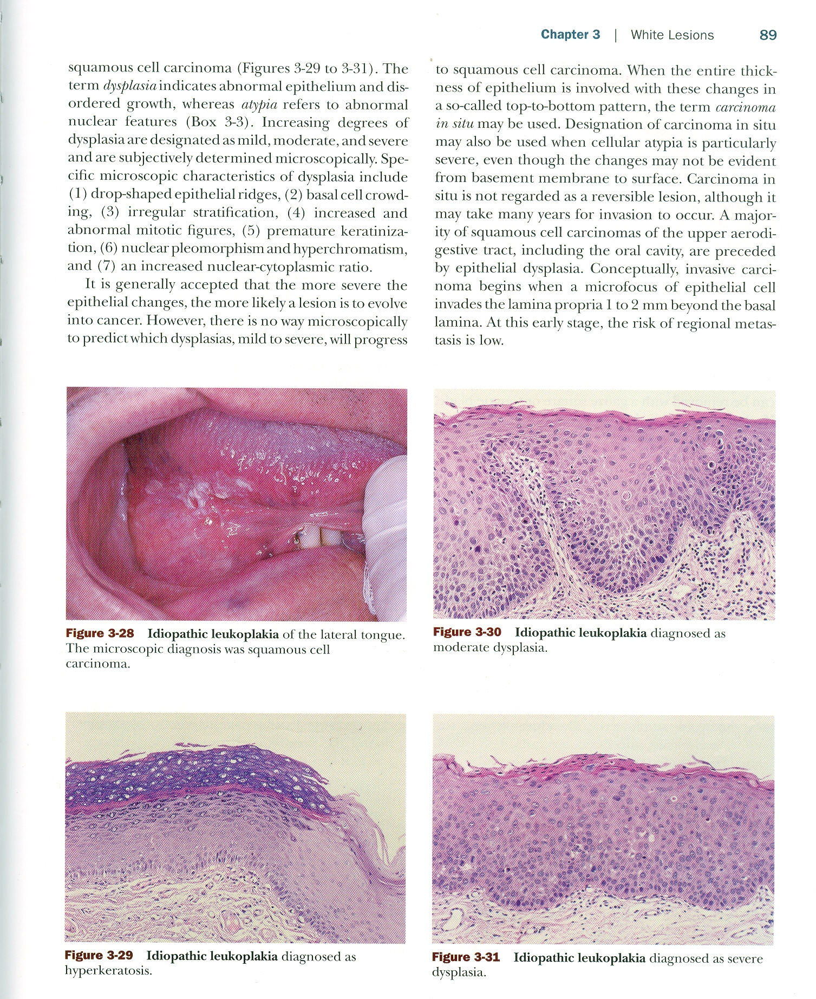
HISTOPATHOLOGIC FEATURES
Moderate Dysplasia
Severe Dysplasia

Slide 20
A Important clinical criteria include location, appearance, known irritants, and clinical course.
Many white lesions can mimic leukoplakia clinically and should be ruled out before a diagnosis of leukoplakia is made.
These include lichen planus, lesions caused by cheek biting, frictional keratosis, smokeless tobacco–induced keratosis, nicotinic stomatitis, leukoedema, and white sponge nevus.

Slide 21
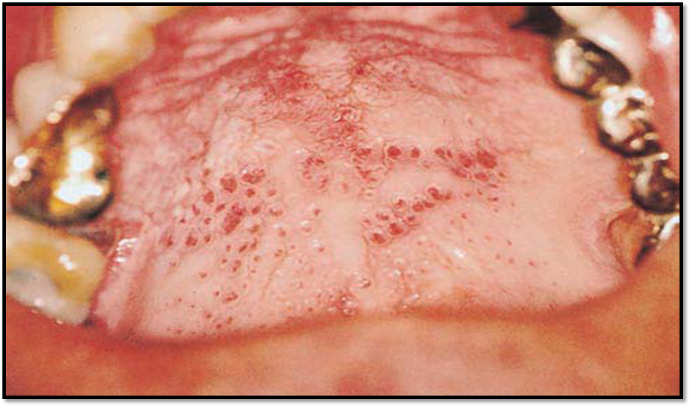
Nicotine stomatitis
Clinical features | Asymptomatic, generalised opacification of palate with red dots: salivary gland orifices
Cause | Heat and smoke associated with combustion of tobacco
significance | Rarely develops into palatal cancer, completely reversible once the habit is discontinued.
H/P | Surface epithelium exhibits hyperkeratosis and acanthosis Squamous metaplasia and hyperplasia of the salivary ducts as they approach the surface Mild to moderate scattered chronic inflammation. No atypical or dysplastic changes are usually identified.

Slide 22
White lesion associated with smokeless tobacco
Clinical features | Common, Asymptomatic white folds where tobacco is held, found: labial & buccal vestibule, granular or wrinkled.
Cause | Chronic irritation from snuff or chew
significance | Possible increased risk: verrucous and squamous cell carcinoma
H/P | - The epithelium is hyperkeratotic and thickened. - A characteristic vacuolization or edema may be seen in the keratin layer and in the superficial epithelium. - Frank dysplasia is uncommon in tobacco pouch keratosis.

Slide 23
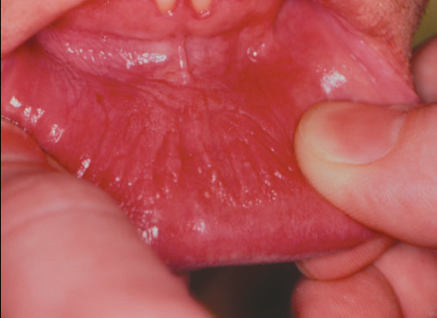
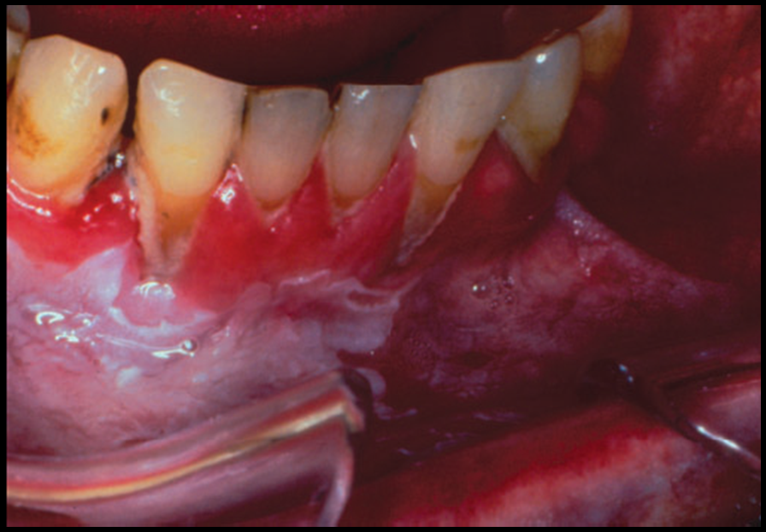
Snuff pouch with a white wrinkled mucosal surface.
Snuff pouch showing extensive periodontal tissue destruction and a thickened area of leukoplakia.

Slide 24
Precancerous conditions

Slide 25
A precancerous condition is “a generalized
state associated with significantly increased risk of cancer.”
The precancerous conditions include-
1. Oral submucous fibrosis
2. Lichen planus
3. Epidermolysis bullosa
4. Discoid lupus erythematous.

Slide 26
Sub mucosa fibrosis
The use of chillies (capsicum annum and capsicum frutescens), nutritional deficiencies, arecanut chewing have been proposed to causes of oral submucos fibrosis, but the etiology of this crippling condition is still unknown.
Epithelial dysplasia - 7- 26%
malignant transformation rate - 7%
Oral submucos fibrosis affects both sexes equally.
The most common site - buccal mucosa, retromolar areas, soft palate, palatel faces, uvula, and labial mucosa.

Slide 28
Histopathological features:
Atrophic epithelium, juxtra epithelial hyalinization and collagens of varying density.
In advanced cases this epithelium appears as a ribbon shape.
Features of OSF dysplasia is marked irregular stratification, nuclear pleomorphism and pronounced intercellular oedema.

Slide 29
Very early changes:- finely fibrillar collagen, interspread with odema and strong fibroelastic response. The blood vessels were dilated and congested. Inflammatory cells in this stages consisted of polymorphs and occasional eosinophils.
Early stage: - juxtra epithelial hyalinization, the collagen was thickened and seen as separate bundles. Chronic inflammatory cell infiltrate predominantly lymphocytes plasma cells and occasional eosinophils.
Moderately advanced and advanced stages: - hyalinization of the connective tissue to a variable extent. There was no odema and predominant inflammatory cells were lymphocytes and plasma cells.

Slide 30
Lichen planus
Clinical features | Bilaterally whote straie(whickhams), asymptomatic except when erosions seen. Middle age, buccal mucosa, occasionally: tongue, gingiva, palate. Skin: occasional, purple pruritic papules; fore arm, lower leg.
Cause | Unknown, may be precipitated by stress, hyper immune condition mediated by t cell, diabetes, hepatitis C, trauma, hypersensitivity to drugs and metals
significance | May regress after many years; treatment may control disease, rare malignant transformation.

Slide 31
Oral lichen planus
OLP is a common chronic immunologic inflammatory mucocutaneous disorder that varies in appearance from keratotic (reticular or plaquelike) to erythematous and ulcerative.
About 28% - OLP also have skin lesions.
Annual malignant transform rate 0.36%/ year.
The skin lesions are flat violaceous papules with a fine scaling on the surface.

Slide 32
Unlike oral lesions, skin lesions are usually self-limiting, lasting only 1 year or less.
Thus, there are many clinical and histologic similarities between lichen planus and lichenoid dermatoses and stomatitides associated with drugs, some autoimmune disorders, and graft-versus-host reactions.
In “true” OLP a specific causative factor cannot be identified.

Slide 33
However when clinical and microscopic changes, consistent with OLP will occur in response to a variety of agents (eg. drugs, chemicals, metals, and foods), they are referred to as “lichenoid” reactions.
When the offending agent or antigen is removed, the signs and symptoms are reversed.
These reactions are not to be confused with other hypersensitivity reactions such as urticaria or erythema multiforme, which differ both clinically and microscopically.

Slide 34
The skin lesions of lichen planus have been classically described as purple, pruritic, and polygonal papules.
OLP
Atrophic (keratotic changes combined with
Mucosal erythema),
Reticular (lacelike keratotic mucosal
Configurations)
Erosive & Bullous

Slide 36
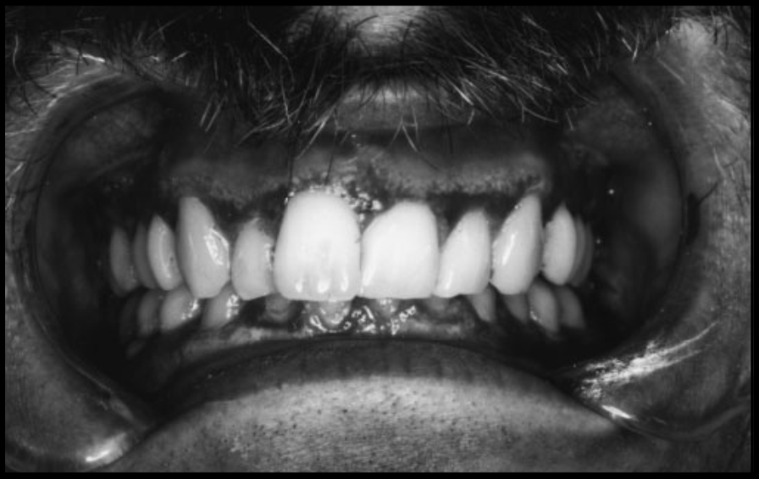
Reticular lichen planus of the
buccal mucosa.
Atrophic lichen planus of the gingiva.

Slide 37
Erosive lichen planus of the tongue.

Slide 38
The reticular form consists of
(a) slightly elevated fine whitish lines (Wickham’s striae) that produce either a lacelike pattern or a pattern of fine radiating lines or
(b) annular lesions.
However, even large plaque like lesions may occur on the cheek, tongue, and gingivae, and these are difficult to distinguish from leukoplakia.

Slide 39
Bullous lichen planus is rare
Atrophic lichen planus presents as inflamed areas of the oral mucosa covered by thinned red-appearing epithelium.
Erosive lesions probably develop as a complication of the atrophic process when the thin epithelium is abraded or ulcerated.
These lesions are invariably symptomatic, with symptoms that range from mild burning to severe pain.

Slide 40
Characteristically, the affected areas of the oral mucosa are not bound down or rendered inelastic by lichen planus, and the keratotic white lines cannot be eliminated by either stretching the mucosa or rubbing its surface.

Slide 41
Histopathologic Features
Three essential features for the histopathologic diagnosis of lichen planus:
Areas of hyperparakeratosis or hyperortho keratosis often with a thickening of the granular cell layer and a saw-toothed appearance to the rete pegs;
“liquefaction degeneration,” or necrosis of the basal cell layer, which is often replaced by an eosinophilic band; and
A dense subepithelial band of lymphocytes

Slide 42
Hyperkeratosis, epithelial atrophy, and a dense subepithelial band of lymphocytes.(H&E 40x)

Slide 43
Lupus erythematous
Clinical features | symptomatic, especially if the patient ingests hot or spicy foods, and often consist of erythema, surface ulceration, keratotic plaques, and white striae or papules. These lesions frequently appear lichenoid although they may be nonspecific and resemble leukoplakia, vesiculobullous disease, or even a granulomatous lesion. most prevalent on the buccal mucosa, gingival tissues, the vermilion border of the lip, and the palate
Cause | immunologically mediated inflammatory condition
H/P | Hyperorthokeratosis with keratotic plugs, atrophy of the rete ridges, and liquefactive degeneration of the basal cell layer. Edema of the superficial lamina propria is also quite prominent. Immediately subjacent to the surface epithelium is a band of PAS-positive material, and frequently there is a pronounced vasculitis in both superficial and deep connective tissue.

Slide 44
DIFFERENTIAL DIAGNOSIS

Slide 45
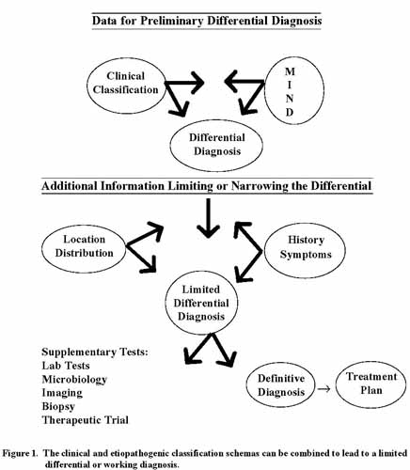

Slide 46
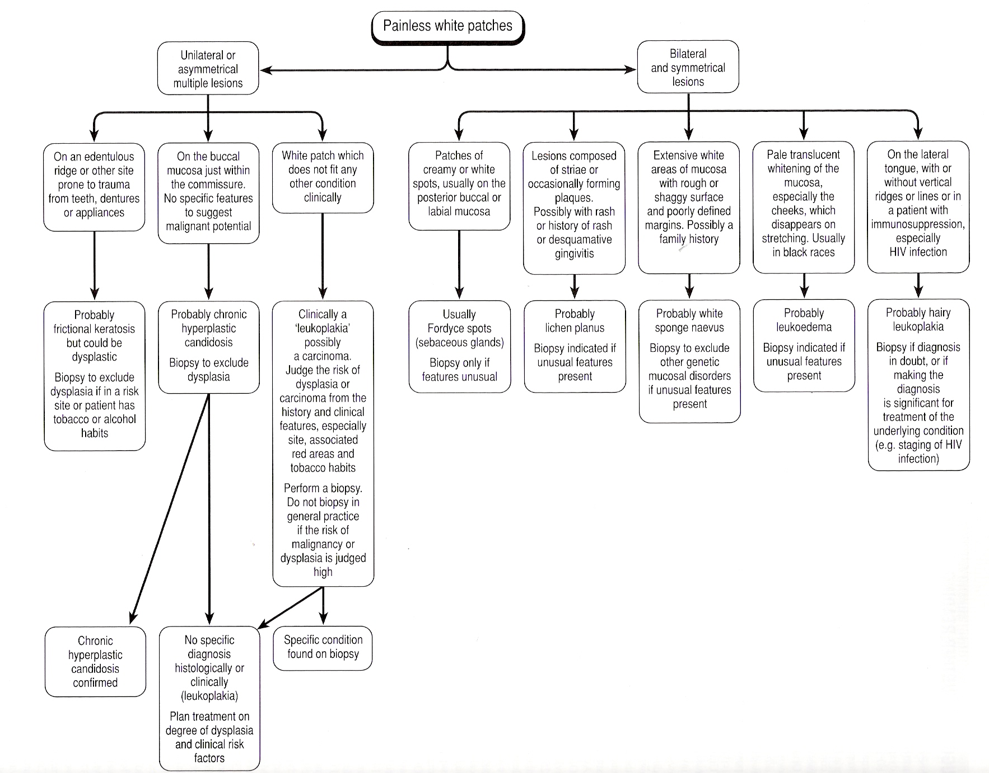

Slide 47
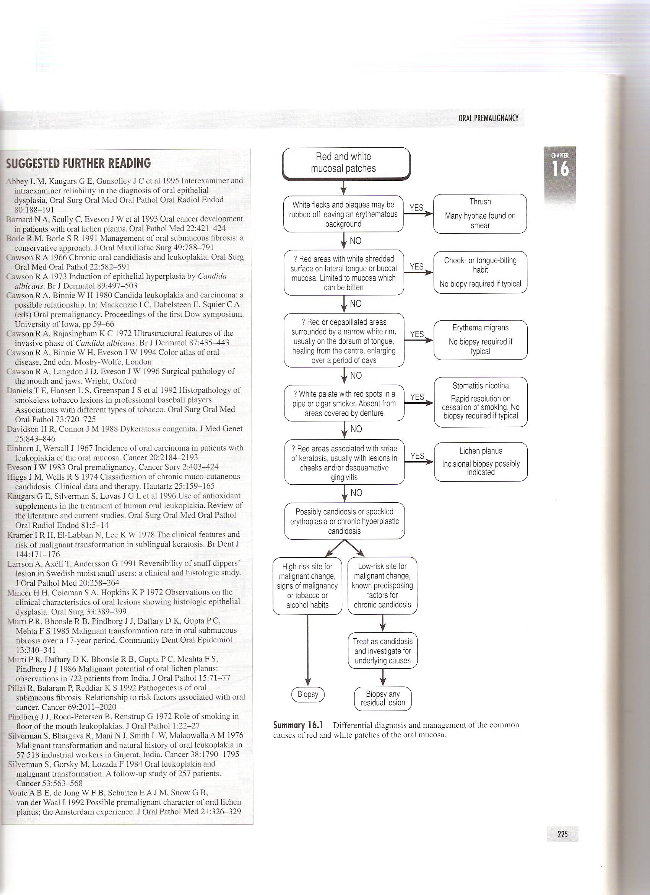

Slide 48
CONCLUSION

