Slide 1
Primary Health Care

Slide 2

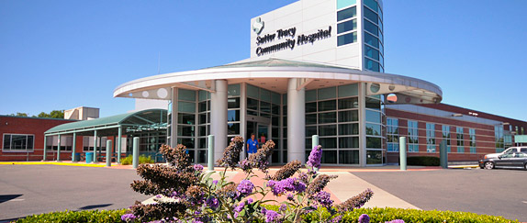
Introduction
Health: fundamental human right
State has responsibility for the health of its people.
Current criticism against heath care services.
    Predominantly urban oriented
    Mostly curative
    Accessible mainly to small part of the population

Slide 3
Concept of health care
Health is influenced by number of factors e.g. food, housing, basic sanitation, healthy life styles, environmental hazards etc.
Thus “health” care implies more than “medical care”.
Health care is a public right and its responsibility is of government.

Slide 4
Levels of health care
Primary care level
  First level of contact of individual, family and community to the national health system
  Provided by the primary health care centres and their subcentres

Slide 5
Secondary care level:
  Next higher level of care
  More complex problems are dealt
  Generally provided in district hospitals and community health centres

Slide 6
Tertiary care level:
  More specialized level
  Provided by regional or central level institutions

Slide 7
Changing concepts of Health Care
Comprehensive Health Care:
  Term is coined by Bhore Committee in 1946

Slide 8
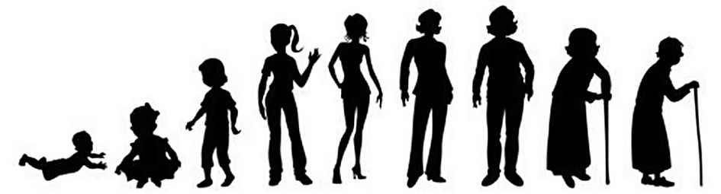
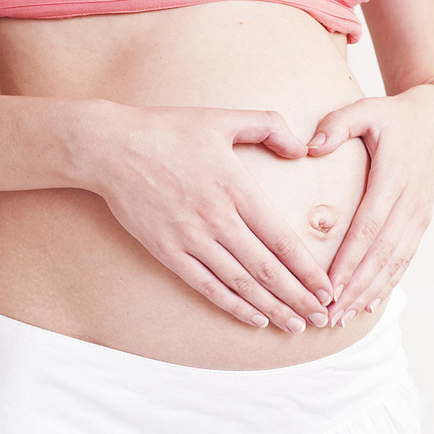
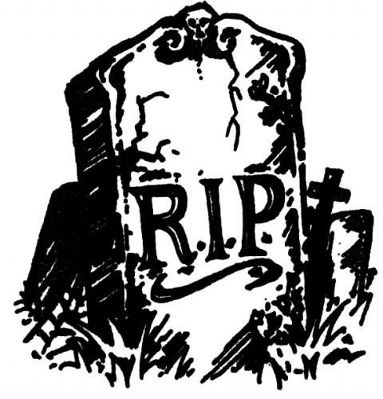
It meant provision of integrated preventive, curative and promotional health services from “womb to tomb” to every individual

Slide 9


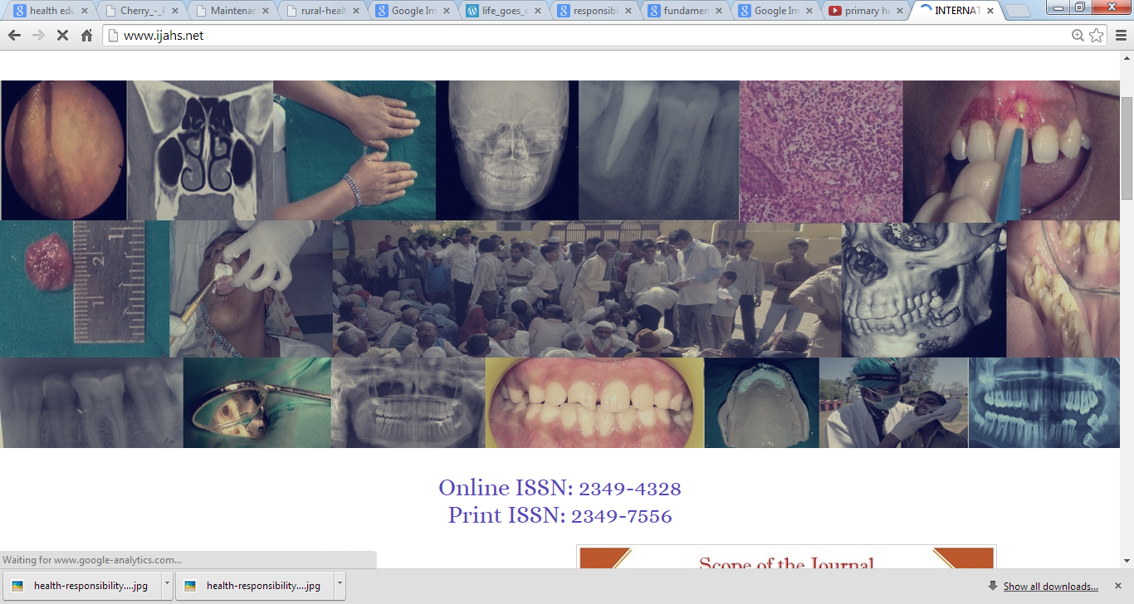
Criteria's
Provide adequate preventive, curative and promotive health services

Slide 10
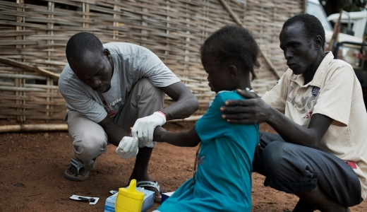
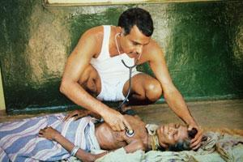
Be as close to the beneficiaries as possible

Slide 11

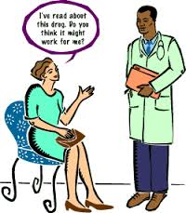
Widest cooperation b/w the people, the service and the profession

Slide 12


Available to all irrespective of their ability to pay

Slide 13
Look after specifically weaker sections of community
Create and maintain a healthy environment both in homes as well as working places

Slide 14
Basic Health Services
Used by UNICEF/WHO in 1965
“A basic health service is understood to be a network of coordinated, peripheral and intermediate health units capable off performing effectively a selected group of functions essential to the health of an area and assuring the availability of competent professional and auxillary personnel to perform these functions.”

Slide 15
Drawbacks:
  Lack of community participation
  Lack of intersectoral coordination
  Dissociation from the socioeconomic aspects of the health

Slide 16
Primary health care
Came into existence in 1978 following an international conference at Alma Ata(USSR).
“Primary health care is essential health care made universally accessible to individuals and acceptable to them, through their full participation and at a cost the community and country can afford”
Notes:
Union of Soviet Socialist Republics

Slide 17
The concept of primary health care is accepted by all the countries
Also accepted as an integral part of the country’s health system

Slide 18
Elements of primary health care
Education concerning prevailing health problems and the methods of preventing and controlling them;
Promotion of food supply and proper nutrition;
An adequate supply of safe water and basic sanitation;
Maternal and child health care, including family planning;

Slide 19
Immunization against major infectious diseases;
Prevention and control of locally endemic diseases;
Appropriate treatment of common diseases and injuries;
Provision of essential drugs.

Slide 20
Principles of Primary Health Care

Slide 21
Primary Health Care
Equitable Distribution
Appropriate Technology
Intersectoral Co-ordination
Community Participation
Focus on Prevention & Health Promotion

Slide 22
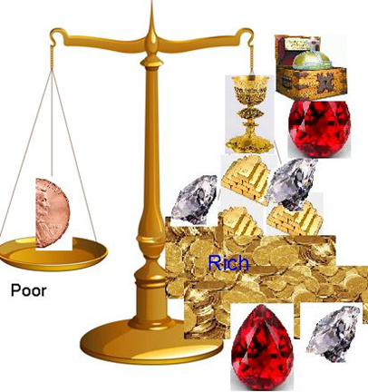
Equitable distribution
Health services must be shared equally by all the people, irrespective of the ability to pay and have access to health services.
Aim is to balance the social injustice done to weaker sections due to inaccessibility to services.

Slide 23
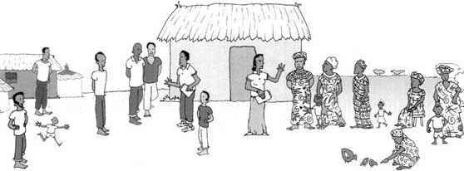
Community participation
It is a process by which individuals and their families assume responsibility for the health and welfare of their own as well as for the community, contributing to community’s development.
It produces a sense of responsibility on individuals.
India – use of village health guides and trained dais, similarly to china's bare-foot doctors, is a revolutionary step towards own health.

Slide 24
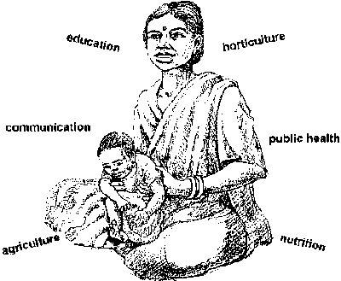
Intersectoral co-ordination
Health is the outcome of a large number of determinants.
Factors like unemployment, inadequate unsafe water, poverty, illiteracy, poor housing influence health status.

Slide 25

For betterment of health, countries need to review their administrative system, relocate resources, introduce co-ordination and co-operation between different sections of planning and evaluation.

Slide 26
Appropriate technology
Defined as – technology that is scientifically sound, adaptable to local needs, acceptable to those who apply it and use it and can be maintained by the people themselves in keeping with the principles of self-reliance with the resources the community and the country can afford.

Slide 27
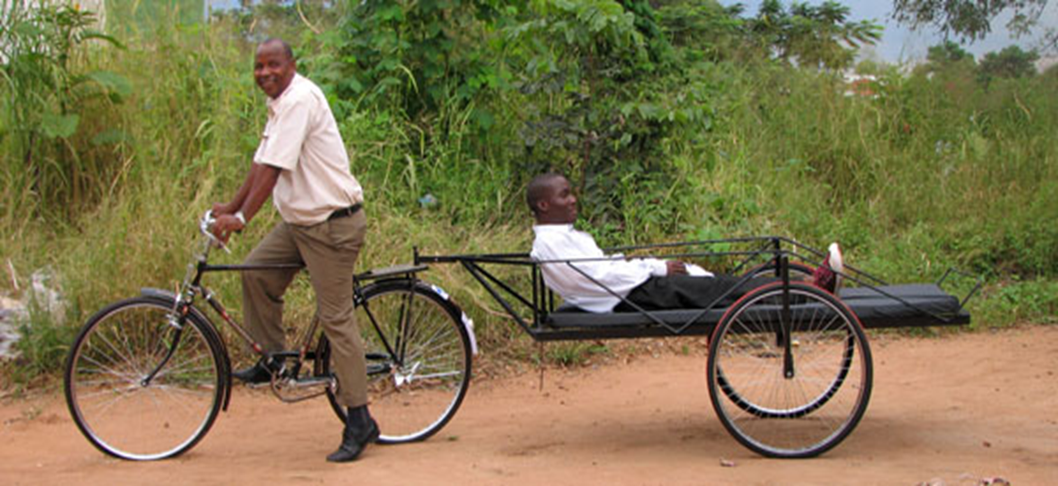

Slide 28
Focus on
Prevention and Health Promotion
Focus should be shifted from medical care/dental care to prevention and health promotion
Heart of Health Promotion is EMPOWERMENT
(refers to increasing economic, political, social, educational, gender or spiritual health of individuals and community)

Slide 29
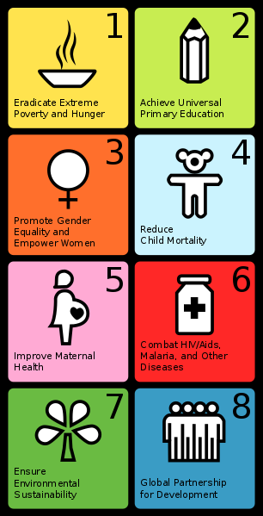
The Millennium Development Goals (MDGs) were the eight international development goals for the year 2015 that had been established following the Millennium Summit of the United Nations in 2000, following the adoption of the United Nations Millennium Declaration.

Slide 30
Indian Scenario

Slide 31
Public health sector
Private sector
Health care
systems
Indigenous systems of
medicine
Voluntary health agencies
National health programmes

Slide 32
Public Sectors
Primary health care centres
  Primary health centres and
  subcentres
Hospitals/health centres
  Community health centres
  Rural Hospitals
  District Hospital
  Special care Hospitals
  Teaching Hospitals
Health Insurance scheme
  Employees state insurance
  Central Government Health scheme
Other agencies
  Defense services
  Railways

Slide 33
Private sector
Private hospitals, nursing homes, polyclinics and dispensaries
General practitioners and clinics

Slide 34
Indigenous systems of Medicine
Ayurveda
Yoga
Unani
Siddha
Homeopathy

Slide 35
1977 – Govt. of India launched rural health scheme based on “placing people’s health in people’s hands”.
Primary care is based on three –tier system of health care.
To achieve WHO goal of health for all by 2000 A.D, India evolved national health policy based on primary health care (approved by Parliament 1983).

Slide 36
“3” Tier System
Primary health care worker at local community / village level
Trained paraprofessional worker at Second / intermediate level
Trained professional worker at Third level

Slide 37
Rural primary health care
The health care infrastructure in rural areas has been developed as a three tier system and is based on the following population norms:
centre | Population norms
 | Plain areas | Hilly/tribal/difficult areas
Sub-Centre | 5000 | 3000
Primary Health Centre | 30,000 | 20,000
Community Health Centre | 1,20,000 | 80,000

Slide 38
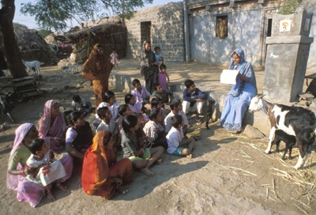
  Village level:
  the schemes under this are:
    Village health guides schemes –
      Scheme was introduced on 2nd October 1977.
      A village health guide is a person with an aptitude for social service and is not a full time government employee.
      May 1986 – guides replaced by females chosen by the community.

Slide 39
      Guidelines for their selection –
        They should be permanent residents of the local community.
        They should be able to read and write.
        They should be acceptable to all sections of the community.
        They should be able to spare 2-3 hours every day.

Slide 40
      After selection, the health guides undergo short training in PHC for 200 hrs/ 3 months.
      Stipend of Rs. 200 / month.
      On completion of training – working manual & kit of medicines is given.

Slide 41
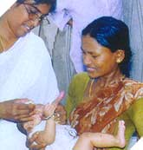
      Duties of health guide –
        Treatment of simple ailments.
        First-aid
        Maternal-child care and family planning.
        Health education.
        Sanitation.

Slide 42
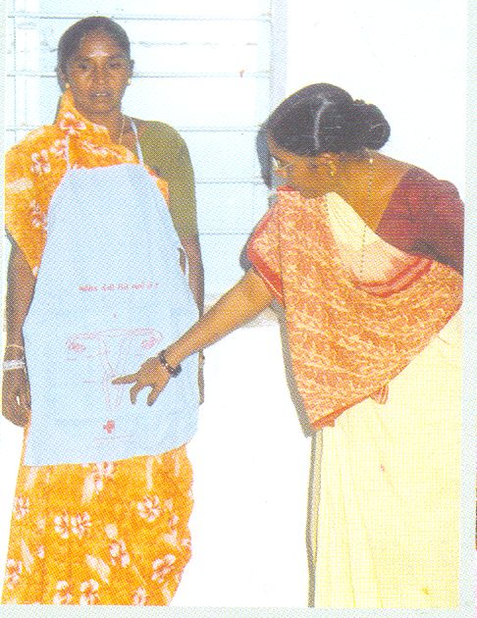
Local dais
Also called as traditional birth attendants.
The training is for 30 working days given at PHC, sub centre for 2 days/ week and remaining days accompany the health worker to villages.

Slide 44
Stipend of Rs. 300 during the training.
Requirements during training – conduction of 2 deliveries under supervision with emphasis on asepsis.

Slide 45
On completion of training –
  given a delivery kit
  Certificate
  Rs. 10/ delivery
  Rs. 3/ infant registration
National target – 1 local Dai in each village

Slide 46
Anganwadi worker
Word ANGAN – courtyard
Under ICDS Scheme – 1 Anganwadi worker/ 1000 population.
Selected from within the community.

Slide 47
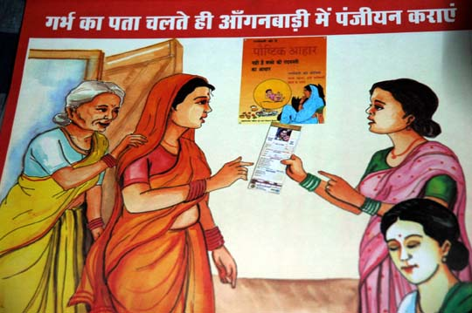
Training in – (4 months)
  Health
  Nutrition
  Child development
Worker is part-time, receive stipend of Rs. 200-250/ month

Slide 48
Duties –
  Health check-up
  Immunization
  Supplementary nutrition
  Health education
  Referral services

Slide 49
Beneficiaries are –
  Nursing mothers
  Other women aged 15-45 yrs
  Children below age 6 years

Slide 50
Accredited Social Health Activist
Accredited social health activists (ASHAs) is community health workers instituted by the government of India's Ministry of Health and Family Welfare(MoHFW) as part of the National Rural Health Mission (NRHM)
The mission began in 2005; full implementation was targeted for 2012. Once fully implemented, there is to be "an ASHA in every village" in India, a target that translates into 250,000 ASHAs in 10 states.
The grand total number of ASHAs in India was reported in July 2013 to be 870,089

Slide 51
The Indian MoHFW describes them as:
“Health activist(s) in the community who will create awareness on health and its social determinants and mobilize the community towards local health planning and increased utilization and accountability of the existing health services.”

Slide 52
Roles and responsibilities
Their tasks include
  motivating women to give birth in hospitals,
  bringing children to immunization clinics,
  encouraging family planning (e.g., surgical sterilization),
  treating basic illness and injury with first aid,
  keeping demographic records, and improving village sanitation

Slide 53
they receive outcome-based remuneration and financial compensation
if an ASHA facilitates an institutional delivery she receives Rs. 600 and the mother receives Rs. 1400. ASHAs also receive Rs. 150 for each child completing an immunization session and Rs. 150 for each individual who undergoes family planning.

Slide 54
Sub – centre level :
the most peripheral and first contact point between the primary health care system and the community.
Under Minimum Needs Program –
  1 sub-centre /5000 population
  1 sub-centre/3000 population in hilly/tribal areas

Slide 55
Functions –
  Mother and child health care
  Family planning
  Immunization

Slide 56
    The Sub- Centres are provided with basic drugs for minor ailments.
    staffing pattern -
Staffing pattern for sub - centre | No. of posts
Health worker (female) | 1
Health worker (male) | 1
Voluntary worker (Paid @ Rs.100/- p.m. as honorarium). | 1
Total | 3

Slide 57
Primary health Centre level
Basic health unit
  1 PHC / 30,000 rural population
  1 PHC / 20,000 population in hilly, tribal and backward areas
It acts as a referral unit for 6 Sub Centres.
It has 4 - 6 beds for patients.

Slide 58
Staffing pattern at PHC | No. of posts
Medical officer | 1
Pharmacists | 1
Nurse mid-wife | 1
Health worker (female)/ANM | 1
Block extension educator | 1
Health assistant (male) | 1
Health assistant (female) | 1
Upper division clerk( U.D.C) | 1
Lower division clerk (L.D.C) | 1
Lab. Technician | 1
Driver | 1
Class IV | 4
Total | 15

Slide 59
Duties of the PHC medical officer
General
Organize outpatient clinic
Supervisory
Supervise other members
Administrative
Co-ordinates with other agencies working in the area
Attend medico-legal / emergency cases
Organize indoor services/ laboratory services
Refer cases to hospitals
Visit other sub-centers and villages
Guide & check staff tours
Report all activities to chief medical officer
Maintain indents, receipts and supplies

Slide 60
    Functions of PHC –
      Medical care
      MCH including family planning
      Safe water supply and basic sanitation
      Prevention and control of locally endemic diseases
      Collection and reporting of vital statistics
      Education about health
      National health programmes
      Referral services
      Training of health guides, health workers and assistants
      Basic laboratory services
    Under ROME (Reorient Medical Education) – 3 PHC attach to 1 medical college.

Slide 61
Community health centre
CHCs are being established and maintained by the State Government.
It serves as a referral centre for 4 PHCs.
31st March 2008 – 4276 CHC established
CHC officer- selected from supervisory category of staff at PHC.

Slide 62
Functions
Care of routine and emergency cases in surgery & medicine
24-hours delivery services
Care of routine and emergency cases in obstetric
Abortion
New born care
National health program
Blood storage facility & essential laboratory services

Slide 63
Staffing pattern at CHC | No. of posts
Medical officer | 4
Nurse mid-wife | 7
Dresser | 1
Pharmacist | 1
Lab. Technician | 1
Radiographer | 1
Ward boys | 2
Dhobi | 1
Sweeper | 3
Mali | 1
Chowkidar | 1
Aya | 1
Peon | 1
Total | 25

Slide 64
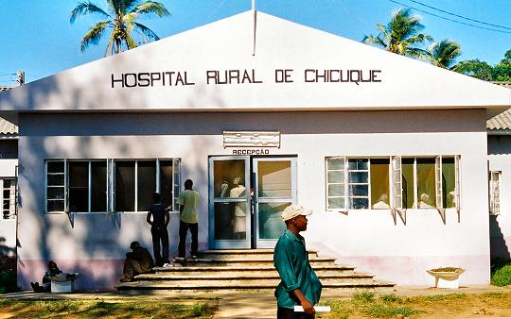
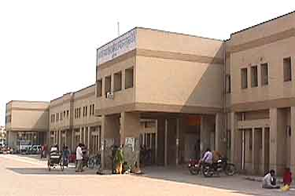
Hospitals
Rural hospitals:
  Located at Tehsil/Sub-divisional/ Taluka Headquarters.
  It is proposed to convert Sub-Divisional hospitals into sub-divisional health centers to cover about 5 lakh population and will have an epidemiological wing attached to it.
District hospitals:
  Under multipurpose worker scheme –
    An integrated set-up at district level
    Chief medical officer of district with 3 deputy CMO, each in charge of ⅓ of the district.

Slide 65
HOSPITALS | HEALTH CENTER
Services provided are curative | Integrated services (curative, preventive, promotive)
No catchment area (no specific area of responsibility). | Responsible for specific area & population
Health team consist of curative staff (doctors, nurses) | Health team is mix (medical & paramedical workers)

Slide 66
Health Insurance
There is no universal health insurance in India
At present it is limited to the industrial workers and their families
Central Government employees are also covered by Central Government Health Scheme

Slide 67
Employees state insurance scheme:
1948 – introduced by Act of Parliament
It provides for
  medical care in cash and kind
  benefits in the emergency of sickness
  Maternity
  Employment injury
  Pension for dependents of death worker because of employment injury

Slide 68
The act covers employees
  with the wage range of Rs. 15,000 / month.
  Manual workers
  Clerical workers
  Technical workers

Slide 69
Central Government Health Scheme:
1954 – scheme introduced in Delhi.
Provide comprehensive medical care to Government employees.
Based on co-operative effort of employees/employers.

Slide 70
    Facilities provided –
      Out patient care
      Essential drugs supply
      Lab investigations/x-rays
      Hospitalization
      Specialist consultation
      Antenatal/natal/post-natal care
      Supply optical/dental aids
      Family welfare services

Slide 71
    Beneficiaries –
      Retired central government employees
      Members of parliament
      Ex-governors & retired judges
      Widows receiving family pension

Slide 72
Other Agencies
Defense Medical Services:
  Have own organization under Armed Forces Medical Services.
  Services provided are integrated/ comprehensive.
Health Care of Railway Employees:
  Railways provide comprehensive health care services through agencies of railway hospitals, health units and clinics.
  Health check-up done at the time of entry into services.
  Presence of lady medical officers, health visitors for MCH and school health services.
  Specialist services also available at divisional hospitals.

Slide 73
Private sector
Private practice in India provides a large share to health services.
General practitioners constitute 70% of the medical profession for providing curative services.
MCI & IMA regulate the functions and activities of the private medical professionals.

Slide 74
Indigenous system of medicine
Practitioners of indigenous systems like Ayurveda, Homeopathy provide bulk of medical care.
90% of Ayurveda physicians serve rural areas.
Ayurveda dispensaries are state run.
Government of India established –
  National Institute of Ayurveda (Jaipur)
  National Institute of Homeopathy (Kolkata)

Slide 75
Voluntary health agencies
Defined as –
  An organization that is administered by an autonomous board which holds meetings, collect funds for its support chiefly from private sources and expends money, whether with or without paid workers, in conducting a programme directed primarily to furthering the public health by providing health services or health education, or by advancing research or legislation for health, or by a combination of these activities.

Slide 76
Indian Red Cross Society
  Established in 1920.
  400 branches all over India.
  Activities –
    Relief-work during disaster, epidemics
    Milk and medical supplies in hospitals, schools, orphanages
    Armed forces –
      care of sick & wounded
      The red cross home – Bangalore
    Maternal & child welfare services
    Family planning
    Blood banks & first aid – St. John ambulance association

Slide 77
Hind Kusht Nivaran Sangh
  1950 – founded with headquarters in New Delhi
  Activities –
    Render financial assistance to leprosy homes/clinics
    Health education
    Training of medical workers
    Conduct research and field investigations
    Organize All-India Leprosy Workers Conferences

Slide 78
Indian Council for Child Welfare
  1952-established, affiliated to International Union for Child Welfare.
  Service for India’s children – enable to grow mentally, morally, spiritually and socially in health and in conditions of freedom & dignity.

Slide 79
Tuberculosis Association of India:
  1939 – formed with branches in all states.
  Activities –
    Train doctors, health workers in anti-TB work
    Health education
    Promote consultation & conferences

Slide 80
Bharat Sewak Samaj
  Non-political/non-official organization
  1952-formed
  Objective – help people to achieve health by own action/efforts.
  Activites – improvement of sanitation in villages

Slide 81
Central council welfare board
  Autonomous organization under Ministry of Education.
  1953 – established
  Functions –
    Survey the needs & requirements of voluntary welfare organizations.
    Promote & set social welfare organizations
    Render financial aid to other organization

Slide 82
Kasturba Memorial Funds
  Formed in 1944 after death of Kasturba Gandhi
  Objective – improve lot of women through gram-sevikas.

Slide 83
Family Planning Association of India:
  1949- established with headquarters in Mumbai.
  Promote family planning in India.

Slide 84


Slide 85


