Slide 1

Good morning

Slide 2
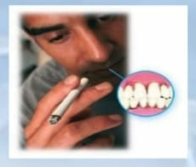
Smoking and periodontium

Slide 3
Learning objectives
Classification of smokers
Methods and constitute of tobacco smoking
Prevalence and severity of periodontitis
Effect of smoking _immunology and physiology
Effect of smoking on periodontal diseases
Effect of smoking on periodontal therapies

Slide 4
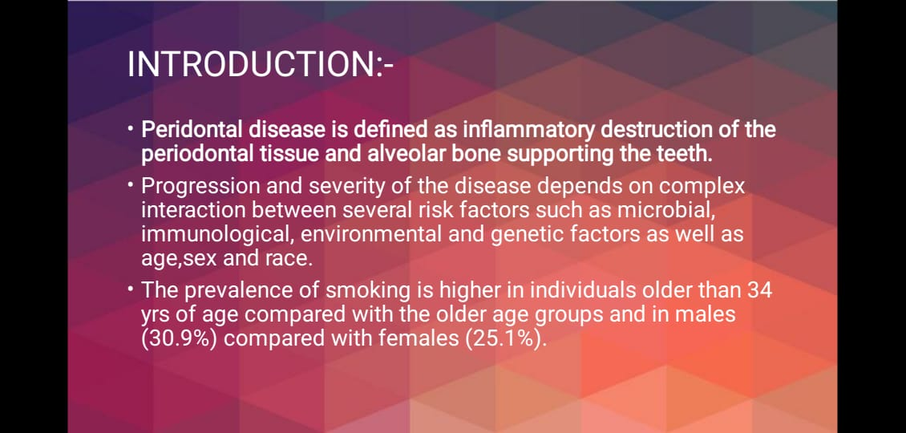

Slide 5
Introduction
Smoking is associated with a wide spectrum of disease including stroke ,coronary artery disease ,peripheral artery disease, cancer of mouth ,larynx, oesophagus ,pancreas.
It is also a major cause of chronic obstructive pulmonary diseases and risk factor for low birth weight babies.
Approximately 50% of regular smokers are killed by there habit and smoking causes 30% of cancer death.

Slide 6
Classification of smokers
Heavy smokers _ more than 20/day
Light smoker _less than 20 /day
Current smoker _who have smoked more than 100 cigarette in their life time and currently smokers
Non smokers _ who have not smoked cigarette in their life time and do not currently smokers.

Slide 7
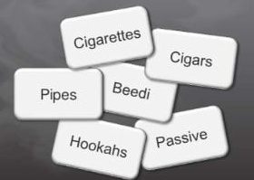
Different methods of tobacco smoking
1.cigarettes
2.cigar
3.beedi
4 .pipes
5.hookh
6.passive.

Slide 8
Constituent of tobacco smoking
Tobacco smoking consists of 4000known constitute _
Solid phases_nicotine,tar , benzene , benzopyrene
Gaseous phases _carbon monoxide and hydrogen cyanide Ammonia formaldehyde I dimethynitrosamine.

Slide 9
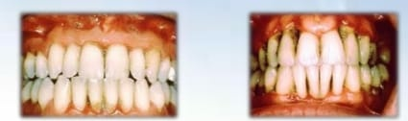
Prevalence of moderate and severe periodontitis
Current smokers 25%
Former heavy smokers 20%
Pipe smokers 17.6 %
Non-smoker 13.7%

Slide 10
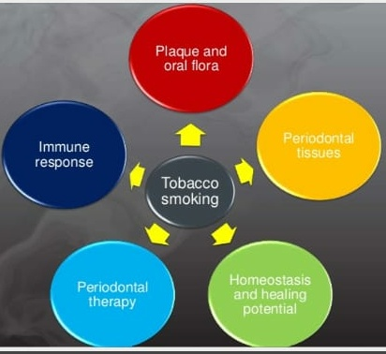

Slide 11
effect of smoking on etiology n pathogenesis of periodontal disease
Increased prevalence and severity of periodontal destruction associated with smoking suggest that host bacterial interaction normally seen in chronic periodontitis are altered, resulting in more destructive periodontal breakdown.
The imbalance between bacterial challenge and host response may be caused by_
Change in composition of Sub gingival plaque.
With increase in in number and virulence of pathogenic microorganisms.
Changes in in host response to the bacterial challenge
And combination of both.

Slide 12
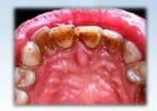
Effect of smoking
Increased level of microbial Colony_
Eiknella corrodens
Bacteroides forsythus
Prevotella nigrescens
Fusobacterium nucleatum.
A.actinomycetum comitans

Slide 13
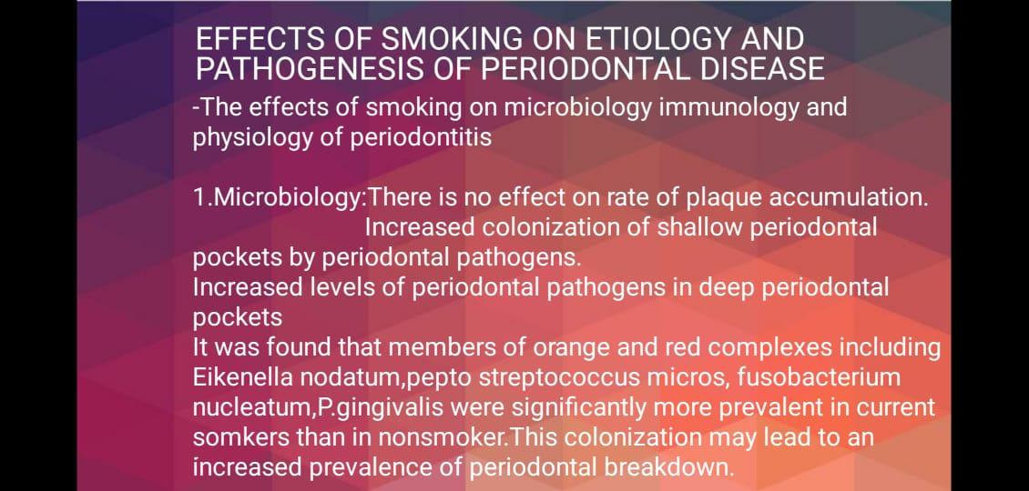

Slide 14
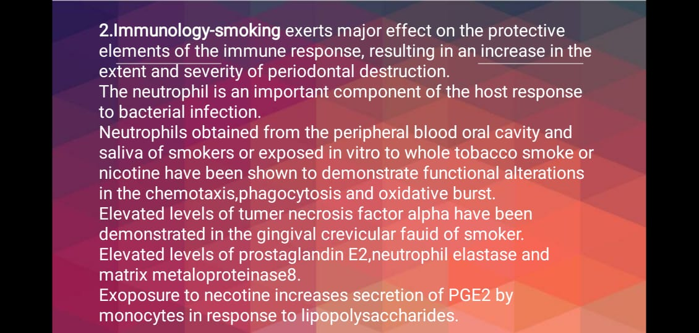

Slide 15
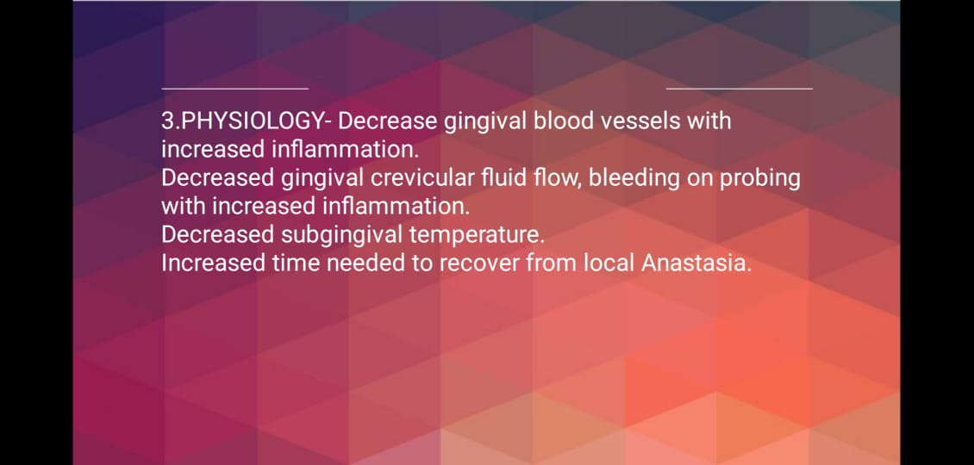

Slide 16
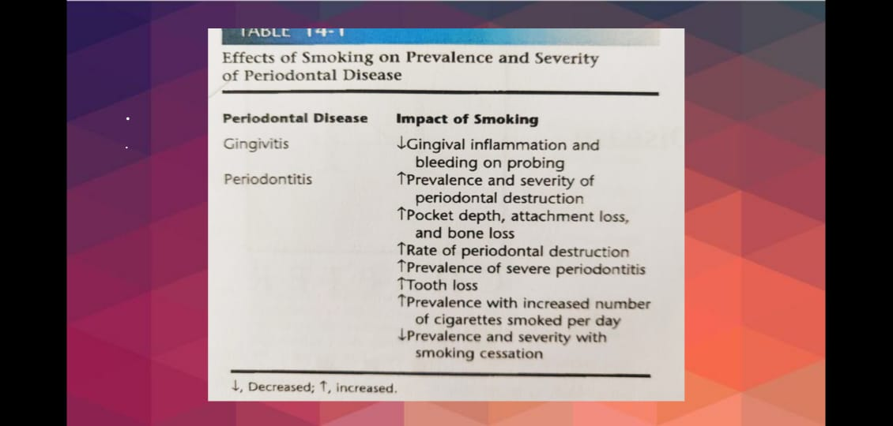

Slide 17
Effect of smoking on immunology
Altered neutrophil chemotaxis phagocytosis oxidative burst.
Increased TNF_alpha and PGE2 in GCF .
Increase the production of of PGE2 by monocytes in response to lipopolysaccharides.
Decreased igG2 level suggest reduced protection against periodontal infection.

Slide 18
Effect effect of smoking _physiology
Decreased GCF flow.
Decrease the subgingival temperature.
Increased bleeding on probing with increased inflammation.
Increased a time needed to recover from local anaesthesia.
Increased gingival blood vessel with increased inflammation.

Slide 19
Effect of smoking on periodontal diseases
Gingivitis_
1. Decreased gingival inflammation and bleeding on probing
Periodontitis_
Increased prevalence and severity of periodontal destruction.
Increase the pocket depth ,attachment and bone loss
Increased prevalence of severe periodontitis .
Increased tooth loss.

Slide 20
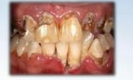
Smoking _predisposing factor for ANUG
Increased use of tobacco _increased frequency of ANUG
Reason_Tar in smoking _ irritating effect on gingiva
Nicotine _vasoconstriction of capillaries .

Slide 21
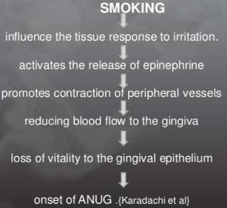

Slide 22
Effect of smoking on periodontal therapies
Non surgical_
Decreased clinical response to scaling and root planning .
Decrease reduction in pocket depth
Decrease the gain in clinical attachment level

Slide 23
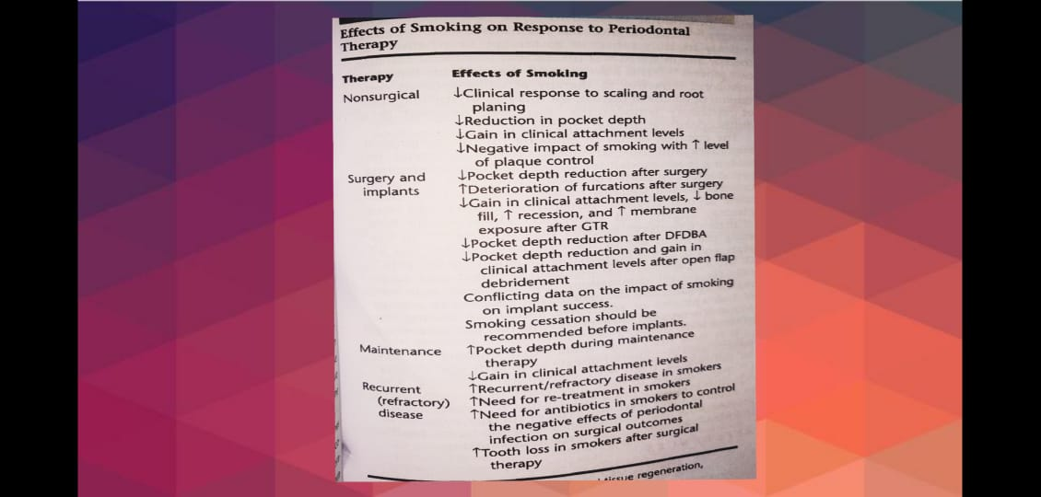

Slide 24
Surgery and implants
Decrease the pocket depth reduction post surgery
Decrease the pocket depth reduction after DFDBA allograft.
Decreased pocket depth reduction and gain in clinical attachment level after open flap debridement.
Decrease the gain in clinical attachment level decrease the bone fill, increased recession, increased membrane following GTR .

Slide 25
Maintenance phase
Increase the pocket depth during maintenance. Decreased gain in in clinical attachment level.
Recurrent disease _
Increased recurrent refractory disease in smokers
Increased need for or Re treatment in smoker
Increased tooth loss after surgical therapy.

Slide 26
Thank you !

