Slide 1
Gingival enlargement

Slide 2
Learning objective
Classification of gingival enlargement
Inflammatory GO
Drug induced GO
Conditioned GO
Clinical features
Histological features

Slide 3
classification
Based on etiologic & pathologic factors
Inflammatory enlargement
Chronic
Acute
II. Drug induced enlargement
III. Enlargements associated with systemic diseases or conditions
Conditioned enlargement
Pregnancy
Puberty
Vit c deficiency
Plasma cell gingivitis
b) Systemic diseases causing gingival enlargement
Leukemia
Granulomatous diseases
IV. Neoplastic enlargement
Benign tumors
Malignant tumors
V. False enlargement

Slide 4
Based on location & distribution
Localized- limited to the gingiva adjacent to a single tooth or group of teeth.
Generalized- involving the gingiva throughout the mouth.
Marginal- confined to the marginal gingiva.
Papillary- confined to the interdental papillae.
Diffuse- involving the marginal & attached gingivae & papillae.
Discrete- an isolated sessile or pedunculated, tumorlike enlargement.

Slide 5
Drug induced gingival enlargement
General clinical features:
Initially the growth starts as a painless beadlike enlargement of the interdental papilla & extends to the facial & lingual gingival margins.
Then it develops into a massive tissue fold covering a considerable portion of crown, interfering with occlusion.
When uncomplicated by inflammation :
It is mulberry shaped, firm, pale pink, & resilient, with a minutely lobulated surface and no tendency to bleed.
When it is complicated by inflammation :
The size of the lesion is increased, red or bluish red discoloration & shows increase tendency to bleed.

Slide 6
The enlargement is usually generalized throughout the mouth but it is more severe in the maxillary & mandibular anterior regions.
It occurs in areas in which teeth are present, not in edentulous spaces, & the enlargement disappears in areas from which teeth are extracted.
HISTOPATHOLOGY :
Hyperplasia othe connective tissue & epithelium.
Acanthosis of the epithelium.
Connective tissue shows densely arranged collagen bundles, increased fibroblast and blood vessels.
Elongated rete pegs.
An abundance of amorphous ground substance has also been reported.

Slide 7
anticonvulsants
Anticonvulsants like phenytoin, ethotoin, mephenytoin, succinimides, methsuxinimide & valproic acid are known to induce gingival enlargement.
Gingival enlargement occurs in about 50% patients receiving the drugs.
More often affects younger patients.
Phenytoin stimulates proliferation of fibroblast like cells & epithelium.
Fibroblasts show increased synthesis of sulfated glycosaminoglycans leading to gingival enlargement.
Also phenytoin induce a decrease in collagen degradation as a result of the production of an inactive fibroblastic collagenase.

Slide 8
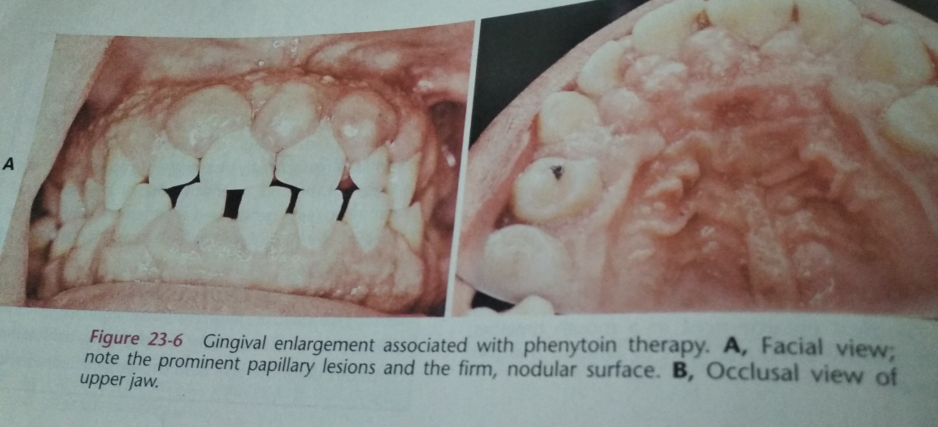

Slide 9
immunosuppressants
Cyclosporine is the immunosuppressant known to induce gingival enlargement.
It selectively and reversibly inhibits helper T cells, which play a roll in cellular & humoral immune responses.
Cyclosporine A is administered intravenously or by mouth, & dosages greater than 500mg/day lead to gingival enlargement.
Cyclosporine induced enlargement is more vascularized than phenytoin enlargement.
Incidence rates vary from 25% - 70% & it affects children more frequently.
Other side effects include- nephrotoxicity, hypertention, hypertrichosis.

Slide 10
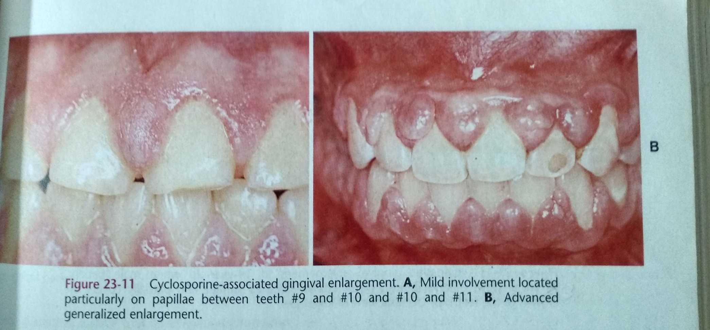

Slide 11
CALCIUM CHANNEL BLOCKERS
CCB’s inducing gingival enlargement are nifedipine, diltiazem, felodipine, nitrendipine & verapamil.
Nifedipine causes enlargement in 20% of patients.
Nifedipine is also used with cyclosporine in kidney transplant recipients, & the combined use of both drugs induces larger overgrowths.

Slide 12
TREATMENT OPTIONS
First, consideration should be given to the possibility of discontinuing the drug, or changing medication.
Alternative medications:
Nifedipine – diltiazem or verapamil
Cyclosporine – tacrolimus, azithromycine
Second, consideration should be oral hygiene reinforcement.
Third, if enlargement still persists then patients may require surgery, either gingivectomy or periodontal flap technique.

Slide 13
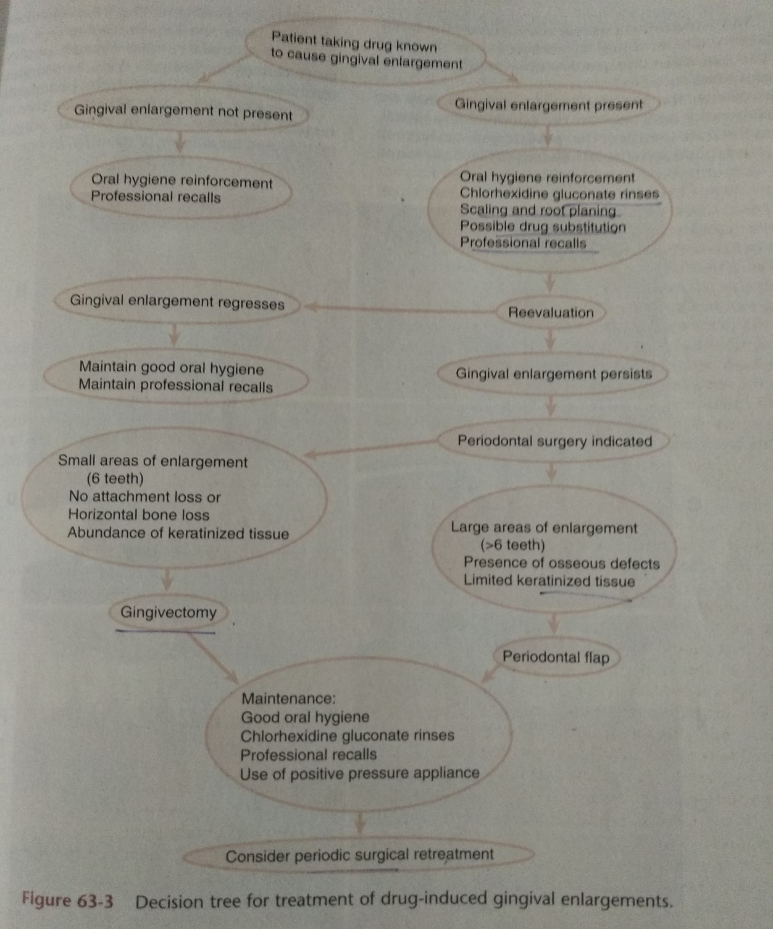

Slide 14
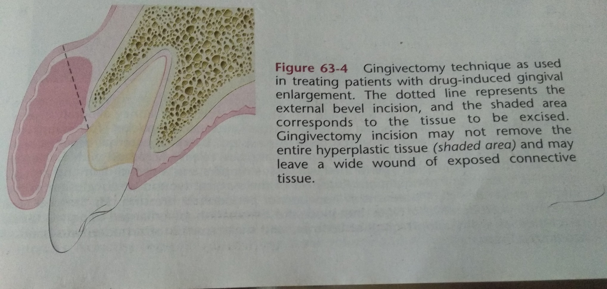
gINGIVECTOMY

Slide 15
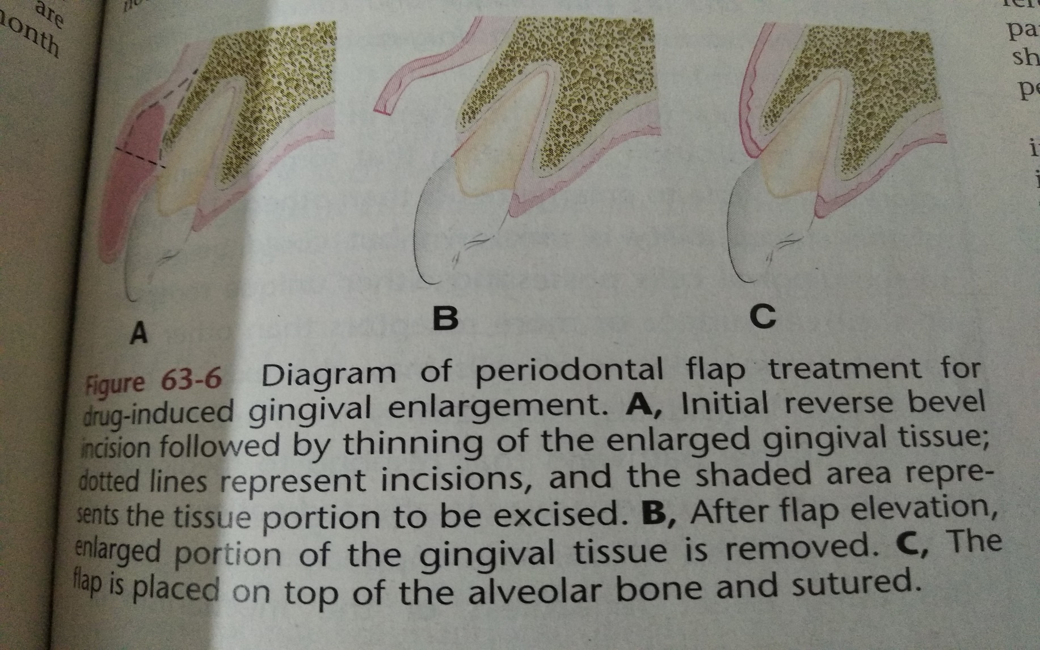
FLAP TECHNIQUE

Slide 16
THANKYOU

