Slide 1
PERIODONTAL LIGAMENT

Slide 2
LEARNING OBJECTIVES
The student should know
PDL composition, principle fibers
Functions of PDL fibers
Blood supply, venous drainage

Slide 3
GUIDED BY-
Dr Bhandari sir
Dr Om sir
Dr Mukesh sir
Dr Gauri mam
Dr Sukanya mam
PRESENTED BY-
Anjali G. Hirve
IV BDS (Roll no- 04)

Slide 4
CONTENT-
INTRODUCTION
DEFINITION
SYNONYMOUS
EXTENT AND SHAPE
AVERAGE WIDTH
STRUCTURE
PRINCIPLE FIBRES
CELLULAR ELEMENTS
GROUND SUBSTANCE
BLOOD SUPPLY
NERVE SUPPLY
LYMPHATIC DRAINAGE

Slide 5
INTRODUCTION-
The term periodontium arises from Greek words “peri”meaning around and “odont” meaning tooth. Tissues that invest and support the teeth are collectively termed periodontium.

Slide 6
DEFINITION-
According to Carranza-
The periodontal ligament is composed of complex vascular and highly cellular connective tissue that surrounds the tooth root and connects it to the inner wall of alveolar bone.

Slide 7
SYNONYMS
1- PERIODONTAL MEMBRANE
2- ALVEOLO-DENTAL LIGAMENT
3- DESMODONT
4- PERICEMENTUM
5- DENTAL PERIOSTEUM
6- GOMPHOSIS

Slide 8
EXTENT AND SHAPE
In the coronal direction it is continuous with lamina propria of gingiva and is demarcated by the alveolar crest fibers.
At the root apex it merges with the dental pulp.
It ranges in width from 0.15-0.38.
It is thinnest around the middle third of the root, with an hour glass appearance.

Slide 9
AVERAGE WIDTH
DEPENDING ON AGE-
11-16 yrs- 0.21mm
32-52 yrs- 0.18mm
51-67 yrs- 0.15mm
ACC. TO FUNCTIONAL STATE OF THE TISSUES-
Time of eruption – 0.1- 0.5mm
At function - 0.2 -0.35mm
hypo function - 0.1- 0.15mm

Slide 10
STRUCTURAL COMPONENT OF PERIODONTAL LIGAMENT
CELLULAR COMPONENT-
4 TYPES OF CELLULAR COMPONENT
1-Connective tissue component
2-Epithelial rest cells
3-Immune system cells
4-Neurovascular elements

Slide 11
CONNECTIVE TISSUE COMPONENT-
1] FIBROBLAST-
Most common ovoid or elongated. Exhibits pseudopodia like process. Can synthesize and phagocyte old collagen fibres.
2] ODONTOBLAST-
Produce matrix for new bone formation.
Functional osteoblast – plumpy cuboidal with large nucleus.
Other time- flat
3] CEMENTOBLAST-
Develops from mesenchymal cells/fibroblast.
Have centrally placed nucleus and basophilic cytoplasm.
Formation of cementum.

Slide 12
EPITHELIAL REST CELLS-
Epithelial cells rest of malassez are remenant of HERS.
Found close to cementum and most numerous in apical areas.
No. decreases with age.
Some get degenerated and some disappear/some get converted to cementicles.
Get proliferated when stimulated and form periapical cyst and lateral root sheet.

Slide 13
IMMUNE SYSTEM CELLS-
Neutrophils, lymphocytes, macrophages, eosinophils and mast cells.
GROUND SUBSTANCE-
PDL contains large portion of ground substance filling spaces between fibres and cells.
2- MAIN COMPONENTS-
1-Glycosaminoglycans- hyaluronic acid and proteoglycans
2-Glycoprotins- fibronectin and laminin
3- 70% water

Slide 14
PRINCIPLE FIBRES-
Are important elements of pdl are principle fibres.
They are collagenous and arranged in bundles and follow wavy course when viewed in longitudinal section.
Terminal portion of principle fibres are embeded in bone and cementum are termed as sharpeys fibres.
Collagen is a protein composed of different amino acid like glycine, proline, hydroxy lysine, hyroproline.
Amount of collagen can be seen /determined by hydroxyproline.
Principle fibres are made of type one collagen fibres
Reticular fibres- Type 3
Basal lamina- type 4

Slide 15
SIX TYPES OF PRINCIPLE FIBRES OF PDL
1- TRANSSEPTAL FIBRES
2- ALVEOLAR CREST FIBRES
3- HORIZONTAL FIBRES
4- OBLIQUE FIBRES
5- APICAL FIBRES
6- INTERRADICULAR FIBRES

Slide 16
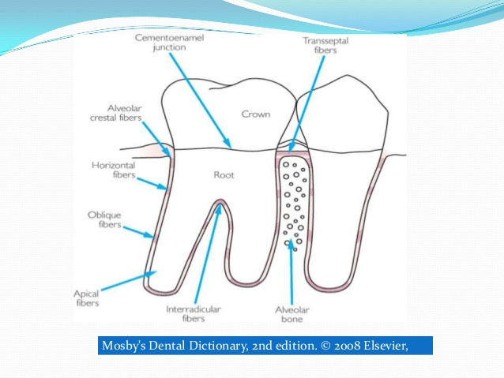
PRINCIPAL FIBRES

Slide 17
1-TRANSSEPTAL FIBRES-
Extends interproximally over the alveolar bone crest and are embeded into the cementum.
FUNCTION-
-reconstructed after destruction of alveolar bone in periodontal disease.
- do not have osseous attachment.

Slide 18
2- ALVEOLAR CREST FIBRES-
Extend obliquely from cementum just below the junctional epithelium to alveolar bone crest.
FUNCTION-
Retain the tooth in socket.
Resist lateral tooth movement.
Protect deeper periodontal structure.

Slide 19
3-HORIZONTAL GROUP OF FIBRES-
Extend at right angle to long axis of teeth from cementum to alveolar bone.
FUNCTION-
Resist tipping forces.
Prevent lateral tooth movement.

Slide 20
4-OBLIQUE FIBRES-
Largest group of pdl.
Occupy middle 2/3.
Extend in coronal direction obliquely to the bone
FUNCTION-
Resist vertical masticatory forces.
Transfer them into the tension on the alveolar bone.

Slide 21
5- APICAL FIBRES- radiate irregularly from cementum to alv. Bone at the apical region. Do not occurs in incompletely formed tooth
FUNCTION-
Resist tipping forces.
protects delicate blood vessels and nerves

Slide 22
INTERRADICULAR FIBRES-
Fan out from cementum to bone in multirooted teeth.
FUNCTION-
Resist tipping forces.

Slide 23
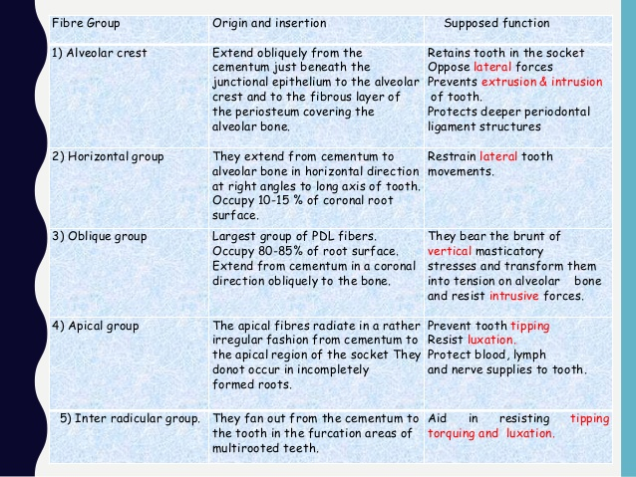

Slide 24
FUNCTIONS-
1- PHYSICAL FUNCTION
2- FORMATIVE AND REMODELLING
3- NUTRITIVE
4- SENSORY

Slide 25
PHYSICAL FUNTION-
1- Provision of a soft tissue casing to protect the vessels and nerves from injury by mechanical forces.
2- Transmission of occlusal forces to the bone.
3- attachment of the teeth to the bone.
4- maintenance of the gingival tissues in their proper relationship to the teeth.
5- resistance to the impact of the occlusal forces.[shock absorption].
2 theories of transmission of occlusal forces and mechanism of tooth support-
1] tensional theory ; 2] visco-elastic theory

Slide 26
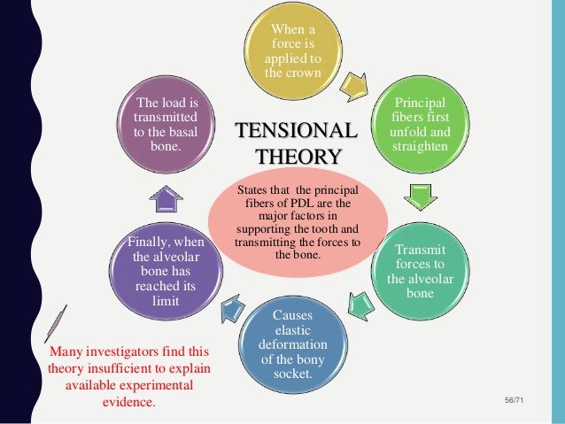
TENSIONAL THEORY-

Slide 27
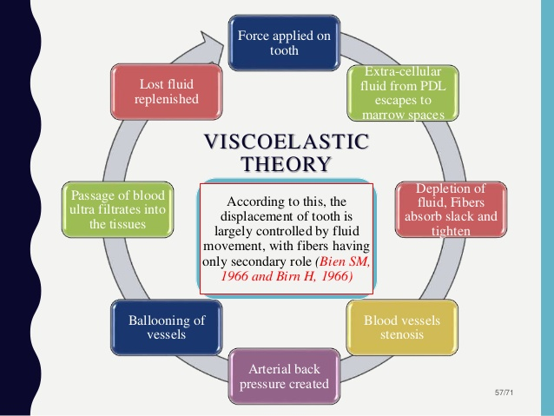
VISCO- ELSATIC THEORY-

Slide 28
FORMATIVE AND REMODELING FUNCTION-
Cells of pdl participate in the formation and resorption of cementum and bone, which occurs in
-physiologic tooth movement , accommodation of the periodontium to occlusal forces in the repair of injuries.
REMODELING- the 3D organization of the fibre meshwork is adapted to accommodate for positional changes in functional state.
It relates to adaptability of pdl tissues.
Both these processes can occur simultaneously and may therefore be indistinguishable.
The pdl is constantly undergoing remodelling . Old cells and fibres are broken down and replaced by new ones.

Slide 29
NUTRITIONAL -
PDL supplies nutrients to the cementum , bone and gingiva by the way of blood vessels and provides lymphatic drainage.
The PDL contains blood vessels , which provide anabolites and other substance to the cementum, bone and gingiva and removes catabolites.

Slide 30
SENSORY FUNCTIONS-
The PDL is abundantly supplied with sensory nerve fibres capable of repair of transmitting tactile, pressure, and pain sensation by the trigeminal pathway.
The PDL provides most efficient proprioceptive mechanism.
4 types of neural terminates are seen
1- free nerve endings- pain
2- Ruffini like mechanoreceptors (apical area)
3- Meissner's corpuscle – mechanoreceptors (middle third)
4- spindle like pressure and vibration endings (apex)

Slide 31
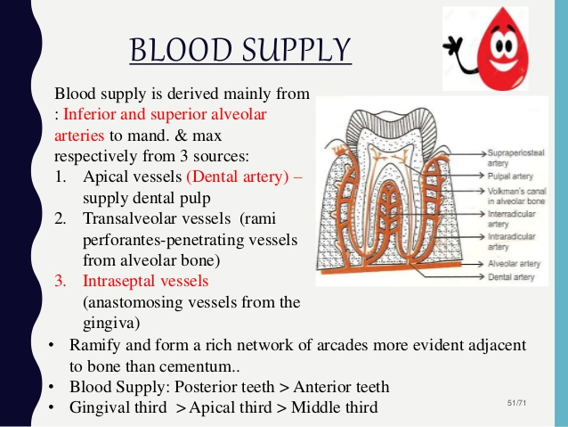
BLOOD SUPPLY-

Slide 32
LYMPHATIC DRAINAGE-
PDL mainly drains in-
Submandibular lymph nodes
Submental lymph nodes
Superficial lymph nodes
Deep cervical lymph nodes

Slide 33
THANK YOU

