Slide 1
Desquamative gingivitis

Slide 2
Learning objectives
Terminology
Classification
Diagnosis
Treatment plan

Slide 3
Coined in 1932 - Prinz to describe a peculiar condition characterized by intense erythema, desquamation, and ulceration of the free and attached gingiva.
McCarthy and colleagues (1960) concluded that desquamative gingivitis was not a specific disease entity but a gingival response associated with a variety of conditions.

Slide 4
Etiology
Certain dermatoses
Hormonal influences.
Abnormal responses to irritation
Chronic infections
Idiopathic
Clinical features (Glickman and Smulow ) mild, moderate and severe forms

Slide 5
A. Mild form Diffuse erythema. Condition is painless Age: 17 – 23 years common in females.
B. Moderate form
Patchy distribution of bright red and gray areas.
Surface is smooth and shiny and soft in consistency.
Slight pitting on pressure.
Nicolsky’s sign +ve
Remainder of the mucosa is also extremely smooth ad shiny.
Age: 30 – 40 years.
C/o of burning sensation and sensitivity to thermal changes.
C. Severe form
Scattered, irregularly shaped areas -striking red appearance.
areas is grayish blue giving an overall speckled appearance.
Surface epithelium - shredded and friable and can be peeled off in small patches.
Areas of involvement seem to shift to different locations on the gingiva.
Patient cannot tolerate coarse food, condiments or temperature changes.
Constant dry and burning sensation throughout the oral cavity,

Slide 6
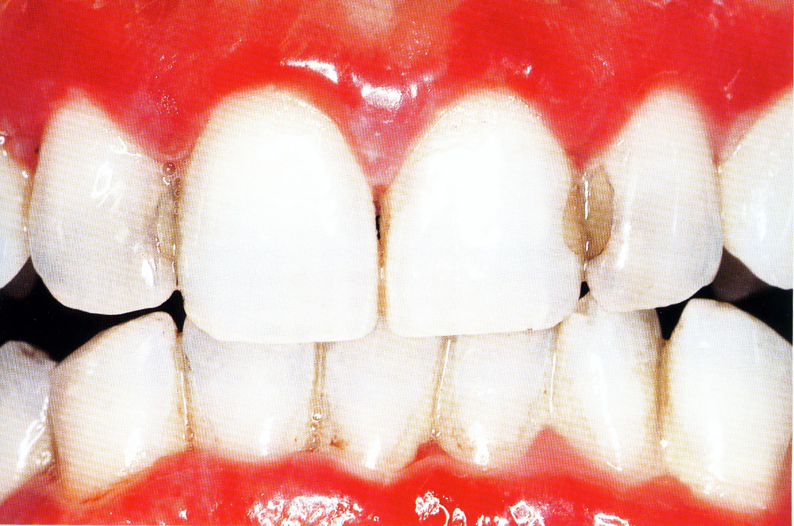
The gingiva presents erythema and edema! And ulcerous areas in the anterior vestibular sectors of the mouth.

Slide 7
DIAGNOSIS OF DESQUAMATIVE GINGIVITIS: A SYSTEMATIC APPROACH
Clinical history
Clinical examination Biopsy
Microscopic Examination:- Immunofluorescence:-
Management. 1)Practitioner's experience,
Systemic impact of the disease, and
Systemic complications of the medications.

Slide 8
Treatment
Local treatment
Plaque control via soft toothbrush.
Mouth wash: 3% diluted to 1/3 peroxide and 2/3 warm water should be used twice daily.
Use of corticosteroid ointments and creams has limited success.
Triamincinolone 0.1% (Kenalog, Aristocort)
Flucocinonide 0.5% (Lidex)
Desonide 0.5% (Tridesilon)

Slide 9
Systemic Therapy.
Ø Systemic corticosteroid therapy should not be randomly considered as a variety of side effects occur.
Ø High dose prednisone therapy.
100 – 200-mg/day up to 7 days followed by maintenance on 15mg/day.
Ø Moderate dose therapy
Ø Daily or alternate day administration of 30-40mg prednisone increase to maintenance dose of 5-10mg/day or 10-20mg /2days.
Ø Nutritional supplements as a supportive mode for suspected vitamins deficiency.

Slide 10
LICHEN PLANUS
Skin lesions - flexor surfaces of wrist and forearms Surface covered by characteristic, very fine grayish white lines called wickhams striae.
Characterized by the presence of cutaneous violaceous papules that may coalesce to form plaques.
Immunologically mediated mucocutaneous disorder- T cells play a central role.

Slide 11
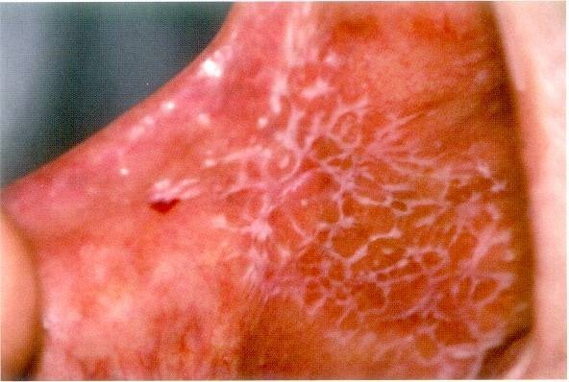
ORAL MANIFESTATIONS:-
Radiating white or gray, velvety, thread-like papules in a linear, annular or retiform arrangement forming typical lacy, reticular patches, rings and streaks over the buccal mucosa, lips, tongue and palate.
Vesicle and bulla formation.

Slide 12
ETIOLOGY
Unknown
Seen mostly in nervous, high strung persons
Course of disease is long
Other causes- traumatism
malnutrition infection
A triad of lichen planus, diabetes mellitus and vascular hypertension-GRINSPAN SYNDROME
  Hereditary etiology also suggested

Slide 13
Forms of lichen planus
Bullous :- Raised fluid filled blisters
Erosive form- when bullae rupture; eroded or frankly ulcerated lesions –irregular in size and shape and appear as raw, painful areas.; characteristic radiating striae noted on the periphery of lesions.
Atrophic form – smooth, red, poorly defined areas, often but not always with peripheral striae present.
Hypertrophic form- well –circumscribed, elevated white lesion resembling leukoplakia

Slide 14
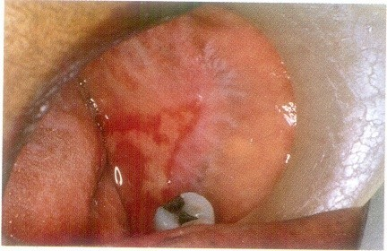
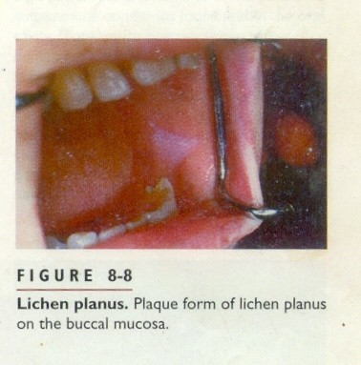
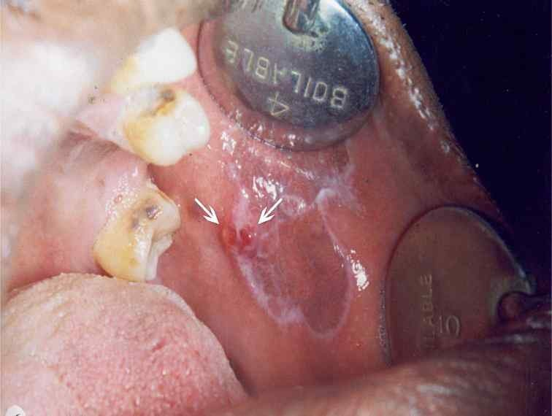
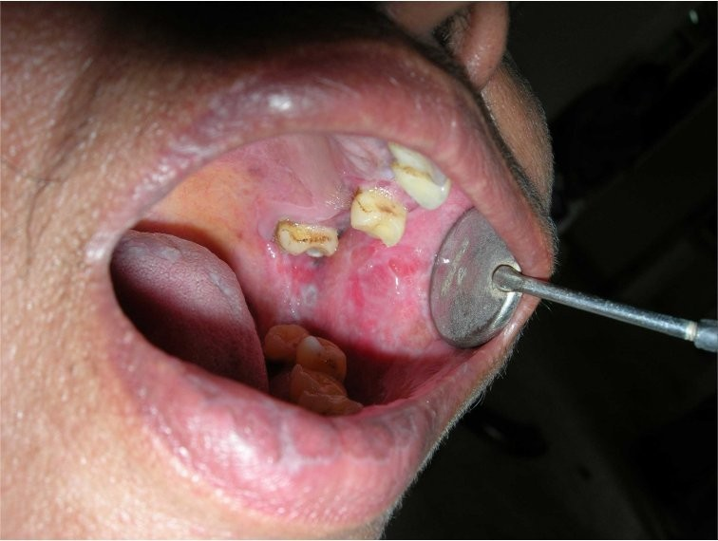
Erosive lichen planus18

Slide 15
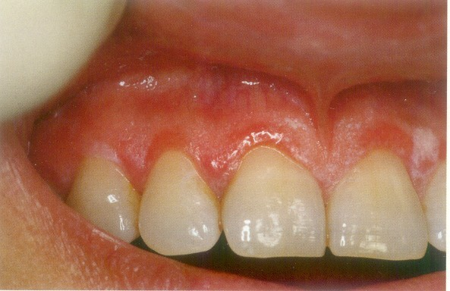
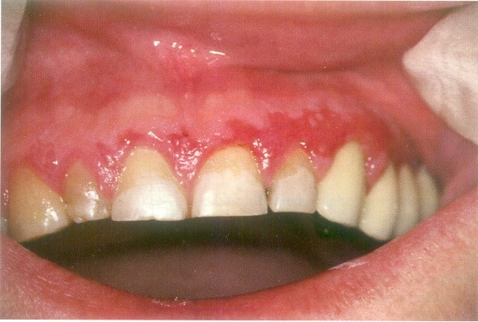
Erythema and white lines
Lesions of desquamation

Slide 16
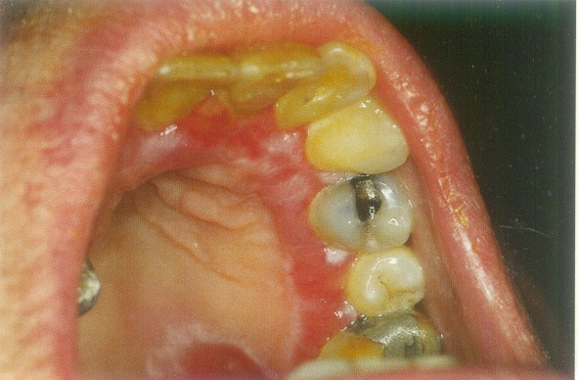
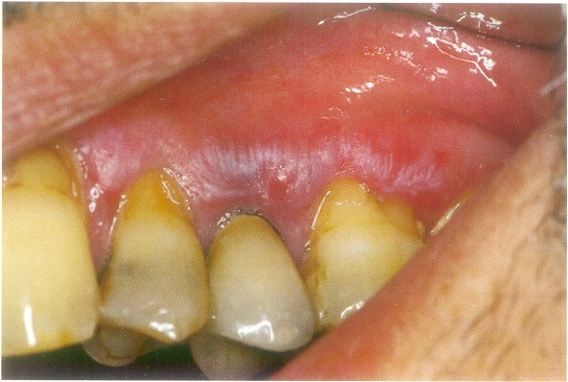
Palatal
Characteristic papules and lines

Slide 17
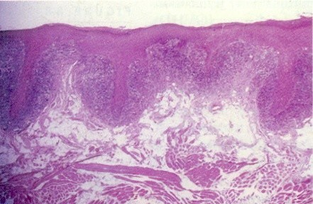
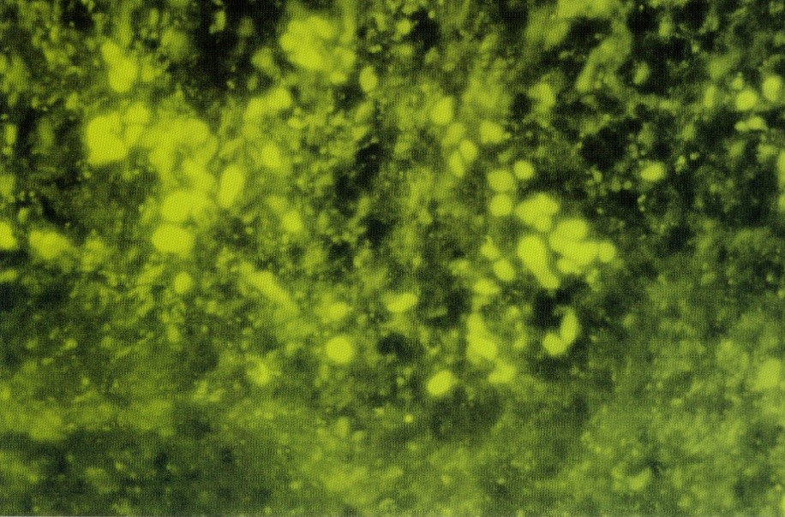
Histologic features
Hyper parakeratosis or hyper orthokeratosis
Thickening of the granular layer
Acanthosis with intercellular edema of the spinous cells
Saw tooth appearance of rete pegs
Necrosis or liquefaction degeneration of the basal layer
Infiltration of lymphocytes and occasionally plasma cells.
Colloid bodies– present mostly in spinous and basal cell layers- APPEAR as round , eosinophilic globules probably representing degenerated epithelial cells\ or phagocytosed epithelial cell remnants within macrophages.

Slide 18
TREATMENT AND PROGNOSIS
Keratotic lesions- no Rx- but follow up every 6-12 months to monitor suspicious clinical changes
Erosive, bullous or ulcerative lesions-
High potency topical corticosteroids fluocinonide)
(0.05%-
Severe cases- intralesional injections of triamcinolone acetonide(10-20mg) or
40 mg prednisone daily for 5 days followed by 10-20 mg daily for additional 2 weeks
Topical tacrolimus (unresponsive cases)

Slide 19
PEMPHIGOID
Cutaneous, immune-mediated, subepithelial bullous diseases that are characterized by a separation of the basement membrane zone(bullous pemphigoid, mucous membrane pemphigoid and pemphigoid (herpes) gestonitis
Bullous(benign mucous membrane pemphigoid)
mucous membrane cicatricial pemphigoid have received considerable attention.

Slide 20
BULLOUS PEMPHIGOID
Chronic, autoimmune, subepidermal, bullous disease with tense bullae that rupture and become flaccid in the skin
Oral involvement- 1/3 cases
Age- elderly (over 60 yrs)
Cutaneous lesions-
Begin as generalized non specific rash, commonly on the limbs, which appears urticarial or eczematous- which may persist for several weeks to months before appearance of vesiculobullous lesions
Abdomen may also be affected
Bullae are thick walled and remain intact for longer- don’t necessarily rupture.

Slide 21
Oral Manifestations
Vesicles and areas of erosion and ulceration
Gingival lesions similar to cicatricial pemphigoid- generally involves most of gingival mucosa- exceedingly painful.
Gingival tissues erythematous and desquamate even on minor friction.
Vesicles and ultimately erosions appear on gingiva and even on buccal mucosa, palate, floor of mouth and tongue

Slide 22
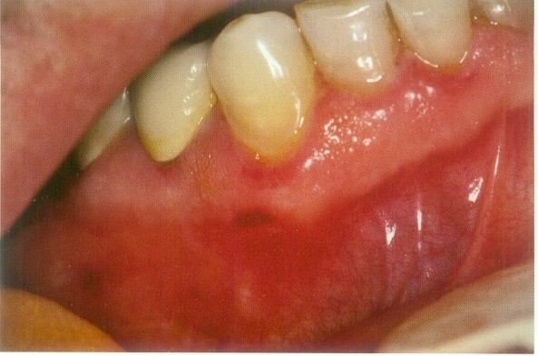
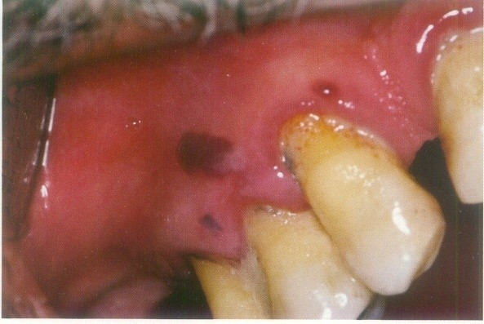
Erythema of gingiva
Bullae on gingiva

Slide 23
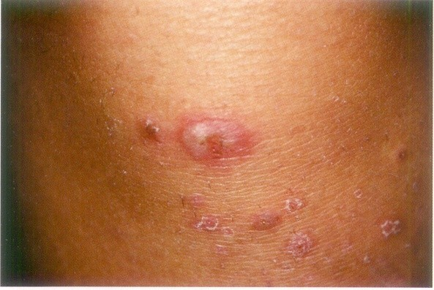

Slide 24
H/P
No acantholysis Vesicles subepithelial
Electron microscopy shows- horizontal splitting of basal lamina

Slide 25
Treatment
Etiology unknown- control signs and symptoms Primary Rx –moderate dose of systemic prednisone
Steroid sparing strategies (Prednisone+immunomodulator drugs) used when steroids have to be used in large doses or steroids alone not affective.
Local lesions- topical steroids

Slide 26
MUCOUS MEMBRANE PEMPHIGOID (CICATRICIAL PEMPHIGOID)
Chronic, vesiculobullous autoimmune disorder of unknown
cause
Predominant in women (5th decade of life)
Rarely reported in children
Involvement- oral cavity, conjunctiva, mucosa of nose, vagina, rectum, esophagus, and urethra; 20% cases skin involved.

Slide 27
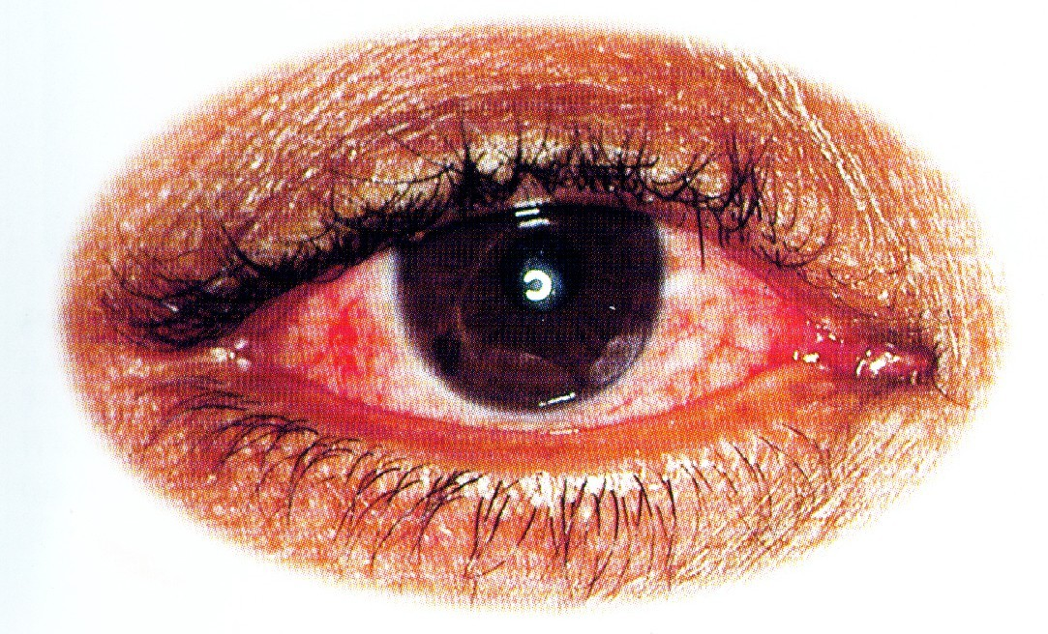
OCCULAR LESIONS:-
Adhesions of eyelids to eyeball
Adhesions at edges of eyelids
Small vesicular lesions on conjunctiva – eventually produces scarring, corneal damage and blindness

Slide 28
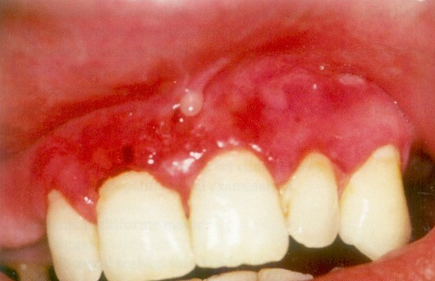
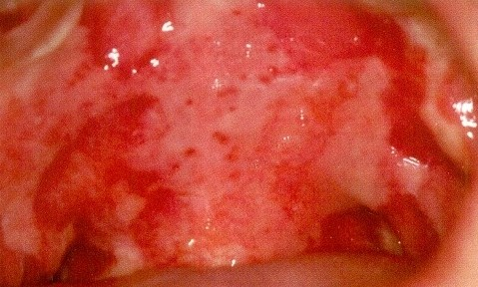
ORAL MANIFESTATIONS
•
Desquamative gingivitis with areas of erythema, desquamation, ulceration, and vesiculation of the attached gingiva
•
Lesions may also occur in other areas of the mouth
•
Bullae- thick roof- rupture in 2-3 days leaving irregular shaped areas of ulceration; healing- 3 weeks or longer

Slide 29
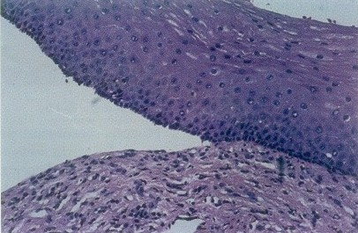
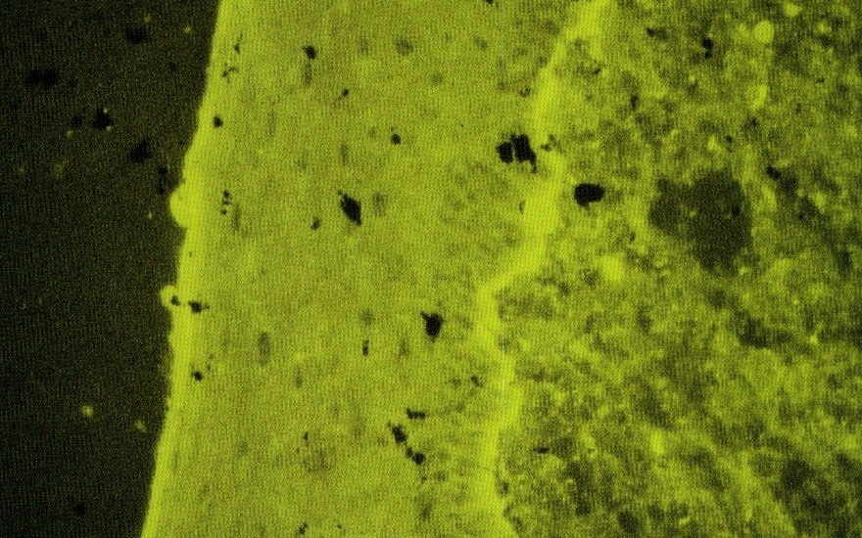
H/P
Striking subepithelial vesiculation with intact basal layer
EM- shows spilt in basal lamina
A mixed inflammatory infiltrate in connective tissue.
Immunofluorescence-
+ve along the basement membrane (direct and indirect)- IgG and C3

Slide 30
THERAPY
Topical steroids
Fluocinonide(0.05%) and Clobetasol propionate (0.05%) in an adhesive vehicle can be used 3 times a day for 6 mnths
Optimal oral hygiene
Gingival irritation due to any dental prosthesis should be minimized.
Systemic corticosteroids- ocular lesion
If steroids not effective- systemic Dapsone has proven to be effective-but because of side effects of hemolysis and methemaglobulinemia, patients with - G-6-PD deficiency should be ruled out.

Slide 31
PEMPHIGUS VULGARIS
Group of autoimmune bullous disorders cutaneous and/or mucous membrane blisters
that
produce
Most common of pemphigus disease (pemphigus vulgaris, pemphigus foliaceous, pemphigus vegetans, and pemphigus erythematosus)
Lethal chronic condition
Predilection in women(after 4th decade of life);

Slide 32
ETIOLOGY
Mostly idiopathic
Drug-induced:- penicillamine and captopril (reversible)
Paraneoplastic pemphigus- genetically distinct from associated with underlying malignancies\
pemphigus-

Slide 33
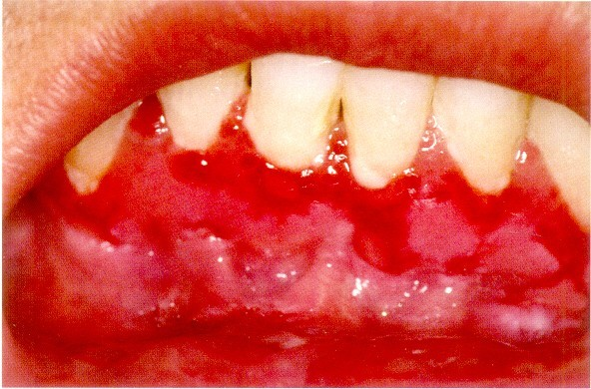
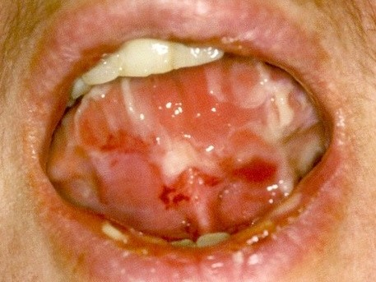
ORAL LESIONS:-
60% of the patients oral lesion is the 1st sign and may herald dermatological lesion by a yr or more.
Range from small vesicles to large bullae
Rupture of bullae leads to extensive areas of ulceration
Any area of oral cavity involved- Oral lesions confine less often to gingival tissues

Slide 34
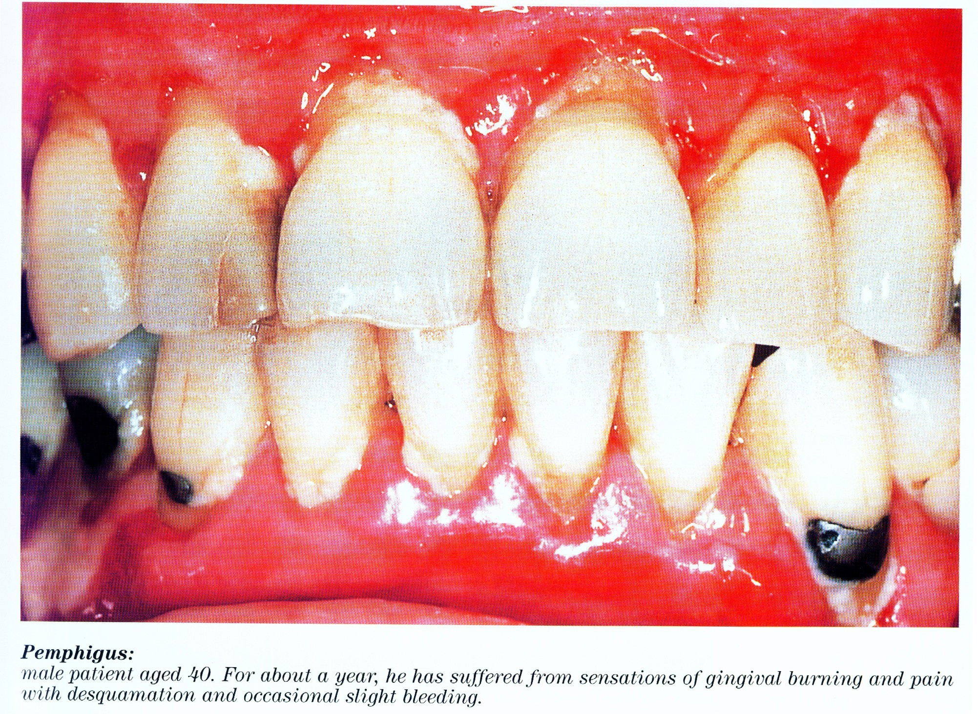

Slide 35
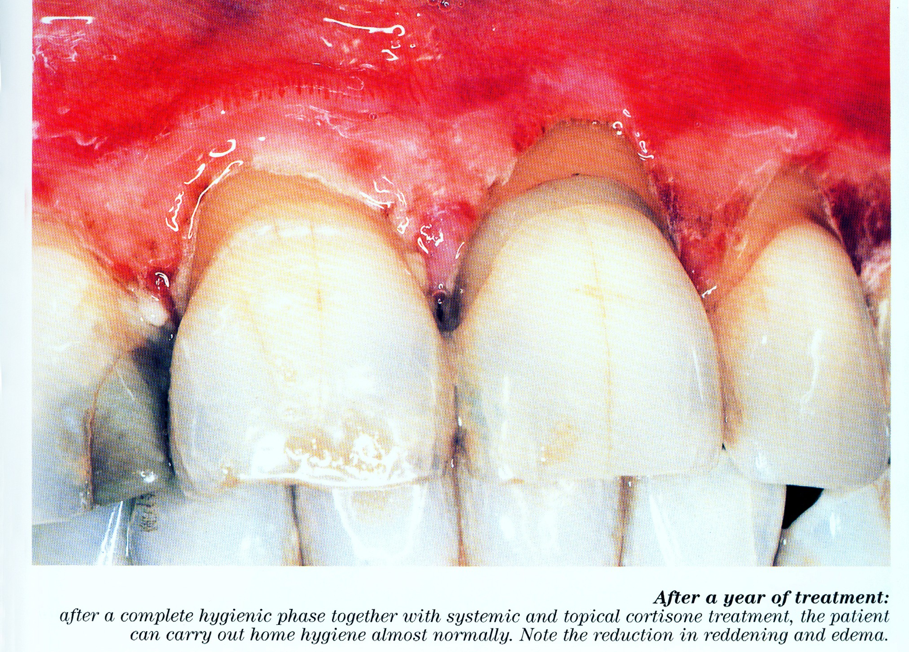

Slide 36
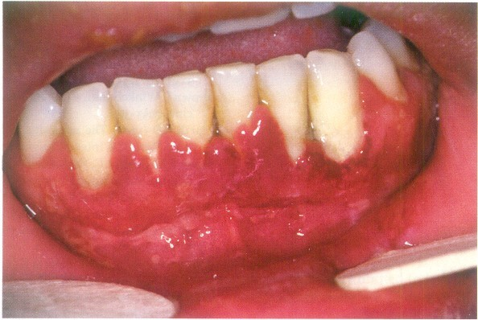
Paraneoplastic pemphigus

Slide 37
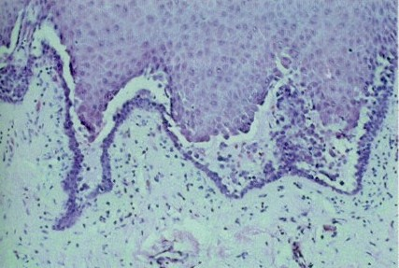
H/P:-
Intraepithelial vesiculation begins as microscopic alteration and gradually results in a grossly visible, fluid filled bulla
Occasionally – entire superficial layers of epithelium lost, leaving only basal cells attached to underlying lamina propria- TOMBSTONE appearance of epithelial cells.
Acantholysis characterized by round rather than polyhedral epithelial cells- intercellular bridges are lost& nuclei are large and hyperchromatic
Mild to moderate chronic inflammatory infiltrate in underlying connective tissue.

Slide 38
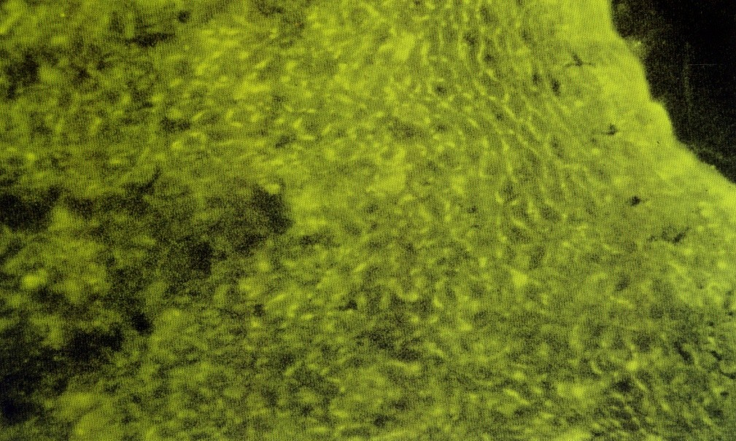
Immunofluorescence-
Intercellular deposits in epithelium
( IgG in most; C3 in some) of perilesional mucosa

Slide 39
THERAPY-
Systemic corticosteroids with or without other immunosuppressive agents
Steroid sparing therapies- pt not responsive to corticosteroid.
Optimal oral hygiene
Intravenous human Ig (high dose)
Pts in maintenance phase- predisone before oral prophylaxis to prevent flare ups.

Slide 40
ERYTHEMA MULTIFORME
An acute bullous and/or macular inflammatory mucocutaneous disease where a series of immunopathologic mechanisms occur.
3 factors
Herpes simplex infections
Mycoplasma infection
Drug reactions- sulfonamides, penicillin's,
phenylbutazone, and phenytoin
•
•
Hemorrhagic crusting of the vermillion border of lips common; Presence of crusting important in arriving at diagnosis

Slide 41
Target or iris lesions with central clearing
Multiple, large, shallow painful ulcers with an erythematous borders
Lesions –so painful that chewing and swallowing is impaired
EM minor- lasts approx 4weeks-
  moderate cutaneous and mucosal involvement
Stevens –Johnson syndrome- lasts month or longer –
  involves skin, conjunctiva, oral mucosa and genitalia requiring more aggressive therapy.
Toxic epidermal necrolyisis – most severe form of EM

Slide 42
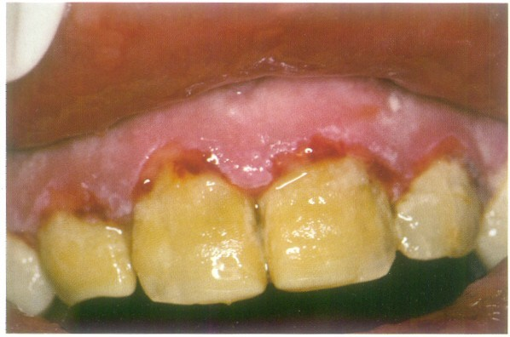
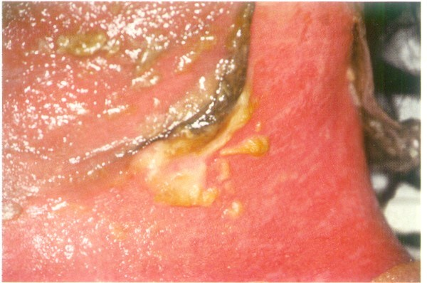
Toxic epidermal necrolysis

Slide 43
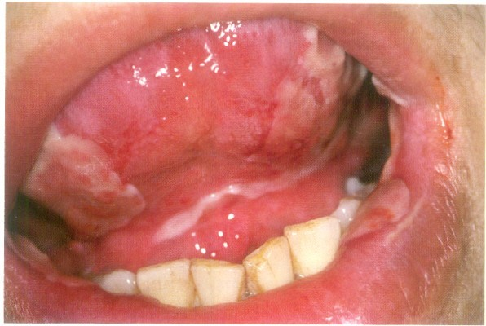
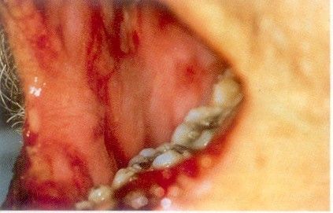
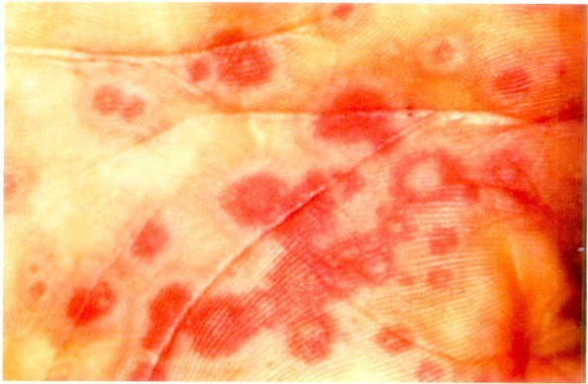

Slide 44
H/P:-
Liquefaction degeneration of upper epithelium and intraepithelial microvesicles but without acantholysis
Pseudoepitheliomatous hyperplasia and necrotic keratinocytes
Degenerative changes- basement membrane
Dense inflammatory cell infiltrate at the junction of epithelium and lamina propria, which becomes indistinct
Edema of the lamina propria, vascular dilation, and congestion are also present.

Slide 45
Immunofluorescence:- -ve in EM
Treatment
No specific Rx, some cases resolve spontaneously
bullous or ulcerative lesions require intervention-
Mild symptoms- systemic and local antihistamines topical anesthetics and
debridement of lesions with an oxygenating agent.
Intravenous human Ig (high dose)
Severe symptoms- corticosteroids- but its use is not completely accepted

Slide 46
CHRONIC ULCERATIVE STOMATITIS
Condition presents with chronic oral ulcerations
Predilection for women(4th decade)
Erosions and ulcerations in oral cavity- few cases with cutaneous lesions
ORAL LESIONS
Painful, solitary small blisters and erosions with surrounding erythema – mainly on gingiva and lateral border of the tongue ; hard palate may also present similar lesions.

Slide 47
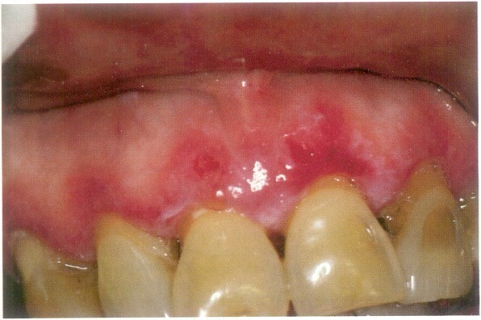
H/P:
Hyperkeratosis, acanthosis, and liquefaction of the basal layer, areas of subepithelial clefting
underlying lamina propria – lymphohistiocytic chronic infiltrate in a band like configuration.
Immunofluorescence :-
Direct (normal and perilesional tissues) –
IgG with a speckled pattern - basal cell layer of the normal epithelium.
Fibrin deposits at the epithelial- connective tissue interface.

Slide 48
DIAGNOSIS
Direct and Indirect Immunofluorescence required to arrive at correct diagnosis
TREATMENT
Mild cases- topical steroids (fluocinonide, clobetasol propionate) and topical tetracycline
Severe cases- systemic steroids
Hydroxychloroquinine sulphate 200-400 mg/ day – Rx of choice for complete, long lasting remission

Slide 49
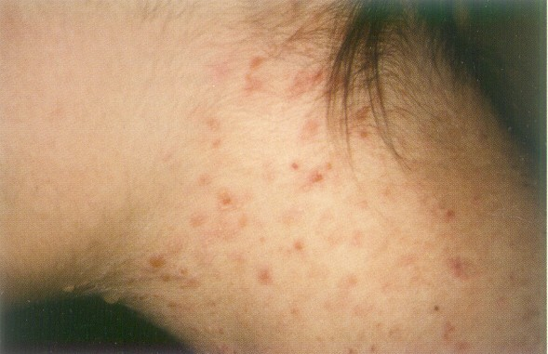
LINEAR IgA DISEASE (LINEAR IgA DERMATOSIS)
Uncommon mucocutaneous disorder with predilection in women
C/F
Pruritic vesiculobullous rash during middle to late age
plaques or crops with an annular presentation surrounded by a peripheral rim of blisters .
skin of upper and lower trunk, shoulders, groin and lower limbs- face and perineum may also be affected.

Slide 50
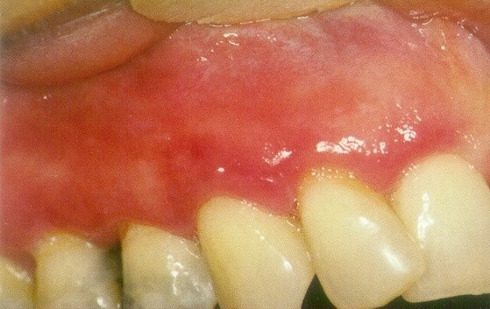
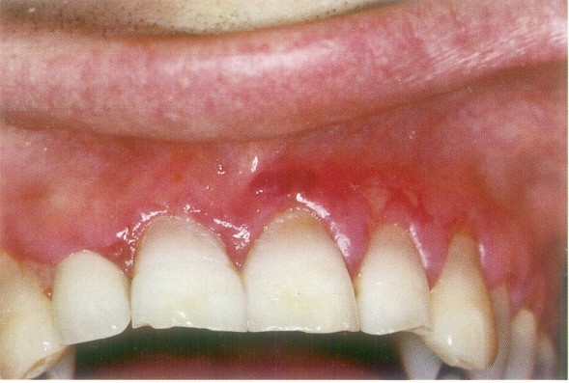
ORAL LESIONS
Mucosal- oral involvement – 50-100% of cases
Vesicles
Painful ulcerations or erosions
Erosive gingivitis/chelitis
Hard and soft palate commonly affected → tonsillar pillars, buccal mucosa, tongue and gingiva
Occasionally oral lesion only
manifestation for several years before cutaneous lesions

Slide 51
Immunofluorescence- linear deposits of IgA at epithelial- connective tissue interface
D/D :- Erosive lichen planus Chronic ulcerative stomatitis Pemphigus vulgaris
Bullous pemphigoid Lupus erythematosus
Microscopy and Immunofluorescence required for diagnosis

Slide 52
Treatment
Combinations of dapsones and sulfones
Small amounts of prednisone (10 - 30 mg/ day)

Slide 53
LUPUS ERYTHEMATOSUS
Historically described as discoid or
systemic forms, lupus erythematosus is now classified into the systemic form, a bullous form of systemic
lupus erythematosus, a neonatal form, a chronic cutaneous form, and a subacute cutaneous form..
SYSTEMIC LE
females(10:1)
vital organs → kidneys, heart, skin and mucosa
Diagnosis – - fever, weight loss & arthritis are common

Slide 54
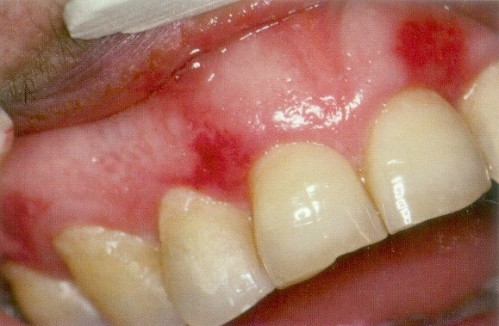
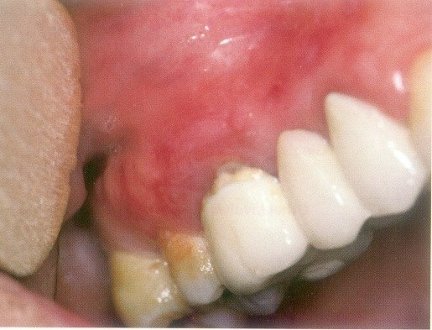
Oral lesions are characterized by the presence of a central erythematous erosion or ulceration surrounded by a white rim with radiating keratotic striae.
The most frequent sites of involvement are the hard and soft palate, buccal mucosa, and the vermillion border of the lips. The gingiva may take on a desquamative appearance, and patients may complain of burning or soreness

Slide 55
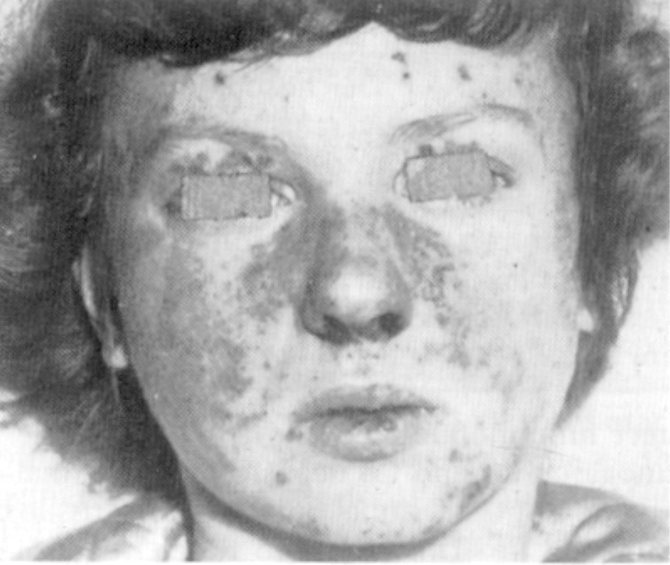
Cutaneous lesions:-
Rash on the malar area with a butterfly distribution

Slide 56
Immunofluorescence
(perilesional and normal tissue)
Direct immunofluorescence testing reveals immunoreactants at the basement membrane zone with granular deposits of IgM, IgG, IgA, C3, and fibrinogen as well as the occasional presence of cytoid bodies
TREATMENT.
Topical and intralesional corticosteroids
Systemic corticosteroids alone or in combination with other Immunosuppressive agents such as cyclophosphamide Antimalarial drugs may topical or systemic retinoids may be beneficial.
Gold salts and cyclosporin

Slide 57
Drug reactions
DRUG ERUPTIONS
Drug acts as an allergen either alone or in combination, sensitizing the tissues and then causing the allergic reaction.
TYPES
Stomatitis medicamentosa - mouth or parenterally
Stomatitis venenata(contact dermatitis) – local use.

Slide 58
Etiology
Gold salts, aminopyrine, phenacetin, sulphonamides and antibiotic may produce agranulocytosis characterized by necrotic oral lesions, sore throat and leukopenia.
Barbiturates and salicylates
Phenopthalein (laxative) - single erosive lesion.
Iodides and bromides
Sulphonamides – sulfadiazines
Cancer chemotherapy
Chlorhexidine

Slide 59
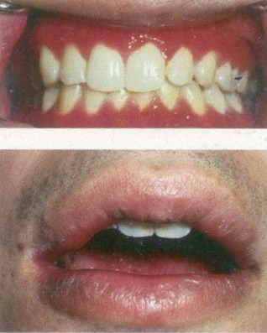
ORAL LESIONS
Vesiculo bullous to pigmented or non-pigmented macular
lesions.
Eruptions result in ulceration and purpuric lesions too.

Slide 60


