Slide 1
PROGNOSIS

Slide 2
Learning objectives-
1.Definition
2.Types
3.Classification
4.Factors determining

Slide 3
DEFINITION
Prognosis is the prediction of the probable course , duration , and outcome of a disease and the likelihood of its response to treatment, based on general knowledge of the pathogenesis of the disease and the presence of risk factors .

Slide 4
Types of prognosis:-
1.Excellent prognosis
2.Good prognosis
3.Fair prognosis
4.Poor prognosis
5.Questionable prognosis
6.Hopeless prognosis

Slide 5
1.Excellent prognosis:-
No bone loss
Excellent gingival condition
Good patient cooperation
No systemic or environmental factors
2.Good prognosis:-
- Adequate remaining bone support
Adequate possibilities to control etiological factors
Adequate patient cooperation
No systemic or environmental factors or if present they are well controlled

Slide 6
3.Fair prognosis:-
Less than adequate remaining bone support
Some tooth mobility
Grade 1 furcation involvement
Acceptable patient cooperation
Presence of limited systemic or environmental factors
2.Poor prognosis:-
Moderate to advanced bone loss
Tooth mobility
grade 1 and2 furcation involvement
Doubtfull patient cooperation
Presence of systemic or environmental factors

Slide 7
5.Questionable prognosis:-
Advanced bone loss
Grade2 and 3 furcation involvements
Tooth mobility
Presence of systemic or environmental factors
6.Hopeless prognosis:-
Advanced bone loss
Non maintainable areas
Extractions indicated
Presence of uncontrolled systemic or environmental factors

Slide 8
For descriptive purposes and better understanding , prognosis is classified as follows
1. overall prognosis:-
it is concerned with patient and dentition as a whole and it is determined by several factors including the type of disease , age of the patient , systemic background.
2. individual tooth prognosis:-
it is determined after the overall prognosis and is affected by it.

Slide 9
Prognosis is also classified as:-
1.Therapeutic prognosis:-
It deals with the response of tissues to treatment and successful arrest of disease process.
It is the prognosis of teeth after an appropriate periodontal treatment is provided

Slide 10
2.Prosthetic prognosis:-
It indicates the ability of the remaining teeth to support a prosthesis
it is the prognosis of the teeth for supporting the prosthetic restoration after an appropriate periodontal treatment has been provided

Slide 11
Factors in determination of overall prognosis:-
1.Type of disease:-
A) prognosis for patients with gingival diseases
B) prognosis for patients with periodontitis
2.Age of the patient
3.Rate of disease progression
5.Systemic background
6.Genetic factors
7.Smoking
8.Stress
9.Number of remaining teeth and their distribution
10.Patient compliance and cooperation

Slide 12
1.Prognosis of patient with gingival diseases:-
A) plaque induced gingival diseases:-
- Gingivitis associated with dental plaque only:-
plaque induced gingivitis is reversible disease that occurs when bacterial plaque accumulates at gingival margin.
so, in this case prognosis is good.
-Plaque induced gingival diseases modified by systemic factors:-
inflammatory response to bacterial plaque at the gingival margin can be influenced by systemic factors such as endocrine related changes associated with puberty, menstruation , pregnancy and diabetes.

Slide 13
So , the long term prognosis for these patients depends not only on the control of bacterial plaque but also on control of systemic factors.
- Plaque- induced gingival diseses modified by medication:-
Gingival diseases associated with medications include drug induced gingival enlargement , continuous use of the drugs usually results in recurrence of the enlargement even after the surgical intervention.
Long term prognosis is given which depends on whether the patients systemic problem can be treated with medication that does not have this side effect

Slide 14
B) Non plaque induced gingival diseases:-
This can be seen in patients with a variety of bacterial ,fungal and viral infections.
In this case prognosis depends on elimination of source of infectious agents.

Slide 15
2.Prognosis for patient with periodontitis :-
A)chronic periodontitis :-
In case of slight to moderate periodontitis , prognosis is generally good provided good oral hygiene and removal of local retentive factors.
In patients with severe periodontitis , prognosis may be fair to poor.

Slide 16
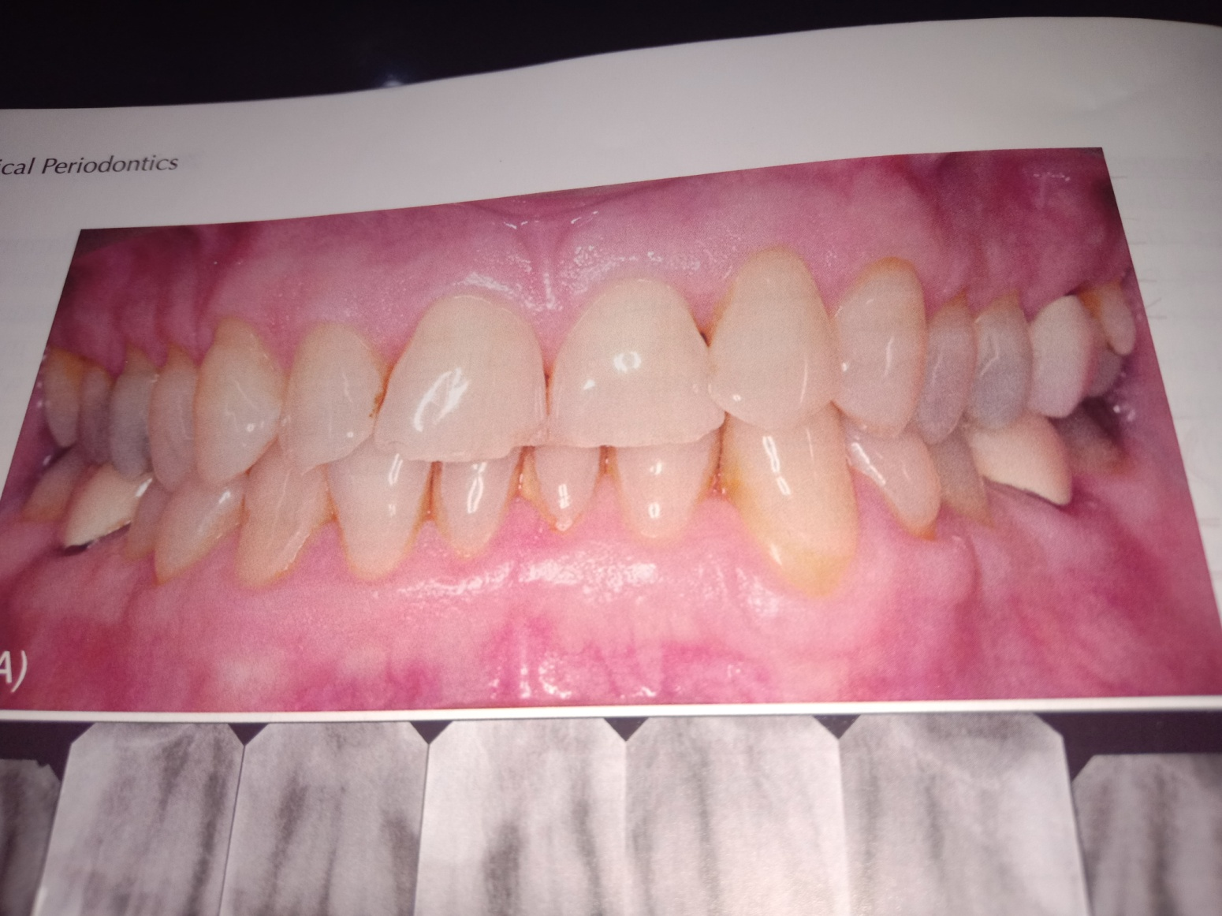
Fig. Slight to moderate Chronic periodontitis .

Slide 17
B)Aggressive periodontitis:-
Aggressive periodontitis can be present in a localized or generalized form.
When localized aggressive periodontitis diagnose early, these can be treated by giving oral hygiene instructions and antibiotic therapy ,resulting in excellent prognosis .
patients diagnosed with generalized aggressive periodontis, have fair, poor or questionable prognosis.

Slide 18
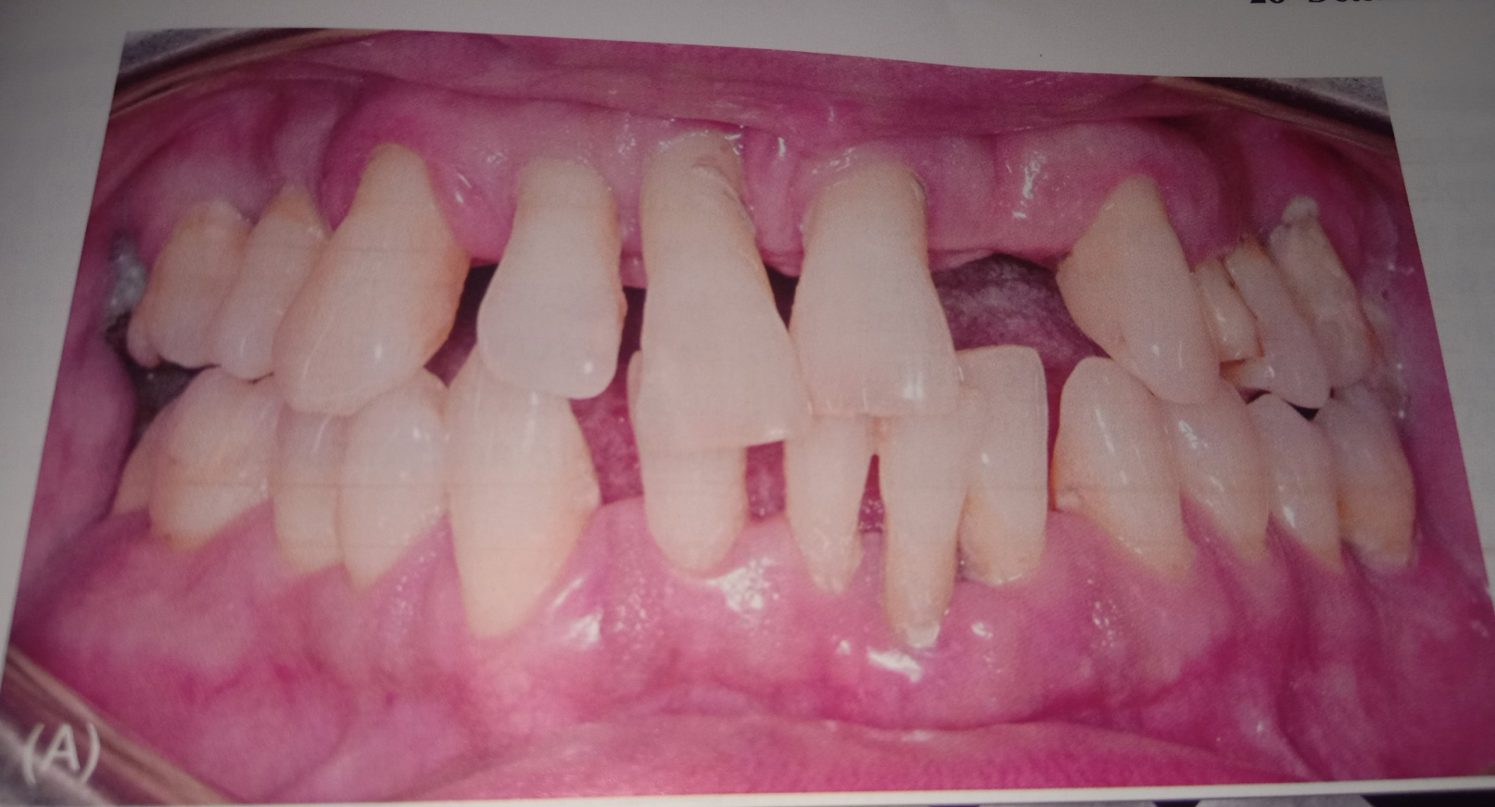
Fig.Gen.severe chronic periodontitis

Slide 19
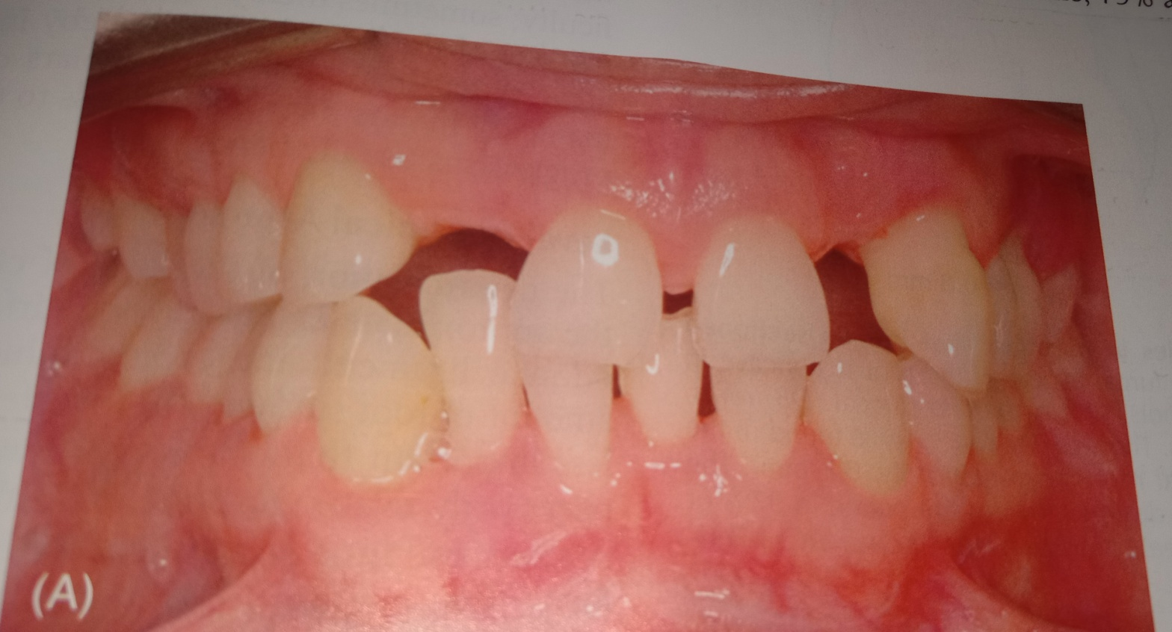
Fig . gen. aggressive periodontitis

Slide 20
3.Age of the patient:-
For two patients with comparable levels of remaining connective tissue attachment and alveolar bone, prognosis is generally better for the older of the two.
4. Rate of disease progression:-
A rapid loss of bone in a short time is indicative of factors beyond local irritants and often difficult to control.
Prognosis is poor in such cases.

Slide 21
5.Systemic background:-
It follow that prognosis in these cases depends on patients compliance relative to both medication and dental status .
Well controlled diabetes patients with slide to moderate periodontitis have good prognosis.
6.Genetic factors:-
Detection of genetic variations linked to periodontal disease can influence the prognosis in several ways:-

Slide 22
1.Early detection of patients at risk because of genetic factors can lead to early implementation preventive and treatment measures for these patients.
2. Identification of genetic risk factors later in the disease or during the course of treatment can influence the treatment recommendations.
3.Identification of young individuals who have not been evaluated for periodontitis but who are recognized as being at risk because of the familial aggrigation seen in aggressive periodontitis.
In each of these cases early diagnosis and alterations in the treatment regimen may lead to an improved prognosis for the patient.

Slide 23
9.Number of remaining teeth and their distribution:-
More the No.of teeth remaining better is the overall prognosis.
10.patient compliance and cooperation:-
Prognosis for patients with gingival and periodontal disease depends on patients attitude, desire to retain the natural teeth n willingness and ability to maintain good oral hygiene.
If the patients are unwilling then dentist can,
- Refuse to accept the patient for treatment ,or extract teeth that have hopeless or poor prognosis

Slide 24
7.smoking:-
Prognosis in patient who smoke and have slight to moderate periodontitis is generally fair to poor.
In patients with severe periodontitis prognosis may be poor to hopeless.
8.stress:-
Physical and emotional stress may alter the patients ability to respond to the periodontal treatment performed, these factors must be faced when attemping to establish prognosis.

Slide 25
Factors in determining individual tooth prognosis:-
1.Tooth mobility
2.Anatomical factors
3.Prosthetic and restorative factors

Slide 26
1.Tooth mobility:-
The principle causes of tooth mobility are loss of alveolar bone inflammatory changes in PDL and trauma from occlusion.
Tooth mobility caused by inflammation and trauma from occlusion may be corrected.
Stabilization of tooth mobility through the use of splinting may have a beneficial impact on overall and individual tooth prognosis.

Slide 27
2.Anatomical factors:-
Anatomical factors that affect the prognosis includes:
Short , tapered roots with large crowns.
Cervical enamel projections
enamel pearls
Bifurcation ridges
Root concavities and developmental grooves
Furcation invovement .

Slide 28
1.Short tapered roots and relatively large crowns will have poor prognosis.
2. Presence of enamel projection on the root surface may have negative effect on prognosis.
3.Presence developmental grooves root proximity and furcation involvement can worsen prognosis.
4.Anatomical factors that decrease the efficiency of scaling and root planing can have the negative impact on prognosis.

Slide 29
3. Prosthetic and restorative factors:-
For teeth with extensive caries feasibility of adequate restoration and endodontic therapy should be considered before undertaking periodontal treatment.
More rigid standards are required when evaluating the prognosis of teeth adjacent to edentulous area.
A tooth with discrepancy in its sub gingival margin have a poorer prognosis than a tooth with well contoured supra gingival margin

Slide 30
Thank you !

