Slide 1
IMPACT OF PERIODONTAL INFECTION ON SYSTEMIC HEALTH

Slide 2
Learning objectives
Focal infection theory revisited
Periodontal disease and mortality
Periodontal disease and coronary heart disease
Periodontal disease and stroke
Periodontal disease and diabetes
Periodontal disease and prgnancy
Periodontal disease and COPD
Periodontal disease and acute respiratory infections

Slide 3
Periodontal disease is an inflammatory disease initiated by bacterial pathogens.
Environmental ,physical ,social ,and host stresses may affect and modify disease expression through a multitude of pathways .
Certain systemic condition can affect the initiation and progression of gingivitis and periodontitis .

Slide 4
Organ systems and conditions possibly influenced by periodontal infection
1)Cardiovascular and cerebrovascular systems :
Atherosclerosis
Coronary heart disease
Angina
Myocardial infarction
Cerebrovascular accident
Erectile dysfuction
anemia
2]kidney diseases
Renal insuffiency
Chronic kidney diseases
End –stage kidney disease

Slide 5
6] Respiratory system
Chronic obstructive pulmonary disease
Acute bacterial pneumonia
7] Cognitive function
Dementia
Alzheimer disease
8] Cancers
Colorectal
Pancreatic
Hapatocellular
others
3] Endocrine system
Metabolic syndrome
Diabetes mellitus
4] Reproductive system
Preterm low birth weight infants
Preeclampsia
5] Autoimmune disease
Rheumatoid arthritis
Ankylosing spondylitis

Slide 6
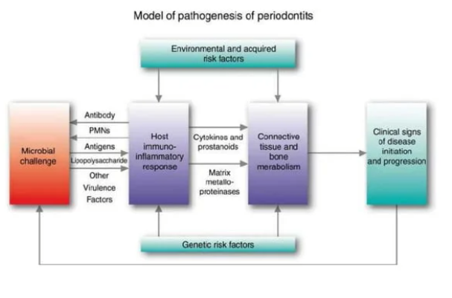

Slide 7
Focal infection theory revisited
William hunter ,a british physician ,first developed the idea that oral microorganisms were responsible for a wide range of systemic conditions.
Extraction of teeth with these gingivitis and periodontitis helps to eliminate the source of sepsis .
The focal infection theory fell into dispute in the 1940s and 1950s when widespread extraction ,often of the entire defination ,failed to reduce or eliminate the systemic conditions .

Slide 8
Periodontal disease and mortality
Patient with poor periodontal health may also have other risk factors that increase mortality rates .
Host susceptibility factors that predispose the patients to periodontitis also predispose them to systemic conditions such as ischemic heart disease , stroke, respiratory infections
May cause mortality if chronic low bacteremia persists

Slide 9
Periodontal disease and coronary heart disease
Coronary heart disease and related events are a major cause of death .
MI has been associated with acute systemic bacterial and viral infections ,and is sometimes preceded by influenza like symptoms .
Localized infections chronic inflammatory reaction has been suggested mechanism underlying CHD in these individuals .

Slide 10
Study done by matilla et al found that MI patients had significantly worse dental health than did the controls
This association between poor dental health and MI was independent of the known risk factor for heart disease such as age ,hypertention ,chlosterol levels ‘ diabetes.
Periodontal infection may affect the onset or progression of atherosclerosis and CHD through certain mechanisms increasing viscosity of blood ,thrombus formation and embolization .

Slide 11
Factors affecting the blood viscosity
Plasma fibrinogen
Plasma lipoproteins
White blood count
Von willebrand factor
Increased viscosity of blood increase risk of thrombus formation ischemic heart disease and cerebrovascular accident
Increase blood viscosity

Slide 12
Effect of periodontal infection
Ischemic heart disease
IHD is associated with a process of atherogenesis and thrombogenesis

Slide 13
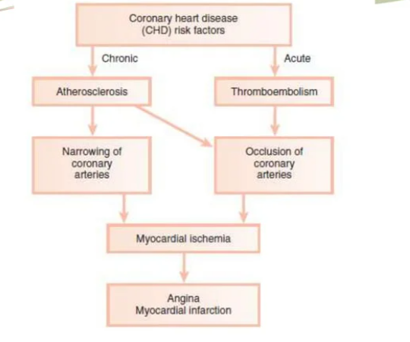

Slide 14
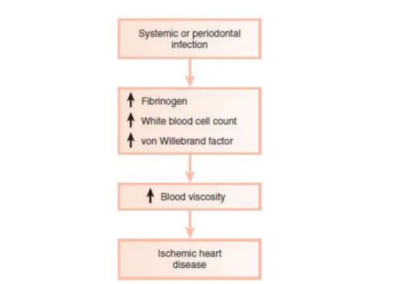
Systemic infections

Slide 15
DAILY ACTIVITIES
The exposure time to bacteremia from routine daily chewing and tooth brushing is much greater than from dental procedures .
An estimated 8% of all cases of infective endocarditis are associated with periodontal or dental disease without a preceding dental procedure .

Slide 16
Thrombogenesis
Platelet aggregation plays a major role in thrombogenesis .
Most cases of acute myocardial infarction are precipitated by thromboembolism
Oral organisms may be involved in coronary thrombogenesis i.e S .sanguis and P. gingivalis

Slide 17
Thromboembolism mechanism
Oral pathogens –steptococcus sanguis and p.gingivalis
Expression of –platelate aggregation associated protein on some of strains
Bacterial strains enters the circulation and aggregation of platelets
Forms thromboemboli

Slide 18
Atherosclerosis
It is a focal thickening of the arterial intima , the innermost layer lining the lumen of the vessel , and the arterial media , the thick layer under the arterial intima consisting of smooth muscle ,collagen ,and elastic fibers .
Intimal lesion is called atheroma or atheromatous or fibro fatty plaques
Enlarges gradually ,protrude into and obstruct vascular lumen

Slide 19
Periodontitis and atherosclerosis have many potential pathogenic mechanism in common
Both have
Complex causation
Genetic and gender predisposition
Share many risk factors ,most significant is smoking status
Periodontitis , which is a chronic a chronic inflammation initiated by microbial plaque can predispose to atherosclerosis

Slide 20
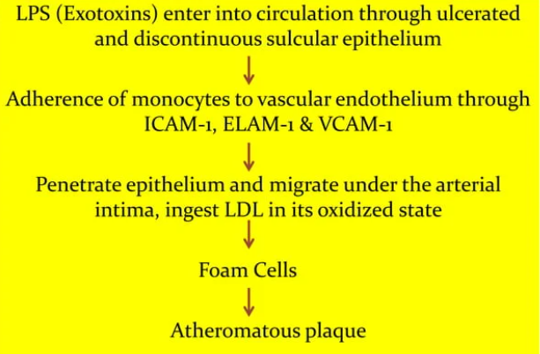

Slide 21
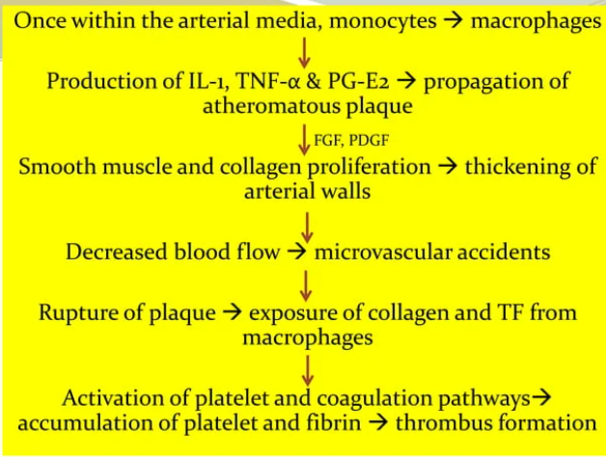

Slide 22
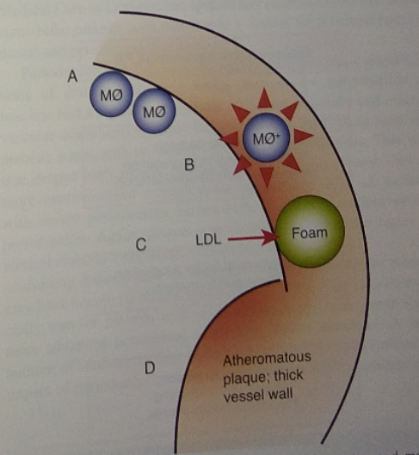
Pathogenesis of atherosclerosis

Slide 23
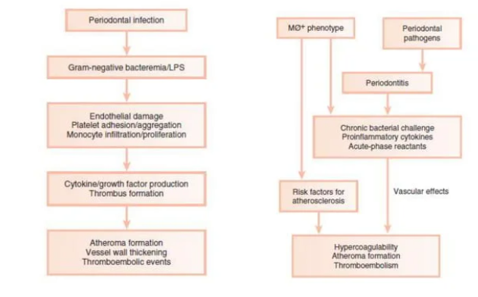

Slide 24
Role of periodontal disease disease in MI or stroke
Possible mechanism are ;
Effects of infectious agents in atheroma formation
Host mediated effects
Common genetic predisposition for periodontal disease and atherosclerosis
Common risk factors such as life style

Slide 25
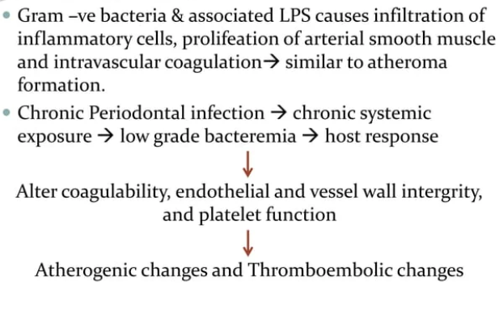

Slide 26
Periodontal disease and stroke :
Presence of systemic infection
Production of acute phase reactant proteins (CRP & fibrinogen )
Hypercoagualable state decreased micro –cerebral perfusion ,increased risk of thromboembolism
Greater ischemia & more severe post ischemic neurologic defect

Slide 27
Periodontitis and diabetes
DIABETES MELLITUS
Chronic hyperglycemic state due to relative and absolute deficiency of insulin
Hyposecrection of insulin or peripheral resistance of insulin impaired glucose uptake by the cells impaired glucose utilization chronic hyperglycemia
Result into lipid and protein metabolism

Slide 28
Two types
Type 1 diabetes mellitus (insulin dependent )
Type 2 diabetes mellitus (non –insulin dependent )
Gestational diabetes

Slide 29
Mechanism of action of insulin
Ingestion of food
Secretion of insulin -ve Type I DM
Glucose uptake through glucose transpoters through insulin dependent process
-ve Type II DM
Utilization of blood glucose
Decreased blood glucose

Slide 30
COMPLICATIONS OF DIABETES MELLITUS
Retinopathy
Nephropathy
Neuropathy
Macrovascular disease
Altered wound healing
Periodontal disease

Slide 31
Periodontitis and diabetes mellitus
It is clear from epidemiological data that DM increase risk and severity of periodontitis .
The increased prevalence and severity of periodontitis typically seen in patients with diabetes , especially those with poor metabolic control led to the designation of periodontal disease as sixth complication of diabetes

Slide 32
Effect of periodontal infection on glycemia
Acute viral and bacterial infection have shown to increase insulin resistance and aggravates glycemic control .
Systemic infection increases tissue resistance to insulin ,preventing glucose from entering into the cell causing elevated blood glucose level required increased amount of insulin to maintain normoglycemia.

Slide 33
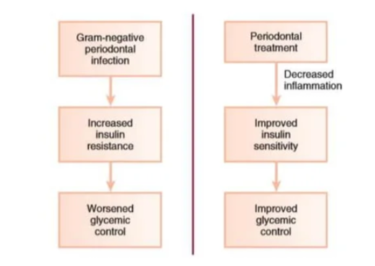

Slide 34
Periodontal disease & pregnancy
LOW BIRTH WEIGHT
They are 40 times more likely to die in neonatal period than normal birth weight infants and account for two third of neonatal death .
Infants who survive increased risk of congenital anomalies ,respiratory disorders and neuro developmental disabilities .

Slide 35
CAUSES OF LBW
Preterm labor or premature rupture of membranes
Smoking , alcohol or drugs use during pregnancy
Inadequate prenatal care
Race ,low socioeconomic status
Hypertention ,diabetes
High or low maternal age
Genitourinary tract infection
Maternal stress and genetic background
Periodontal disease

Slide 36
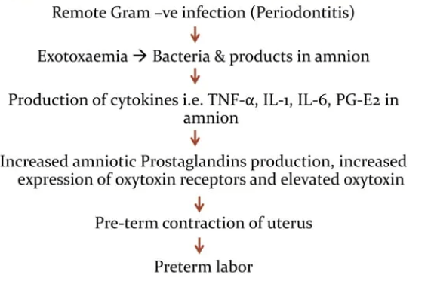

Slide 37
Periodontitis and COPD
CHRONIC OBSTRUCTIVE PULMONARY DISEASE
Characterized by aieflow obstruction resulting from chronic bronchitis or emphysema
Emphysema is a chronic enlargement of airways distal to bronchioles due to bronchiolar smooth muscles and elastic fiber destruction .

Slide 38
Chronic bronchitis is narrowing of airways proximal to distal bronchi due reactive hyperplasia of bronchial mucos glands and hypertrophy of muscles

Slide 39
RISK FACTORS OF COPD
Cigarette smoking
Industrial smoke tars
Genetic conditions
Presence of defective alpha 1 antitrypsin
Defective alpha 1 antichymotrypsin
Alpha 2 macroglobulin
Vitamin d binding protein

Slide 40
Effect of periodontitis
Neutrophil influx
Release of oxidative & hydrolytic enzymes
Tissue destruction
Release of proinflammatory cytokines
Recruitment of monocyte & macrophages

Slide 41
Acute respiratory infection
The upper respiratory tract are often contaminated with organisms derived from oral ,nasal ,and pharyngeal region .
Pnumonia is an infection of lungs parenchyma by bacteria ,virus ,fungi and or mycoplasma .

Slide 42
It is classified as
1 ) community acquired pneumonia
2)hospital acquired pneumonia

Slide 43
Community acquired pneumonia
Caused by sreptococcus pneumonia and H.influenzae in individuals hospitalized 90 days or before for 2days or more .
Caused by :
Inhalation of infectious aerosol
Aspiration of oropharyngeal organism
Till now no association between periodontal disease and community acquired pneumonia has been found .

Slide 44
Hospital acquired pneumonia
Gram –ve aerobic organism
It is usually caused by the aspiration of oropharyngeal contents during esophageal reflux containing potential respiratory pathogens
Potential respiratory pathogens may also originate in oral cavity ,dental plaque serve as a reservoir

Slide 45
Subgingival plaque harbor potential respiratory pathogens and periodontal pathogens, asociated with nosocomial pneumonia .

Slide 46
Thank you

