Slide 1


Slide 2
Radiographic Aids in diagnosis of periodontal diseases

Slide 3
Learning objectives
Use of radiograph
Different radiograhic aids
Bone destruction in periodontal disease

Slide 4
Introduction
Radiographs are valuable for -
diagnosis of periodontal disease
Estimation of severity
Determination of prognosis
Evaluation of treatment outcome
However radiographs are an adjunct to clinical examination not a substitute for it.

Slide 5
Normal Interdental Bone
Evaluation of bone changes in periodontal disease is based mainly on the appearance of interdental bone because the relatively dense root structure obscures the facial and lingual bony plates.
The interdental bone normally is outlined by a thin radiopaque line adjacent to PDL & at the alveolar crest referred to as lamina Dura.
Because the lamina Dura represents the cortical bone lining the tooth socket,the shape and position of root and changes in the angulation of x-ray beam produce considerable variation in its appearance

Slide 6
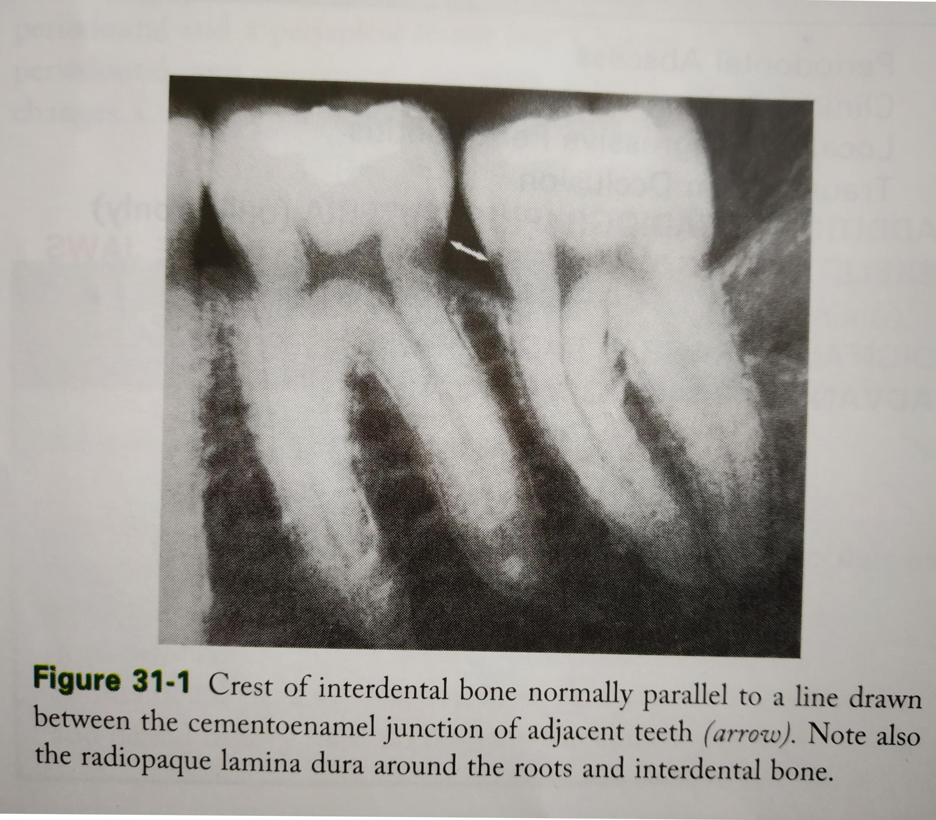

Slide 7
Radiographic Techniques
In conventional radiographs periapical and bitewing projections offer the most diagnostic information and are most commonly used in evaluation of periodontal disease

Slide 8
Prichard established the following four criteria to determine adequate angulation of periapical radiographs
1.the radiograph should show the tips of molar cusp with little or none of occlusal surface showing
2.enamel caps and pulp chamber should be distinct
3.interproximal spaces should be open
4.proximal contacts should not overlap unless teeth are out of line anatomically

Slide 9
Variety of radiographs assist in development of periodontal treatment plans
1.panoramic radiographs
2.periapical radiographs
3.Bitewing radiographs

Slide 10
Panoramic radiographs
•They provide general view of oral structures
•are useful for screening bone loss patterns in general
•useful in assessing generalised Periodontal
•they are not suitable for assessing degree of bone loss associated with individual tooth,as there is sever distortion and outline of bone margin is unclear due to superimposition of structures.

Slide 11
2. Periapical radiographs :
They help in diagnosis of periodontal diseases
They provide useful information that can’t be obtained through examination of the soft tissues alone
3. Bitewing Radiographs:
These are taken to show the proximal surfaces of the teeth and crest of alveolar bone
primarily they are used to detect interproximal decay they can also provide some information on the patients periodontal status
The height of the interproximal Alveolar bone margin relative to the CEJ can be observed also deposits of subgingival calculus may be detected

Slide 12
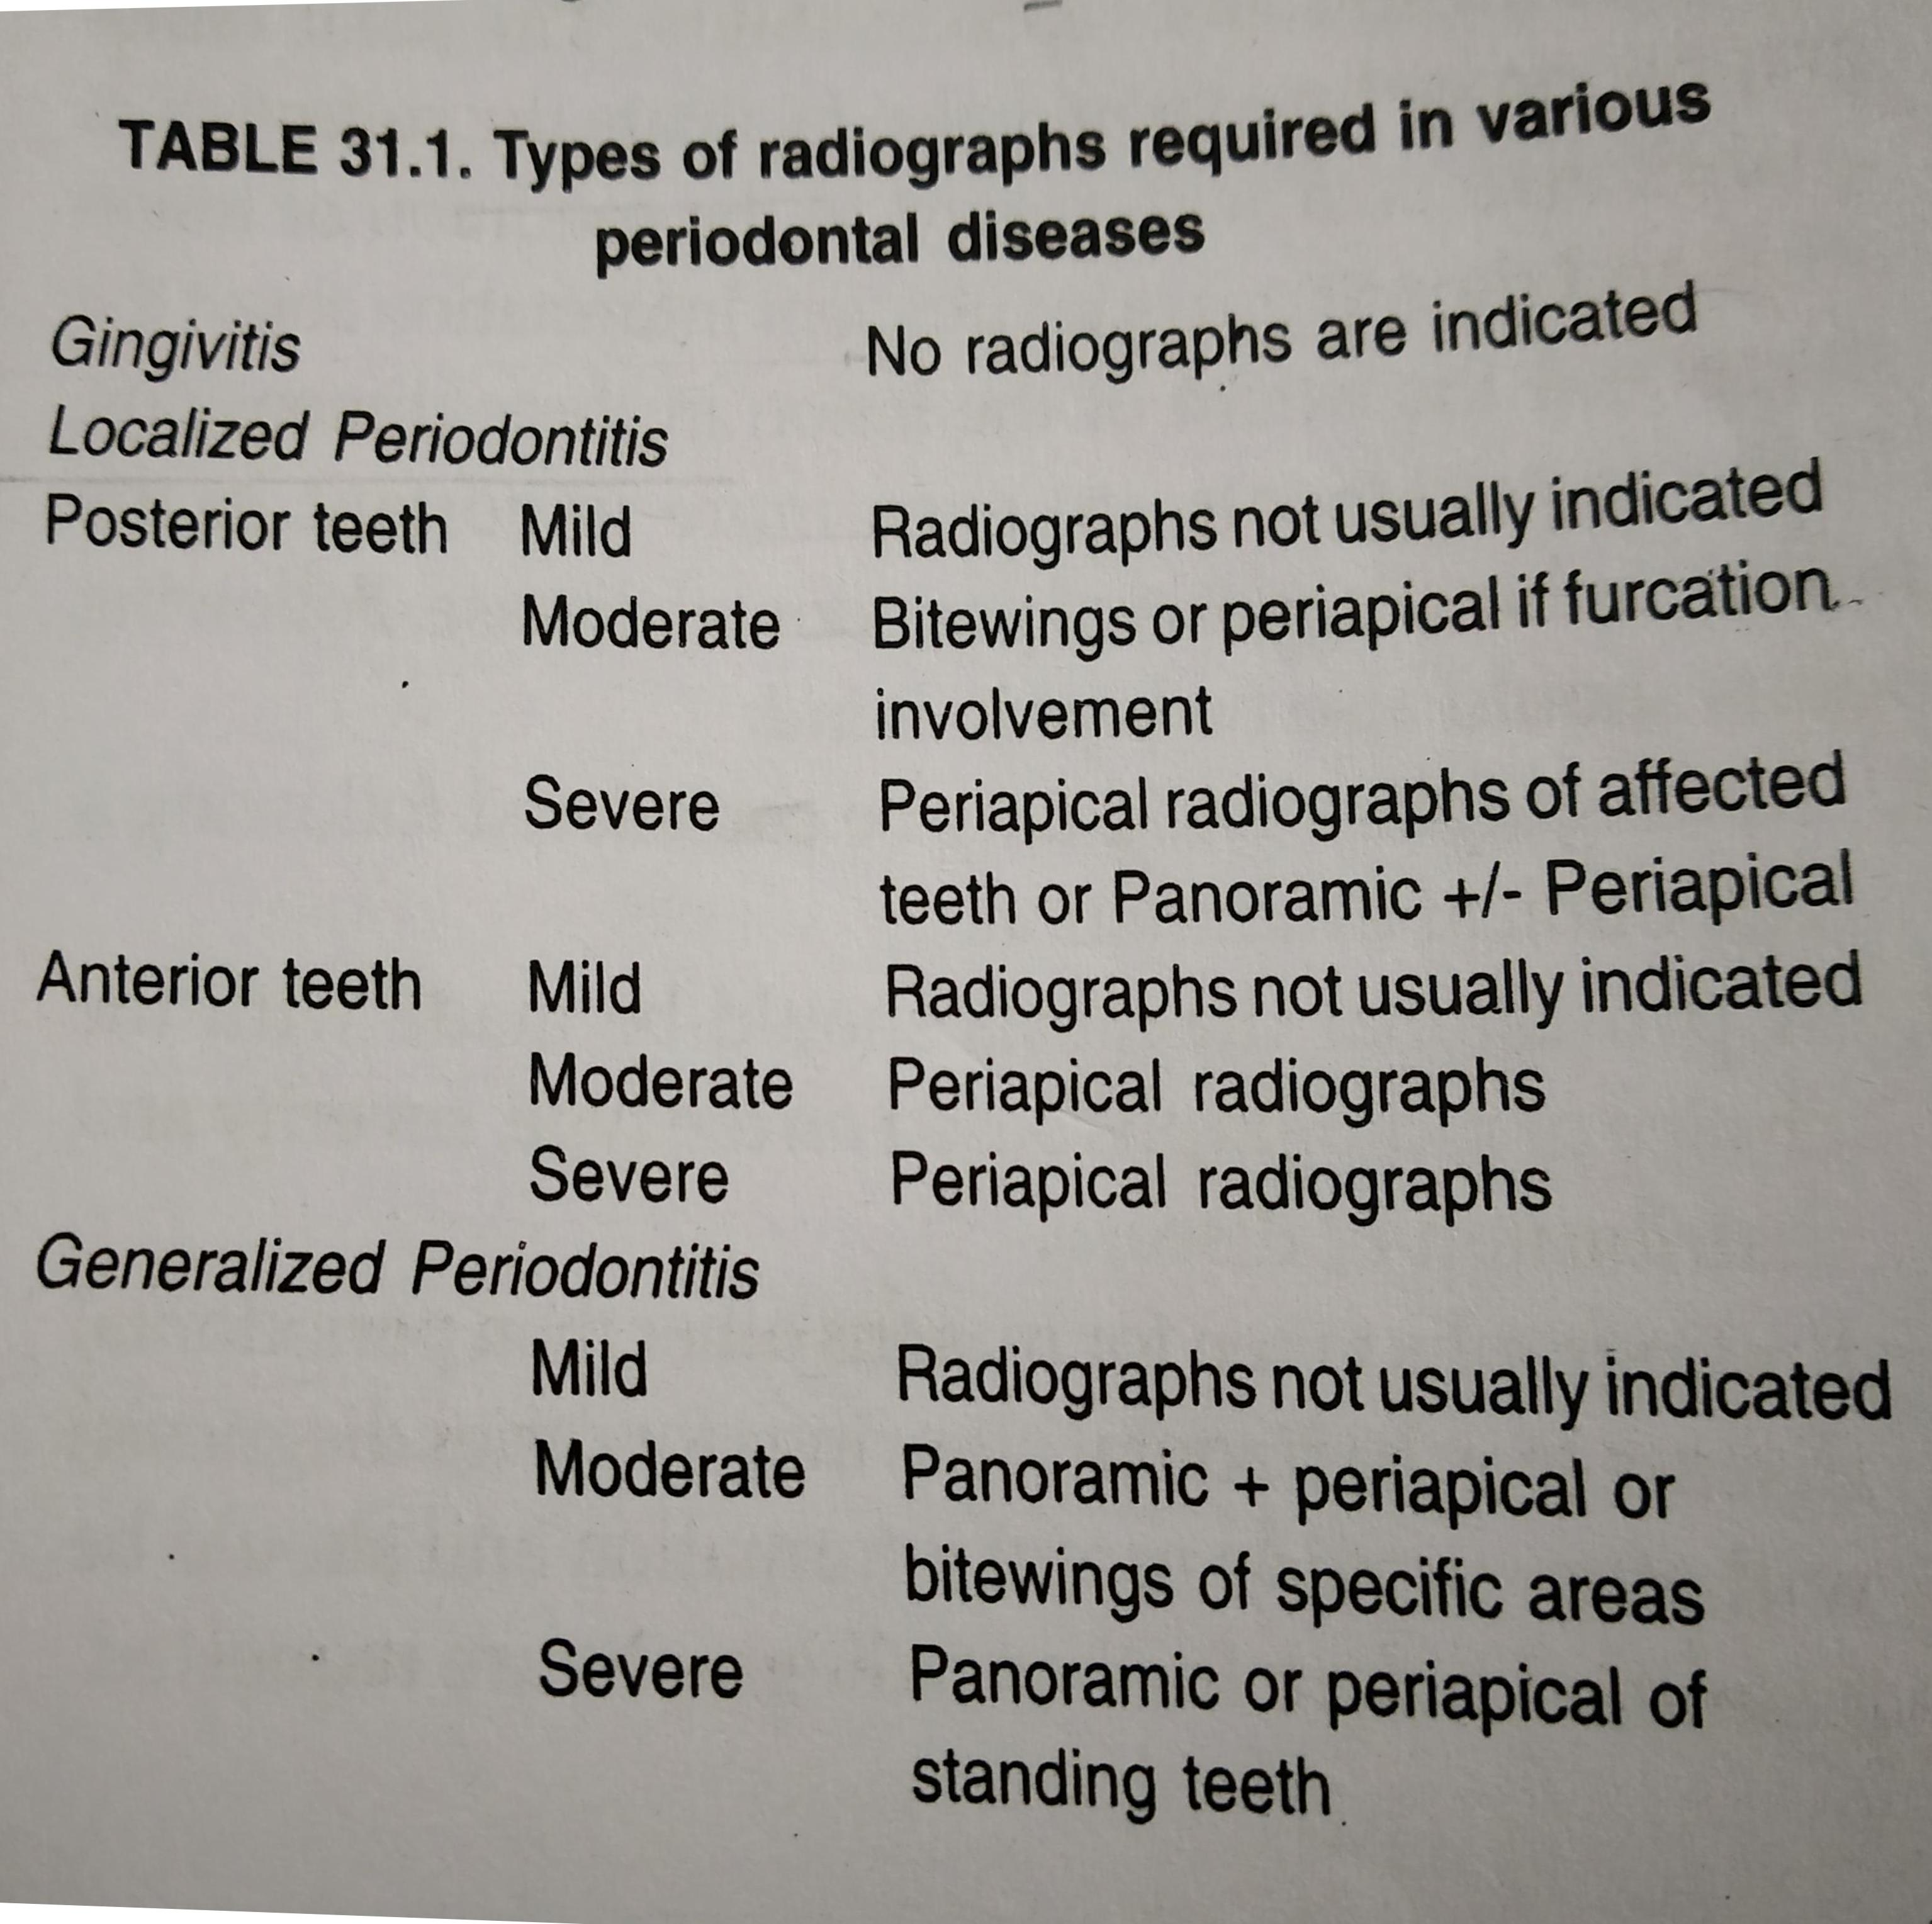

Slide 13
Bone Destruction In Periodontal Disease
Early destructive changes of bone that don’t remove sufficient mineralised tissue can’t be captured on radiographs
Therefore slight radiographic changes of the periodontal tissues suggest that the disease has progressed beyond its earliest stages
The earliest sign of periodontal disease must be detected clinically
Bone Loss:the radiographic image tends to underestimate the severity of bone loss
The difference between Alveolar crest height and radiographic appearance ranges from 0-1.6mm

Slide 14
Amount: radiographs are indirect method for determining the amount of bone loss in periodontal disease they image amount of remaining bone rather than the amount lost.
The amount of bone loss = Physiologic bone level – the height of remaining bone
Distribution: destructive local factors in different areas of mouth and in relation to different surfaces of the same tooth

Slide 15
Pattern of bone Destruction
In periodontal disease the interdental bone undergoes changes that affect the lamina Dura crestal radio density ,size and shape of the medullary spaces and height and contour of the bone
Height of interdental bone may be reduced with the crest perpendicular to long axis of adjacent tooth (horizontal Bone loss) or angular or arcuate defects (angular or vertical bone loss) could form

Slide 16
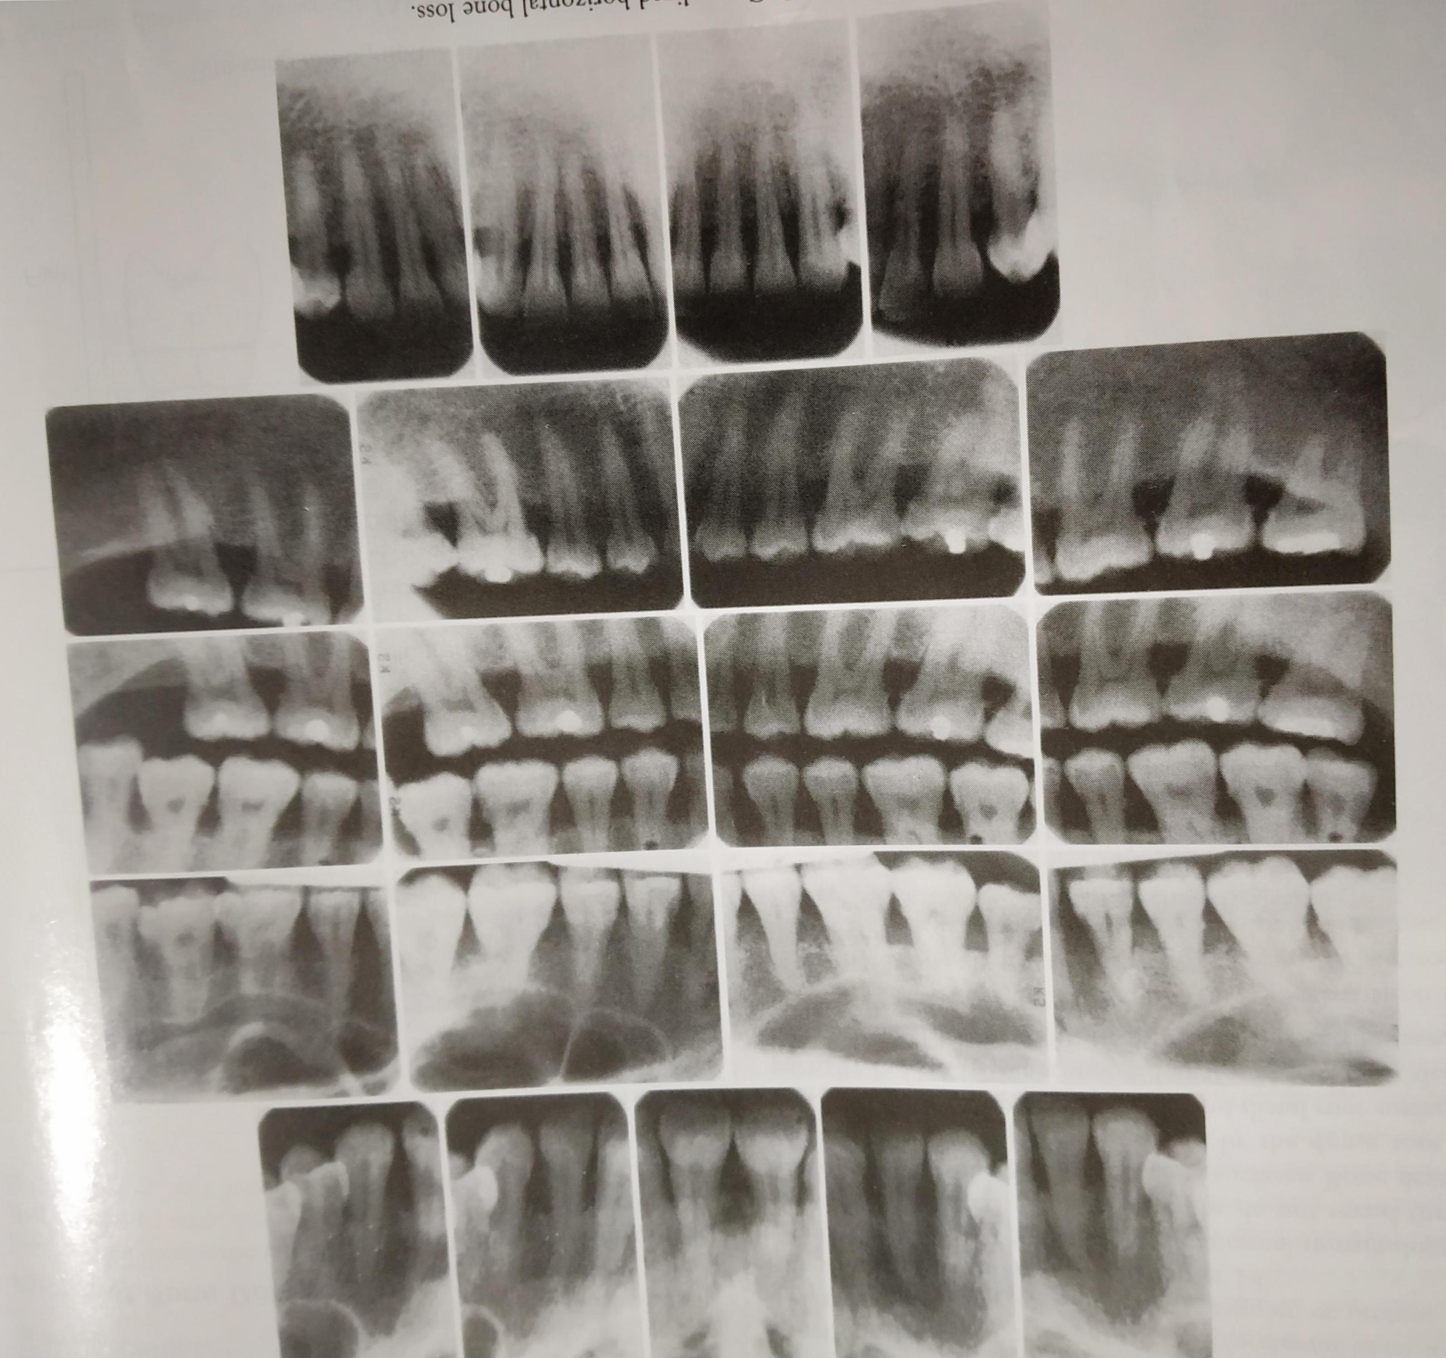
Generalised horizontal Bone loss

Slide 17
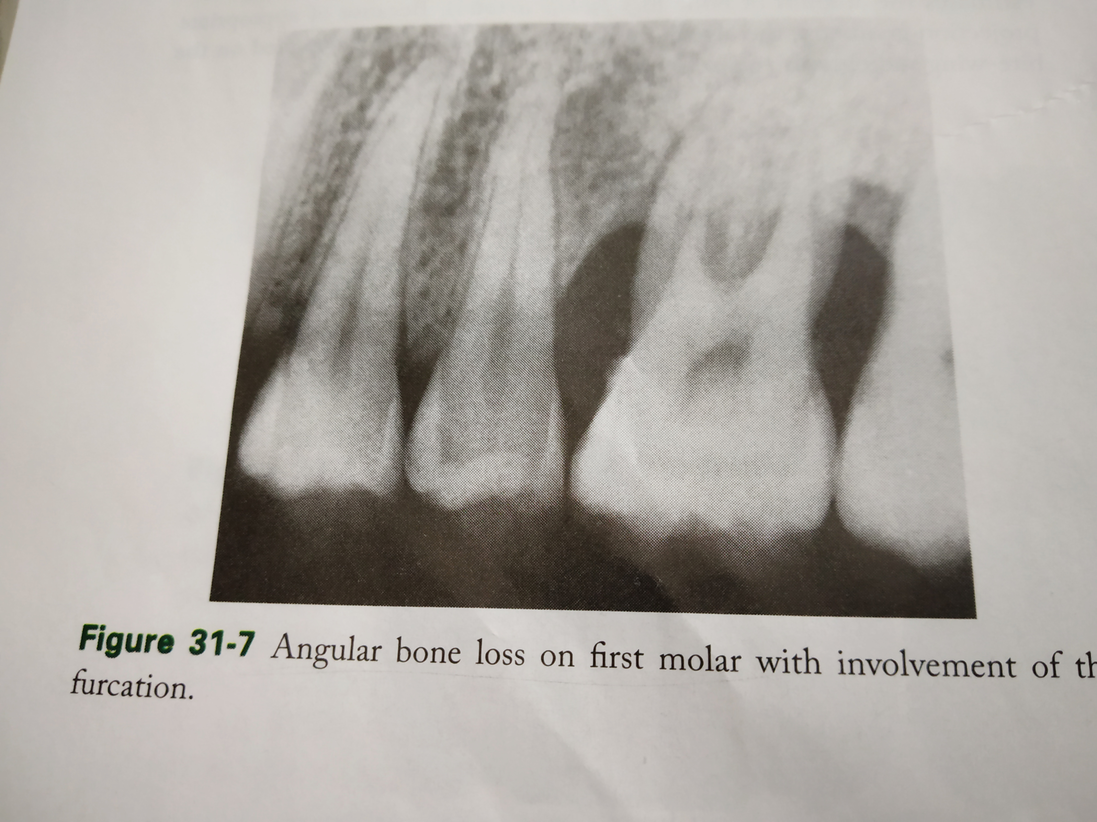
Angular bone loss

Slide 18
Interdental bone loss may continue facially and / lingually to form a trough like defect that could be difficult to appreciate radiographically
These lesions may terminate on the radicular surface / may communicate with the adjacent interdental area to form one continuous lesion

Slide 19
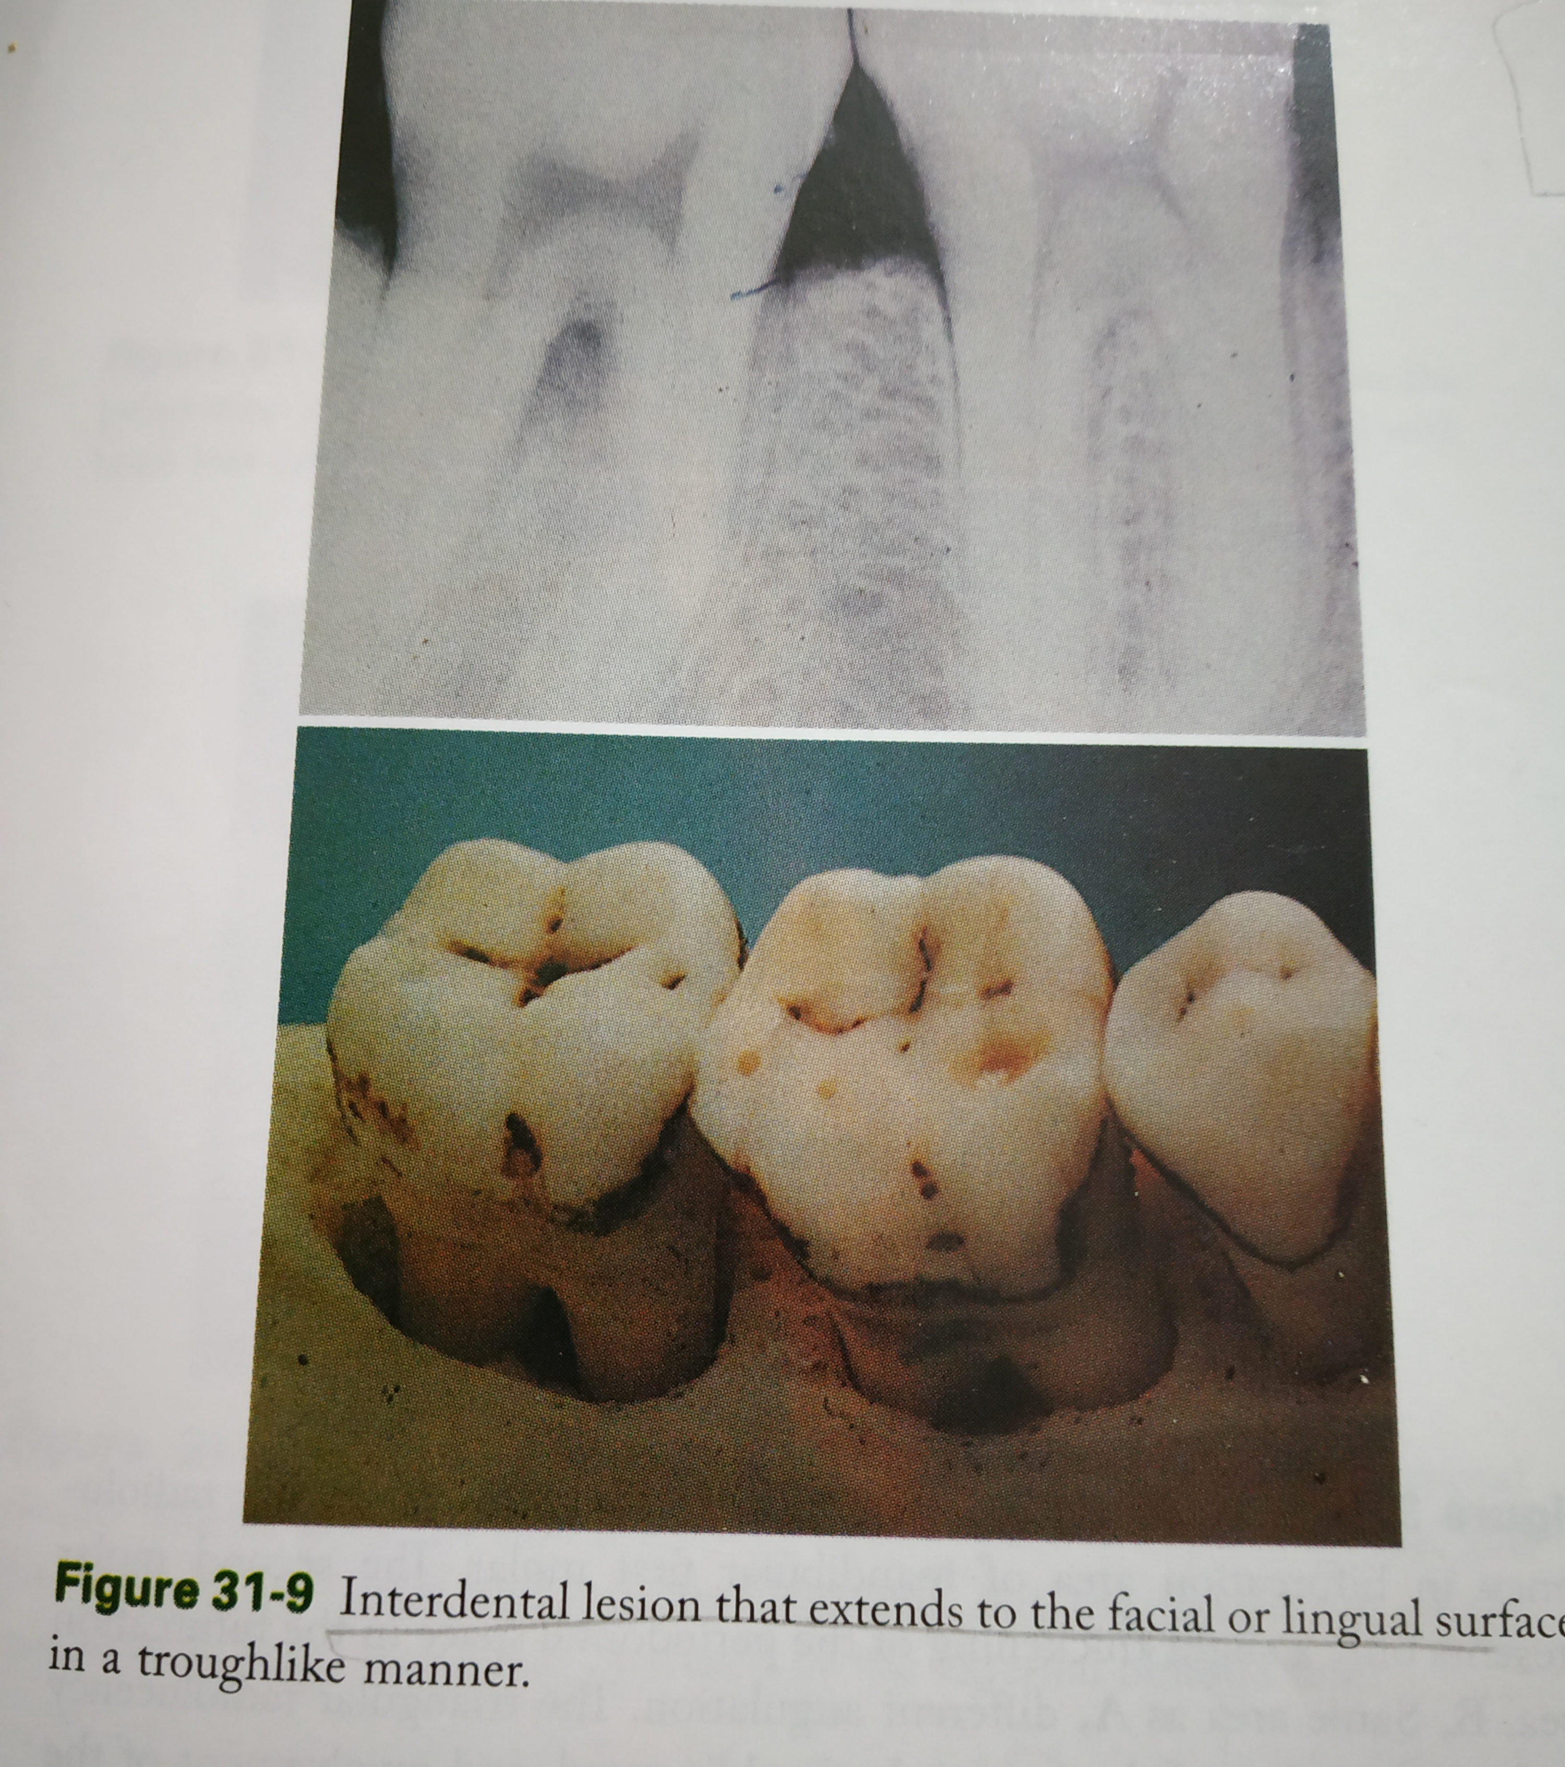

Slide 20
Digital Intraoral Radiography
Intraoral digital radiographs offer several advantages over the conventional film based radiographs in clinical dentistry
Telediagnosis,videoconferencing , rapid image transmission among dentist and third parties,a seamless electronic patient record and integration with computer aided diagnostic software are areas in which digital information is revolutionizing dentistry.
Two major digital intraoral systems are currently available
The first system uses charge coupled devices (CCDs) or complimentary metal oxide semiconductor (CMOS) receptors as detectors

Slide 21
The second system uses photostimulable phosphor (PSP) plates as a detectors
PSP plates resemble film with one of the sides lined with PSP coating
PSP plates are placed and exposed similar to regular films
The exposed plates are placed on a plate scanner and scanned by a laser beam and the radiographic image appears on computer screen

Slide 22
Advantages of intraoral digital radiography
Low Xray exposure
Speed of image capture & display
Ability to manipulate the image
Maximise diagnostic efficacy

Slide 23
Advanced Imaging Modalities
CBCT finds application in almost every diagnostic task of clinical dentistry, including evaluation of periodontal and periapical structures
CBCT offers many advantages over conventional radiography including the accurate 3D imaging of teeth and supporting structures
CBCT avoids the problems of geometric superimposition and unpredictable magnification and can provide valuable diagnostic information in periodontal evaluation
Periapical and Bitewing radiographs provide information mostly for interdental bone
However a 3 wall defect that preserves the buccal or lingual cortices can be difficult to diagnose and the buccal lingual and furcational periodontal bone levels are hard to evaluate in conventional radiographs in such areas CBCT imaging can add diagnostic value

Slide 24


