Slide 1
PROGNOSIS in periodontal Diseases
Presented by : Shruti Tanaji Deshmukh
Intern

Slide 2
CONTENTS
-Introduction
-Definition
-Prognosis and risk
-Prognosis and causality
-Types of prognosis
-Factors in determination of prognosis
-Relationship between diagnosis and prognosis
-Reevaluation of prognosis after phase I therapy
-Conclusion
-Refferences

Slide 3
PROGNOSIS: A prediction as to the progress, course, and outcome of a disease.
DEFINITION
A prognosis is a prediction of the probable course, duration, and outcome of a disease based on a general knowledge of the pathogenesis of the disease and the presence of risk factors for the disease.

Slide 4
Diagnostic factors: factors associated with the analysis and determination of a disease process.
Risk factors: factors associated with disease development in people who do not yet have the disease. (Newman and Kornman, 1994)
Prognostic factors: factors used to predict disease progression once the disease is present. (McGuire and Nunn, 1996)

Slide 5
Periodontal Risk Factor
Smoking
Subgingival plaque
Initial attachment loss
Probing depth increases
Bleeding on probing
Suppuration
Level of plaque control
Low socioeconomic level
Sporadic dental care
Level of education
Poor dietary habits
Infectious and other acquired diseases
Side effects of medication

Slide 6
Prognosis is often confused with the term risk.
Prognosis | Risk
It is the prediction of the duration, course and the termination of disease and its response to treatment. Prognostic factors are characteristics that predict the outcome of disease once the disease is present. | Deals with the likelihood that an individual will get a disease in a specified period. Risk factors are those characteristics of an individual that put them at increased risk for getting a disease.

Slide 7
GOOD PROGNOSIS
-Control of the etiologic factors -Adequate periodontal support as measured clinically and radiographically. -Easy to maintain by the patient and clinician assuming proper maintenance.
FAIR PROGNOSIS
Approximately 25% attachment loss as measured clinically and radiographically and/or Class I furcation involvement. The location and depth of the furcation would allow proper maintenance with good patient compliance.

Slide 8
POOR PROGNOSIS
-50% attachment loss -Class II furcations. - The location and depth of the furcations would allow proper maintenance, but with difficulty.
QUESTIONABLE PROGNOSIS
->50% attachment loss . -poor crown/root ratio. -Poor root form. -Class II furcations not easily accessible to maintenance care, or Class III furcations. ->2 mobility. -Significant root proximity.

Slide 9
HOPELESS PROGNOSIS
-Inadequate attachment to maintain the tooth in health, comfort, and function. -Extraction was performed or suggested.

Slide 10
Overall Versus Individual Tooth Prognosis
Overall prognosis
Concerned with the dentition as a whole.
Factors that may influence the overall prognosis include:-
Patient age
Current severity of disease
Systemic factors
Smoking
The presence of biofilm, calculus, and other local factors;
Patient compliance
Prosthetic possibilities

Slide 11
The overall prognosis answers the following questions:
• Should treatment be undertaken?
• Is treatment likely to succeed?
• When prosthetic replacements are needed, are the remaining teeth able to support the added burden of the prosthesis?

Slide 12
Individual tooth prognosis
- Determined after the overall prognosis and is affected by it.
-For example, in a patient with a poor overall prognosis, the dentist likely would not attempt to retain a tooth that has a questionable prognosis because of local conditions.

Slide 13
INDIVIDUAL TOOTH PROGNOSIS | OVERALL TOOTH PROGNOSIS
Percentage of bone loss | Age
Deepest probing depth | Medical history
Horizontal vertical bone loss | Family history
Deepest furcation involvement | Oral hygiene
Mobility | Patient compliance
Crown root ratio | Maintenance
Root form | Parafunctional habits
Caries or pulpal involvement
Tooth malposition
Fixed or removable prosthesis

Slide 14
Factors to Consider When Determining a Prognosis
Overall Clinical Factors | Systemic and Environmental Factors | Local Factors | Anatomic Factors | Prosthetic and Restorative Factors
Patient age Disease severity Biofilm control Patient compliance | Smoking Systemic disease or condition Genetic factors Stress | Biofilm and calculus Subgingival restorations | Short, tapered roots Cervical enamel projections Enamel pearls Bifurcation ridges Root concavities Developmental grooves Root proximity Furcation Tooth mobility Caries Tooth vitality Root resorption | Abutment selection

Slide 15
Overall Clinical Factors
Patient Age
For two patients with comparable levels of remaining connective tissue attachment and alveolar bone, the prognosis is generally better for the older of the two.

Slide 16

For the younger patient, the prognosis is not as good because of the shorter time frame in which the periodontal destruction has occurred; the younger patient may have an aggressive type of periodontitis, or disease progression may have increased because of systemic disease or smoking.

Slide 17
Disease Severity
History of previous periodontal disease may be indicative of their susceptibility to future periodontal breakdown .
Therefore the following variables should be carefully recorded because they are important in determining the patient’s past history of periodontal disease:
Probing pocket depth
Level of attachment
Amount of bone loss
Type of bony defect.

Slide 18
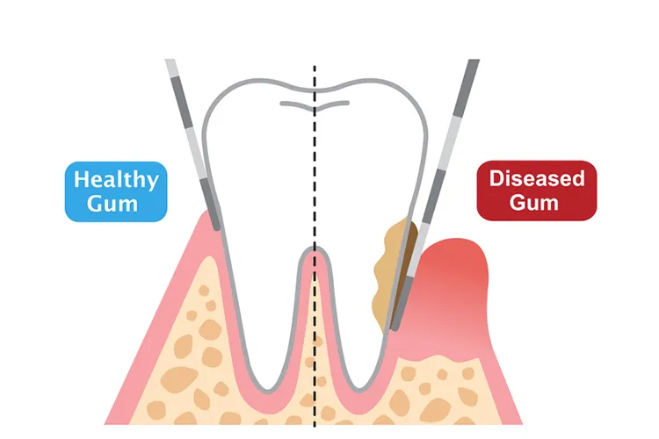
Pocket depth:
Shallow pockets have a better prognosis than deep pockets.
Deep pockets have a favorable prognosis if attachment and bone levels are high.

Slide 19
Level of attachment:
Determining clinical attachment loss reveals the approximate extent of root surface that is devoid of periodontal ligament; the radiographic examination shows the amount of root surface still invested in bone.
Probing pocket depth is less important than level of attachment because it is not necessarily related to bone loss.

Slide 20
Tooth with deep probing depths and little attachment and bone loss has a better prognosis than one with shallow pockets and severe attachment and bone loss.
However, a biofilm in deep pockets is difficult to control and may contribute to disease progression.

Slide 21
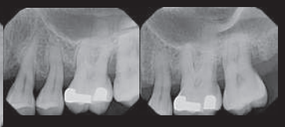
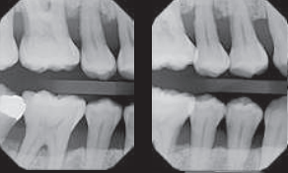
BONE LOSS
The prognosis also can be related to the height of remaining bone.
when there is so little bone loss when bone loss is so severe that the that tooth support remaining bone is obviously insufficient for proper tooth support
.
not in jeopardy

Slide 22
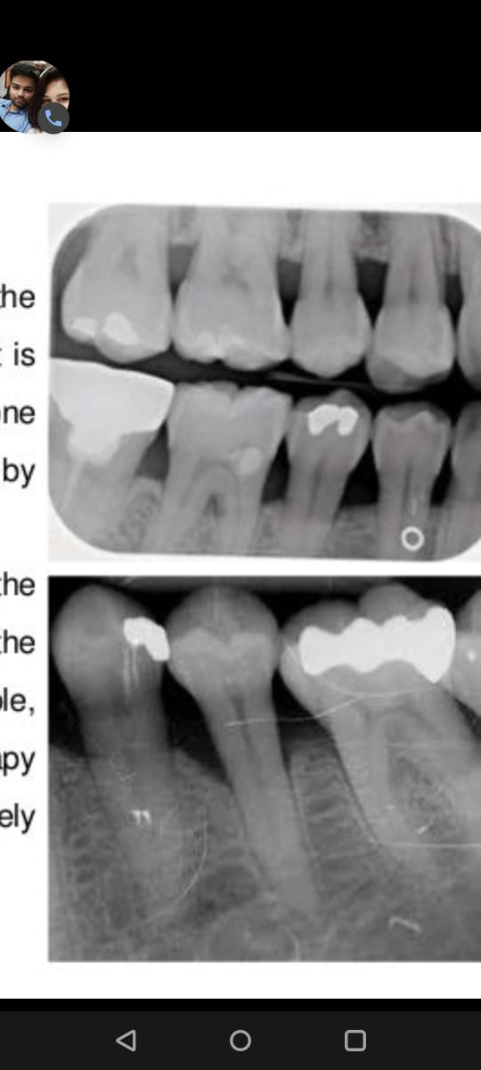
Horizontal bone loss :depends on the height of the existing bone because it is unlikely that clinically significant bone height regeneration will be induced by therapy.
Angular, intrabony defects: If the contour of the existing bone and the number of osseous walls are favorable, there is an excellent chance that therapy could regenerate bone to approximately the level of the alveolar crest.

Slide 23
Osseous defect :
Three-walled osseous defect provides a scaffold for repair and thus have good regenerative potential.
Two-walled osseous lesion has poorer and one-walled the poorest prognosis for bone regeneration.
Thus, prognosis is related to the height of remaining bone.

Slide 24
When greater bone loss has occurred on one surface of a tooth, the bone height on the less involved surfaces should be taken into consideration when determining the prognosis.
Because of the greater height of bone in relation to other surfaces, the center of rotation of the tooth will be nearer the crown .
This results in a more favorable distribution of forces to the periodontium and less tooth mobility

Slide 25
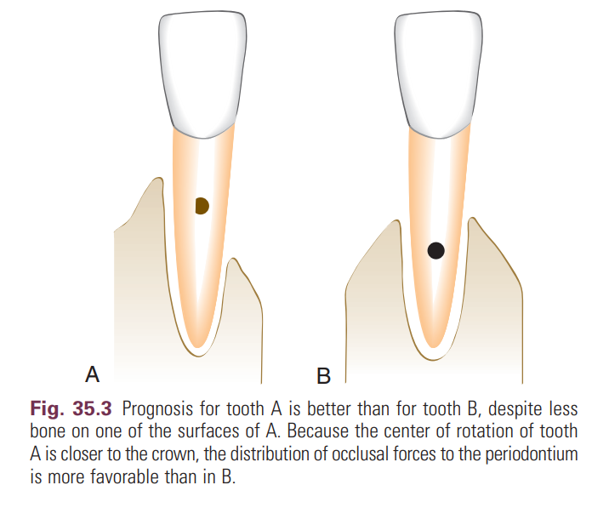

Slide 26
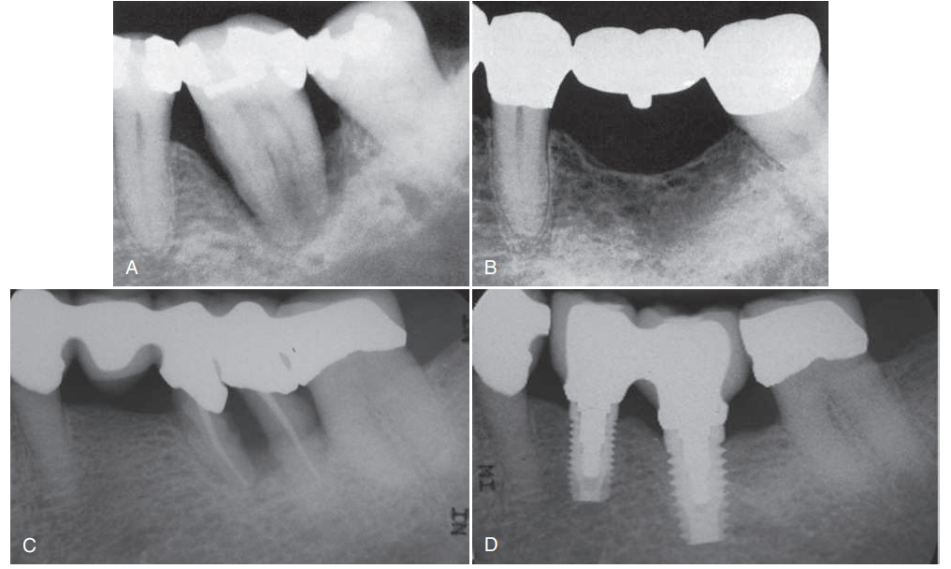
“Watch and wait” approach
.

Slide 27
Extraction of teeth with a questionable prognosis to enhance the likelihood of partial restoration of the bone supporting of the adjacent teeth or successful implant placement.
With the growing evidence of the long-term success of dental implants, it is proposed that a “watch and wait” approach.
This means that the practitioner should weigh the potential success of one treatment option (extraction and implant placement) versus the other (periodontal therapy and maintenance) carefully when assigning a questionable prognosis to teeth..

Slide 28

Patient Compliance and Cooperation
.
The prognosis for patients with gingival and periodontal disease is critically dependent on:
The patient’s attitude
Desire to retain the natural teeth
Willingness and ability to effectively control biofilm.

Slide 29
.
Without these, treatment cannot succeed.
Patients should be educated on the etiology and prevention of dental caries and periodontal diseases, and they should be clearly informed of the important role they must play for treatment to succeed.

Slide 30
The major etiologic factor for periodontal disease is plaque-induced infection and inflammation.
Studies showed that lack of maintenance can result in disease recurrence, even after years of periodontal health, and periodontal instability was more pronounced as time progressed.
In the study of periodontal surgery in plaque-infected dentitions by Nyma et al, plaque accumulation after different kinds of pocket-reduction surgery resulted in the recurrence of destructive periodontitis.
Even in patients receiving non-surgical therapy, discontinuous maintenance led to an increase in tooth loss.
.

Slide 31
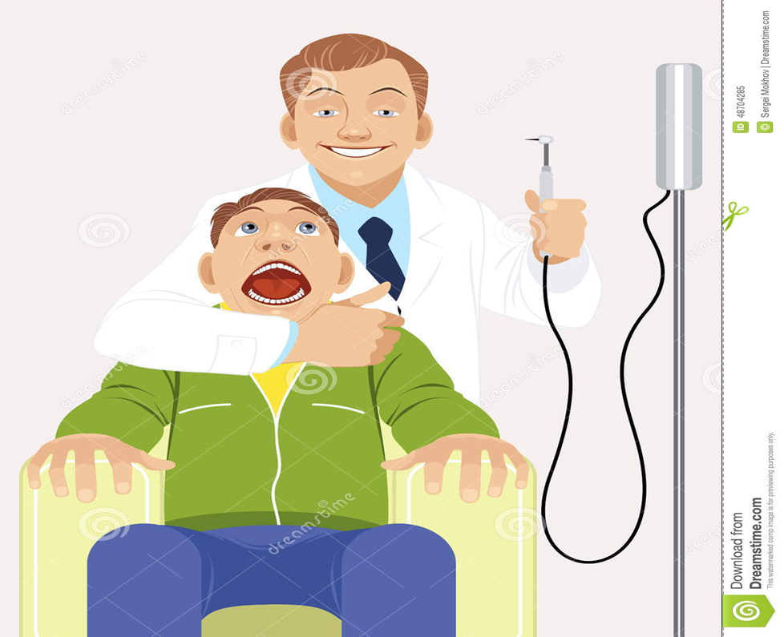
If a patient is unwilling to perform adequate biofilm control and receive the timely periodic maintenance checkups and treatments that the dentist deems necessary, the dentist can refuse to accept the patient for treatment.
The dentist should make it clear to the patient and in the patient record that further treatment is needed but will not be performed because of a lack of patient cooperation.
.

Slide 32
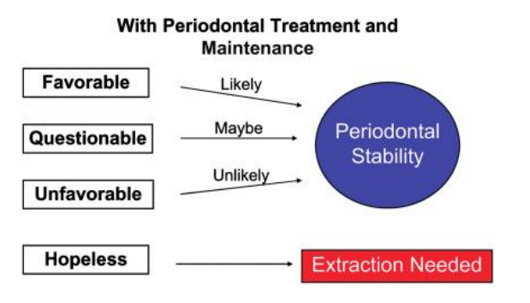
Prognosis Revisited: A System for Assigning Periodontal Prognosis Vivien Kwok*† and Jack G. Caton

Slide 33

Systemic and Environmental Factors
.
Smoking :
Epidemiologic evidence suggests that smoking may be the most important environmental risk factor impacting the development and progression of periodontal disease.
Smoking affects not only the severity of periodontal destruction but also the healing potential of the periodontal tissues.
patients who smoke do not respond as well to conventional periodontal therapy as patients who have never smoked.

Slide 34



Slight to moderate Questionable favourable prognosis
chronic periodontitis prognosis
.
Smoke
Severe periodontitis unfavorable or Questionable prognosis
hopeless.
Smoking cessation can affect the treatment outcome and therefore the prognosis.
Newman and Carranza’s Clinical Periodontology 13th edition

Slide 35
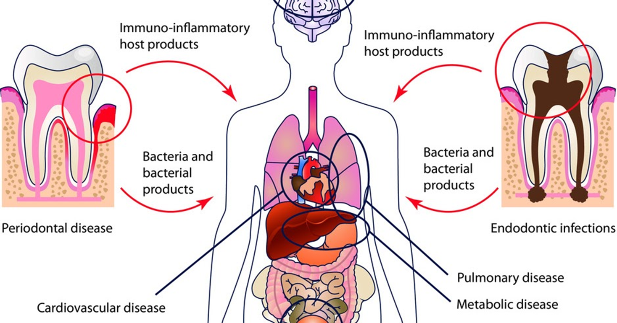
Systemic Disease or Condition
The patient’s systemic background affects the overall prognosis in several ways.

Slide 36
Diabetes:
.
Prevalence and severity of chronic periodontitis are significantly higher in patients with poorly controlled diabetes than in those whose diabetes is well controlled or those who do not have diabetes.
Therefore patients at risk for diabetes should be identified as early as possible and informed of the relationship between periodontitis and diabetes.

Slide 37
.
Similarly, patients diagnosed with diabetes must be informed of the impact of diabetic control on the development and progression of periodontitis.
It follows that the prognosis in these cases depends on patient compliance relative to both medical and dental status.
Patients with well-controlled diabetes and slight to moderate periodontitis who comply with their recommended periodontal treatment should have a favorable prognosis.

Slide 38
Diabetes affects the host response by decreasing polymorphonuclear leukocyte function and affects collagen metabolism by decreasing collagen production and increasing collagenase activity.
Hyperglycemia can cause the formation of advanced glycation end products with other extracellular proteins.
These end products result in reduced solubility and a decreased turnover rate of collagen.
They also thicken the basement membrane, impeding oxygen diffusion, metabolic waste product elimination, and immune defense.
As a result, wound healing is compromised in patients who have uncontrolled diabetes.
Diabetes was also shown to worsen the long-term periodontal prognosis.
.

Slide 39
.
The prognosis is questionable when surgical periodontal treatment is required but cannot be provided because of the patient’s health.
Incapacitating conditions that limit the patient’s performance of oral procedures (e.g., Parkinson disease) also adversely affect the prognosis. Newer “automated” oral hygiene devices, such as electric toothbrushes, may be helpful for these patients and may improve their prognosis

Slide 40

.
Genetic Factors
Genetic factors may play an important role in determining the nature of the host response.
Evidence for this type of genetic influence exists for patients with both chronic and aggressive periodontitis.

Slide 41
.
Genetic factors also appear to influence serum immunoglobulin G2 (IgG2) antibody titers and the expression of FcγRII receptors on neutrophils, both of which may be significant in aggressive periodontitis.
Other genetic disorders, such as leukocyte adhesion deficiency type 1, can influence neutrophil function, creating an additional risk factor for aggressive periodontitis.

Slide 42
.
Detection of patients at risk because of genetic factors can lead to early implementation of preventive and treatment measures for these patients.
Second, identification of genetic risk factors later in the disease or during the course of treatment can influence treatment recommendations, such as the use of adjunctive antibiotic therapy or increased frequency of maintenance visits.

Slide 43
.
Third, identification of young individuals who have not been evaluated for periodontitis but who are recognized as being at risk because of the familial aggregation seen in aggressive periodontitis can lead to the development of early intervention strategies.
In each of these cases, early diagnosis, intervention, and alterations in the treatment regimen may lead to an improved prognosis for the patient.

Slide 44

Stress
.
Physical and emotional stress, as well as substance abuse, may alter the patient’s ability to respond to the periodontal treatment performed .
These factors must be realistically faced when attempting to establish a prognosis.

Slide 45
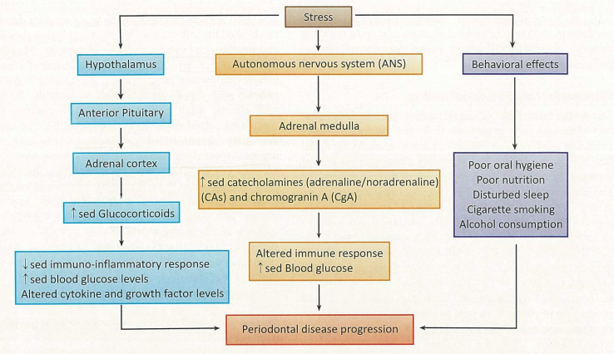

Slide 46
Race
Racial differences in periodontal disease prevalence seem to be largely because of socioeconomic factors.
However, race and ethnicity do play a role in disease susceptibility in certain chronic diseases.
There are distinct racial differences in the host immunoinflammatory response to periodontal pathogens that may provide some explanation for the greater prevalence of this disease in these populations.

Slide 47
Sex
Male individuals tend to have more periodontal disease than female individuals, and the disease tends to be more severe when it does occur.
Although men, as a group, use dental services less than women and tend to have poorer home care, the increase in periodontal disease persists after correcting for these factors.

Slide 48
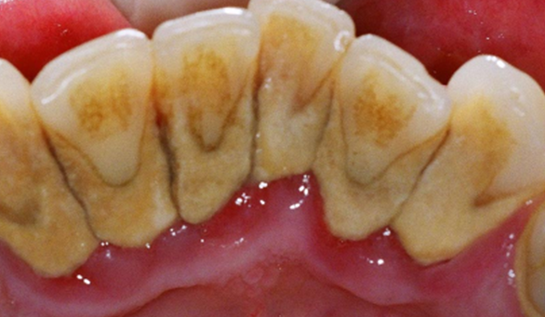

Local Factors
.
Biofilm and Calculus
The microbial challenge presented by bacterial biofilm and calculus is the most important local factor in periodontal diseases.
Therefore in most cases, having a favorable prognosis depends on the ability of the patient and the clinician to remove these etiologic factors.

Slide 49
Anatomic Factors
Anatomic factors that may predispose the periodontium to disease and therefore affect the prognosis include:
Short, tapered roots with large crowns
Cervical enamel projections
Enamel pearls
Intermediate bifurcation ridges
Root concavities
Developmental grooves
Root proximity
Location and anatomy of furcation
.

Slide 50
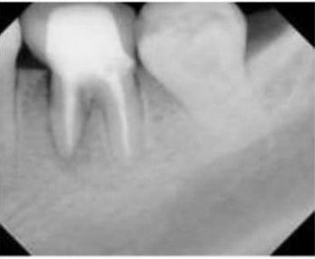
Short, tapered roots with large crowns
Prognosis is less favorable for teeth with short, tapered roots and relatively large crowns .
Because of the disproportionate crown-to-root ratio and the reduced root surface available for periodontal support, the periodontium may be more susceptible to injury by occlusal forces.
.

Slide 51
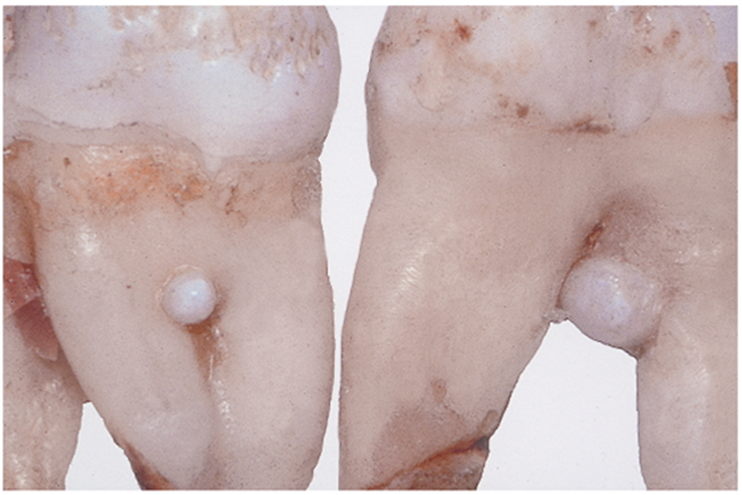
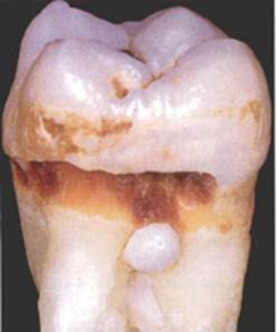
Enamel pearls
Larger, round deposits of enamel that can be located in furcations or other areas on the root surface.
Enamel pearls are seen less frequently (1.1% to 5.7% of permanent molars; 75% appearing in maxillary third molars) than ceps.
.

Slide 52
Root concavities
Exposed through loss of attachment can vary from shallow flutings to deep depressions.
They appear more marked on maxillary first premolars, the mesiobuccal root of the maxillary first molar, both roots of mandibular first molars, and the mandibular incisors and Any tooth, however, can have a proximal concavity.
Although these concavities increase the attachment area and produce a root shape that may be more resistant to torquing forces, they also create areas that can be difficult for both the dentist and the patient to clean.
.

Slide 53
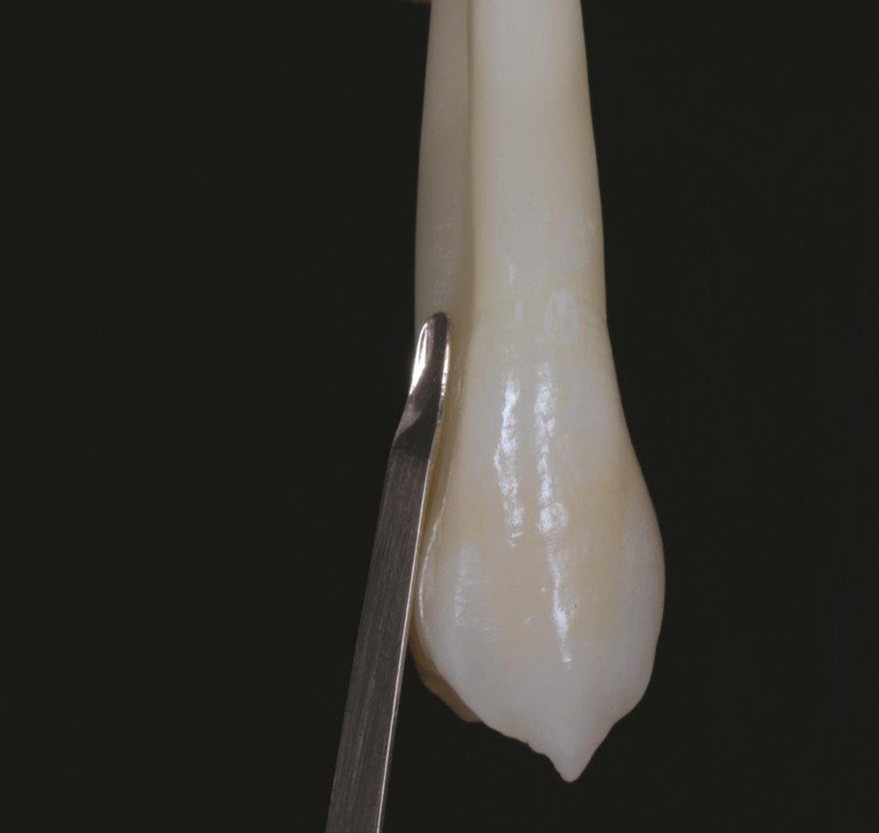
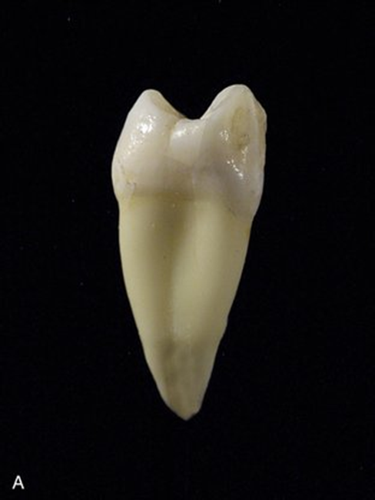

Slide 54
Other anatomic considerations that present accessibility problems are:
Developmental grooves
Root proximity
Furcation involvement
-The presence of any of these can worsen the prognosis.

Slide 55
Developmental grooves, which sometimes appear in the maxillary lateral incisors (palatogingival groove) or in the lower incisors, create an accessibility problem.
They initiate on enamel and can extend a significant distance on the root surface, providing a plaque-retentive area that is difficult to instrument.
These palatogingival grooves are found on 5.6% of maxillary central incisors .

Slide 56
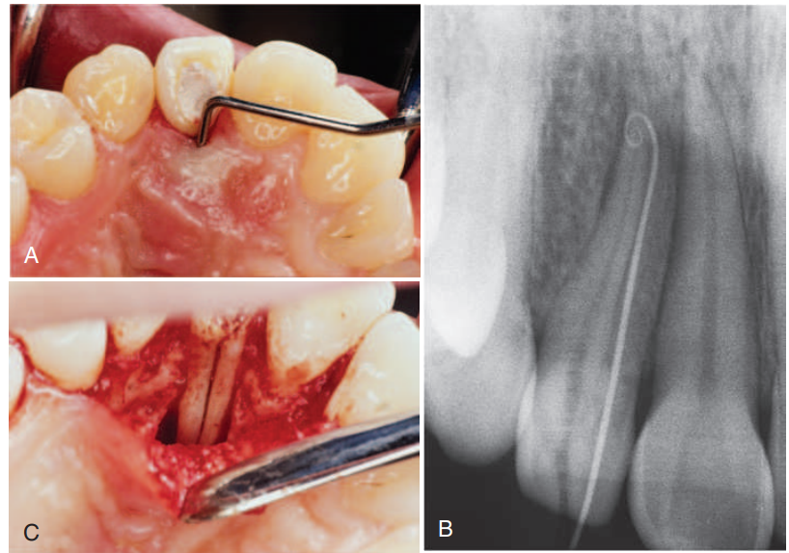

Slide 57
.
Prognosis of Endo –Perio Lesion

Slide 58
Primary endodontic disease
An acute exacerbation of a chronic apical lesion on a tooth with a necrotic pulp may drain coronally through the periodontal ligament into the gingival sulcus.
This condition may mimic clinically the presence of a periodontal abscess.
In reality, it is a sinus tract from pulpal origin that opens through the periodontal ligament area.
.
Rotstein I.& James H. S. SimoN Diagnosis, prognosis and decision-making in the treatment of combined periodontal endodontic lesions Periodontology 2000, Vol. 34, 2004, 165–203

Slide 59
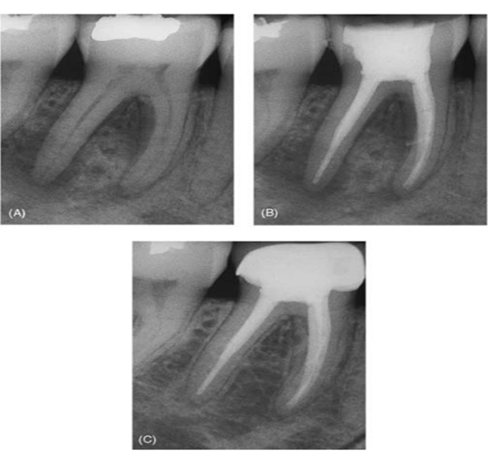
The sinus tract extending into the gingival sulcus or furcation area disappears at an early stage once the necrotic pulp has been removed and the root canals are well sealed .
It is important to recognize that failure of any periodontal treatment will occur when the presence of a necrotic pulp has not been diagnosed, and endodontic treatment has not followed.
.
Rotstein I.& James H. S. SimoN Diagnosis, prognosis and decision-making in the treatment of combined periodontal endodontic lesions Periodontology 2000, Vol. 34, 2004, 165–203

Slide 60
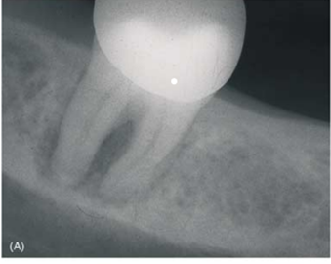
Primary periodontal disease
These lesions are caused primarily by periodontal pathogens.
In this process, chronic periodontitis progresses apically along the root surface.
In most cases, pulp tests indicate a clinically normal pulpal reaction .
There is frequently an accumulation of plaque and calculus and the pockets are wider.

Slide 61
The prognosis depends upon the stage of periodontal disease and the efficacy of periodontal treatment.
The clinician must also be aware of the radiographic appearance of periodontal disease associated with developmental radicular anomalies.

Slide 62
.
Combined diseases Primary endodontic disease with secondary periodontal involvement
If after a period of time a suppurating primary endodontic disease remains untreated, it may become secondarily involved with periodontal breakdown .
Plaque forms at the gingival margin of the sinus tract and leads to plaque-induced periodontitis in the area.

Slide 63
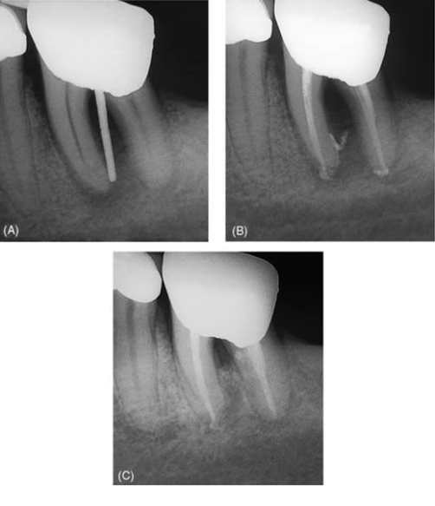
.
The tooth treated with both endodontic and periodontal treatments.
If the endodontic treatment is adequate, the prognosis depends on the severity of the plaque-induced periodontitis and the efficacy of periodontal treatment.

Slide 64
.
Symptoms
May be acute, with periodontal abscess formation associated with pain, swelling, pus or exudate, pocket formation, and tooth mobility.
A more chronic response may sometimes occur without pain, and involves the sudden appearance of a pocket with bleeding on probing or exudation of pus.

Slide 65
.
Primary periodontal disease with secondary endodontic involvement
The apical progression of a periodontal pocket may continue until the apical tissues are involved.
In this case the pulp may become necrotic as a result of infection entering via lateral canals or the apical foramen.

Slide 66
In single-rooted teeth the prognosis is usually poor.
In molar teeth the prognosis may be better.
It has been reported that pulpal changes resulting from periodontal disease are more likely to occur when the apical foramen is involved .
In these cases, bacteria originating from the periodontal pocket are the most likely source of root canal infection.
A strong correlation between the presence of microorganisms in root canals and their presence in periodontal pockets of advanced periodontitis has been demonstrated .

Slide 67
Treatment include endodontic and periodontal therapies.
Prognosis depends upon the severity of periodontal disease and response to periodontal treatment.

Slide 68
Role of microorganisms/biofilm in prognosis
The microflora at both tooth and implant sites can be identified as biofilms.
The adhesion of bacteria depends on the surface characteristics to which it adheres.
In a study, failing implants showed the presence of Porphyromonas gingivalis, Prevotella intermedia, Prevotella nigrescens, and Aggregatibacter actinomycetemcomitans.

Slide 69
In another study, patients with peri‑implantitis showed very high counts of Fusobacterium nucleatum, A. actinomycetemcomitans, and P. gingivalis.
From these clinical and microbiological studies, it can be concluded that periodontal pathogens immediately colonized around implants in patients previously treated for severe periodontal disease.
This microbiota remained almost unchanged over a 6‑month period, did not hamper the clinical and radiographic osseointegration, and did not lead to peri‑implantitis, mucositis, or beginning of bone destruction.

Slide 70
It is a known fact that colonization of bacteria depends on the surface characteristics.
Hence, it is very important to develop implant surfaces that reduce the number of initially adhering bacteria, which minimizes biofilm formation and subsequent inflammation of the soft tissues.

Slide 71
PROGNOSIS SCORING SYSTEM

Slide 72
Miller–McEntire periodontal prognostic index:
Miller–McEntire periodontal prognostic index (2014)is an evidence-based quantitive scoring system that incorporates six prognostic factors that includes:

Slide 73
Miller-McEntire Periodontal Prognosis Scoring System
FACTORS SCORED
Age
Probing Depth (PD)
Mobility
Furcation involvement
Molar type
Smoking

Slide 74
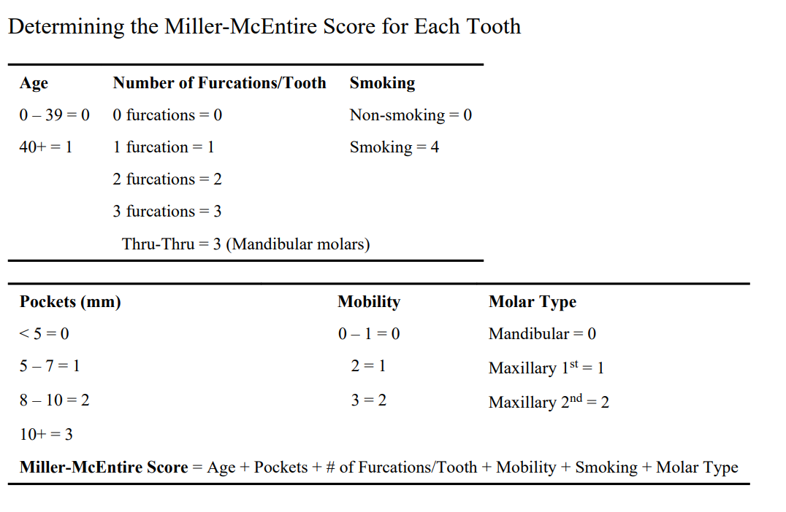

Slide 75
Thank You !!

