Slide 1
RATIONALE FOR PERIODONTAL TREATMENT
- Mandar Manohar Joshi

Slide 2
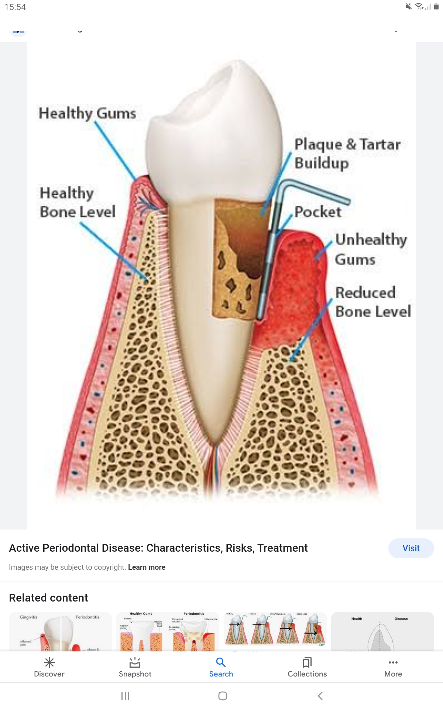
The effectiveness of PERIODONTAL THERAPY is made possible by the remarkable healing capacity of the periodontal tissues.

Slide 3
What does periodontal therapy
accomplish?
Eliminate pain,exudate, gingival inflammation, and bleeding
Reduce periodontal pockets
Eliminate infection
Arrest the destruction of soft tissue and bone
Reduce abnormal tooth mobility

Slide 4
What does periodontal therapy
accomplish?
Establish optimal occlusal function
Restore tissue destroyed by disease
Reestablish physiologic gingival contour
Prevent the recurrence of disease which will all help to maintain the naturaldentition

Slide 5
LOCAL THERAPY
▪︎ The removal of plaque and all of the factors that favor its accumulation is the primary goal in local therapy.
▪︎The cause of periodontitis and gingivitis is bacterial plaque accumulation on the tooth surface in close proximity to gingival tissue.
▪︎ The thorough elimination of plaque and the prevention of its formation can help maintain periodontal health.
• Factors Favouring : calculus
overhanging margins of restorations
food impaction

Slide 6
SYSTEMIC THERAPY
Systemic therapy may be employed as an adjunct to local measures for specific purposes such as :
1.controlling systemic complications fromacute infections or chemotherapy
2. preventing harmful effects of post treatment bacteremia
3.Supportive nutritional therapy
4.The control of systemic disease that aggrevate patients periodontal condition
▪ ︎Systemic therapy for treatment of the periodontal condition and in conjunction with local therapy is indicated in localized and generalized aggressive periodontitis
In these diseases, systemic antibiotics are used to completely eliminate the bacteria that invade the gingival tissues and can repopulate the pocket after scaling and root planning.

Slide 7
▪︎ Evidence was then presented that some nonsteroidal antiinflammatory drugs (NSAIDs), such as -
flurbiprofen and ibuprofen, can reduce the development of experimental gingivitis as well as the loss of alveolar bone in periodontitis.
These drugs are propionic acid derivatives and act by inhibiting the cyclooxygenase pathway of arachidonic acid metabolism, thereby reducing prostaglandin formation. These
NSAIDs can be administered by mouth or applied topically.
▪︎ Another drug that has a strong inhibitory effect on bone resorption
is alendronate, a bisphosphonate, which is currently used to treat
metabolic diseases in humans, such as Paget disease or hypercalcemia
of malignancy, which result in bone resorption.
▪ ︎Host modulation is still in its experimental stages, and protocols for its clinical use have not been established. However, current studies indicate that future treatment modalities may attempt not only to control the bacterial cause of the disease but also to suppress the self-
destructive components of the host inflammatory response.

Slide 8
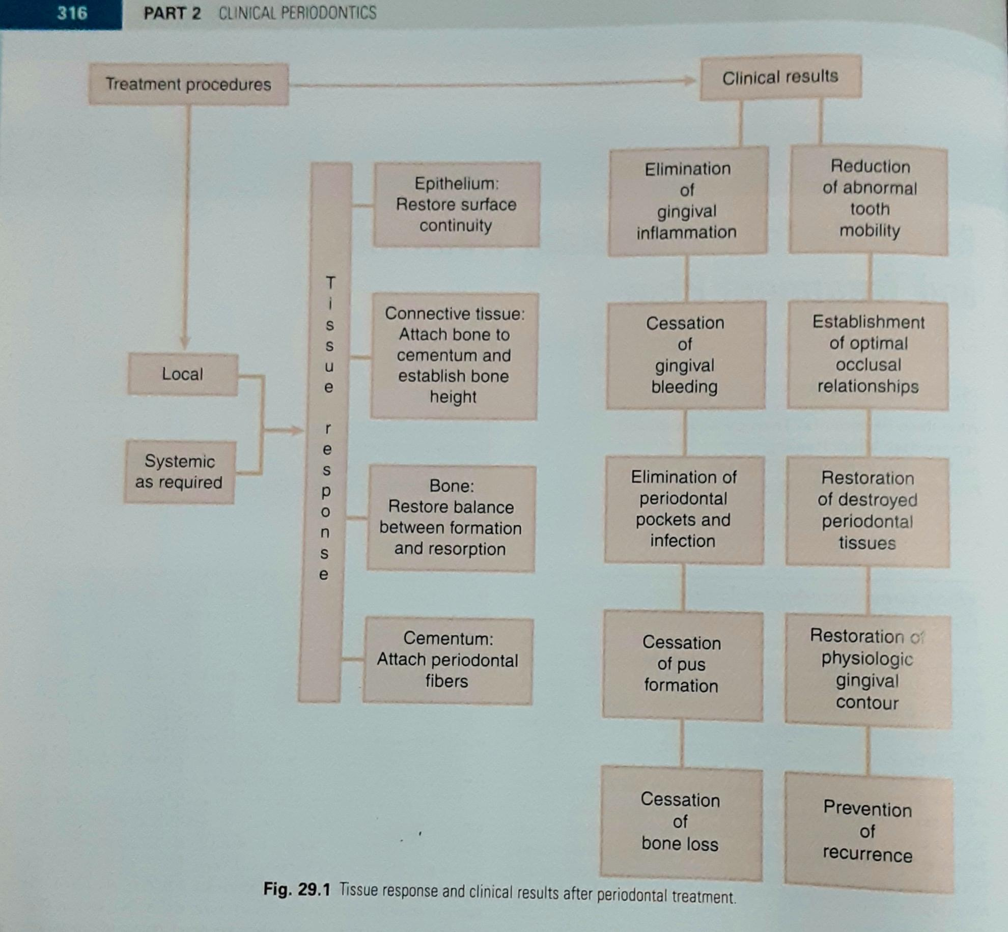
TISSUE RESPONSE AND CLINICAL RESULTS AFTER PERIODONTAL TREATMENT

Slide 9
FACTORS AFFECTING HEALING

Slide 10
LOCAL FACTORS
• Systemic conditions that impair healing may reduce the effectiveness of local periodontal treatment and should be corrected before, or along with, local procedures.
• Plaque microorganisms are the most common detterents to healing after periodontal treatment.
Healing is also delayed by
(1) excessive tissue manipulation during
treatment
(2) trauma to the tissues
(3) the presence of foreign bodies,
and
(4) repetitive treatment procedures that disrupt the orderly
cellular activity in the healing process.

Slide 11
▪︎An adequate blood supply isneeded for the increased cellular activity during healing.
If the blood supply is impaired or insufficient, areas of necrosis will develop and
delay the healing process.
▪︎Healing is improved by: debridement (removal of degenerated and necrotic tissue)
Immobilization of the healing area, and pressure on the wound.
▪︎The cellular activity in healing entails an increase inoxygen consumption, but healing of the gingiva is not accelerated byartificially increasing the oxygen supply beyond the normal
requirements.

Slide 12
HOW HEALING IS IMPROVED?
▪︎ DEBRIDEMENT: Removal of degenerated and necrotic tissue
▪︎ Immobilization of the healing area
▪ ︎Pressure on the wound
▪︎ Cellular activity in healing entails an increase in oxygen consumption

Slide 13
SYSTEMIC FACTORS
▪︎ Healing capacity diminishes with age, probably because of the atherosclerotic vascular changes common in aging and the resulting reduction in blood circulation. Healing is delayed in patients with generalized infections and in those with diabetes and other
debilitating diseases.
▪︎ Healing is impaired by insufficient food intake; bodily conditions that interfere with the use of nutrients; and deficiencies in vitamin C, proteins, and other nutrients. However, the nutrient requirements of the healing tissues in minor wounds, such as those created by periodontal surgical procedures, are usually satisfied by a well- balanced diet
▪︎ Systemic stress, thyroidectomy, testosterone, adrenocorticotropic hormone (ACTH), and large doses of estrogen suppress the formation of granulation tissue and impair healing. Progesterone increases and accelerates the vascularization of immature granulation tissue and appears to increase the susceptibility of the gingiva to mechanical
injury by causing dilation of the marginal vessels.

Slide 14
HEALING AFTER PERIODONTAL THERAPY

Slide 15
This process consists of removal of degenerated tissue
debris and the replacement of tissue destroyed by disease

Slide 16
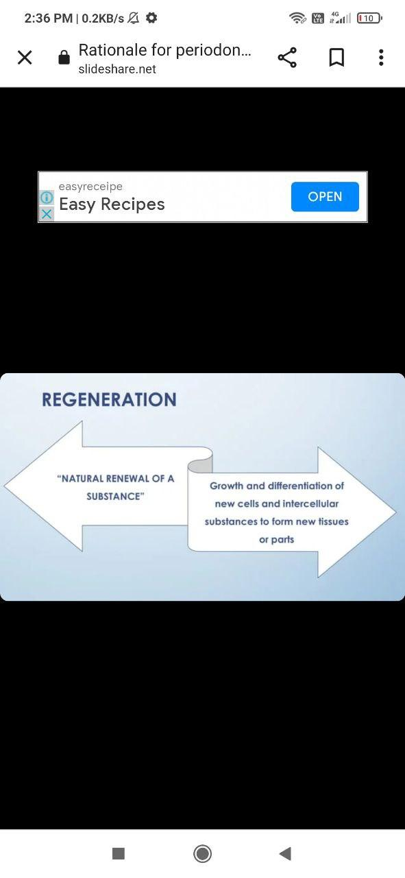

Slide 17
IN PERIODONTIUM :
• Gingival epithelium is replaced by epithelium
• Underlying connective tissue and periodontal ligament derived from connective tissue
• Bone and cementum replaced by connective tissue
• Undifferenciated connective tissue cells develop into osteoblast and cementoblast form bone and cementum

Slide 18
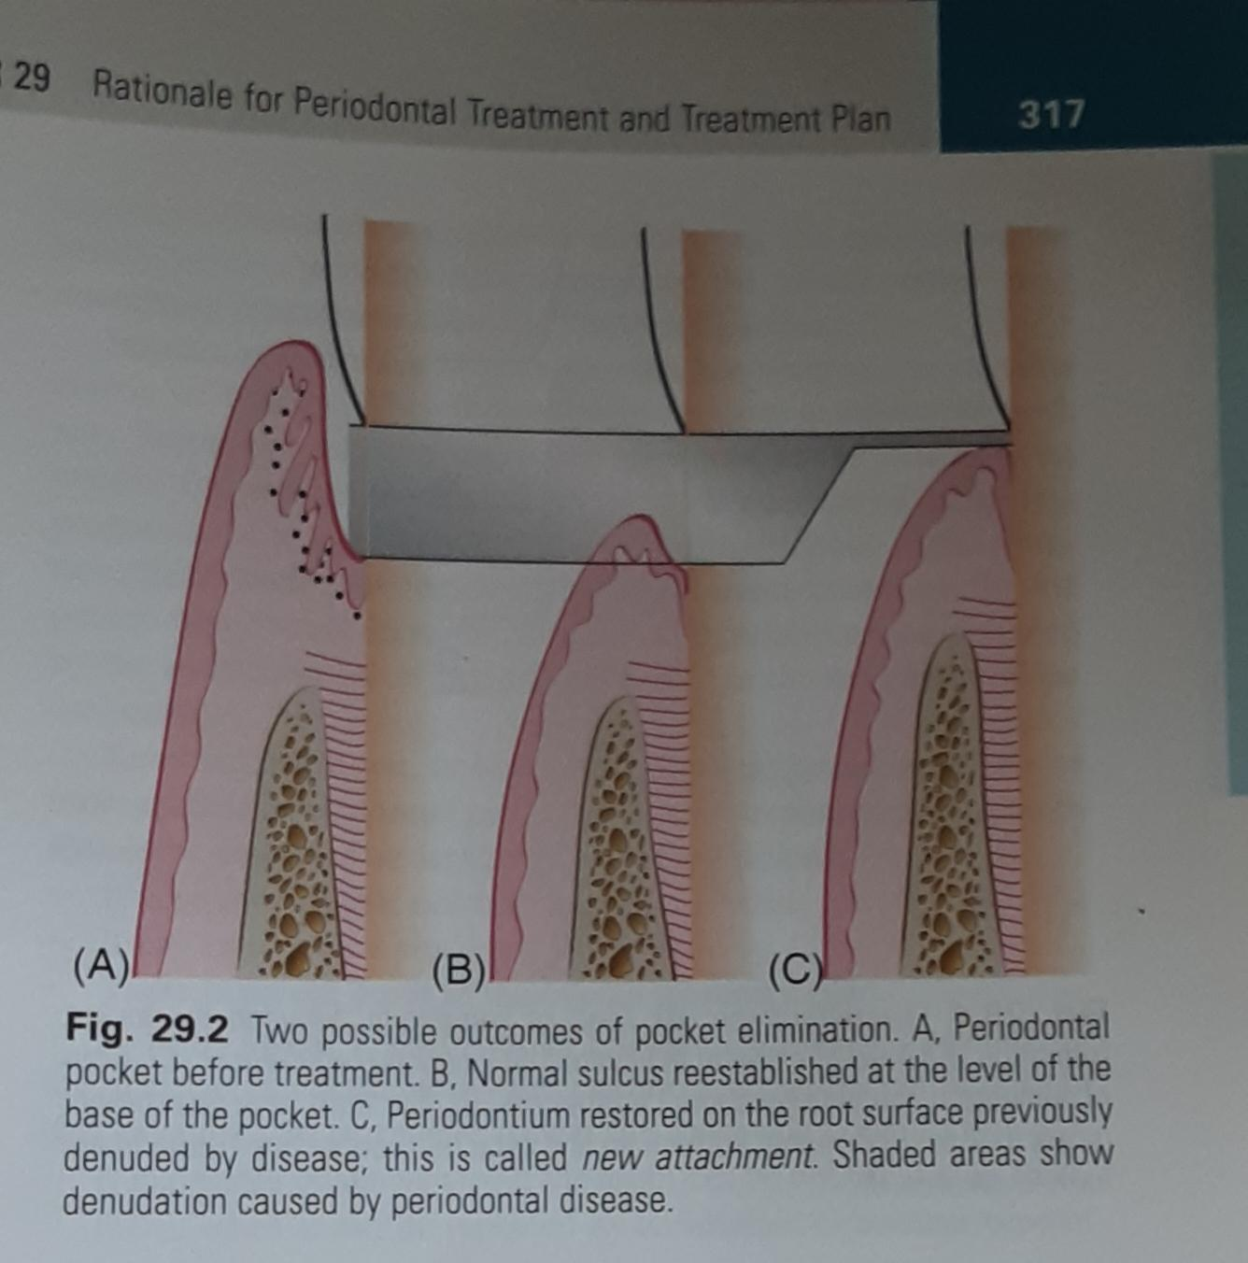
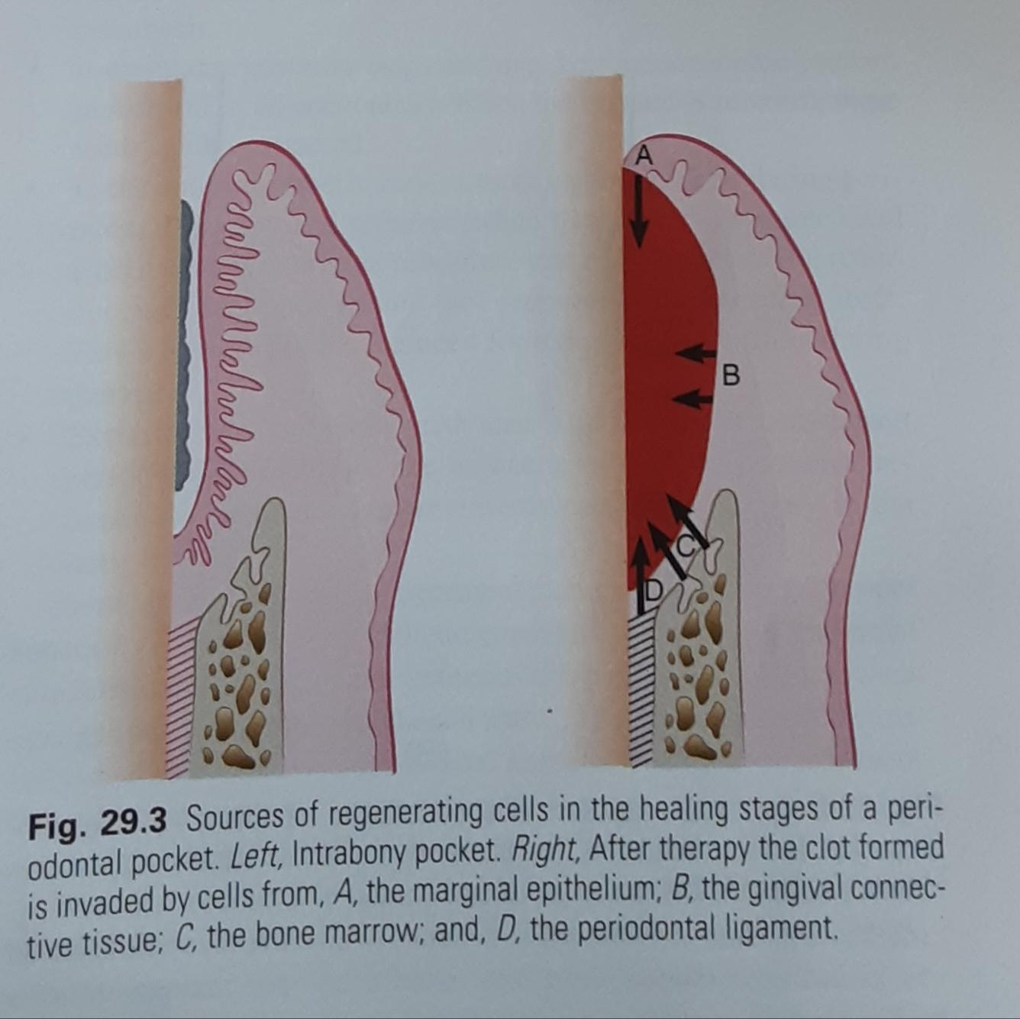

Slide 19
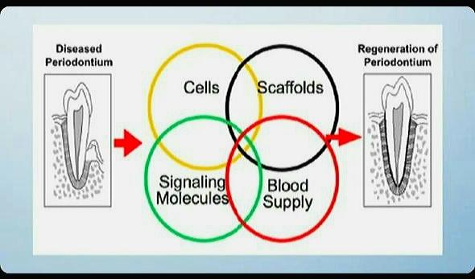

Slide 20
WEAR AND TEAR REPAIR
In periodontium regeneration is a continuous physiologic process.
• Under normal conditions. new cells and tissues are constantly being formed to replace those that mature and die. This is termed as 'Wear and Tear' repair.
• Manifested by
1. Mitotic activity
2. New bone formation
3. Continuous deposition of cementum

Slide 21
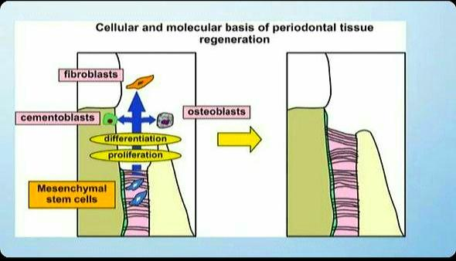

Slide 22
REPAIR
Repair simply restores the continuity of the diseased marginal gingiva and reestablishes a normal gingival sulcus at the same level on the root as the base of the preexistent periodontal pocket. This process, called healing by scar arrests bone destruction without necessarily increasing bone height.
• Restoration of the destroyed periodontium involves:
1. Mobilization of epithelial and connective tissue cells into the
damaged area
2. Increased local mitotic divisions to provide sufficient number of cells

Slide 23
NEW ATTACHMENT
It is the embedding of new periodontal ligament fibers into new cementum and the attachment of the gingival epithelium to a "Tooth surface previously denuded by disease"

Slide 24
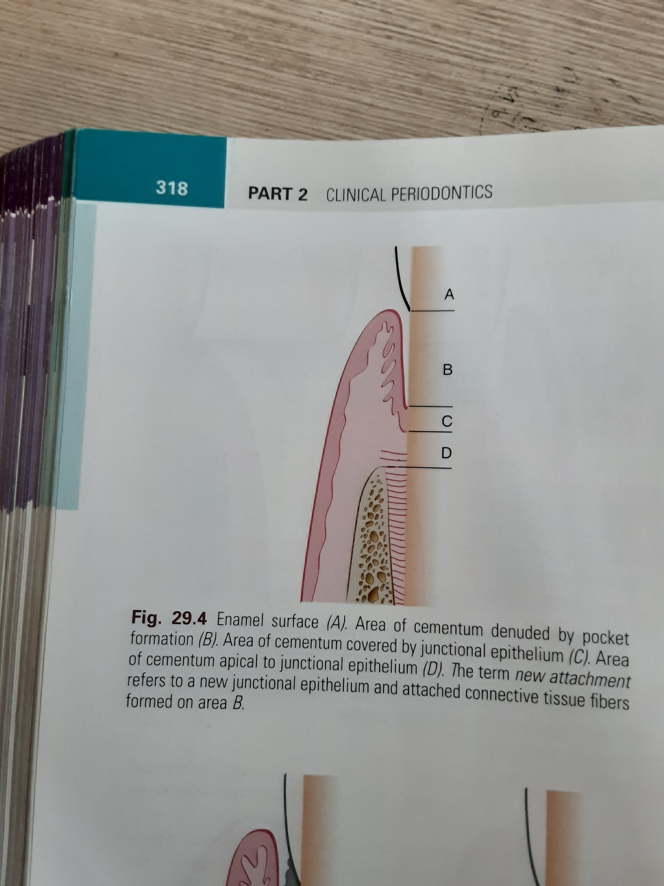
NEW ATTACHMENT

Slide 25
REATTACHMENT
The attachment of the gingiva or the periodontal ligament to areas of the tooth from which they have been removed in the course of treatment represents simple healing or reattachment
The term reattachment refers to repair in areas of the root not previously exposed to pocket such as after surgical detachment of the tissues or following traumatic tears in the cementum, tooth fractures,or the treatment of periapical lesion.

Slide 26
EPITHELIAL ADAPTATION
"It is the close apposition of the gingival epithelium to the tooth surface, with no gain in height of gingival fiber attachment.
The pocket is not completley obliterated , although it may not permit passage of a probe.

Slide 27
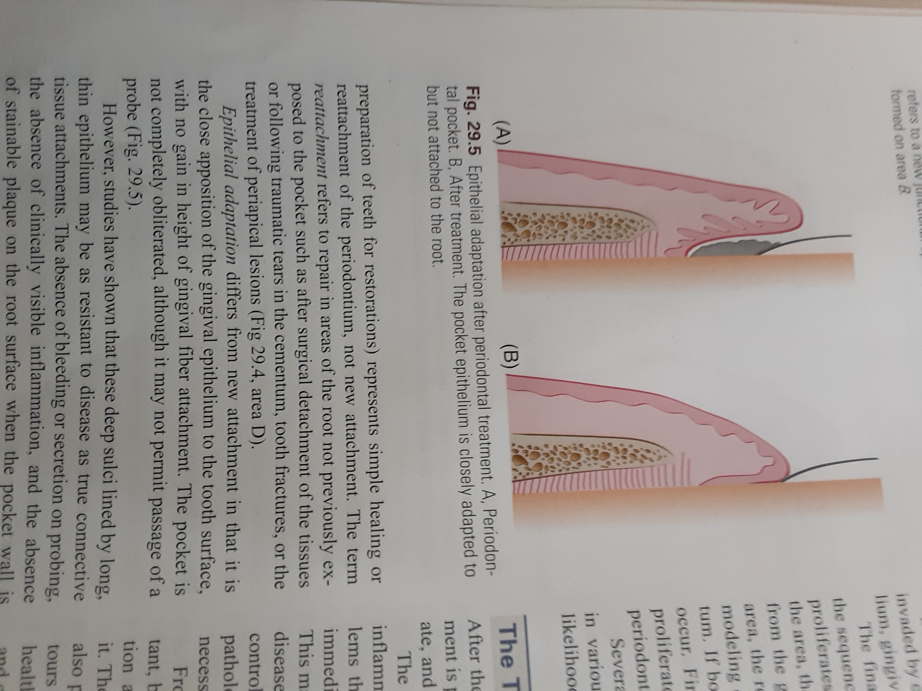
EPITHELIAL ADAPTATION

Slide 28
PERIODONTAL RECONSTRUCTION
As previously discussed, the term periodontal reconstruction refers to the process of regeneration of cells and fibers and remodeling of the lost periodontal structures that results in
(1) gain of attachment level
(2) formation of new periodontal ligament fibers
(3) a level of alveolar bone significantly coronal to that present before treatment.

Slide 29
A technique to attain these ideal results has been a constant but elusive goal of periodontal therapy for centuries. Since the 1970s, renewed laboratory and clinical research efforts have resulted in new concepts and techniques that have moved us much closer to attaining this ideal result of therapy.
Melcher pointed out that the regeneration of the periodontal ligament is the key to periodontal reconstruction because it "provides continuity between the alveolar bone and the cementum and also because it contains cells that can synthesize and remodel the three connective tissues of the alveolar part of the periodontium."
The final outcome of periodontal pocket healing depends on the area invaded by cells from different sources during the healing stages
1.Oral epithelium
2.Gingival connective tissue
3.Bone
4.Periodontal ligament

Slide 30
SEQUENCE OF EVENTS DURING HEALING STAGE
• If the epithelium proliferates along the tooth surface before other tissues reach the area, the result will be along junctional epithelium.
If the cells from the gingival connective tissue are the first to populate the area, the result will be fibers parallel to the tooth surface are remodeling of the alveolar bone with no attachment to the cementum

Slide 31
If bone cells arrive first, root resorption and Ankylosis may occur.
• Finally, onlywhen cells from the periodontal ligament proliferate
coronally is there new formation of cementum and periodontal
ligament

Slide 32
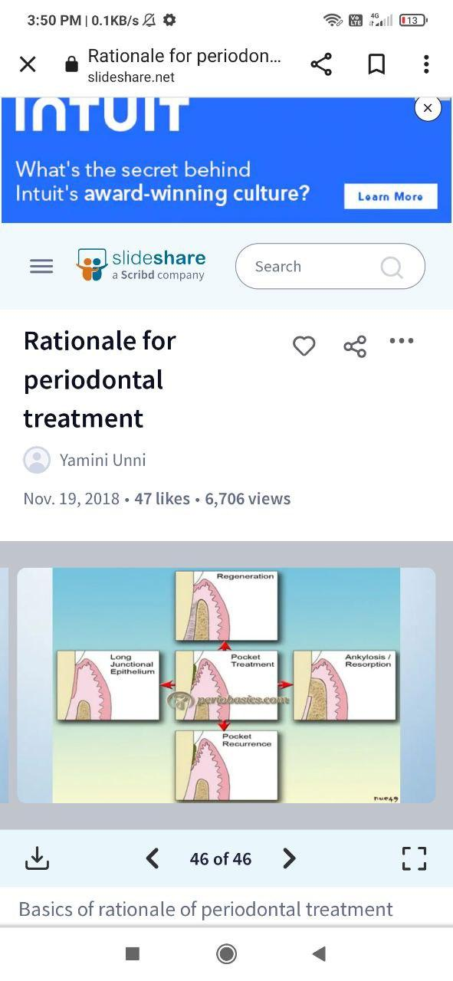

Slide 33
THANK
YOU

