Slide 1
Good Morning

Slide 2
Defense mechanism of gingiva

Slide 3
Learning Objectives
Gingival crevicular fluid
saliva
Quantity ,Methods of collection
Function

Slide 4
Gingival Tissue
Constantly subjected to mechanical trauma and bacterial aggression
Saliva, Epithelial surface and inflammatory response provide resistance to these actions

Slide 5
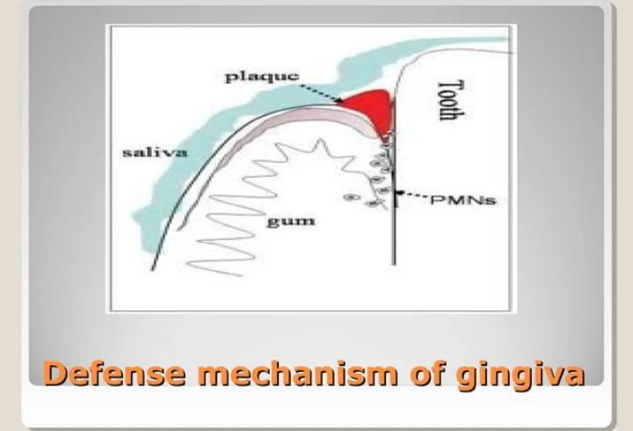

Slide 6
Gingival Sulcular fluid
Inflammatory ExudateHas been known since 19th century
• Composition and role in periodontal disease has been elucidated by pioneering work of Brill andKrasse in 1950.
• Filter paper in the sulcus of animals previously injected im with flourescein; within 3 minutes the flourescent from the filter paper

Slide 7
Method of collection of GCF
Absorbing paper strips
Twisted threads
Micropipettes Intracrevicular Washings

Slide 8
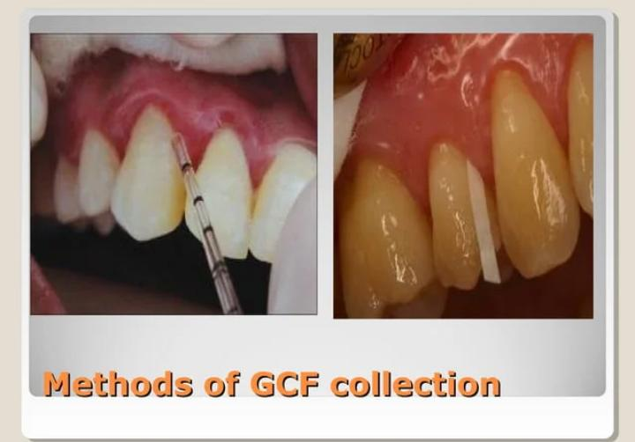

Slide 9
Compounds found permeable to junctional and sulcular epithelium [Brill and krasse (flourecein dye)]
Albumin
Endotoxin
Thymidine
Histamine
Phenytoin
Horse radish Peroxidase
Substances with mol wt upto 1000KD were permeable

Slide 10
The amount of GCF on paper strip can be evaluated
The wetted area on paper strip can be visualized by staining with Ninhydrin and measures plainimettrically or on enlarged photograph with glass or a microscope
⚫ Electronically through blotter paper (Periopaper) using electronic transducer (Periotron, Harco Electronics, Winnipeg, Manitoba, Canada)
⚫ The wetness of paper affects the flow of electronic current and gives digital readout

Slide 11
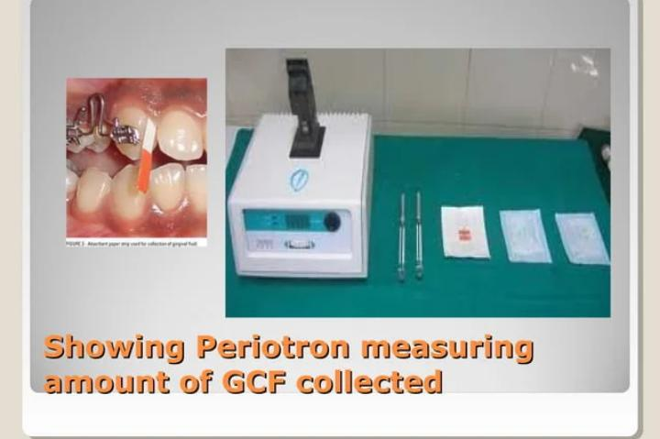

Slide 12
Amount of GCF is extremely small
1.5 mm wide filter paper inserted 1mm into the pocket only absorbs 0.1mg of GCF in 3 minutes
Mean GCF volume in proximal surface of molar teeth ranged from 0.43-1.56μl in human volunteer with mean gingival index less than 1

Slide 13
Composition
• More than 40 compounds from GCF have been analysed but their origin is not known with certainity
⚫ They can be derived from host, bacteria like Collagenases (MMPs), B-glucouronidases

Slide 14
Cellular element:
Bacteria,Desquamated epithelial cells and leukocytes(PMN's, Lymphocytes, Monocytes/macrophages)
Electrolyt :, K , Na and Ca have been studied in GCFPositive correlation of Ca and Na conc and Na/K ratio with inflammation

Slide 15
Organic Compounds
Organic compounds:
Glucose hexosamine and hexuronic acid are two compounds found in GCF
• Blood glucose is 3-4 times greater thanserum
• Total protein content is much less thanserum

Slide 16
Metabolic products in GCF
Metabolic products in GCF
⚫ lactic acid,
urea,
⚫ hydroxyproline,endotoxin
⚫ cytotoxic substances,Hydrogen sulphide and antibacterial factors

Slide 17
Methods to analyze GCF composition
Methods to analyse GCF composition
Fluorometry: MetalloproteinasesELISA:Enzymes and IL-1ẞ
Radioimmunoassay:Cyclooxygenase derv. and Procollagen III
HPLC:Timidazole
Direct & Indirect Immunodot test: Acute phase proteins

Slide 18
Cellular and Humoral activity in GCF
⚫ IL-1a and IL-1ẞ increase the binding of PMNs and monocyte/macrophage to endothelial cells and stimulate the production of PGE-2 and release of lysosomal enzymes and stimulate bone resorption

Slide 19
Clinical significance
GCF is inflammatory exudate and positively correlates with amount and severity of inflammation
GCF flow is increased by Mastication, coarse food, toothbrushing, gingival massage, Ovulation, Hormonal contraceptives and smoking

Slide 20
GCF secretion follows cicardian periodicity increases 6am to 10 pm then decreases afterwards
• Female sex hormone increase GCF flow as they enhance vascular permeability

Slide 21
Mechanical stimulation like chewing and vigorous tooth brushing increases GCF flow
Smoking causes immediate transient but markedincrease in GCF flow
There is increase in GCF production during healingperoid following periodontal surgery

Slide 22
Drugs in GCF
Tetracycline and Metronidazole are secreted through GCF

Slide 23
Leukocytes in dentogingival area
PMNs are the most common leukocytes present in the Gingival sulcus
Neutrophils are the first line of defense in the Dentogingival area.
Gingival sulcus is the port of entry of leukocytes into the oral cavity

Slide 24
• Leukocytes are present in gingival sulcus even when histologic area are free of inflammatory infiltrate
• Differential count of leukocytes from clinically healthy human gingival sulci have shown 91.2% to 91.5% PMNs and 8.50 8.8% mononuclear cells

Slide 25
• Mononuclear cells have 58% B cells, 24% T cells and 18% mononuclear phagocytes
The ratio of T-lymphocytes to B- lymphocytes is reversed from from normal 3:1 in peripheral blood to 1:3 in GCF

Slide 26
Saliva
⚫ It's a physiologic secretion by various major and minor salivary glands
Its has got certain major functions like mechanical cleansing, lubricating and buffering actions
⚫ It has got antibacterial property as well

Slide 27
Antibacterial factors
Can be divided into
Inorganic factor
2. Organic factor

Slide 28
Inorganic factors
Includes ions and gases like
Bicarbonate,
Na, k, Phosphate,
Ca,Ammonium,
and Carbon dioxide

Slide 29
Organic factors ; includes Enzymes like
ㅁ Lysozyme: Hydrolytic enzyme that cleaves the linkages of cell wall of bothGm+ve and Gm -ve bacteria.
Targets Veillonella and A aLactoperoxide-thiocyanate system:Bactericidal to Lactobacillus and Streptococcus by preventing accumulation of lysine and glutamic acid essential for their growth.

Slide 30
Lactoferrin;
Effective against Actinobacillus species
Myelperoxidase:
Released by leukocytes and is bactericidal toActinobacillus .
Also inhibits attachment of Actinomyces to Hydroxyapatite.
It is similar to salivary peroxidase

Slide 31
Salivary Enzymes
Following Enzymes are increased in periodontaldiseaseHyaluronidase,B-glucouronidase,
• Chondroitin sulfate,
• Aspartate aminotransferase,
• Alkaline phosphatase,Amino acid decarboxylases, Catalase, Peroxidase and Collagenase

Slide 32
Saliva also contains TIMP which inhibit collagenases

Slide 33
Salivary antibiotics
Predominant antibody in saliva is IgA although IgG and IgM are present
IgG is more prevalent in GCF
• Major and Minor salivary gland contribute to all the secretory IgA (sIgA)

Slide 34
• GCF contributes to most of IgG,Complement and PMN that, in conjunction with IgG or IgM, inactivate or opsonize bacteria

Slide 35
Salivary Antibodies are synthesized locally as they react with strains of bacteria indigenous to mouth but not that of intestinal tract
Antibodies in saliva impairs the abilty of bacteria to attach to mucosal or tooth surface

Slide 36
Salivary Buffers and Coagulation factors
Salivary buffers maintain physiologic hydrogen conc (pH) both at mucosal surface and toothsurface
• Bicarbonate-carbonic acid system is the salivary buffer

Slide 37
Saliva also contains Coagulation factors viz; (Factors VIII, IX and X, PTA, Hageman factor)
which hasten blood coagulation and protect wound from invasion

Slide 38
Leukocytes
Saliva contains all types of leukocytes, but principal cells are PMN
PMN numbers varies from person to person and at different times of day and are increased ingingivitis

Slide 39
⚫ PMN in saliva are called
Orogranulocyte
⚫ PMN reach the oral cavity through gingival sulcus
and this is called Orogranulocyte migration.

Slide 40
Role in Periodontal pathology
⚫ Saliva effects plaque intiation , maturation and metabolism
⚫ Salivary flow and composition also influences calculus formation, periodontal disease and dental caries

Slide 41


