Slide 1
Occlusal Evaluation Therapy and Splints
Presented by – priyanjali jadhav

Slide 2
CONTENTS:
Introduction
Forces during jaw movements
Biologic basis of occlusal function
Occlusal function and dysfunction
Parafunction
Clinical Examination
Occlusal Therapy
Clinical studies

Slide 3
INTRODUCTION:
Occlusion is the static relationship between the incising or occlusal surfaces of maxillary or mandibular teeth or tooth analogues. The occlusion should be balanced as stress free as possible
Among the numerous local and systemic factors with the potential to influence the progression of periodontitis ,the patients occlusion remains a variable that requires an exact diagnosis

Slide 4
Occlusion becomes a factor for consideration when the occlusal forces acting on a tooth produce displacement of the root in the socket which results in an injury to the supporting periodontal ligament
This periodontal tissue injury from occlusal forces has been defined as the the lesion of trauma from occlusion

Slide 5
FORCES DURING JAW MOVEMENTS:
The teeth and their periodontium are subjected to functional dynamic loading during chewing,swallowing and the performance of parafunctional habits,including bruxism and clenching
Tooth contact is minimal during speech ( Gibbs CH 1972)

Slide 6
The forces generated by these contacts are of relatively low magnitude ,averaging 81 N and short acting with a duration of about 20-50 ms
Harmonious occlusal force on a tooth simulates the physiologic arrangement of its periodontal attachment fibers and its osseous architecture and encourages its stability
Forces that exceed the tolerance of the periodontium result in resorption of the bone and disruption of the attachment

Slide 7
BIOLOGIC BASIS OF OCCLUSAL FUNCTION
A Physiologic occlusion is present when no signs of dysfunction or disease are present and no treatment is indicated
A Nonphysiologic occlusion is associated with dysfunction or disease caused by tissue injury and treatment may be indicated .
A Therapeutic occlusion is the result of specific interventions designed to treat dysfunction or disease

Slide 8
Maintenance of a physiologic occlusion require favourable structure function relationships and optimal tissue adaptation throughout the masticatory system
When occlusal forces are distributed optimally the occlusion will be stable by objective criteria and is likely to be subjectively comfortable for the patient

Slide 9
OCCLUSAL FUNCTION AND DYSFUNCTION
The identification of masticatory system disharmonies allows the clinician to recognize dysfunctional relationships which may influence the accuracy of the diagnosis
Stability is enhanced by the simultaneous bilateral contact of multiple posterior teeth with occlusal forces in the long axis of ost posterior teeth.

Slide 10
PARAFUNCTION
BRUXISM- An oral habit consisting of involuntary rhythmic or spasmodic non functional gnashing, grinding or clenching of teeth , in other than chewing movements of the mandible , which may lead to occlusal trauma
Common cause for attritional wear , loose teeth , fractured cusp and muscle pain

Slide 11
In the case of a sustained low level force the amount of deformation of the periodontal membrane increase with the passage of time,due to viscous drag and capillary vessels in the periodontal membrane is compressed causing ischmia.
Repetition of this ishemic condition may affect the resistance of the periodontal tissue.

Slide 12
BRUXISM AND PERIODONTAL DISEASE
Bruxism does not initiate gingivitis or pocket formation
The most frequent results of bruxism are compensatory hypertrophy of the periodontal structures and increase in width of the periodontal membrane

Slide 13
When there is pre-existing gingival inflammation and particuraly when there is some loss of tooth support the weight of evidence suggests the bruxism probably accelerates the destructive process as does any other form of secondary occlusal trauma

Slide 14
CLINICAL EXAMINATION
A comprehensive evaluation of masticatory system and muscles and occlusal anatomy is pre requisite to identify any occlusal disharmony
Clinical assements to be done are-
TMJ evaluation
Testing for mobility of teeth
Centric relation assessment
Evaluation of excurions
Articulated diagnostic casts

Slide 15
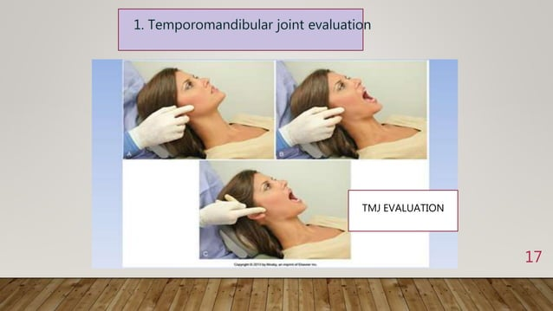

Slide 16
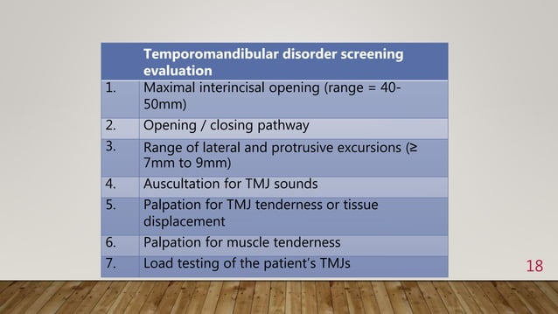

Slide 17
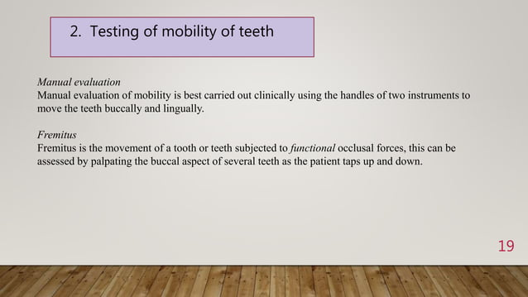

Slide 18
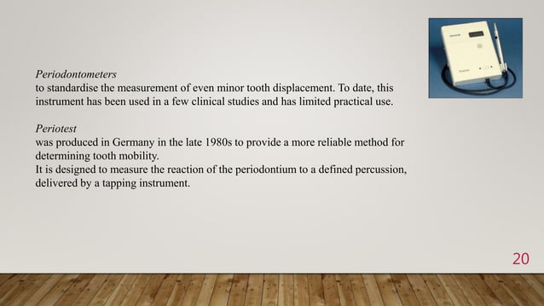

Slide 19
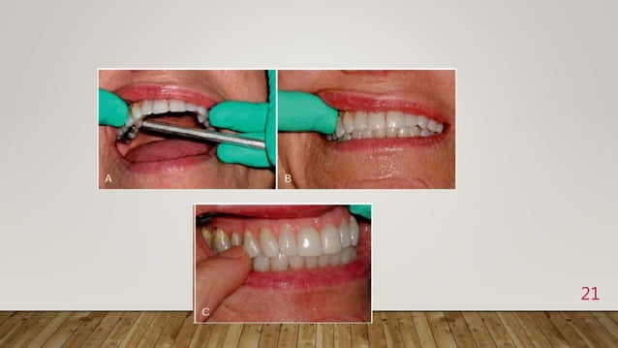

Slide 20
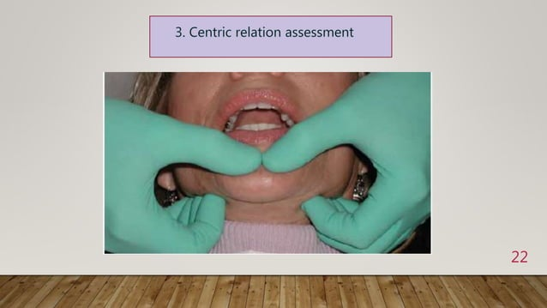

Slide 21
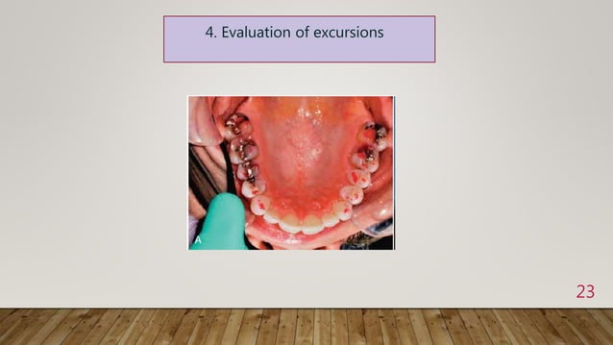

Slide 22
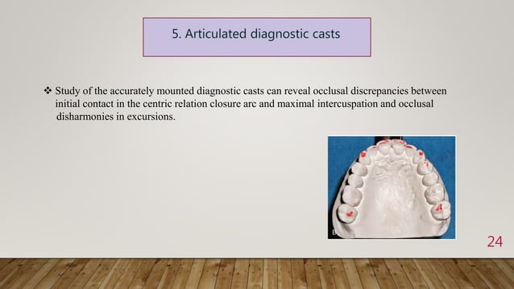

Slide 23
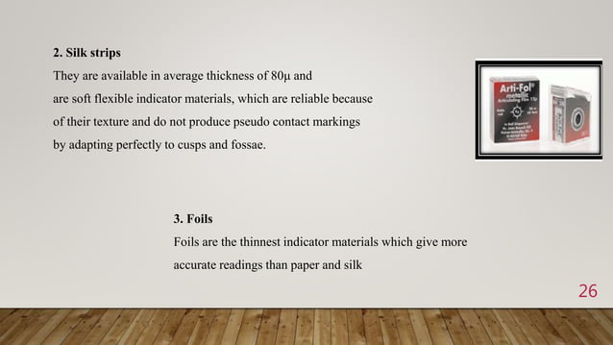

Slide 24
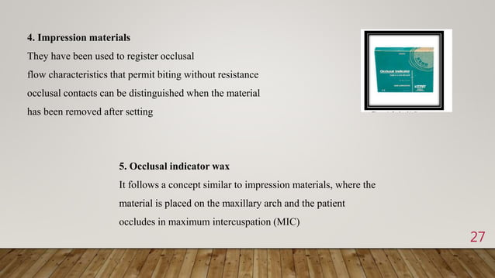

Slide 25
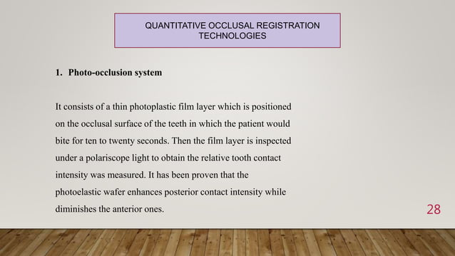

Slide 26
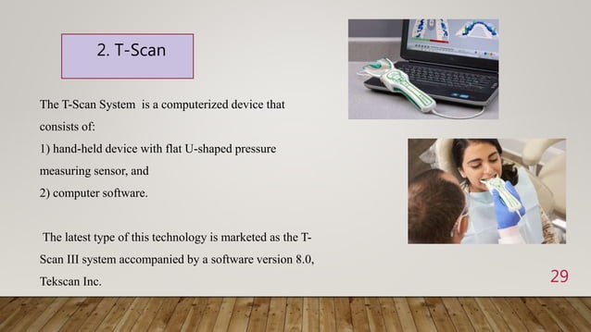

Slide 27
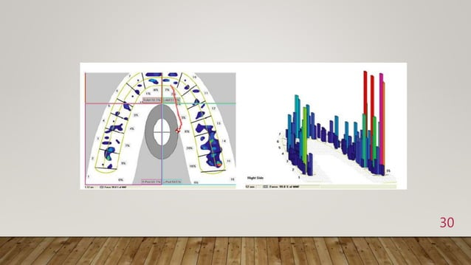

Slide 28
Occlusal therapy
The purpose of occlusal therapy is to establish stable functional relationship favourable to the oral health of the patient including periodontium
effective nonsurgical therapy usually reduces inflammation within the periodontium and results in some healing of attachment which often results in mobile teeth becoming more stable

Slide 29
Requirement for occlusal stability
Maximum intercuspation
Light or absent anterior contacts
Well distributed posterior contacts
Cross tooth stablilization
Smooth excursive movements without interferences
No trauma from occusion
Favorable subjective response to occlusal form and function

Slide 30
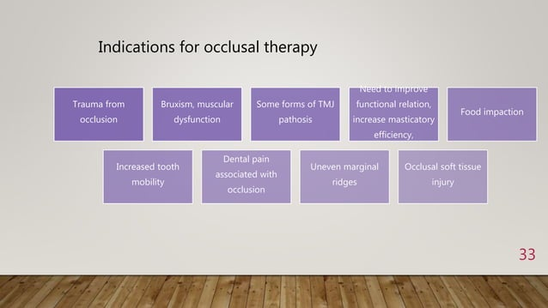

Slide 31
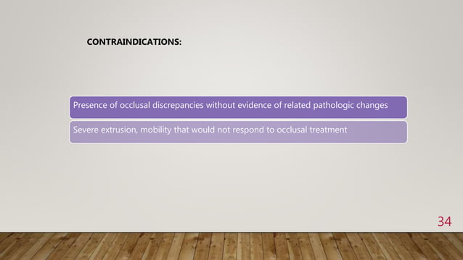

Slide 32
Treatment options:
When there is sufficient evidence of excessive occlusal forces on the patients teeth or when masticatory system disharmony exists and the patients desires a more stable occlusion, then an occlusal appliance is prescribed-
Treatments options are-
Occlusal appliance therapy
Occlusal adjustment
Occlusal stability for restorative dentistry
Orthodontic tooth movement
Orthognathic therapy

Slide 33
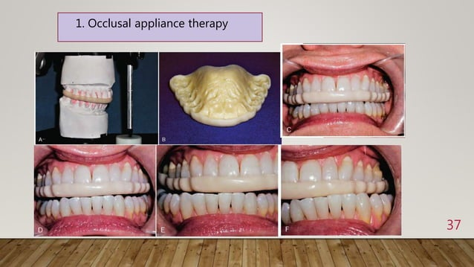

Slide 34
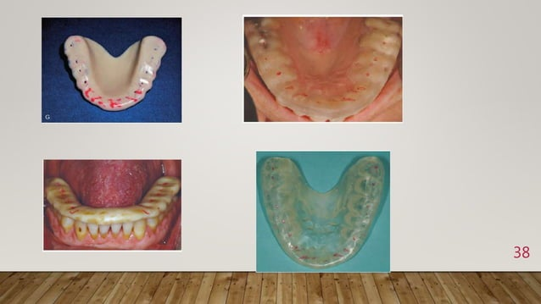

Slide 35
Occlusal adjustment
Occlusal adjustment or the selective reshaping of the occluding surfaces of the teeh can reduce the magnitude of occlusal interferences or direct the forces to be more compatible with the long axes of the effected teeth
Accurately mounted duplicate models can be used to accomplish a trial occlusal adjustment to determine safety and efficacy for patient

Slide 36
The clinical goal of intercuspal position and returded contact position adjustment are to reduce the supracontacts as as to create unobstructed closure of cusps into fossae and argina ridges
The correction of occlusal supracontacts consisting of grooving,spheroiding and pointing.

Slide 37
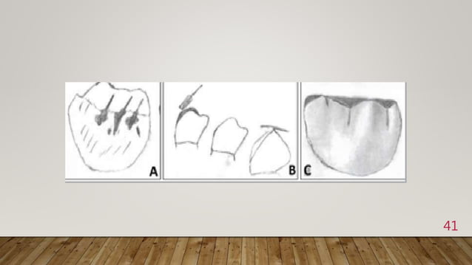

Slide 38
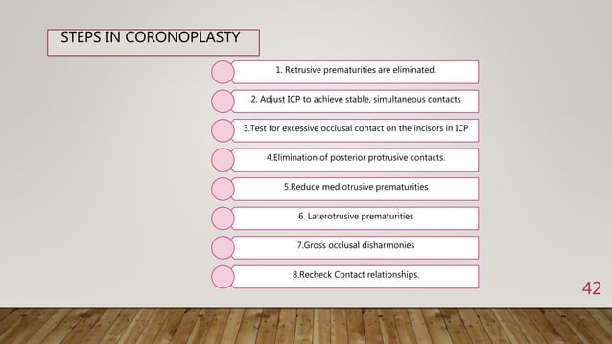

Slide 39
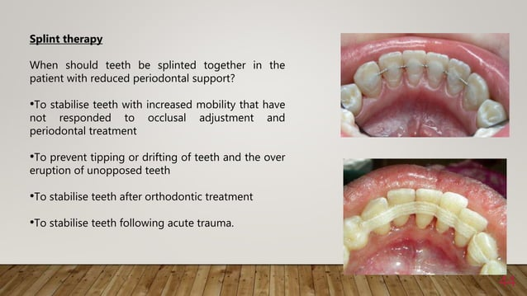

Slide 40
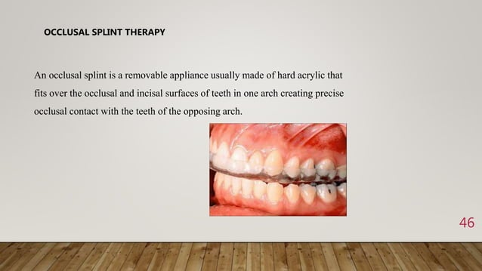

Slide 41
Types of splints
PERMISSIVE OCCLUSAL SPLINT
Have a smooth surface on one side that allow the musles to move the mandible without interference from deflective tooth inclines so the condyles can slide back and up to complete seating in to the centric realtion
DIRECTIVE OCCLUSAL SPLINT
Direct the lower arch into a specific occlusal relationship that in turn directs the condyles to a predetermined position

Slide 42
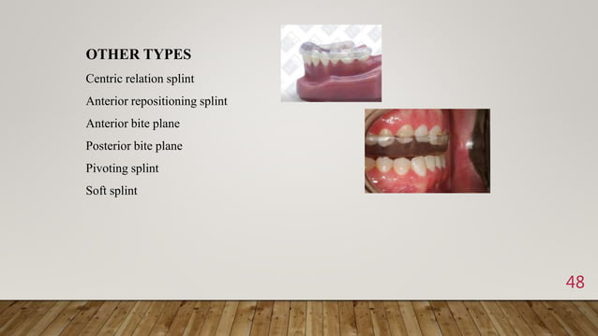

Slide 43
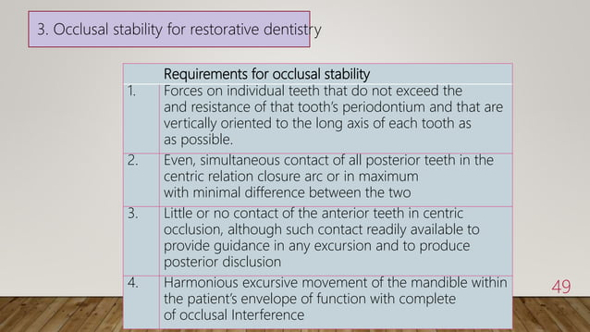

Slide 44
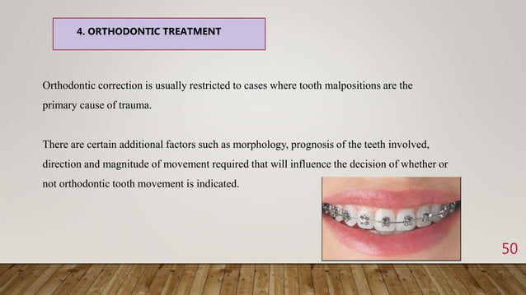

Slide 45
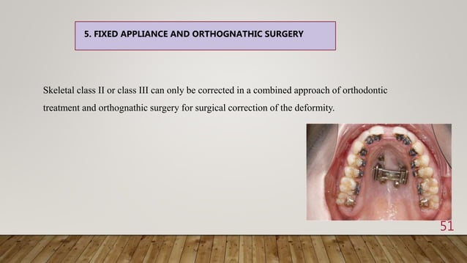

Slide 46
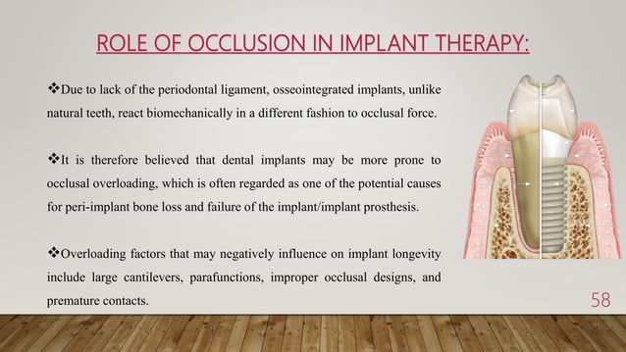

Slide 47
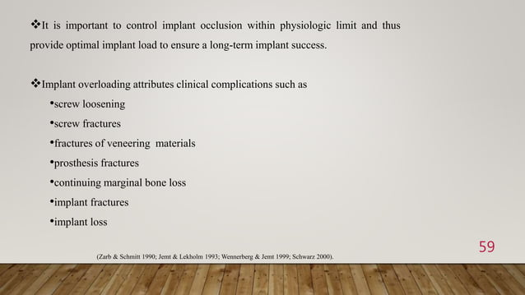

Slide 48
Thank you……..

