Slide 1

Gingival Surgical Techniques
Presented by : Disha Khandade

Slide 2
CONTENTS
Introduction
Gingival curettage
Gingivoplasty
Gingivectomy
Gingivectomy by Electrosurgery
Laser Gingivectomy
Gingivectomy by Chemosurgery
References

Slide 3
Introduction
Periodontal pocket reduction surgery limited to the gingival tissues only and not involving the underlying osseous structures, without the use of flap surgery, can be classified as gingival curettage, gingivectomy and gingivoplasty. Both gingival curettage and gingivectomy have
limited use currently because of the change in the understanding of etiology of periodontal disease.

Slide 4
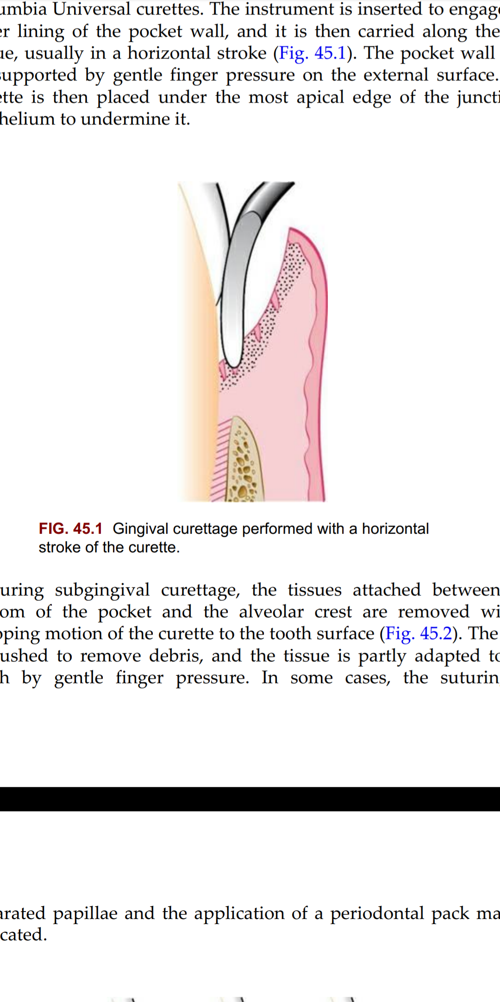
Gingival Curettage
The word curettage is used in periodontics to mean the scraping of the gingival wall of a periodontal pocket to remove diseased soft tissue. Scaling refers to the removal of deposits from the root surface, whereas planing means smoothing the root to remove infected and necrotic tooth substance. Scaling and root planing may inadvertently include curettage to a certain degree. This is often called inadvertent curettage.

Slide 5
Indications:
1. Single deep infra-bony pocket with good access.
2. Accessible supra-bony pockets.
3. To reduce inflammation prior to surgery selected for pocket elimination
(As preparation) .
4- During the recall and maintenance visit to avoid disease recurrence.
(Follow up)

Slide 6
Contraindications:
There are no absolute contra-indications for sub-gingival curettage except
patient with severe systemic diseases that contra-indicate any minor
surgical intervention.
Following conditions are not suitable to sub-gineival curettage:
1- Tortuous (spiral) pockets as they have poor accessibility.
2- Furcation involvement especially grades II and III.
3- Generalized deep pockets involving mainly molars area.

Slide 7
Basic Procedure:
1- Scaling and root planing.
2- Local anesthesia is given to the area.
3-Suitable curette should be introduced with its cutting edge against the tissue.
4- The instrument should be moved in a horizontal gentle stroke with a finger support on its external surface.
5- Tissue between bottom of the pocket and alveolar crest is curetted by scooping motion.

Slide 8
6- The area should be flushed with normal saline, and properly adapt the tissue to tooth by gentle finger pressure.
7- Suture and/or periodontal pack if they are needed.
8- Proper instruction in home care should be given to the patient. Chlorhexidine antiseptic is prescribed and mild analgesics are prescribed if it is needed.

Slide 9
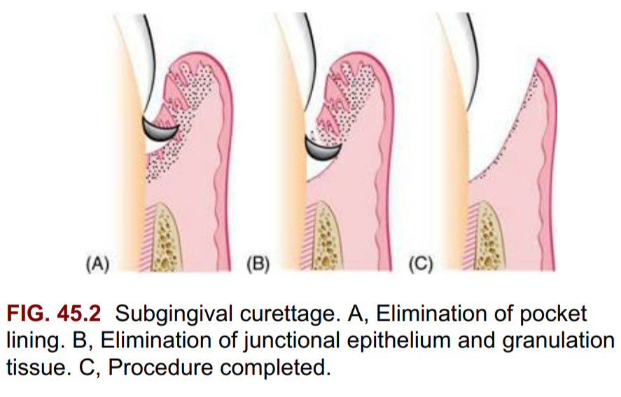

Slide 10
Excisional new attachment procedure:
The excisional new attachment procedure which was developed and used by the US Naval Dental Corps is a definitive subgingival curettage procedure that is performed with a knife.
Its usefulness is very limited today as it has been found that most of the time healing occurs by formation of long junctional epithelium rather than any true new attachment

Slide 11
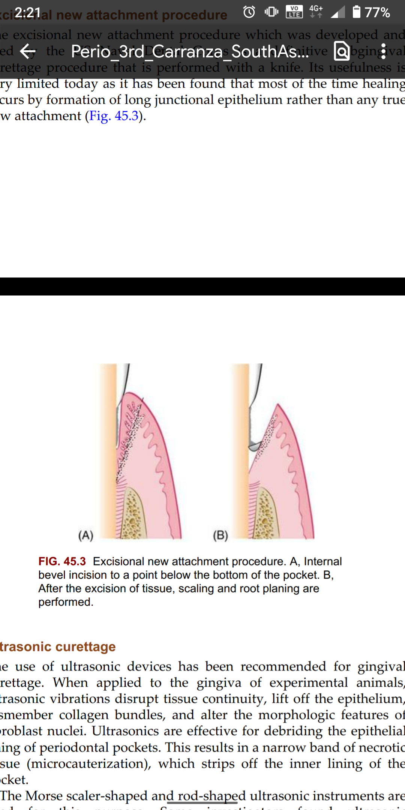

Slide 12
Healing following sub-gingival curettage::
1- Proliferation of granulation tissue occurs in 12 – 24 hours after the surgery.
2- Epitheliazation starts in 24– 48 hours.
3- The gingival appearance and pocket epithelium return to normal within 2–3 weeks.

Slide 13
Gingivoplasty:
Gingivoplasty is a reshaping of the gingiva to create physiologic gingival contours with the sole purpose of recontouring the gingiva in the absence of pockets.
Gingivoplasty may be accomplished with a periodontal knife, a scalpel, rotary coarse diamond stones, or electrodes.

Slide 14
Indications:
1. Deformities produced by gingival and periodontal diseases as gingival clefts, craters, shelf like inter dental papillae caused by ANUG.
2. Following gingivectomy
3. Unsatisfactory gingival contour following surgeries

Slide 15
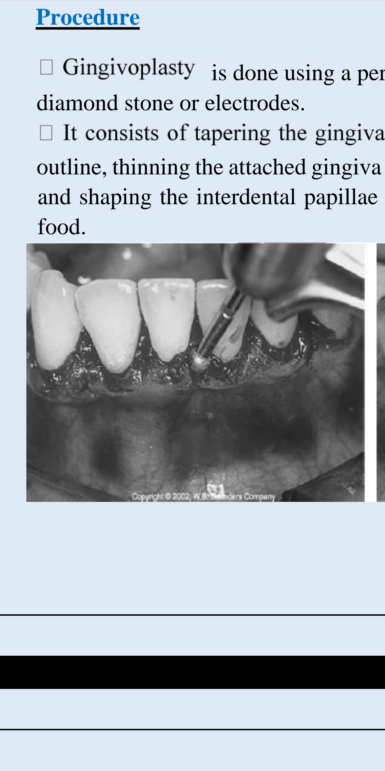
Procedure:
1. Gingivoplasty is done using a periodontal knife, a scalpel, a rotary coarse diamond stone or electrodes.
2. It consists of tapering the gingival margin, creating a scalloped outline, thinning the attached gingiva and creating vertical interdental grooves and shaping the interdental papillae to provide spillways for the passage of food.

Slide 16
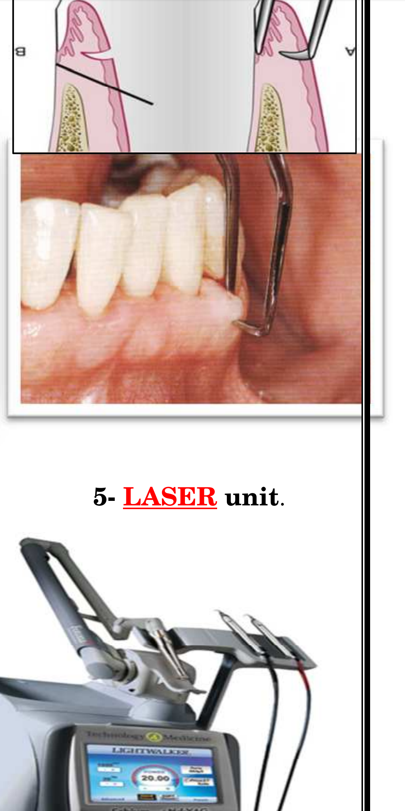
Gingivectomy
The word gingivectomy means “excision of the gingiva.” By removing the pocket wall, gingivectomy provides visibility and accessibility for complete calculus removal and the thorough smoothing of the roots. This creates a favorable environment for gingival healing and restoration of a physiologic gingival contour. The gingivectomy technique was widely performed in the past. Improved understanding of healing mechanisms and the development of more sophisticated flap methods have relegated the gingivectomy to a lesser role in the current repertoire of available techniques. However, it remains an effective form of treatment when indicated.

Slide 17
Indications:
1. Elimination of suprabony pockets, regardless of their depth, if the pocket wall is fibrous and firm.
2. Elimination of gingival enlargements.
3. Elimination of suprabony periodontal abscesses.

Slide 18
Contraindications:
1. The need for osseous surgery or examination of the shape and morphology of bone.
2. Situations in which the bottom of the pocket is apical to the mucogingival junction.
3. Esthetic considerations, particularly in the anterior maxilla.

Slide 19
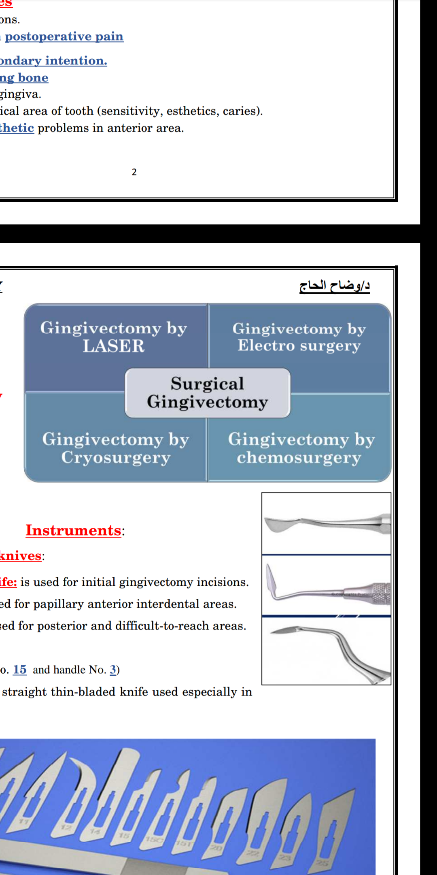
Types of Gingivectomy:

Slide 20
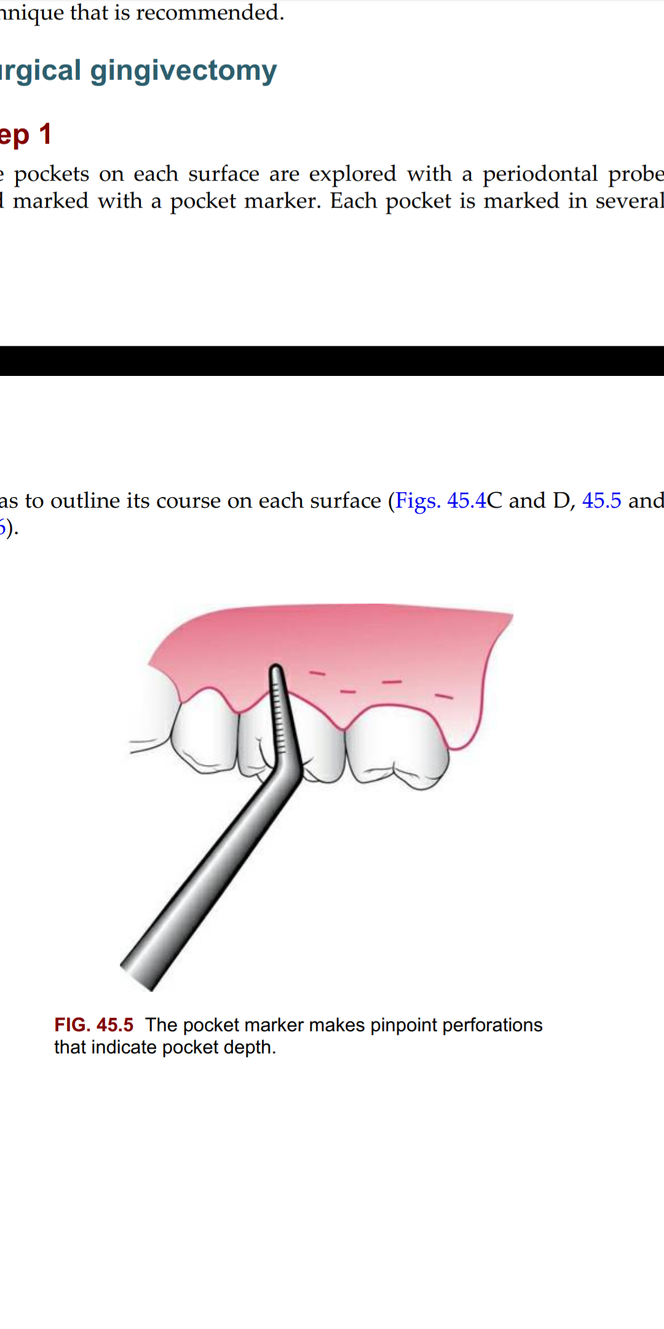
Surgical Gingivectomy:
Step 1 : The pockets on each surface are explored with a periodontal probe
and marked with a pocket marker. Each pocket is marked in several areas to outline its course on each surface

Slide 21
Step 2 : Periodontal knives (e.g., Kirkland knives) are used for incisions on the facial and lingual surfaces and on those distal to the terminal tooth in the arch. Orban periodontal knives are used for interdental incisions. Bard–Parker blades (nos. 12 and 15) as well as scissors are used as auxiliary instruments.
The incision is started apical to the points marking the course of the pockets, and it is directed coronally to a point between the base of the pocket and the crest of the bone.
Either interrupted or continuous incisions may be used. The incision should be beveled at approximately 45 degrees to the tooth surface,

Slide 22
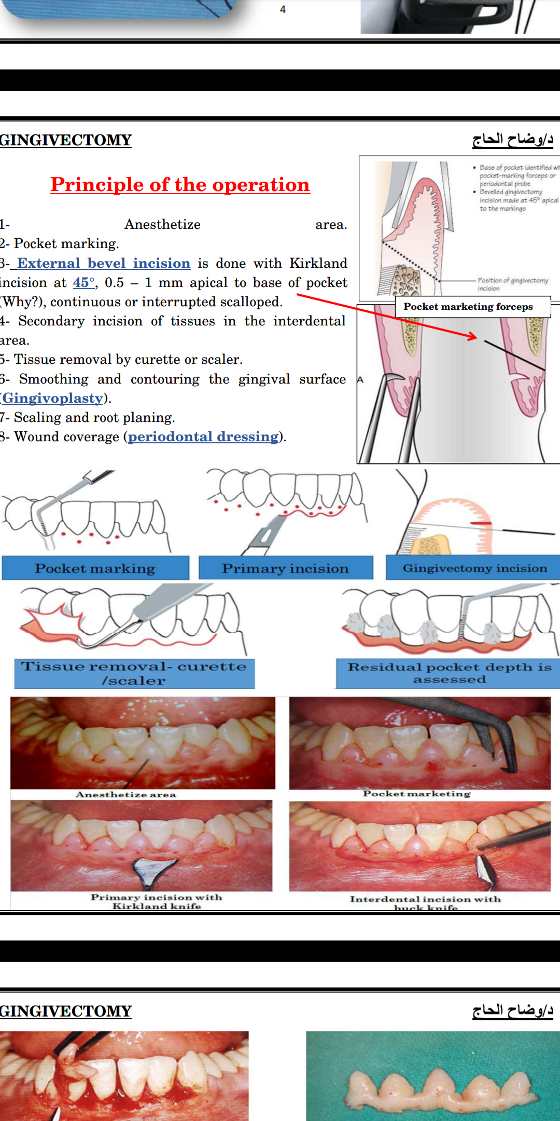

Slide 23
Step 3 : Remove the excised pocket wall, clean the area, and closely examine the root surface.
Step 4 : Carefully curette the granulation tissue and remove any remaining calculus and necrotic cementum to leave a smooth and clean surface.
Step 5 : Cover the area with a surgical pack.

Slide 24
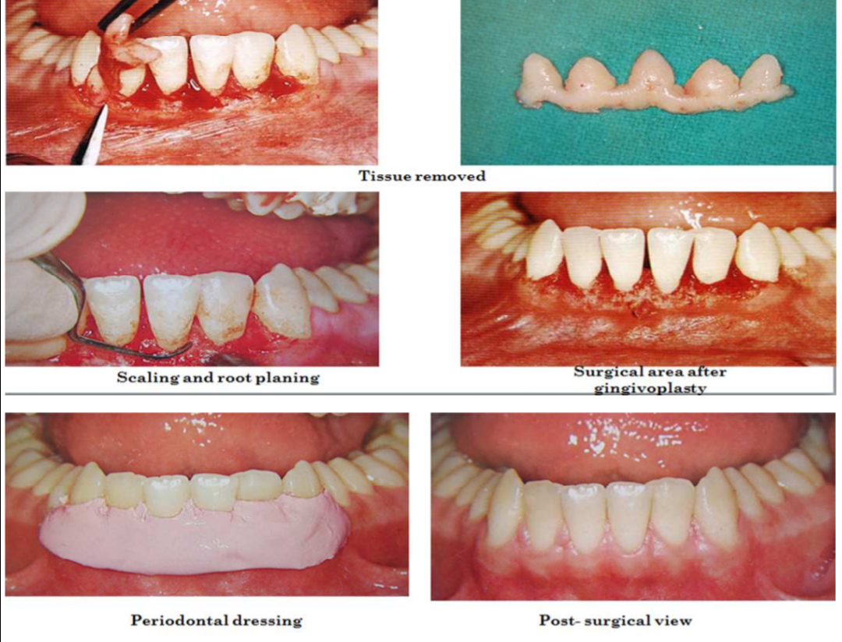

Slide 25
Healing after Surgical Gingivectomy:
1-The initial response after gingivectomy is clot formation.
2-Underlying tissue become acutely inflammed with some necrosis.
3- The clot is replaced by granulations tissue.
4- After 24 Hours, increased in new connective tissue cells mainly fibroblasts and angioblasts.

Slide 26
5- Capillaries derived from blood vessels of periodontal ligament migrates into the granulation tissue and within two weeks they connect with gingival vessels.
6- Then, epithelial cells at the margin start to migrate over the granulation tissue separating it from the clot.
7-Epithelial cells advance by tumbling action
8-Surface epithelialization is generally complete after 5 to 14 days.

Slide 27
Gingivectomy by electrosurgery
Indications : It should be limited to superficial procedures such as removal of gingival enlargements, gingivoplasty, relocation of frenum and muscle attachments and incisions of periodontal abscesses.

Slide 28
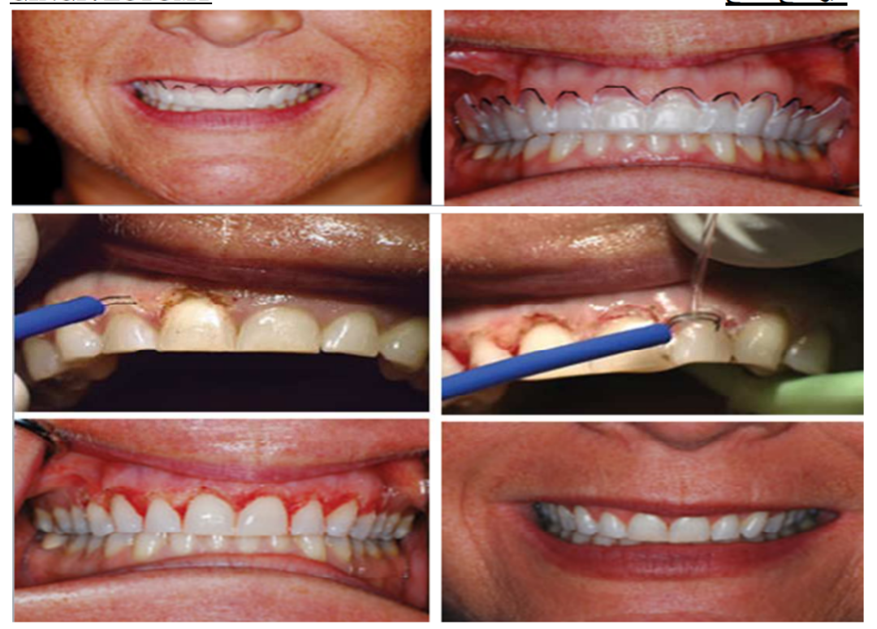

Slide 29
Advantages:
1. Hemostatic effect.
2. Electrosurgery permits adequate contouring of the tissue.

Slide 30
Disadvantages:
1. It cannot be used in patients who have a non-compatible or a poorly shielded cardiac pacemaker.
2. The treatment causes an unpleasant odor.
3. If the electrosurgery point touches the bone, irreparable damage can be done.
4. The heat generated by injudicious use can cause tissue damage and loss of periodontal support when the electrode is used close to bone.
5. When the electrode touches the root, areas of cementum burn are produced.

Slide 31
Laser gingivectomy:
It is has the advantage of less bleeding and less post-operative pain. But it is expensive and need special equipment.
The diode laser has been used for the excision of gingival growths, although healing is delayed as compared with healing after conventional scalpel gingivectomy.
The use of a laser for oral surgery requires precautionary measures to
avoid reflecting the beam on instrument surfaces, which could result in injury to neighboring tissues and to the eyes of the operator.

Slide 32
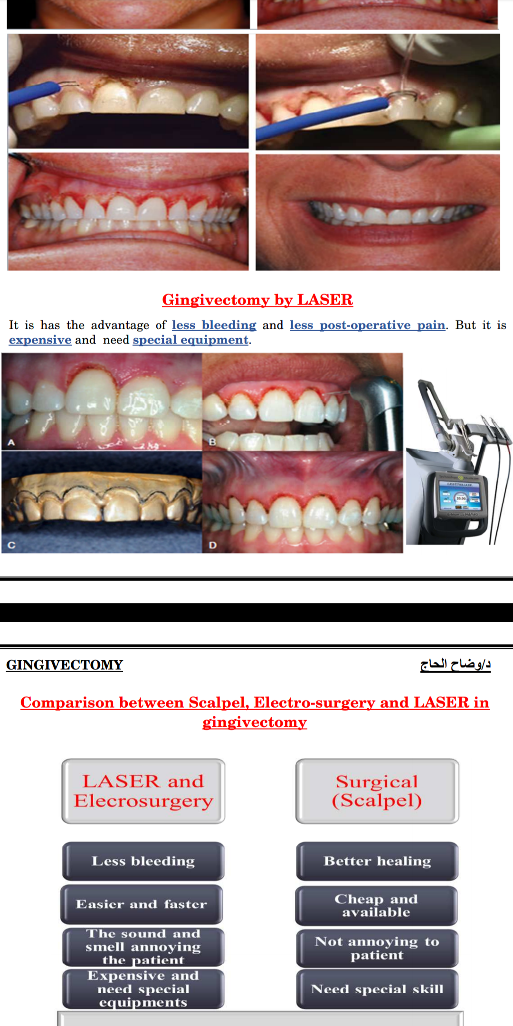

Slide 33
Gingivectomy by chemosurgery:
Techniques to remove the gingiva with the use of chemicals such as 5% paraformaldehyde or potassium hydroxide have been described in the past, but they are not currently used.

Slide 34
Disadvantages:
1. Their depth of action cannot be controlled.
2. Gingival remodeling cannot be accomplished effectively.
3. Epithelization and reformation of the junctional epithelium and reestablishment of the alveolar crest fiber system are slower. Their use therefore is not recommended.

Slide 35
conclusion:
The gingivectomy surgical technique has a long history of use in periodontal surgery. This technique has been attempted with the use of scalpels, electrosurgery, laser, and chemical cautery. Although this technique may have some use for the minimal reduction of redundant gingival tissue, many limiting factors must be considered. Current periodontal surgery must consider the following: (1) the conservation of keratinized gingiva; (2) minimal gingival tissue loss to maintain esthetics; (3) adequate access to the osseous defects for definitive defect correction; and (4) minimal postsurgical discomfort and bleeding by attempting surgical procedures that will allow for primary closure.

Slide 36
The gingivectomy surgical technique has limited use in current surgical therapy, because it does not satisfy these considerations for periodontal therapy. The clinician must carefully evaluate each patient to address the proper application of this surgical procedure.

Slide 37
References:
Dwarakanath, C.D., 2019. Carranza's Clinical Periodontology-Ebook: Third South Asia Edition. Elsevier Health Sciences.
Lindhe, J., Westfelt, E., Nyman, S., Socransky, S.S., Heijl, L. and Bratthall, G., 1982. Healing following surgical non‐surgical treatment of periodontal disease: A clinical study. Journal of clinical periodontology, 9(2), pp.115-128.

Slide 38
Thank You !!
Presented by : Disha Khandade

