Slide 1
Laser in periodontal and peri- implant Therapy
Presented by – Hople sneha

Slide 2
Content:
Introduction
Classification of Lasers
Laser Delivery Systems & Emission Modes
Laser Interaction With Tissues
Laser effects on Tissues
Common dental Lasers
Advantages & Disadvantages of Laser
Lasers Safety in Dental Practice

Slide 3
Introduction:
LASER is an acronym for light amplification by stimulated emission of radiation, is a form of electromagnetic energy in which photons are generated from a medium by stimulating the medium from external energy source.
•The intraoral use of lasers has evolved over the last 4 decades as clinical experience along with scientific investigation, has increased the body of knowledge.
•The dental lasers of today have benefited from decades of laser research and have their basis in certain theories from the field of quantum mechanics, initially formulated during the early 1900s by Danish physicist Bohr.

Slide 4
Classification of Laser:
I. Based on application
Soft tissue laser eg: Argon, Co2, diode; Nd:YAG.
Hard tissue laser eg: Er:YAG
Resin curing laser eg: Argon
II. Mode of action
Contact mode (focused or defocused)
eg: Ho: YAG; Nd:YAG
Non-contact mode (focused or defocused)
eg: CO2

Slide 5
III. Based on Level of energy emission:
Soft lasers (low level energy): Athermal low energy lasers emitted at wave length, which are supposed to stimulate cellular activity. Example: He-Neon; Ga-Arsenide.
Hard lasers (High level energy): Thermal lasers emitted at wavelength in the visible infra red and U.V range. Example: Er:YAG laser; Nd: YAG laser.
IV. Based on radiant energy generation:
Continuous wave or continuous form (CW)
Discreet or single pulses
Multiple timed pulses (Pulse modes)

Slide 6
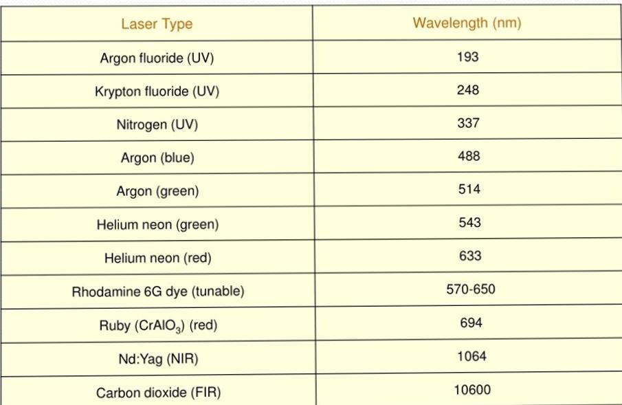
V.Based on wavelength &Medium

Slide 7
Laser beam Delivery Systems:
Mainly two types:
1.Hollow tube waveguide
It is hollow tube lined with series of well aligned mirror which reflect the laser beam from the unit of the handpiece- CO2, Er:YAG
2.Fibro optic
Quartz silica fibers with a handpiece- Diode, Nd:YAG.
This come in various diameters, the operator can select the diameter (range from 200 microm to 800 microm) as per the use

Slide 8
Emission Modes:
Laser device can emit the light energy in one of 3 basic modes:
1.Continuous wave: the beam is emitted at one power level continuously as long as the device is activated by pressing the foot switch.
2.Gated pulse mode: there are periodic alterations of the laser energy being on and off, similar to a blinking light. This mode is achieved by the opening and closing of a mechanical shutter in front of the beam path of a continuous wave emission.
3.Free running pulsed mode. This mode is unique in that large peak energies of laser light are emitted for an extremely short time span, usually in micro seconds, followed by a relatively long time in which the laser is off.

Slide 9
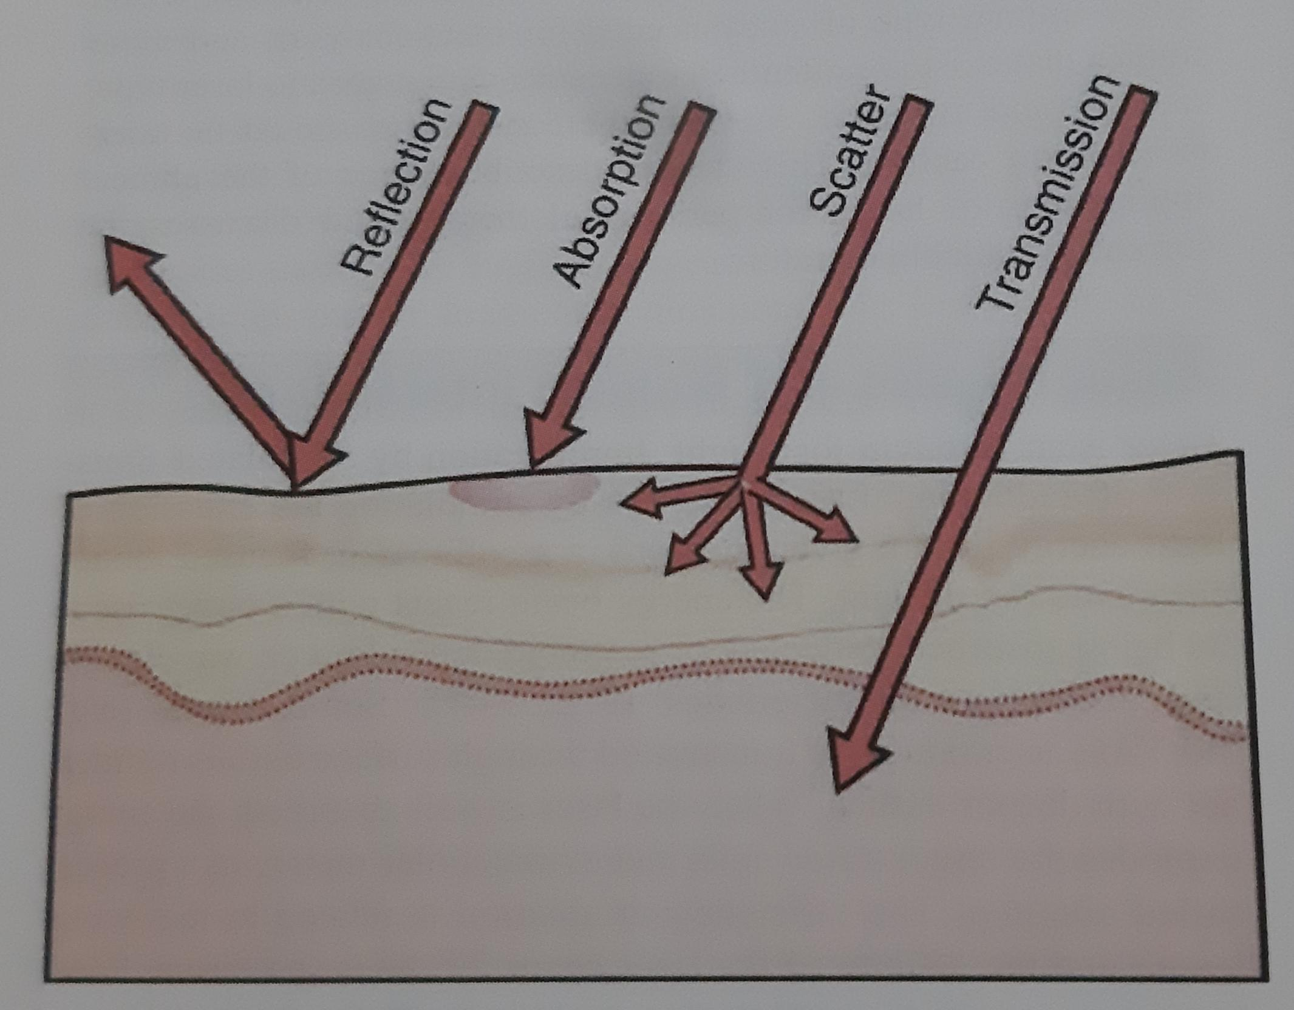
Laser interaction with tissues:
Laser energy can be transmitted or absorbed based on the composition of the target tissue

Slide 10
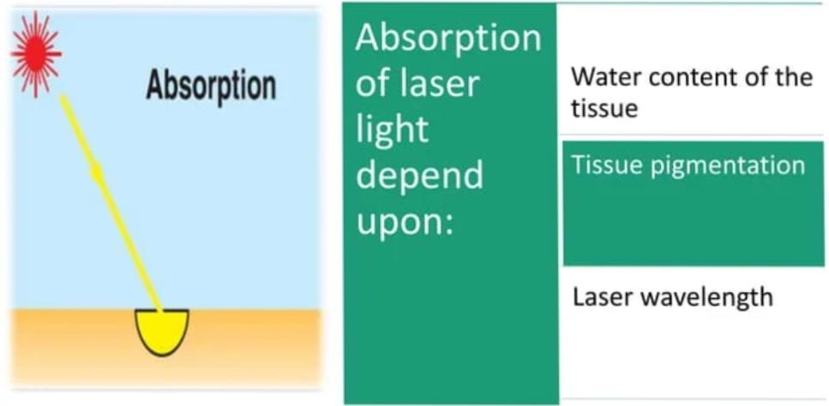
Absorption:
Absorption of the laser light by the target tissue is the primary and beneficial effect of laser energy.
When absorbed, light energy is converted into thermal energy.

Slide 11
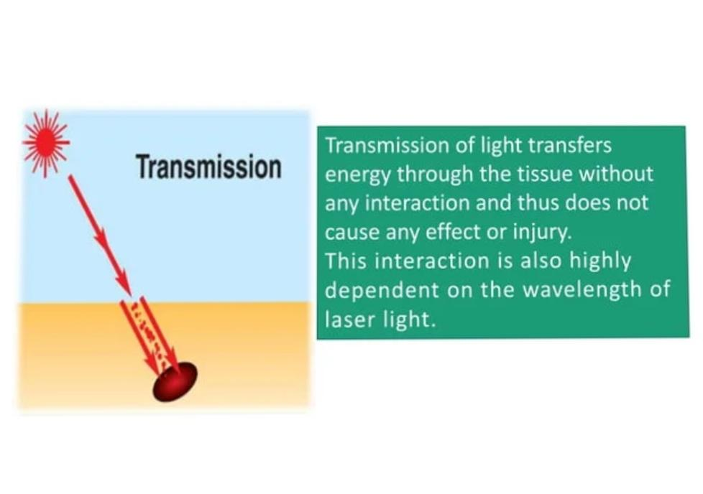
Transmission:

Slide 12
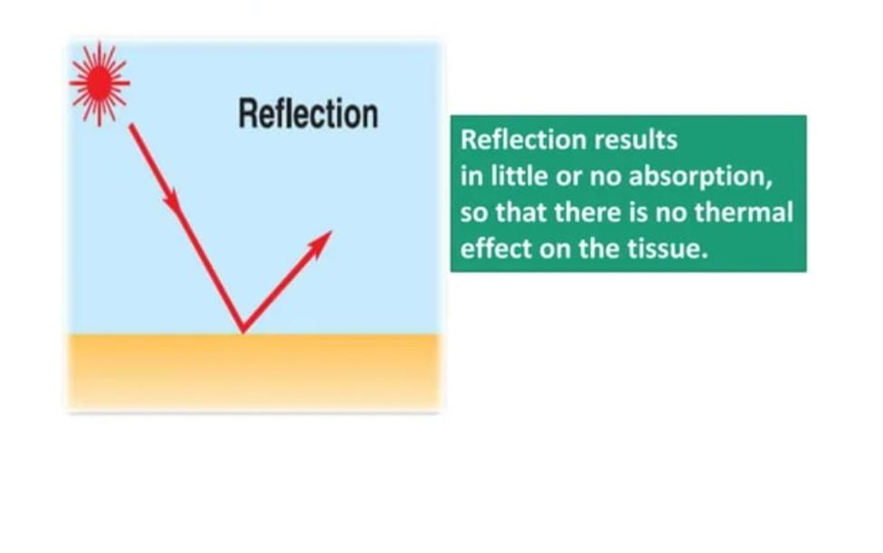
Reflection:

Slide 13
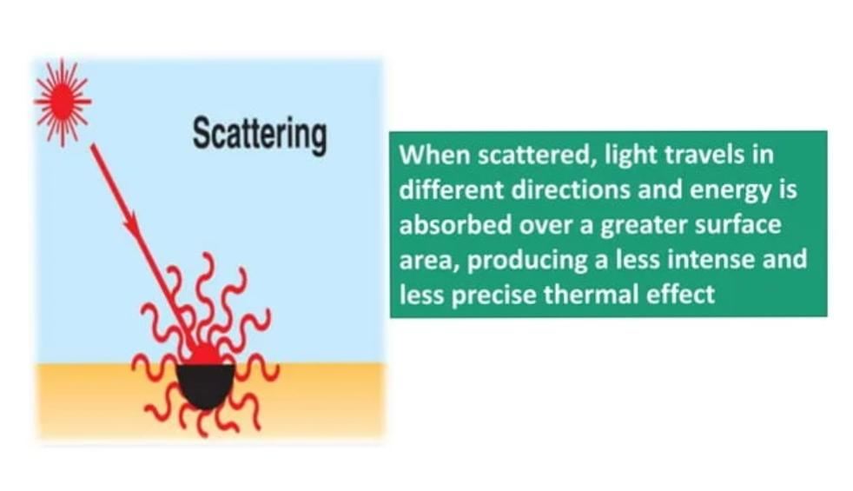
Scattering:

Slide 14
Laser Effects On Tissues:
The light energy from a laser can have four different interactions with the target tissue.
Photo thermal interaction.
Photo chemical interaction.
Photo mechanical interaction.
Photo electrical interaction.

Slide 15
Photo Thermal Interaction:
The principle effect of laser energy is photo thermal i.e. conversion of light energy into heat.
Light energy~Heat energy
Photo ablation-, or the removal of tissue by vaporization and superheating of tissue fluids.
Type of thermal reaction depends on the --
●Spot size
●Power density
●Optical properties and composition of irradiated tissue

Slide 16
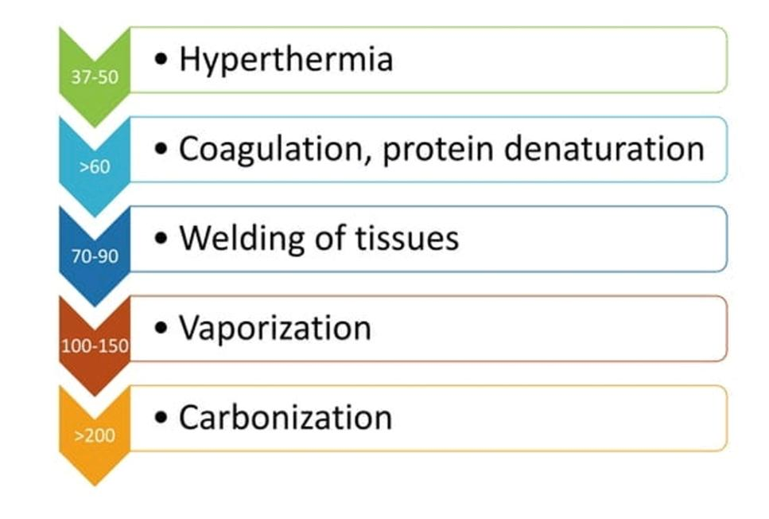
Effects on tissues on certain temperature:

Slide 17
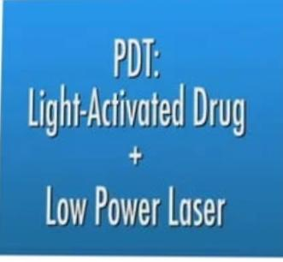
Photo Chemical interaction:
There are photochemical effects from the laser light that can stimulate chemical reactions (e.g. the curing of composite resin) and breaking of chemical bonds (e.g. using photosensitized drugs exposed to laser light to destroy tumor cells, a process called photodynamic therapy).

Slide 18
Photo mechanical interaction:
Photo-disruption-shock waves by laser-rupture the intermolecular and atomic bonds.
Photo-disassociation which is the breaking apart of structures.
Photo-acoustic interactions- Removal of the tissue with Shockwave therapy.

Slide 19
Photo electrical interaction:
Photo plasmolysis, tissue is removed through the formation of electrically charged ions.

Slide 20
Common dental Lasers:
1.Co2 laser:
▪︎10,600 nm
▪︎Both pulsed and continuous wave
▪︎ Readily absorbed by water- very effective for soft tissue surgery
▪︎Advantage over Scalpel- strong hemostatic and bacterocidal effects

Slide 21
• When applied to hard tissues produces severe thermal damage,
  such ascracking
  melting, and
  Carbonization(Sasaki et al 2002)
  So its use has been limited to soft tissue surgery

Slide 22
2.Nd:YAG laser
Free-running pulsed wave laser.
wavelength of 1,064 nm.
Low absorption in water.
Energy scatters or penetrates to the biological tissue.
its photo thermal effect is useful for soft tissue surgery.
Produce relatively thick coagulation layer.

Slide 23
Has been widely accepted in soft tissue surgery.
1990- FDA approved for soft tissue surgery.
Easy to deliver by optical fiber contact tip.
Easy insertion into the pockets.
1997- FDA approved for sulcular debridemnt, first approval of laser application in periodontal pocket by FDA
Not suitable for hard tissue ablation.

Slide 24
3. Er:YAG laser
Solid-state laser that generates a light with a wavelength of 2,940 nm
Since the Er:YAG laser is well absorbed by all biological tissues that contain water molecules, this laser is indicated for both soft and hard tissue ablation

Slide 25
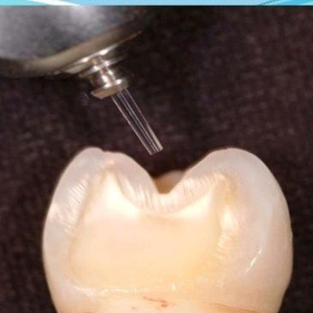
The free-running pulsed Er:YAG laser has already been used clinically for caries. removal and cavity preparation.
1997- FDA approved for hard tissue treatment such as caries removal and cavity preparation

Slide 26
Advantages:
Cut and coagulate precisely, in one step
Eliminate collateral tissue damage
Minimize post-operative inflammation and discomfort
Clean, bloodless operating field
Radiant coagulation: seal blood vessels without cauterization via conductive heat or carbonization
Lasers seal lymphatic vessels thus leading to less postoperative swellling
Greater comfort during and after surgery.
Homeostasis and reduced risk of blood borne pathogen
Rarely needs suture
High patient acceptance of treatment.

Slide 27
Controlled depth of laser penetration
Hemostasis provides excellent visibility-even down in thpocket
Reduce patient discomfort and the need for anesthetic
Laser incisions heal faster than electro-cautery

Slide 28
Disadvantages:
Retinal burn if no protection
Prolonged exposure to pulp causes irreversible pulp damage.
High cost.
Specially trained personnel required.-
Chances of explosion.
Aerosol contamination- respiratory hazards.

Slide 29
Laser safety in Dental pratice:
1. Eye: Acute exposure of the eye to lasers of certain wavelengths and power can cause corneal or retinal burns (or both). Chronic exposure to excessive levels may cause corneal or lenticular opacities (cataracts).
2 Skin: Acute exposure to high levels of optical radiation may cause skin burns; while carcinogenesis may occur for ultraviolet wavelengths (290-320 nm).
3.Chemical: Some lasers require hazardous or toxic substances to operate (i.e., chemical dye, Excimer lasers).
4. Electrical: Most lasers utilize high voltages that can belethal
5. Fire: The solvents used in dye lasers are flammable. High voltage pulse or flash lamps may cause ignition.

