Slide 1
ENDO – PERIO Lesion
Presented By – Hrishikesh Sugave

Slide 2
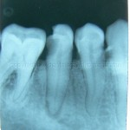
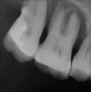
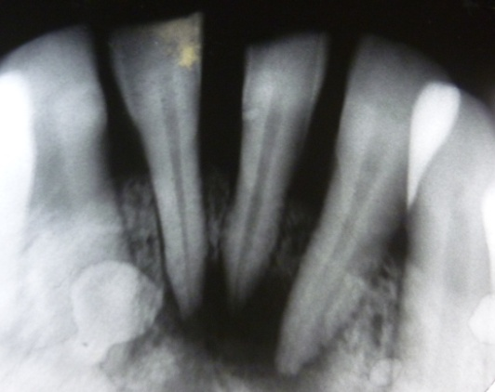
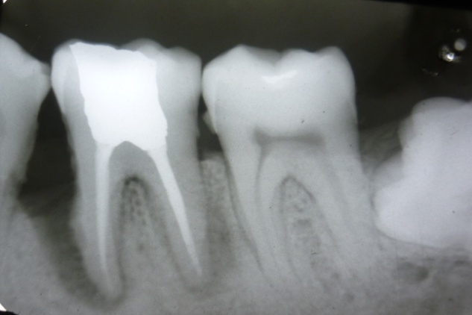
Contents
Introduction
Pathways of communication between dental pulp and periodontium
Effect of pulp disease and its treatment on the periodontium
Effect of periodontal disease and its treatment on the pulp
Classification of Endo-Perio lesions
Etiological factors
Clinical diagnostic procedures
Individual lesion description
Alternative treatment modalities
Conclusion
References

Slide 3
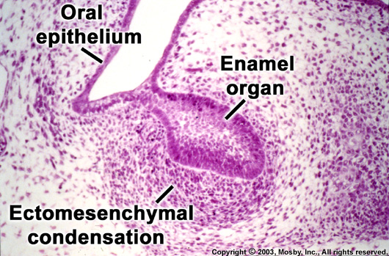
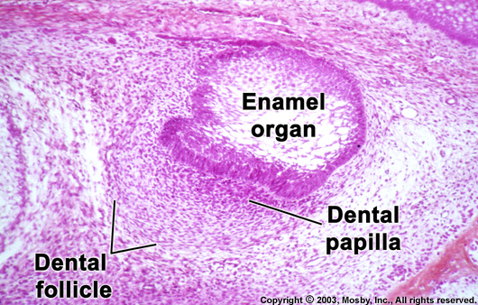
Ectomesenchymal in origin
Cells proliferate
Dental Papilla
(Precursors Of The Pulp)
Dental Follicle
(Precursors Of The Periodontium)

Slide 4
Endodontic lesion denotes an inflammatory process resulting from noxious agents present in the root canal system of the tooth.
Periodontal lesion denotes inflammatory process resulting from accumulation of dental plaque on the external tooth surfaces.
If a periodontal and an endodontic lesion affects the same tooth simultaneously and presents as a single lesion, the condition is termed as a true endodontic- periodontal lesion.
True endodontic -periodontal lesion implies that the lesion either is the result of, or the cause of, the other, or the lesion may represent two separate processes. An endodontic and a periodontal which have developed independently.

Slide 5
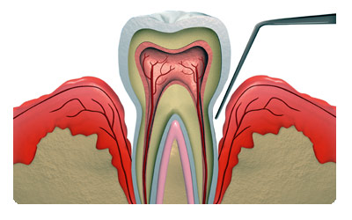
DEFINITION
An isolated, usually narrow, deep probing depth of pulpal or periodontal origin.
Lesion with sub marginal or intrabony periradicular bone loss of pulpal and/or periodontal origin that communicates with the oral cavity via probing defect.
A localized periodontal probing depth of pulpal or periodontal origin.
Inflammation from pulp may extend into the periodontium through the apex, lateral or accessory canals causing destruction of periodontal tissues. Such a periodontal lesion is termed as “Retrograde periodontitis”.
Inflammation from periodontal tissues may extend into the pulp which results in “Retrograde pulpitis”.
Stock et al. 2004

Slide 6
Endodontic/Periodontic Lesion - A process involving interaction of diseases of the pulp and periodontium. These interactions or lesions are classified by etiology, diagnosis and prognosis as follows:
Primary pulpal lesions with extension to the periradicular tissues;
Primary pulpal lesions with extension to the periradicular tissues with secondary imposition of periodontal disease;
Primary periodontal lesions;
Primary periodontal lesions with extension to the pulpal tissues;
Combined pulpal-periodontal lesions in which independent disease processes in both tissues have joined or coalesced in the periradicular tissues;
Concomitant pulpal-periodontal lesions in which disease processes exist independently in both tissues and are not apparently interrelated.
AAE Glossary of Endodontic Terms.

Slide 7
What is a Perio-Endo lesion??
Tooth should be pulp less.
Destruction of attachment apparatus
Endodontic therapy & Periodontal treatment necessary to resolve lesion

Slide 8
CLASSIFICATION OF ENDO-PERIO LESIONS
Simon, Glick, Frank (Cohen) classification
Oliet, Pollock (Grossman) classification
Weine’s classification

Slide 9
According to Simon, Glick & Frank – based on etiology (1972)
Type I – primary endodontic lesions
Type II – primary endodontic lesions with secondary
periodontal involvement
Type III – primary periodontal lesions
Type IV – primary periodontal lesions with secondary
endodontic involvement
Type V – true combined lesions
Cohen

Slide 10
Modified Simon’s classification (1988)
Type I – primary endodontic lesions
Type II – primary endodontic lesions with secondary
periodontal involvement
Type III – primary periodontal lesions
Type IV – primary periodontal lesions with secondary
endodontic involvement
Both type II and type IV lesions in advanced stages – combined lesions
Separate class not necessary!!
Stock

Slide 11
Type I – primary endodontic lesion (with potential for true secondary
periodontal involvement)
Type II – primary periodontal lesion (with potential for true secondary
pulpal involvement)
Type III – true combined lesions of dual origin
Stock

Slide 12
According to Oliet, Pollock – based on treatment plan (1968)
Lesions that require endodontic procedures only
Necrotic pulp and apical granulomatous tissue replacing periodontium and bone with or without sinus tract
Chronic periapical abscess with sinus tract
Longitudinal and horizontal root fractures
Pathologic and iatrogenic root perforations
Teeth with incomplete apical root development
Endodontic implants / replants / transplants
Teeth that require hemisection / radisectomy
Root submergence
Intentional endodontic therapy for prosthodontic consideration
Grossman 1988

Slide 13
Lesions that require periodontic procedures only
Occlusal trauma causing reversible pulpitis
Occlusal trauma plus gingival inflammation resulting in pocket formation and reversible pulpitis
Suprabony or infrabony pocket formation treated with overzealous root planing and curettage leading to pulpal sensitivity
Extensive infrabony pocket formation extending beyond the root apex and sometimes coupled with lateral or apical resorption yet with pulp that responds with in normal limits to clinical testing
Grossman 1988

Slide 14
Lesions that require combined endo – perio treatment procedures
Any lesion in Group I That results in irreversible reactions in the attachment apparatus and requires periodontal treatment
Any lesion in Group II that results in irreversible reactions to the pulp tissue and also requires endodontic treatment
Grossman 1988

Slide 15
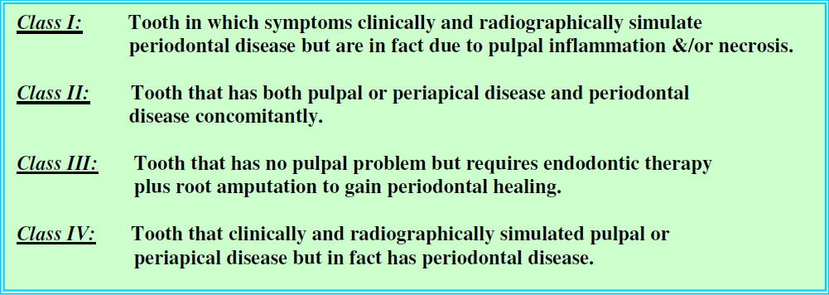
According to Weine

Slide 16
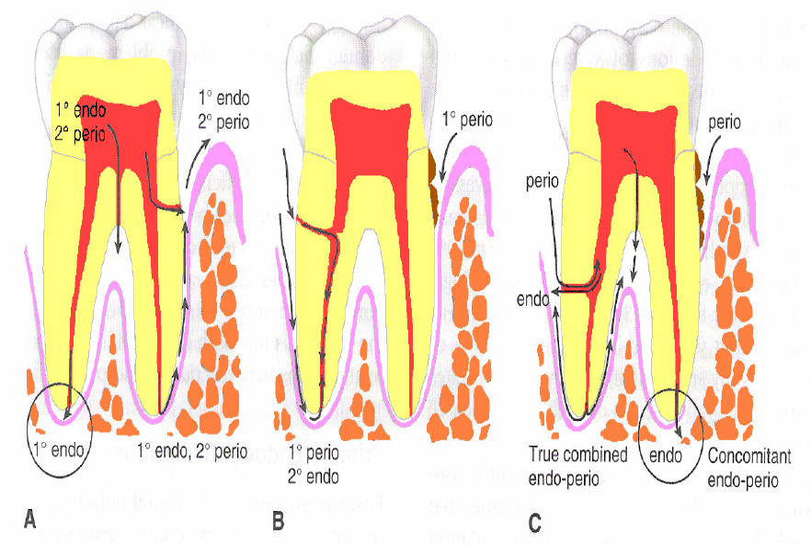
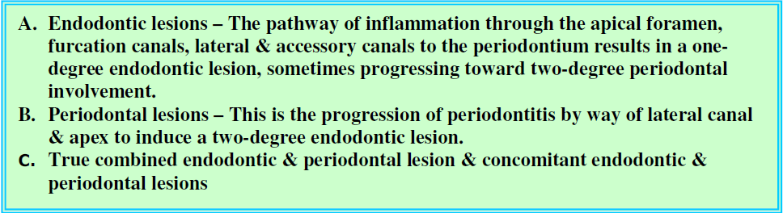

Slide 17
Pathways Of Communication
Pathways of developmental origin
Pathways of pathological origin
Pathways of iatrogenic origin

Slide 18
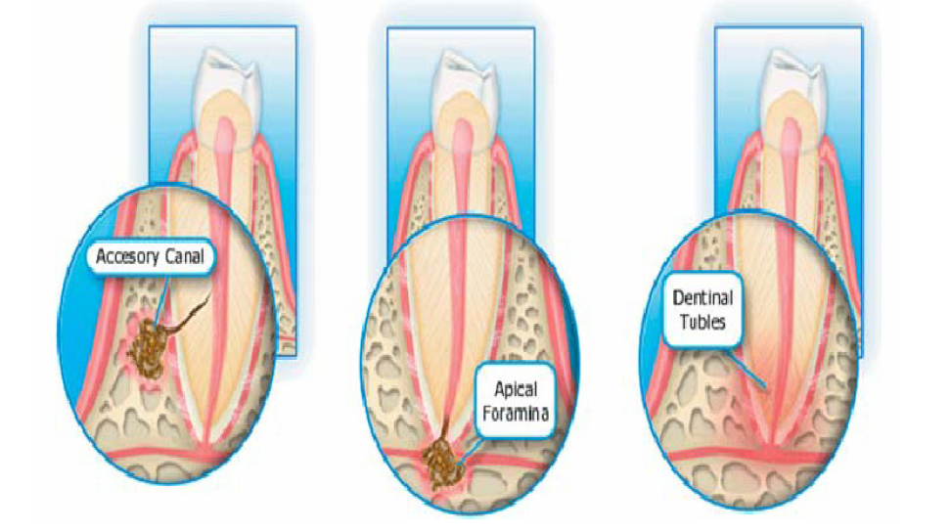
Pathways of developmental origin
Apical foramen:
Principal route of communication between the pulp and the periodontium.
Bacterial by products and inflammatory mediators in a diseased pulp may exit readily via the apical foramen- periapical pathosis.
Apex is also a portal of entry of inflammatory elements from deep periodontal pockets to the pulp.
Local inflammatory response often associated with bone and root resorption.

Slide 19
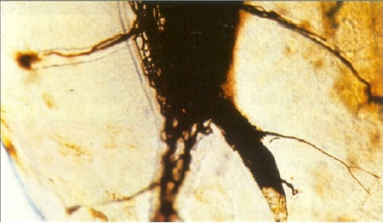

2. Lateral and accessory canals –
Lateral and accessory canals can be present anywhere along the root.
30–40% of all teeth have lateral or accessory canals and majority - apical third of the root.
DeDeus [J Endod 1975:1; 361] found that 17% of teeth presented lateral canals in the apical third of the root, about 9% - middle third, and less than 2% - coronal third.
However, it seems that the incidence of periodontal disease associated with lateral canals caused by irritants in the dental pulp is low.
Kirkham [J Am Dent Assoc 1975: 91: 353], studying 1000 human teeth with extensive periodontal disease, found only 2% of lateral canals associated with the involved periodontal pocket.

Slide 20

Accessory canals contain connective tissue and blood vessels that connect the circulatory system of the pulp with that of the periodontium.
However, not all these canals extend the full length from the pulp chamber to the floor of the furcation. [J Endod 1987: 13; 176]
Incidence - 23% to 76% [Endod Topics 2006]
Accessory canals - furcation of molars - direct pathway of communication between the pulp and the periodontium.
Seltzer et al. [OOOOE 1963] reported that pulpal inflammation – Inflammatory reaction in the interradicular periodontal tissues.
Potential pathway for the spread of microorganisms and their toxic by-products from the pulp to the PDL and vice versa - inflammatory process.

Slide 21
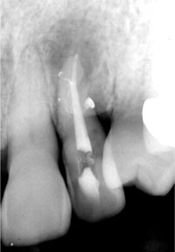
Clinically lateral canals are very difficult to detect.
According to Pineda & Kuttler – 2 view radiographs can identify upto 30% of lateral canals and standard radiographs about 8%.
Several clinical aids may be helpful for identification of lateral and accessory canals:
Radiographic image of a discrete lateral lesion associated with a necrotic pulp
Radiographic identification of a “notch” on lateral root surface
Demonstration of root canal filling material or sealer extruding through the patent orifices.

Slide 22
3. Dentinal tubules –
Via patent dentinal tubules if the cementum layer is interrupted.
Exposure of dentinal tubules - due to developmental defects, disease processes, or periodontal or surgical procedures.
Radicular dentin tubules extend from the pulp to the cemento-dentinal junction (CDJ).
Run a relatively straight course.
Diameter - 1 mm in the periphery to 3 mm near the pulp.
Tubular lumen decreases with age or as a response to chronic low-grade stimuli causing apposition of highly mineralized peritubular dentin.
Density of dentin tubules varies from approximately 15 000/mm sq. at the CDJ in the cervical portion of the root - 8000 near the apex, whereas at the pulpal ends the number increases to 57 000/ sq mm.
Notes:
Exposed dentinal tubules in areas devoid of cementum may serve as communication pathways between the pulp and the periodontal ligament

Slide 23
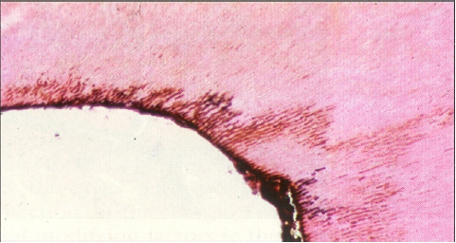

When the cementum and enamel do not meet at the CEJ, these tubules remain exposed, thus creating pathways of communication between the pulp and the periodontal ligament.
Cervical dentin hypersensitivity is a classic example of such tubular exposure
SEM studies - dentin exposure at the CEJ - 18% of teeth in general and in 25% of anterior teeth in particular. [Rotstein et al. Endodontic Topics 2006].
Same tooth may have different CEJ characteristics presenting dentin exposure on one side while the other sides are covered with cementum.
This area becomes important in assessing the progression of endodontic pathogens, as well as the effect of root scaling and planing on cementum integrity, trauma, and bleaching-induced pathosis.
Notes:
Exposed dentinal tubules in areas devoid of cementum may serve as communication pathways between the pulp and the periodontal ligament

Slide 24
Pathways Of Pathological Origin
Empty spaces on root created by Sharpey’s fibers
Root fractures following trauma
Idiopathic resorption – Internal and external
Loss of cementum due to external irritants
Hypophosphatasia

Slide 25
Pathways Of Iatrogenic Origin
Exposure of dentinal tubules following root planing
Accidental root perforations during endodontic procedures
Root fractures caused due to endodontic procedures
Teeth restored due to intracanal post are more prone to fracture.

Slide 26
PULPAL PERIODONTAL INTERRELATIONSHIP
When the pulp becomes inflamed/infected, it elicits an inflammatory response of the periodontal ligament at the apical foramen and/or adjacent to openings of lateral & accessory canals.
Inflammatory mediators, bacterial by-products, toxic irritants may leach out through the apex, lateral and accessory canals, and dentinal tubules – periodontal destruction apically – Retrograde periodontitis.
Products released - living bacterial strains, fungi & viruses including as well as of non-living pathogens.
Lesion related to pulpal necrosis – sinus tract draining through attached gingiva or alveolar mucosa. localized or diffuse swelling that occasionally involves the gingival attachment.

Slide 27
Pulpal Degeneration
Periapical infection
Dysfunction of PDL
Osteoclastic activity
Periodontal inflammation & bone loss
The endodontic infection has been regarded as a local modifying risk factor for periodontitis progression if left untreated.
Aggravate periodontal pocket formation, bone loss & impair wound healing to further accelerate periodontal disease development and progression.
The inflammation may contribute to
Horizontal bone loss
Sub marginal bone loss
Vertical intrabony defects
Furcation involvement
Nature & extent of periodontal destruction depends on
Virulence
Foreign body reactions
Duration & severity of disease
Host defense mechanisms

Slide 28
Periodontal wound healing
Certain procedures involved in root canal treatment – transient inflammatory response in the periodontium.
Procedural mishaps such as perforations apical to gingival attachment, strip perforations or root perforations; vertical root # due to excessive force during obturation or restorative procedures – attachment breakdown and periodontal defects
Teeth with pulps necrotized by acute trauma may have compromised periodontal healing.
Periodontal wound healing after surgery may also be compromised if root canal infection is present.
Periodontal healing after periapical surgery is often associated with post-surgical attachment loss or recession.
This is why many periodontist’s insist on RCT on teeth with “doubtful" pulp status when regenerative surgery is planned in the site…….the rationale is to eliminate possible sources of infection to maximize the potential for successful outcome!!

Slide 29
Periodontal wound healing
Many factors influence this that includes –
Gingival tissue thickness
Alveolar bone level
Surgical trauma to the flap
Effective flap repositioning
Persistent root canal infection - results in greater attachment loss after surgery.

Slide 30
PERIODONTAL PULPAL INTERRELATIONSHIP
The effect of periodontal inflammation on the pulp is controversial.
Some investigators have proved that pulpitis & pulp necrosis can occur as a result of periodontal inflammation involving lateral, accessory & apical canals.
Bacterial products & toxins may also gain access to the pulp by way of exposed dentinal tubules.
The pulp may eventually succumb either because the periodontal disease reaches the root apex or the infection in the pulp spreads (due to bacterial products).
It has been suggested that periodontal disease has no effect on the pulp before it involves the apex. [J Endod 1979: 6: 242]

Slide 31
Periodontal - Pulpal Interrelationship
Mazur & Massler 1964, Ross & Thomson 1978, Bergenholtz & Nyman 1984, Torebinejad & Kiger 1985, Harrington et al 2002
Seltzer et al 1963, Stahl et al 1965,Rubach & Mitchell 1965, Stallard 1972, Bender and Seltzer 1972,Sinai & Soltanoff 1973, Wong & Glickman 2002
Studies supporting the effect of periodontal disease on the pulp
Studies not supporting the effect of periodontal disease on the pulp

Slide 32
Effect of periodontal disease on the pulp is degenerative in nature - increase in dystrophic pulp calcifications, fibrosis, and collagen resorption, in addition to the direct inflammatory sequelae.
Reparative response - Canals associated with periodontally involved teeth were reported to be narrower than canals of teeth that were not periodontally involved.
Not all researchers agree about the effect of periodontal disease on the pulp.
Additional studies have failed to confirm a direct correlation between periodontal disease & pulp tissue changes. When pathologic changes occur in the pulp as a result of periodontal disease, the pulp usually does not degenerate as long as the main canal is not involved.
Generally, as long as the blood supply through the apical foramen remains intact, the pulp is usually capable of withstanding physiologic insults induced by periodontal disease.
Chacker stated that the periodontal disease would not usually cause pulpal disease because inflammation follows the venous drainage, & venous blood flows outward from the pulp into the periodontium.
Notes:
This result is thought to be a reparative process rather than an inflammatory response, where the pulp tends to close off channels of communication by the laying down of secondary dentin & sclerosis of dentinal tubules.

Slide 33
The effect of periodontal treatment on the pulp is similar during scaling, curettage as well as periodontal surgery if accessory canals are severed &/ or opened to the oral environment.
Pathogenic invasion and secondary inflammation - necrosis of the pulp.
Effects of endodontic infection on periodontal probing depth and the presence of furcation involvement in mandibular molars were also investigated [Jansson L et al. J Periodontol 1998: 69: 1392–1396]
It was found that endodontic infection in mandibular molars was associated with more attachment loss in the furca.
These authors suggested that endodontic infection in molars associated with periodontal disease might enhance periodontitis progression by spreading pathogens through accessory canals and dentinal tubules.
In contrast to these findings, Miyashita et al.[ J Periodontol 1998: 69: 158–164] failed to observe a correlation between a reduced marginal bone support and endodontic status.

Slide 34
CAUSES OF ENDO-PERIO LESIONS
Lesions with a higher chance of primary endodontic etiology exhibit the following features:
Relatively narrow, deep, isolated, periodontal probing depths.
Lesions with a higher chance of primary periodontal etiology exhibit the following features:
Generalized periodontal disease
Poor oral hygiene
Broad rather than narrow periodontal probing depths.
Notes:
The different causes & their presenting features are described below.

Slide 35

ETIOPATHOGENESIS OF ENDO-PERIO LESIONS
Dentinal tubules, lateral/ accessory canals, apical foramen
ANATOMICAL
CONSIDERATIONS
PERIO – ENDO
LESIONS
Poor endodontic treatment, poor restorations, trauma, resorption, perforation, developmental malformation
Live pathogens
CONTRIBUTORY
FACTORS
ETIOLOGIC
FACTORS
Non living etiologic agents

Slide 36
Microbial factors – Bacteria
Bacteria play a critical role in endodontic and periodontal disease.
The periapical tissues become involved when bacteria invade the pulp, causing either partial or total necrosis.
Kakehashi (1965) et al. demonstrated the relationship between the presence of bacteria & the pulp & periapical diseases.
In this study, pulps of normal rats were exposed & left open to the oral environment - pulp necrosis, periapical inflammation & periapical lesion formation.
However, when the same procedure was performed in germ-free rats - pulps remained vital and relatively non-inflamed.
The study demonstrated that without bacteria & their products, periapical lesions of endodontic origin do not occur .
Notes:
The live pathogens in a diseased pulp that can cause lesions in the periodontal tissues are bacteria, fungi, viruses and their byproducts & need to be eliminated during RCT.

Slide 37
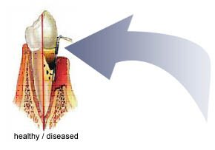
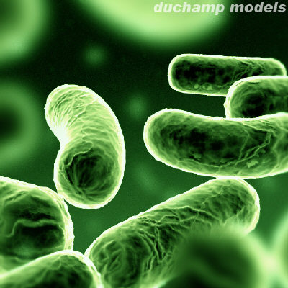
Proteolytic bacteria predominates the root canal flora - changes to anaerobic microbiota.
Specific PCR methods were used to detect Actinobacillus actinomycetemcomitans, Bacteroides forsythus, Eikenella corrodens, Fusobacterium nucleatum, Porphyromonas gingivalis, Prevotella intermedia, and Treponema denticola.
These pathogens were found in all endodontic samples & the same pathogens were found in teeth with chronic apical periodontitis & chronic adult periodontitis.
It therefore appears that periodontal pathogens accompany endodontic infections & that endo–perio interrelationships are a critical pathway for both diseases.

Slide 38
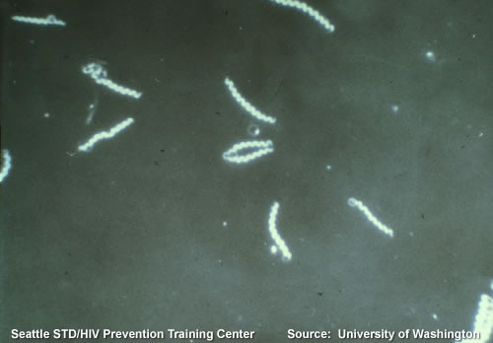
Spirochetes are another type of microorganism associated with both endodontic and periodontal diseases.
It has been demonstrated that the spirochete species most frequently found in root canals are T. denticola and T. maltophilium.
The main virulence factor of T. denticola includes surface-expressed proteins with cytotoxic activities such as the major surface protein and the chymotrypsin-like protease complex, extracellular or membrane-associated proteolytic and hydrolytic enzymes, and metabolites.
This microorganism possesses an array of virulence factors associated with periodontal disease and may also participate in the pathogenesis of periradicular disease.
Although the virulence factors of T. maltophilium have not yet been fully elucidated, it was proposed that its motility due to rotation of periplasmic flagella, might contribute to its pathogenicity.
T. maltophilum was also frequently isolated from patients with rapidly progressive periodontitis.

Slide 39
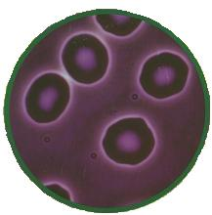
L-form bacteria may also have a role in periapical disease.
Some bacterial strains can undergo morphological transition to their L-form after exposure to certain agents, particularly penicillin.
The L-form and the bacterium may appear individually or together & this may occur either spontaneously or by induction in a cyclic manner.
Under certain conditions, depending on host resistance factors and bacterial virulence, the L-forms revert to their original pathogenic bacterial form and may then be responsible for acute exacerbation of chronic apical lesions.

Slide 40
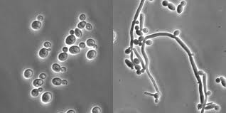
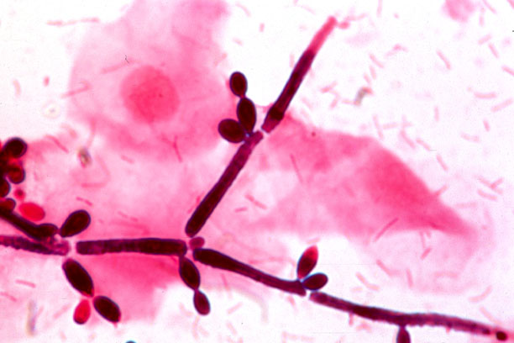
Microbial factors – Fungi
Yeast colonization associated with periradicular pathosis has been demonstrated in untreated root caries, dentinal tubules, failing root canal treatments, apices of teeth with asymptomatic apical periodontitis, and in periapical tissues.
The majority of the recovered fungi from infected canals were Candida albicans.
Other species such as C. glabrata, C. guillermondii, C. incospicia, and Rodotorula mucilaginosa were also detected.
Factors affecting the colonization of the root canal by fungi are immunocompromising diseases such as cancer, certain intracanal medicaments, local and systemic antibiotics, and previous unsuccessful endodontic therapy.

Slide 41
Reduction of specific strains of bacteria in the root canal during endodontic treatment may allow fungi overgrowth in the remaining low-nutrient environment.
Another possibility is that fungi may gain access to the root canal from the oral cavity as a result of poor asepsis during endodontic treatment or post space preparation procedures.
In addition, it has been demonstrated that the presence of fungi in root canals is directly associated with their presence in saliva.
Importance of using aseptic endodontic and periodontal techniques, maintaining the integrity of dental hard tissues, and covering the tooth crown as soon as practical with a well-sealed permanent restoration in order to prevent re-infection.

Slide 42
Microbial factors – Viruses
In periodontal disease, the HSV was frequently detected in gingival crevicular fluid and in gingival biopsies of periodontal lesions.
Human Cytomegalovirus & Epstein–Barr virus type I was observed in periodontal pocket samples and gingival tissue samples.
Gingival herpes viruses were found to be associated with increased occurrence of subgingival P. gingivalis, B. forsythus, P. intermedia, P. nigrescens, T. denticola, and Actinobacillus actinomycetemcomitans, thus suggesting their role in over-growth of periodontal pathogenic bacteria.
Herpes virus activation in periapical inflammatory cells may impair the host defence mechanisms and give rise to overgrowth of bacteria.

Slide 43
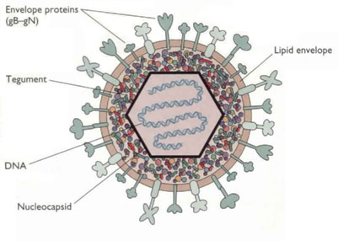
Herpes virus-mediated immune suppression may also be detrimental in periapical infections due to already compromised host-resistant factors and affected connective tissues in situ.
Alterations between prolonged periods of herpes virus latency interrupted by periods of activation may explain some burst-like symptomatic episodes of periapical disease.
Frequent reactivation of periapical herpes virus may support rapid periapical breakdown.
The absence of herpes virus infection or viral reactivation may be the reason why some periapical lesions remain clinically stable for extended periods of time.

Slide 44
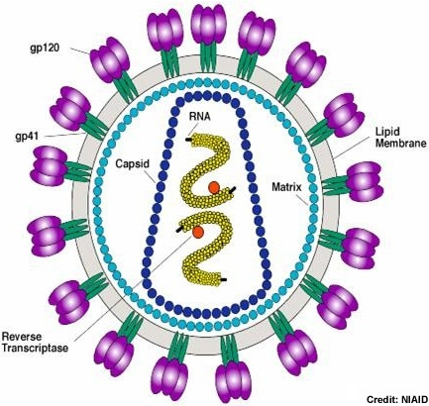
The presence of viruses in the dental pulp was first reported in a patient with AIDS.
DNA of HIV virus was also detected in periradicular lesions. However, it has not been established that HIV virus can directly cause pulpal disease.
HSV is not associated with inflammatory pulpal lesions & that other common types of human viruses may be involved in pulpal disease and associated periapical pathoses.
It appears that active virus infection may give rise to production of an array of cytokines and chemokines with the potential to induce immunosuppression and tissue destruction.
More research is needed to demonstrate a causal relationship of viral infections with both pulpal and periodontal disease processes.

Slide 45
Microbial factors – Infectious Biofilms
Biofilm is a community of microorganisms of one or more species embedded in an extracellular polysaccharide matrix, attached to solid surface.
Majority of bacteria grow in biofilms that are composed of approximately 15% cells (by volume) embedded in 85% matrix material.
These communities are regulated by signals analogous to the hormones and pheromones.
Biofilm formation has a developmental sequence that results in the formation of tower-shaped and mushroom-shaped micro-colonies.
Sequence of events - microbial surface attachment, cell proliferation, matrix production, and detachment.
Biofilm formation and detachment are under the control of chemical signals that regulate and guide the formation of slime-enclosed micro-colonies and water channels.

Slide 46
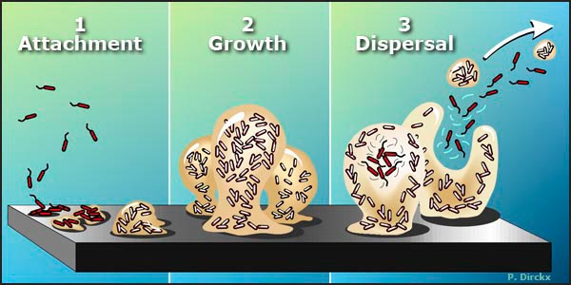

Slide 47
Infectious biofilms are difficult to detect in routine diagnostic methods and are inherently tolerant to host defences and antibiotic therapies.
In addition, biofilms facilitate the spread of antibiotic resistance by promoting horizontal gene transfer.
Actively adapted to environmental stresses, such as alteration in nutritional quality, cell density, temperature, pH, and osmolarity.
Prolonged starvation induces loss of cultivability under standard conditions, while the microorganism remains metabolically active and structurally intact.
This is considered the main reason for the low detection rate of biofilm infections by routine culture methods.
The exact role of biofilms in endodontic infections has not been well established as yet and merits further investigation.

Slide 48
Non Microbial factors – Extrinsic agent - Foreign bodies
Foreign bodies are often found to be associated with the inflammatory process of the periradicular tissues.
Substances such as dentin and cementum chips, amalgam, root canal filling materials, cellulose fibres from absorbent paper points, gingival retraction cords , leguminous foods, and calculus-like deposits.
A foreign body response may occur in any of these substances and the clinical reaction may be either acute or chronic.
Clinically such conditions may be either symptomatic or asymptomatic.
Microscopically, these lesions demonstrate the presence of multinucleated giant cells surrounding the foreign material in a chronic inflammatory infiltrate.
Mechanical or surgical removal of the foreign bodies is usually the treatment of choice.
Notes:
They can be extrinsic such as foreign bodies or intrinsic such as a variety of tissue components.

Slide 49
Non Microbial factors – Intrinsic agent –
Epithelial cell rests of Malassez
Epithelial rests of Malassez are normal constituents of both the lateral and apical periodontal ligament.
Term “rests” is misleading in that it evokes a vision of discrete islands of epithelial cells.
It has been shown that these rests are actually a fishnet-like, three-dimensional, interconnected network of epithelial cells.
In many periapical lesions, the epithelium is not present and therefore presumed to have been destroyed.
If the rests remain, they may respond to the stimuli and proliferate in an attempt to wall off the irritants coming through the apical foramen. The epithelium can be surrounded by chronic inflammation.
This lesion is termed epitheliated granuloma and if not treated, the epithelium will continue to proliferate – cyst.
Notes:
.

Slide 50
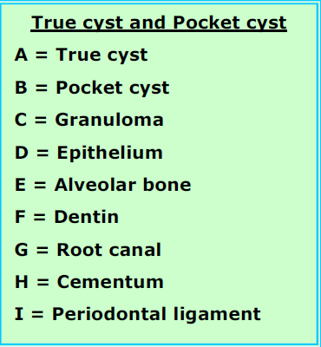
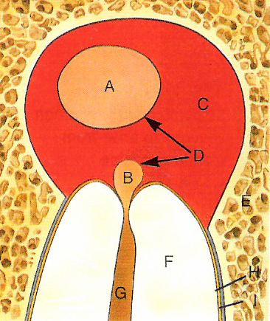
The term ‘bay’ cyst was introduced to depict a chronic inflammatory periapical lesion that has an epithelium lining surrounding the cyst lumen, and has a direct communication with the root canal system. [Simon JHS et al. J Endod 1980: 6: 845–848]
The term ‘true’ cyst was given to a 3D, epithelium-lined cavity with no communication between the lumen and the canal system.
Notes:
E-p art: When periapical lesions are studied in relation to the root canal, a clear distinction between these two entities should be made (33, 34).

Slide 51
Contributing Factors – Developmental malformations
The commonest endo-perio defect associated with such anomalies is caused by developmental grooves on the palatal aspects of maxillary central or lateral incisors beginning in the central fossa crossing over the cingulum, and continuing apically down the root for varying distances.
Such a groove is probably the result of an attempt of the tooth germ to form another root.
As long as the epithelial attachment remains intact, the periodontium remains healthy. However, once this attachment is breached and the groove becomes contaminated, a self-sustaining infrabony pocket can be formed along its entire length.
This fissure-like channel provides a nidus for accumulation of bacterial biofilm and an avenue for the progression of periodontal disease that may also affect the pulp.
Radiographically, the area of bone destruction follows the course of the groove.

Slide 52
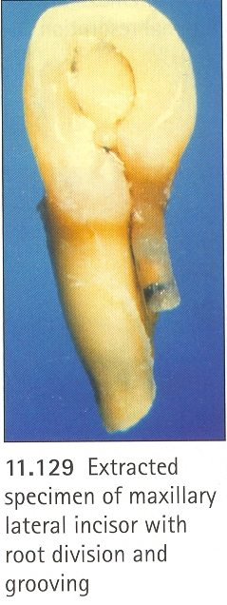
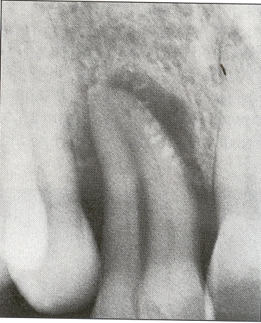
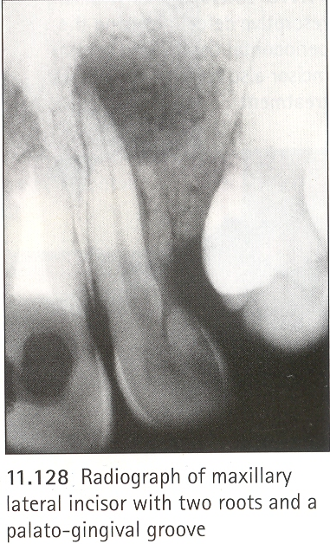
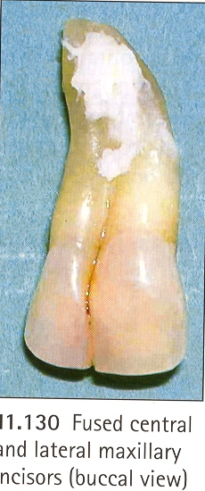
Max : lateral incisor with two roots and a palato gingival groove

Slide 53
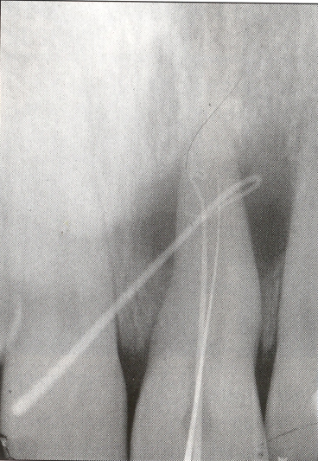
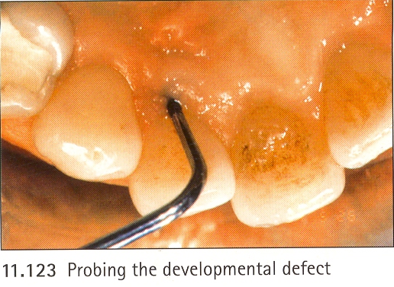
The prognosis of root canal treatment in such cases is guarded, depending upon the apical extent of the groove.
Appearance of a teardrop-shaped area on the radiograph. The developmental groove may actually be visible on the radiograph. If so, it will appear as a dark vertical line.
Treatment consists of burring out the groove, placing bone substitutes, and surgical management of the soft tissues and underlying bone.
Other anatomical anomalies include root divisions, fused teeth, invaginations that communicate directly with the periodontium rather than the pulp & the presence of enamel ‘pearls’ in the furcation or proximal areas.

Slide 54
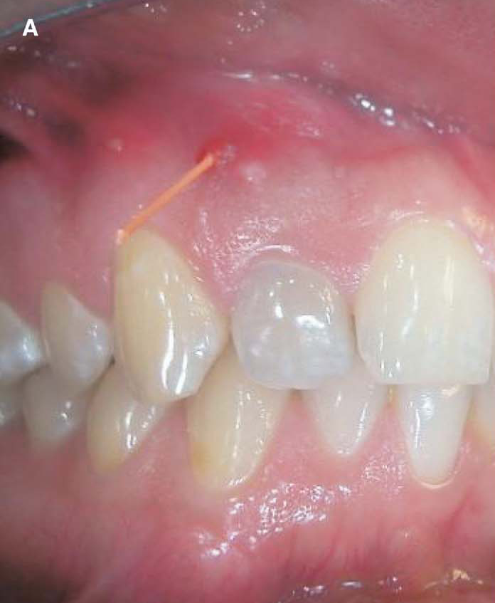
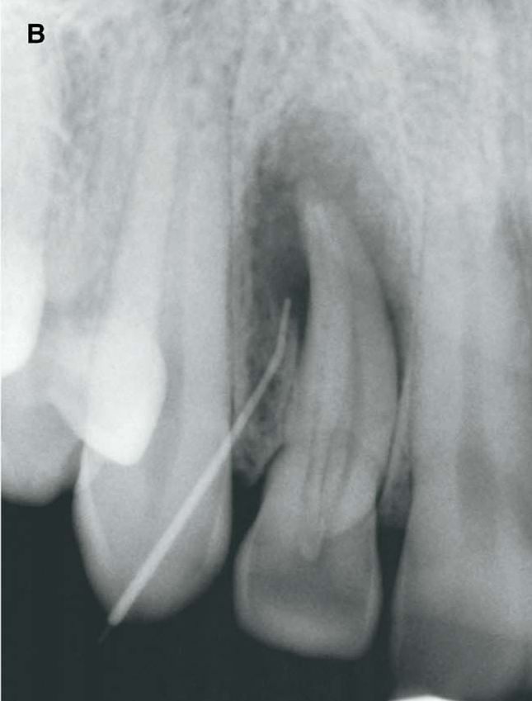
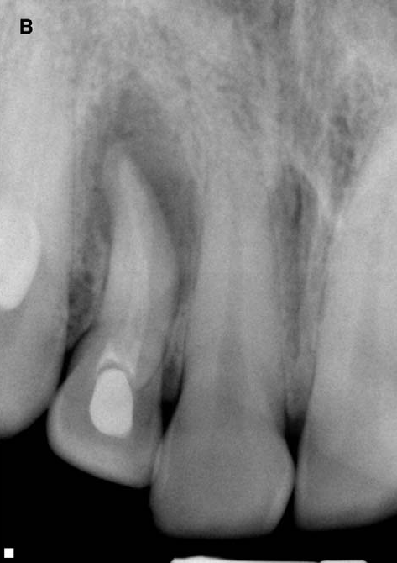
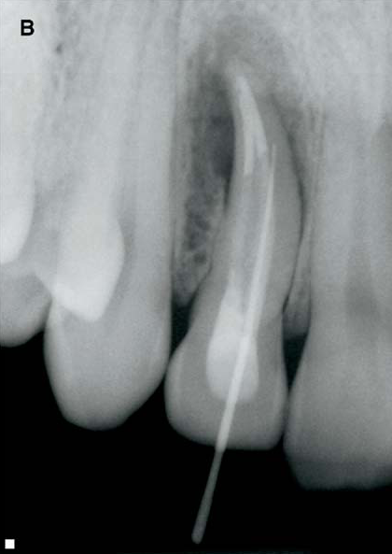
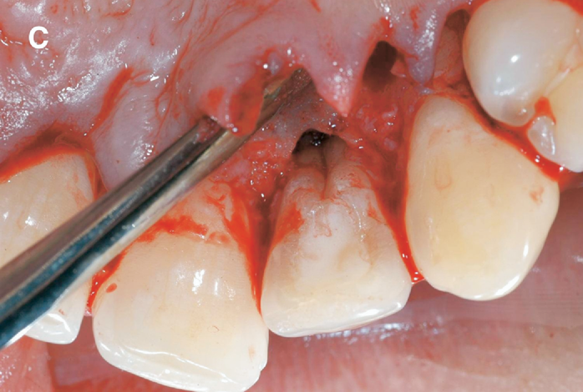
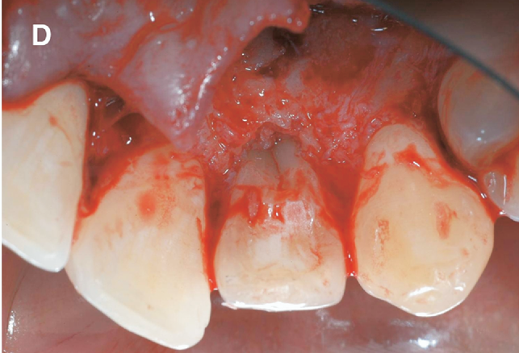
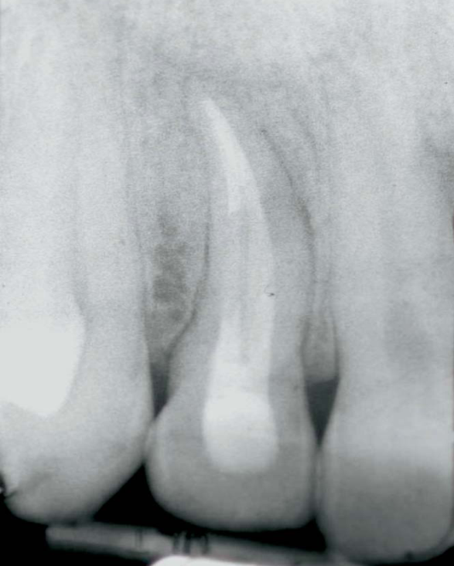
Schwartz et al. Combined Endodontic-Periodontic Treatment of a Palatal Groove: A Case Report J Endod 2006;32:573–578.

Slide 55
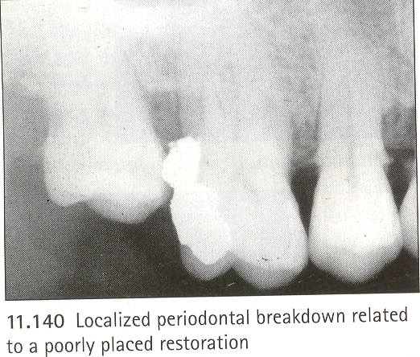
Contributing Factors – Poorly designed restorations
Overhanging restorations, over-contoured crowns & poor embrasure contours all contribute to periodontal breakdown either by compromising the oral hygiene or encroaching on the biologic width.
The probing profile is localized to the site of restorations.
Replacing the restorations with those of acceptable contours & improvement of oral hygiene usually stabilizes the situation.

Slide 56
DIAGNOSIS OF ENDO-PERIO LESIONS
Endo-Perio lesions continue to challenge clinicians in arriving at a definitive diagnosis of origin.
Diagnosis of primary endodontic disease and primary periodontal disease usually present no difficulty.
All the other conditions appear very similar clinically and radiographically.
Diagnosis is based on taking a systematic & careful history & on clinical examination; encompassing both endodontic & periodontal components.
Notes:
Endo-Perio lesions continue to challenge clinicians in arriving at a definitive diagnosis of origin.
The principle reason for this is the difficulty in ascertaining the pulp status, as the tissues are invisible.
Total pulp necrosis is relatively easy to diagnose (because of the high sensitivity & specificity of pulp tests under those conditions) but partial pulp necrosis & infection pose a problem, particularly in multirooted teeth.
Diagnosis is based on taking a systematic & careful history & on clinical examination; encompassing both endodontic & periodontal components.

Slide 57
History of Dentinal, Pulpal or Periapical Pain
Clues about the pulpal history of the tooth & the likelihood of partial pulp necrosis as the cause of the presenting findings.
History of Periodontal symptoms
The duration & nature of the periodontal symptoms will help to:
Characterize the general periodontal status.
Will give an indication of the individual’s susceptibility to periodontal breakdown.
Helps differentiate & distinguish problems associated with generalized periodontal problems as opposed to those associated with non-periodontal causes.
Prognosis of the teeth can be assessed in relation to the patient’s motivation & compliance, which will affect the response to treatment.

Slide 58
Duration: primary pulpal condition mostly acute.
Secondary pulpal, periodontal and combined most of the times are chronic.
A combined or a concomitant condition have a chronic periodontal with acute pulpal involvement.
Pain: duration and type of pain – pulpal – sharp and acute; dull discomfort, chronic – periodontal conditions. If abscess is present then pain is severe.

Slide 59
VISUAL EXAMINATION
Alveolar mucosa and attached gingiva are examined for the presence of inflammation, ulcerations, or sinus tracts.
Frequently, the presence of a sinus tract is associated with a necrotic pulp.
Teeth are examined for abnormalities such as caries, defective restorations, erosions, abrasions, cracks, fractures, and discolorations.
A discolored permanent tooth may often be associated with a necrotic pulp.
A ‘‘pink spot’’ detected in the tooth crown may indicate an active internal resorption process.
Distribution – endodontic infections – localized; periodontitis – generalized.
Swelling – endodontic infections – mucobuccal fold; periodontal infections – attached gingiva.
Enhanced magnification & illumination – facilitate the location of calculus, caries, coronal and radicular fractures, developmental defects, and areas of denuded dentin mainly at the CEJ
Notes:
A thorough visual examination of the lips, cheeks, oral mucosa, tongue, palate and muscles should be done routinely.
Digital examination of the same tissues is performed simultaneously.

Slide 60
PALPATION
Applying firm digital pressure to the mucosa covering the roots and apices.
With the index finger the mucosa is pressed against the underlying cortical bone.
This will detect the presence of periradicular abnormalities or ‘‘hot’’ zones that produce painful response to digital pressure.
A positive response to palpation may indicate active periradicular inflammatory process.
However, this test does not indicate whether the inflammatory process is of endodontic or periodontal origin.
Periodontal lesion – gingiva is soft & edematous
Endodontic lesion – healthy.
Notes:
compare with control teeth

Slide 61
PERCUSSION
Tapping on the incisal or occlusal surfaces of the teeth either with the finger or with a blunt instrument such as the back end of a mirror handle.
The tooth crown is tapped vertically and horizontally.
Although this test does not disclose the condition of the pulp, it indicates the presence of a periradicular inflammation.
An abnormal positive response indicates inflammation of the PDL that may be either from pulpal or periodontal origin.
Corono-apical direction – pulpal; lateral – periodontal.
This test should be done gently - in highly sensitive teeth.
Should be repeated several times and compared to control teeth.

Slide 62
MOBILITY
Mobility testing can be performed using two mirror handles on each side of the crown.
Pressure is applied in a facial–lingual direction as well as in a vertical direction and the tooth mobility is scored.
Tooth mobility is directly proportional to the integrity of the attachment apparatus or to the extent of inflammation in the periodontal ligament.
Teeth with extreme mobility generally have little periodontal support, indicating that the primary cause may be periodontal disease.
Fractured roots, recently traumatized teeth & periradicular abscess often present high mobility – transient.
Pressure exerted by an acute apical abscess, orthodontic movement and pulp necrosis of previously traumatized teeth - transient tooth mobility.
Mobility of the tooth
Grade 0: Normal mobility (Physiologic)
Grade 1: Slight mobility
Grade 2: Marked mobility
Grade 3: Mobility with depressibility

Slide 63
PROBING
Important test to differentiate between endodontic and periodontal disease.
A blunt calibrated periodontal probe is used to determine the probing depth and clinical attachment level.
Pockets purely relate to periodontal if the tooth is vital.
A deep solitary pocket extending to the apices - lesion of endodontic origin or a vertical root fracture.
Periodontal lesions – wide and do not extend apically.
Periodontal probing can be used as a diagnostic and prognostic aid.
Prognosis for a tooth with a necrotic pulp that has developed a sinus tract is excellent following adequate root canal therapy.
However, the prognosis of root canal treatment in a tooth with severe periodontal disease is dependent on the success of the periodontal therapy.

Slide 64
PROBING
Furcation involvement
Degree I horizontal loss of periodontal support < one-third of the width of the tooth;
Degree II horizontal loss of periodontal support < one-third but not encompassing the total width of the tooth;
Degree III horizontal through & through destruction of the periodontal tissues in the furcal area.
Root resection is considered in teeth with Degree II or III furcation involvement.
Classifications based on vertical bone loss are not in common use.
In maxillary teeth, furcation involvement is evaluated from mid-buccal, mesio-palatal & disto-palatal aspects. While in mandibular teeth, they are evaluated from the mid-buccal & midlingual aspects.
Furcation probing is performed with special probes, such as the Naber’s probe which is curved to allow access in the furcation.

Slide 65
PROBING
Probing pockets
This includes:
Presence and distribution of pocket on each tooth surface.
Depth of the pocket
Level of attachment on root
Type of pocket (suprabony / infrabony) should be examined.
"Pocket Depth" is the distance between base of the pocket and gingival margin. It keeps changing with the position of gingival margin and maybe unrelated to the existing attachment of the tooth.
Although probing is the only accurate method for detecting pockets there are some signs and symptoms too.

Slide 66
Signs:
Bluish red marginal gingiva/vertical zone extending from marginal to attached gingiva
"Rolled" edge separating gingival margin from tooth surface
Enlarged edematous gingiva
Bleeding, suppuration, loose extruded teeth.
Symptoms:
Usually painless, but sometimes localized or radiating pain or sensation of pressure after eating which gradually diminishes
Foul taste in localized areas
Sensitivity to hot and cold
Tooth ache in absence of caries
Interpretation:
3-5 mm pocket and Grade 1 mobility indicates "Moderate Periodontitis”.
More than 5 mm pocket with or without Grade II/III mobility indicates “Severe periodontitis".
Notes:
Degree of furcation involvement is classified based on the amount of periodontal destruction in the inter-radicular area

Slide 67
Detection of Pockets:
GP points or calibrated silver points can be used with radiographs to determine the level of attachment of periodontal pockets. Their use in localized cases is feasible but when used in generalized cases it would be cumbersome.
Clinical Probing is more efficient. Two different pocket depths are:
“Biologic depth" /histologic depth - is ascertained in histologic sections, it is the depth from gingival margin to base of pocket (coronal end of junctional epithelium).
Clinical/"Probing depth" is the depth to which an adhoc instrument (probe) penetrates into the pocket. It is described as the distance between the gingival margin & the apical depth of probe penetration & is used to characterize the distribution of the attachment & bone loss.
Notes:
Degree of furcation involvement is classified based on the amount of periodontal destruction in the inter-radicular area

Slide 68
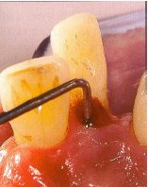
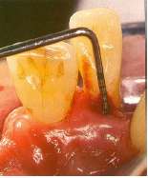
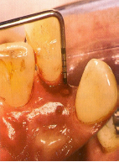
Probing profile – Includes three point probing & continuous probing profile.
This will help define the nature of the pocket, i.e. whether it is long and narrow or broad and wide, and also aid monitoring of its response to treatment.
Long & narrow pockets are classically considered to be of endodontic origin.
However, lateral endodontic abscesses may result in “blow – out” lesions that exhibit extremely wide, as well as deep, probing profiles yet respond favourably to endodontic treatment alone.
Notes:
Degree of furcation involvement is classified based on the amount of periodontal destruction in the inter-radicular area

Slide 69
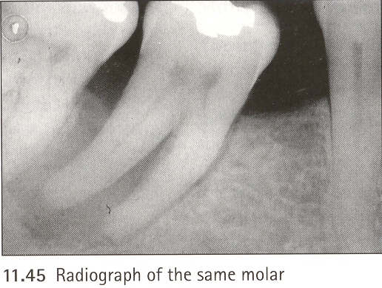
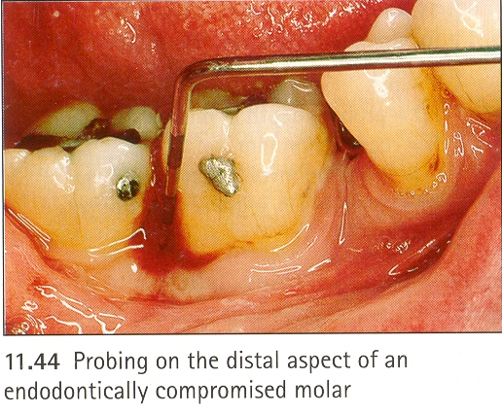
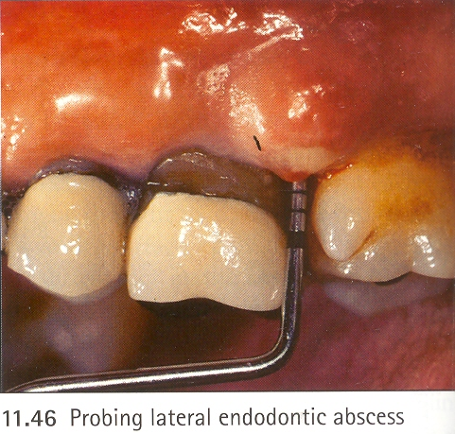
Long narrow pockets: Endodontic origin
Wide deep pockets “Blow Out lesion”: lateral endodontic abscess
Notes:
Degree of furcation involvement is classified based on the amount of periodontal destruction in the inter-radicular area

Slide 70
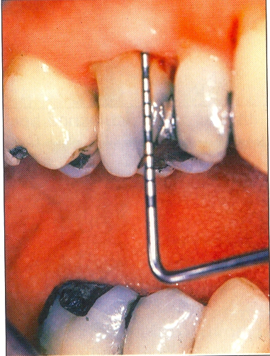
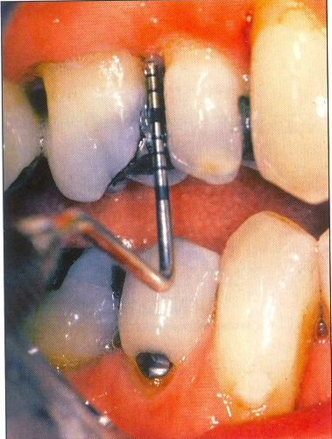
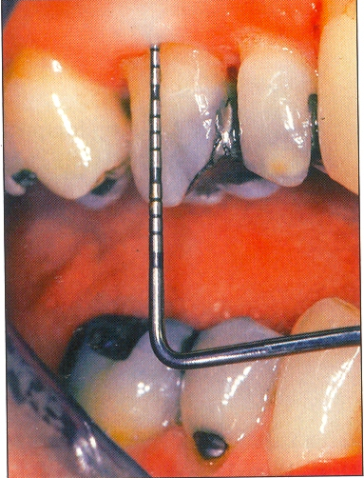
A continuous probing profile is obtained by running the probe gently along the entire circumference of the gingival sulcus of the tooth suspected to be associated with an endo-perio lesion.
Continuous probing around maxillary molar showing sudden changes in probing depths
Notes:
Degree of furcation involvement is classified based on the amount of periodontal destruction in the inter-radicular area

Slide 71
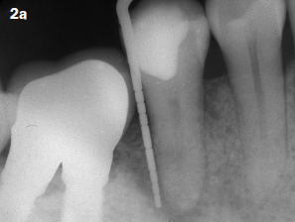
FISTULA TRACKING
Identification of the sinus tract by simple visual examination does not necessarily indicate the origin of the inflammatory exudate or the tooth involved.
Occasionally, the exudate exists through the periodontal ligament, thus mimicking a pocket of periodontal origin.
Identifying the source of inflammation by tracking the fistula will help to differentiate between diseases of endodontic and periodontal origin.
Fistula tracking is done by inserting a semi-rigid radiopaque material into the sinus tract until resistance is met.
Commonly used materials include gutta percha cones or presoftened silver cones.
A radiograph is then taken that will reveal the course of the sinus tract and the origin of the inflammatory process.
If GP goes to the apex – endodontic origin
Goes to midroot or furcation – periodontal origin.

Slide 72
RADIOGRAPHIC PATTERN OF MARGINAL AND PERIRADICULAR BONE LOSS
Radiographic pattern of bone loss further helps characterize the nature & extent of the periodontal breakdown.
Apical extent of the bone loss, absence of PDL space around the periapex & the general shape of the bone defect (angularity & presence of marginal bone).
In patients with generalized periodontal disease, the following types of bone defects are more likely contributed to by pulp infection in the associated tooth:
-Periodontal intrabony defect affecting more than 2/3rd of the root length,
-Horizontal bone loss affecting more than 2/3rd of the root length,
-Periodontal bone loss involving the root-end.
Chance of pulp involvement is further enhanced by the presence of - Large restorations with marked changes in contour of the pulp chamber, Negative or delayed vitality responses, Technically poor root filling(s).
Periodontal lesions – generalized bone loss extending from cervical region to apex, crestal bone loss, horizontal or vertical.
Pulpal lesions – bone loss confined to involved tooth, wide periapical radiolucency with marginal widening.
Notes:
Degree of furcation involvement is classified based on the amount of periodontal destruction in the inter-radicular area

Slide 73
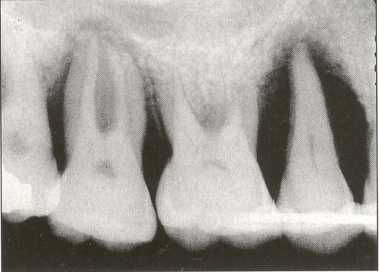

Radiographic pattern
Angularity and presence of marginal bone
Bone loss and absence of periodontal ligament space
Notes:
Degree of furcation involvement is classified based on the amount of periodontal destruction in the inter-radicular area

Slide 74
VITALITY TESTING
Cold test, electric pulp test, heat test, blood flow test, cavity test.
Moderate transient response – normal vital pulp
Quick painful response – reversible pulpitis
Lingering painful response – irreversible pulpitis
Abnormal response – degenerative changes
No response – pulp necrosis
Periodontally involved teeth – respond within normal limits
Pulpally involved – negative response

Slide 75
DIFFERENTIAL DIAGNOSIS
 | PULPAL | PERIODONTAL
CLINICAL SIGNS
Etiology | Pulp infection | Periodontal infection
Vitality | Non - vital | Vital
Pain | Sharp throbbing pain | Dull chronic pain
Swelling | Mucobuccal fold | Attached mucosa
Sinus tracing | Periapical area | Midroot/ furcation area
Mobility | Limited to isolated tooth | Generalized
Restorative | Deep or extensive | Not related
Plaque/ calculus | Not related | Primary cause
Inflammation | Acute | Chronic
Pockets/ Fistula | Single & narrow | Multiple & wide coronally
pH value | Acidic | Alkaline
trauma | Primary or secondary | Contributing factor
Microbial | Few | Complex

Slide 76
Differentiation of a sinus tract from an infrabony pocket
It is clinically important to differentiate between a sinus tract draining into the gingival crevice & an infrabony pocket extending to the root apex of a tooth.
A sinus tract originates from the root canal & progresses occlusally from the apical foramina or from a lateral canal, whereas an infrabony pocket originates in the gingival crevice & progresses apically.
Specifically, a sinus tract closes when routine endodontic procedures have been performed.
An infrabony pocket requires periodontal therapy, with or without endodontic treatment, to facilitate healing.
Fortunately, the clinical differentiation is simple because a sinus tract is narrow & can be traversed only with a thin diagnostic wire or gutta-percha cone, whereas an infrabony pocket, the result of extensive tissue destruction, can be probed with wider & large instruments.

Slide 77
TREATMENT OF ENDO-PERIO LESIONS
Endodontic treatment first
Tooth is non vital & infected
Periodontal treatment first
Cases of doubt (partially necrotic & infected pulp that cannot be confirmed)

Slide 78
Possible causes
Endo
Perio
fracture
Resorptions
Restorations
Anatomy
Endo-Perio lesion
Isolated, narrow localized pocket
Check Endodontic status
Root treated
Not root treated
Evaluate adequacy
Vitality testing
Preparation:
Over prepared
Underprepared
Perforation
Zipping
Ledges
Obturation:
Over filled
Underfilled
Poor adaptation
Positive
Negative
Periodontal
treatment
Endodontic
treatment
Final Treatment Options:
Extract, Resect, Hemisect
Is root canal treatment feasible???
Notes:
Degree of furcation involvement is classified based on the amount of periodontal destruction in the inter-radicular area

Slide 79
CLINICAL FEATURES, DIAGNOSIS, TREATMENT OF DIFFERENT TYPES OF ENDO-PERIO LESIONS
Primary endodontic lesions
Primary endodontic lesions with secondary periodontal involvement
Primary periodontal lesions
Primary periodontal lesions with secondary endodontic involvement
True combined lesions

Slide 80
Primary Endodontic Lesion
Caries
Large restoration approximating the pulp
Traumatic injuries
h/o pulpotomy, pulp capping
Poor root canal treatment
Causes
Pain, tenderness to pressure & percussion, increased tooth mobility & swelling of the marginal gingiva, simulating a periodontal abscess.
The suppurative process may cause a sinus tract along the PDL space or through patent channels
This usually results in a narrow opening of the sinus tract into the gingival sulcus & pocket that can be easily traced with a GP cone or a periodontal probe down to the root apex or the lateral canal.
Periodontal probing usually shows normal sulci around the tooth except in one area with a narrow defect.
Clinical features
Notes:
These are lesions that arise from the diseased pulp.
Signs of inflammation such as…..

Slide 81
Clinical features
In multirooted teeth, a periodontal ligament sinus tract can drain off into the furcation area & resemble a grade III, “through-and-through” furcation defect resulting from periodontal disease.
Vitality tests
will reveal a necrotic pulp or, an abnormal response in case of multi rooted teeth indicating the pulp is degenerating & at least one canal is necrotic.
Radiographic
features
Radiograph may show deep dental caries, deep filling or fractured restoration.
The drainage through the sulcus often appears as radiolucency along the mesial or distal root surface or in the bifurcation area.
Endodontic lesions resorb bone apically and laterally which results in destruction of attachment process adjacent to a non-vital tooth.

Slide 82
Treatment
Because the primary lesion is an endodontic problem that has merely manifested itself through the periodontal ligament, complete resolution is usually anticipated following non-surgical endodontic therapy without any periodontal treatment.
The sinus tract extending into the gingival sulcus or furcation area disappears at an early stage once the affected pulp has been removed and the root canals well cleaned, shaped, and obturated.
Periodontal curettes are used to plane the root surface to be sure it is free of plaque and deposits.
Excellent
Prognosis

Slide 83

Primary Endodontic Lesions with secondary periodontal involvement
Causes
Long standing endodontic lesion without treatment will lead to destruction of the periapical alveolar bone.
Accumulation of plaque & calculus results in further apical migration of attachment.
Root perforation during root canal treatment, or where pins or posts have been misplaced during coronal restoration.
Root fractures that typically occur on root-treated teeth often with post and crowns & molar teeth that have been treated by root resection.

Slide 84
Clinical Features
Symptoms may vary from acute – abscess formation, swelling, pain, mobility, exudate, pocket formation to chronic - no symptoms and sudden appearance of a pocket with bleeding on probing.
Widening of gingival sulcus, extensive sinus
Vitality tests
reveal a necrotic pulp
Radiograph may show deep dental caries, deep filling or fractured restoration.
Plaque or calculus accumulation, demonstrable by a probe & radiograph.
Periapical pathology & angular bone loss.
Radiographic
features

Slide 85
Treatment
The tooth now requires both endodontic and periodontal treatments.
If the endodontic treatment is adequate, the prognosis depends on the severity of the marginal periodontal damage and the efficacy of periodontal treatment.
Endodontic treatment results should be evaluated in 2-3 months and only then should periodontal treatment be considered. [International journal of dental clinics 2009:1 (1): 34-38]
Periodontal therapy requires curettage and root planing.
When the root perforation is situated close to the alveolar crest, it may be possible to raise a flap and repair the defect with an appropriate filling material.
In deeper perforations, or in the roof of the furcation, immediate repair of the perforation has a better prognosis than management of an infected one.
Prognosis
If endodontic therapy is adequate, the prognosis depends on the severity of periodontal involvement & efficacy of periodontal therapy.
Notes:
Y? cz This sequence of treatment allows sufficient time for initial tissue healing and better assessment of the periodontal condition.

Slide 86

Primary Periodontal Lesions
Primarily by periodontal pathogens.
Plaque
Calculus
Trauma from occlusion
Causes
Clinical features
Tooth is vital.
Important diagnostic finding is to see whether the cervical lesion is isolated to a single tooth or is generalized.
Periodontal disease is usually generalized. It may be localized because of traumatic occlusion.
Periodontal examination will reveal tooth mobility, broad-base (infrabony) pocket formation, an accumulation of plaque & calculus & soft tissue inflammation associated with purulent exudates.
Periodontal abscess during acute phase.
Notes:
Periodontal disease has a progressive nature.
Unchecked or untreated periodontitis begins in the sulcus & progresses to the apex as deposits of plaque & calculus produce inflammation, causing loss of surrounding alveolar bone & supporting periodontal soft tissues.
This leads to a loss of clinical attachment & formation of a periodontal abscess during the acute phase of destruction.

Slide 87
Positive response indicating vital pulp
Vitality
Osseous defects of periodontal origin appear along the lateral aspects of roots & in furcation areas.
Generalized vertical & horizontal bone loss.
Radiographic
Features
Treatment
Treatment is only periodontal therapy
Depends on the extent of the periodontal disease and the patient’s ability to comply with potential long term treatment and maintenance therapy.
Depends on the outcome of the periodontal therapy and care must be taken not to devitalize the pulp during deep therapy.
Prognosis

Slide 88

Primary Periodontal Lesions with secondary Endodontic involvement
Causes
Treatment of periodontal disease can also lead to secondary endodontic involvement.
Lateral canals and dentinal tubules may be opened to the oral environment by curettage, scaling, or surgical flap procedures.
A strong correlation between the presence of microorganisms in root canals and their presence in periodontal pockets of advanced periodontitis has been demonstrated, indicating that similar pathogens may be involved in both diseases.
Most difficult diagnostic lesion
Notes:
Primary periodontal lesions with secondary endodontic involvement differ from the primary endodontic lesion with secondary periodontal involvement only by the temporal sequence of the disease processes.
Causes: - periodontal lesions communicate the canal through - ……..

Slide 89
Clinical features
Deep pockets.
History of extensive periodontal disease.
Various degrees of mobility.
Plaque, calculus and soft tissue inflammation.
When the pulp becomes involved the patient reports accentuated pain and clinical signs of pulpal disease.
Effect of progressive periodontitis on the vitality of the pulp is controversial.
As long as the neuro-vascular supply of the pulp remains intact, prospects for survival are good. If lost to periodontal disease, pulpal necrosis is about to occur.
Once the pulp becomes involved, pulp tests will confirm pulpal necrosis.
Vitality
Notes:
c/f – intro…When the progression of the periodontal disease involves the primary pulp vessels at the apex retroinfection takes place and the pulp becomes inflammed and necrotic.
It is possible for a blood vessel within a lateral canal to be severed by a curette and for microorganisms to be pushed into the area during treatment, thus resulting in pulp inflammation and necrosis.
Progressive periodontal disease results in the apical migration of the attachment and root surface exposure to the oral cavity and to irritants such as bacterial plaque.
"Seltzer" states that oral flora can transmit toxic products into the pulp via the lateral canals or dentinal tubules to cause atrophic, degenerative, inflammatory and resorptive alterations.

Slide 90
Radiographic
Features
Wider ligament space present coronally.
Absence of caries/ restorations
Both endodontic and periodontal treatment required.
The endodontic treatment should be completed first because the toxic reservoir in the root canal will continue to abort the desired periodontal healing.
Treatment
Prognosis in these cases of primary periodontal etiology is not as good as when the primary lesion is endodontic because a periodontal therapy has a much more guarded prognosis than endodontic therapy.
In single-rooted teeth – poor prognosis.
In molar teeth – prognosis may be better as not all the roots may undergo the same loss of supporting tissues & root resection can be considered as a treatment alternative.
Prognosis

Slide 91

True Combined Lesions
Causes
In essence, both disease states exist but with different causative factors & with no clinical evidence that either disease state has influenced the other.
It is formed when an endodontic disease progressing coronally joins with an infected periodontal pocket progressing apically.
The degree of attachment loss in this type of lesion is invariably large and the prognosis is guarded.

Slide 92
Clinical features
These consist of two concurrent lesions, one is an independent periapical lesion originating from a necrotic pulp and other is an independent periodontal lesion that has progressed apically towards the periapical lesion.
Depending on the stage of their development, lesions may or may not communicate.
The infrabony defect occurs when the two lesions meet and merge.
A new term "concomitant pulpal-periodontal lesion" has given to those teeth which have both disease processes occurring but do not communicate. [Endodontic Topics 2006].
A necrotic pulp or a failing endodontic treatment, plaque, calculus, periodontitis and a wide and conical periodontal pocket will be present in varying degrees.
Vitality
Reveals confirmed pulpal necrosis.

Slide 93
Radiographic
Features
True combined – uniform widened periodontal space.
Concomitant lesions – no communication between apical and coronal radiolucency
Treatment
Both concomitant endodontic and periodontal treatment required.
In cases where periapical and periodontal lesions communicate, complete cleaning and obturation of the root canal system prevents egress of the irritants from the periapical lesion into the periodontal defect.
Then, the prognosis of the affected tooth then depends totally on the outcome of the periodontal therapy.
If a combined lesion is found in a mouth otherwise free of periodontal disease, we can suspect vertical root fracture; particularly if the lesion does not respond to combined therapy (it may be necessary to lay a flap to find the defect which has hopeless prognosis).

Slide 94
Treatment
In molar teeth, root resection can be considered as a treatment alternative if not all roots are severely involved.
Sometimes, supplementary surgical procedures are necessary.
In most cases, periapical healing may be anticipated following successful endodontic treatment.
The periodontal tissues, however, may not respond well to treatment and will depend on the severity of the combined disease.
Prognosis
Depends on the removal of the individual etiologic factors & prevention of any further factors that may affect the respective disease processes.

Slide 95
Combined Lesion Treatment
Separate Unrelated Lesion
Single lesion with both Endodontic –Periodontal Pathoses
Periodontal Endodontic Lesion that have merged
Notes:
When traditional endodontic & periodontal treatments prove insufficient to stabilize an affected tooth, the clinician must consider treatment alternatives that include:

Slide 96
Combined Lesion Treatment
Separate Unrelated Lesion
Cases of this type have separate lesions that coincidentally have attacked the same tooth.
The method of therapy is quite straightforward. First, it must be determined if periodontal condition is treatable.
Performing endodontic therapy on teeth with hopeless periodontal lesion is disastrous. Endodontic therapy is performed first and then periodontal therapy.
The healing of the periapical lesion is unaffected by the periodontal therapy to follow!!!

Slide 97
Combined Lesion Treatment
Single Lesion with both Endodontic & Periodontal Pathoses
This is most difficult to treat successfully.
Involved teeth has single lesion radiographically.
Deep periodontal pocket.
Patient has periodontal condition involving other teeth.
Endodontic therapy should be initiated followed by periodontal therapy.
Results are not predictable and patients must be forewarned concerning doubtful prognosis.

Slide 98
Combined Lesion Treatment
Endodontic & Periodontal Lesion that have merged
A periapical lesion merges with periodontal pocket even though separate lesions are present.
Portion of lesion extending from apical area towards the crestal bone is periapical due to pulpal damage.
Whereas, the lesion from the sulcus extending apically is periodontal breakdown.
If endodontic therapy is only performed, the periapical lesion heals to where periodontal lesion begins.
If periodontal therapy is only performed, the crestal bone may heal upto where the periapical lesion begins.
Both pulpal therapy followed by periodontal should be performed
If the untreated lesion in either case is very active with considerable virulence, the treated lesion will not heal to its full potential because of continued irritation & inflammation from the untreated segment

Slide 99
TREATMENT ALTERNATIVES
Root resection or root amputation
Hemisection & Bicuspidization
Endodontic implant
Regenerative techniques
Forced eruption or extrusion
Notes:
When traditional endodontic & periodontal treatments prove insufficient to stabilize an affected tooth, the clinician must consider treatment alternatives that include:

Slide 100
Root Amputation/ Resection
Root resection is defined as the removal of one or two roots of mutirooted teeth, leaving the crown of the tooth intact.
Root resections are considered when the furcation is compromised by endodontic complications or Degree II or III involvement.
Factors to be considered when deciding on root resection are:

Slide 101
Root Resection
BONE RELATED
Residual bone,
Localized deep attachment loss
TOOTH RELATED
Restorability,
Strategic value,
Feasibility of endodontic Rx,
Post treatment stability
ROOT RELATED
Length of root trunk,
Divergence between roots,
Length & Shape of roots
ROOT
RESECTION
Notes:
Length of the root trunk – ideally a tooth with a short root trunk is a better candidate for resection. Teeth with long trunks will have a low furcation entrance & once established the amount of periodontal support remaining around the roots will be poor.
o Divergence between the roots – the smaller the divergence (closely proximated roots), the smaller the inter-radicular space & these teeth are poor candidates for resection

Slide 102
INDICATIONS:
Root fracture
Perforation
Root caries
Dehiscence
Fenestration
External root resorption involving one root
Impaired endodontic treatment of a particular root
Severe periodontitis affecting only one root
Severe Grade II or III furcation involvement.
CONTRAINDICATIONS:
Lack of necessary osseous support for the remaining roots.
When the bridge span is long & the abutment tooth would lend inadequate support.
Fused roots.
Remaining root or roots endodontically inoperable.
Poor patient compliance to perform home care measures.

Slide 103
TWO APPROACHES
HORIZONTAL / OBLIQUE
Resection of the involved root at the point where it joins the crown.
A process termed root amputation/ resection
VERTICAL
Amputation of pathologic root and its associated portion of crown.
Termed as Hemisection or Trisection.

Slide 104



PROCEDURE:
The roots to be retained should exhibit both good endodontic & restorative prognosis.
Before resection endodontic treatment is done on roots to be retained.
To be retained root canal is filled & access is permanently restored followed by resective surgery.
Surgical length smooth fissure bur.
Root is sectioned via coronal aspect of tooth. Root is removed.
Distance between pulp chamber floor & coronal aspect of root separation = 3mm.
Recontouring of crown at point of resection – plain fissure burs & tapered diamond stones.
Notes:
The coronal & radicular access cavities for endodontic treatment should be conservative & compatible with the requirement of debridement to achieve the goal of infection elimination as well as maintaining restorability.

Slide 105
Flap design is dictated by the extent of periodontal breakdown.
Although some operators use ‘buccal’ flaps only, it is important that both a buccal & palatal (lingual) flap is raised to allow access to all the furcal entrances.
Relieving incisions are only used when visibility into the furcation & periodontal defect is poor.
Intracrevicular incisions are normally used & it is important that a full thickness flap is elevated to allow access to both the furcal entrances from a buccal & palatal aspect.
Junction of crown with the furcation should be smooth with gradual taper towards interdental embrasure.
Clearance between undersurface of crown and tissue.

Slide 106

Hemisection
Hemisection is defined as “the surgical separation of a multirooted tooth (mandibular molar) through the furcation in which the pathologic root and its associated portion of the crown are removed”.
Before carrying out any such procedures the occlusal forces, restorability and the value of the remaining roots must be examined.
Radisectomy and Hemisection are often desirable for periodontal reasons.
Whenever possible, Endodontic treatment should precede root removal because it is difficult to treat a tooth properly when it has been sectioned through the pulp chamber because asepsis is impossible and anatomic guidelines used in the treatment are destroyed.

Slide 107
INDICATIONS:
Endodontic reasons
Separated instrument
Root resorption
Obstructed canals
Perforations
Restorative reasons
Caries destruction
Erosion of large part of crown and root
Fracture
Periodontal reasons
Furcation involvement
Severe bone loss around one root
Combination of these.
Notes:
Hemisection is indicated when one or two roots of multirooted teeth become untreatable because of;

Slide 108

Root to be retained is endodontically treated, permanent access restoration is done followed by hemisection.
Elevation of buccal & palatal flap – access to involved tooth & adjacent bone.
Long fissure bur on high speed handpiece – placed along buccal groove & cut made.
Cut is channeled towards centre of tooth & then directed towards interproximal furcation opening of the affected root.
Interproximal opening – buccal area in back & forth motion & concurrently moved apically towards furcation

Slide 109
Once the bur severs chamber floor, root is separated from remaining portion of tooth.
Bur must not be extended apically to the floor of the chamber to resect the underlying osseous structures.
These are recontoured once the root is removed.
Severed portion of root removed with forcep or elevator.

Slide 110

Se-Lim Oh et al. J Endod 2009;35:1331–1336.

Slide 111
ROLE OF ANTIBIOTICS IN ENDO-PERIO LESIONS
In Endodontic Therapy
The treatment of acute and chronic infections of endodontic origin is primarily by operative intervention.
Endodontic therapy emphasizes the importance of debridement procedures, thereby eliminating or reducing the microorganisms.
Severe infections rarely occur, even if it occurs, establishing the surgical drainage is the primary treatment in order to remove the cause of infection.
Antibiotics should be given:
Only when the drainage becomes difficult to obtain.
If there is a diffuse spread of infection (e.g. In case of acute dento alveolar abscess).
When the host resistance is low (as in case of medically compromised patients).
When the virulence of the microorganism is very high.
The most commonly prescribed antibiotics are erythromycin amoxicillin, penicillin and metronidazole

Slide 112
In Periodontal Therapy
The use of antibiotics in the treatment of periodontal disease is based on the infectious nature of the disease.
In the early stages of periodontal disease, gram positive bacteria will be seen where as in the later stages gram negative bacteria and spirochetes play an important role.
The bacterial cultures and antibiotic sensitivity test should be performed before selecting an antibiotic.
No single antibiotic at concentrations achieved in body fluids inhibits all periodontal pathogens.
A combination of antibiotics may be necessary to eliminate all the pathogens from periodontal pockets. Both systemic and topical antibiotics have been evaluated.
Advantages of topical application:
Antibiotics can be directed to their specific target areas
Reduced drug dosage
Increased concentrations
Reduces side effects.

Slide 113
Antibiotics for Endo-Perio Lesions:
There are no studies to support the use of systemic antibiotics in the management of endo-perio lesions.
Systemic antibiotics are not a substitute for the effective mechanical debridement of root canal system and the root surface.
Topical antibiotics such as tetracyclines or metronidazole may be applied to the periodontal ligament as an adjunct to root planing.
Tetracyclines appear to be more useful for both endodontics and periodontal infections.
Systemic antibiotics can be used prophylactically for patients with a history of rheumatic heart disease and other systemic conditions.
They can be used as an adjunct to the surgical procedures involving root resection, osseous grafting etc.

Slide 114

Antibiotics for Endo-Perio Lesions:
Chlorhexidine is gaining increasing popularity as a microbial agent.
Chlorhexidine is incorporated in the small strip which is placed directly in the periodontal defect and left in place. This is called PERIO CHIP.

Slide 115
CONCLUSION
Endodontic & periodontal lesions result from the close interrelationship of pulp tissue & the periodontium.
The differential diagnosis of endodontic & periodontal lesions is not always straightforward & requires clinical data accumulation from a number of diagnostic tests to obtain a correct diagnosis.
Lesions with combined causes will require both endodontic & periodontal therapy, & endodontic therapy should be completed first. In addition, root resection & regenerative techniques offer alternative approaches, thus enhancing the clinician’s ability to deal with these complex clinical problems.
Thus, with adequate tender love and care we can nourish it for a peaceful coexistence between the tooth and gums.

Slide 116
References
Ingle’s Endodontics 6th edition.
Stock and Gulabivala’s Endodontics 3rd edition.
Weine’s Endodontic therapy 6th edition.
Cohen’s Pathways of Pulp 9th edition.
Grossman’s Endodontic practice 12th edition.
Textbook of Endodontics by Dr. Mithra Hegde
Textboook of Endodontics by Dr. Anil Kohli
Simring M, Goldberg M. The pulpal pocket approach: retrograde periodontitis. J Periodontol. 1964;35(1):22-48.
Rotstein I, Simon JH. Diagnosis, prognosis and decision-making in the treatment of combined periodontal endodontic lesions. Periodontol. 2000;34(3):165-203.
Rotstein et al. Endo Perio lesion: critical appraisal of the disease condition Endodontic Topics 2006, 13, 34–56.
Sunitha Raja et al. The periodontal – endodontic continuum. J Conservative Dent, April- June 2010.

Slide 117

Thank you!!

